Slide 1
Deliver more features faster with a modern development and test solution
BRK2103
Claude Remillard
Group Program Manager

Slide 2


Dev-test in the cloud: drivers and concerns
Drivers
Concerns
Agility
Integration
Economics
Security
IT admin
Scale
Compliance
Speed
Performance

Slide 3


Challenges of running dev-test on premises
Your datacenter
IT admin
VMs in dev-test
environment
Developers
Provision VMs
Request VMs
65%
of developers say it is too complicated and time-consuming to get development and test resources
Your challenges
Compromised agility
Limited hardware budget
Limited software licensing
Resource contention with VMs
Realistic scale tests often challenging
Procurement delays
10%
Average utilization of dedicated dev-test infrastructure
Source: Business Case for Test Environment Management Whitepaper, Cognizant

Slide 4
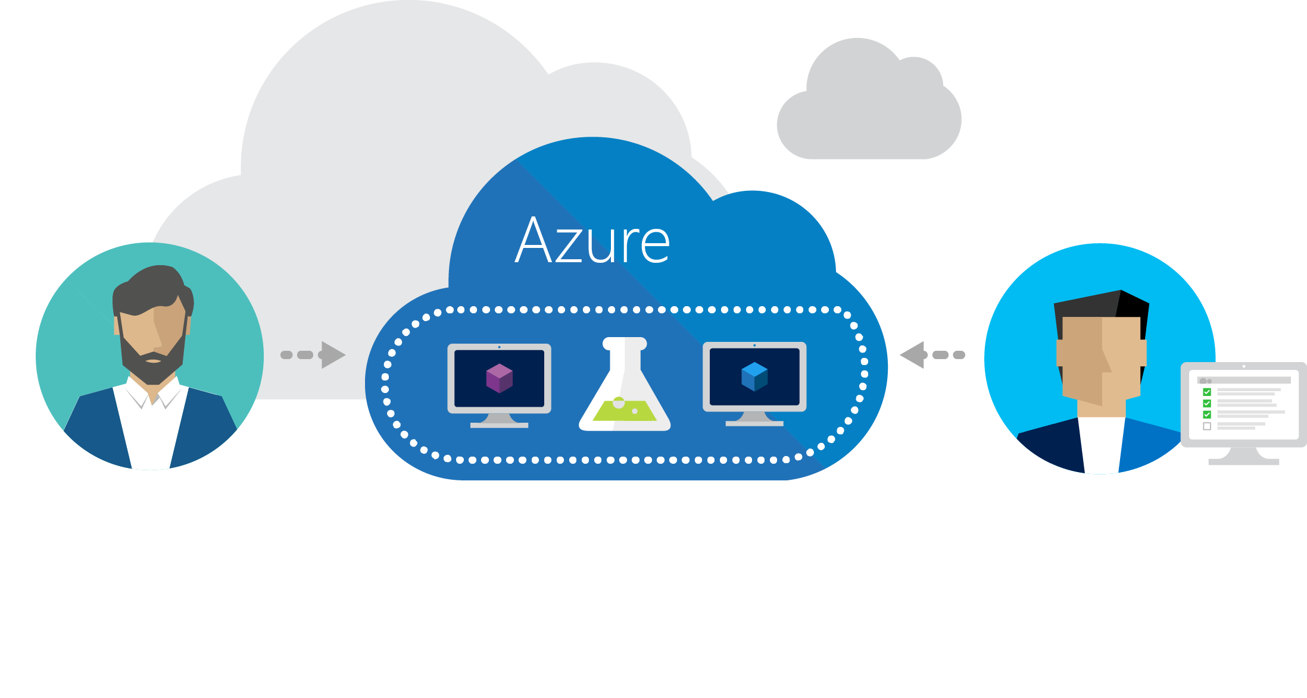
Azure DevTest Labs
Fast, easy, and lean dev-test environments in Azure.
Specifically for your team. On demand.

Slide 5
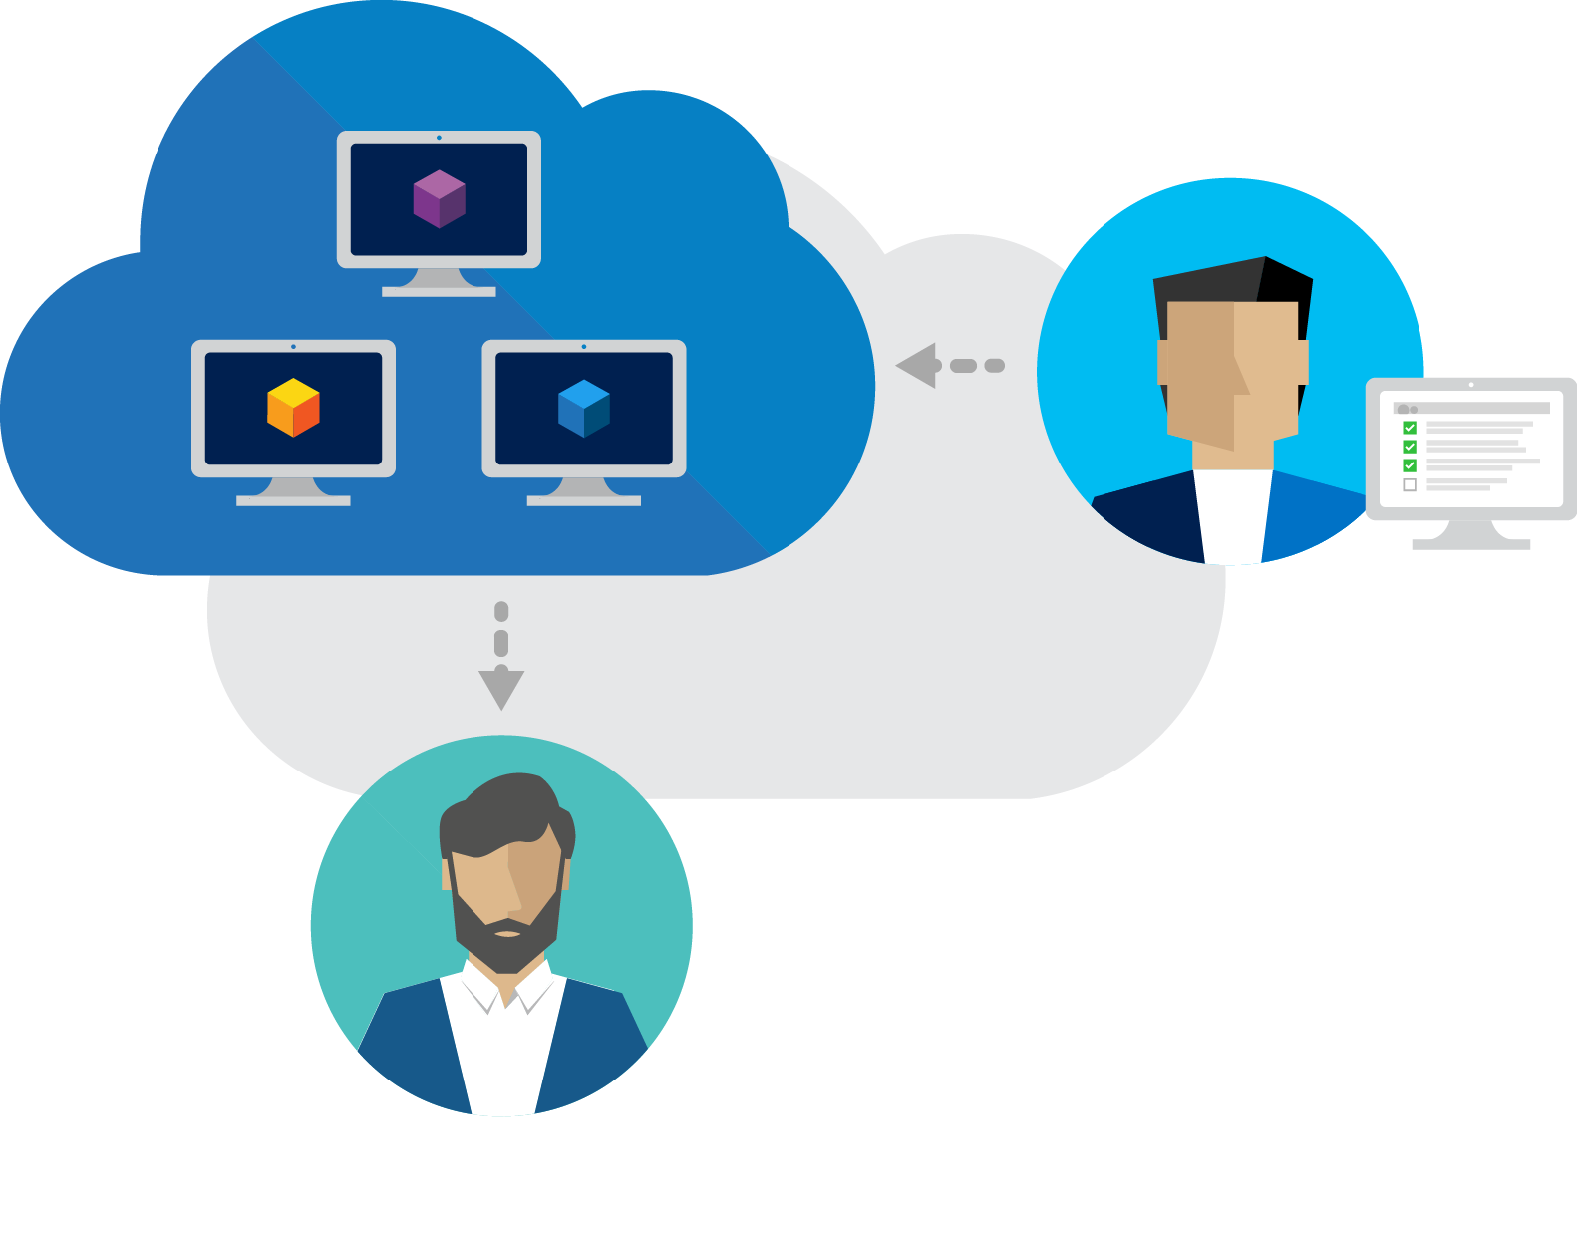
Worry-free self-service
Fast
provisioning
Share Templates
Integrate with your toolchain

Slide 6
DevBox
In the Cloud
Test my App
Pipeline
Training
Events/
Hackathon
Trials

Slide 7


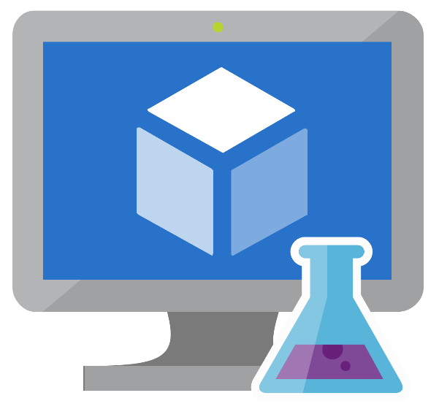


Dev Box in the Cloud

Slide 8

Let’s talk about cake!
My bits
Tools
Base OS

Slide 9
DevBox Demo

Slide 10
Use Formula as a reusable base

Slide 11


Bring your VNET with ExpressRoute
ExpressRoute

Slide 12

Add/Attach additional data disks

Slide 13
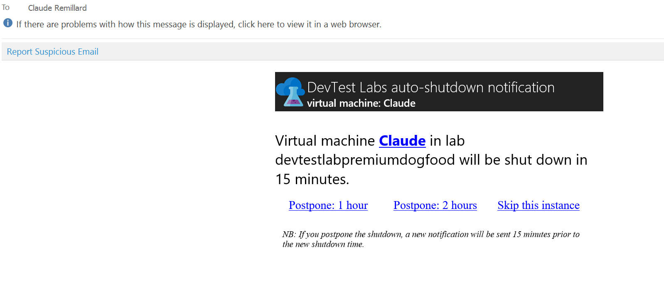
Shutdown notifications

Slide 14
Test/pipeline environments

Slide 15


Automated Pipeline - Release Management
Automates Deployments
Build
DEV
INT
QA
PROD

Slide 16


BudgetIT*
s
Add tasks – Dev
Environments Artifacts(1) Variables Options History
Azure
Save draft Publish Release | Export
All tasks (60) Azure (4) Test (8) Deploy (10) Other (30)
Azure Website Deployment
Deploy an Azure Website | Microsoft Corporation
BudgetIT
Add
Owner
Lan
…
Azure Cloud Application Deployment
Deploy an Azure Cloud Application | Microsoft Corporation
Add
Add environments
Add tasks…
…
…
…
…
Azure Powershell
Run an Azure Powershell script | Microsoft Corporation
Dev
0 tasks
0 approvals
No tasks here.
Solution
***.buildproj
…
Add
…
***.buildproj
…
Solution
***.buildproj
Solution
MSBuild location
Azure Resource Group Deployment
Deploy a resource group in Azure | Microsoft Corporation
MSBuild location
MSBuild location
Add
Visual Studio Location
Visual Studio Location
Visual Studio Location
Azure Dev/Test Lab Provisioning
Provision a VM or Container in a Dev/Test Lab in Azure | Microsoft Corporation
MSBuild arguments
Add
MSBuild arguments
MSBuild arguments
Platform
$(platform)
Platform
Platform
$(platform)
$(platform)
Configuration
$(config)
$(config)
Configuration
$(config)
Configuration
Clean
$(forceClean)
Clean
Clean
$(forceClean)
Restore NuGet packages
$(forceClean)
Restore NuGet packages
Restore NuGet packages
Close

Slide 17
More cake!

Slide 18
Training/Hackathon

Slide 19
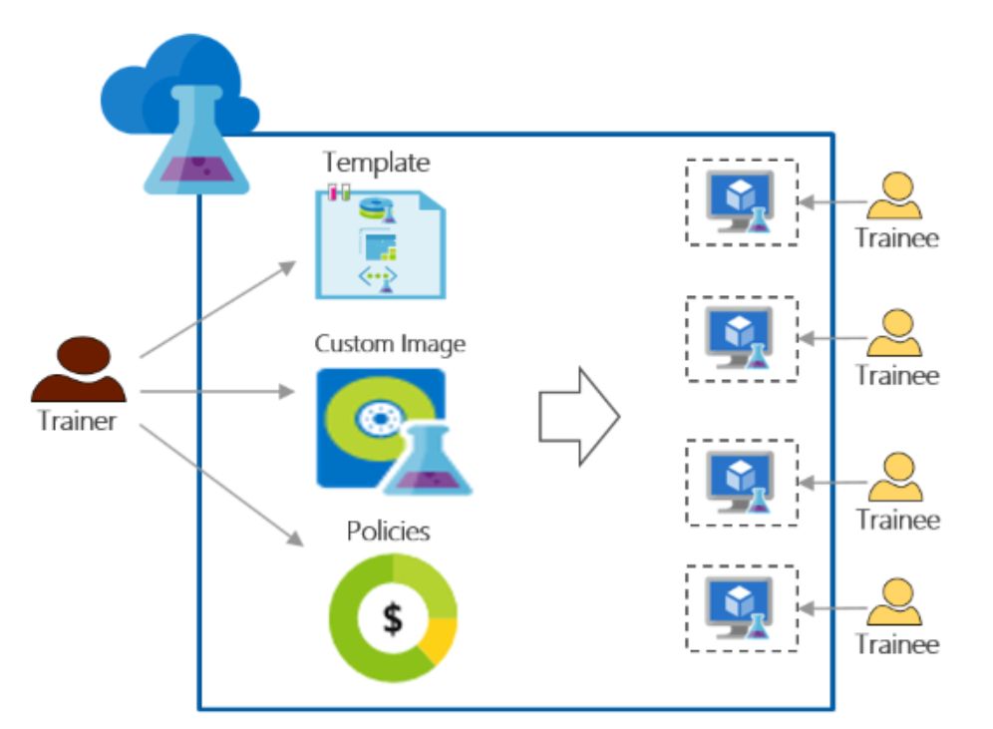
Training Scenario

Slide 20

Save a VM as a reusable image

Slide 21
Demo

Slide 22
Image Factory

Slide 23


Image Bakery
Distribute
Images
IMAGE
VM
VM
VM
VM
DEV TEST LAB
DEV TEST LAB
Create
Golden
Image
Created Updated
Golden Images
AZURE SUBSCRIPTION TEAM A
Check-in
Image
Definition
IMAGE
BUILD
AGENT
IMAGE
VM
VM
VM
VM
DEV TEST LAB
DEV TEST LAB
IMAGE
IMAGE
AZURE SUBSCRIPTION TEAM B
Azure DevTest Labs
SCHEDULED BUILD
IMAGE
IMAGE
REPOSITORY
SUBSCRIPTION
VISUAL STUDIO TEAM SERVICES
IMAGE
VM
VM
DEV
DEV TEST LAB
AZURE SUBSCRIPTION TEAM C

Slide 24
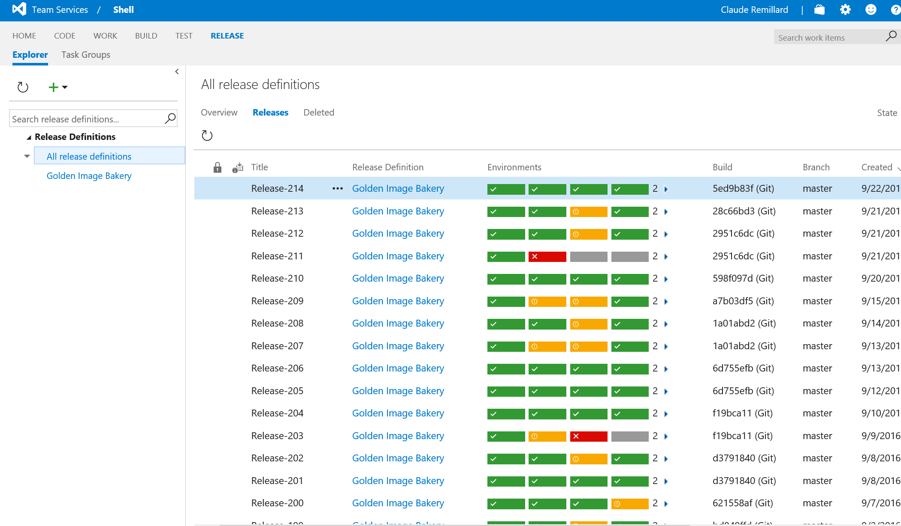

Slide 25
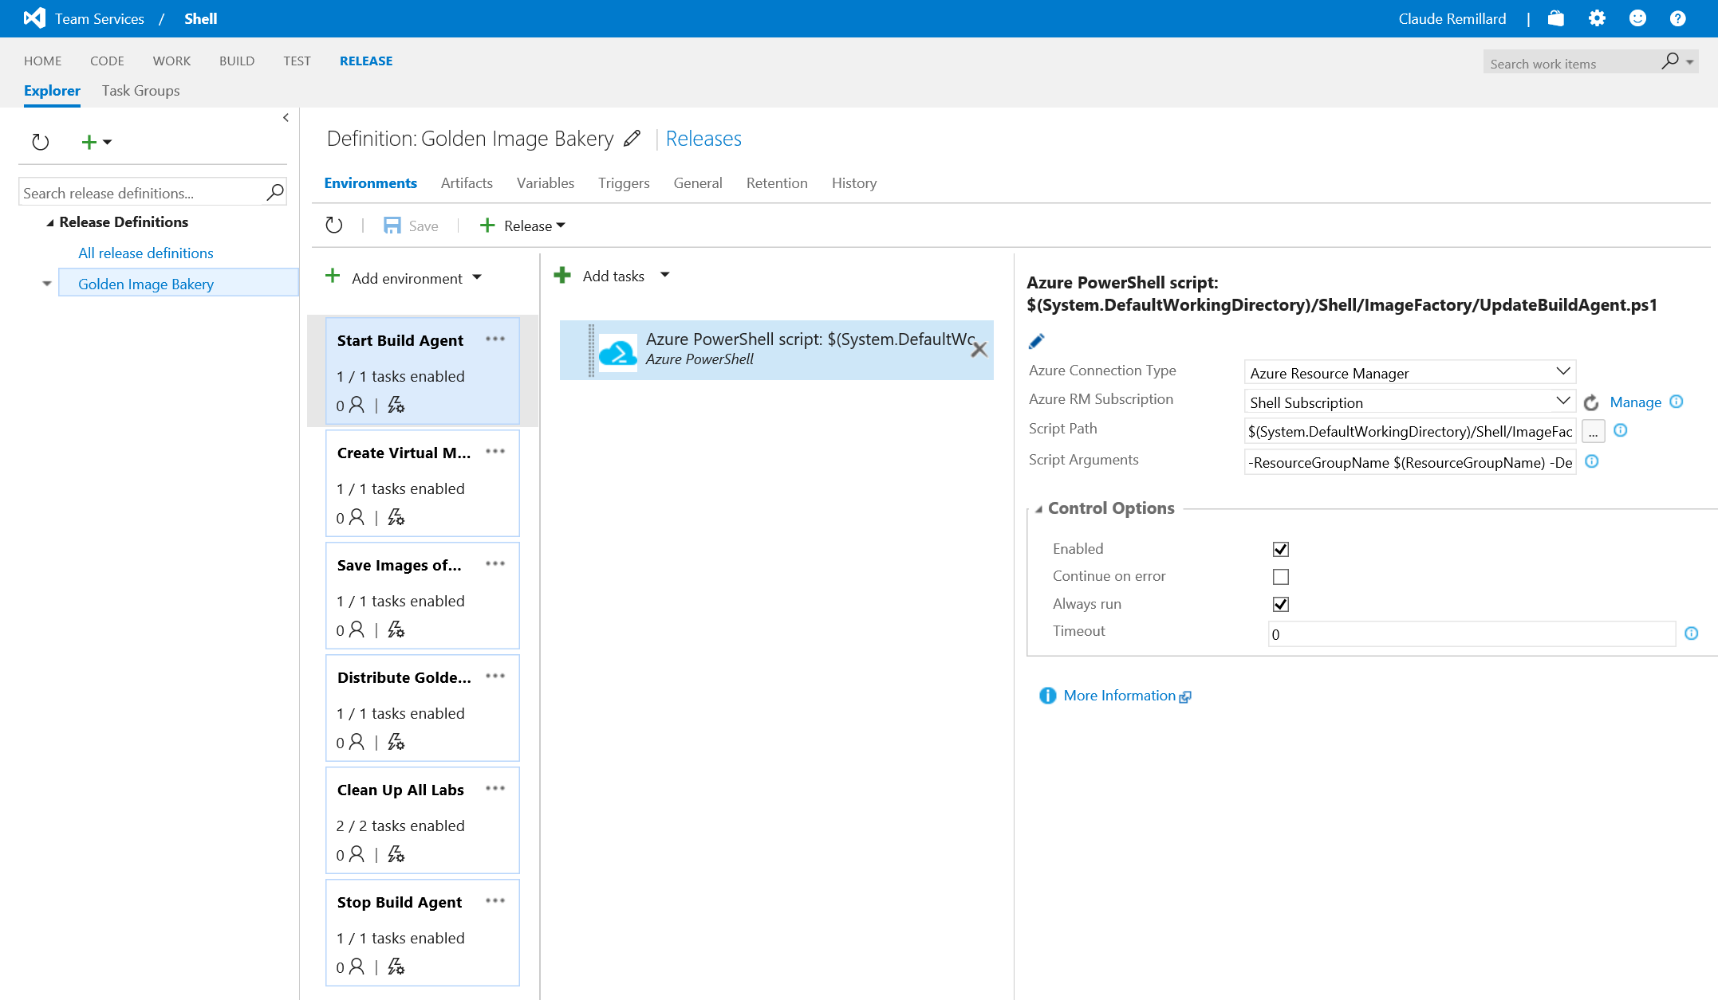

Slide 26
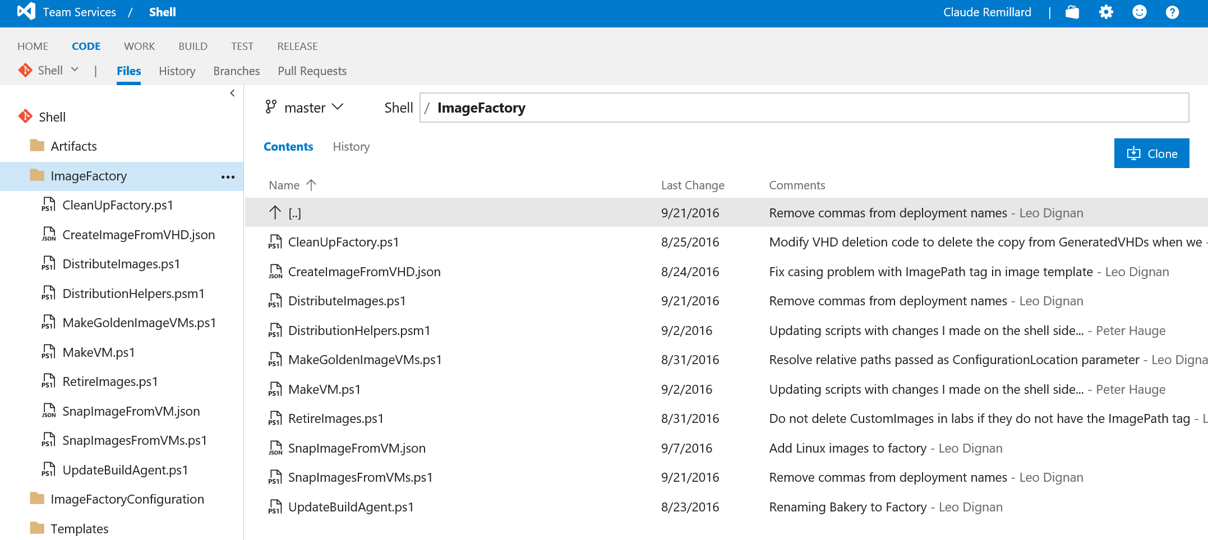

Slide 27
Quickly be “ready to test”
Worry-free self-service
Create once, use everywhere
Integrate with your existing toolchain

Slide 28
Roadmap

Slide 29
Roadmap
ARM-based environments
Scaled Labs
Second Disks
Time-bomb VMs
My Secrets
Cost thresholds
Shutdown notifications
Finish ARM Based - PaaS policies
Claim
Team secrets
Artifacts diagnostics
Second disk improvements

Slide 30
Azure DevTest Labs
Try at http://aka.ms/dtl
Fast, easy, and lean dev-test environments in Azure.
Specifically for your team.
On demand.

Slide 31


Please evaluate this session
Your feedback is important to us!
From your PC or Tablet visit MyIgnite at http://myignite.microsoft.com
From your phone download and use the Ignite Mobile App by scanning the QR code above or visiting https://aka.ms/ignite.mobileapp

