Slide 1
Driving Office 365 Adoption
Methodology, Best-Practices, and Resources from Microsoft
BRK2097
Gideon Bibliowicz
Director, Office 365 Business Group
Matt Ontell
Principal Program Manager, Office 365 Engineering

Slide 2

HAS CHANGED
THE WORLD IS CHANGING

Slide 3
If the rate of change on the outside exceeds the rate of change on the inside, the end is near.
JACK WELCH

Slide 4
Building the new IT
“
…the role of the CIO is shifting from the technology steward to business solutions enabler…”
Service-optimized IT organizations are growth enablers and a source of both operational and strategic differentiation. Here, the IT organizations constructively and proactively engage with the business to improve business operations to enrich enterprise performance.
How to Establish a Service-Optimized Organizational Structure
Published: 31 August 2016 ID: G00301661
Analyst(s): Monika Sinha, Gartner
Monika Sinha
Gartner Analyst

Slide 5
Mott MacDonald’s
Transformation
“
We don’t need to innovate around Office 365. We’ll leave that to Microsoft.
Our job is to adopt the technology as quickly
as we can, and to stay focused on using it to deliver value to our clients.”
Vision
To be the consultant
of choice, recognized
for the quality of our people and our
customer service
Challenge
A global management, engineering and
development consultancy, with over 17,000 employees and
clients in more than
150 countries
Solution
A phased transformation of the communication and collaboration infrastructure with training and support
to drive user adoption
Darren Russell
Digital Transformation Director
Mott MacDonald
//aka.ms/mottmacdonaldstory

Slide 6

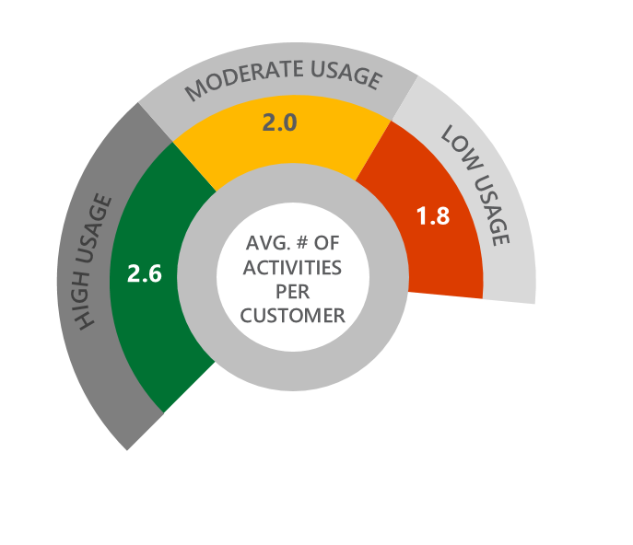
Prioritizing user adoption activities leads to greater impact
End-users awareness is still a common blocker to greater adoption
% AGREE (T2B)
End users are aware that [service] has been made available to them
Senior management has endorsed the use of [service]
Driving adoption of [service] among end users is/was a high-priority
Specific individuals had a responsibility to drive usage of [service] among end users
End users have a firm understanding of what [service] can do and the benefits to them in doing their job
End users have a firm understanding of how to use [service]
…CUSTOMERS WHO PLAN FOR USAGE REALIZE GREATER SUCCESS
Average # of adoption activities implemented by managed customers—by usage levels
Greater usage drives greater business value realization
Source: Office 365 Customer Research Study, May 2015, Microsoft Corporation.

Slide 7


Slide 8
DRIVE VALUE
ONBOARD
ENVISION
An Iterative Approach
to Success
Your Journey
to the Cloud

Slide 9
Microsoft FastTrack
Onboarding and adoption assistance
Plan for a
successful rollout
Move to Office 365
with confidence
DRIVE VALUE
ENVISION
ONBOARD
Included as part of Office 365 for all customers >50 seats
Exchange, SharePoint, Skype, Yammer & Office, incl. E5 support
Service onboarding and user adoption assistance
Email migration from Exchange, Notes, Gmail and GroupWise
Files migration from file shares, SharePoint, Box and Google Drive
FastTrack.microsoft.com
METHODOLOGY &
RESOURCES
TOOLS &
INSIGHTS
ENGINEERS
Boost user engagement

Slide 10













Customer Momentum
“
Moving at the pace of change, and not breaking the business was really important to us. Our partnership with the FastTrack team was fantastic. They helped
us work through lots of our onboarding challenges, as well as strategically how to setup our business processes and business change.”
22k+
2.45 PB
3M+
185
Customers
enabled
Data
migrated
Seats
migrated
Customer satisfaction
(NSAT)
600+
51k+
4k+
FastTrack Engineers
worldwide
Success
plans
New customers in
FastTrack/month
Omar Bhatti
Senior Principal, CSC

Slide 11
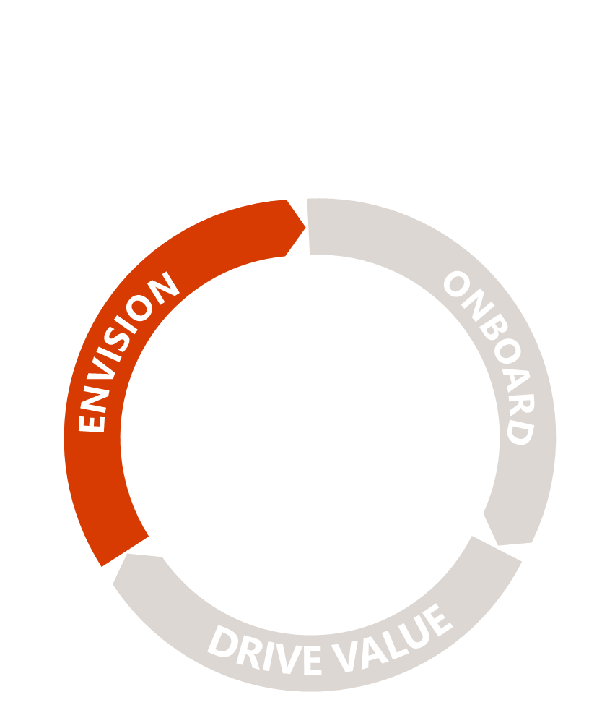
Envision
Define your vision, identify and prioritize business scenarios, and collaborate with key stakeholders to plan for successful rollouts at your own pace.
Identify your key stakeholders
Define your vision and
business scenarios
Plan for a
successful rollout

Slide 12





The Faces of Change…
Human
Resources
Talent
Agent
Sales and
Marketing
Customer
Excellence
Operations
Execution
Optimization
Legal
Compliance
Manager
IT
Business
Enabler

Slide 13
Office 365 Adoption Enablers
Enablers represent the types of people critical to driving user adoption. Research shows that engaging additional personas can help boost user engagement.
ENGAGE FOR SUCCESS—EXPAND YOUR NETWORK TO INCLUDE:
Executive Sponsor
Shepherd
Champions
The Executive Sponsor comes from the very top of
the business organization or unit. She is focused on business goals and concerned about risks to
business operations.
The best, most impactful Executive Sponsors to engage are also Visionaries- passionate about tech, they pursue innovation as a means to help increase competiveness.
The Shepherd helps nurture and guide change
in their organization. She directly contributes to driving change through formal change management programs, or as a trusted and valued liaison between business and IT.
Champions are engaged and capable users who
may be involved in a team helping to define initiatives and make change happen. Work with and through the Shepherd to identify Champions across the organization.
62% IT
22% IT
100% Non-IT
38% Non-IT
78% Non-IT

Slide 14
Why are executives important to Office 365 success?
Executive sponsors should:
Ensure they understand the ABCs
Active and visible participation
Building a coalition with their executive peers
Communicating directly with employees
Executives
have the greatest influence on culture, and their participation is essential in driving employees’ adoption of new technologies.
Organizations
that secure executive sponsors to actively communicate the value and benefit of Office 365 are more likely to be successful with their rollout.
Executive support
is an essential aspect of driving end-user adoption.
Help the project team craft the overarching vision of Office 365 by tying it to broader organizational objectives.
Play a role in communicating the vision to other leaders across the organization.
Actively participate and use the Office 365 capabilities to help drive adoption across end users and reinforce desired behaviors.

Slide 15
Complete a Visioning Exercise
Consider these questions to drive
the conversation:
What are the current collaboration and communications challenges within the organization?
Why is the organization changing the way we work
at this time?
How does working in a new way support the organization’s overarching mission, vision, and strategy?
How will a more social and open way of working benefit the overall organization and employees personally?
What does success look like following the adoption
of this new way of working?
Host a meeting
with executives, key department stakeholders, project managers, and champions who understand overarching company goals.
Discuss
the challenges and barriers that may be affecting workflows, and start to identify how new ways of working could make an impact.
1
2
3
4
5

Slide 16
“
Create more agile responses to clients with anytime, anywhere access to your personal workplace and our collective knowledge and expertise.
“
Mott MacDonald’s Vision Statement
//aka.ms/mottmacdonaldstory

Slide 17
Define Your
Scenarios
Consider these questions to drive
the conversation:
What are some of the organization’s challenges or pain points related to communication and collaboration?
What are the main areas in which your organization
would like to see improvement?
What methods of communication and collaboration are typically better received by your organization than others?
What is the process for drafting,
distributing and sharing information?
What are some of the factors that would help drive
the business scenario forward?
Host a meeting
to delve deeper into current
challenges, strategies, and goals.
Identify
the important business objectives and challenges, and start to recognize areas
of opportunity to improve work processes.
1
2
3
4
5

Slide 18
Jumpstart your project with our core scenarios
Get it done
from anywhere
E-mails and
calendar on the go
Collaborate
on content
Make meetings matter
Bring your
team together
With Office 365, you can work with others wherever you are—with a consistent experience on any device.
  Coordinate meetings on the go, access synchronized contacts, check task lists, and use intelligent tools to
  manage e-mail.
  With one place for all your work files, you can access them anytime, from any device, and share the latest version with the rest of
  the team.
  What if you and your team could join a meeting in just one click, whether you are across the hall or across the globe?
  What if you were connected to everything important at work? Plugged into every document, person and activity that mattered?
//fasttrack.office.com/envision

Slide 19
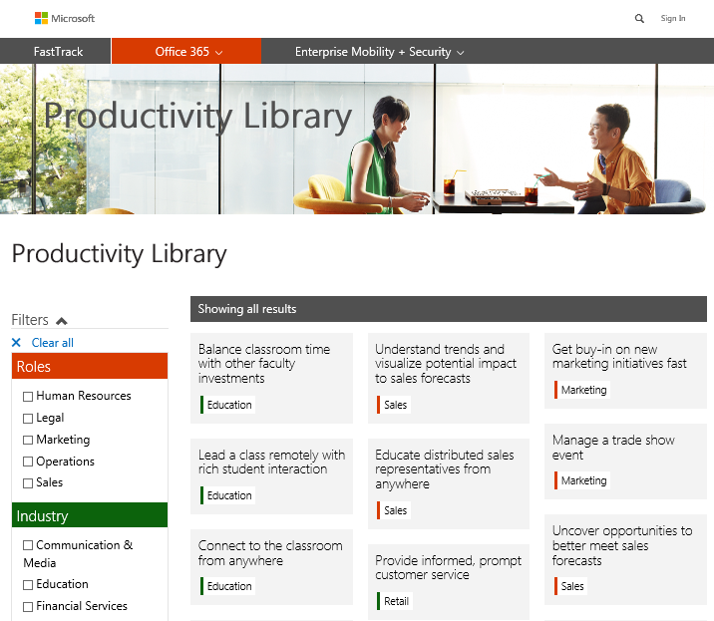
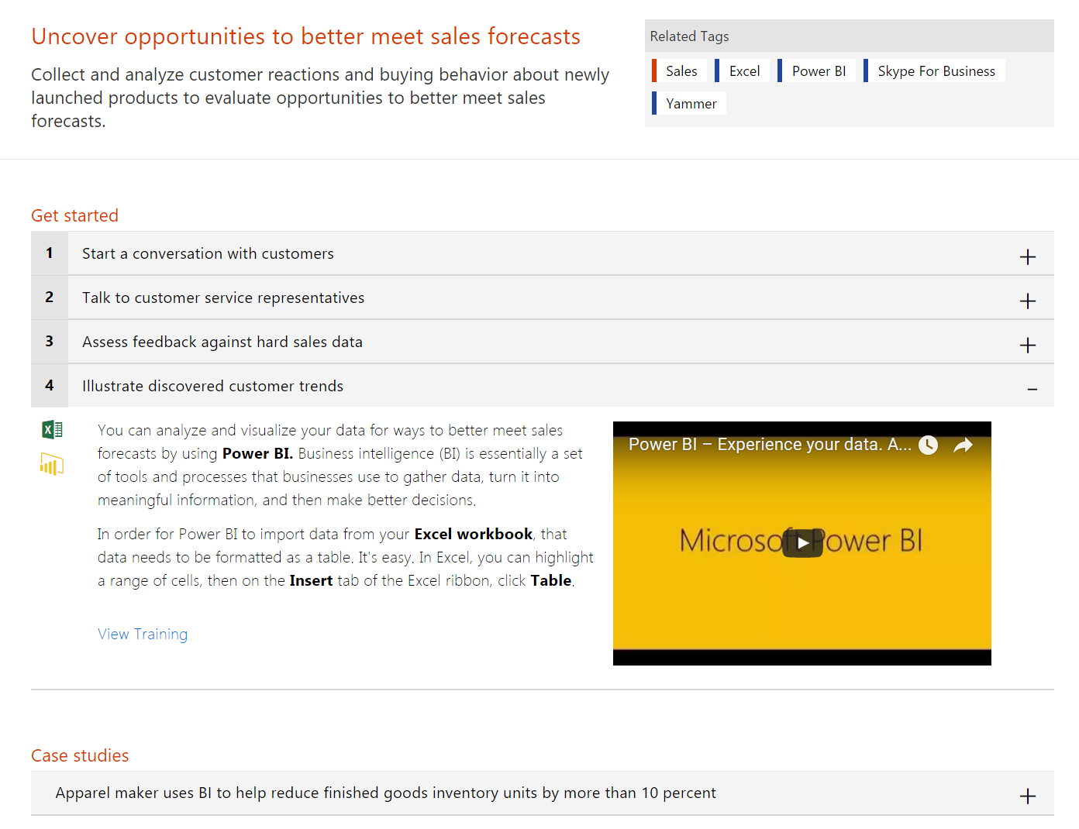
Tailor your story with functional scenarios
Dive deeper into how Office 365 can solve business tasks and challenges particular to your industry and role.
The Productivity Library helps you showcase how Office 365 is relevant to your business stakeholder’s daily activities.
//fasttrack.office.com/envision

Slide 20
Plan for activities driving user adoption
To maximize results, use a variety of tactics
Communications
Engagement events
Training
Including internal announcements
or newsletters, is critical to driving adoption, as it informs and inspires users about the new technology
and helps create a natural “buzz”
or excitement
Such as parties, town hall meetings, contests, and giveaways, can help further momentum and encourage employees to start interacting with the new tools. Events should require users to interact with Office 365, so that they can experience the value first hand
Which can vary from classroom-style sessions to self-help getting started guides, is essential to ensure that employees understand how to actually
use the new technologies to get their
work done

Slide 21
Define Your
Success Criteria
As you draft your success criteria,
use the SMART mnemonic to guide you:
When you develop
your ideal business scenarios and solutions,
it’s critical to come up with a formal set of success criteria to measure the impact resulting from your Office 365 rollout. You’ll need to determine what should be measured, and how you will go about collecting both quantitative and qualitative data.
We recommend
that you choose criteria that will help you showcase success to leadership, such as user satisfaction, employee engagement, adoption velocity, and figures related to your desired business scenarios.
S
  Specific
  Clear & unambiguous; answers the questions, “What, why, who, where?”
M
  Measurable
  Concrete; clearly demonstrates progress.
A
  Attainable
  Realistic; not extreme.
R
  Relevant
  Matters to stakeholders.
T
  Timely
  Grounded to a specific target date; answers the question, “When?”

Slide 22
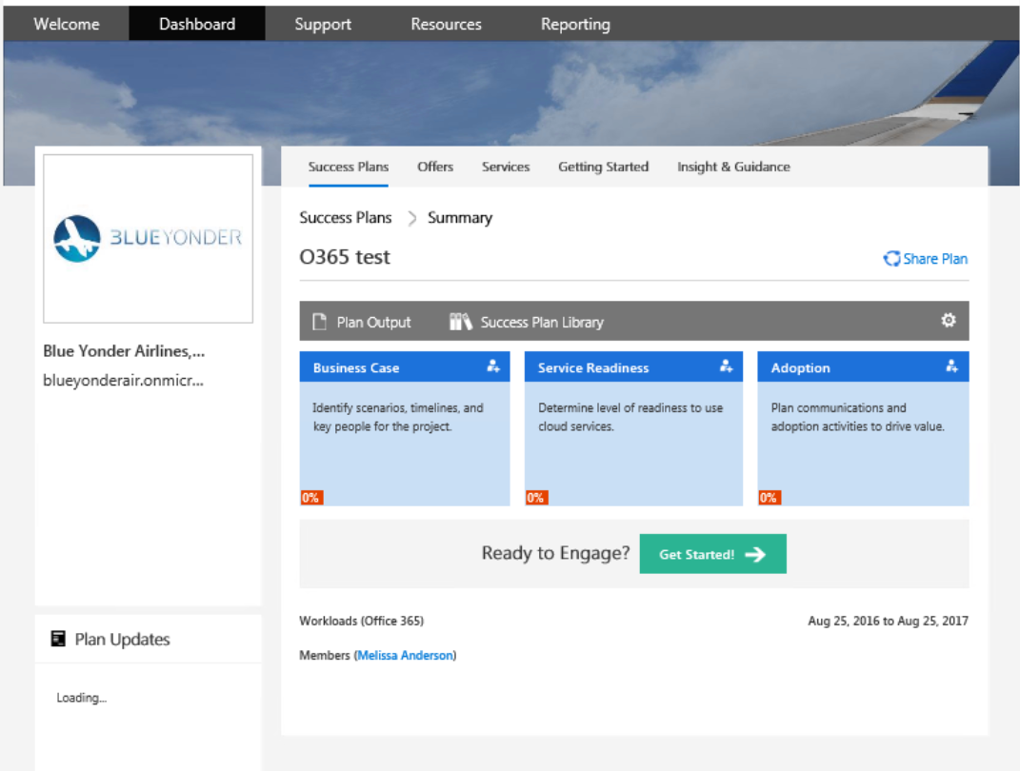
Capture your plan and request assistance
Capture business case, onboarding approach and adoption activities in one place
Create, share, and collaborate on your plan with key stakeholders
Leverage Microsoft’s methodology and blueprint consolidated across thousands of engagements
Include EMS, Azure, and other Microsoft products
Iterate on your plan as you continue your journey
//fasttrack.microsoft.com/

Slide 23
Envision | Demo

Slide 24
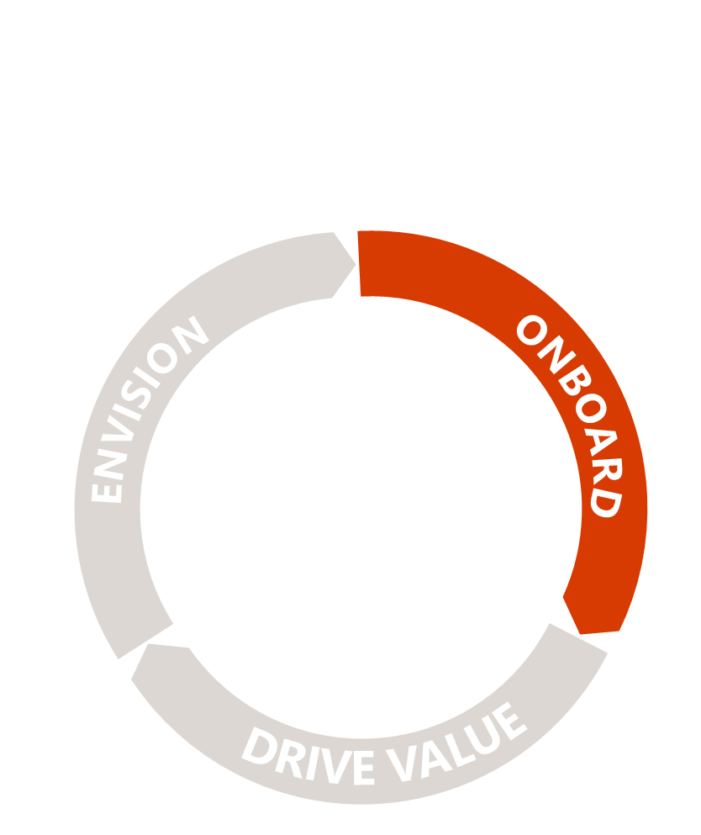
Onboard
Confidently onboard new users and capabilities with remote assistance from Microsoft engineers committed to guide your IT team and partner.
Prepare your technical infrastructure
Ensure a smooth migration experience
Enable new users
and capabilities

Slide 25

Drive Value
Generate more value with resources available to help your teams and partner drive user adoption across your organization; and prepare for and manage change.
Boost user engagement and drive adoption
Manage and prepare
for change
Measure success,
learn, and iterate

Slide 26

Groom Champions
  Champions are not only passionate about what they do, but are also excited to evangelize and help their peers to learn more effective solutions.

Slide 27
Why is this important?
Learning via co-workers is among the most effective and most used methods
  Percent using learning method vs. helpfulness
% Who said method was “very helpful”
These methods are under-utilized (low usage, but have high effectiveness)
Learning via coworkers is among the most effective and most used methods
My manager
IT employee
Coworker
(non-manager, non-IT)
Formal training (external)
Formal training (internal)
Community
forums
User guide or manual
Online tutorials or webinars
Myself, through trial and error
Microsoft’s
website
Search engine
Self-learning is largely ineffective, but currently part of learning process for many
% Using method to learn
Source: SharePoint End-User Study, Apr 2013, Microsoft Corporation

Slide 28
Build a sustainable champions community
Champions
Should be formally trained to increase their depth
and breadth of knowledge
Should be encouraged and empowered to guide, teach, and train their peers
Need consistent positive reinforcement that affirms the impact of their efforts
Need a clear plan upon which to execute
1
2
Help build, grow, and sustain your Office 365 rollout by evangelizing and helping their peers with the new solutions.
3
4
Customer stories
Best Buy: http://aka.ms/bestbuyninjas
Qantas: http://aka.ms/qantasstory

Slide 29

Drive awareness
Show people what’s in it for them
Clearly communicate goals & milestones
Tailor your language & target your audience
“
If people understand how it’s going to help them they will
be more motivated to learn it.”

Slide 30
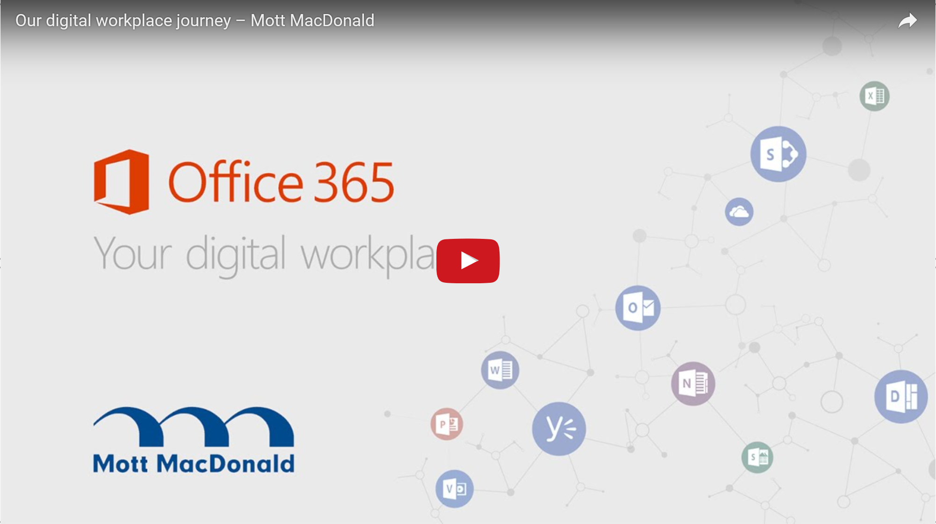

Slide 31
Launch & engagement events
  Launch day tips:
  Host a large-scale launch event, such as a company all-hands or town hall style meeting, in which the executive sponsor and rollout team can officially introduce Office 365 and discuss the value proposition.
  Throughout the event, have champions actively engage with the audience to answer questions, address concerns, and encourage the use of Office 365.
  Create a Yammer group and point users there to continue the conversation and help consolidate information that is captured.
  Organize contests, scavenger hunts, prizes, and giveaways that require people to interact with the Office 365 tools.
  Have t-shirts printed for champions to wear on launch day for a unified and recognizable look.
  Display printed materials to raise awareness about the day’s activities and showcase the most exciting Office 365 features.

Slide 32
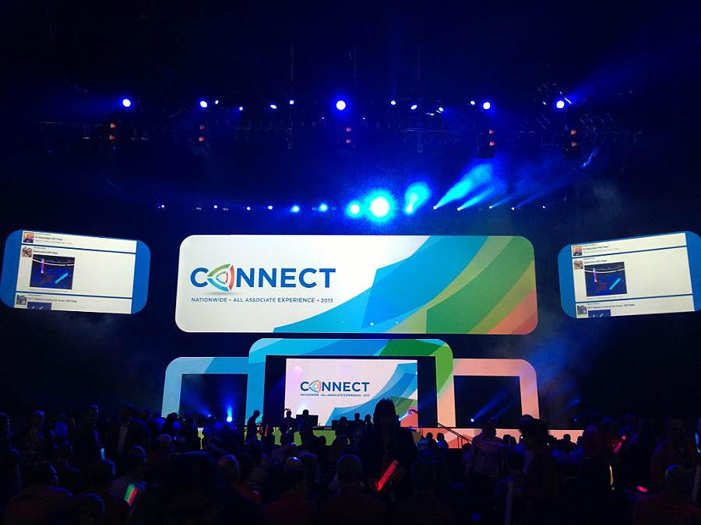
Nationwide:
Building a World-Renowned Intranet with SharePoint 2013 and Yammer.
http://aka.ms/natiowideSPOT 

Slide 33
End-user training
The “why” should be the most important
  aspect of your training. If your end users are new to Office 365, your training should do more than simply introduce them to procedural “how-to” information for performing tasks. They need to know why the change is happening, what’s in it for them, and why they’re being asked to change.
A key part of your training plan
  is to demonstrate the benefits of the change. Understanding and addressing user concerns is key toward easing the transition and ensuring a successful deployment. Here are some tips:
Lead with benefits
Use real work scenarios
Include governance model
Create a learning center
Mobilize champions
Explain what their specific work will look like with Office 365, and what types of efficiencies or benefits they can expect in comparison with any old tools or processes.
Use the tasks or business processes that are familiar
to your audience as a
way to draw them into
feature-specific information.
Make sure to integrate information about the rules, processes, and best practices that your organization has put into place around Office 365.
Use an internal team site to store training resources such as getting started guides and tips & tricks.
Call upon your network of champions who are committed to developing Office 365 expertise to provide coaching and assistance across their teams.

Slide 34
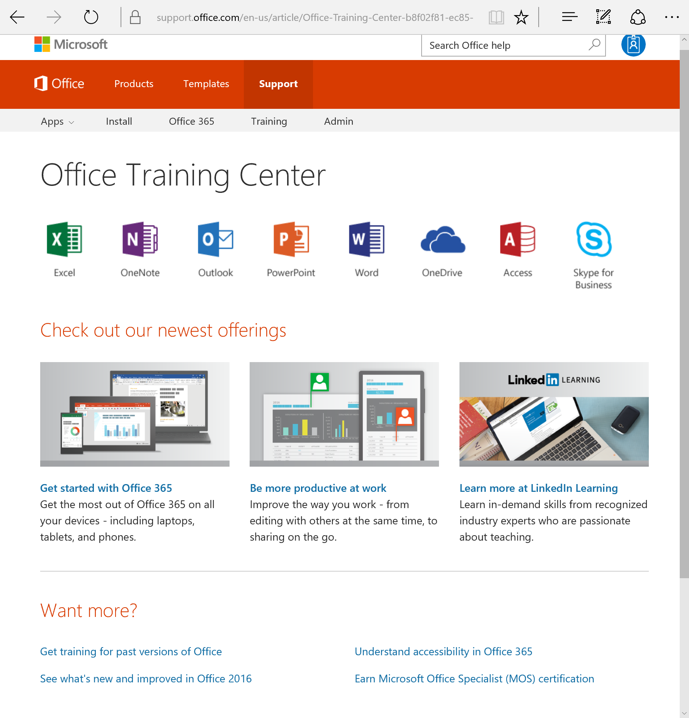
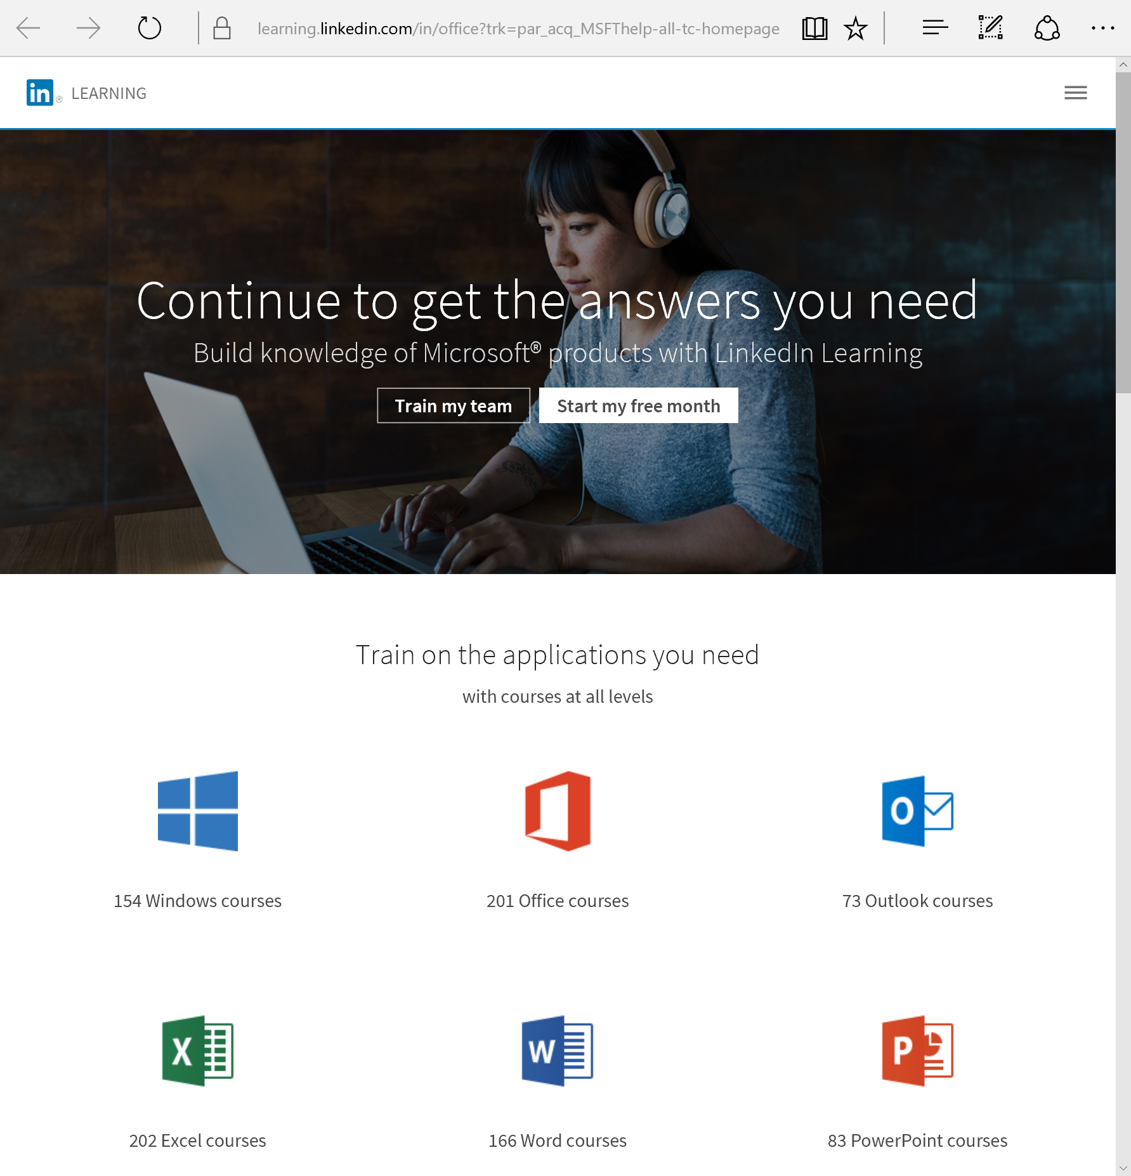
Office 365 Training Content
//aka.ms/o365learning
//learning.linkedin.com

Slide 35
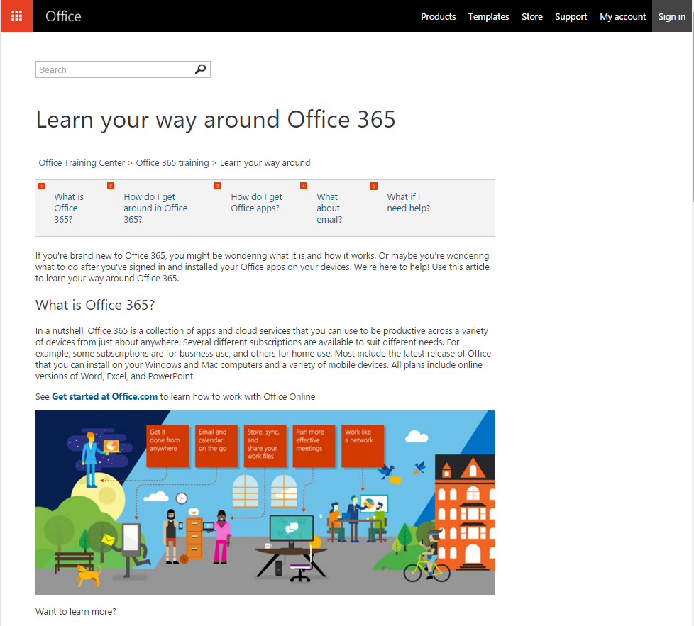
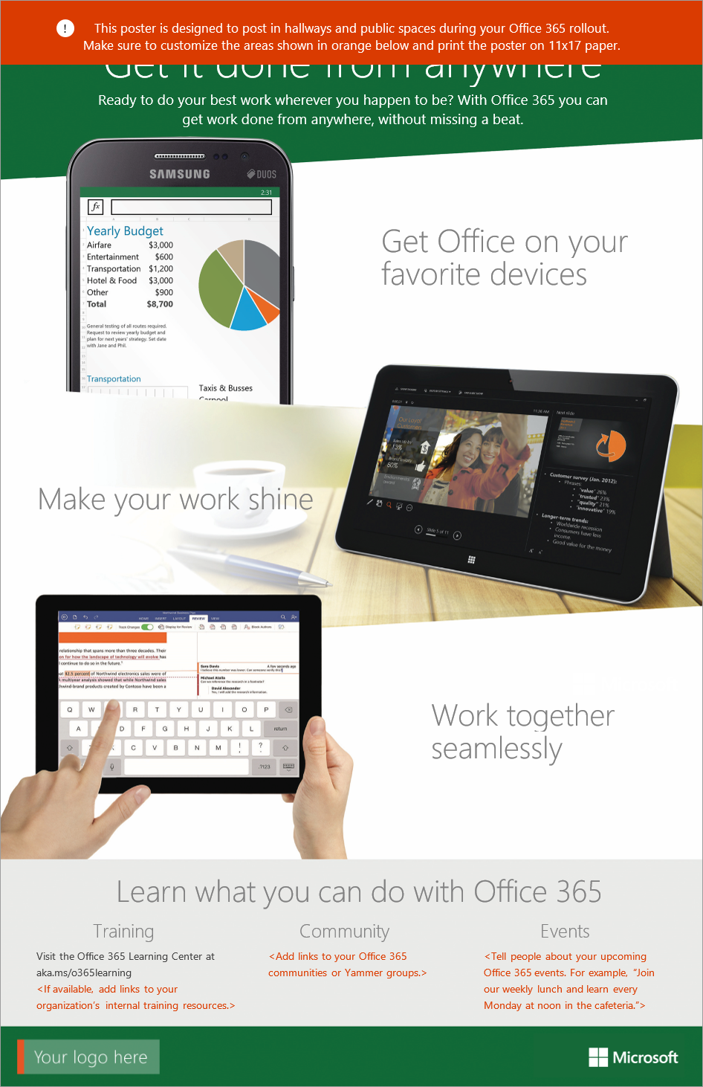
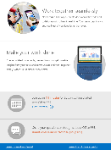
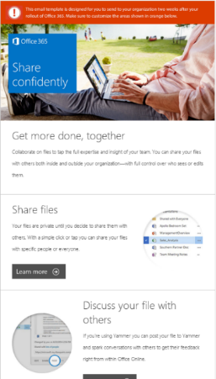
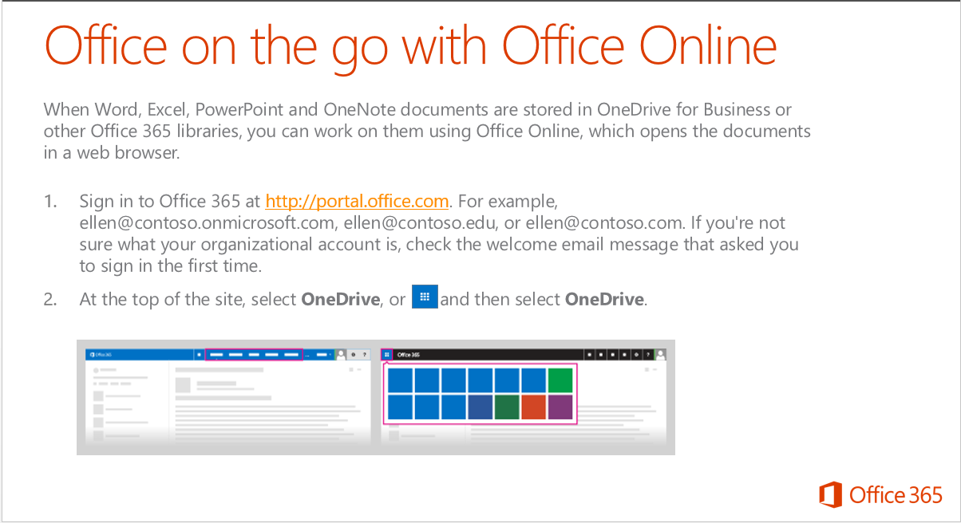

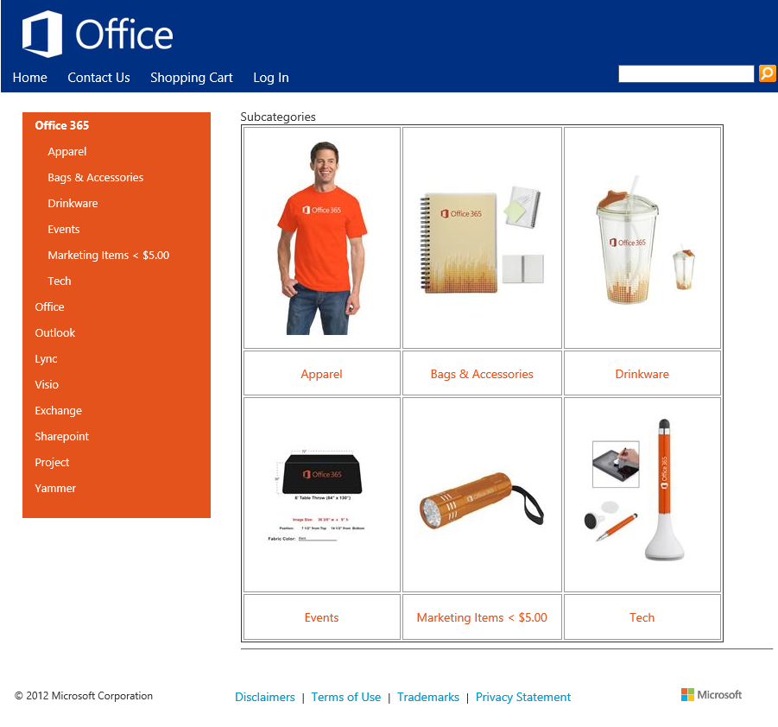
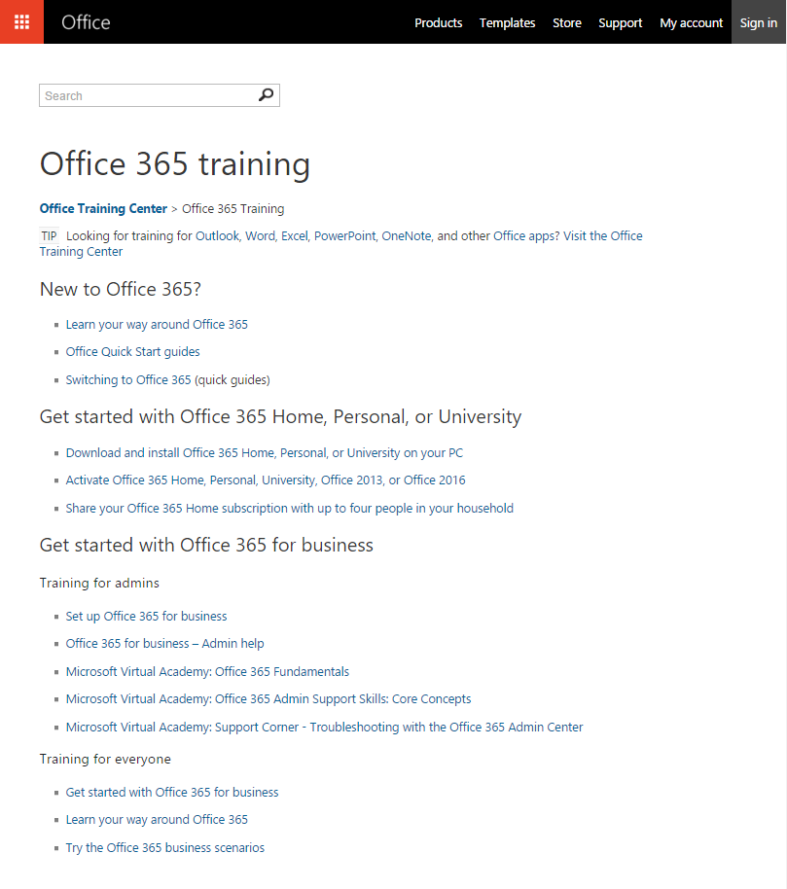
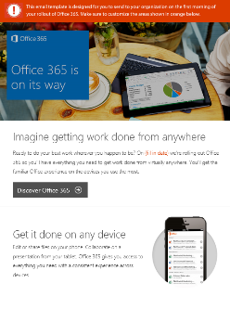
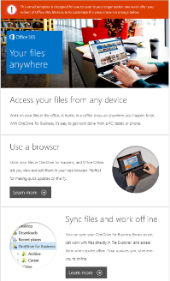
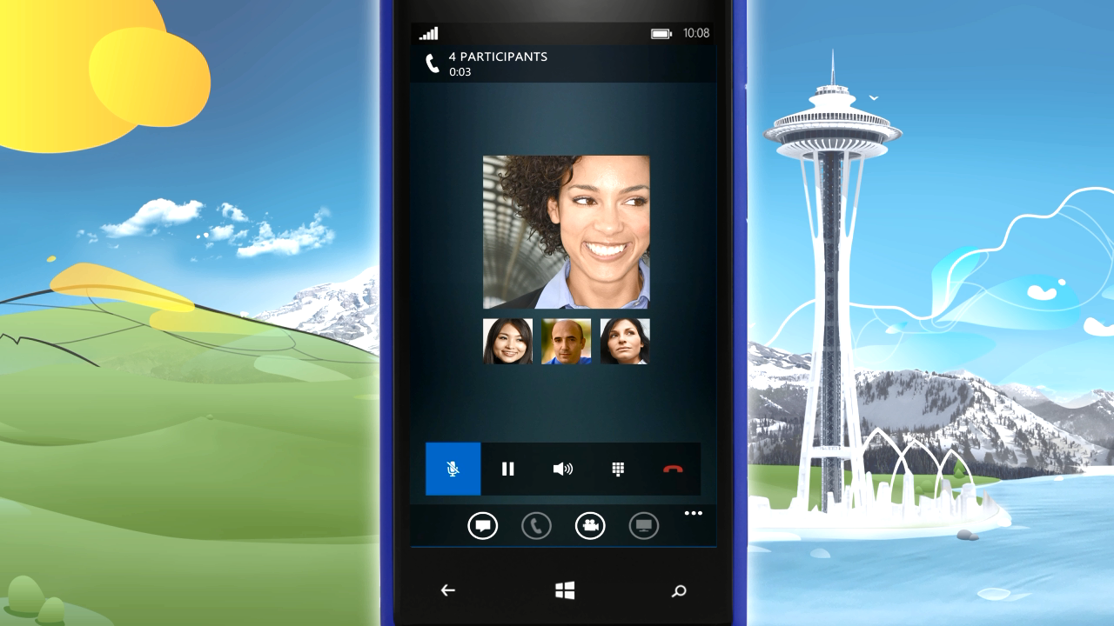

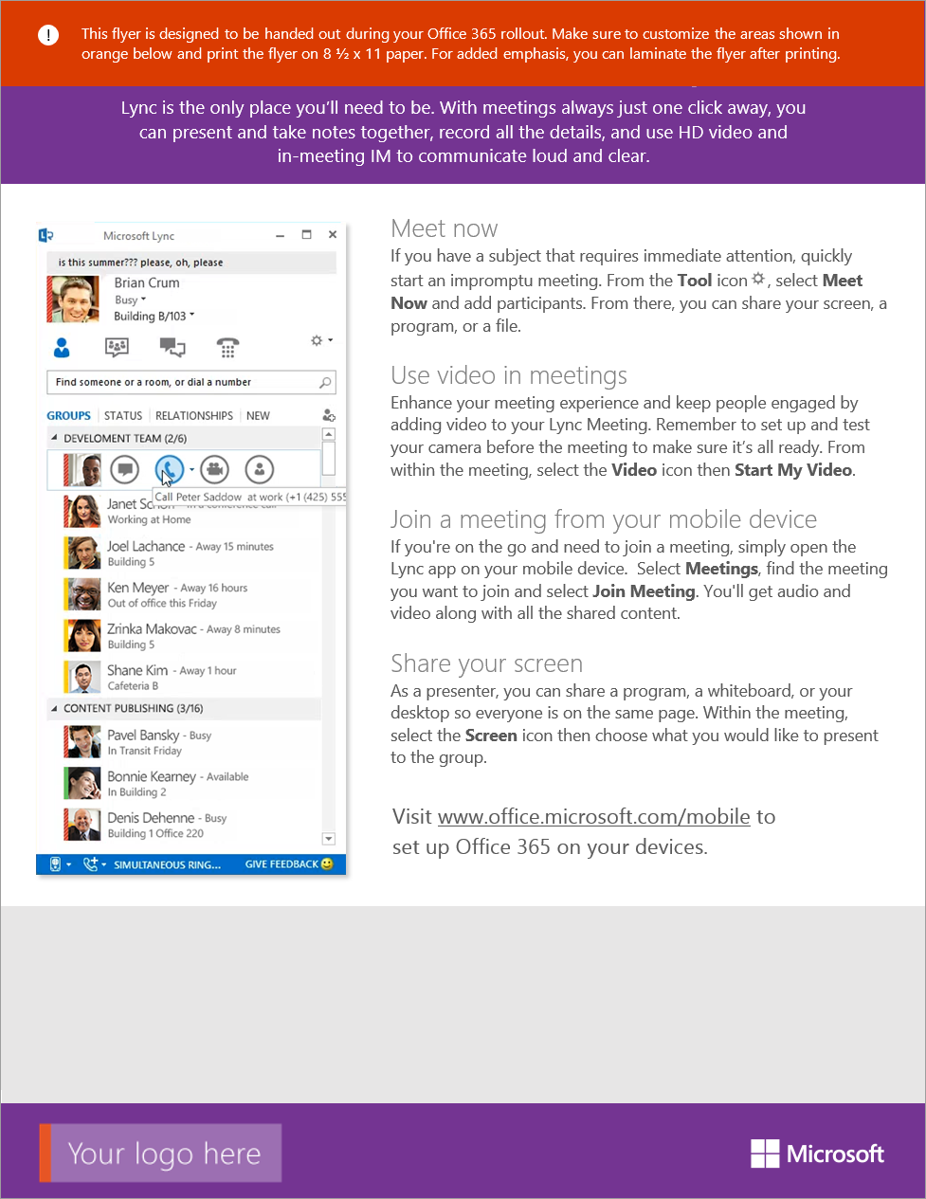
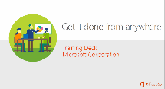
Awareness & Communications
Ongoing Usage & Support
  Inform users of upcoming rollout,
  and share benefits with them to
  create anticipation
  Inform users of upcoming rollout, and share benefits with them to create anticipation
  Increase depth & breadth of usage
  and manage upcoming changes
  in the service
  Increase depth & breadth
  of usage and manage upcoming changes in the service
  Highlights & Video Teasers
  Posters & Flyers
  Tips & Tricks Emails Series
  Office 365 Training Center
  A great way to generate buzz and get people excited is to play teaser videos during an event or by the cafeteria.
  Ensure that Office 365 has a visual presence throughout your corporate offices by using print messaging.
  Customizable email templates to
  help maximize depth and breadth of usage over time.
  Get people up and running quickly with these essential learning and training resources for Office 365.
  First Touch Events & SWAGs
  Countdown &
  Announcement Emails
  Scenarios-based Training
  Lunch and learn sessions are a great way to showcase benefits, get people excited, and involve Champions within your organization.
  Learning path to help
  people learn the most fundamental Office 365 usage scenarios at their own pace.
  Let people know what’s coming, setup expectations and spark interest by focusing on the “What’s in it for me?”.
//fasttrack.office.com/resources
//aka.ms/o365learning

Slide 36
Drive Value | Demo

Slide 37

Create a feedback loop
Establish communication avenues
Maintain momentum & dialog among users
Seek feedback and act on it
“
Rally people around the solution,
keep listening, and drive change”

Slide 38


“
We want them to love this tool, and part of that is not only listening to employees, but taking that feedback and truly turning it around and implementing that feedback.”
Jeff Schuman
Nationwide
Video

Slide 39

Measure, share successes, and expand
Measure progress against benchmark
Improve solution based on user feedback
Add more scenarios, one step at a time
“
Showcase success,
celebrate, and reiterate”

Slide 40
What do you need to showcase success?
A mix of qualitative and quantitative results
Evaluate where you are before getting started. Establish your benchmark and user surveys
Identify business KPIs that may improve based on
desired outcomes (satisfaction, time to process an order, etc.)
Identify success stories and gather quotes using interviews, roundtables, Yammer Groups, etc.
Measure progress against your KPIs to complement the qualitative analysis with data

Slide 41
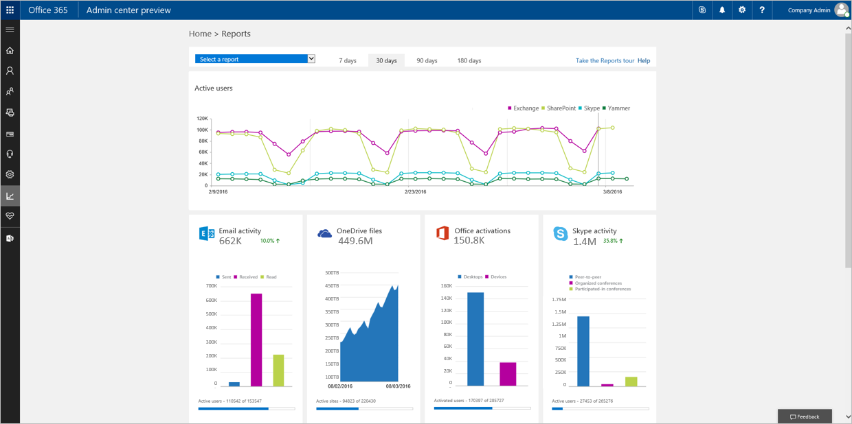
Monitor usage from the Office 365 Admin Center

Slide 42
Microsoft FastTrack
Resources
Summary of resources available today
DRIVE VALUE
Success
Plans
Productivity Library
Assessment &
Remediation Tools
ONBOARD
ENVISION
Usage
Scenarios
Onboarding
Services
FastTrack.microsoft.com
Adoption Methodology
METHODOLOGY &
RESOURCES
TOOLS &
INSIGHTS
Migration
Services
ENGINEERS
Office 365
Roadmap
Service
Management
Toolkit
Offers
Awareness Kits
& User Training
Adoption
Services

Slide 43

Microsoft FastTrack Roadmap
Coming Soon in FastTrack
File shares to Office 365 data migration (150+ seats)
Google drive to OneDrive for business data migration (150+ seats)
Office 365 user adoption services
Box to OneDrive for business data migration services (150+ seats)
New Box to SharePoint Online data migration services (150+ seats)
New Exchange Online Protection onboarding guidance
New Advanced Threat Protection onboarding guidance
New Office mobile app deployment guidance for IT
New SharePoint 2013 to SP Online migration services (150+ seats)
Dropbox to OneDrive for business data migration services (150+ seats)
//roadmap.office.com/

Slide 44

Build your success plan and Request assistance
FastTrack.Microsoft.com
Join the Community and learn from your peers
http://aka.ms/Community/DrivingAdoption

Slide 45

Deploy, ramp-up on new services and onboard new users with Microsoft FastTrack: http://fasttrack.microsoft.com/

Slide 46

Join the Microsoft Tech Community to collaborate, share, and learn from the experts: http://techcommunity.microsoft.com

Slide 47


Please evaluate this session
Your feedback is important to us!
From your PC or Tablet visit MyIgnite at http://myignite.microsoft.com
From your phone download and use the Ignite Mobile App by scanning the QR code above or visiting https://aka.ms/ignite.mobileapp

