Slide 1
Explore Configuration and Change Management in Operations Management Suite
BRK2092
Lavanya Krishnan
Eamon O’Reilly
Program Managers in Operations Management Suite

Slide 2


Modern cloud management
DEVOPS TOOLING
PACKAGING
ORCHESTRATION
PATCHING
BUILD
CONFIG MONITORING
CONFIG
GOVERN
OPTIMIZE
SUBSCRIPTION
MONITOR
ANALYTICS
ALERTS
POLICY
DISCOVERY
SECURE
PROTECT
DETECT
PREVENT
BACKUP
RECOVERY

Slide 3

Automation & Control Scenarios
Build
Create VMs and Cloud infrastructure
Integrate into Dev tools
Configure
Update management
Configure cloud and VMs per application
Monitor
Identify changes causing issues
Integrate into ITSM solutions
Protect
Recover application / VM from backup
Secure
Quarantine VM if exploited
Govern
Set up RBAC per user / group
Integrate into Site Recovery for fail over
Set policy
Recover unused resources
GOVERN
BUILD
Automation & Control
SECURE
CONFIG
PROTECT
MONITOR

Slide 4

Automation & Control
Key Features
Manage any cloud & on premises
Process Automation
Configuration Management
Update Management
Windows & Linux
Process Automation
Author PowerShell, PowerShell workflow, Graphical runbooks
Hybrid Runbook Workers with Proxy support
Update Management
Insights across Windows & Linux
Orchestrated updates and troubleshooting
Configuration Management
DSC Configurations, Pull service
Node Management & Reporting
Change tracking
Easy Onboarding
RunAs account for Azure management
Gallery of runbooks and modules from Microsoft and community
Shared capabilities across features
Role Based Access Control
Secure, global store for variables, credentials, certificates, connections
Schedules
Modules
Source control support
Auditing
Tags
Integration
Full SDK with PowerShell, .Net, and REST
Webhooks to start runbook remotely
ITSM support
OMS
AWS & Service Providers
Azure
Automation & Control
Hybrid Worker
On-Premises
Hyper-V
VMWare
OpenStack
Reliable, highly available, scalable
Hybrid management Integrate existing systems

Slide 5
Configuration Management
Key Features
Configure any cloud or on premise machine
Windows & Linux
  Desired State Configuration
Change Tracking
Desired State Configuration (DSC)
Proactively respond to configuration drift by defining a baseline for your environment
Deliver Infrastructure as code
Flexible Delivery
    Apply and monitor
    Apply and autocorrect
Detailed reporting and diagnostics at a per resource level
Available for both Windows & Linux
Change Tracking
Track changes made to your system
Valuable for root-cause analysis
Available for both Windows & Linux
  Windows
      Software
      Services
      Files
  Linux
      Software (Packages)
      Daemons
AWS & Service Providers
Automation & Control
Azure
Configuration Management
Hybrid Worker
On-Premises Datacenter
Reliable, highly available, scalable
Unified visibility and deployment

Slide 6
Desired State Configuration

Slide 7
PS DSC configuration management
Simplifies configuration
Prevents configuration drift
Flexible deployment options
Enables continuous deployment
Development
Test
Production

Slide 8
Automation DSC solves enterprise challenges
How do I limit access?
  Which users can create / edit which configurations? Which users can compile which configurations (to create node configurations), and apply these node configurations to nodes?
  What nodes map to what node configurations? How do I prevent malicious nodes from accessing others?
How do I track change / compliance across my environments?
  Who edited what configurations when? Who compiled what configurations, to generate which node configurations, when?
  What nodes are compliant or not, pending changes, or failed to become compliant? What specifically is each not compliant with? What services and roles are overall in compliance or not?
How do I orchestrate configuration changes without impacting uptime?
  How do I make sure to only cause configuration changes during maintenance windows?
  How do I manage configuration changes across upgrade domains within a service?
  How do I manage configuration change dependencies across nodes in a service?

Slide 9
Configuration & Automation DSC
Staging
Authoring
MOF
MOF
Configuration
(script)
Node Configuration
(MOF)
Reports
checksum
Rest Endpoint
DSC
Resources
Zip
Zip
Zip
Azure
Automation
Azure VM
Physical server
On-prem
VM

Slide 10
Runbooks with DSC

Slide 11
DSC and Runbooks – better together
Use PS DSC to declaratively configure VMs / physical hosts
Use runbooks to orchestrate complex processes across systems
Use PS DSC within Azure Automation runbooks to configure machines as part of larger processes
  Test & deploy DSC Configurations to all of your servers
  Receive request from self service portal from end user, runbook deploys the machine and decides which DSC policy to apply to it based on user type

Slide 12


Demo – DevOps Scenario
Application code / Infrastructure requirements
Source Control for Application / Configuration
Infrastructure policy / Application policy
Manage Builds / Test coverage
Approve releases
Developer
Operations
VS Team Services
Template for infra requirements
Infrastructure policy / Application policy
Configure OS / Deploy application using DSC
Azure / On-Premises / AWS
Automation Service

Slide 13
Demo
Eamon O’Reilly

Slide 14
Change Tracking

Slide 15
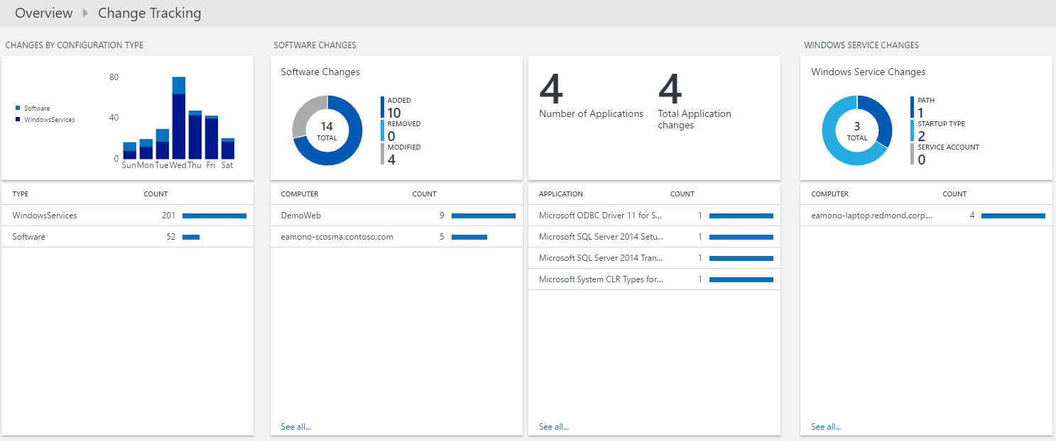
Change Tracking
Identify software, Windows Services and file (new for Ignite)
  View changes for:
  Configuration type for software, file, daemons, and Windows services
  Software changes to applications and updates
  Windows service changes for individual servers
  File changes for specific files or under a directory
Key Features:
  Spans across Windows and 10 distributions of Linux
  Correlate configuration changes with other relevant data
  Create an alert & remediate if service stops
  Reporting for package/software updates

Slide 16
Demo
Lavanya Krishnan

Slide 17
Integrating with ITSM systems

Slide 18
ITSM Scenarios (Provance, ServiceNow, Cherwell)
Self Service
Create and request a Service Catalog Item
Service the item using Automation Runbooks
Alert Remediation
Incident Management
Take action on the alert using Automation
Trigger an alert in ITSM solution
File an incident from OMS into ITSM solution
Manage/Resolve incident by calling Automation
GOVERN
Automation & Control
BUILD
SECURE
CONFIG
PROTECT
MONITOR

Slide 19
Demo
Lavanya Krishnan

Slide 20
Automation & Control
Key Features
Manage any cloud & on premises
Process Automation
Configuration Management
Update Management
Windows & Linux
Process Automation
Author PowerShell, PowerShell workflow, Graphical runbooks
Hybrid Runbook Workers with Proxy support
Update Management
Insights across Windows & Linux
Orchestrated updates and troubleshooting
Configuration Management
DSC Configurations, Pull service
Node Management & Reporting
Change tracking
Easy Onboarding
RunAs account for Azure management
Gallery of runbooks and modules from Microsoft and community
Shared capabilities across features
Role Based Access Control
Secure, global store for variables, credentials, certificates, connections
Schedules
Modules
Source control support
Auditing
Tags
Integration
Full SDK with PowerShell, .Net, and REST
Webhooks to start runbook remotely
ITSM support
OMS
AWS & Service Providers
Azure
Automation & Control
Hybrid Worker
On-Premises
Hyper-V
VMWare
OpenStack
Reliable, highly available, scalable
Hybrid management Integrate existing systems

Slide 21
Free IT Pro resources
To advance your career in cloud technology
Plan your
career path
Cloud role mapping
Expert advice on skills needed
Self-paced curriculum by cloud role
$300 Azure credits and extended trials
Pluralsight 3 month subscription (10 courses)
Phone support incident
Weekly short videos and insights from Microsoft’s leaders and engineers
Connect with community of peers and Microsoft experts
Microsoft IT Pro Career Center
www.microsoft.com/itprocareercenter
Get started
with Azure
Microsoft IT Pro Cloud Essentials
www.microsoft.com/itprocloudessentials
Demos and
how-to videos
Microsoft Mechanics
www.microsoft.com/mechanics
Connect with peers and experts
Microsoft Tech Community
https://techcommunity.microsoft.com

Slide 22


Please evaluate this session
Your feedback is important to us!
From your PC or Tablet visit MyIgnite at http://myignite.microsoft.com
From your phone download and use the Ignite Mobile App by scanning the QR code above or visiting https://aka.ms/ignite.mobileapp

