Slide 1
Drive real-world success with
Skype for Business platform solutions
BRK2088
James Skay
Senior Product Marketing Manager

Slide 2
Session Objective
Better understand how you can extend the power of Skype for Business via the Skype Developer Platform and partner solutions.

Slide 3
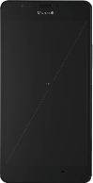
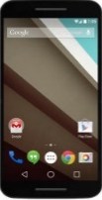
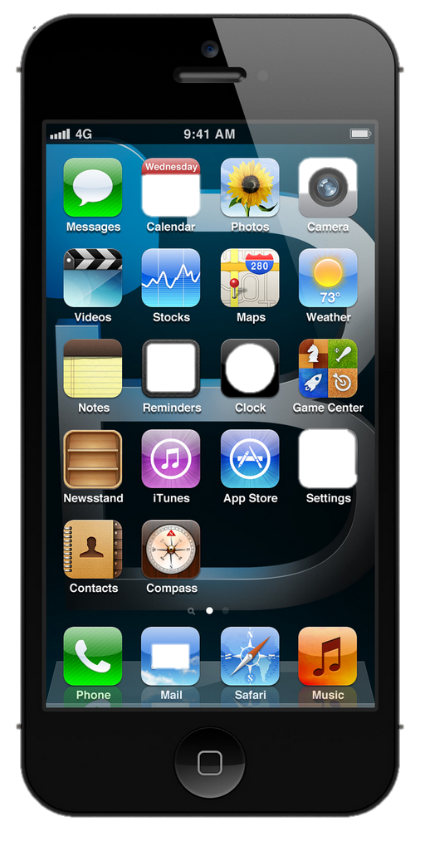
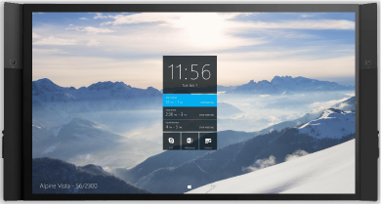




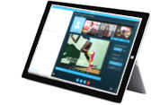
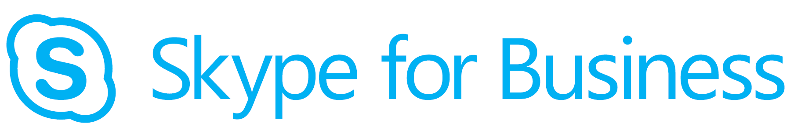


Skype Developer Platform Overview
Experiences
Devices
Web
Appliances
Authoring
z
APIs/Services
Calling
Messaging
Sharing
Management
Federation
Meetings
Presence
People
Network
Interop
O365 Services – Microsoft Graph
Cloud/Networks
PSTN

Slide 4
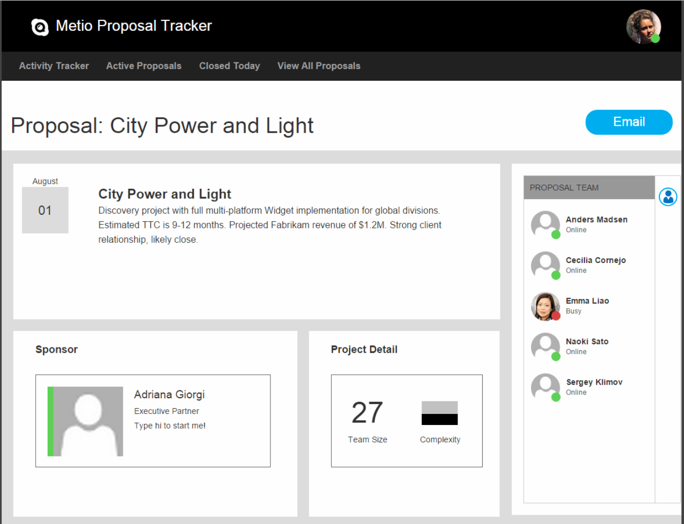
Line of Business App Integration
Bring awareness and instant engagement to the people-centric web and mobile experiences they already use every day:
Approval workflows
Help Desk and Chat Support
“Meet Now” with virtual teams
CRM and Sales teams
and more

Slide 5
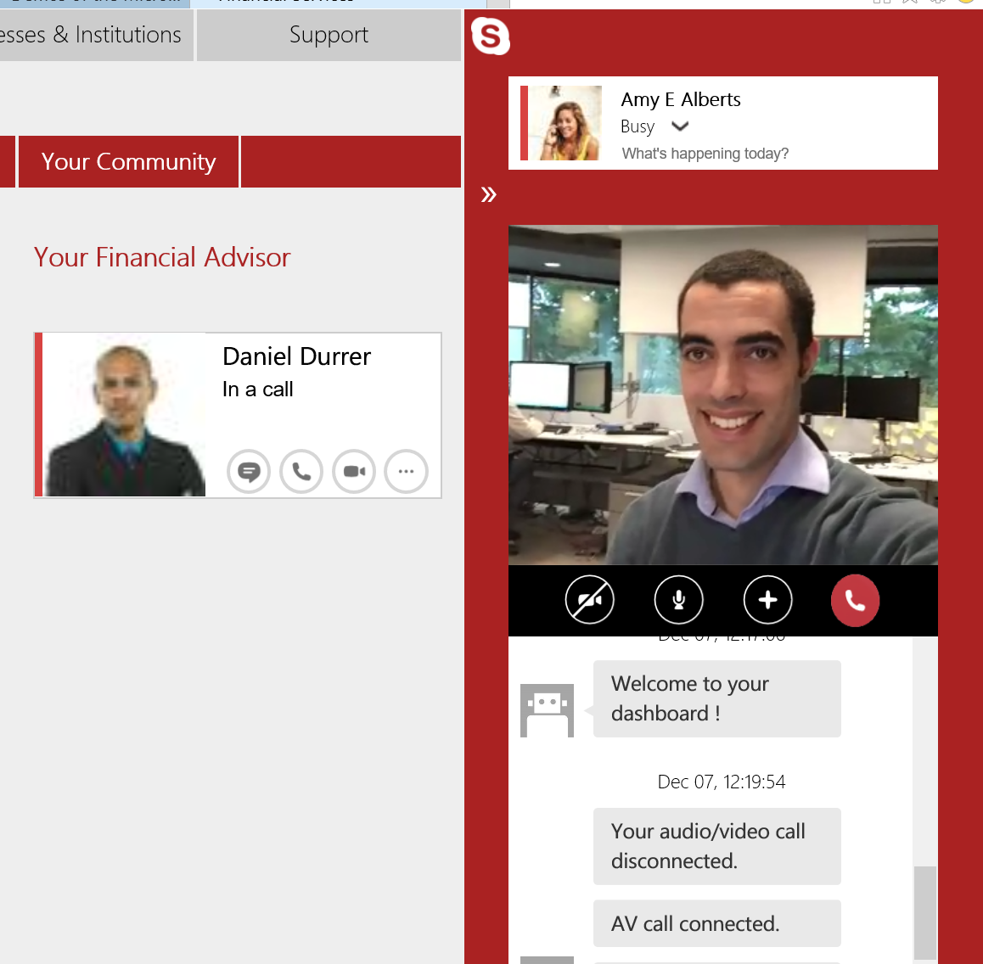
Remote Advisor: Web
Clients get integrated, personal, audio/video engagement with web and mobile experiences:
Wealth management
Telehealth Virtual Office Visit
Ad-hoc advisor engagement
Remote interviews

Slide 6
Remote Advisor: Mobile & Tablet
Customers
Providers
Easy, seamless engagement
Download single provider app from store
Single Sign-on using provider credentials
Collab in app context
Seamless voice + video
Voice + Video
Shared context with customer
Integrated agent experience

Slide 7

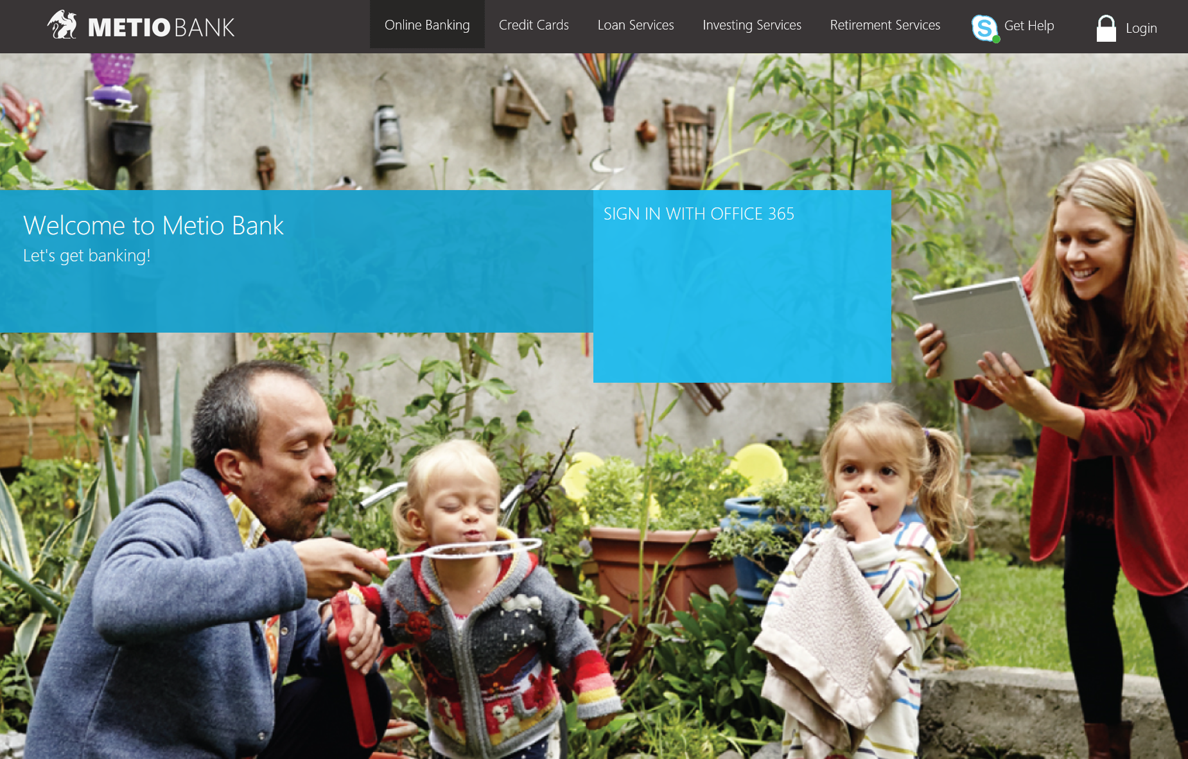
Demo:
Metio Bank

Slide 8


Slide 9

Partner
Demo
Smartsheet
Jennifer Savage
Vice President of Product & Partner Marketing

Slide 10









Smartsheet Company Overview
Smartsheet is the world’s leading SaaS platform for managing and automating collaborative work.
95,000+ Companies
190+ Countries
10M+ Registered Users
72 Fortune 100 Companies
50%+ Fortune 500 Companies
1st Overall
3rd Best Performing
3rd Best User Interface
App Awards

Slide 11
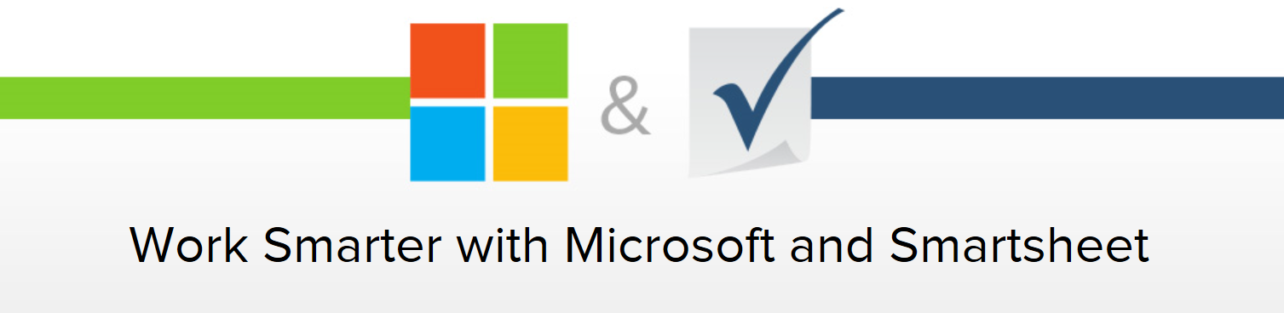
For more information, visit our website:
www.smartsheet.com/Microsoft

Slide 12

Partner
Demo
Enghouse Interactive
John Cray
VP, Global Product Management

Slide 13


The Enghouse Attendant Console for Office 365 and Skype for Business Cloud PBX
John Cray
VP, Global Product Management
Enghouse Interactive

Slide 14
Why is the Attendant Console so important?
Virtually every business has an “operator” or “attendant” function …
  … to provide a personal touch for a better customer experience.
  … to handle complex requests that an “auto-attendant” can’t handle.
Why the Enghouse Attendant Console for Skype for Business?
  Enghouse has deployed hundreds of thousands of console users worldwide.
  Enghouse has over 400 customers with over 10,000 contact center agents deployed on Skype for Business.
  Enghouse is first to market with attendant console for SfB Online.
Office 365 with
Skype for Business Cloud PBX
Skype for Business
Enabled Enterprise
Enghouse
Enabled Operators

Slide 15
What must an Attendant Console application for SfB do?
It must operate with the Skype for Business Cloud PBX …
  … without a requirement for on-premise equipment.
  … with queuing to operators leveraging new SfB Online Hunt Group functionality.
It must be very easy to learn and use …
  … to support operators who need to be productive … fast.
It must handle all required use cases, across all verticals …
  … like hospitals, and law firms, and hotels, …
  … with full integration to SfB call control, directory searches, and so on.

Slide 16

SfB Certified on Console and Contact Center
Market Guide for Skype for Business Contact Center Partners
http://info.enghouseinteractive.com/gartnerskypereport
About 1/3 of our now, 400+ Skype for Business customers, use our Attendant Console

Slide 17
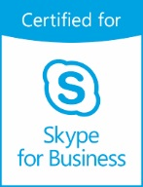

Receive Your Own Demo and a Free Trial of the Attendant Console http://info.enghouseinteractive.com/Cloud-Attendant-Console.html
  Attendant Console 2016
  Communications Center 2016

Slide 18

Partner
Demo
ComputerTalk
Chris Bardon
Chief Software Developer
Brandon Viamonte
Global Director, Business Development

Slide 19
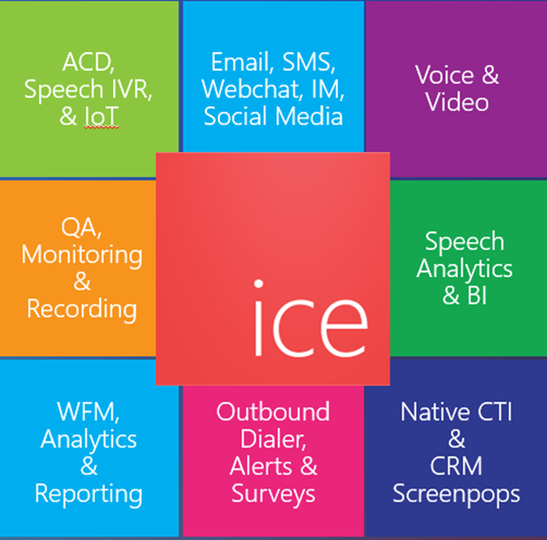
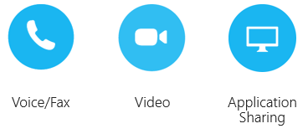
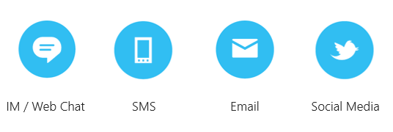
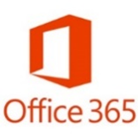

Microsoft Native Contact Center for Skype4B
Chris Bardon
Chief Software Developer
Brandon Viamonte
Global Director
Business Development
Contact Us:
contact@computer-talk.com

Slide 20


Contact Center and Auto-Attendant for Skype4B/O365
For more information:
contact@computer-talk.com
Transition at your pace
Reduced TCO
Reduced time to manage
More powerful communications
Enhanced customer experience

Slide 22
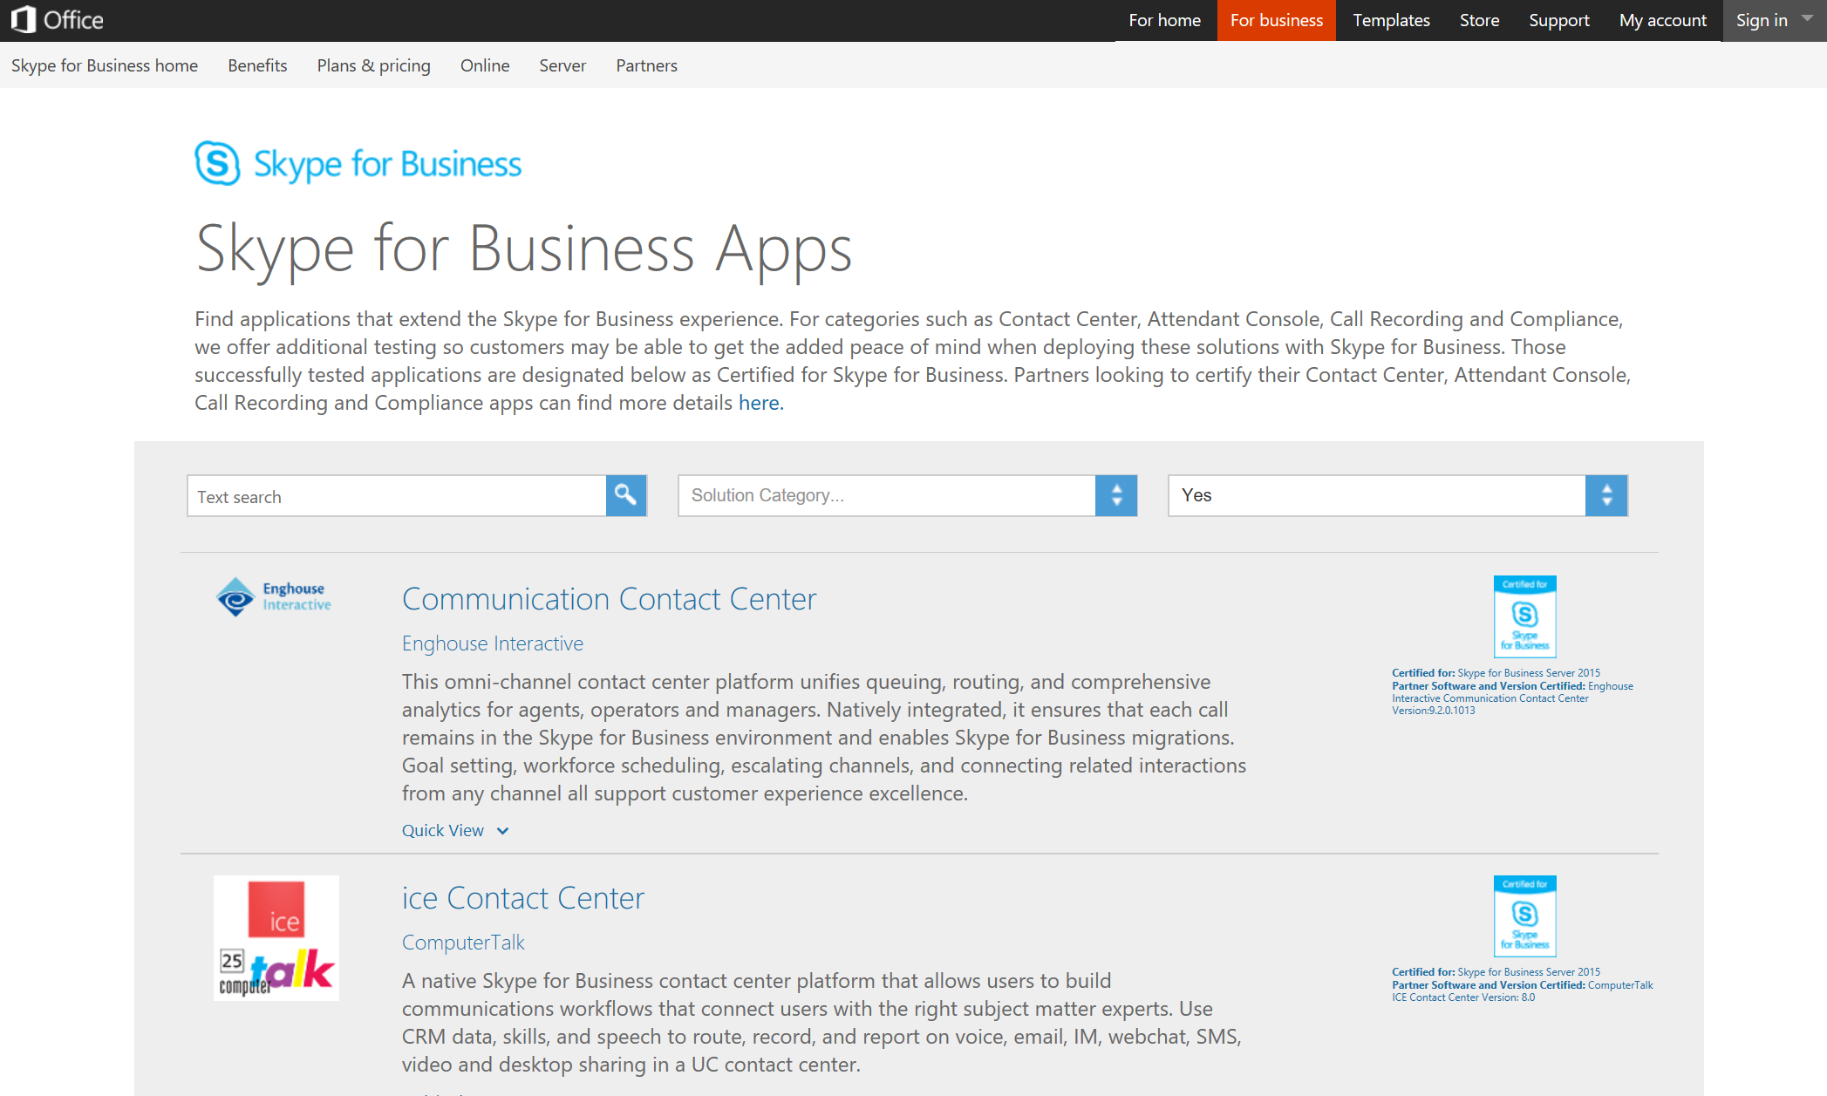
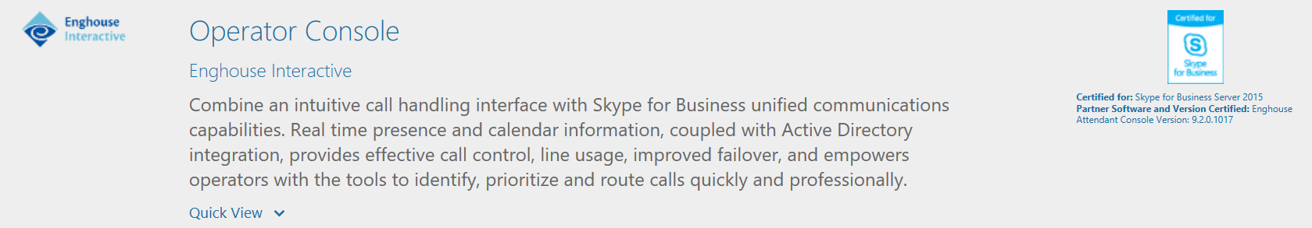
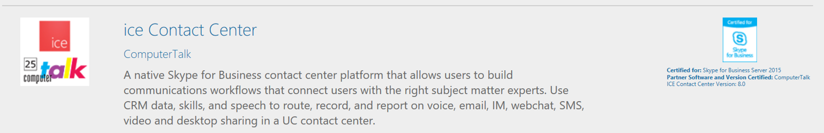

Skype for Business App Certification & Catalog
The Skype for Business App Certification Program is designed to offer Microsoft customers the added assurance of third-party solutions that have demonstrated a high quality experience and compatibility when deployed with Skype for Business.
Only products that pass the specifications outlined in the Skype for Business Certification Program can be associated with this designation.
http://apps.skypeforbusiness.com

Slide 23











Certified Category Solutions – as of Sept 2016
 | Category | Certified Solutions
 | Attendant Console
 | Contact Center
 | Recording
 | Compliance

Slide 24
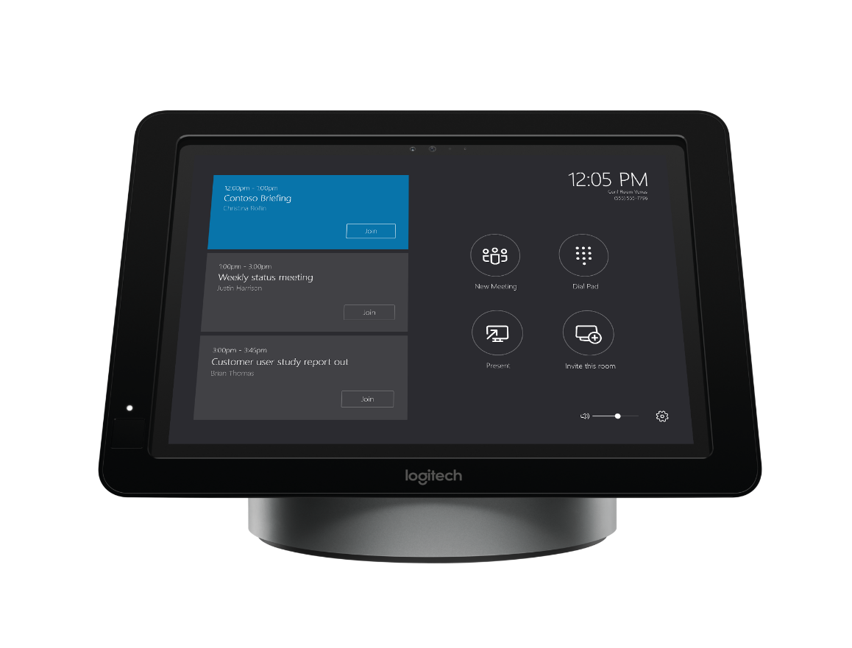
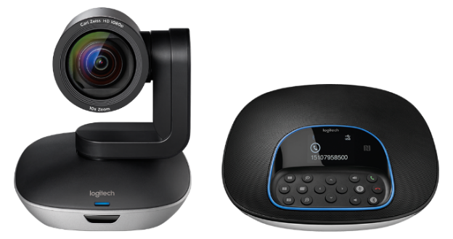
#MeetingAccomplished
Want to win a new Skype Room Systems meeting room bundle from Microsoft and Logitech?
Check out Skype Room Systems in the Expo Hall at
Microsoft Showcase MS 111 or Logitech Booth 1818.
Snap a photo of the device in action and share your photo on Twitter or Instagram with the hashtag #MeetingAccomplished, or upload it to www.SkypeMeetingAccomplished.com,
to enter to win your own Skype Room Systems bundle!*
*No purchase necessary. Open only to legal United States residents. Sweepstakes ends 9/30/2016. See www.SkypeMeetingAccomplished.com for Official Rules.
Microsoft Ignite #MeetingAccomplished

Slide 25

Deploy, ramp-up on new services and onboard new users with Microsoft FastTrack: http://fasttrack.microsoft.com/

Slide 26

Join the Microsoft Tech Community to collaborate, share, and learn from the experts: http://techcommunity.microsoft.com

Slide 27
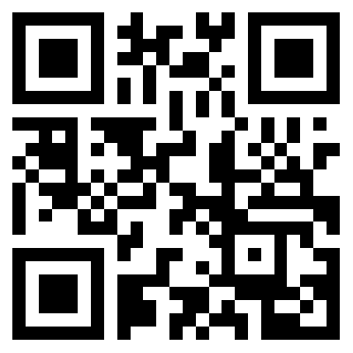
Join the Skype for Business Community
Discover rich discussions and
information sharing across
customers, partners, and users
IT Pro Forums
User Forums
Broadcast Updates
Tips and Tricks
Product Updates
http://aka.ms/sfbcommunity

Slide 28


Please evaluate this session
Your feedback is important to us!
From your PC or Tablet visit MyIgnite at http://myignite.microsoft.com
From your phone download and use the Ignite Mobile App by scanning the QR code above or visiting https://aka.ms/ignite.mobileapp

