Slide 1
Plan your Cloud PBX Deployment
BRK2081
Jamie Stark
Product Manager
@nomorephones

Slide 2
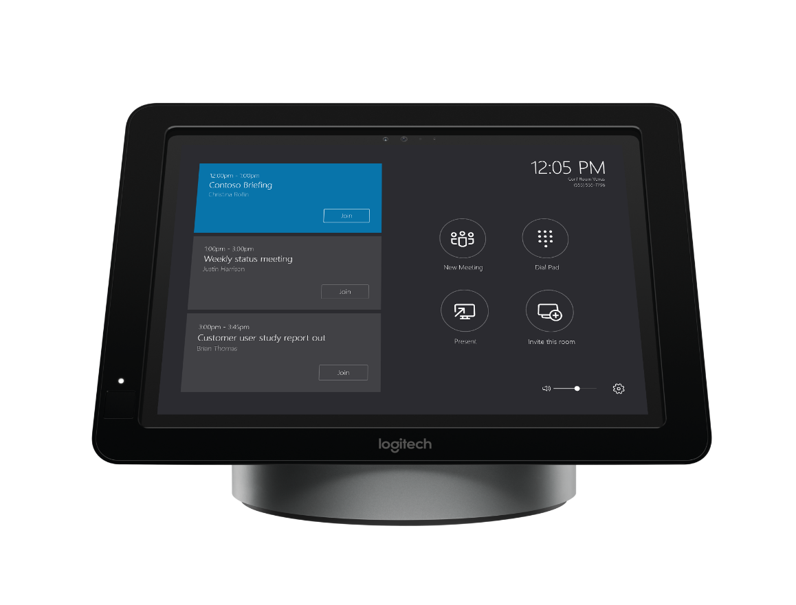
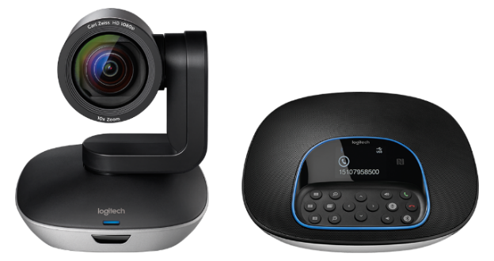
#MeetingAccomplished
Want to win a new Skype Room Systems meeting room bundle from Microsoft and Logitech?
Check out Skype Room Systems in the Expo Hall at
Microsoft Showcase MS 111 or Logitech Booth 1818.
Snap a photo of the device in action and share your photo on Twitter or Instagram with the hashtag #MeetingAccomplished, or upload it to www.SkypeMeetingAccomplished.com,
to enter to win your own Skype Room Systems bundle!*
*No purchase necessary. Open only to legal United States residents. Sweepstakes ends 9/30/2016. See www.SkypeMeetingAccomplished.com for Official Rules.
Microsoft Ignite #MeetingAccomplished

Slide 3
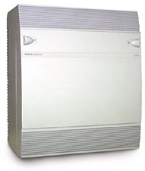

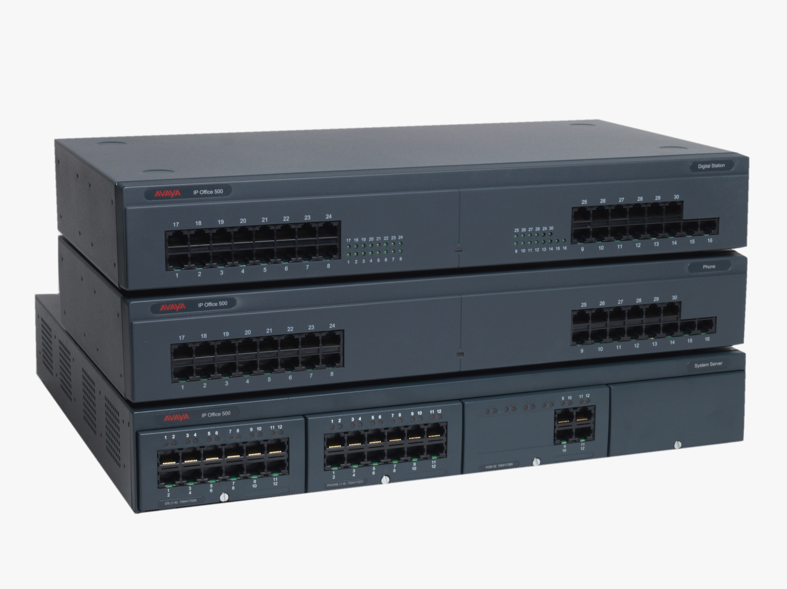


Communication Eras
Circuit PBX
IP-PBX
On-Prem UC
Cloud UC

Slide 4
Online
Hybrid
On Premises
Cloud PBX in Office 365
PSTN services provided by Microsoft
Users online or on-premises
Integration with PSTN services on-premises
End-user features & customer PSTN services integrated on-premises

Slide 5

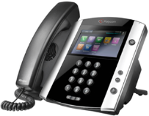
Modern Voice with Cloud PBX
  Make, receive, and transfer business calls
  in the office, at home, or on the road using phone, PC and mobile.
  Interoperate with existing assets and eliminate separate PBX systems over time
  Increase agility and consolidate management with rapid provisioning, reporting, and diagnostics of voice services in Office 365
INCREASE AGILITY AND CONSOLIDATE MANAGEMENT WITH VOICE SERVICES IN OFFICE 365
Online
Hybrid

Slide 6
Demo!!

Slide 7
Cloud PBX
Ready your Network!
BRK3061
Tuesday 10:45
B302-303
Complete call control in Office 365.
Two core parts always in the cloud:
- Cloud-based call control for end-users
- Tenant admin user experience for IT Pros
Azure ExpressRoute
or Public Internet
Deploy ExpressRoute
BRK4011
Friday 10:45
B216-217
Customer Premises
Office 365

Slide 8
Cloud PBX: Calling Features
Call answer / initiate (by name & number)
Call hold / retrieve
Call History
Call Delegation & Call On-behalf
**Call Queuing & Routing
Call Transfer (Blind, Consult & Mobile)
Camp-on
Caller ID
Call Waiting
Call forwarding & simul-ring
Clients for PC, Mac & Mobile
Device switching
Distinctive ringing
Do-not-disturb routing & call blocking
Enterprise calendar call routing
Financially-backed SLA
Integrated dial-pad
Music on Hold
**Organizational Auto Attendant
Qualified IP Desk Phones
Skype & Federated calling
Team calling
Video call monitor
Voice Mail
**Coming to preview in October!

Slide 9
Cloud PBX: Phones and Clients
Devices for SFB
BRK3055
Thursday 10:45
Thomas Murphy Ballroom 4
Rich Clients
All supported PC & Mac clients in Office 365
Mobile Clients
Skype for Business clients for iOS, Android & Windows Phone
IP Phones
Polycom VVX201-VVX600 series with minimum UCS 5.4.0A firmware 5.4.0.10182
AudioCodes & Yealink: Currently under testing, qualification expected in October
Lync Phone Edition: Polycom CX600, CX3000*; Mitel, HP, etc., w/latest firmware
Unsupported
VDI Plug-in, Lync Server Attendant, *PIN Authentication

Slide 10
Cloud PBX: Voicemail
New voicemail service with no configuration required.
Exchange used for deposit, compliance & archiving.
Features Include
Personalized Greeting
Message waiting indicator
Reply to voicemail with call
Customer
Premises
Office 365

Slide 11
Cloud PBX: Voicemail
23 Supported Languages
Language | Country/Region | Culture ID
Catalan | Spain | ca-ES
Chinese (Hong Kong) | China | zh-HK
Chinese (Simplified) | China | zh-CHS
Chinese (Traditional) | Taiwan | zh-TW
Danish | Denmark | da-DK
Dutch | Netherlands | nl-NL
English | Australia | en-AU
English | Canada | en-CA
English | India | en-IN
English | United Kingdom | en-GB
English | United States | en-US
Finnish | Finland | fi-Fl
French | Canada | fr-CA
Language | Country/Region | Culture ID
French | France | fr-FR
German | Germany | de-DE
Italian | Italy | it-IT
Japanese | Japan | ja-JP
Korean | Korean | ko-KR
Norwegian (Bokmal) | Norway | nb-NO
Polish | Poland | pl-PL
Portuguese | Brazil | pt-BR
Portuguese | Portugal | pt-PT
Russian | Russia | ru-RU
Spanish | Spain | es-ES
Spanish | Mexico | es-MX
Swedish | Sweden | sv-SE

Slide 12
Cloud PBX: Voicemail
Exchange Server 2010/2013: October availability
1.) Establish Hybrid & Configure OAuth
DNS: https://technet.microsoft.com/en-us/library/mt473798(v=exchg.150).aspx
OAuth: https://technet.microsoft.com/en-us/library/mt652109.aspx
2.) Enable UM users with on-premises mailboxes
User: https://technet.microsoft.com/en-us/library/bb124147(v=exchg.150).aspx
Mailbox: https://technet.microsoft.com/en-us/library/aa998033(v=exchg.160).aspx
3.) Turn off Exchange Online licenses

Slide 13
Cloud PBX: Service Level Availability
Financially accountable for availability & quality
Ensuring every call has great quality
Our Goal: Great calls anywhere, anytime, on any device
Industry-leading media stack
Integrated end-to-end w/devices
Skype covered under Office 365 SLA
  Included with every Office 365 subscription
  Availability of IM and Meetings
  Availability of PSTN Calling and Conferencing
Skype for Business also includes SLA for Call Quality
Requirements: Certified IP Phone for Skype for Business with wired Ethernet connection
Media issues need to be due to Microsoft networks
Skype for Business Quality SLA
Monthly uptime % | Service credit
< 99.9% | 25%
< 99% | 50%
< 95% | 100%

Slide 14
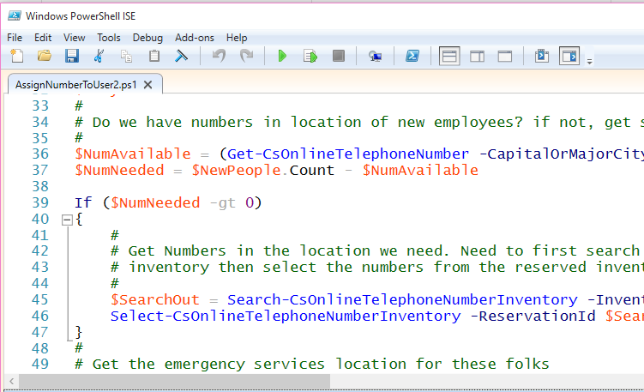
Cloud PBX: Administration Features
Operations
Tenant Admin with PowerShell
Call Detail Records
Call Quality Dashboard
Admin features
Multiple Emergency numbers
Rate my Call Reporting
Unassigned number handling
Deterministic Networking with Azure ExpressRoute

Slide 15
Cloud PBX: Org Auto Attendant & Call Queues
OrgAA & Call Queues
BRK3056
Wed 14:15
C113
Auto Attendant: Service for inbound call handling
“Auto Attendant” is general term used for call treatment capability.
Organizational Auto Attendant provides for call routing to end-users in a Cloud PBX tenant.
Complete support for Hybrid & Cloud Connector with cloud-side call handling.
Call Queues: Hunt Groups and Routing
Hunt groups responsible for managing call queues and scenarios for routing to end users
Organizational Auto Attendant provides for call routing to end-users in a tenant
Planned Availability by end of CY16
Preview will be for basic capability with more advanced features arriving for GA.
Both of these capabilities address same requirements as Response Groups in SFB Server.

Slide 16
Cloud PBX: Conferencing
PSTN Conferencing
BRK3048
Wed 10:45
C113
All Cloud PBX users are homed in Office 365.
User services include Presence & Meetings.
PSTN Dial-in and Dial-out through native
PSTN Conferencing service or ACP
“Hybrid” scenarios for splitting dial-in and user
locations are unavailable.

Slide 17
Cloud PBX Roadmap
Enabling ongoing user expansion
Meet Users Comm Needs
BRK2075
Fri 11:00
C101
Information workers—especially mobile and remote workers
USER
COVERAGE
Branch offices—specialized workers like help desk
Entire organizations
NOW
2H CY2016
CY2017
Android, iOS, Windows clients
IP desk phones
Answer/hold/transfer
Voicemail
Team calling
Delegation
Static E-911
Org Auto Attendant
Hunt Groups/Call Queues
Common Area Phones
Additional voice policies
Simple phone authentication
Extension dialing
Outbound DID manipulation
Busy on Busy
Private Line
Location Discovery
Voicemail transcription
Group Call Pickup
Multi-line appearance
Dynamic E-911
CLOUD PBX
FEATURE SET
VOICE
CONNECTIVITY
PSTN Calling in US
Cloud Connectivity
PSTN Calling in UK + more countries
Cloud Connectivity
PSTN calling expansion
Cloud Connected Appliance

Slide 18
Cloud PBX: PSTN Options
PSTN Calling plans delivered by Microsoft ⁽¹⁾
On-Premises PSTN Connectivity ⁽²⁾
Office 365
ExpressRoute
Customer
Premises
Public
Internet
⁽¹⁾
PSTN
⁽²⁾

Slide 19
Cloud PBX: PSTN Interfaces
PSTN Calling add-on
First party offer from Microsoft available in specific countries as regulated utility.
Completely cloud-based with no required infrastructure on-premises.
Tightly integrated with Office 365 and Cloud PBX.
On-premises PSTN Connectivity
Connecting Office 365 with the customer’s carrier, contract, & circuit.
Skype for Business Server software on-premises interoperates with legacy PBX.
Cloud Connector Edition delivered as Packaged VMs for new customer deployments.

Slide 20
PSTN Calling: Benefits
Cheaper and faster to get started.
Pay one bill for all your communications.
All the latest updates delivered automatically.
Pick new numbers or port what you have today.
No need for any server software on-premises.
Easier to administer.

Slide 21
PSTN Calling: Plans
PSTN Calling combines with Cloud PBX license
  Option 1: Add PSTN Calling Plan license to E5 licensed users (includes Cloud PBX).
  Option 2: Add PSTN Calling Plan license + Cloud PBX to Enterprise E3 or E1 licensed user.
Calling Plans available in US, UK & Puerto Rico
    Domestic: Calling covers country only. For the US, area codes are available across all 50 States.
    Domestic + International: Calling supports 196 countries including landline & mobile
Minutes included in plans, pooled by Tenant
Limits for abuse, fraud and to protect service performance.
Minutes included for calling based on region
US & Puerto Rico: 3000 minutes of Domestic Calling; UK: 1100 minutes of Domestic Calling.
International plan includes 600 minutes of International Calling

Slide 22
PSTN Calling: Plans
Consumption Billing for International Calling & Toll Free
  Integrated Setup & Management from the Office 365 Administration Portal.
    Use EA Enrollment as payment instrument in addition to credit card.
    Initial pre-paid balance amount, minimum balance threshold & replenishment amounts selected.
Preview starting October for France and Spain
  Operates similar to UK availability with 1100 fair use minutes, pooled by tenant.
  Sign up today! http://www.skypepreview.com

Slide 23
Worldwide Calling Plan Coverage
Afghanistan | Belize | Comoros | Fiji | Hungary | Lesotho | Montenegro | Panama | Slovakia | Turks and Caicos
Albania | Benin | Congo, Democratic Republic of | Finland | Iceland | Libyan Arab Jamahiriya | Montserrat | Paraguay | Slovenia | Uganda
Algeria | Bermuda | Congo, People's Republic of | France | India | Liechtenstein | Morocco | Peru | South Africa | Ukraine
American Samoa | Bhutan | Costa Rica | French Guiana | Indonesia | Lithuania | Mozambique | Philippines | Spain | United Arab Emirates
Andorra | Bolivia | Cote D'Ivoire | French Polynesia | Iran | Luxembourg | Myanmar | Poland | Sri Lanka | United States
Angola | Bosnia & Herzegovina | Croatia | Georgia | Iraq | Macau | Namibia | Portugal | St. Pierre & Miquelon | United Kingdom
Anguilla | Botswana | Cyprus | Germany | Ireland | Macedonia | Nepal | Puerto Rico | Sudan | Uruguay
Antigua & Barbuda | Brazil | Czech Republic | Ghana | Israel | Malawi | Netherlands | Qataar | Suriname | Uzbekistan
Argentina | Brunei Darussalam | Denmark | Gibraltar | Italy | Malaysia | Netherlands Antilles | Reunion | Swaziland | Vatican City State
Armenia | Bulgaria | Djibouti | Greece | Jamaica | Mali | New Caledonia | Romania | Sweden | Venezuela
Aruba | Burkina Faso | Dominica | Greenland | Japan | Malta | New Zealand | Russian Federation | Switzerland | Viet Nam
Australia | Cambodia | Dominican Republic | Grenada | Jordan | Marshall Islands | Nicaragua | Rwanda | Syrian Arab Republic | Virgin Islands (British)
Austria | Cameroon | Ecuador | Guadeloupe | Kazakhstan | Martinique | Niger | Saint Kitts & Nevis | Taiwan | Virgin Islands (U.S.)
Azerbaijan | Canada | Egypt | Guam | Kenya | Mauritius | Nigeria | Saint Lucia | Tajikistan | Wallis and Futuna Islands
Bahamas | Cape Verde | El Salvador | Guatemala | Korea, Republic of | Mayotte | Northern Mariana Islands | Saint Vincent & the Grenadines | Tanzania, United Republic of | Yemen
Bahrain | Cayman Islands | Equatorial Guinea | Guinea | Kuwait | Mexico | Norway | San Marino | Thailand | Zambia
Bangladesh | Central African Republic | Eritrea | Guyana | Kyrgyzstan | Micronesia | Oman | Saudi Arabia | Togo | Zimbabwe
Barbados | Chile | Estonia | Haiti | Lao | Moldova, Republic of | Pakistan | Senegal | Trinidad and Tobago
Belarus | China | Ethiopia | Honduras | Latvia | Monaco | Palau | Serbia | Turkey
Belgium | Colombia | Faroe Islands | Hong Kong | Lebanon | Mongolia | Palestinian Territory | Singapore | Turkmenistan

Slide 24
Get New Numbers or Bring your own
Number acquisition designed for maximum simplicity
Search by country / state for the numbers you want & add to your organization’s inventory.
  You can acquire more numbers than licenses to have some head room for changes.
  Telephone numbers be available for area codes across the supported countries.
Number porting to move existing numbers into Skype
  In US, FCC rules require current carrier allows & provides a centralized body (NPAC) to transact moves.
  Losing carriers set different requirements to approve a move – the process can be complex.

Slide 25
Number Porting - Basics
Preparing to port
  Do not disconnect service with current carrier.
  Make sure there are no freezes on your account.
  Turn off any special carrier side features for the numbers.
    (e.g. Distinctive ring, Centrex service, ISDN/DSL lines).
Creating a port request
  All numbers need to be from a single carrier, not part of any pending port requests nor residential.
  Company name and address, matching exactly losing carrier file.
  Billing Telephone Number (BTN), Account Number & PIN/Passcode (if required).
  Letter of Authorization (LOA) signed by authorized party.
  Choose Full Port (No numbers left behind) or Partial Port (Leaving some numbers with losing carrier).

Slide 26
Number Porting - Scope
Standard Porting | Project Porting | Complex Porting
Single order with <100 Telephone Numbers | Single order with more than >100 Telephone Numbers | Single order with >999 Telephone Numbers
Single BTN, single address, single losing Carrier and single rate center | Single BTN, single address, single losing Carrier and single rate center | Multiple BTNs, multiple addresses, single losing Carrier and multiple rate centers
Generally gets completed within 7 business days provided no rejections for the Port Order | Requires manual handling, generally gets completed within 3-4 weeks provided no rejections for the Port Order | Requires manual handling, generally gets completed within 3-4 weeks provided no rejections for the Port Order
Supported by Skype for Business Admin Center | Supported by Skype for Business Admin Center | Supported by Skype for Business Help Desk
For large moves: Do a standard port (e.g. 1 number) early in migration project to validate you have right information to get approval from losing carrier.

Slide 27
Emergency Services Dialing
Integrated E911 Calling
Integrates with E911 service provider & public safety access point (PSAP).
Location Required
Location must be defined when users are assigned a phone number.
  Create locations for all sites upfront and then assign when new users are added.
  Clients
  Rich clients: 911 calls sent to national screening center, caller location retrieved & transferred to PSAP.
  Mobile clients: 911 calls will be sent through mobile carrier.

Slide 28
Changing Outbound Caller ID
Get-CsCallerIdPolicy – View all of the settings currently in place
New-CsCallerIdPolicy – Create a new policy for setting to Anonymous
New-CsCallerIdPolicy -identity MyPolicy -Name MyPolicy -Tenant e3295443-d3657788-4125-872f-b37466ecb035 -CallerIDSubstitute Anonymous
Set-CsCallerIdPolicy – Set a new Caller ID Policy to a Service Number
Set-CsCallerIDPolicy -identity MyPolicy -CallerIDSubstitute Service -ServiceNumber 14255551234
Grant-CsCallerIdPolicy – Assign policy to user
Grant-CSCallerIdPolicy -PolicyName MyPolicy -identity amos.marble@contoso.com
Can change to a service number or LineURI
Today, doesn’t support changing to “any” number

Slide 29
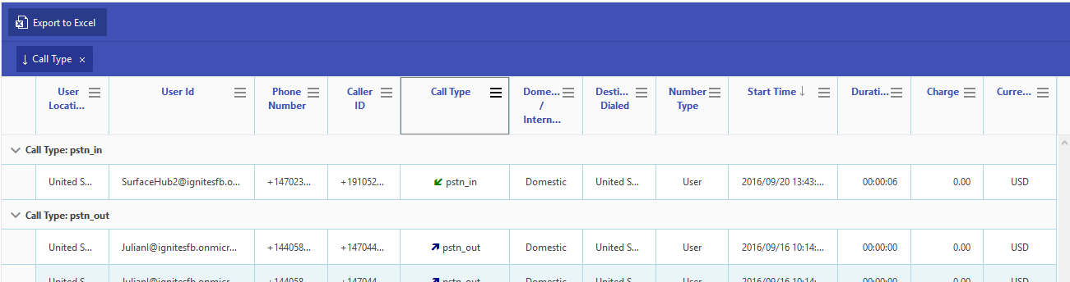
Tenant Admin PSTN Calling Usage Reports
PSTN Usage Reports in Admin Console
  Last 90 days usage
  Date, time, duration, Orig TN, Dest TN, Call Type (inbound/outbound, call/conf)
  Export to Excel for offline data analysis, graphing, retention
Built in protection from Microsoft to prevent fraudulent calling

Slide 30
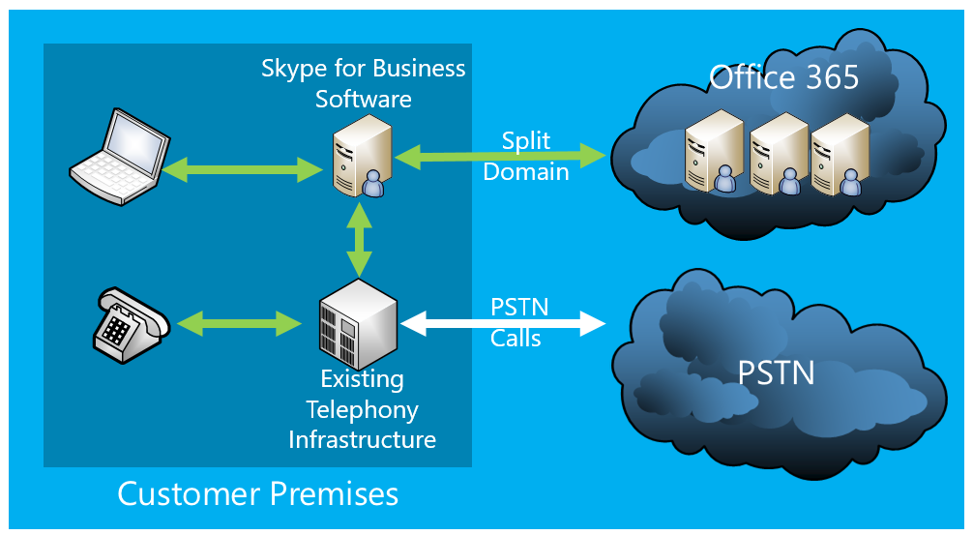
Cloud PBX with On-premises PSTN Connectivity
Skype for Business software deployed on-premises.
Cloud Connector Edition delivered as Packaged VMs for rapid deployment
Current customers can use their existing topology / pool and reduce size of footprint.
Hybrid Offering
Deployment integrated with Office 365 using split domain.
Users log into Office 365, services delivered from cloud.
Media Path
PSTN calls connect through on-premises hardware.
Standard Direct SIP Connectivity to Next Hop SIP Peer
(Gateway/SBC/PBX).

Slide 31
Cloud PBX with On-premises PSTN Connectivity
Plan Cloud Connectivity
BRK3054
Thurs 12:30
Thomas Murphy Ballroom 1
Skype for Business
Software
Office 365
Split
Domain
PSTN
Calls
PSTN
Existing Telephony Infrastructure
Customer Premises

Slide 32
On-premises PSTN Connectivity: Benefits
Take advantage of existing comms infrastructure.
Retain your carrier contract.
Simply migrate users from on-premises to cloud.
Preserve customization in Server deployment.
Significantly smaller HW footprint onsite.

Slide 33
On-premises PSTN Connectivity
Multiple ways to implement this topology
Existing Customer Server Pool
New Customer Server Pool
Cloud Connector Edition
Partner Appliance
Connect existing topology to Office 365 using Split Domain & migrate users to Cloud PBX.
Cloud PBX user’s PSTN Traffic transits pool.
Deploy Skype for Business Server and connect it with Office 365.
Customers can operate additional services on-prem (VIS, etc.)
Packaged VMs on Customer Hardware provides PSTN connectivity components with Office 365.
Cloud PBX users PSTN Traffic transits VMs
Partner offering where required Skype for Business Server software or VMs packaged with SBC/Gateway.

Slide 34
On-premises PSTN Connectivity
Comparing New Server Pool vs. Cloud Connector Edition
 | New Customer Server Pool | Cloud Connector Edition
Maximum Simultaneous Calls¹ | 150 | 500
Users Supported (worst case)² | 750 | 2,500
Physical Servers Required³ | Two; Dual proc, Hex core | One; Dual Proc, Hex Core
Server Licenses⁴ | 2x – WS Standard Edition | 1x – WS Datacenter Edition
Other Resources Required | AD Schema Modifications, Reverse Proxy, File Share | None
Install Time (est.) | Three days | Half-Day
Cloud Config Time⁵ | Equivalent
PSTN / PBX Integration⁵ | Equivalent
Additional Scenarios Supported⁶ | Users homed on-premises Video Interoperability Enterprise Voice (RGS, CAC, Branch – analog, etc.) On-Prem Dial-in Conferencing | None (** Much simpler to scale out)

Slide 35
Pre-requisites: Server Pool
Pool: Lync Server 2013 or Skype for Business 2015 Server
Standard or Enterprise Edition
Edge: Lync Server 2013 or Skype for Business Server 2015
Mediation: Lync Server 2013 or Skype for Business Server 2015
Co-located or in a separate pool
Tested On-premises PSTN infrastructure
Active directory synchronization
Skype for Business Hybrid Organization configured

Slide 36
Pre-requisites: Cloud Connector Edition
Deploy Cloud Connector
BRK3059
Thurs 14:15
C113
Requirements
No on-premises Skype For Business Deployment
Qualified next-hop SIP Peer: IP-PBX, SIP Trunk, SBC or Gateway
Hosts located in the DMZ
Capacity
Stand-alone capacity estimated with 70% Internal Users, 30% External users
Multiple Packaged VM sets can be stacked for greater scale.
 | 500 Simultaneous Calls | 50 Simultaneous Calls
CPU | 64-bit dual processor, six core, 2.50 gigahertz (GHz) or higher | Intel i7 4790 quad core
RAM | 64 GB ECC RAM | 32 GB DDR3-1600 non-ECC
Disk | Four 600 GB 10K RPM 128M Cache SAS 6Gbps disks, RAID 5 | Two 1TB 7200RPM SATA III (6 Gbps) in RAID 0
Network | Three 1 Gbps Ethernet High throughput network adapters | Two 1 Gbps Ethernet

Slide 37
Summary
Cushman and Wakefield
BRK2073
Wed 14:00
C101
Cloud PBX is ready for your users today!
Try it at http://aka.ms/E5Trial
Stop by the Expo hall to learn more
Kelly Services
BRK2074
Thurs 14:00
C114

Slide 38
Tues 10:45 | BRK3061 | Ready your network for Skype for Business Online | B302 - B303
Wed 10:45 | BRK3048 | Get under the hood of Skype for Business PSTN conferencing | C302
Wed 14:00 | BRK2073 | Cushman and Wakefield with Skype for Business: A customer’s story | C101
Wed 14:15 | BRK3056 | Plan for call management with Skype for Business Cloud PBX | C113
Thurs 10:45 | BRK3055 | Plan and deploy Skype for Business Voice Devices | TM Broom 4
Thurs 12:30 | BRK3054 | Plan for Skype for Business cloud connectivity with Microsoft Office 365 | TM Broom 1
Thurs 14:00 | BRK2074 | Kelly Services & Skype for Business: A customer’s story | C114
Thurs 14:15 | BRK3059 | Deploy Cloud Connector Edition with Microsoft Office 365 | C113
Fri 10:45 | BRK4011 | Deploy ExpressRoute for Skype in Microsoft Office 365 | B216 - B217
Fri 11:00 | BRK2075 | Meet the communications needs of your users with Skype for Business | C101

Slide 39

Deploy, ramp-up on new services and onboard new users with Microsoft FastTrack: http://fasttrack.microsoft.com/

Slide 40

Join the Microsoft Tech Community to collaborate, share, and learn from the experts: http://techcommunity.microsoft.com

Slide 41


Please evaluate this session
Your feedback is important to us!
From your PC or Tablet visit MyIgnite at http://myignite.microsoft.com
From your phone download and use the Ignite Mobile App by scanning the QR code above or visiting https://aka.ms/ignite.mobileapp

