Slide 1
Success through Skype Operations Framework
BRK2077
Srini Raghavan
Ali Rohani

Slide 2
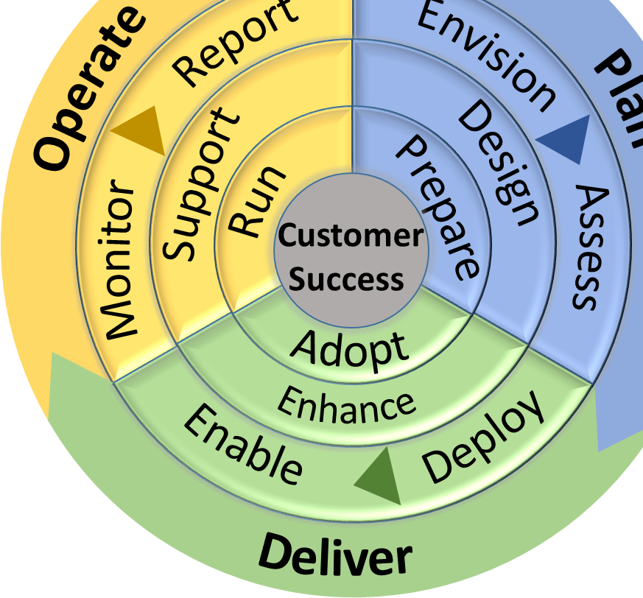
Questions to ponder…
  What does it take to run high-quality real-time communications service globally?
  How does the quality of network impact the quality of calls?
  What are the right tools & approach to assess network readiness?
  What steps do I need to take before moving to the cloud?
  How to interconnect existing telephony infrastructure to the cloud?
  What adoption practices will drive habitual usage of Skype for Business?
  Who are the certified partners to help with ongoing managed services?

Slide 3
The shift to cloud requires a rethinking of how to Plan, Deliver, and Operate Skype for Business Online

Slide 4
We would like to introduce you to the Skype Operations Framework (SOF)

Slide 5
Skype Operations Framework (SOF)
SOF defines and enables the right way to deploy or migrate every time, delivering success.
  Best-in-class planning, delivery and operation methodology
  Standardized recommended practices to ensure
  quality experience and fills gaps in tools, readiness and process
  Repeatable and evolutionary for existing and
  new implementations
  Validated by engineering at customers and endorsed by partners
  Enables focus on core competencies rather than creating delivery methodologies
  Provides a common language to use across the ecosystem

Slide 6
Skype Operations Framework (SOF)
SOF
Framework
Readiness
The shift to cloud requires a
rethinking of how enterprises and partners Plan, Deliver, and Operate Skype for Business
SOF is a multi-faceted approach
to the successful deployment of Skype for Business
Customer
Success
Customers
Partners

Slide 7
The shift to the cloud
Accelerated Innovation
  Customers gain business benefits when they adopt new collaboration capabilities, features and workloads
  Cloud services are evergreen, delivering innovation at a much faster pace
  Customers and partners can access business benefits faster but need to engage and adopt a lifecycle mindset
What do you get?
Workshops
Questionnaires
Tools / Scripts
Reports
Delivery Guidance
Tests
Checklists
Project Plans
Templates
Activity Descriptions

Slide 8
Let’s dive in

Slide 9
Foundations of Skype Operations Framework (SOF)
SOF is a built on a layered approach composed of key elements of Plan, Deliver, and Operate to help customers and partners.
SOF is comprised of phases and stages that have correlated activities that are prescriptive and designed with quality
SOF supplies the practical guidance, tools and assets that range from scripts and report to workshops and documents that are aligned with each activity in each stage
SOF guides customers and partners to apply execution excellence
to achieve desired outcomes aligned with business initiatives.
SOF provides a number of offers for that are a combination of activities and tools that follow the SOF methodology enabling execution excellence
Customer
Partners
Operational
Excellence
Initiatives
Go to
Market
Layer 6
Outcomes
Layer 5
Offers
Recommended Practices
Tools and Assets
Layer 4
Activities
Layer 3
Stages
Common
Language
Layer 2
Phases
Layer 1

Slide 10
SOF Customer Journeys to the Cloud
Get Deployed SOF investments released in Summer
Greenfield
Skype for
Business Online
Cloud PBX/PSTN Conf
GET DEPLOYED
Skype for Business Online
On-premises / Hybrid Lync 2013 / Skype Deployment
Plan
Deliver
Operate

Slide 11
Initial Release of SOF: Get Deployed
Get Deployed provides practical guidance on planning, delivering and operating Skype for Business online with a focus on Cloud PBX (PSTN Calling and On Premises PSTN Connectivity) and PSTN Conferencing functionality..

Slide 12
SOF Get Deployed
First release of the structured approach for partners and customers to successfully plan, deliver,
and operate Skype for Business Cloud PBX and PSTN Conferencing capabilities.
  GET DEPLOYED
    Engagement Guide
      Offer Description
      Project Plan and Work Breakdown Structure
      Offer Delivery Workflow
      Delivery Guide
    Prepare for Deployment and Roll Out
      Deployment Guidance Workshop
      Deployment Check Lists
      CQD Configuration
      Handset Configuration
      Setup QOS
      Setup VPN Split Tunnel
  On-board New Users at Scale
      User Enablement Workshop
      User Enablement Scripts
    Perform functional testing
      Test Guidance Workshop
      (who, what, how, where, when)
      Test Plan
      Test Matrix for Skype for Business
      Online tests
      Test Results Report
    Develop habitual use
      Adoption Readiness Workshop
      Adoption Planning Workshop
      Fast Track Centre Adoption Support
Offer/ Outcome
Deliver
    Envision the solution
      Discovery Workshop/Questionnaire /Scripts
      Envisioning Workshop
      Business Use Case Workshop
      Architecture Workshop
      Execution Planning Workshop
      Envisioning Wrap Up/Vision and Scope Document
    Assess Overall Readiness
      Readiness Assessment Evaluation Criteria
      Readiness Assessment Close Out Workshop
    Determine Network Readiness
      Network Discovery Questionnaire
      Network Readiness Workshop
      Bandwidth Planning Tool/Process Guidance
      Close Out Workshop
      Design for Cloud PBX and PSTN Conferencing
      Cloud PBX and PSTN Conferencing Design workshop
      Cloud PBX and PSTN Conferencing Architecture document
Operate
Plan
    Operate in the First Month
    Basic troubleshooting guidance
    Getting started with CQD
    Monitor Usage
    Report service health

Slide 13

What’s new in SOF ?
SOF Cloud Migration with new and updated assets
SOF Quick Start
Updated Network Assessment and Tools
SOF Partners and SOF Assessment
Updated SOF Academy
SOF Community

Slide 14
SOF Customer Journeys to the Cloud
Announcing Cloud Migration Release
Greenfield
Skype for
Business Online
Skype for Business Online
CLOUD MIGRATION
On-premises / Hybrid Lync 2013 / Skype Deployment
Plan
Deliver
Operate

Slide 15
SOF Cloud Migration
Cloud Migration provides practical guidance relating to planning, delivering and operating a migration from on premises Lync 2013 / Skype for Business to Skype for Business Online which includes deploying and operating hybrid during the migration.

Slide 16
Cloud Migration Assets
SOF Cloud Migration release is the structured approach for partners and customers to successfully plan, deliver,
and operate a migration from on premises Lync 2013 / Skype for Business to Skype for Business Online.
    CLOUD MIGRATION
    Engagement Guide
      Description
      Timeline
      Delivery Workflow
    Prepare for Deployment and Roll Out
      Deployment / Migration Guidance Workshop
      Deployment/Migration Check Lists
      Site Implementation Playbook (Site Survey, Site Playbook and T- plan)
      CQD Configuration (on prem/hybrid)
      Handset Migration and Configuration Guidance
  Migrate New Users at Scale
      Migration Script Usage
      User Migration Scripts
    Perform functional testing
      Update Testing Materials for Hybrid
    Develop habitual use
      Updates to Adoption materials
      End user “what changes to expect” materials
      Adoption Readiness Workshop
      Adoption Planning Workshop
      Fast Track Centre Adoption Support
Offer/ Outcome
Deliver
    Envision the migration
      Updated Envision materials envision to cover migration
    Assess Overall Readiness
      Undertake Persona analysis to advise migration schedule (workshop, persona feature matrix and final report)
      Hybrid Health Check (Baseline Health Definition, Assessment Toolset, Assessment Report)
    Determine Network Readiness
      Updated materials PLUS
      ExpressRoute Guidance
      Automated Tool Guidance and Results Interpretation
      Automated Essentials Testing Tool
      Hybrid Design for Cloud PBX and PSTN Conferencing (Coexistence and Migration)
      Hybrid Cloud PBX and PSTN Conferencing Coexistence and Migration Design workshop
      Hybrid Cloud PBX and PSTN Conferencing Coexistence and Migration Architecture document
    Client Migration
      Client Migration Workshop
      Client Migration Design Template
Operate
Plan
    Operate a Hybrid Platform
    Operational Health Guidance
    Monitoring the Hybrid Environment
    Hybrid troubleshooting guidance
    Hybrid Patch Guide
    Daily, Weekly, Monthly Tasks
    Reporting on Key Success Indicators

Slide 17






Network Readiness
Assessment Updates
Existing assets updated to incorporate feedback
Skype for Business Online Express Route Guidance
Guidance on setting up the Skype for Business Online traffic generation activity
Skype for Business Network traffic generation tools to verify connectivity to Skype for Business Online
Guidance on analyzing and interpreting the results of the traffic generation activity

Slide 18
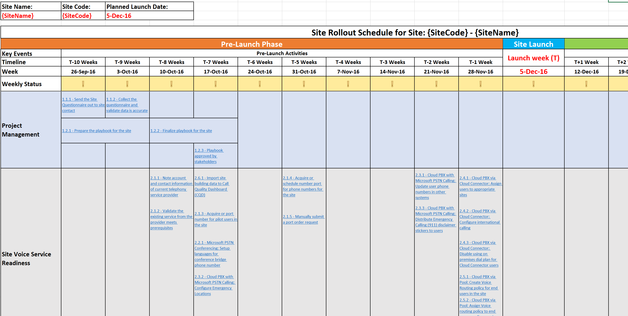
Site Rollout and Migration Playbook
New playbook to plan and execute the site by site deployment or migration activities covering users, peripherals, adoption and training (covers pre-launch, launch and post launch activities)
Site Discovery
Project Management
Service Readiness
User Enablement
Clients and Devices
Usage and Feedback

Slide 19


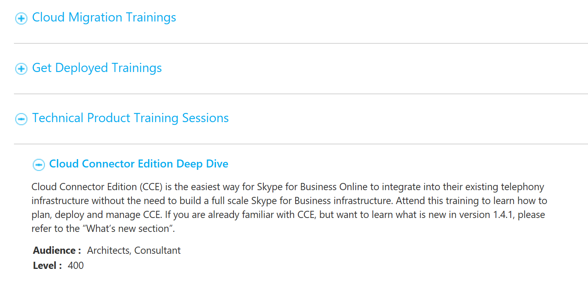
Skype Academy
skypeoperationsframework.com/academy
17 SOF Get Deployed sessions in Aug. Available for viewing now
1,026
People
427 Organizations
11 new Cloud Migration sessions starting Oct 3
Skype for Business product training including Cloud Connector
Visit the SOF Academy page to access readiness resources

Slide 20
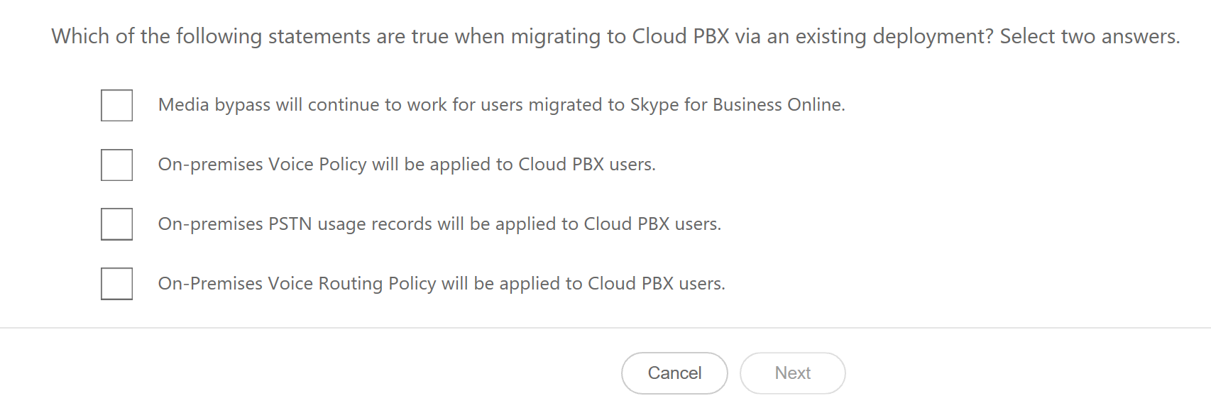
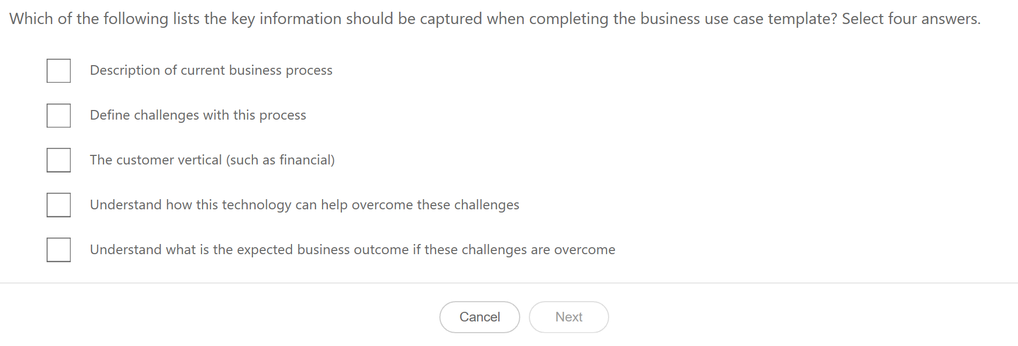
Skype Assessment
skypeoperationsframework.com/assessment
SOF assessment will test your understanding of the Skype Operations Framework, its supporting tools and assets, and associated product knowledge. Successfully completing the assessment will earn the Skype Operations Framework Ready classification.

Slide 21








Skype Partners
skypeoperationsframework.com/partners
Offer managed services based on Skype Operations Framework
Ready to assist customers with planning, delivering, deploying and migration.
SOF Trained Partners: 100’s of organizations have undertaken training
Visit the SOF Partner page to view services and tooling partners

Slide 22
SOF Community
https://aka.ms/sofcommunity
Discuss the application of SOF guidance and assets on projects with your peers and the SOF team
Learn more about how others are applying SOF to their projects
Contribute to the SOF Community
Visit the SOF Community to start your engagement

Slide 23


Feedback?
skypeoperationsframework.com/feedback
What works (and what doesn’t)?
Anything incorrect?
What is missing?
Other feedback?

Slide 24
What to expect going forward
Key Tenets to the future of SOF
Future releases
Skype for Business Roadmap Centric
  Operate
Go Learn More at skypeoperationsframework.com
Virtual Training available
Living breathing framework
  Get Healthy
Agile development
  Incremental - continuous
  Major drops—quarterly
  Room Systems
  Enable New Skype for Business Capability
Feedback is key to the future of SOF
  Multi-Regional Planning
Go Learn More at skypeoperationsframework.com Virtual Training available

Slide 25
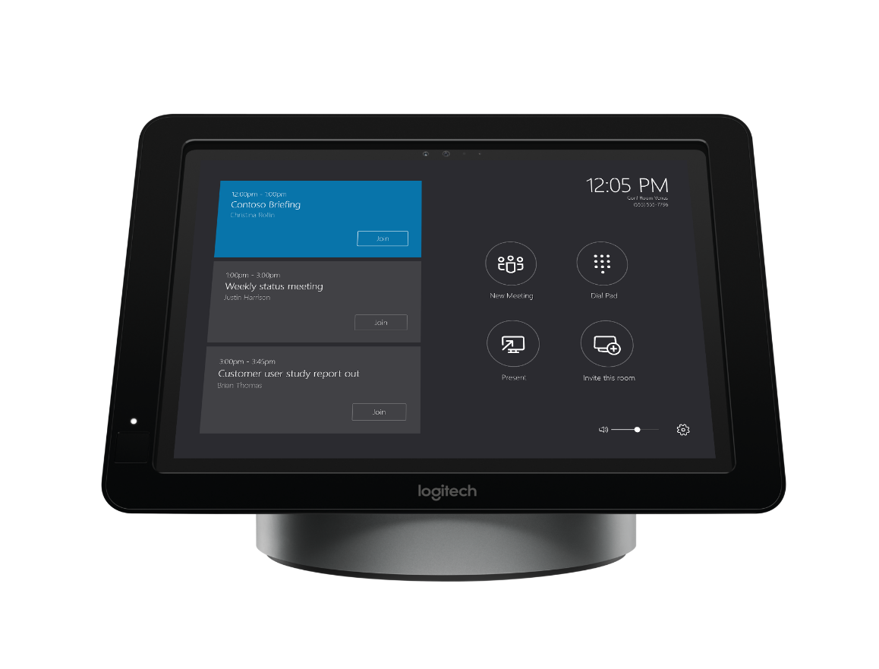
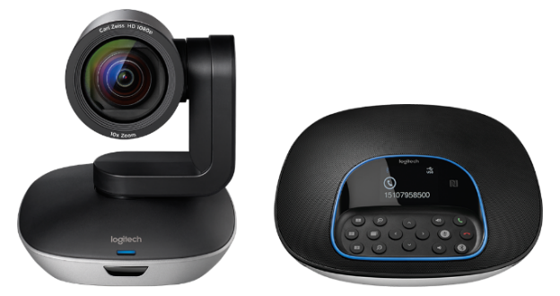
#MeetingAccomplished
Want to win a new Skype Room Systems meeting room bundle from Microsoft and Logitech?
Check out Skype Room Systems in the Expo Hall at
Microsoft Showcase MS 111 or Logitech Booth 1818.
Snap a photo of the device in action and share your photo on Twitter or Instagram with the hashtag #MeetingAccomplished, or upload it to www.SkypeMeetingAccomplished.com,
to enter to win your own Skype Room Systems bundle!*
*No purchase necessary. Open only to legal United States residents. Sweepstakes ends 9/30/2016. See www.SkypeMeetingAccomplished.com for Official Rules.
Microsoft Ignite #MeetingAccomplished

Slide 26

Join the Skype for Business Community
Discover rich discussions and
information sharing across
customers, partners, and users
IT Pro Forums
User Forums
Broadcast Updates
Tips and Tricks
Product Updates
http://aka.ms/sfbcommunity

Slide 27

Deploy, ramp-up on new services and onboard new users with Microsoft FastTrack: http://fasttrack.microsoft.com/

Slide 28

Join the Microsoft Tech Community to collaborate, share, and learn from the experts: http://techcommunity.microsoft.com

Slide 29

Please evaluate this session
Your feedback is important to us!
From your PC or Tablet visit MyIgnite at http://myignite.microsoft.com
From your phone download and use the Ignite Mobile App by scanning the QR code above or visiting https://aka.ms/ignite.mobileapp

