Slide 1
Design a great user experience for Universal Windows Platform apps
BRK2058
Andy Wigley
Senior SDE, Microsoft
@andy_wigley
Ken Rosen
Sr. Director, Infragistics
krosen@infragistics.com

Slide 2
What is a
‘great user experience’ ?

Slide 3
Intuitive and effective
Adapts well to different screen sizes and displays
Layout is clean and effective
Usage is intuitive
Adapts to user input method
…and beautiful
Uses animations effectively
Pleasing to the eye

Slide 4
How to build a great user experience
Good Design
Intelligent Controls
Responsive UI
Tailoring for platform

Slide 5
Design process

Slide 6
Thinking like a designer

Slide 7
brainstorm
moodboards & concept designs
sketch &
wireframe
design

Slide 8

Why prototype?
Finding and fixing a software problem after delivery is up to 100x more expensive than finding and fixing it during the requirements and design phase.
Development teams spend 40 to 50 percent of their effort on avoidable rework.
Source: IEEE Computer v34, n1

Slide 9

Wireframes vs. prototypes
Wireframes are blueprints, skeletons – they show what goes where.

Slide 10
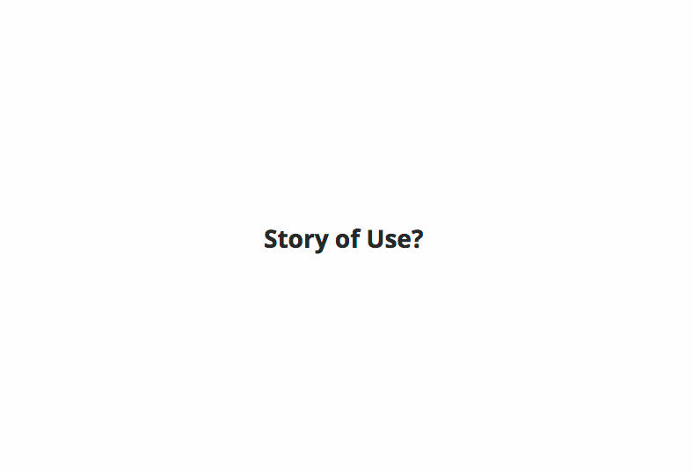
Wireframes vs. prototypes
Prototypes are testable simulations – they let the user interact

Slide 11
prototype
test
iterate

Slide 12
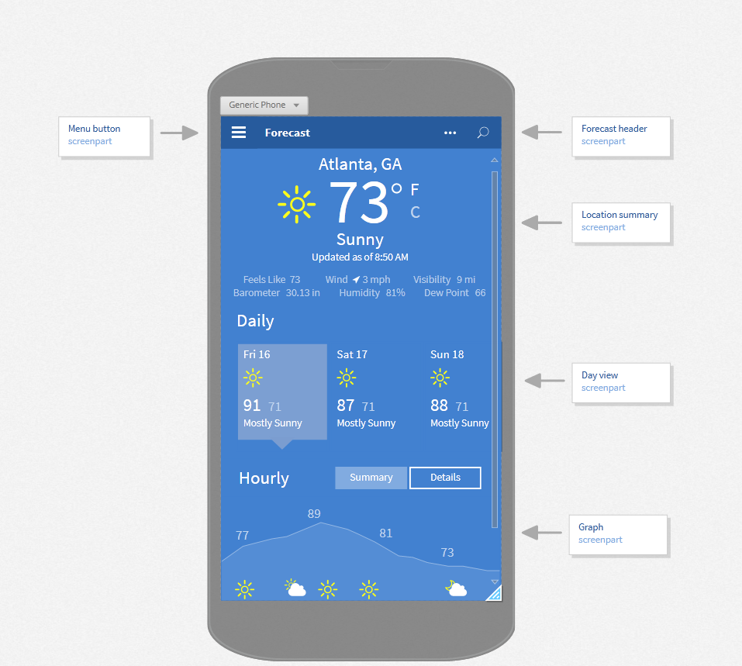
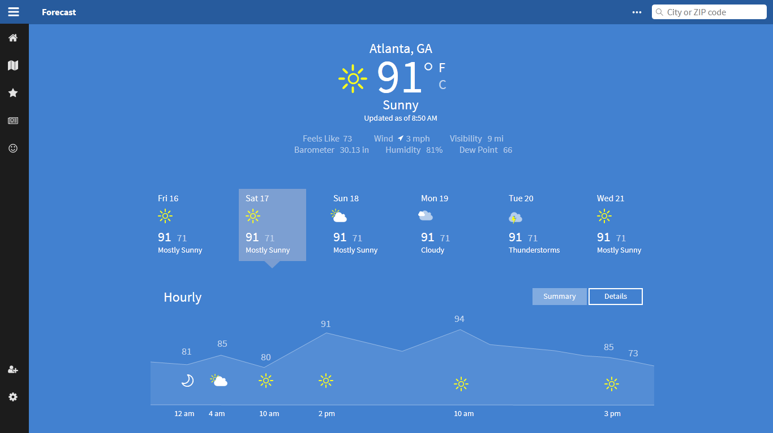
Demo: Weather prototype

Slide 13

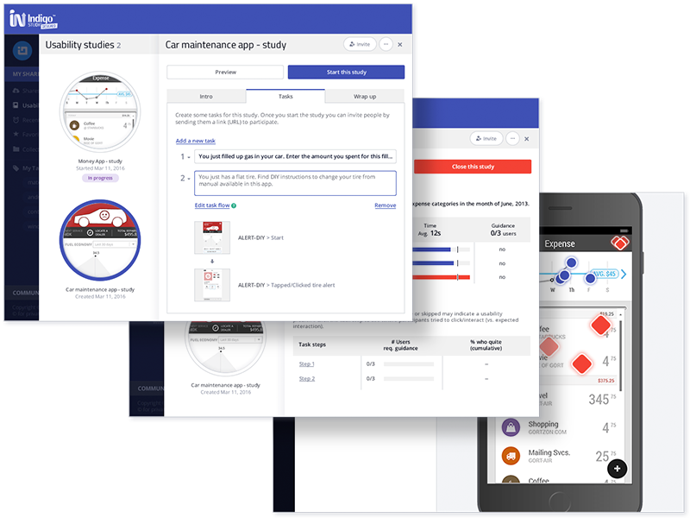
Rapid, code-free prototyping
Collaborative review and feedback
Remote, unmoderated usability testing at scale
http://www.infragistics.com/products/indigo-studio

Slide 14
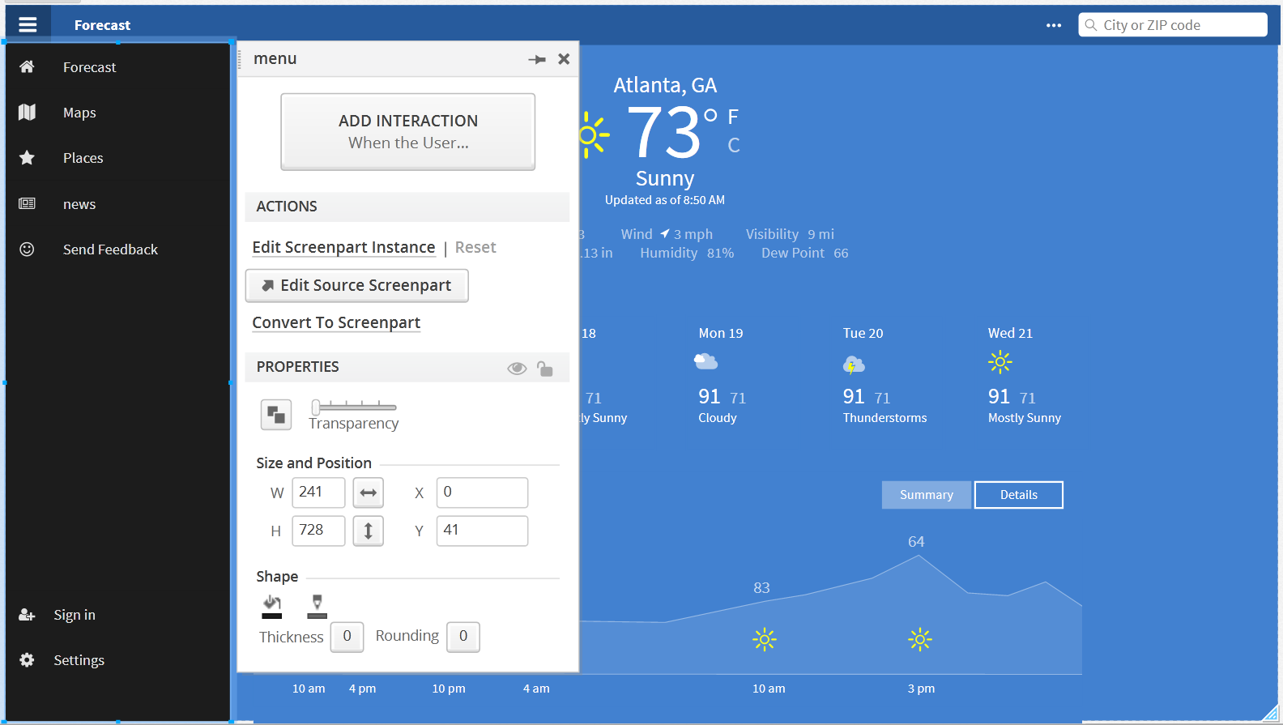
Demo: Designing a Prototype

Slide 15
Intelligent Controls

Slide 16
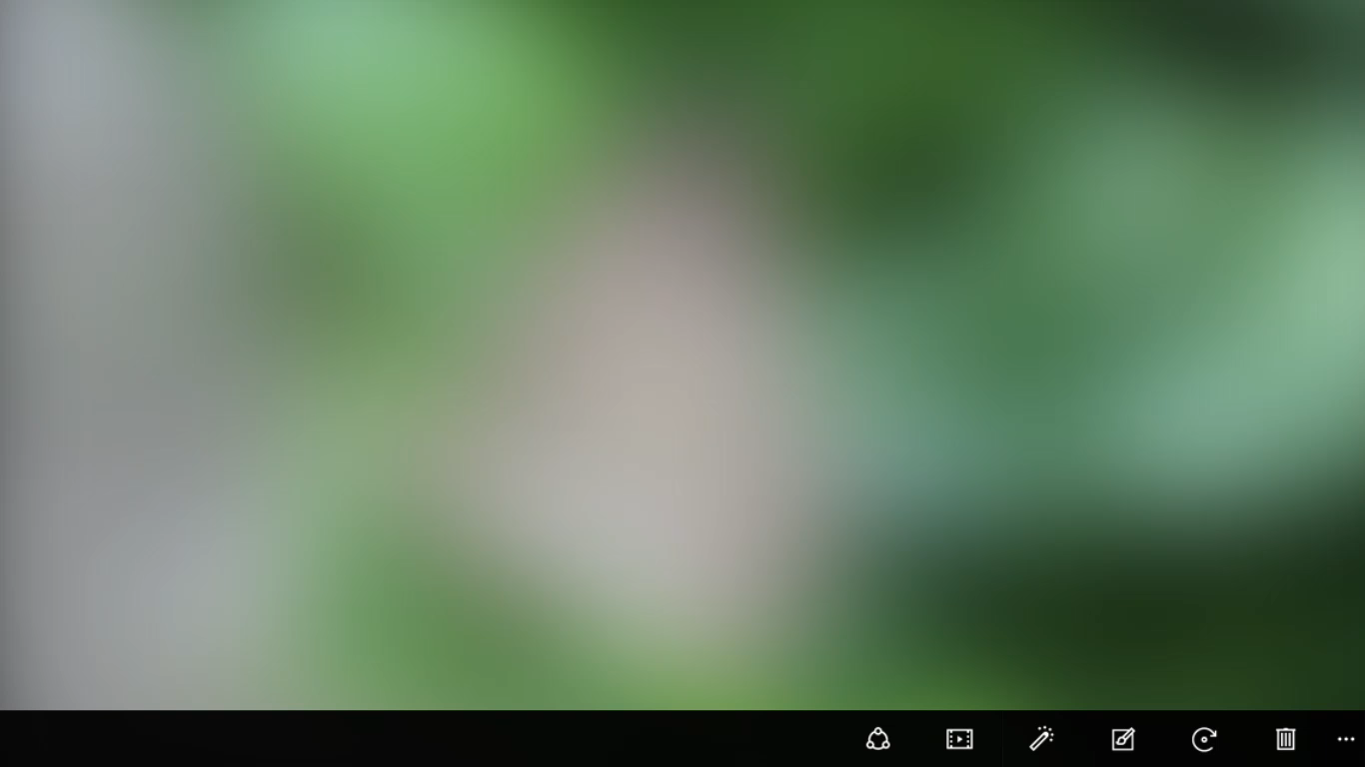

Adaptive controls

Slide 17


Input mode intelligence

Slide 18
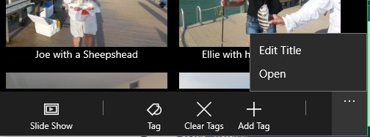
CommandBar Dynamic Overflow
Implicit with CommandBar
<!-- Disable with IsDynamicOverflowEnabled -->
<CommandBar IsDynamicOverflowEnabled="True" DynamicOverflowItemsChanging="…">
<!-- Set overflow order -->
<AppBarButton x:Name="Open" Label="Open" DynamicOverflowOrder="1"/>
<AppBarButton Label="Edit…" DynamicOverflowOrder="2"/>
<AppBarSeparator/>
<AppBarButton Label="Add…"/>
<…/>
</CommandBar>
// Use IsInOverflow to check state
bool overflowed = Open.IsInOverflow;

Slide 19

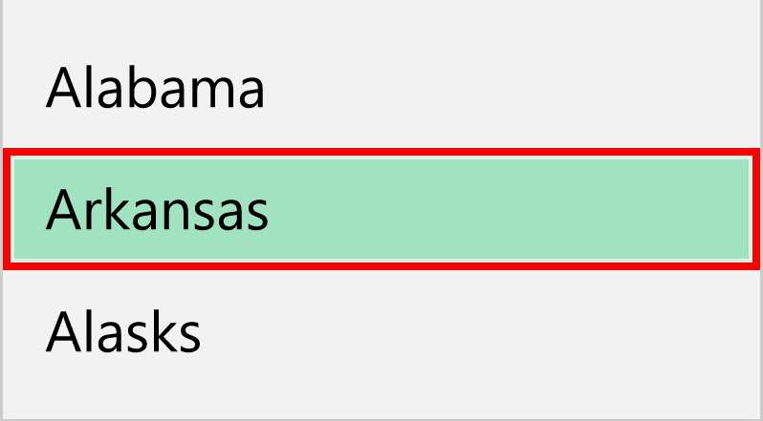

Platform-appropriate Focus Indicators
High Visibility on Xbox
Focus indicators implicit and configurable:
New FrameworkElement properties
FocusVisualMargin
FocusVisualPrimaryBrush
FocusVisualPrimaryThickness
FocusVisualSecondaryBrush
FocusVisualSecondaryThickness
[Red]
[Black]
// To use “dotted line” focus (default is HighVisibility)
Application.Current.FocusVisualKind = FocusVisualKind.DottedLine;

Slide 20
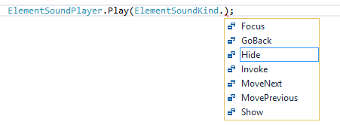
Xbox One Sounds In UWPs
Implicit on Xbox One
// Auto is the default. Will be on for Xbox One, Off elsewhere
ElementSoundPlayer.State = ElementSoundPlayerState.Auto;
Use ElementSoundPlayer to explicitly play sounds:

Slide 21
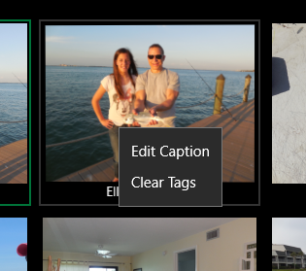
New Context Menu APIs
Use ContextFlyout property and ContextRequested event
<Image ContextRequested="Menu_Handler"/>
<!-- Markup – no code required -->
<Image>
<Image.ContextFlyout>
<MenuFlyout>
<MenuFlyoutItem Text="Edit" …/>
<MenuFlyoutItem Text="Clear" …/>
</MenuFlyout>
<Image.ContextFlyout>
</Image>
<!– Works for Mouse, Touch, Gamepad -->

Slide 22
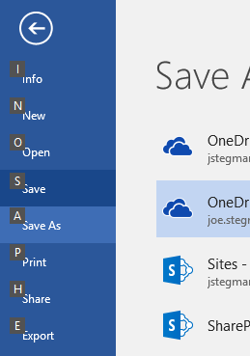
Keyboard Mnemonics
Use AccessKey property and new events on UI/Text elements
<!– ALT + O will invoke the Button -->
<Button Content="Open" Click="OpenCmd" AccessKey="O" AccessKeyDisplayDismissed="OnDismissed" AccessKeyDisplayRequested="OnDisplayed"/>
// Display UX Affordance (not required)
private void OnDisplay(…)
{
// If desired: show all commands and UX affordance
// Example: show tooltip and hide in “OnDismissed” handler
var tooltip = ToolTipService.GetToolTip(sender) as ToolTip;
…
}

Slide 23
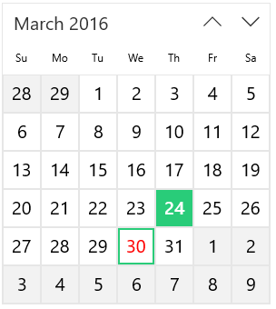

Previously: Control Colors in XAML
XAML Control Colors
Button [PointerOver]
CalendarView [Selection]
Map to ~80 system colors
~80 System Colors
(and Brushes)
SystemBaseHighColor
(SystemControlHighlightBaseHighBrush)

Slide 24
Control Colors in XAML (In Anniversary Update)
XAML Control Colors
Button [PointerOver]
Control Specific Colors
ButtonForegroundPointerOver
~80 System Colors
SystemBaseHighColor
(SystemControlHighlightBaseHighBrush)

Slide 25
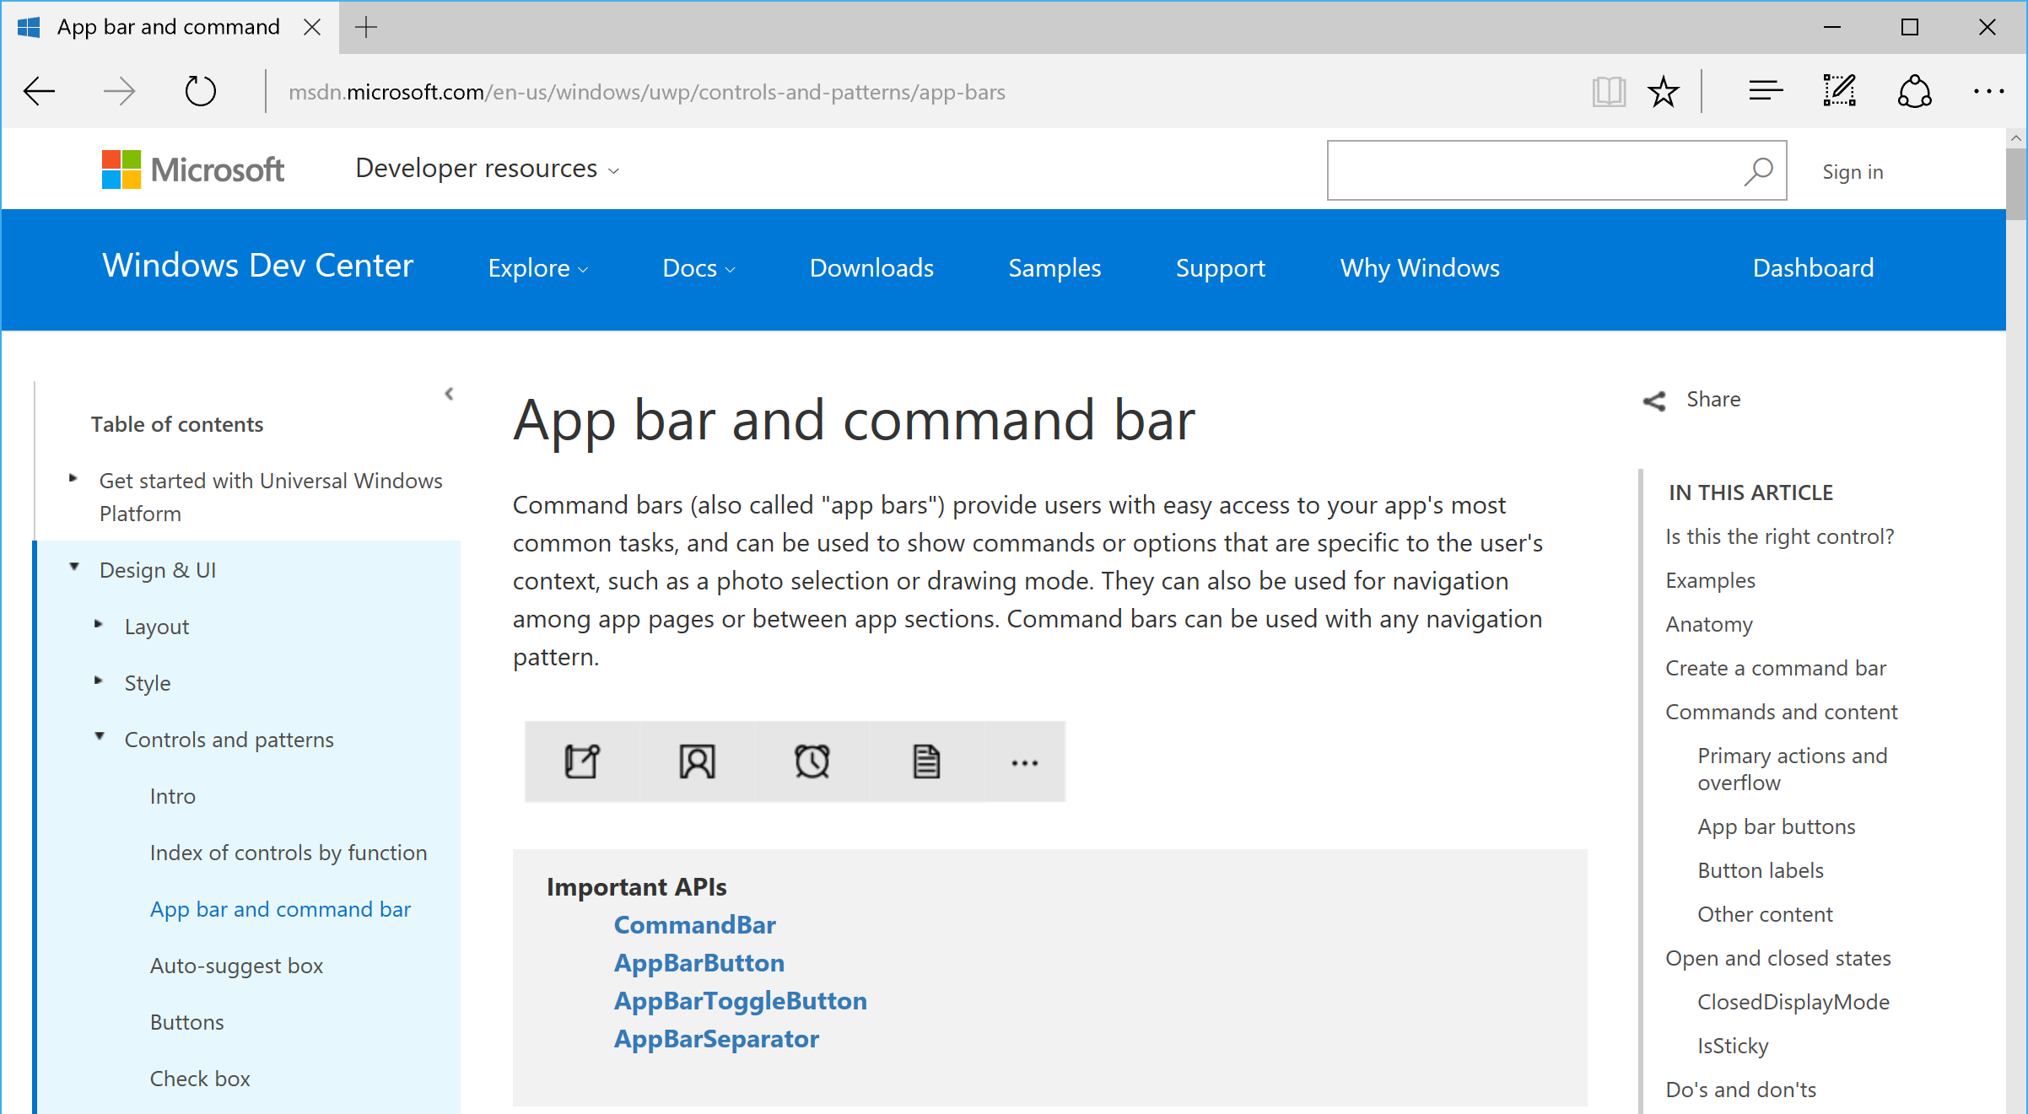
Controls Design Guidance
https://msdn.microsoft.com/en-us/windows/uwp/controls-and-patterns/index

Slide 26
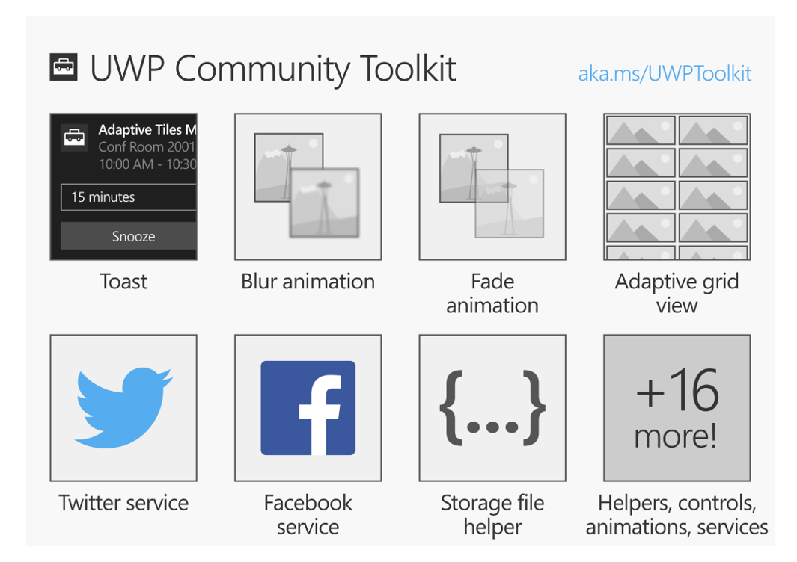
New! UWP Community Toolkit
https://developer.microsoft.com/en-us/windows/uwp-community-toolkit

Slide 27
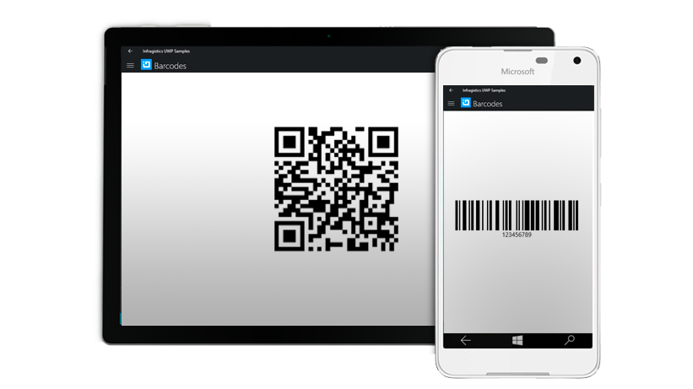
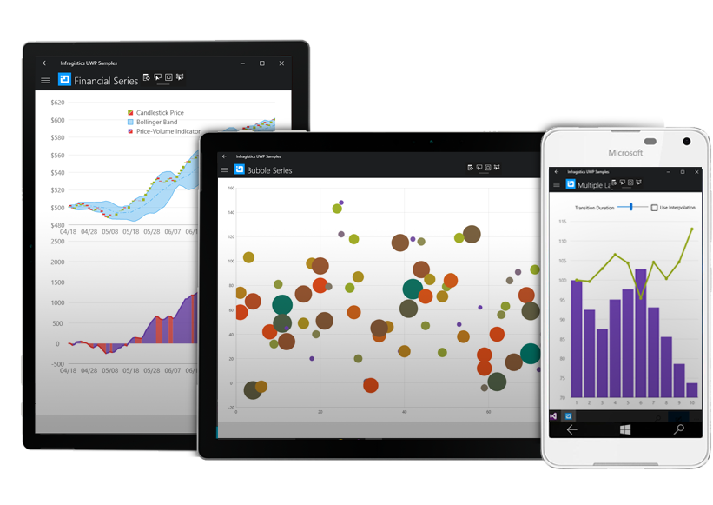
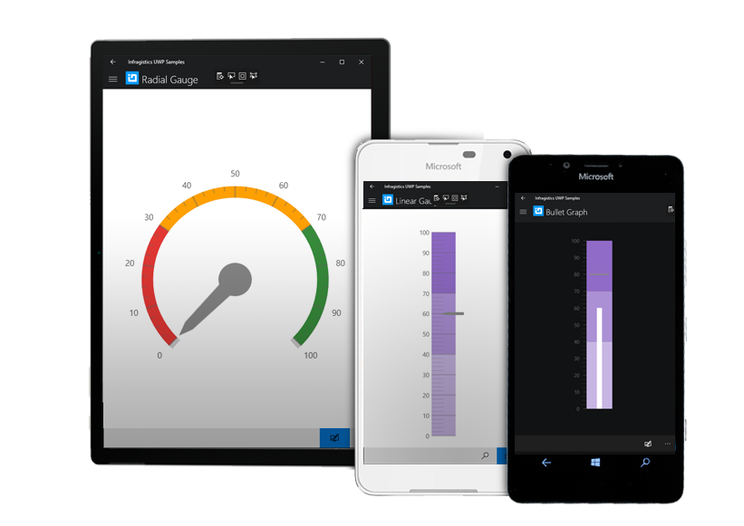
Free Preview: Infragistics UWP Controls
http://www.infragistics.com/products/universal-windows-platform

Slide 28
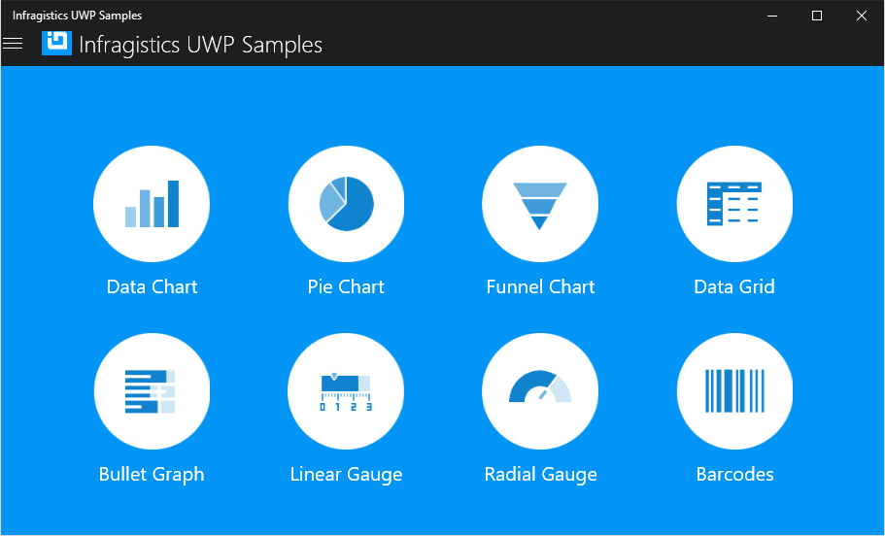
Demo: Infragistics UWP Controls

Slide 29
Responsive UI

Slide 30
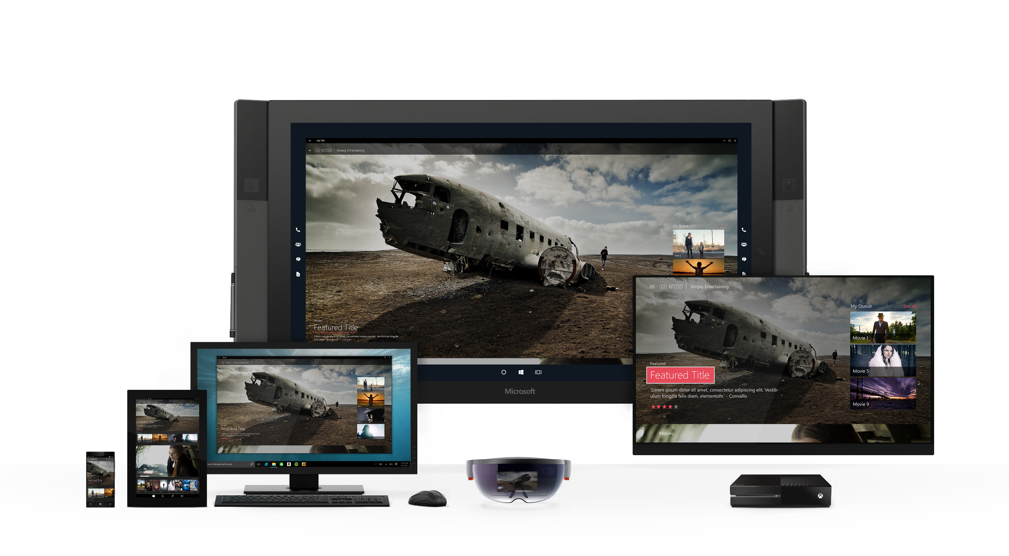
Same universal app, tailored for devices

Slide 31
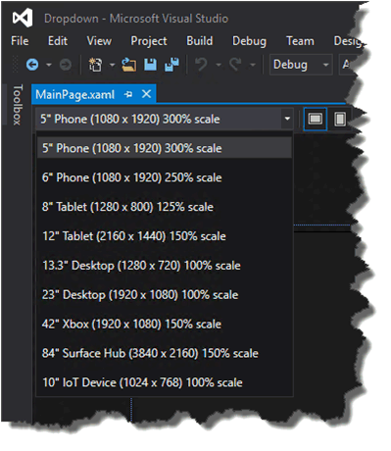
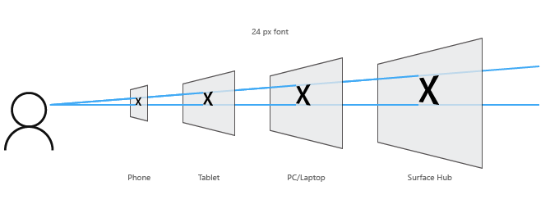
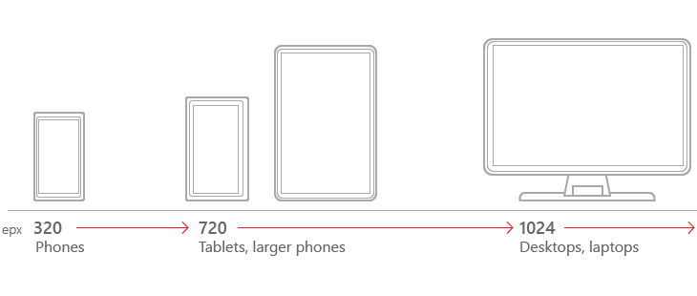
How do I achieve all this with one UWP app?!
Platform
Developer
| Designer
Tooling
Universal Controls + Styling
Fluid Layout Panels
Effective Pixels + Scaling
Utilize the same adaptive layout techniques from Web
Custom triggers, separate XAML, separate code as needed
Define Key Screen “Breakpoints”
Visual Studio + Blend
Simulate at Design time
Platform

Slide 32
Cross-Device Platform Considerations
1’
Standard Device Resolutions
10’
360 x 640*
1024 x 640*
1366 x 768*
1920 x 1080*
1920 x 1080
Web App => 150%
XAML => 200%
* Scale Factor can vary from 100% to 300%

Slide 33
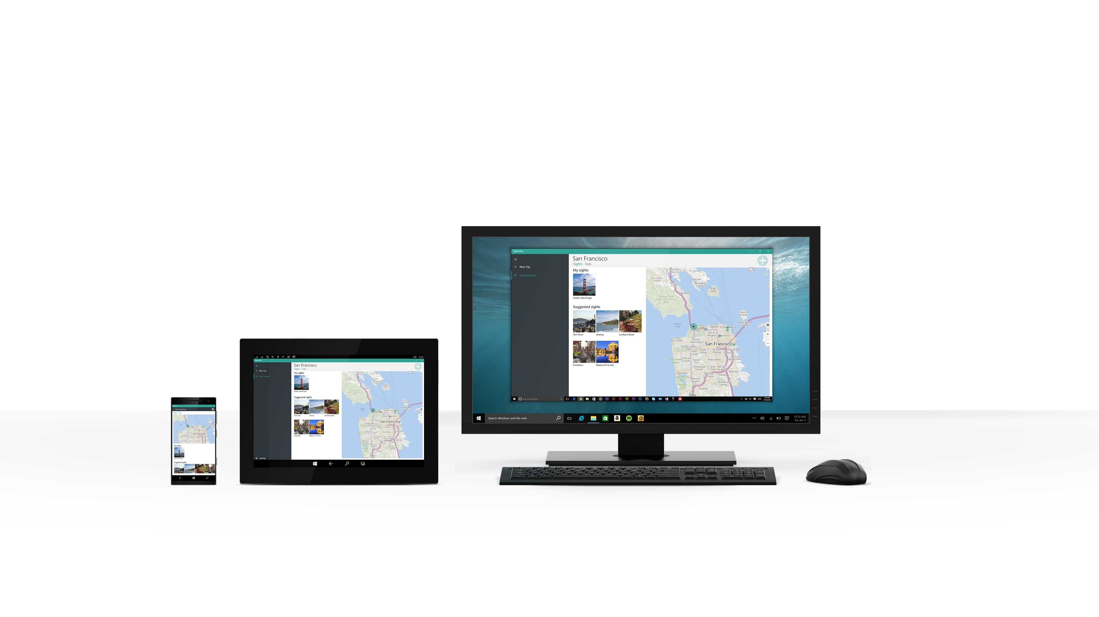
sights2see

Slide 34
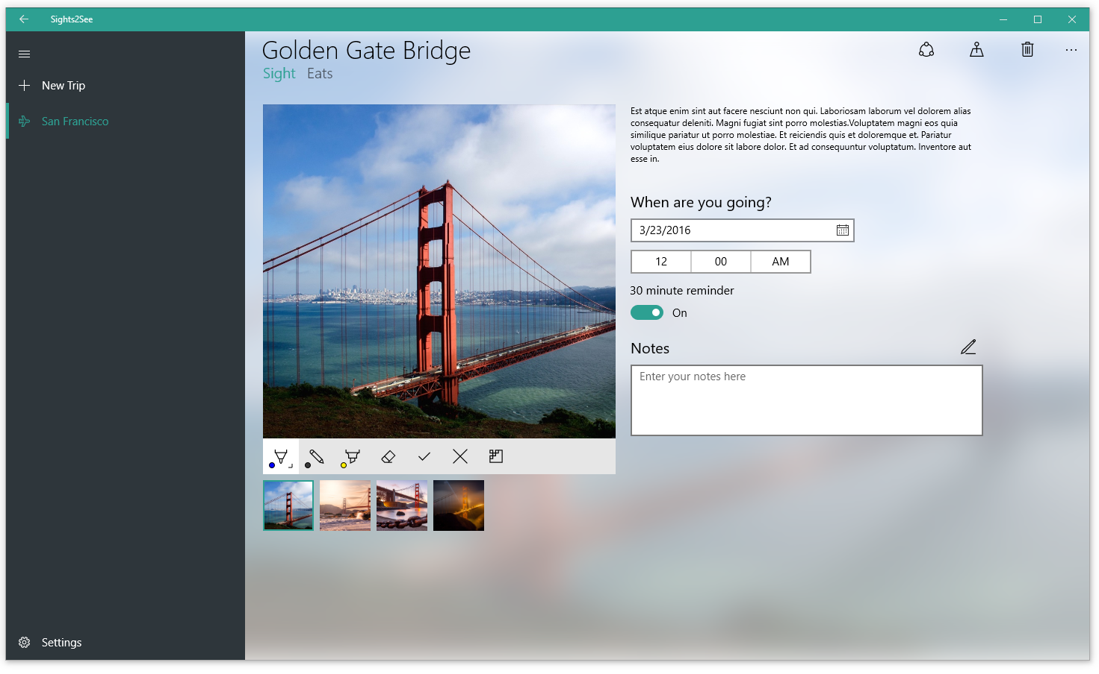
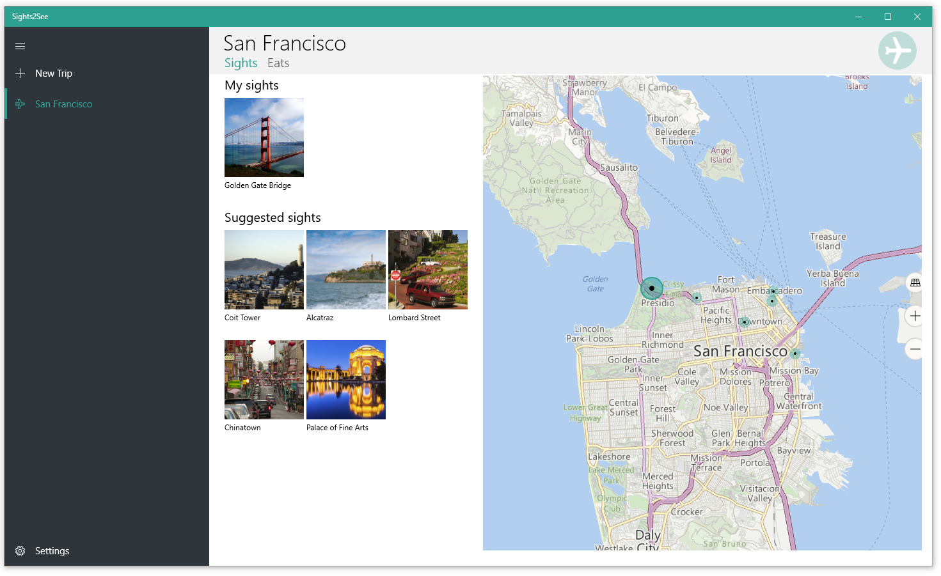
sights2see
2 controls and patterns
SplitView
Map view

Slide 35
Demo: Controls and responsive UI

Slide 36
Composition:
More beautiful UI made easy

Slide 37

What's Beautiful?

Slide 38
Making Beautiful Experiences a reality:
Windows UI Platform

Slide 39
UI Framework Layering
Framework layer
Controls, layout, markup, accessibility, data binding
Windows.UI.XAML
Visual layer
Visuals, Animations & Expressions, Effects, Input Routing & Manipulations
Windows.UI.Composition
Graphics layer
Text rasterization, shapes & vector rasterization, ink rendering
DirectX Family

Slide 40
UI Framework Layering
Easy
Framework layer
Windows.UI.XAML
Visual layer
Windows.UI.Composition
Graphics layer
DirectX Family
Possible

Slide 41
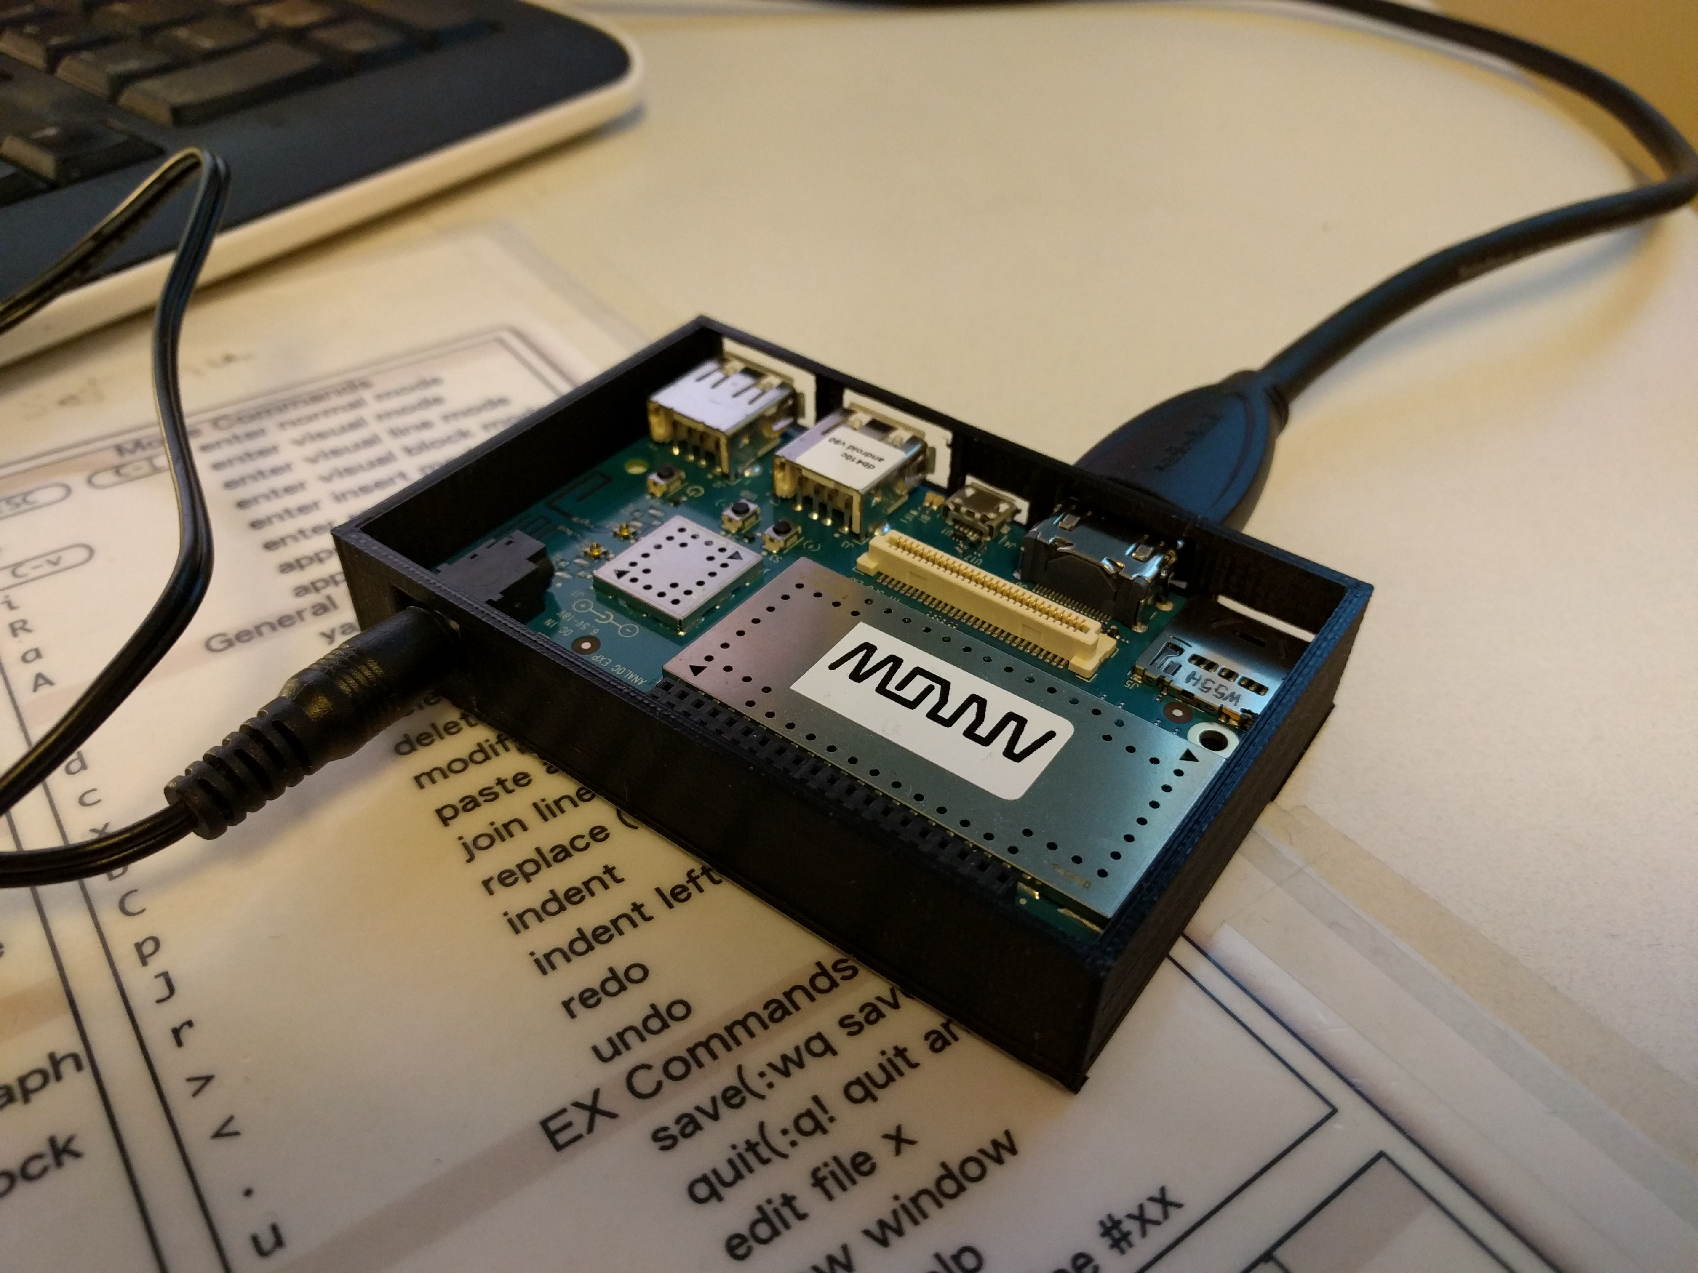
Visual Layer: Optimized for performance
Optimized for all UWP device targets
Target: 1000s of visuals and animations
Linear scalability, no perf cliffs

Slide 42
Visual Layer API
Windows 10
Anniversary SDK
Content Visuals
Animation system
Effects system
SpriteVisual
  Solid color content
  Image content
  D2D/D3D content
Basic XAML interop
  Add Content Visuals to XAML UI tree
Keyframe animations
Expression animations
Color effects
e.g. Contrast, Exposure, grayscale, sepia, tint
Animation & Chaining
Apply effects to Images
Implicit animations
Connected Animations
New Input driven animation capabilities
Blur (yea!)
Drop Shadow
Apply effects in more contexts
Image-based and
Full Scene Lighting
New Brushes (NineGrid, Mask)
Improved XAML interoperability

Slide 43
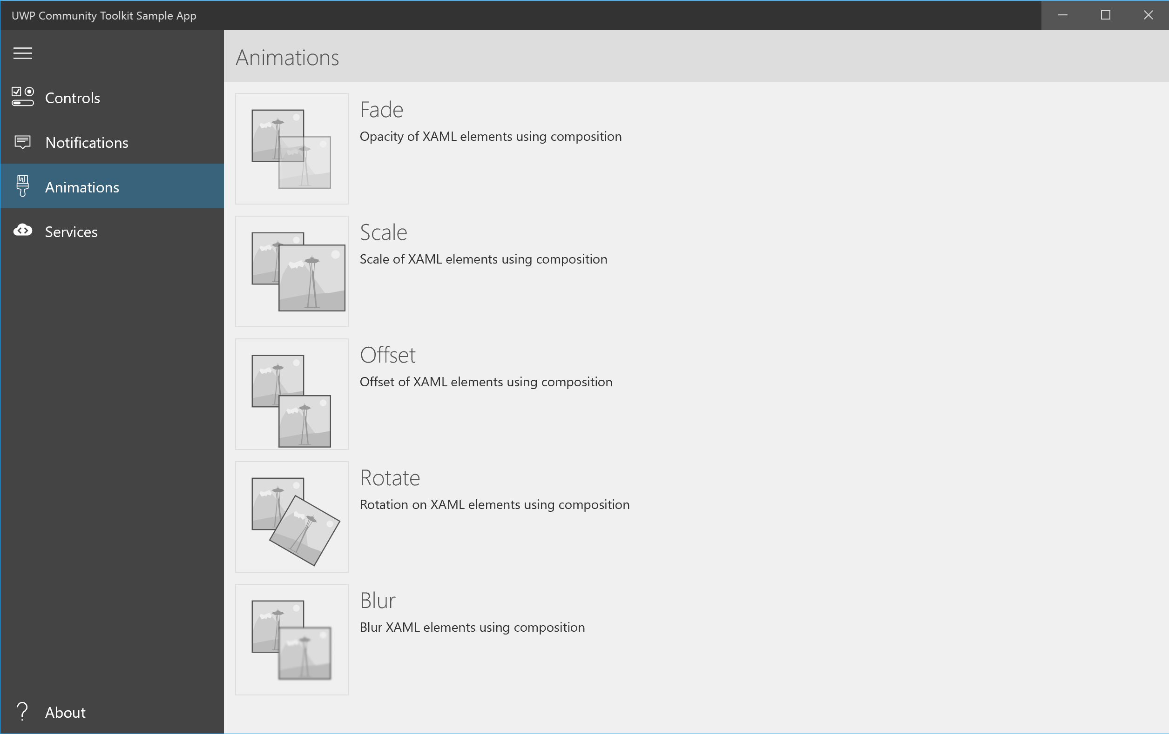
Composition effects made easy!
With the UWP Community Toolkit
https://developer.microsoft.com/en-us/windows/uwp-community-toolkit

Slide 44
Demo:
Beautiful animations using Composition

Slide 45


Please evaluate this session
Your feedback is important to us!
From your PC or Tablet visit MyIgnite at http://myignite.microsoft.com
From your phone download and use the Ignite Mobile App by scanning the QR code above or visiting https://aka.ms/ignite.mobileapp

Slide 46
Windows 10 developer breakout sessions
Monday
Code | Title | Time | Room | Speaker(s)
BRK2056 | Develop for the Universal Windows Platform on Windows 10: What's New | 2:15 PM | A302 | Andy Wigley
Tuesday
Code | Title | Time | Room | Speaker(s)
BRK2133 | Expand Windows Hello Family to companion devices and browser | 9:00 AM | C202 - C204 | Anoosh Saboori
BRK2206 | Bring your existing code to the Universal Windows Platform on Windows 10 | 9:00 AM | A302 | Michael Crump
BRK2057 | Bring existing desktop apps to the Universal Windows Platform (Project Centennial) | 12:30 PM | A315 - A316 | Rajen Kishna, Ken Hilker
BRK2066 | Bring existing web apps to Windows 10 with Hosted Web Apps | 2:15 PM | B207 - B208 | Kiril Seksenov

Slide 47
Windows 10 developer breakout sessions
Wednesday
Code | Title | Time | Room | Speaker(s)
BRK2059 | Increase app engagement and revenue with the Windows Store and Dev Center | 9:00 AM | A313 - A314 | Adrian Maziak
BRK1042 | Run Bash scripts from Windows 10 | 10:15 AM | A305 | Telmo Sampaio
BRK2058 | Design a great user experience for Universal Windows Platform apps | 12:30 PM | A402 - A403 | Andy Wigley, Ken Rosen
BRK2126 | Develop and support apps in Windows as a Service | 3:15 PM | A305 | Rama Shastri

Slide 48
Windows 10 developer breakout sessions
Thursday
Code | Title | Time | Room | Speaker(s)
BRK2061 | Architect your Windows apps to work together, moving away from monolithic apps | 9:00 AM | B302 - B303 | Andy Wigley
BRK2063 | Secure Windows apps and Microsoft Edge websites with Windows Hello | 10:45 AM | A302 | Anoosh Saboori
BRK3238 | Dive deeper into Windows Store for Business | 12:30 PM | Thomas Murphy Ballroom 1 | Jan Kalis, Matt Kotler
BRK2064 | Keep work and personal data separate and secure using Windows Information Protection in Windows apps | 2:15 PM | A313 - A314 | Derek Adam
BRK2062 | Optimize Windows apps across screens with Continuum for phone | 4:00 PM | A402 - A403 | Rouella Mendonca

Slide 49
Windows 10 developer breakout sessions
Friday
Code | Title | Time | Room | Speaker(s)
BRK2060 | Use Windows Pen and Ink to build more engaging enterprise apps | 9:00 AM | B308 - B309 | Jerry Nixon
BRK2065 | Build and distribute enterprise apps with the Windows Store for Business | 12:30 PM | A315 - A316 | Jan Kalis, Kyle Marsh, John Vintzel

Slide 50
Windows 10 theater sessions (Theater 5)
Code | Title | Time | Speaker
THR1013 | Simplify app discovery and distribution with Windows Store for Business | 9/26 1:00 PM | Jan Kalis
THR2115 | Reach customers on Windows 10 with your existing solutions | 9/26 12:30 PM 9/27 12:05 PM 9/29 10:20 AM | Ethel Garcia Simon Matachana
THR2114 | Bring your iOS apps to Windows | 9/27 2:10 PM | Zakir Tyebjee
THR2112 | Build great app experiences with the Universal Windows Platform on Windows 10 | 9/27 2:50 PM 9/28 10:20 AM 9/29 2:10 PM | Andy Wigley, Michael Crump
THR1016 | Manage internal LOB apps with Windows Store for Business | 9/29 11:05 AM | Jan Kalis

Slide 51
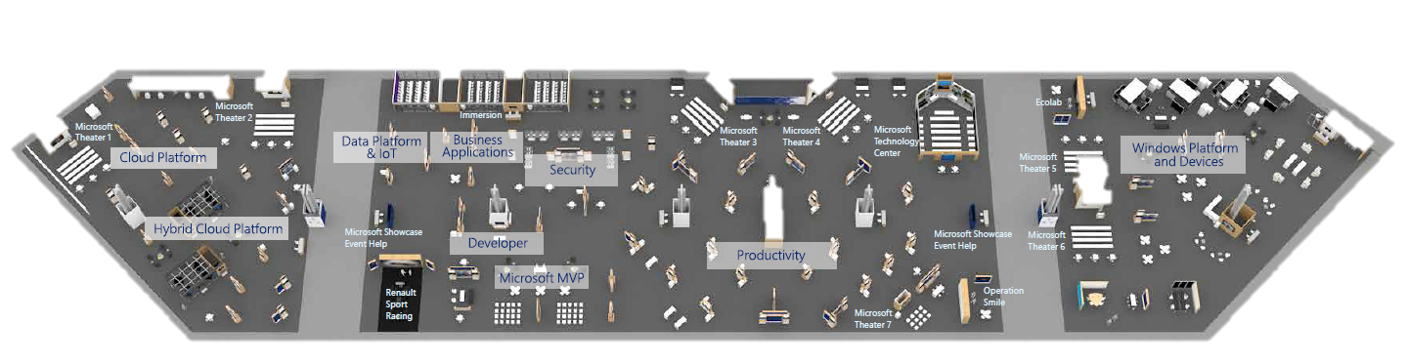
Let’s chat
Come talk to us in the Microsoft Showcase area
  I’ll be there right after this session
Continue the conversation and get resources at https://aka.ms/WinDevAtMSIgnite

Slide 52
Please evaluate this session
Your feedback is important to us!
From your PC or Tablet visit MyIgnite at http://myignite.microsoft.com
From your phone download and use the Ignite Mobile App by scanning the QR code above or visiting https://aka.ms/ignite.mobileapp

