Slide 1
Connect with your customers wherever they are with an Azure based mobile solution
BRK2042
Jeremy Thake Dan Waters
Microsoft Microsoft
@jthake

Slide 2
Agenda
Azure application platform
Ready-to-go architectures
Mobile dev ops
Q&A

Slide 3

Mobile represents
the single largest technology innovation of all time

Slide 4
Smartphone adoption is happening
10X
Faster than
the PC boom
of the 80s
2X
Faster than the Internet boom
of the 90s
3X
Faster than the recent social networking explosion

Slide 5


Azure solutions
DIGITAL MARKETING
PREDICTIVE MAINTENANCE WITH IOT
BUSINESS INTELLIGENCE
MOBILE
SAP ON AZURE
REMOTE MONITORING WITH IOT
DATA WAREHOUSE
E-COMMERCE
DISASTER RECOVERY
SHAREPOINT ON AZURE
DEVELOPMENT AND TEST
BACKUP AND ARCHIVE
BIG DATA AND ANALYTICS

Slide 6
What drives developers working in mobile?
Build once. Reach more customers, across any platform.
Ship quality apps faster
Get closer to your customers
Light up apps with proven mobile services

Slide 7

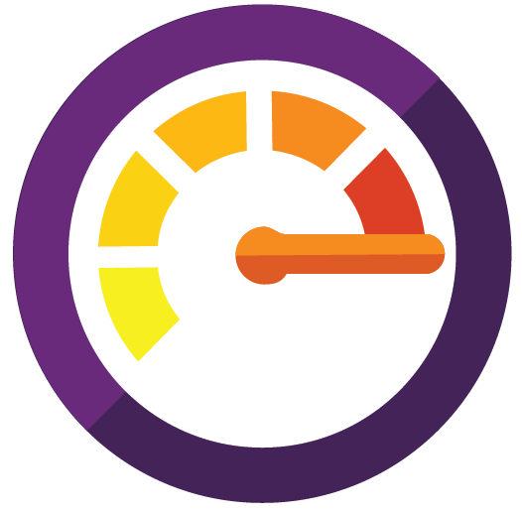
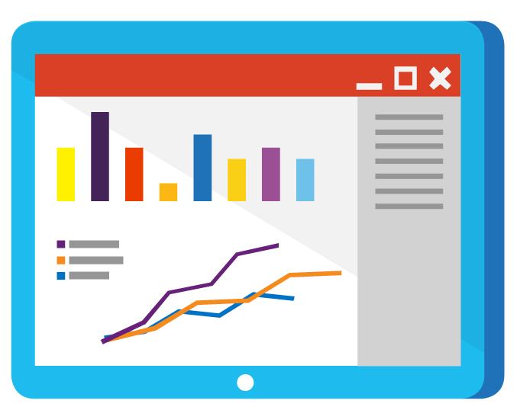
What you need
Create mobile experiences…
New applications or new
end points to existing applications for Android,
iOS, and Windows
…connected to the business…
Enterprise-ready platform
that integrates modern
mobile experiences with
existing business assets
…with mobile-
era agility
Achieve speed with faster
development cycles and
continuous measure and learn

Slide 8
Xamarin approach
iOS
iOS C# UI
Android C# UI
Windows C# UI
Fully native apps
written entirely in C#
Build apps with beautiful UX and native performance for Android, iOS & Windows
Be productive with templates, Intellisense,
debugger, designer integration, emulators, deployment
Code share with PCLs
Create specific UI or share UI with Xamarin.Forms
Use C# APIs with 100% of platform APIs exposed
Connect to Azure for backend enterprise systems
Xamarin.Forms
Shared app logic
Platform specific framework

Slide 9
What you need
Create mobile experiences…
New applications or new
end points to existing applications for Android,
iOS, and Windows
…connected to the business…
Enterprise-ready platform
that integrates modern
mobile experiences with
existing business assets
…with mobile-
era agility
Achieve speed with faster
development cycles and
continuous measure and learn

Slide 10
Microsoft Application Platform
Build the next generation of intelligent apps with an open, comprehensive solution for any developer and any platform
Target any platform,
use any technology
Develop apps with
speed and agility
Gain the broadest reach for every line
of code
Flexible & open
Productive
Reach

Slide 11
IaaS vs. PaaS
Focus on the application, not the infrastructure
Faster go-to-market
Accelerated DevOps
Integrated tools and processes
Lower risk adoption
Start small and grow
Financially-backed SLA
Business
benefits
On-prem, hybrid & cloud
Custom or template based solutions
Built-in elastic scale
Load balancing & DR
Multi-language support
Versioning & rollback
Security services
Monitoring & mgmt
Technical
benefits

Slide 12

Benefits of Microsoft Azure PaaS
Forrester Total Economic Impact results
Interviewed organizations reported on the financial and business benefits of shifting application development and deployment from Azure IaaS to Azure PaaS
466% Return on Investment
$5.91M Net Present Value
80% IT Time Saved
50% Faster Service Deployment Time to Market
Based on five-year, risk-adjusted figures for a composite organization constructed from aggregated interviews with eight Microsoft Azure IaaS customers.
Source: “The Total Economic Impact Of Microsoft Azure PaaS,” a commissioned study conducted by Forrester Consulting, June 2016

Slide 13



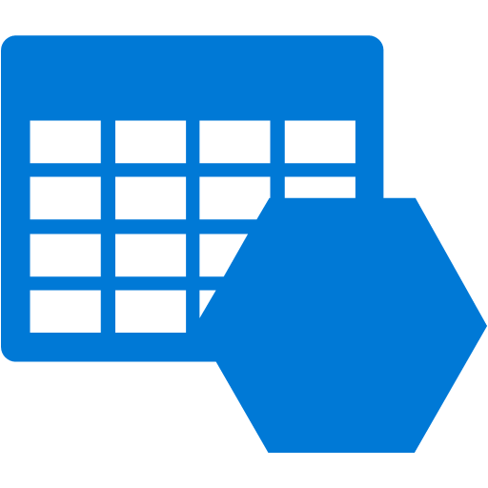

Azure Application Platform
Build on a Developer Platform (PaaS)
App Service
Service Fabric
Functions
Cloud Services
Other PaaS
Web, mobile, API,
and logic apps
Cloud native,
microservices based apps
Serverless,
event driven functions
Custom monolithic
3-tier stateless apps
Cloud Foundry, OpenShift, Apprenda, Jetlastic, etc.
Build on the OS (IaaS)
Web and mobile
Microservices
Serverless
compute
Existing
frameworks
Third-party frameworks
Virtual Machines and Containers
Storage
Networking

Slide 14

Azure App Service
Web apps
Web apps that scale with your business
Mobile apps
Build mobile apps
for any device
Logic apps
Automate business process across SaaS
and on-premises
API apps
Easily build and consume APIs in
the cloud

Slide 15
Mobile backend as a Service
All the service building blocks your developers need.
Supports all major mobile developer platforms.
Streamlined integration into your developers tools.
Scale as needed, pay for what you use.

Slide 16

Mobile apps
Mobile Backend
as a Service
Sync offline
Connect to data
Authenticate
Push notifications

Slide 17

Azure functions
Process events with serverless code
Event based
Accelerate development
+
Serverless
Call from mobile apps

Slide 18
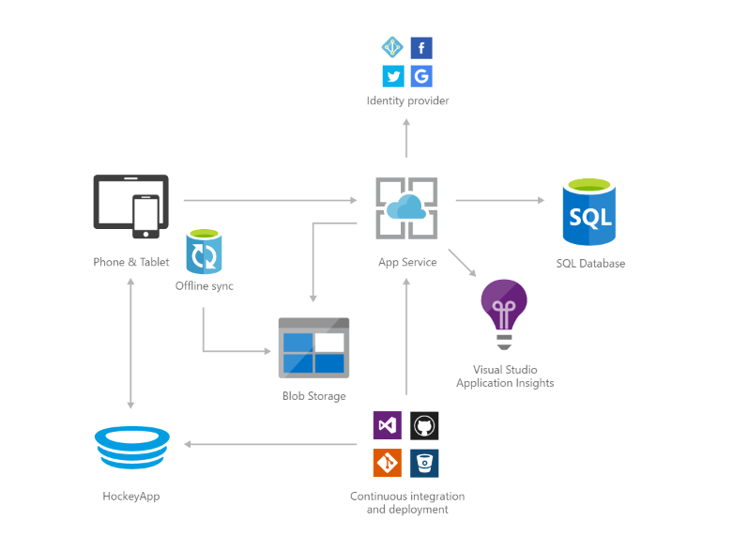
Task-based consumer mobile app

Slide 19
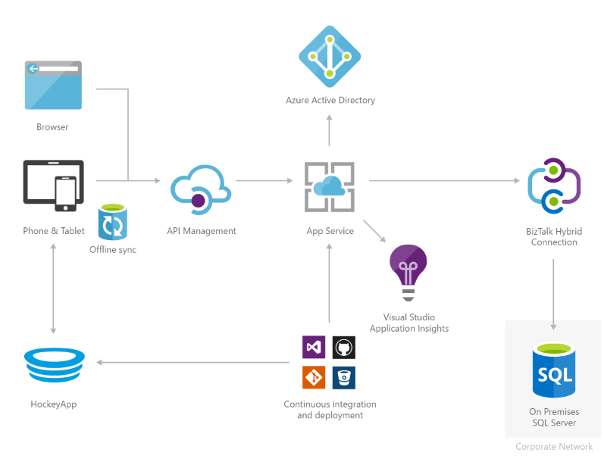
Custom mobile workforce app

Slide 20
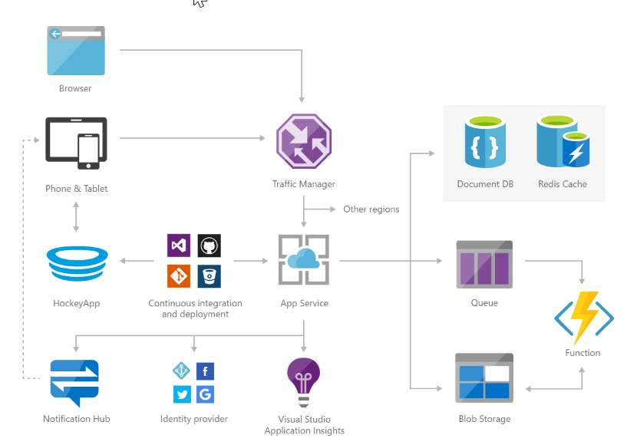
Social mobile and web app with authentication

Slide 21
Demo
Jeremy Thake
Microsoft
@jthake

Slide 22


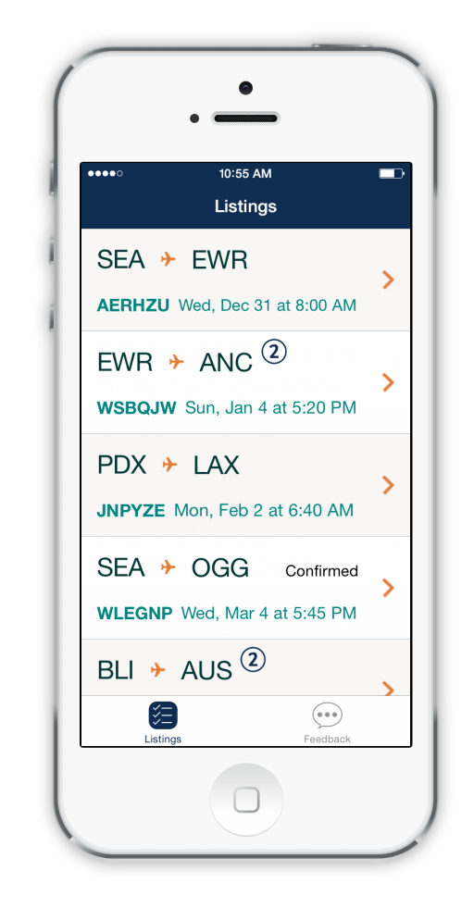

User-centric
Secure
Offline functionality

Slide 23
The breadth of Azure
DBaaS
SQL/No-SQL
Big Data
Search
Caching
Broadcasting
Media streaming
Content delivery
Media analytics
“We’re not in the business of creating new databases, new queuing methodologies,
new storage mechanisms – being able to leverage services and tools on the Azure platform we’ve gone from zero to a fully fledged ecommerce marketplace in about
12 months”
Mike Hanrahan CTO
JET.com
60+ services and growing
Compose highly functional apps
Maximize app lifecycle efficiency
Leverage enterprise-grade services
Limitless possibilities
Media
& CDN
Data
Workflow
B2B
On-Prem/SaaS Connectivity
Messaging
API management
MY APP
Version control
CI/CD
Dev-test
Monitoring
Diagnostics
Integration
Developer
services
Analytics
& IoT
Identity
& security
Machine Learning
IoT device & data
Analytics
Cognitive services
Single sign-on
Access control
User provisioning
Multi-factor auth
Threat detection

Slide 24
What you need
Create mobile experiences…
New applications or new
end points to existing applications for Android,
iOS, and Windows
…connected to the business…
Enterprise-ready platform
that integrates modern
mobile experiences with
existing business assets
…with mobile-
era agility
Achieve speed with faster
development cycles and
continuous measure and learn

Slide 25



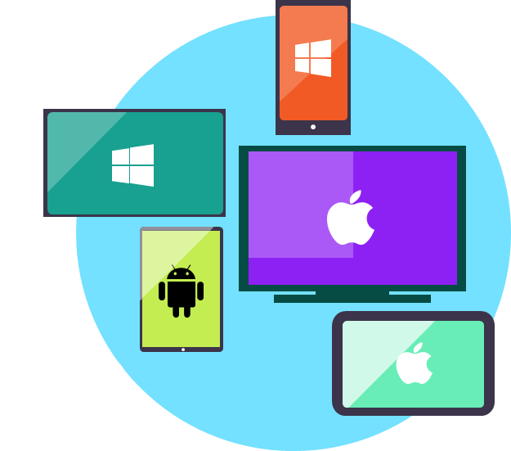


Continuous Integration
& Delivery (CI, CD)
Automate and orchestrate your build, test, and release processes.
Smooth deployment and
beta testing of mobile apps.
Close the loop between development and operations.
Developer
Operations

Slide 26

Continuous monitoring & learning
Get insights about availability and crashes of apps and services.
Analyze results in beta testing and platforms/devices coverage.
Learn from production usage and connect to direct marketing actions.

Slide 27
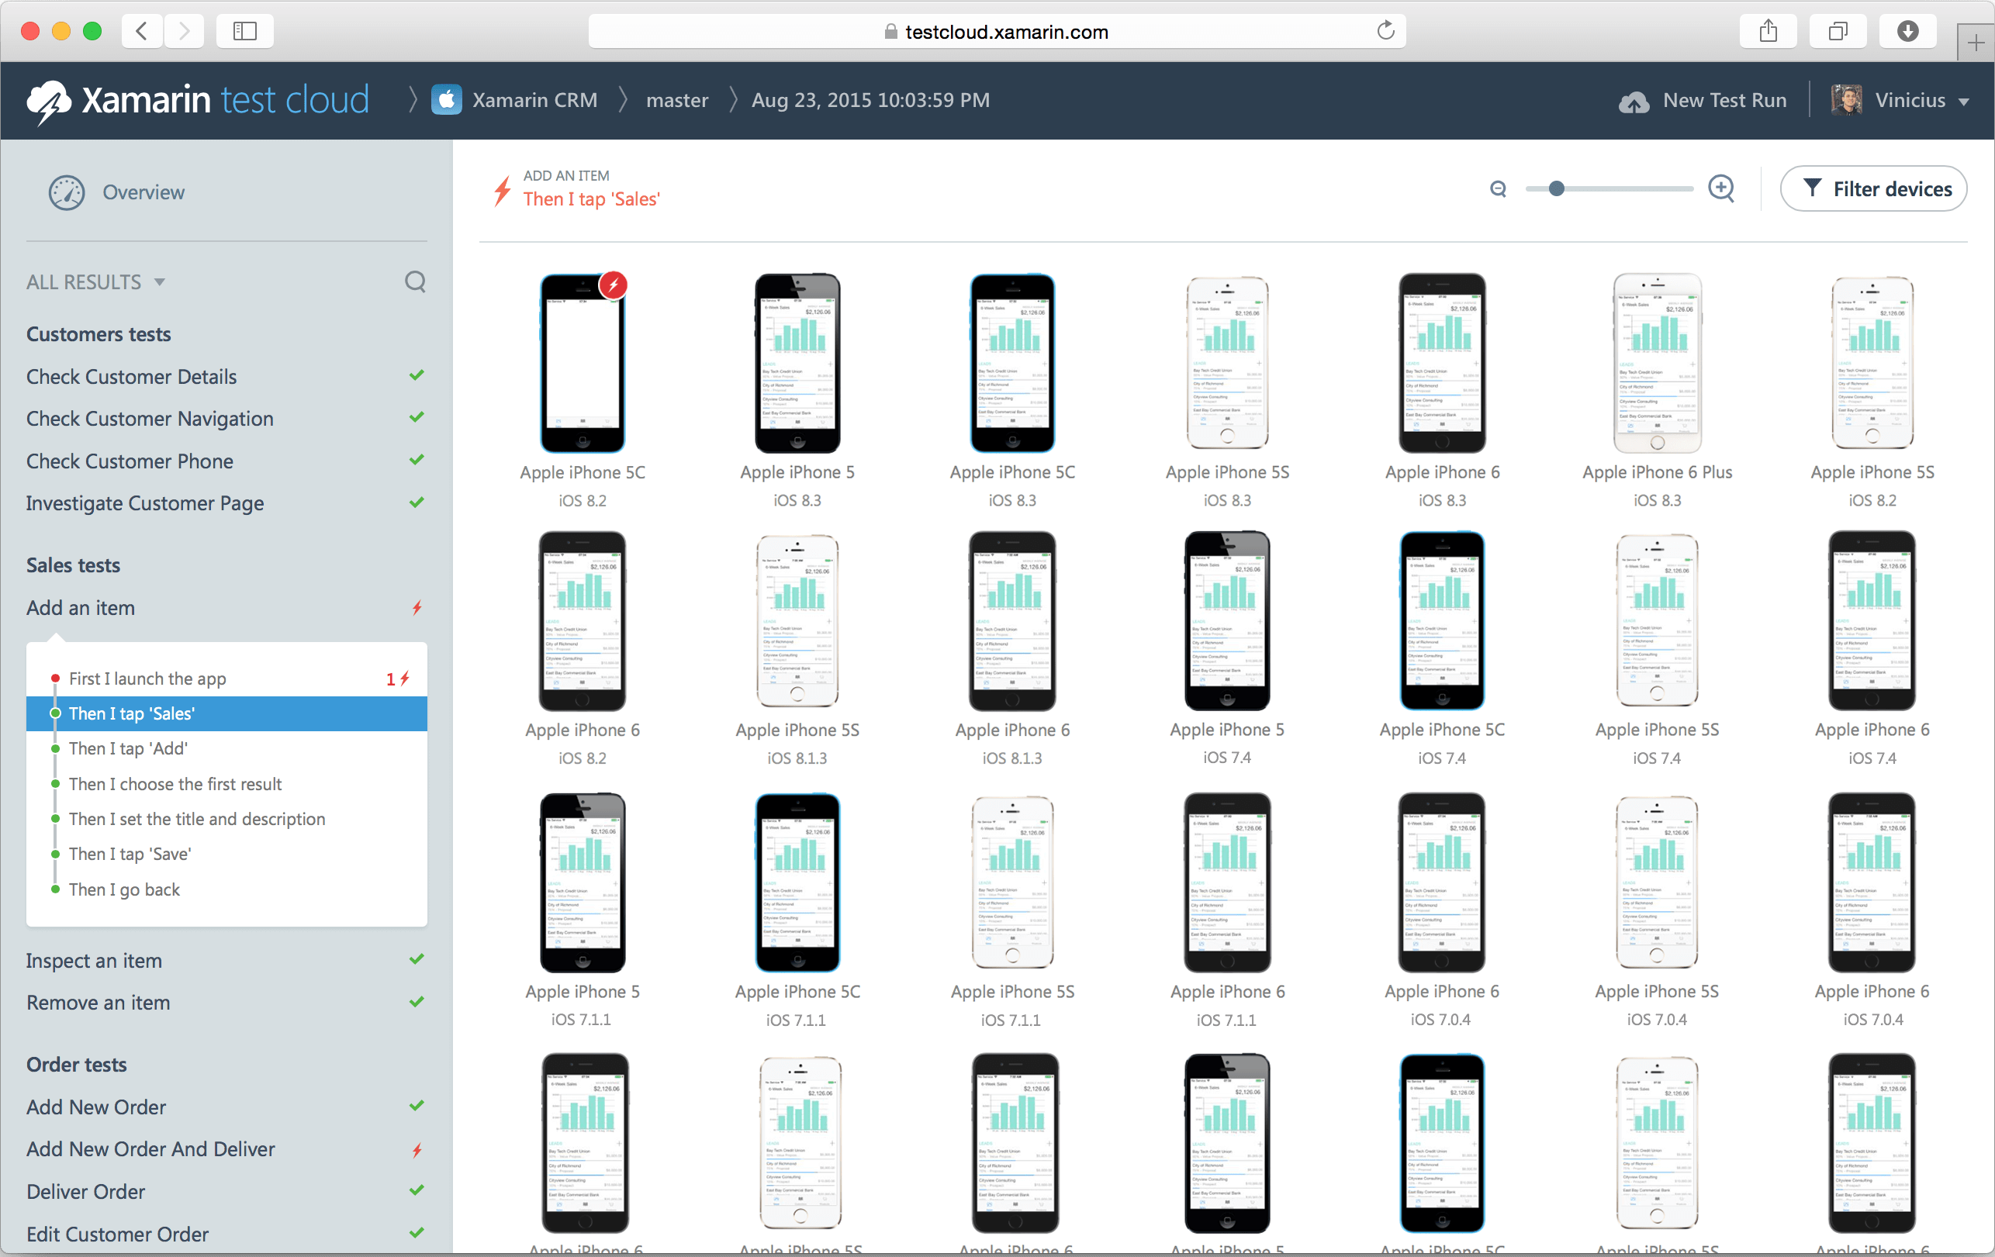
Xamarin Test Cloud
2,000+ real devices
Automate your app testing and run
them on over 2,000 different real devices.
Test everything users do, as well as any performance problems with step-by-step memory and performance tracking
Script C# or Ruby
Xamarin Test
Recorder for Visual Studio

Slide 28
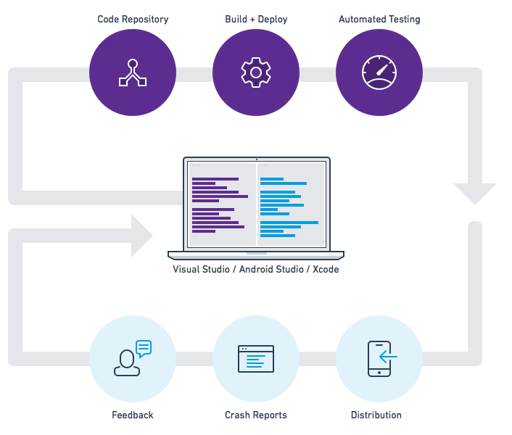
Visual Studio
Team Services and HockeyApp

Slide 29
Integration and delivery
Code repository
Build + deploy
Automated testing
User beta testing
iOS
Xamarin Test Cloud
HockeyApp
Backlog
iOS
Visual
Studio
Xamarin
Studio
HockeyApp

Slide 30
Demo
Dan Waters
Microsoft

Slide 31
Wrap up

Slide 32
Call to action
Get started with $200 in credit, and keep going with free options
azure.com/free
Find Azure training resources
azure.microsoft.com/community/training/

Slide 33
Free IT Pro resources
To advance your career in cloud technology
Plan your
career path
Cloud role mapping
Expert advice on skills needed
Self-paced curriculum by cloud role
$300 Azure credits and extended trials
Pluralsight 3 month subscription (10 courses)
Phone support incident
Weekly short videos and insights from Microsoft’s leaders and engineers
Connect with community of peers and Microsoft experts
Microsoft IT Pro Career Center
www.microsoft.com/itprocareercenter
Get started
with Azure
Microsoft IT Pro Cloud Essentials
www.microsoft.com/itprocloudessentials
Demos and
how-to videos
Microsoft Mechanics
www.microsoft.com/mechanics
Connect with peers and experts
Microsoft Tech Community
https://techcommunity.microsoft.com

Slide 34


Please evaluate this session
Your feedback is important to us!
From your PC or Tablet visit MyIgnite at http://myignite.microsoft.com
From your phone download and use the Ignite Mobile App by scanning the QR code above or visiting https://aka.ms/ignite.mobileapp

