Slide 1
Discover what’s new and what’s coming to SharePoint Modern Team sites
BRK2038
Jeremy Mazner
Group Program Manager

Slide 2
Agenda
What we built
Why we built it
How to govern
What’s next

Slide 3
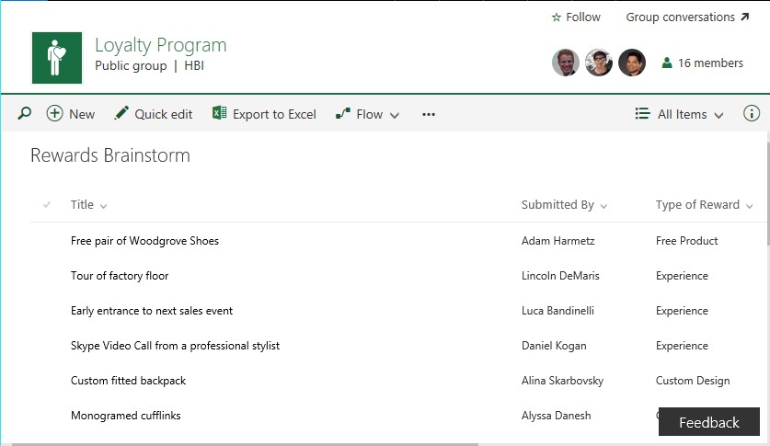
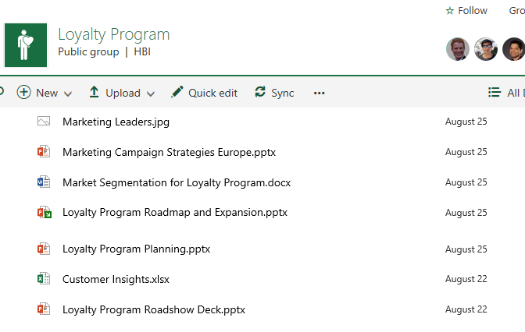
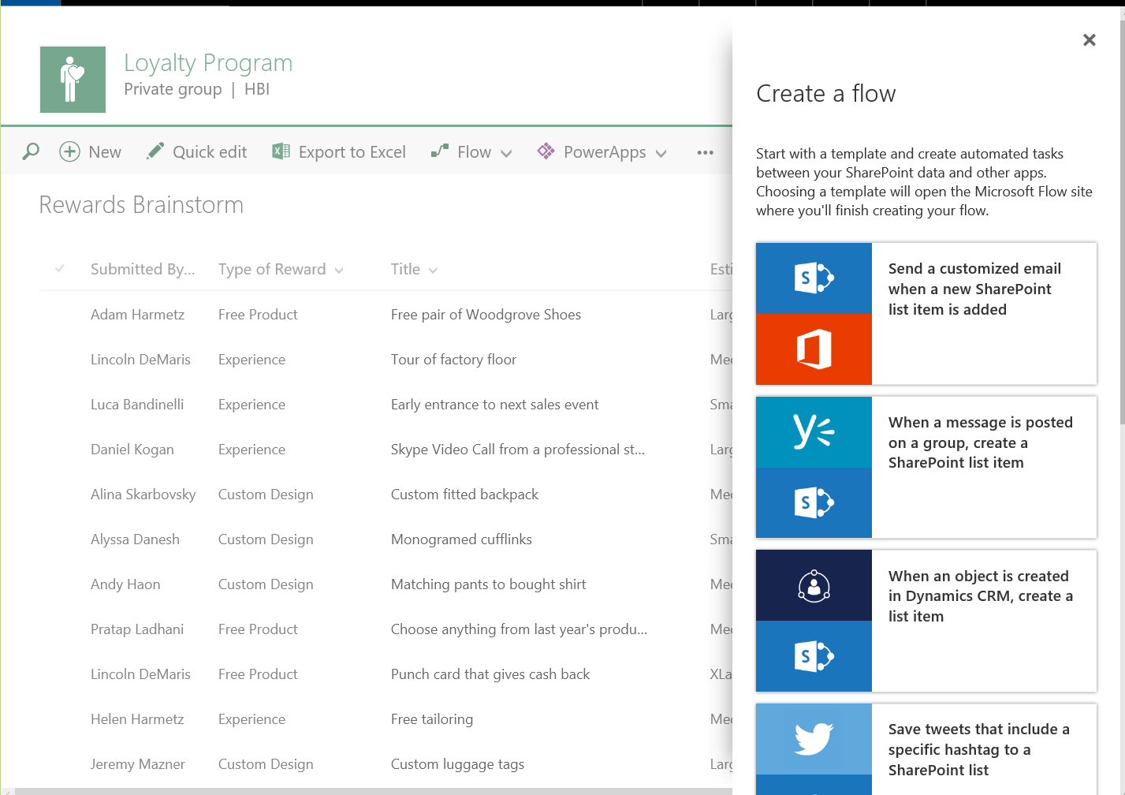
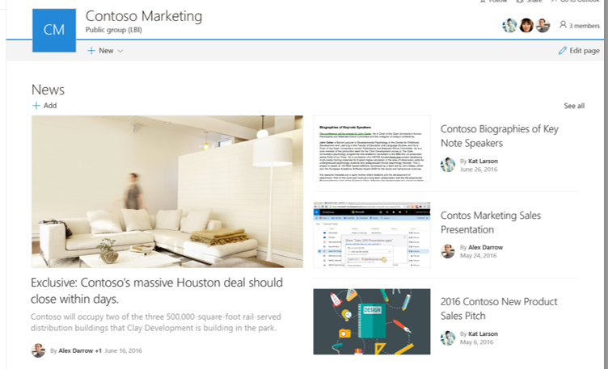
Customizable hub for content collaboration
Lists
Libraries
Pages
News
Groups

Slide 4
Demo: A lap around a team site

Slide 5
The value of a team site
Team-centric
Customization
Content structure

Slide 6
Extensibility powered by SharePoint Framework
Goals
Governed: Custom code is IT approved; doesn’t rely on Add and Customize Pages
Scoped: Clear contracts will continue to work as our experience evolves
Declarative: When possible, customizations will work on web & mobile
Working today in modern UX
Custom actions in command bar, context menu
Editable pages (home page coming soon!)
Future SharePoint Framework-based support
Custom field views, list views, file type handling
List and library webpart and editable pages
Branding and themeing
Until we get there, classic UX/extensions remain supported
More: BRK2043 (doc libraries), BRK2114 (SP Framework)

Slide 7
Governance
Self-service you can feel confident in
Naming policies, public/private, classification, usage guidelines
Restrict to an SG or write a custom creation experience
Guest policies
Group membership
Site access
See BRK3019: Manage Office 365 Groups
Site management
Ownership, lifetime, membership managed via AAD Group
Storage quota, external site access managed via SharePoint
SharePoint site permissions
Information Protection
Auditing, Reporting, DLP, data governance, device management
See BRK2258 and many others (BRK3021, BRK3015, GS06, BRK3016)

Slide 8
Demo: Coming soon

Slide 9
Feature availability
Available now
First release
Coming soon
Modern lists and libraries
Site contents
Groups get a site
Modern pages
Group card
New site creation
Navigation editing
News
Home page editing
Smart filters
Streamlined permissions

Slide 10
Demo: No site left behind

Slide 11
A closer look at sites and groups
Before
Groups get a basic document library
Users create from Outlook
SharePoint self-service creates sub-webs
SharePoint admin creates site collections
Going forward
Groups get a team site in a new site collection
Existing group doc libraries grow into full team site
Users can create from Outlook or SharePoint
SharePoint admin can still create stand-alone site collections

Slide 12
Behind the scenes details
Templates
GROUP#0 and STS#0
Fast site creation
Access policies
SP.Site.owner == Group.Owners
SP.Web.associatedMemberGroup += Group.Members
Our new UX
BRK3246: Looking behind the scenes at how we're making SharePoint's front end/UX modern, responsive, and open
Wednesday, September 28, 12:30pm - 1:45pm

Slide 13
Groups and Sites
Group Sites
Centralized management of membership, policy, lifecycle
Full set of collaborative tools ready for your group to grow into
Robust and fast user self-service
Quota manageable via PowerShell
Standalone Sites
Choice of templates
Can enable user self-service even when group self-service is disabled

Slide 14
Top of mind for 2017
Branding, customization across mobile and web
Usage and intelligence across files, sites, and pages
Yammer integration into team and publishing sites
ECM, metadata, templates, and content types
Corporate news and publishing content flows
Power users of SharePoint Team sites (leveraging Microsoft Flow and Power Apps)
SharePoint Admin experiences
Cloud-born innovation to SharePoint Server

Slide 15
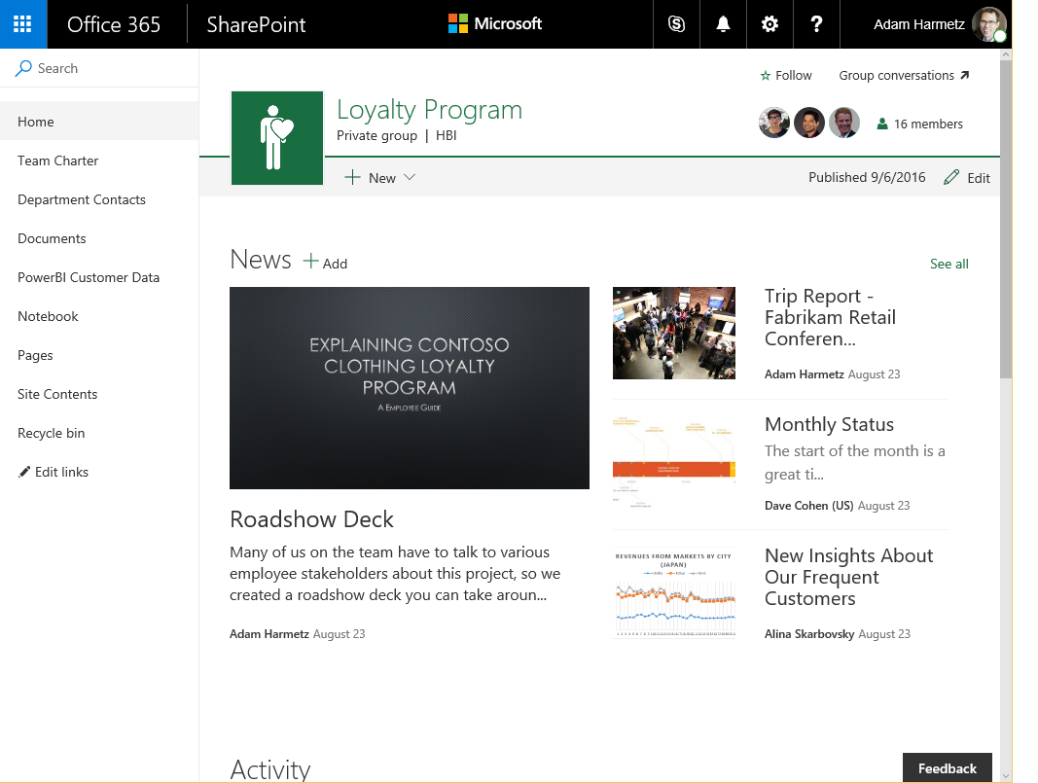
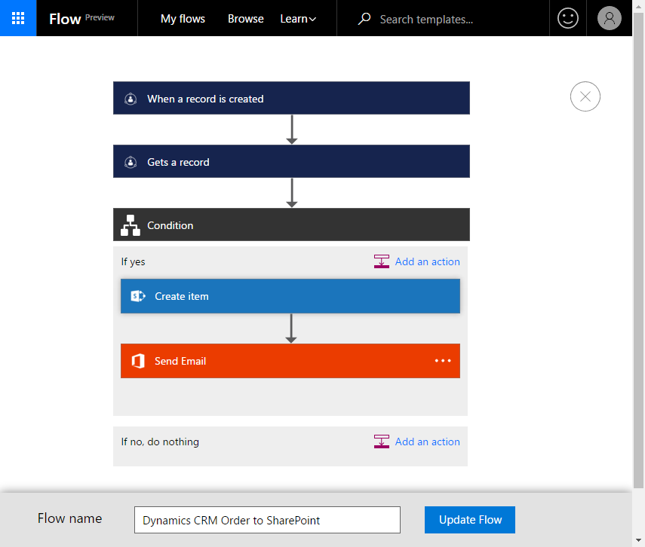
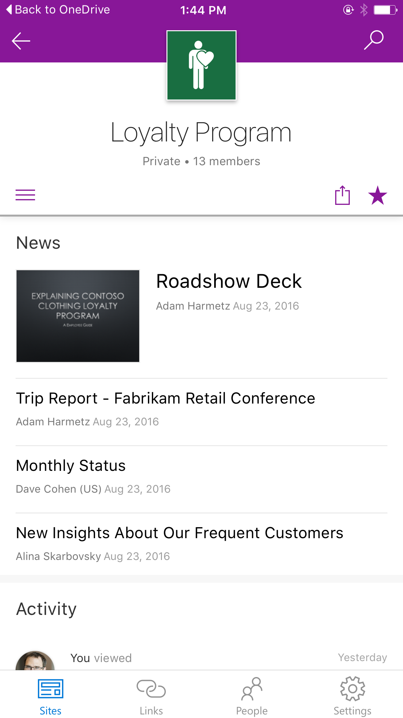
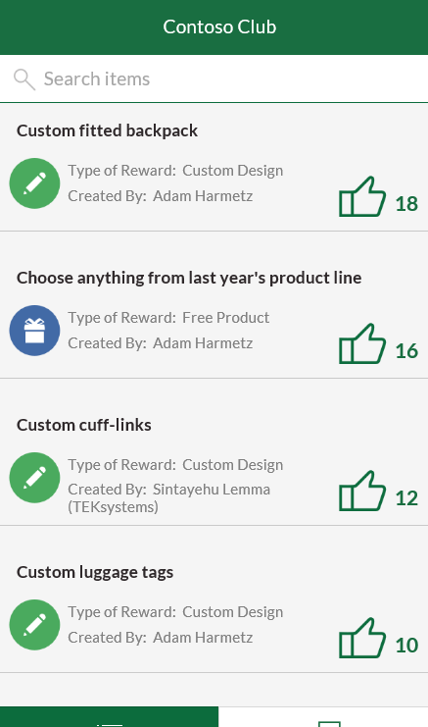
SharePoint: Mobile & Intelligent Intranet
BRK2029 Intranet
Overview
Tues 10:45AM
BRK2037 SP Apps Wed 12:30PM
Native mobile experiences
Team Sites
Portals & Publishing
Business Apps
BRK2038 Team Sites Wed 9AM
BRK2040 Publishing Thur 9AM
BRK2051 Biz Apps Thur 2:15PM
+
+
BRK2036 ECM
Tues 4PM
BRK2033 Groups Tues 10:45AM
BRK2044 Delve Mon 2:15PM
BRK2117 SP Dev
Tues 2:15PM
BRK2258 Compliance
Tues 9AM
Office 365 Groups
Microsoft Graph
SharePoint Framework
Security & Compliance
Hybrid
BRK2050 Hybrid
Tues 2:15PM

Slide 16
Deploy, ramp-up on new services and onboard new users with Microsoft FastTrack: http://fasttrack.microsoft.com/

Slide 17
Join the Microsoft Tech Community to collaborate, share, and learn from the experts: http://techcommunity.microsoft.com

Slide 18
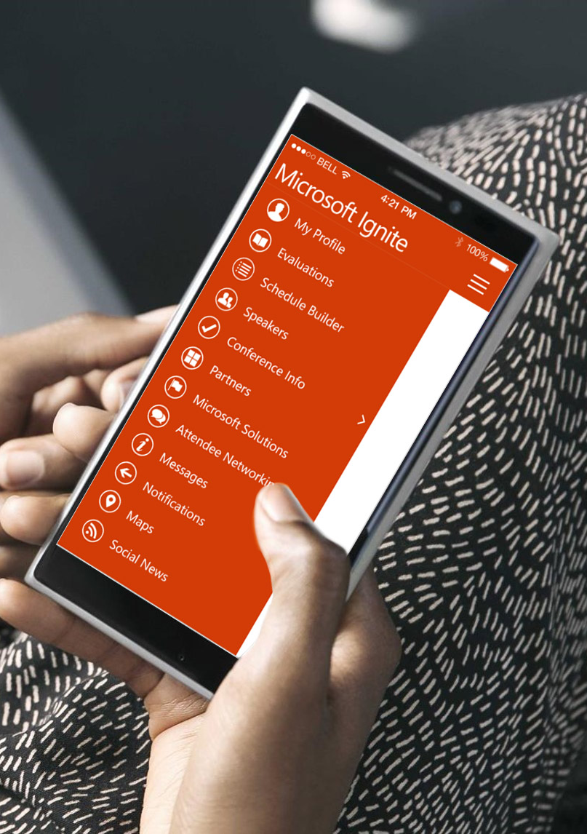
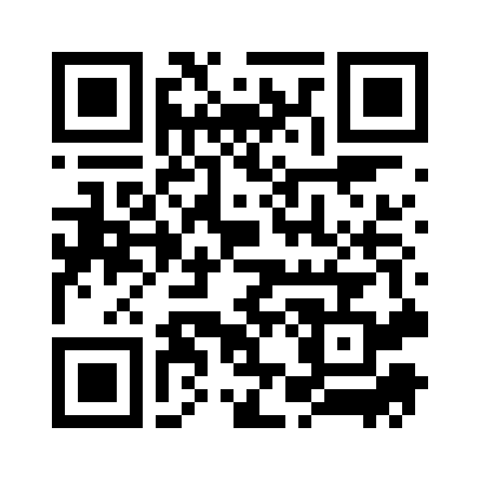
Please evaluate this session
Your feedback is important to us!
From your PC or Tablet visit MyIgnite at http://myignite.microsoft.com
From your phone download and use the Ignite Mobile App by scanning the QR code above or visiting https://aka.ms/ignite.mobileapp

