Slide 1
Learn about Office 365 Advanced Threat Protection
BRK2035
Jason Rogers & Phil Newman
Program Managers on O365

Slide 2
Threat landscape
Solid protection
Full-suite solution
Threat Intelligence
Rich investigation

Slide 3
Threat landscape

Slide 4
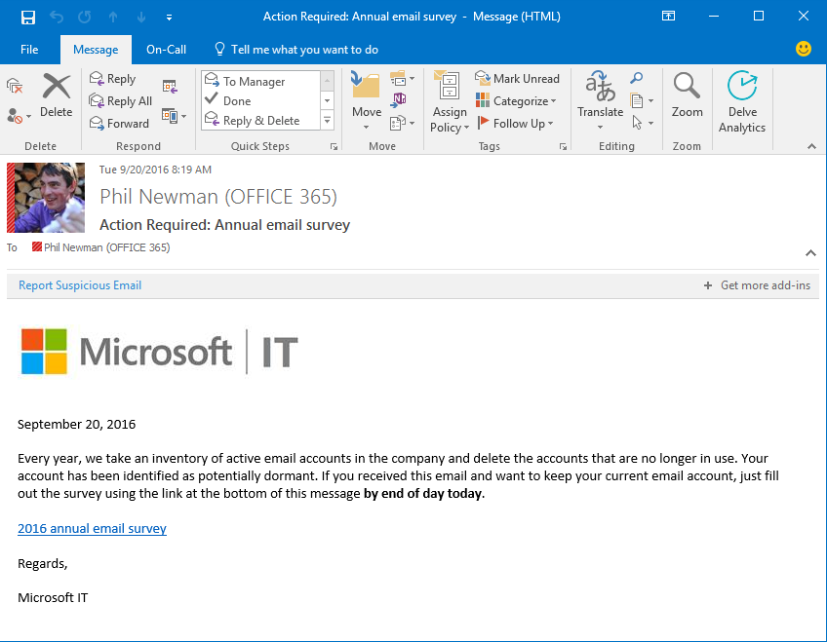
Email threats
Phish
Malware
Spear-phish
Phishing is a social engineering tactic used to turn attack targets into victims
Joe Smith (IT)
Looks legit: Sender has presence, branding is accurate, URLs seem right
Sense of urgency: The attacker wants the victim to act quickly and not raise suspicion
Lures the user: The goal is to get the user to click a link or run an attachment
http://microsoftit.com/survey

Slide 5
Email threats
Phish
Malware
Spear-phish
Malware attacks use malicious code to exploit a victim’s computer
Stealthy attack: Constantly morphing to evade detection
No-vuln: Uses macros and JavaScript to plant a virus, not a patchable vulnerability
The attachment is only stage 1: Most email malware just is a lightweight downloader
Sample: Ransomware downloader

Slide 6
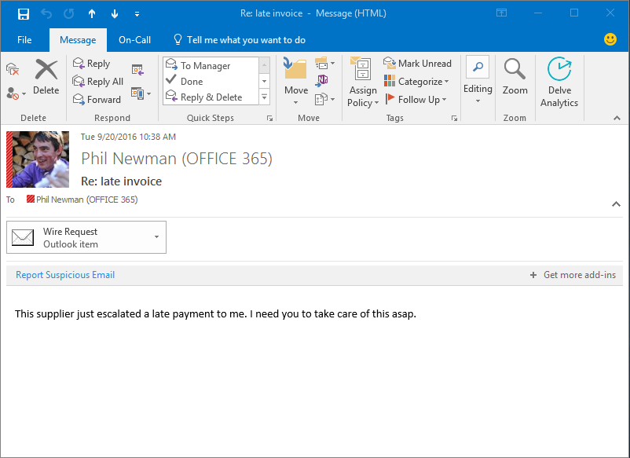
Email threats
Phish
Malware
Spear-phish
Spear-phishing attacks attempt to compromise a high-value target
Low volume, big payday: Highest degree of personalization and largest expected payout
Wendy Johnson (CEO)
Al Frank (Payments)
No detectable threat: No malware or malicious URL used in email
Exploits personal relationships: Use of spoofing and lookalike domains

Slide 7
Attack Progression
Ransom payment from user ($$)
Database exfiltration ($$$$)
Stolen credentials ($)
Steal OneDrive for Business files ($$)
Phish URL click
Explore SPO to find files
Spear-phish
Phish mail
Insider sells data ($$$$)
Commodity
Targeted
Advanced Persistent Threat
Attack Severity (business impact)

Slide 8
Behind the attack – Locky Distribution
Attacker
Zombie computers
Targets
Goal: Steal money from victims
Plan: Infect with victims with ransomware and demand bitcoin payment
Start campaign
Update payload
Command and control

Slide 9
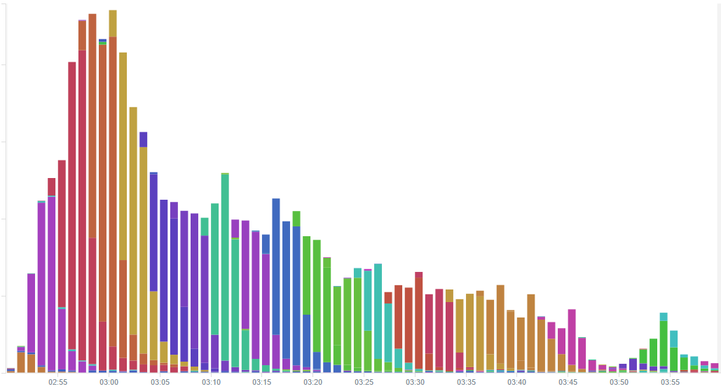
Behind the attack – Locky Distribution
Attack morphs over time to evade detection

Slide 10
Behind the attack – Locky infection
Attacker
Give me the ransomware
Here it is. Start encrypting.
Command and control
! $

Slide 11
Solid protection

Slide 12
ATP: built into Office 365
Edge Block
AV Scanners
Reputation Blocking
Heuristic Clustering
ATP Safe Attachments
Antispam
Phish
Spoof
ATP Safe Links

Slide 13
Preventing advanced attacks
O365 Edge
sender ip: 10.2.1.1
sender: badguy@malicious.com
recipient: goodguy@contoso.com
internal reputation: bad
external reputation: bad
Internet

Slide 14
Preventing advanced attacks
Signature AV Scans
Reputation Block
00101011011010010101011010101101011
01010101010101100110001101010101010
10010101100010101011110101010110101
10010101110101010011111010101001101
1001101010111011010101010100101010
11010101010101010101101010101010101
EXE

Slide 15
Preventing advanced attacks
Heuristic Clustering
ATP Safe Attachments
Sandbox
memory scan
registry
obfuscation
network
evasion
C2 server
encryption
file I/O

Slide 16
Preventing advanced attacks
Safe Links Server
Anti-Spam/Phish/Spoof Filters
Safe Links
Fingerprinting
Content Filters
To: gopi@contoso.com
Check out this URL.
Clustering
Analyst Rules
URL Reputation
Spoof Detection
Sender Rep
Block Lists
Target Server

Slide 17
Preventing advanced attacks
ZAP
Mailbox

Slide 18
Defense in depth
Anti-Malware Pipeline
AV Engines
Reputation
Heuristic
Clustering
ATP

Slide 19
The future of false positives/negatives
False Positives
False Negatives
Empower admins to block or allow specific URLs or files for their organization.
Will provide an early signal to O365 that an FP or FN is impacting customers.
Organization Allow / Block
Release malware caught mail to the recipient or an admin mailbox for further investigation.
Easily submit files, urls, or messages to O365 as spam, malware, phish, etc...
Get admin feedback on the status of your submissions.
Malware Quarantine
O365 Submissions

Slide 20
ATP vs. 3rd Party Solutions
The EOP/ATP filtering pipeline offers world class malware protection.
ATP is built in to EOP. Setup takes less than a minute.
ATP will protect more than just email.
Microsoft is uniquely positioned to respond to the evolving threat space.

Slide 21
SOLID PROTECTION DEMOS
Dynamic Email Delivery
Receive every email immediately. Safe Attachments scanning occurs in the background and email attachments become automatically available when we know the attachments are safe.
Linked Content Detonation
Merging the technologies behind Safe Links and Safe Attachments to provide full sandbox protection for content pointed to by links in emails.

Slide 22
Full-suite solution

Slide 23
Expanding Advanced Threat Protection
Outlook
SharePoint
Exchange
ATP
Word
PowerPoint
Yammer
Skype for Business
Excel

Slide 24
FULL SUITE SOLUTION DEMOS
Safe Attachments in Sharepoint
Extending the protection of Safe Attachments to files stored in SharePoint Online.
Safe Links in Office Clients
Native integration of Safe Links in Office 2016 clients will provide time of click protection, even inside of documents.

Slide 25
Threat intelligence

Slide 26
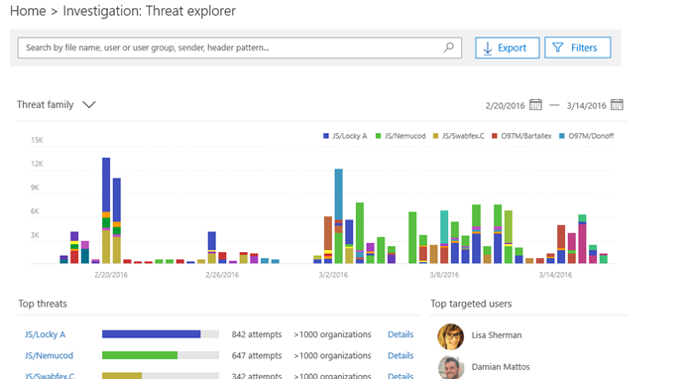
Simplified threat intelligence for O365 customers
Take control of your Office 365 deployment. Get full visibility into what threats are in your environment, which users are compromised and what data is at risk.
!
Phishing, malware, suspicious activity
Rich threat signals from SharePoint, Exchange, OneDrive for Business, Skype for Business and AAD.
Smart correlation and context
Correlation of security signals from across Microsoft, global targeting data and actor profiles give you detailed context.
Visibility into threats
Rich Insights
Threat alerts and guided remediation
Pivot and explore threats, view events from across O365 on a single timeline. Use threat data to drive smart policy.
The Microsoft suite and beyond
First party integration with Microsoft tools, standardized log feed for 3rd party tools.
Investigate Breach
Integrated into the tools you use

Slide 27
Evolving threat recommendations
Locky
Malware
Read
Changed
Linda
Manager
Read
Finance
Gopi
Important
Edited
Credit cards
Forwarded
Sensitive
Read
Received
Targeted
Phish

Slide 28
Evolving threat recommendations
Locky
Malware
Read
Changed
Linda
Manager
Read
Finance
Gopi
Important
Infected
Credit cards
Edited
Forwarded
Sensitive
Read
Received
Targeted
Phish
Infected

Slide 29
Rich investigation

Slide 30
THREAT INTELLIGENCE DEMOS
Threat Dashboard
Learn about the threat landscape and the main risks for your organization
Threat Explorer
Navigate through your threat data to pinpoint hotspots and get a deep understanding of attacks

Slide 31
Office 365 ATP and Threat Intelligence
Threat landscape
Solid protection
Full-suite solution
Threat Intelligence
Rich investigation

Slide 32
Looking for more?
Email security
BRK2035: Learn about advancements in Office 365 Advanced Threat Protection
BRK3023: Understand how Microsoft protects you against Spoof, Phish, Malware, and Spam emails
THR3009: Understand how Microsoft protects you against Spoof, Phish, Malware, and Spam emails
THR2006: Get an edge over attackers – what you need to know about email threats
O365 Security and Compliance
BRK3018: Take control of your security and compliance with Office 365
BRK3040: Own your data with next generation access control technology in Office 365
Monitoring
BRK3024: Build security and compliance solutions using Office 365 security and compliance APIs
icons by icons8.com

Slide 33
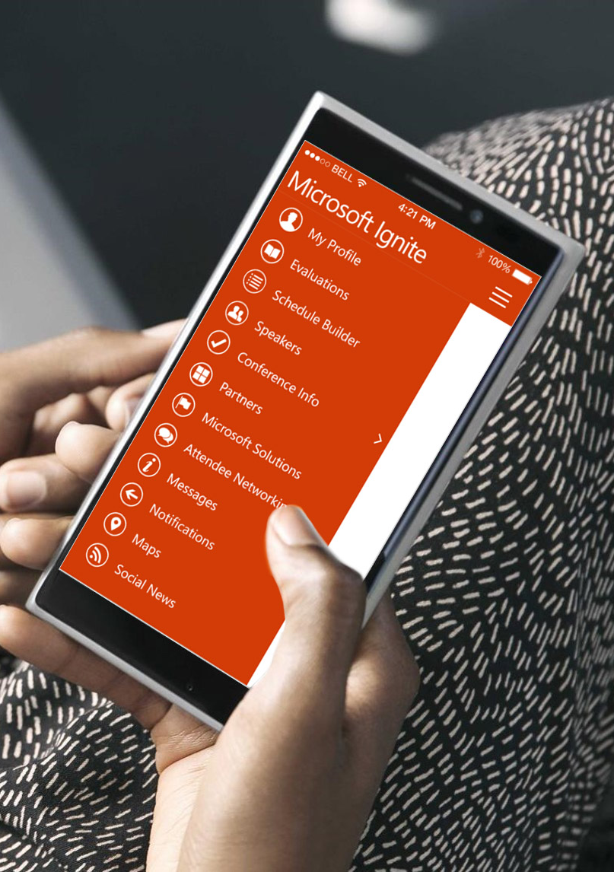
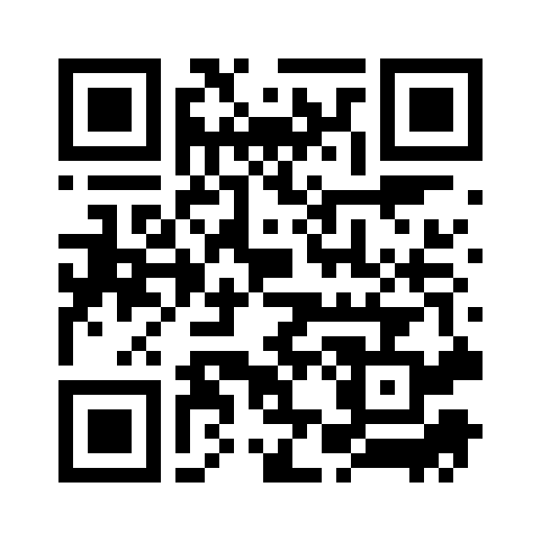
Please evaluate this session
Your feedback is important to us!
From your PC or Tablet visit MyIgnite at http://myignite.microsoft.com
From your phone download and use the Ignite Mobile App by scanning the QR code above or visiting https://aka.ms/ignite.mobileapp

