Slide 1
Learn about Azure Stack Agile Service Delivery
BRK2030
Bradley Bartz
Principal Program Manager

Slide 2

Large & growing ecosystem
Agile self-service experiences
Automated Cloud Service Delivery
Robust Cloud Model
Stable Predictable Environment
Azure Stack Integrated System
MICROSOFT CONFIDENTIAL

Slide 3
Unique point of view: cloud is a model, not just a place
Cloud model is geared for speed
Developers have a critical business role
Services and apps create new complexity
Server is no longer the center point
App is king—app data is business data
Public
Private
Hosted

Slide 4
Focus on Solutions

Slide 5
Azure solutions
Envisioning hybrid solutions with Azure and Azure Stack
Digital marketing | Mobile | E-commerce
Micro-service applications | Development and test | SharePoint on Azure Stack
Business intelligence | Disaster recovery | Backup and archive
Predictive maintenance with IoT | Remote monitoring with IoT | Big data and analytics

Slide 6
Solutions build on Services

Slide 7
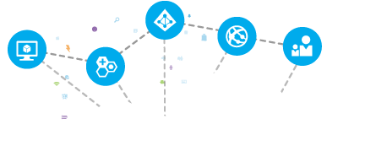
Delivering Services to Azure Stack
Marketplace Content
Additional Platform Services
ISV Services and Experiences
Customization

Slide 8
















Azure Stack Extensible Architecture
Storage Blobs
Websites
(.NET, PHP, Python … )
Guest Workload Resources
(IaaS + PaaS)
Websites
(.NET, PHP, Python … )
Service Fabric Clusters
Virtual Machines
(Linux or Windows)
Virtual Networks
Service Fabric Clusters
End User Experiences
End User Experiences
Azure Portal | Developer Tools (MSFT & Open Source)
From Microsoft
Unified App Model
Unified Application Model
Azure Resource Manager
Marketplace
Core Services
Core Services
Subscriptions | RBAC | Marketplace | Metrics | Usage
Azure Stack Software
Extensible Service Framework
Additional Platform Services
Foundational Services
Compute | Storage | Networking | Platform Services
Foundational Services
Cloud Infrastructure
Infrastructure Management
Cloud Infrastructure
Compute
Storage
Networking
From 3rd Parties

Slide 9

Provider agility with Platform Services from Azure
Develop Azure Services
Deliver Services using
Your Datacenter
Repeat
Operate at
Hyper-Scale
Add Provider experiences
Scale & integration points

Slide 10
Azure Platform Services

Slide 11
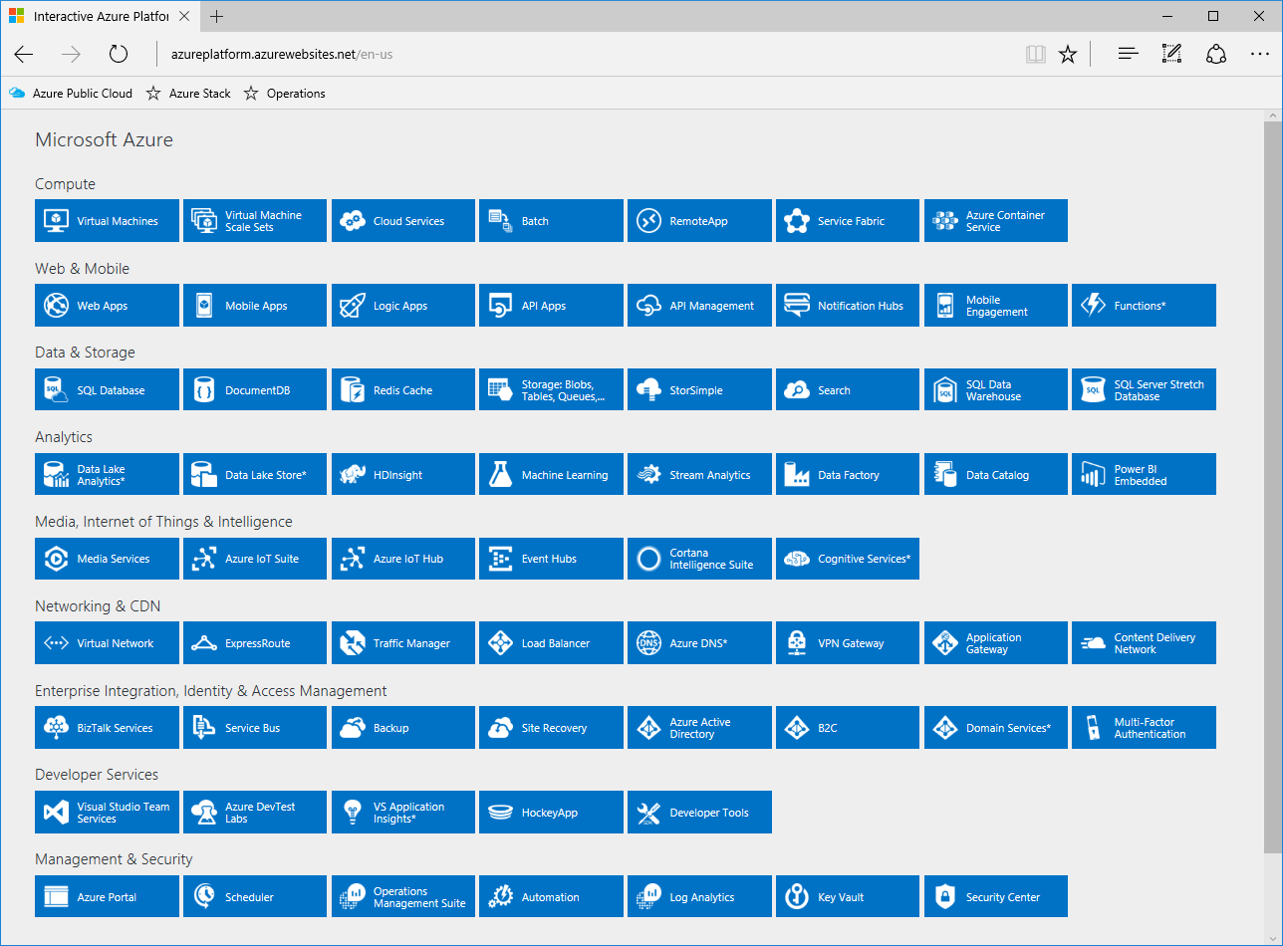
http://azureplatform.azurewebsites.net/

Slide 12
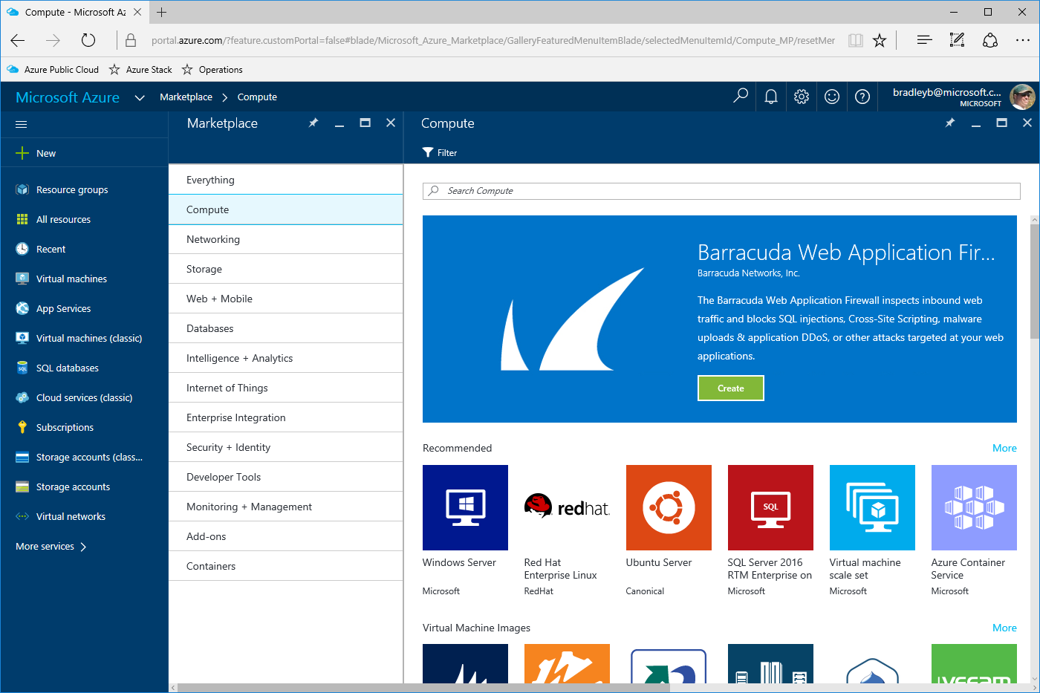
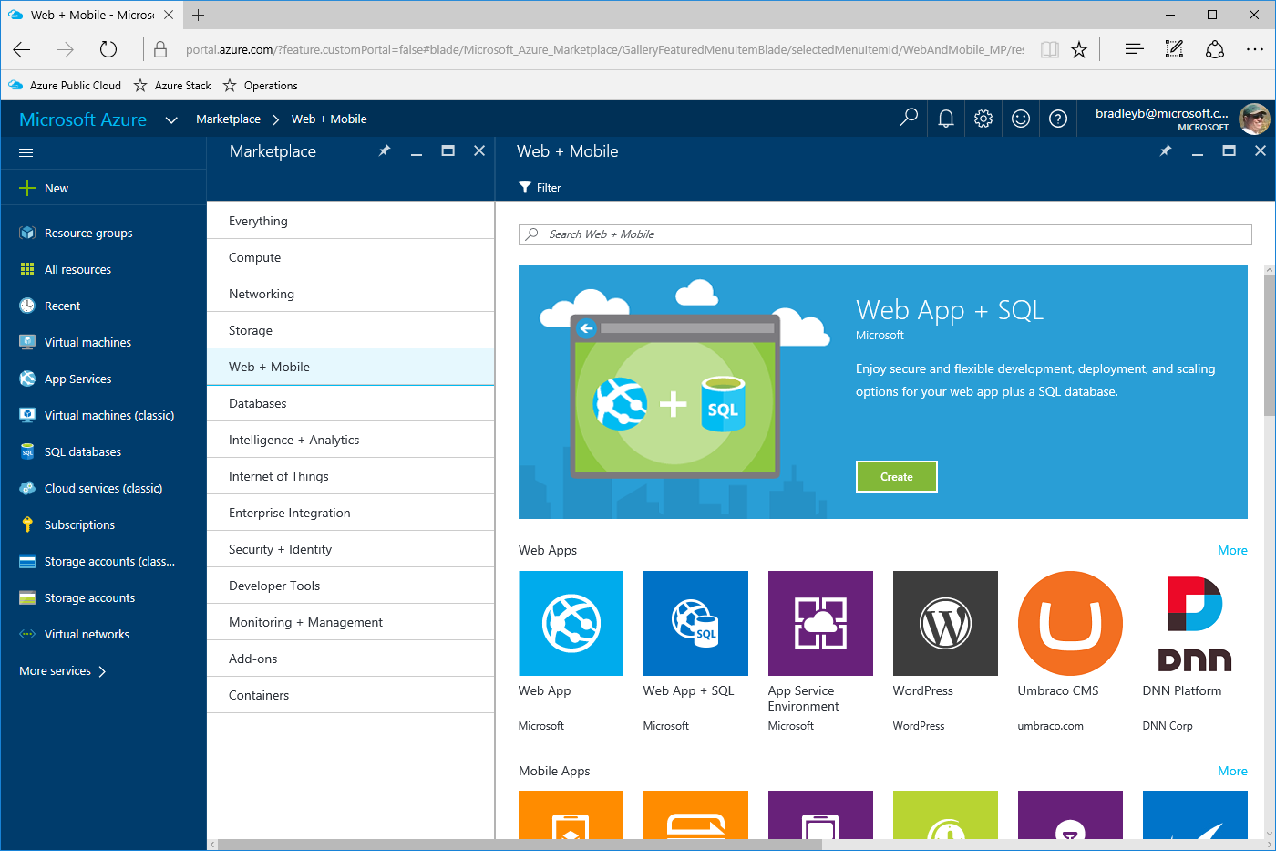


















Platform Services enable Solutions
Platform Services
Solutions
Foundation
Additional
Hybrid from Azure
Development and test
Azure Portal
Web Apps
Azure Active …
Virtual Machines
Mobile Apps
ExpressRoute
Sharepoint on Azure
Storage: Blobs,
Tables, Queues,…
API Apps
Traffic Manager
Microservice applications
Virtual Network
SQL Server Stretch
Database
App modernization
Load Balancer
Operations…
VPN Gateway
SQL Server
Automation
Digital marketing
Key Vault
MySQL Server
Log Analytics
E-commerce

Slide 13
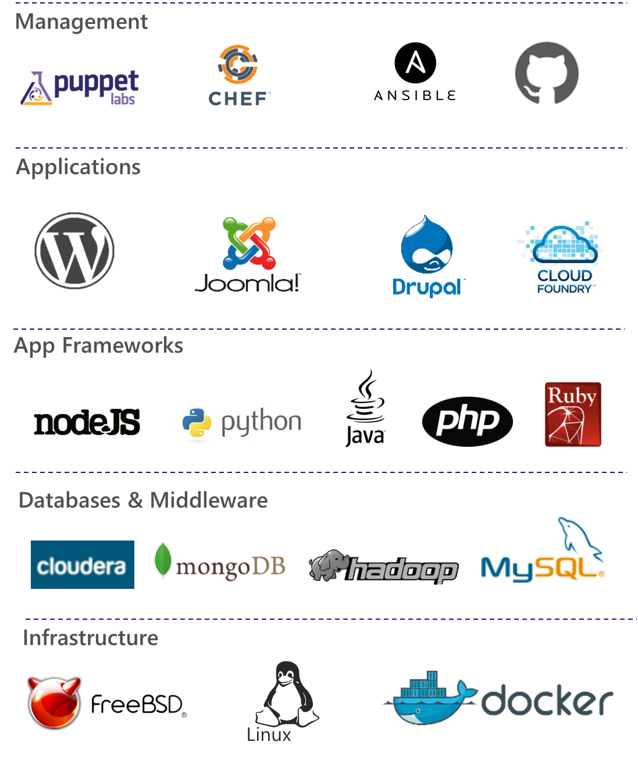
Marketplace content
Growing over time
Open + Flexible
MICROSOFT CONFIDENTIAL

Slide 14
Marketplace Syndication
Delivers Solution Components

Slide 15
Demo

Slide 16
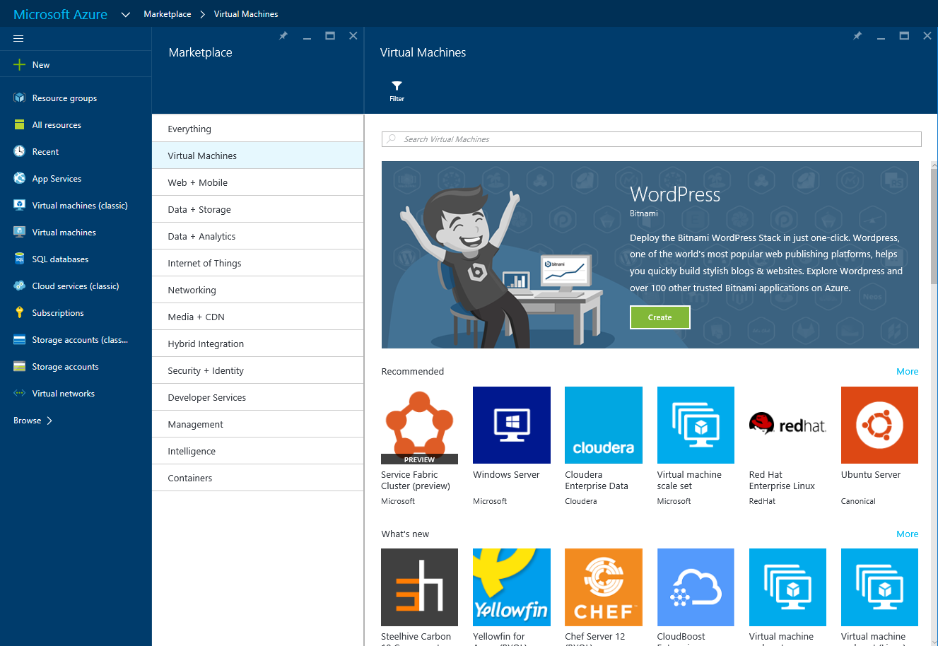
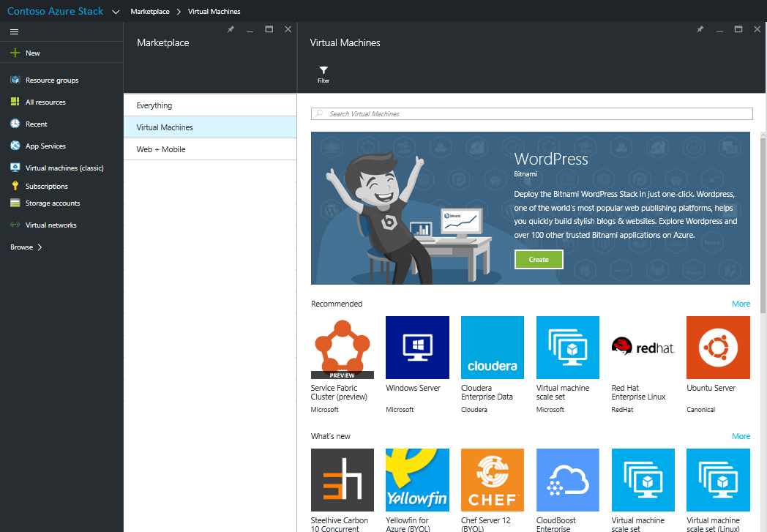
Marketplace: Microsoft and Provider’s

Slide 17
ISV Extending Azure Stack

Slide 18
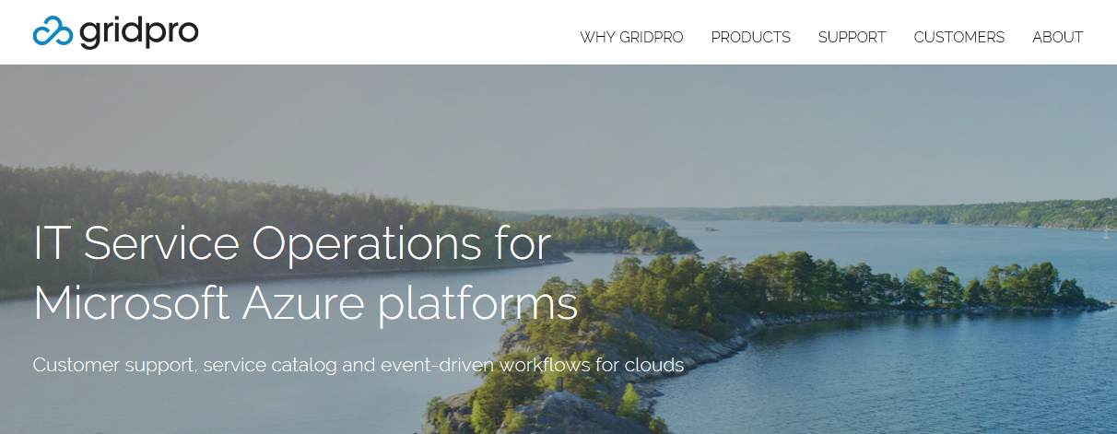
Patrik Sundqvist
CTO & Co-founder
Gridpro
www.gridprosoftware.com

Slide 19








Gridpro
PRODUCTS
CUSTOMERS
Turnkey products for System Center Service Manager and Windows Azure Pack
Our customers includes some of the largest organizations in the world

Slide 20
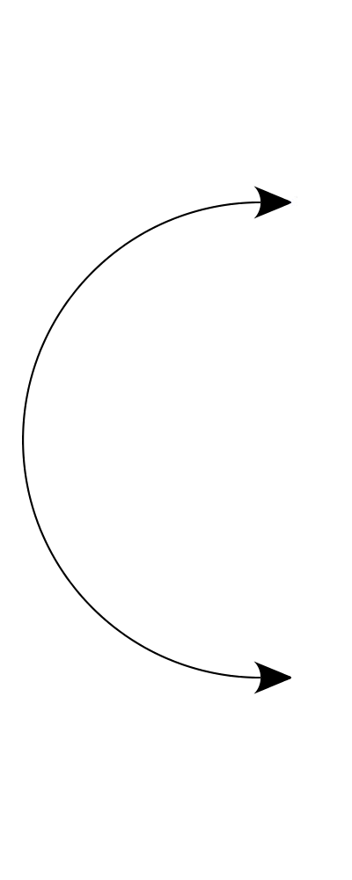







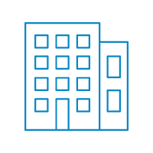
EvOps for Azure Stack
Optional Integration
CUSTOMER SUPPORT
SERVICE CATALOG
EVENT MANAGEMENT
EvOps for Azure Stack
Microsoft Azure Stack
Current ITSM Investment
Service Providers
Enterprises

Slide 21



Features
SERVICE CATALOG
CUSTOMER SUPPORT
EVENT WORKFLOW
Marketplace Integration
Support as a Service
Event Rules
Request templates with predefined workflows
Enterprise, Service Provider and DevOps segment
Collects events from Azure Stack and defined integrated systems
External sources and validation
Azure Stack Reseller model support
Trigger actions on filtered events
Approval, Deployment and Runbook activities
Service Desk Integrations
Integrations with monitoring, collaboration and ticketing tools

Slide 22
Customers Build Solutions

Slide 23
Azure Resource Manager
Describe
Deploy
Control
RESOURCE
GROUP
Azure Resource Manager
Azure Resource Manager
App
Database
Compute
Network
Storage
MICROSOFT AZURE STACK
MICROSOFT AZURE

Slide 24
Complex Deployments

Slide 25



Azure Resource Manager
Describe
WHERE
Resource Inventory
WHAT
Component Relationships
HOW
Tags + links + groups
Provision
WHERE
Across Regions
WHAT
Across Resources
HOW
In service and in guest
Control
WHO
Access control
WHAT
Changes
HOW
RBAC, subscriptions, and locks

Slide 26
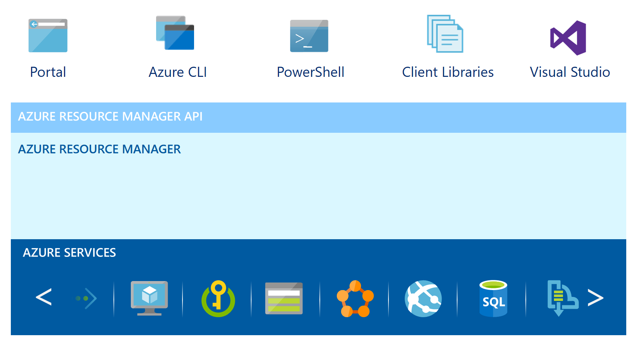
Azure Resource Manager
Whitepaper http://aka.ms/GettingStartedWithARM

Slide 27
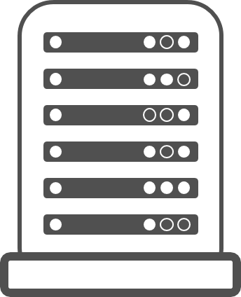
One Azure Ecosystem
Mac OS X & Windows
Windows Server and Linux
Visual Studio
Eclipse
Azure Portal
GitHub
…
PowerShell
Docker
Chef & Puppet
…
Tools
Experiences
Automations
Azure Ecosystem
Microsoft Azure
Microsoft Azure Stack

Slide 28
Monetizing Azure Stack
Rupi Sureshkumar
Program Manager

Slide 29

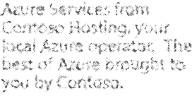
Monetizing Azure in your Datacenter
Meters Spin for:
Compute/Storage/Network
Platform Services
Marketplace Apps
$$$
$$$
$$$
$$$
$$$
38958237
MICROSOFT CONFIDENTIAL

Slide 30
How does it work for
Microsoft Azure?

Slide 31
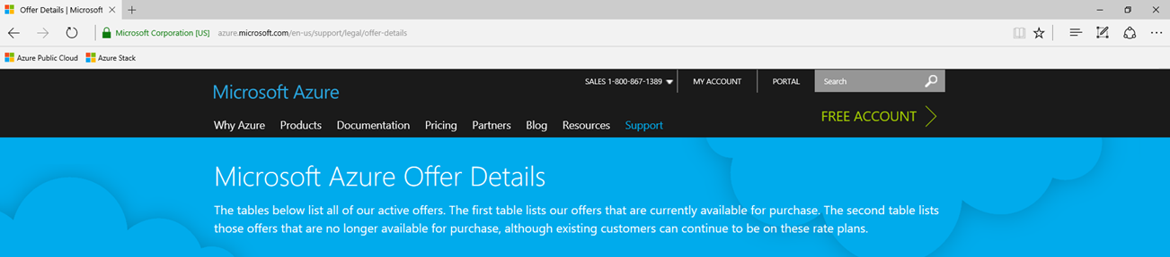
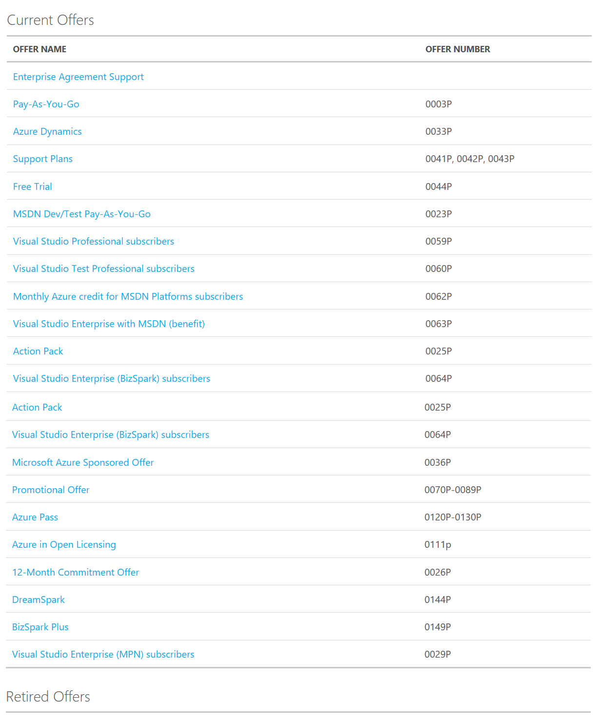
Microsoft Azure has a
variety of “Offers” today
  From Free Trial
  To MDSN
  To Enterprise Support
Each Offer defines:
    Price per meter
    Available Regions
    Quotas
MICROSOFT CONFIDENTIAL

Slide 32



Mapping Offers to Usage to $$
Pay-As-You-Go
User Subscribes to an Offer
Gets a Subscription ID
Provisions Resources with Subscription ID
All Meters are emitted with Subscription ID
Commerce System applies $$ to meter
Customer gets Bill
DA5395F5-E9CA-4F83-8AB9-B764B79C7BAB
Bill
$
$
$
$
$
DA5395F5-E9CA-4F83-8AB9-B764B79C7BAB

Slide 33
How does it work for
Microsoft Azure Stack in your Datacenter?

Slide 34
Azure Stack
You’re the Provider
You Define Offers
You Determine Regions avail per Offer
You Set Quotas Specific to Each Offer
You Set the $$ per Meter
You Bill your Customers

Slide 35
Mapping Offers to Usage to $$
Contoso Offer
User Subscribes to an Offer
Gets a Subscription ID
Provisions Resources with Subscription ID
All Meters are emitted with Subscription ID
Your Commerce System applies $$ to meter
You send your Customer a Bill
2AFD8568-8192-4EE6-8883-04A31650D016
Bill
$
$
$
$
$
2AFD8568-8192-4EE6-8883-04A31650D016

Slide 36
Commerce Integration
You own tenant onboarding
Utility based billing:
https://management.azure.com/.../Microsoft.Commerce
Same in model between Azure & Azure Stack
Offer and SKU pricing from your commerce system
Pricing APIs for show back in Portal
You populate the Marketplace

Slide 37
Business intelligence
Who are my top customers?
Who is underutilizing their allocated resources?
Which services are doing best on my platform?
How can I better understand how customers use my platform?

Slide 38
Demo

Slide 39
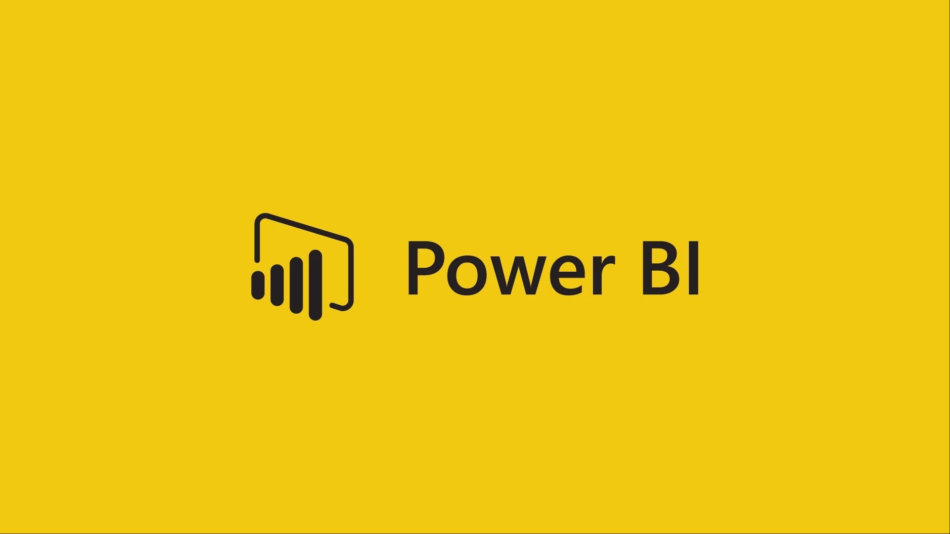
Data pipeline
Azure Stack
Azure Storage Tables
API Endpoints
GET via PowerShell
Offers
Subscriptions
Usage

Slide 40
Service Provider’s use case for Azure Stack

Slide 41
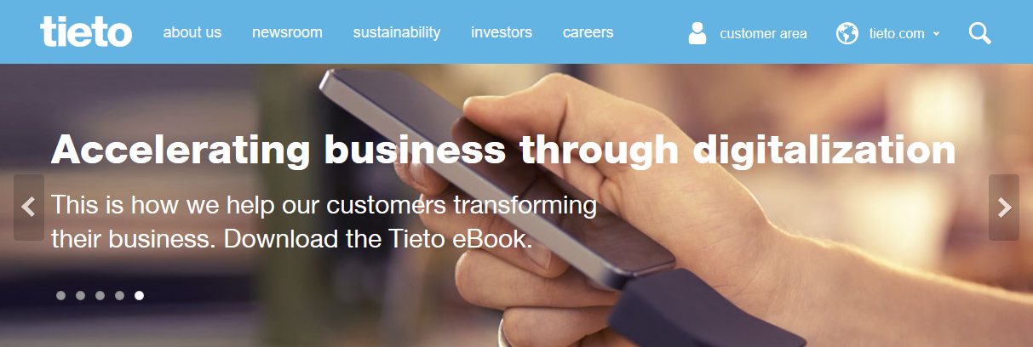
Joni Leskinen
Lead Architect - Enterprise Cloud Platform Services
Tieto
www.tieto.com

Slide 42
Tieto managed services in numbers
800 ERP-related applications
Annual revenue:
+500MEUR
ISO 9001, ISO 27001 and ISO 14001 certified
Tieto Cloud capacity delivered in over 30 countries
One of largest private cloud based on Microsoft technology
= Tieto Productivity Cloud
3000 professionals in
7 countries
+800 customers, more than 150 using our cloud services
20 PB SAN, 15 PB Backups each month
18000 MIPS
40 000 servers
Annual investments of 30MEUR in automation, innovation, competence
X2 cloud revenue - Tieto will double its cloud revenue every year
More than 10 000 servers in the cloud
Multi-technology company, supporting Oracle, IBM, Microsoft, SAP, Open Source etc technologies
80% of Tieto Managed Services revenues in 2020 derived from cloud
+200 000 end users on Tieto Workspace service, delivered on all continents
Sq. meter in data centers: 10500m2
Over 500 000 end users benefitting from Tieto Productivity Cloud platform services – e.g. MS Exchange, Lync, SharePoint
Managing 2500 databases
Tieto Service Desk end user satisfaction: 3.6 in scale 1- 4
Market share:
No.1 Finland, Top 3 Sweden, Top 7 Norway
40+ years of IT and industry experience
300 000 customer interactions each month for Service desk

Slide 43
Service Provider view – Azure / Azure Stack
Offered as part of other services
  Azure services inherits most of IT requirements. Security, reporting and approvals.
MSP value add-on
  Azure services orderable same way as other IT services
  Subscription and license management
  Automatic onboarding (access control & network connectivity)
  Billing and cost allocation
  Add-on services. (monitoring, patching, maintenance windows, security etc)
Azure stack services is just another Azure location
  Different countries, networks which are available from internet
Same value add-on services will be available
Differences between public Azure vs. private Azure Stack
  Country/customer specific security compliance rules
  Country specific regulatory requirements
  Lower latency, closer to customer locations
  SLA
  Dedicated computing platform for different licensing models. (For apps running in VM’s)

Slide 44
Tieto example – “Energy Cloud”
Cloud based SaaS for energy utilities services
Initial designed only for Azure, single installation, multiple customers
Some customers requires high security
  Public deployment is copied to be customer dedicated and to be run in private clouds (in future)
Governmental requirement:
  In event national crisis. All critical infrastructure services
  must be able to run inside county with 7 of days.
API
Business process
portal
Collect
BI
Power Plant
Datacenter
Azure
API
portal
BI
Collect
Business process
Power Plant
Azure Stack

Slide 45
Related Content
Session Code | Title | When
BRK2204 | Drive business transformation with Windows Server 2016 and System Center 2016 | Monday 14:15
BRK2154 | Explore Microsoft Azure Stack “State of the Union” | Tuesday 09:00
BRK2030 | Learn about Azure Stack Agile Service Delivery | Tuesday 12:30
BRK2187 | Review Microsoft Azure Stack with Jeffrey Snover and Mark Russinovich | Tuesday 14:15
BRK2188 | Learn about Azure Stack Infrastructure Operations and Management | Wednesday 09:00
BRK2260 | Explore Microsoft Cloud Platform System - delivering Azure experiences in an integrated system | Wednesday 12:30
BRK4019 | Dive into Microsoft Azure Stack Architecture | Wednesday 14:15
BRK3327 | Dive deep in the Microsoft Azure Stack IaaS | Thursday 14:15
BRK3115 | Become a Microsoft Azure Stack infrastructure rockstar | Thursday 16:00
BRK3112 | Learn about the community of templates for Azure Stack | Friday 09:00
BRK3141 | Discuss Microsoft DevOps on Azure Stack | Friday 10:45
BRK3148 | Learn about hybrid applications with Azure and Azure Stack | Friday 12:45
√
√
√

Slide 46
Free IT Pro resources
To advance your career in cloud technology
Plan your
career path
Cloud role mapping
Expert advice on skills needed
Self-paced curriculum by cloud role
$300 Azure credits and extended trials
Pluralsight 3 month subscription (10 courses)
Phone support incident
Weekly short videos and insights from Microsoft’s leaders and engineers
Connect with community of peers and Microsoft experts
Microsoft IT Pro Career Center
www.microsoft.com/itprocareercenter
Get started
with Azure
Microsoft IT Pro Cloud Essentials
www.microsoft.com/itprocloudessentials
Demos and
how-to videos
Microsoft Mechanics
www.microsoft.com/mechanics
Connect with peers and experts
Microsoft Tech Community
https://techcommunity.microsoft.com

Slide 47


Please evaluate this session
Your feedback is important to us!
From your PC or Tablet visit MyIgnite at http://myignite.microsoft.com
From your phone download and use the Ignite Mobile App by scanning the QR code above or visiting https://aka.ms/ignite.mobileapp

