Slide 1
Understand Project Service Automation in Microsoft Dynamics 365
BRK2025
Elliott Ichimura
Principal Program Manager

Slide 2
Agenda
Context
Features
Demo
Roadmap
Resources
Q&A

Slide 3

Microsoft Dynamics 365
Intelligent business applications in the cloud
Sales
Marketing
Customer Service
Operations
Field Service
Project Service Automation
Office 365 | Azure IOT | Power BI | Cortana Intelligence | AppSource
Application Platform (PowerApps, Power BI Embedded, Flow) and Common Data Model

Slide 4

Complex challenges
9%
Decrease in new client penetration over the last 3 years ¹
6%
Increase in employee attrition over the last 3 years
5%
Decrease in billable employees in the last year
SPI Research analysis for Microsoft based on 2016 Professional Services Maturity™ Benchmark study data for 257 organizations with over 100 employees and an average size of 1,315 employees.

Slide 5




What’s top of mind for service delivery leaders
Deepen engagement
Empower professionals
Optimize growth

Slide 6

Process maturity drives business performance
Top 20% of organizations has implemented structured business processes and utilize integrated information systems to assure there is “one view of the business.”
 | Top 20% |  | Other 80%
SPI Research analysis for Microsoft based on 2016 Professional Services Maturity™ Benchmark study data for 257 organizations with over 100 employees and an average size of 1,315 employees.

Slide 7







Microsoft Dynamics 365
Project Service Automation
Single end-to-end solution for customer engagement
across project sales, resourcing, delivery and billing.
Opportunity
management
Project
planning
Resource
management
Team
collaboration
Time and
expenses
Customer
billing
Analytics and
integration
COO /
Practice Director
Account
Manager
Project
Manager
Resource
Manager
Partner
Manager
Team
Member
End
Customers

Slide 8
Demo

Slide 9
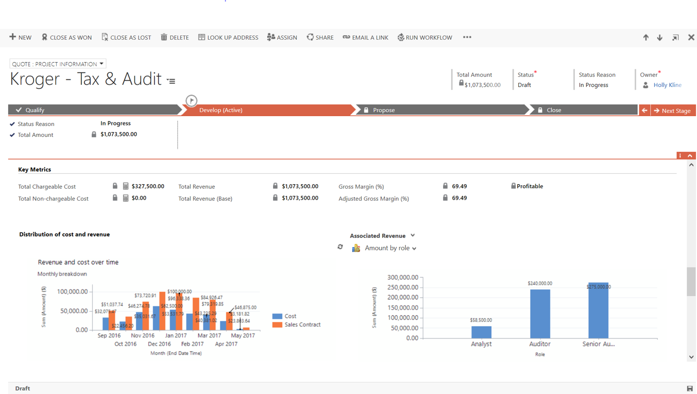
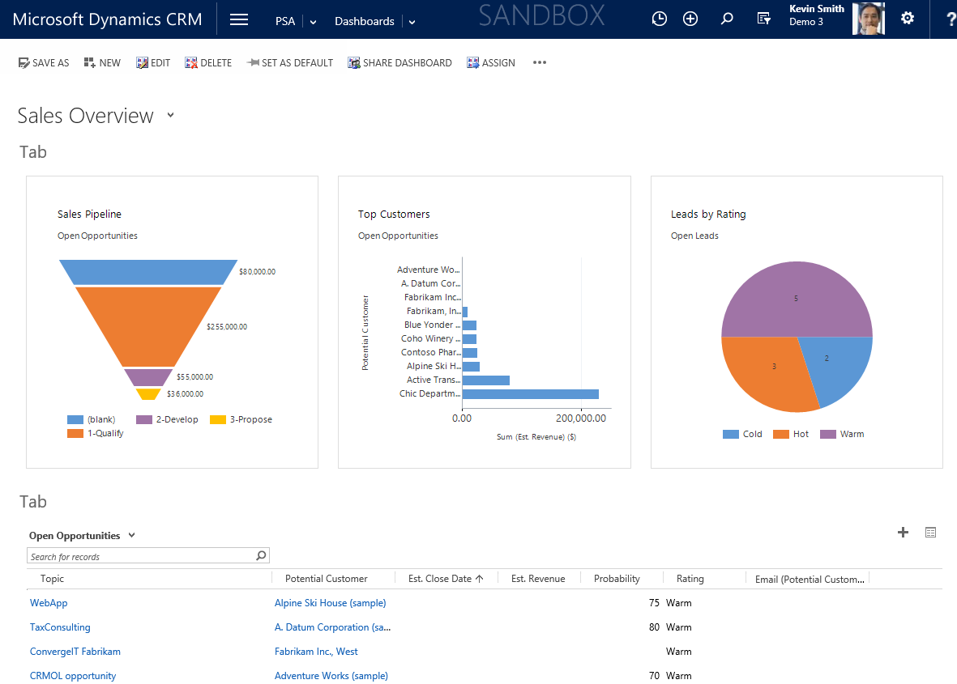

‘Dynamics 365 for Sales’ integration
Chic Dept Stores
Account
Manager
Opportunity
management
Opportunity
management
Project
planning
Resource
management
Team
collaboration
Time and
expenses
Customer
billing
Analytics and
integration

Slide 10
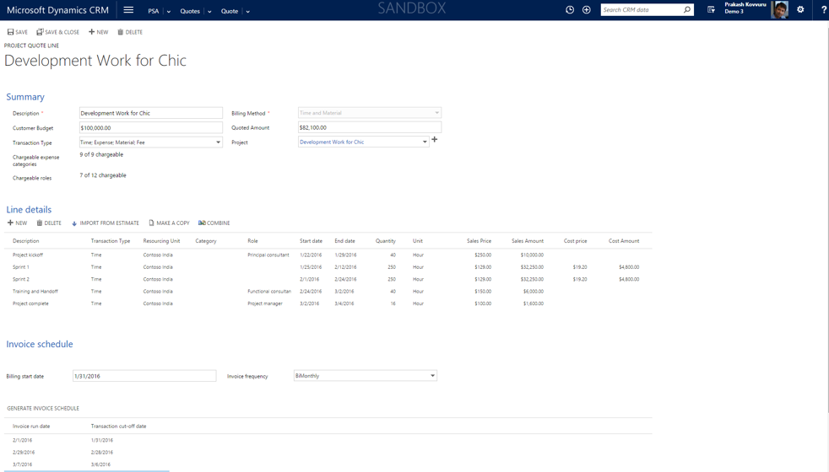
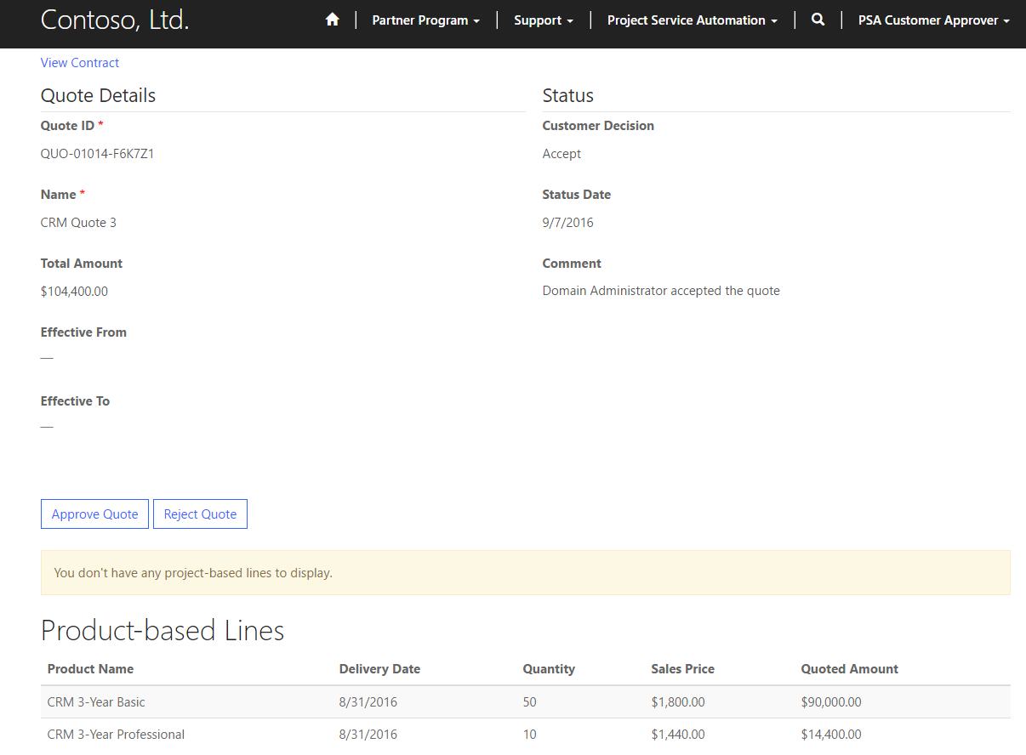
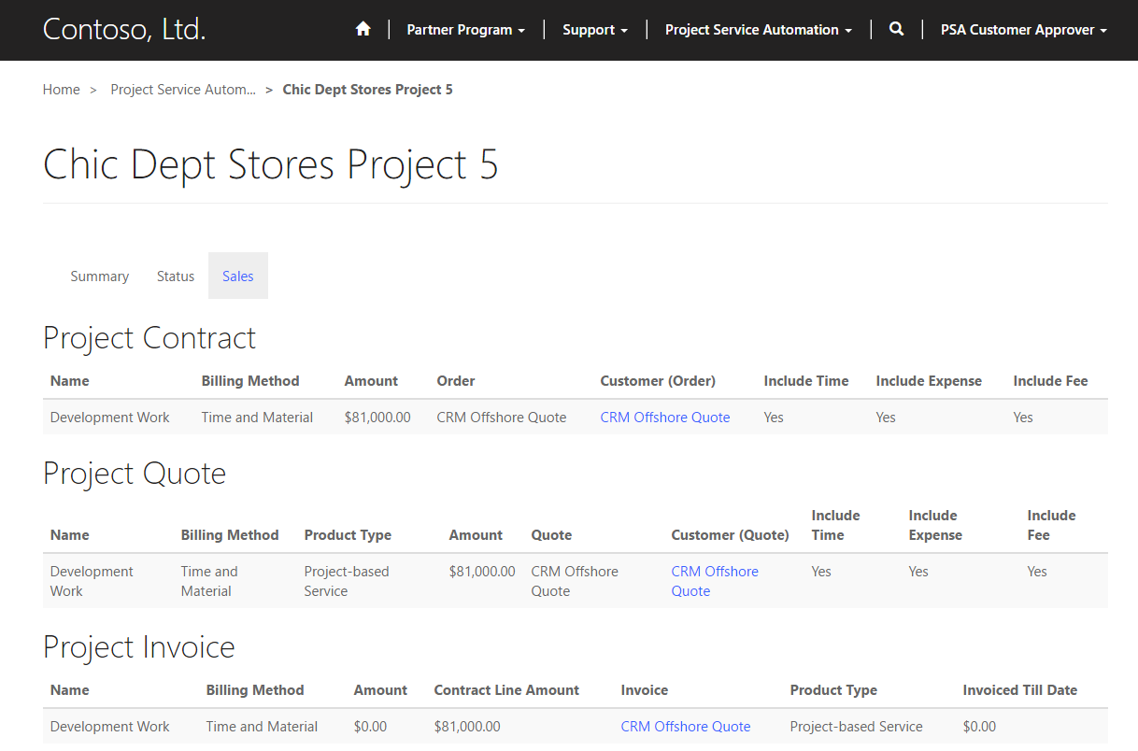

Customer collaboration portal
Account
Manager
End Customer
Opportunity
management
Opportunity
management
Project
planning
Resource
management
Team
collaboration
Time and
expenses
Customer
billing
Analytics and
integration

Slide 11
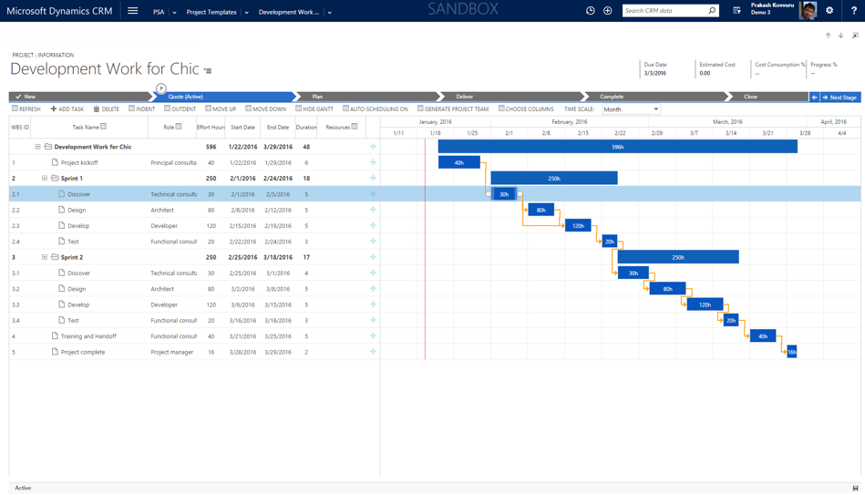
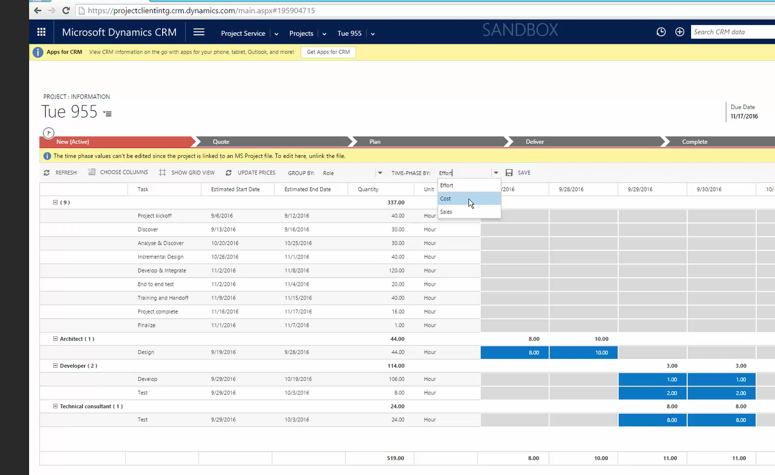

Time and materials and fixed fee projects
Account
Manager
Project
Manager
Opportunity
management
Project
planning
Project
planning
Resource
management
Team
collaboration
Time and
expenses
Customer
billing
Analytics and
integration
End Customer

Slide 12
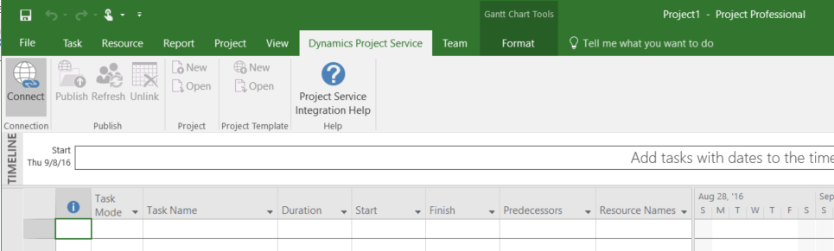
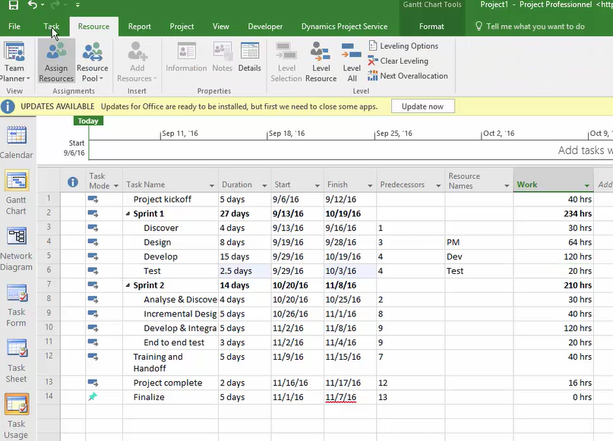
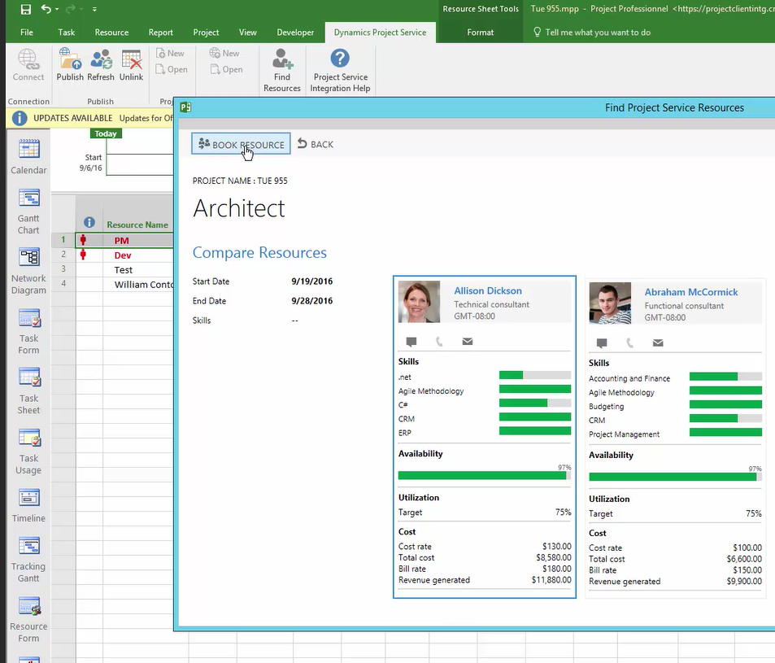
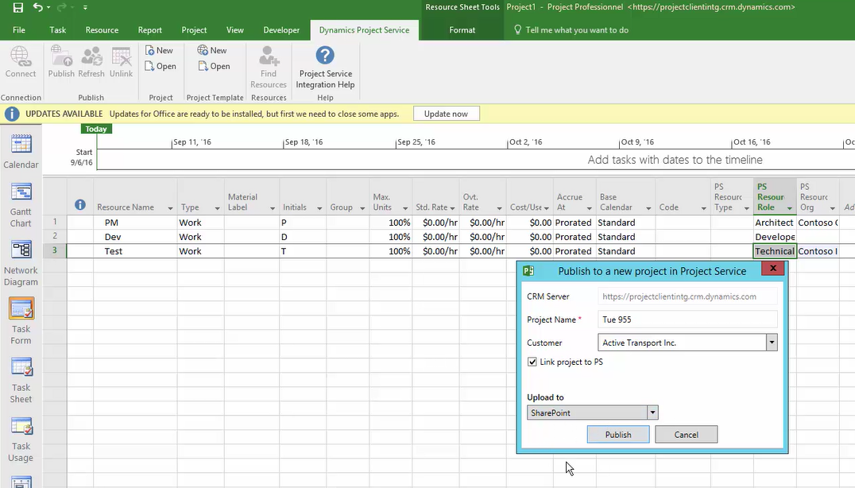
Microsoft Project client integration
Project
Manager
Opportunity
management
Project
planning
Project
planning
Resource
management
Team
collaboration
Time and
expenses
Customer
billing
Analytics and
integration
End Customer

Slide 13

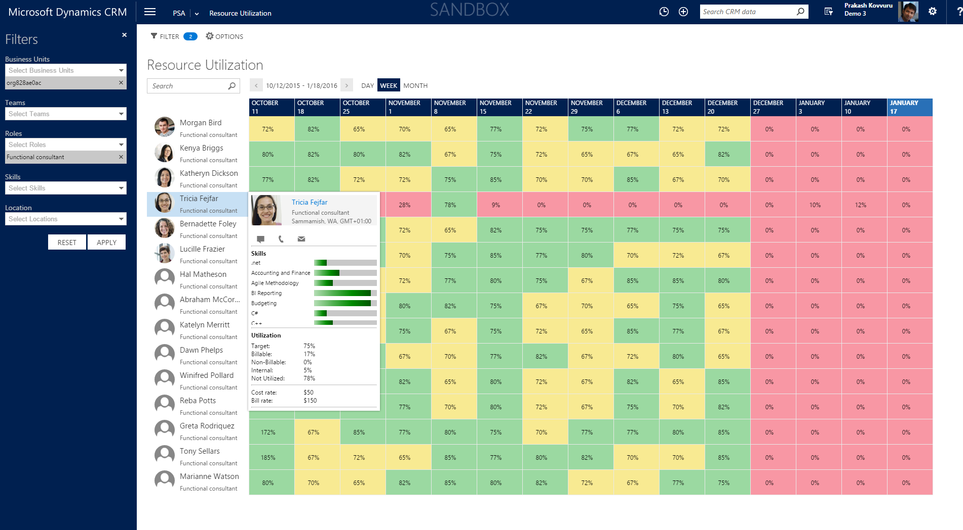
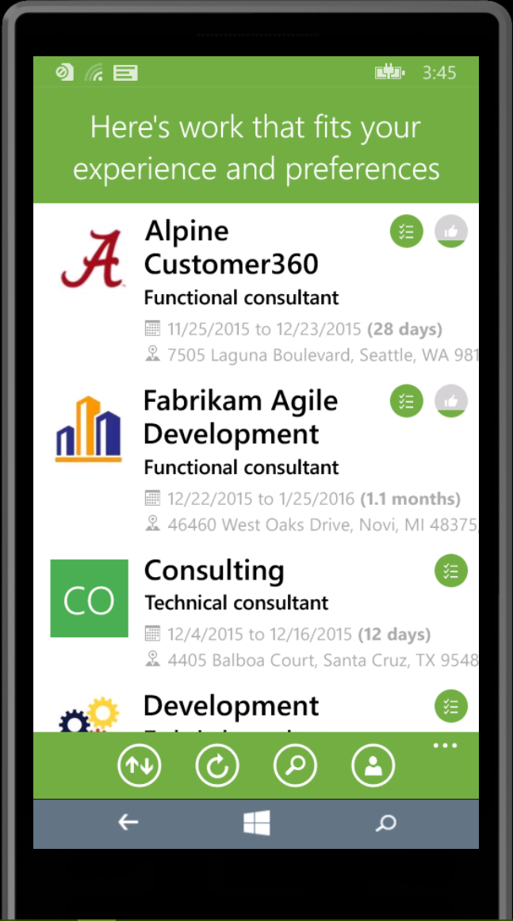
Automated and self-selection resourcing
Resource
Manager
Project
Manager
Opportunity
management
Project
planning
Resource
management
Resource
management
Team
collaboration
Time and
expenses
Customer
billing
Analytics and
integration

Slide 14
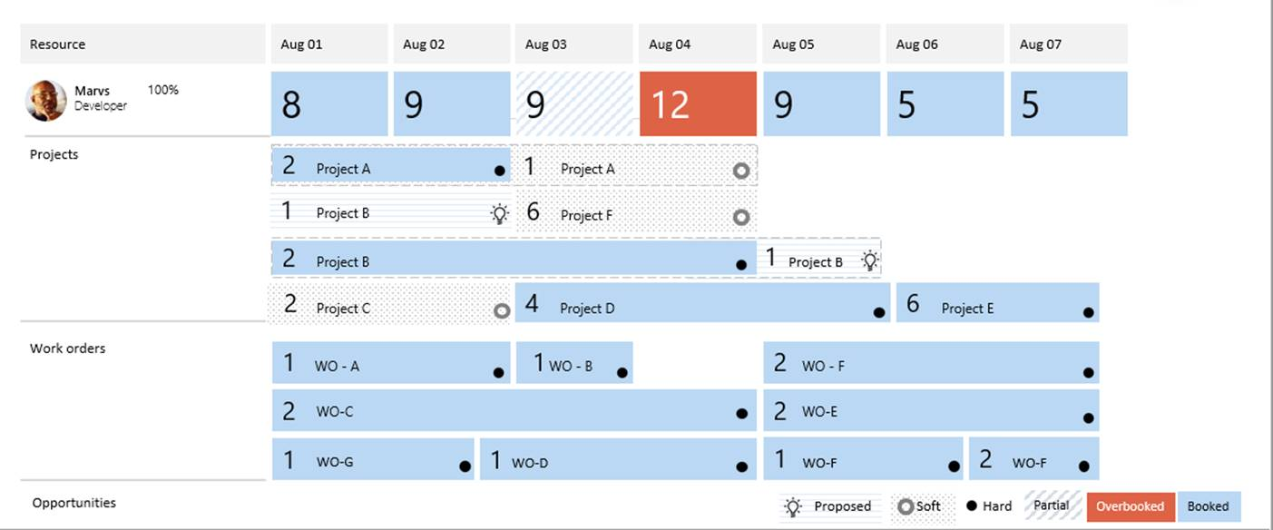
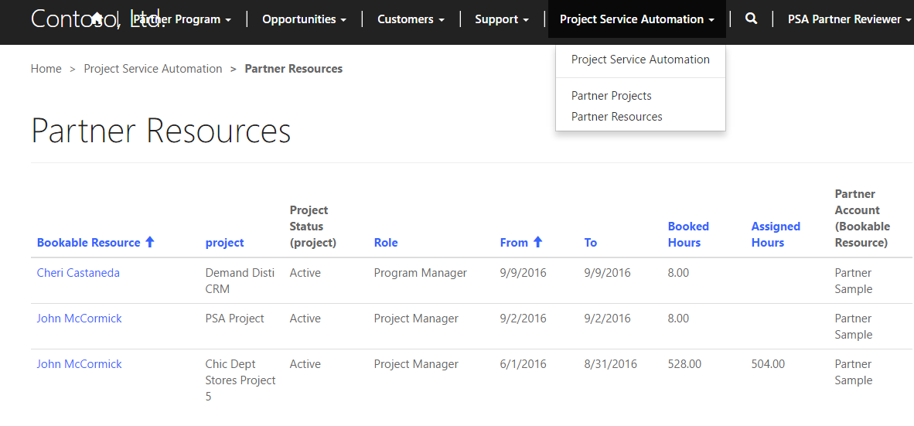

Roadmap: Unified Resource Scheduling
Resource
Manager
Project
Manager
Opportunity
management
Project
planning
Resource
management
Resource
management
Team
collaboration
Time and
expenses
Customer
billing
Analytics and
integration
Partner

Slide 15
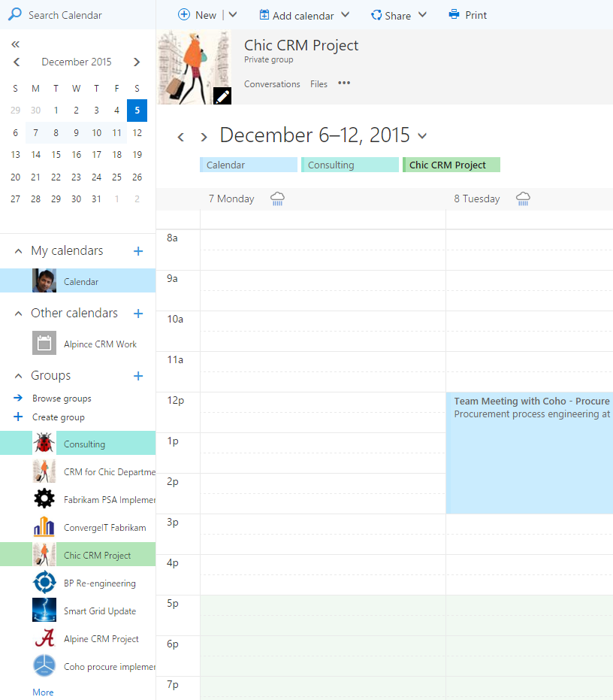

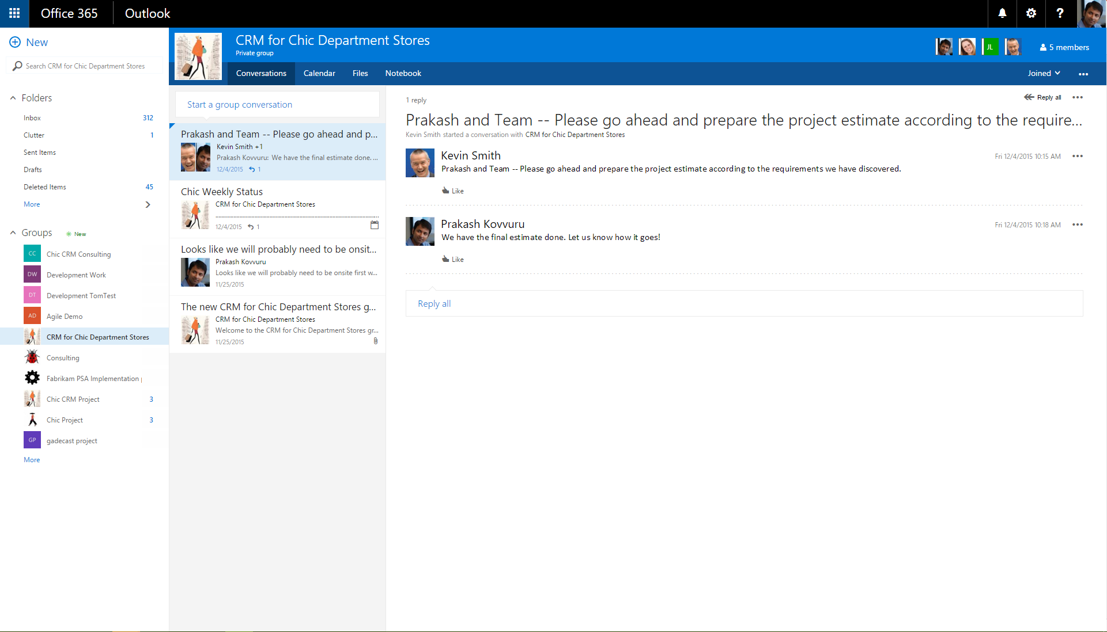







‘One Microsoft’ experience
Team
Member
End Customer
Opportunity
management
Project
planning
Resource
management
Team
collaboration
Team
collaboration
Time and
expenses
Customer
billing
Analytics and
integration

Slide 16
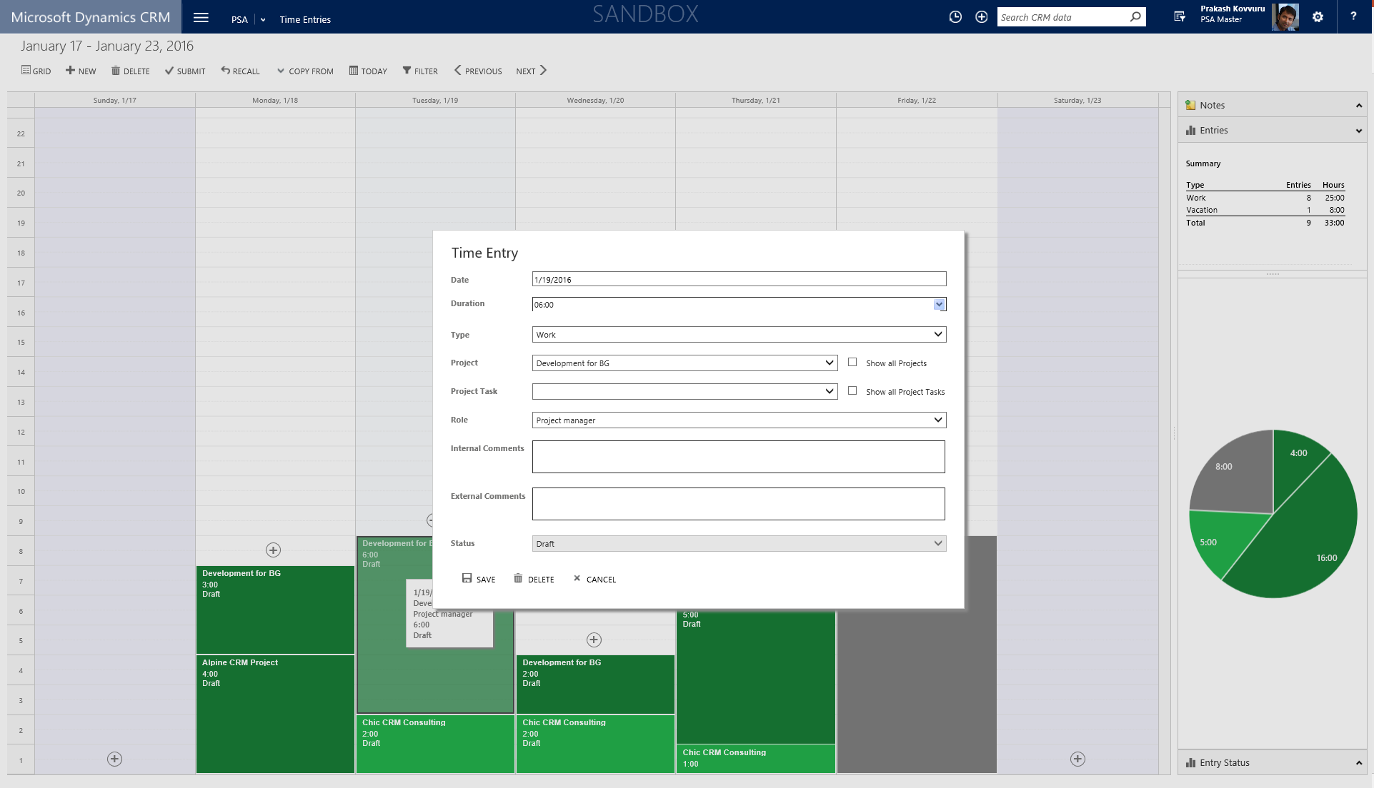
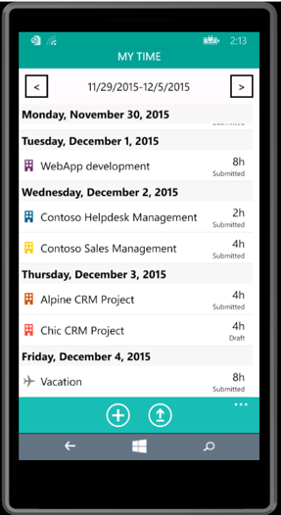
Time and expense management
Team
Member
Project
Manager
Opportunity
management
Project
planning
Resource
management
Team
collaboration
Time and
expenses
Time and
expenses
Customer
billing
Analytics and
integration

Slide 17
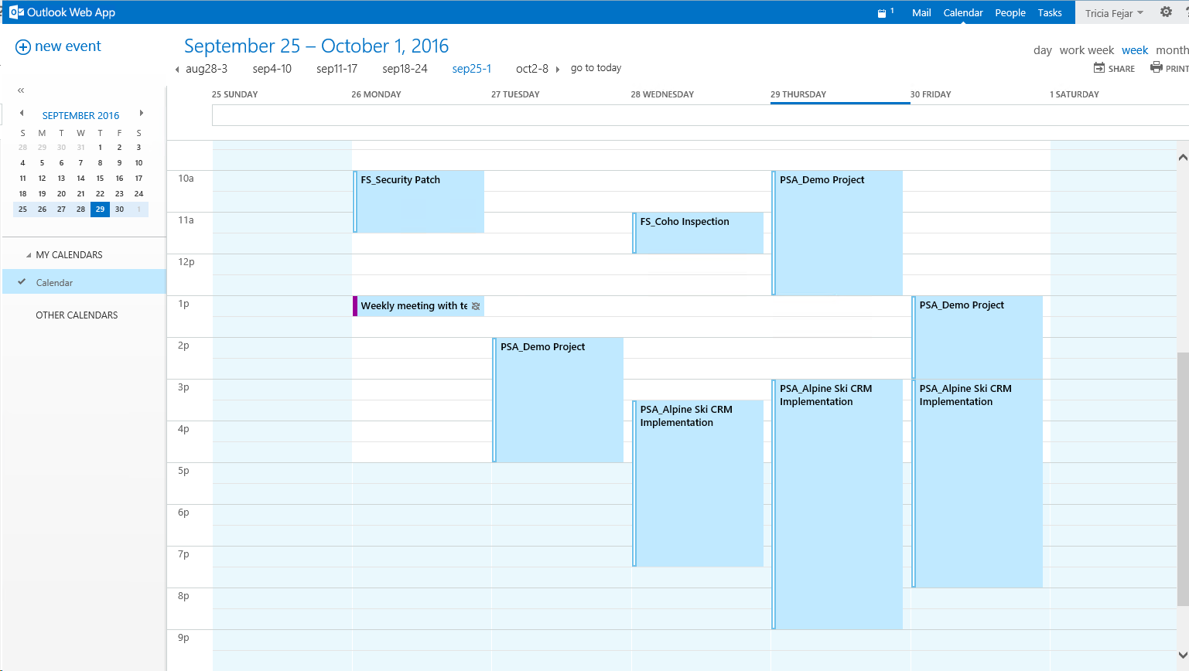
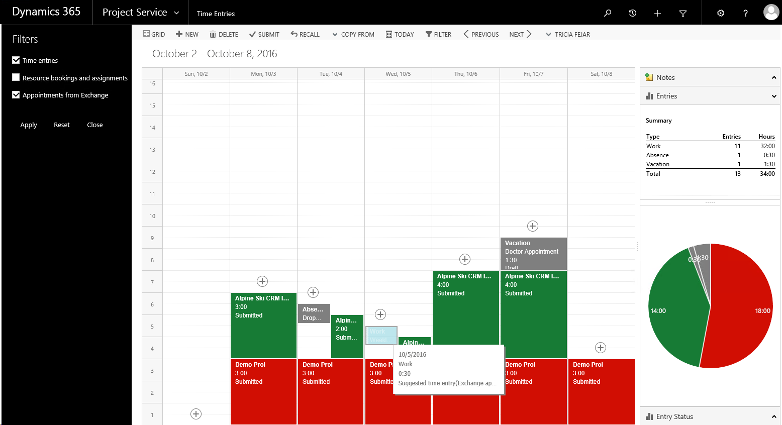
Roadmap: Suggested time entries from Exchange calendar

Slide 18
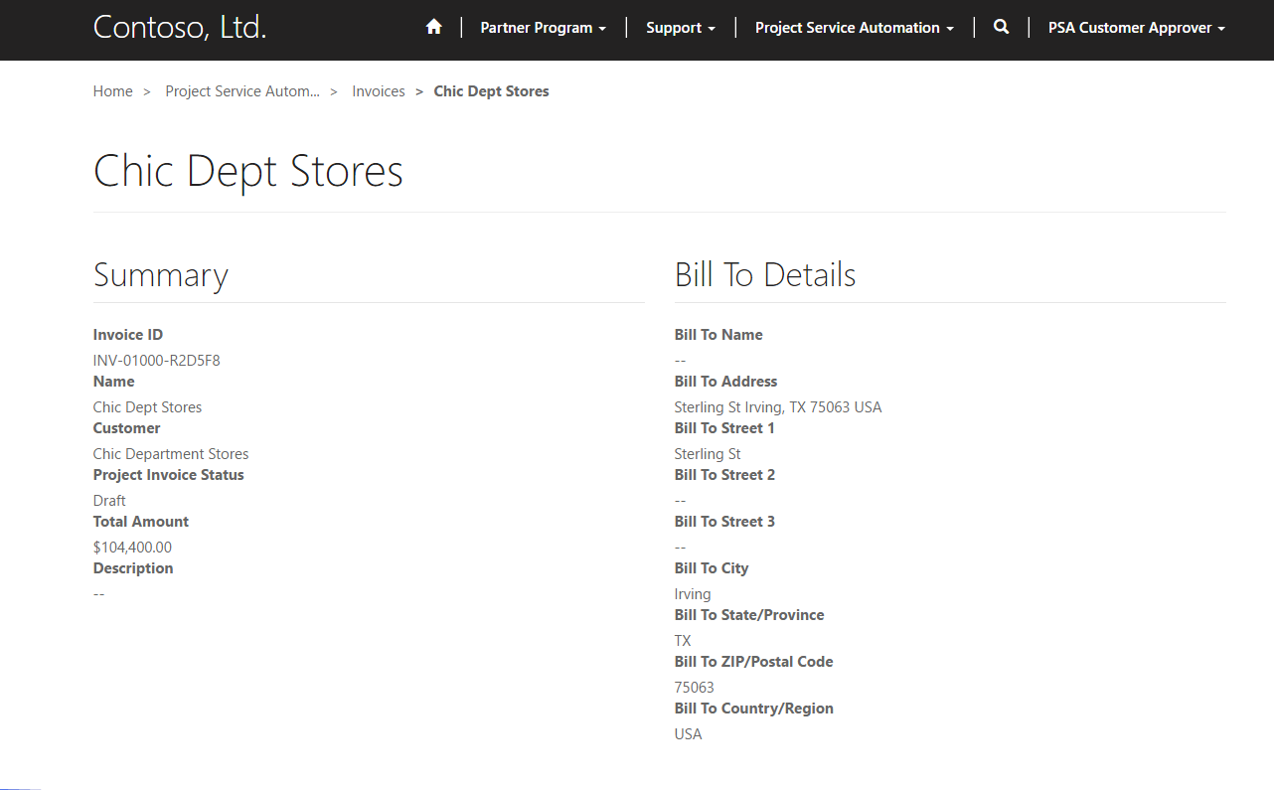
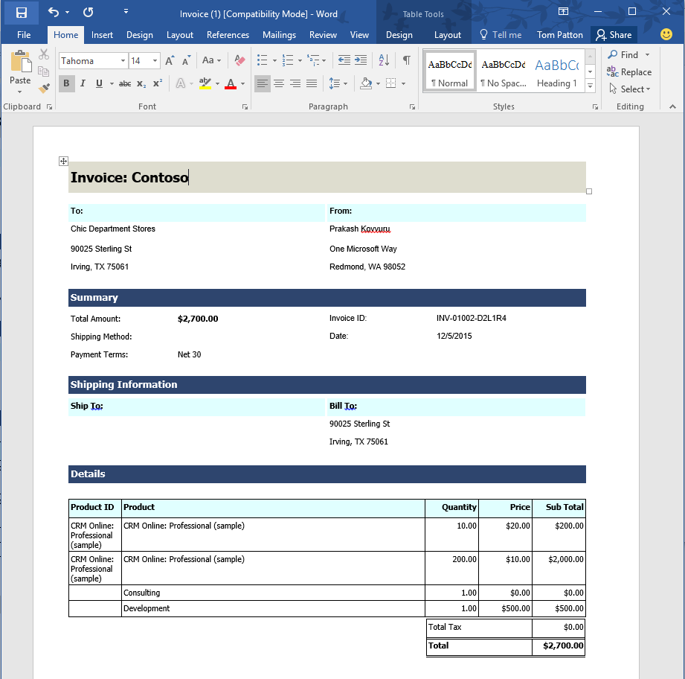
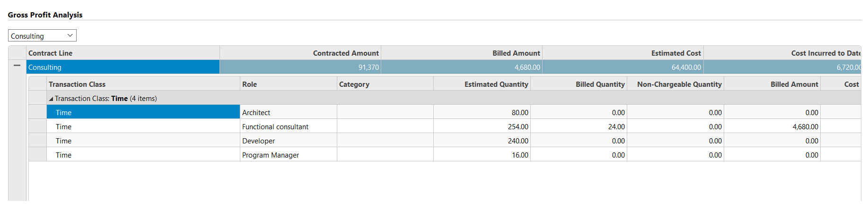
Billing and integration into other systems
Project
Manager
Opportunity
management
Project
planning
Resource
management
Team
collaboration
Time and
expenses
Customer
billing
Customer
billing
Analytics and
integration

Slide 19
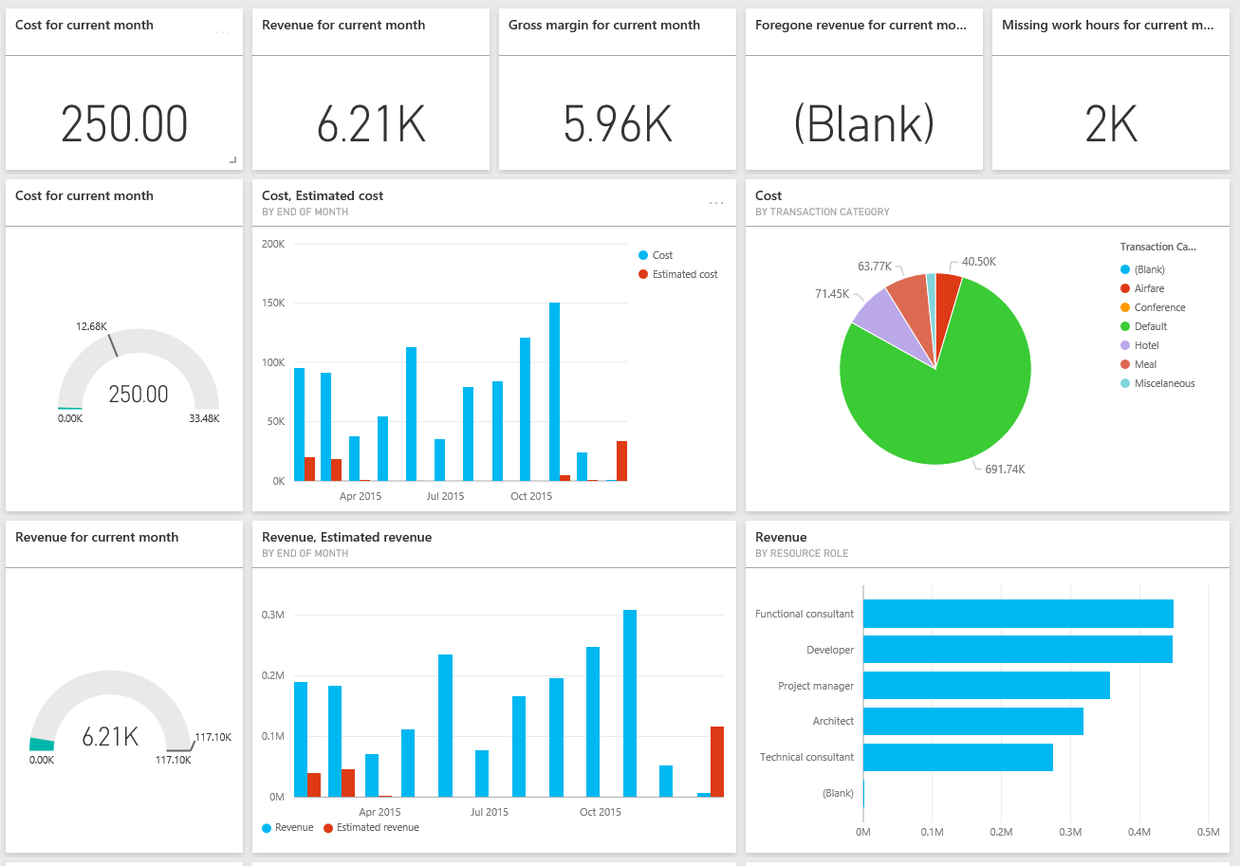

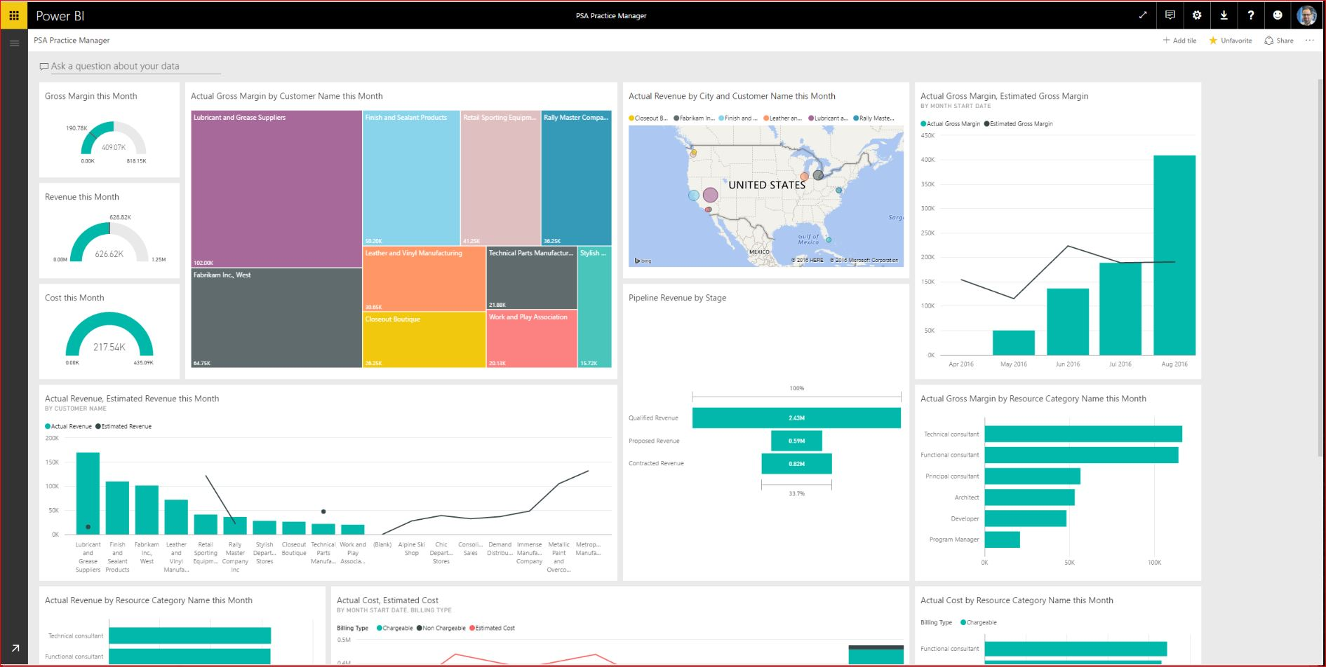
Deep analytics with PowerBI integration
Practice Director
Opportunity
management
Project
planning
Resource
management
Team
collaboration
Time and
expenses
Customer
billing
Analytics and
integration
Analytics and
integration

Slide 20



Solution templates
CRM DSF/
CRM EDW
Power Bl
Dynamics CRM
Azure SQL
Power BI Desktop
PSA Practice Manager
PSA Resource Manager
PSA Account Manager

Slide 21
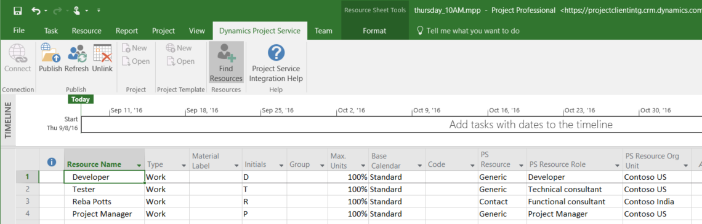
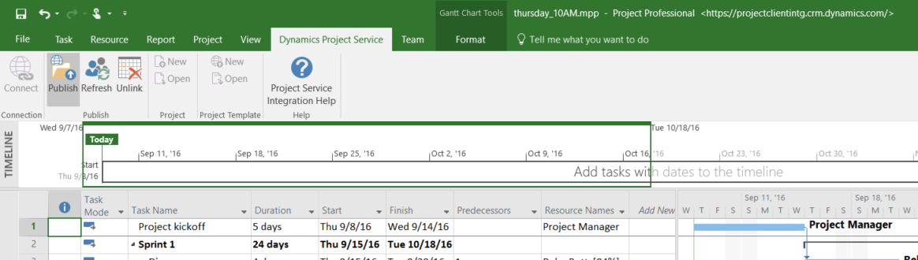
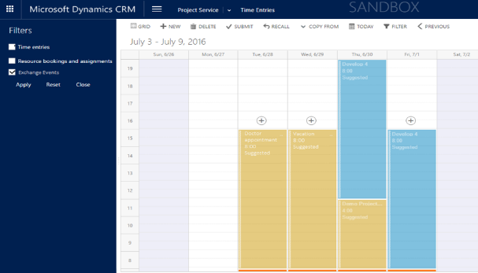
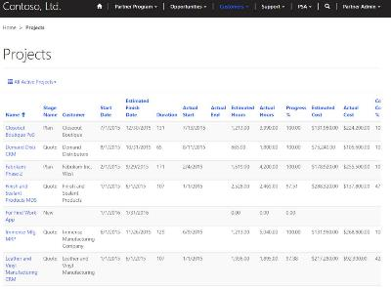
Roadmap recap
Microsoft Project (client) integration
Manage projects more effectively by augmenting the project economics and planning details in PSA with robust project management in MS Project. (n)
Scheduling Unification
Optimize resource assignments and increase utilization by consolidating the resource mix for ‘everything-as-a-service’ scenarios across various workloads. (n)
Exchange Booking integration
Improve employee productivity through ease of tracking and managing all project and non-project related schedules on their device or app of choice. (e)
Unified contracts and billing with Field Service
Simplify customer experience through integrated end-to-end service delivery management and streamlined forecast to actuals reconciliation. (n)
Collaborative Portals
Empower customers and partners by providing a 360 view to all project-related activities, assignments and related dashboards in self-serve capacity. (n)

Slide 22
Why Dynamics 365 for Project Service Automation
Purpose-built
Productive
Intelligent
Adaptable
Start with what
you need and grow
at your own pace
Familiar tools in the context of your business processes
Built-in intelligence
to proactively guide
to optimal outcomes
Grow, evolve and transform with modern, extensible platform

Slide 23
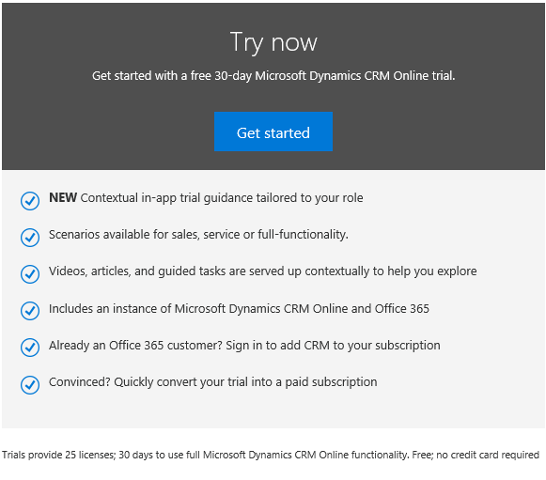
Try Project Service Automation now!
https://www.microsoft.com/en-us/dynamics/crm-free-trial-overview.aspx

Slide 24
Project Service Automation Resources
Get started
  Install and customize Project Service Automation
  Configure Project Service Automation
  Manage project-based sales
Role-based guides
  Account Manager
  Project Manager
  Resource Manager
  Time, Expense, and Collaboration
White papers
  Basic guide to quoting, pricing, and billing
  Advanced guide to quoting, pricing, and billing
  Guide to project planning and tracking
  Resource management
  Reporting
  External system integration

Slide 25
Free IT Pro resources
To advance your career in cloud technology
Plan your
career path
Cloud role mapping
Expert advice on skills needed
Self-paced curriculum by cloud role
$300 Azure credits and extended trials
Pluralsight 3 month subscription (10 courses)
Phone support incident
Weekly short videos and insights from Microsoft’s leaders and engineers
Connect with community of peers and Microsoft experts
Microsoft IT Pro Career Center
www.microsoft.com/itprocareercenter
Get started
with Azure
Microsoft IT Pro Cloud Essentials
www.microsoft.com/itprocloudessentials
Demos and
how-to videos
Microsoft Mechanics
www.microsoft.com/mechanics
Connect with peers and experts
Microsoft Tech Community
https://techcommunity.microsoft.com

Slide 26


Please evaluate this session
Your feedback is important to us!
From your PC or Tablet visit MyIgnite at http://myignite.microsoft.com
From your phone download and use the Ignite Mobile App by scanning the QR code above or visiting https://aka.ms/ignite.mobileapp

Slide 28
Appendices

Slide 29



Microsoft’s Unified Service Delivery model
3rd Party Industry & Functional Solutions (examples)
Cable &
Utilities
Real Estate
& Facilities
Mobile
Health Care
Public
Safety
Transport
Crews
Laboratory
& Testing
Assessors
& Adjustors
Architecture
& Engineering
Accounting
& Legal
Investment
Banking
Advertising &
Public Relations
Installation & Maintenance
Inspection & Compliance
Advisory & Support
1st Party Functional Solutions
Marketing
Sales
Customer
Service
Field & Project
Service
Accelerating
Vertical ISV &
CSP Solutions
Campaign team
scheduling
Opportunity pursuit
team scheduling
Support queue
staffing
Crew dispatch &
project scheduling
Service Delivery Foundation
Resource match recommendations Skill/proficiency/preference updates Schedule optimization
Predictive maintenance Service delivery risk predictions Contingent labor marketplace
Service
Intelligence
  Azure
Recommend
best resource
Self-Service: Omni-channel Voice-of-the-Customer Web Portal Knowledge Management
Agreements
Assisted Service
Field Service
Project Service Automation
Product & Service
Item Orders
(Mobile) Case
Management
Service Parts
Inventory
Service Orders
Project Estimation
& Pricing
Projects
Management
Team
collaboration
Unified Service
Desk
Returns
& Repairs
Appointment
Booking
Project Contracts
& Billing
Project Team
Scheduling
Customer Assets
& Warranties
Azure
IoT Suite
Resources & Bookings
Tracking
Dispatch service
technician
Service Contracts
& Billing
Resources
(people/equipment)
Skills-Capabilities-
Preferences
Bookings &
Availability
Time & Absence
Reporting
Expense
Management

Slide 30
Universal Scheduling
Roadmap
Naos
Shared FS/PSA resource view
ARE
RSO
Unified FS/PSA Scheduling
Universal Scheduling
PSA
FS
PSA
FS
Any entity scheduling
B2C scheduling ready
  (OOB portal planned)
Auto-scheduling for any requirement, including without geocode* (preview)
solution
solution
Availability View
Multi-day Scheduling
Schedule Board
Intra-day Scheduling
Resource Scheduling
resource availability control
(intra-day -> multi-day)
Resource
Requirements
Schedule
Assistant
Scheduling Assistant API & controls
WO
Requirements
Resource Requirements
solution
solution
solution
Resources / Skills / Bookings
Resources / Skills / Bookings
CRM Core
CRM Core
One view of resource availability, bookings across FS/PSA
Common scheduling experience across FS/PSA
Schedule the right resource to any Customer Engagement business process

Slide 31
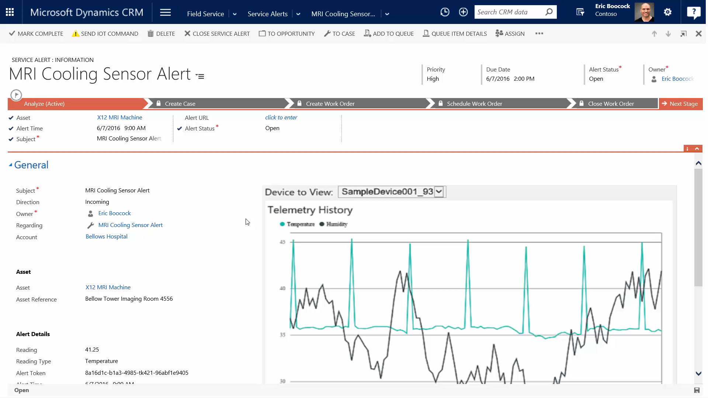
Roadmap: Azure IoT Suite Connection

Slide 32
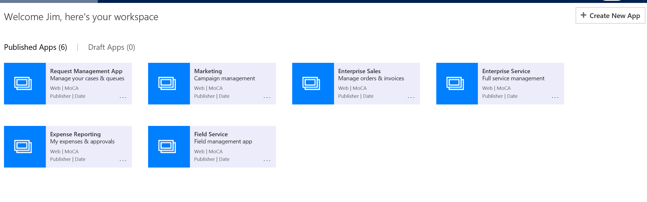
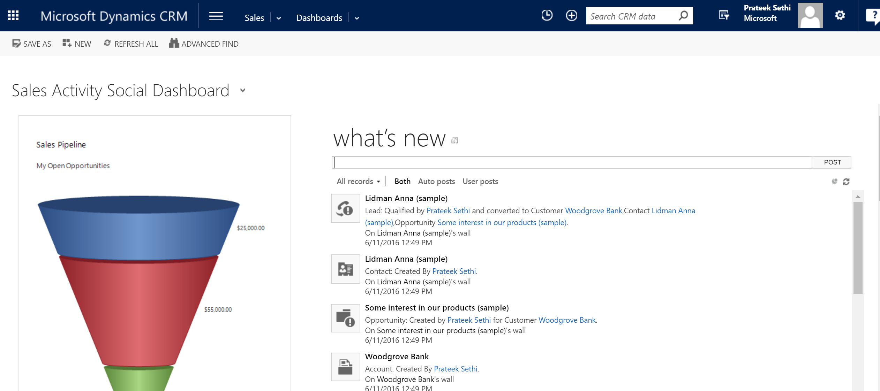

Roadmap: App Modules
Smaller, modular apps that are role based, task based etc
Simplify Navigation: Each App has its unique sitemap
Reduce Clutter: Filtered view of Dashboards, Views, Forms, BPF etc.
Four OOTB Apps: Sales, Service, Field Service, Project Service

Slide 33
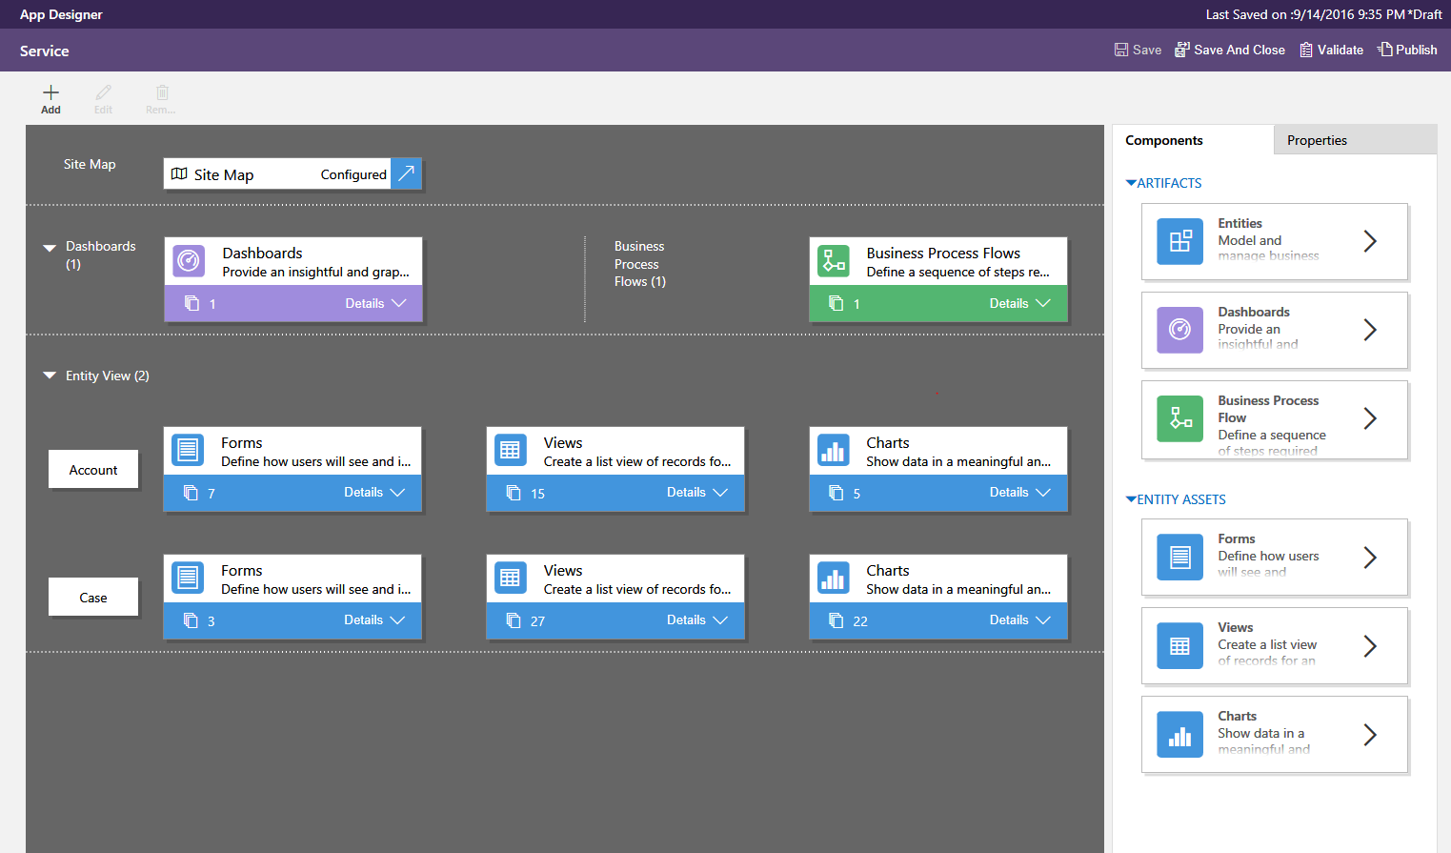
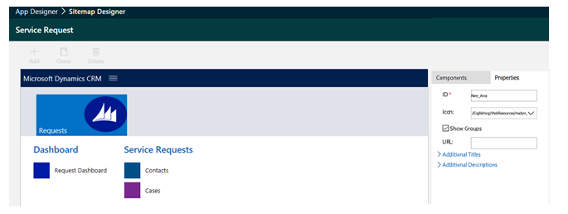
Roadmap: App Modules
Simple, Visual and Contextual
Visual: Tile based view of all artifacts of the application
App development: Add new or existing artifacts to an application , Surface required components of an app
Sitemap Designer: Brand new WYSIWYG integrated sitemap designer

Slide 34
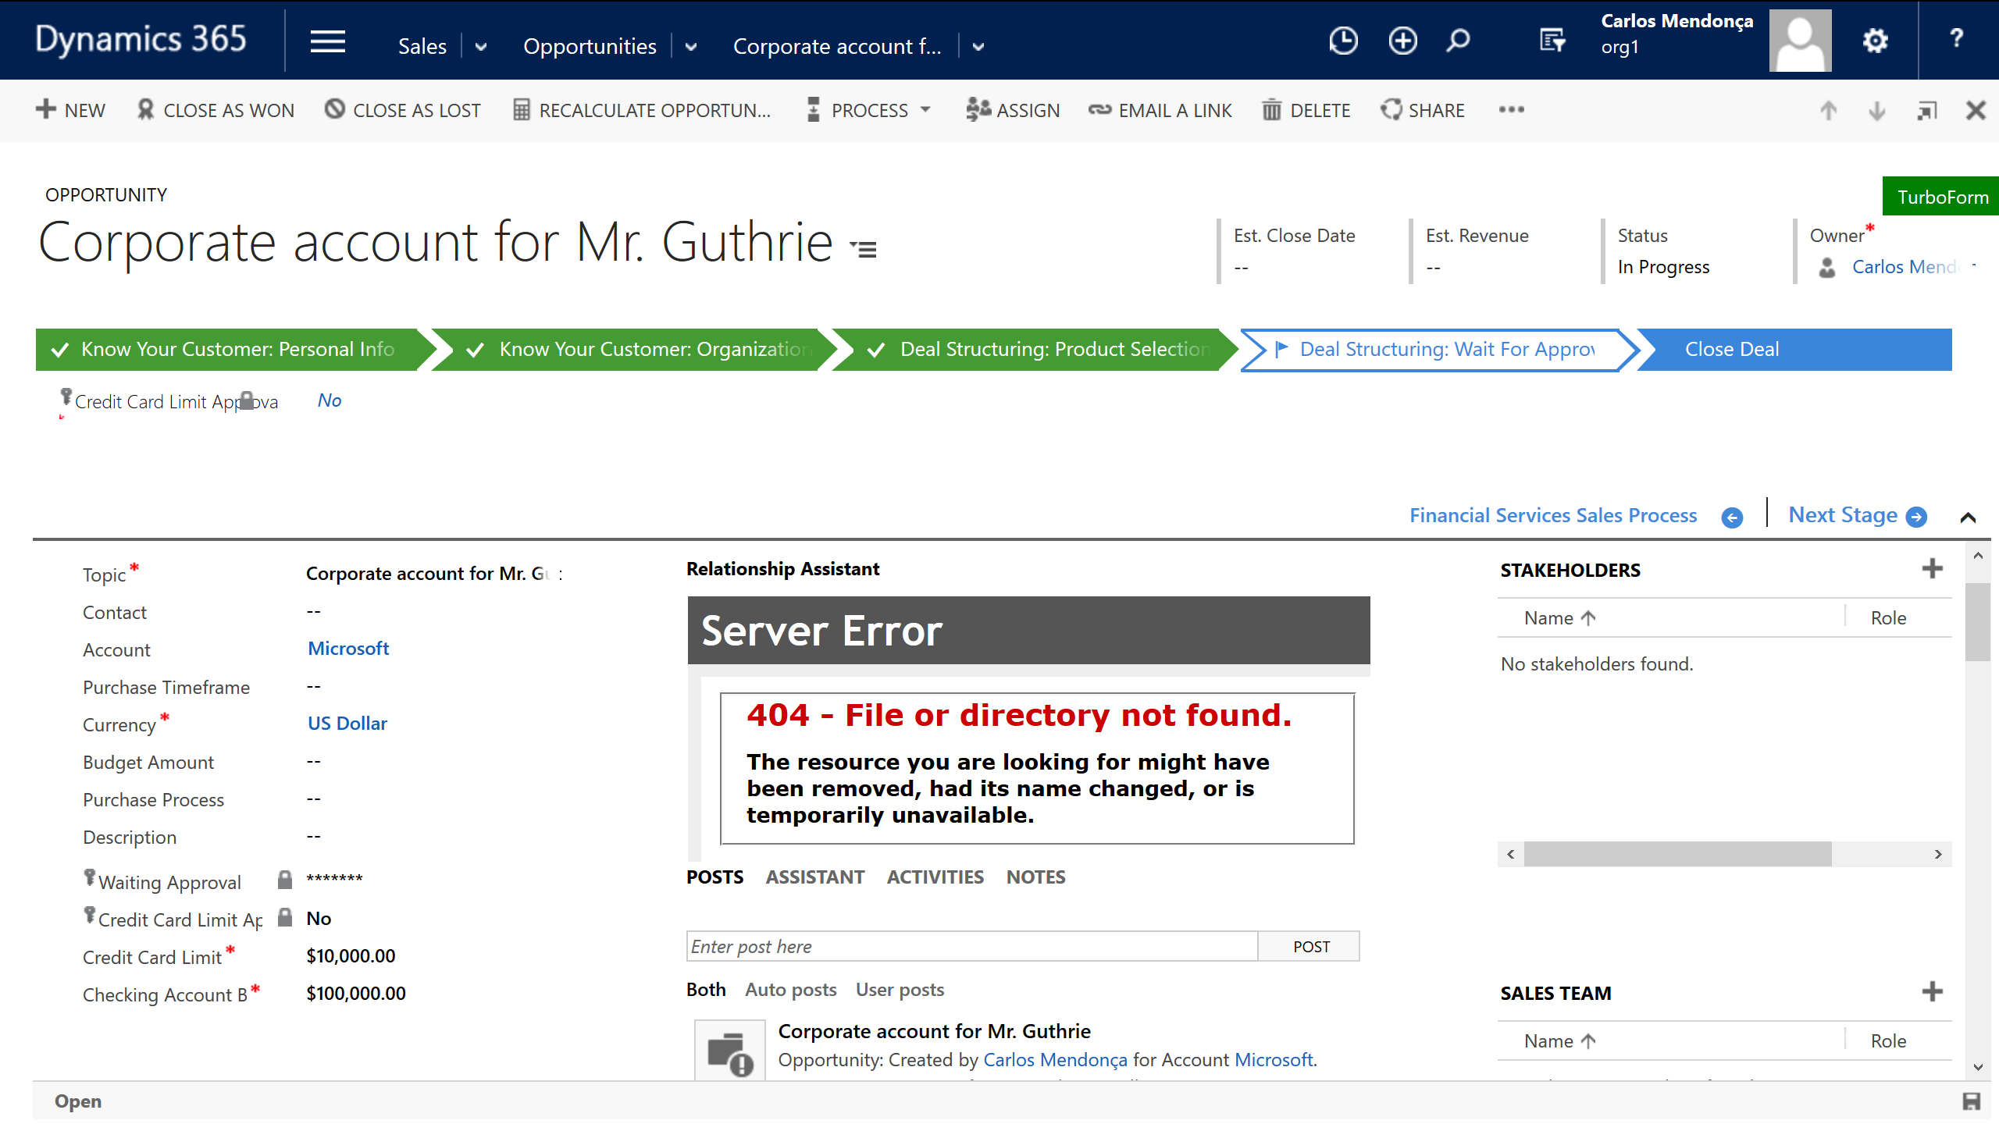

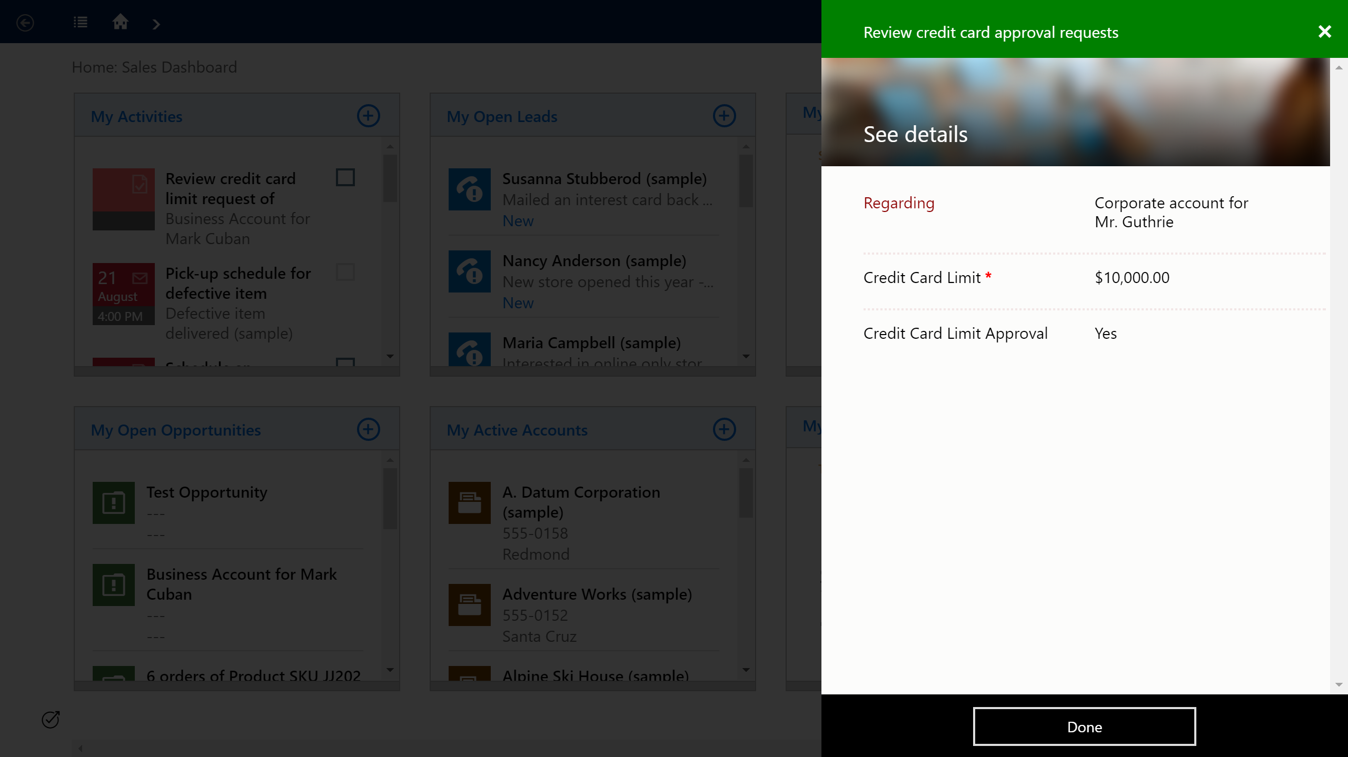
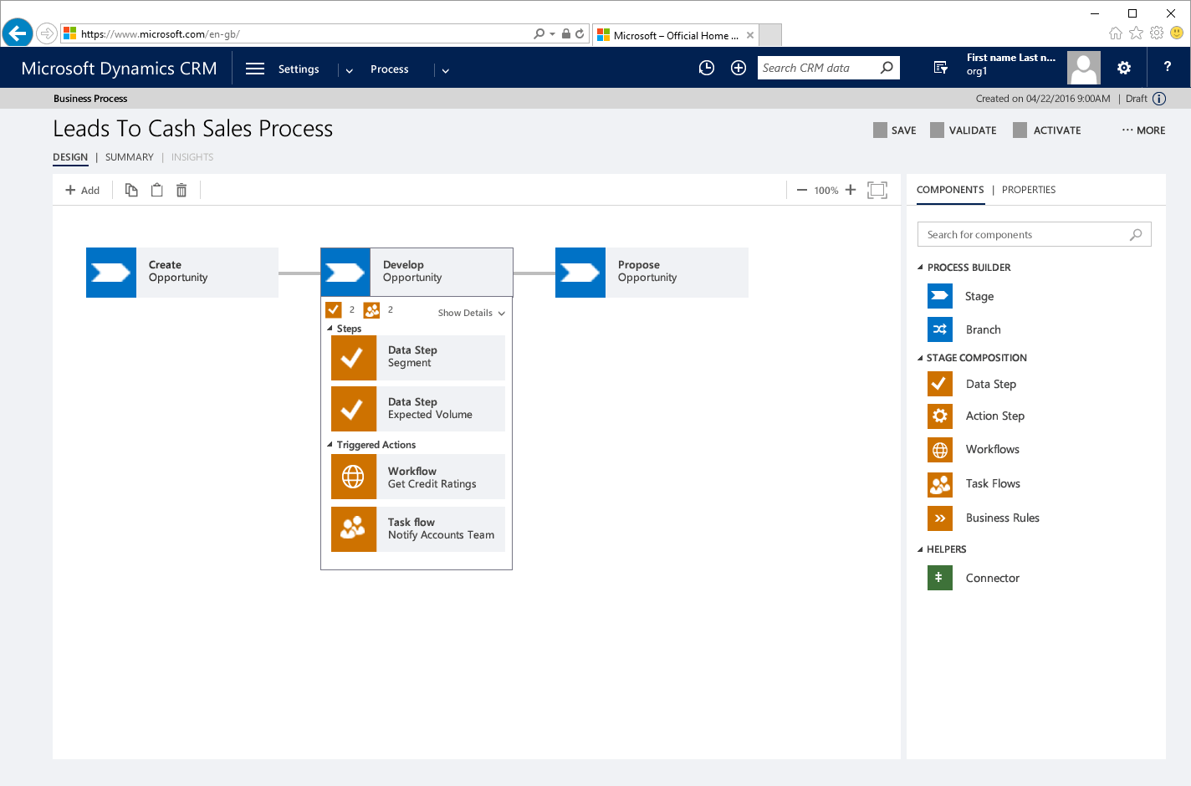
Roadmap: Graphical process designer and orchestration

1
Know your customer: personal info
(Contact)
IF
IF Business Account

Know your customer: org info
(Account)
2
PBL

IF Checking Account > $10K THEN
Set Recommendation
Deal structuring: Product selection
(Opportunity)
(PBL is on the Opportunity entity, not the Process entity)
Microsoft proprietary and confidential information not for distribution

Slide 35

Field & Project service capabilities for Microsoft Dynamics CRM Online
Languages
Americas (31)
Argentina
Bahamas
Barbados Belize Bermuda Bolivia
Brazil
Canada
Cayman Islands
Chile
Colombia
Costa Rica
Curacao
Dominican Republic
Ecuador
El Salvador
Guatemala
Honduras
Jamaica
Mexico
Nicaragua
Panama
Paraguay
Peru
Puerto Rico
St. Kitts and Nevis
Trinidad and Tobago
United States
Uruguay
Venezuela
Virgin Islands, U.S
EMEA (81)
Albania | Hungary | Norway
Algeria | Iceland | Oman
Angola | Iraq | Palestinian Territories
Armenia | Ireland | Pakistan
Azerbaijan | Israel | Poland
Austria | Italy | Portugal
Bahrain | Jordan | Qatar
Belarus | Kazakhstan | Romania
Belgium | Kenya | Russia
Bosnia & Herzegovina | Kyrgyzstan | Rwanda
Bulgaria | Kuwait | Saudi Arabia
Cameroon | Latvia | Senegal
Cape Verde | Lebanon | Serbia
Cyprus | Libya | Slovakia
Côte d'Ivoire | Liechtenstein | Slovenia
Croatia | Lithuania | South Africa
Czech Republic | Luxembourg | Spain
Denmark | Macedonia | Sweden
Egypt | Malta | Switzerland
Estonia | Mauritius | Tunisia
Faroe Islands | Moldova | Turkey
Finland | Monaco | Turkmenistan
France | Mongolia | Ukraine
Georgia | Montenegro | United Arab Emirates
Germany | Morocco | United Kingdom
Ghana | Netherlands | Uzbekistan
Greece | Nigeria | Zimbabwe
Asia Pacific (18)
Australia
Bangladesh Brunei
Fiji
Hong Kong
India Indonesia
Japan
Korea
Macau SAR
Malaysia
New Zealand
Philippines
Singapore
Sri Lanka
Taiwan
Thailand
Vietnam
Web and mobile clients
Arabic* Chinese Simplified Chinese Traditional Danish Dutch English Finnish French German Greek Hebrew* Italian Japanese Norwegian Polish Portuguese Russian Spanish (Neutral) Swedish Thai Turkish
* Right-to-left screen mirroring partially supported in the web client and not in mobile clients.
**Solution availability in government and sovereign clouds varies. CRM admins must decide whether to allow use of mobile apps and services that cross compliance boundaries.
Project service automation capabilities in 20+ languages
May 2016
NDA Disclosure only

Slide 36
Everything-as-a-Service (XaaS) trend as strategic driver
Buyers demand a range of value-added services, tailorable to their business needs
High
Scenario
Elevator manufacturing
Guaranteed elevator uptime
– monthly fee-per-unit
Scenario:
Cloud Solution Provider (CSP)
Business process uptime
– monthly fee-per-user
4
Managed Service
manage, optimize, predict
3
+ Project Service
customize, integrate
Internet-of-Things (IoT)
Accelerating
“servitization” of products
As-a-Service thinking
Driving consumption of “managed services”
2
+ Field Service
install, maintain
1
Self + Assisted Service
support
Low
Degree
of CE
Product
businesses
Service
businesses
Seamless integration across service channels improves provider efficiency and competitive differentiation

