Slide 1
Dive deeper into what’s new and what’s coming in Outlook on the web
BRK1044
Eduardo Melo, Principal Program Manager Lead
Dave Meyers, Senior Program Manager

Slide 2
Agenda
Intros
Outlook family
Demos
Other sessions
Questions

Slide 3




A family of Outlooks
Windows
Mac
Web
Mobile
CY Q4 features | Windows | Mac | Web | iOS | Android | Win 10 Mobile
Focused Inbox
@mentions
Cloud attachments
Summary cards for travel & packages
Archive

Slide 4
Demo

Slide 5
Demo Recap
Triage
  Focused Inbox
  Pin to Top
  Undo
  Sweep
Compose
  Suggested contacts
  Copy + paste images
  @ mentions
  Emoji

Slide 6
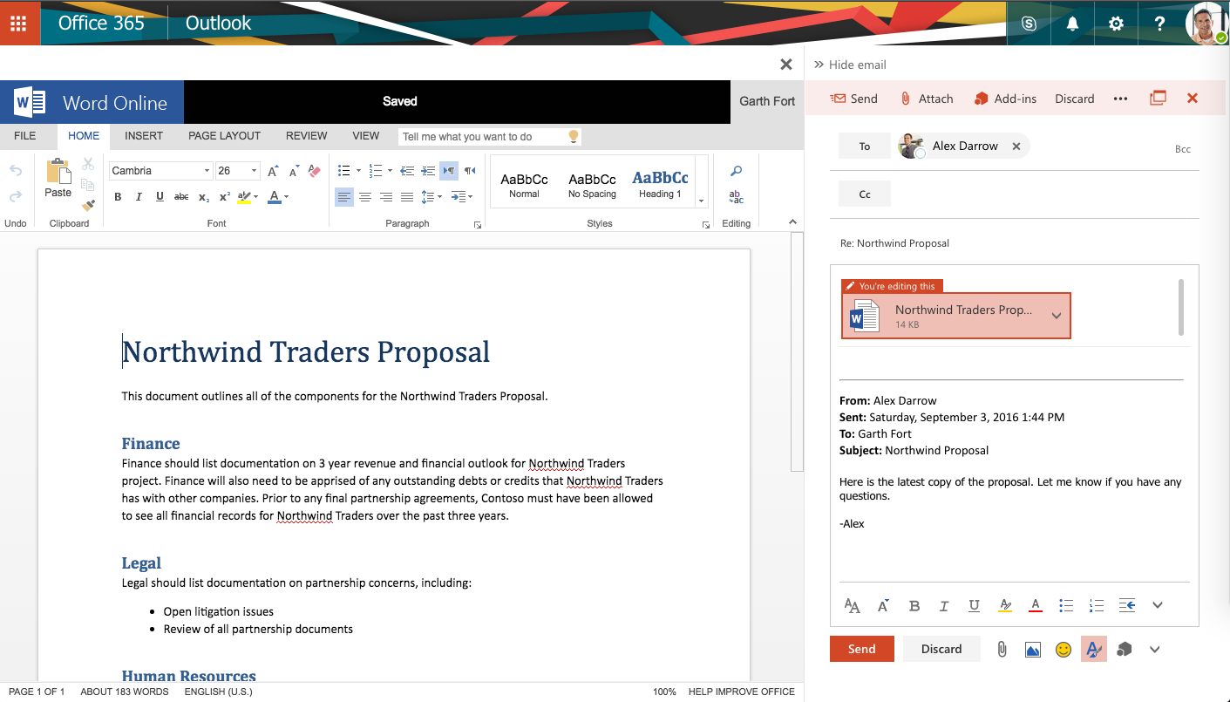
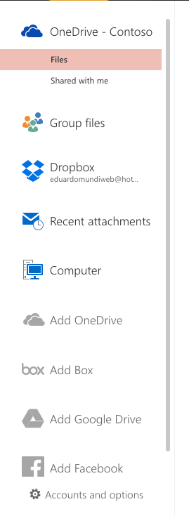
Demo Recap
Attachments
  Modern attachments
  Side-by-side and edit-and-reply
  3rd party integration
  Recent files
  Conversation—level attachments

Slide 7
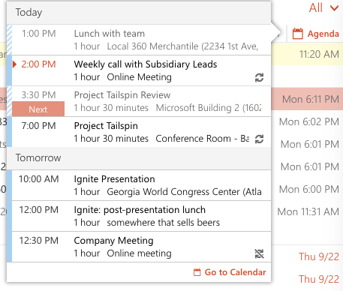
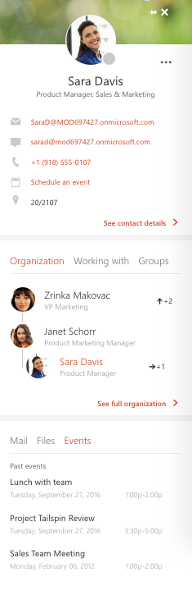
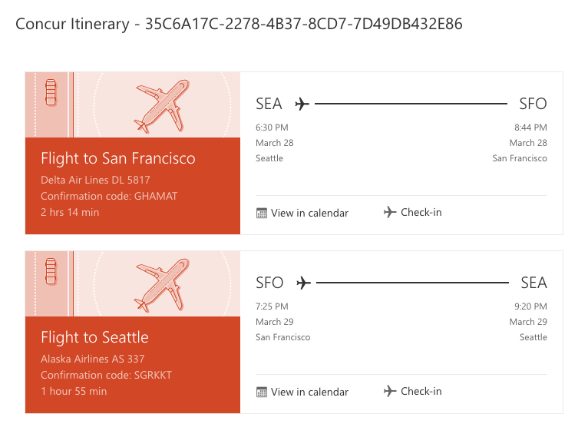
Demo Recap
Tailored Experiences
  Flight reservations
  Shipping updates
  Calendar integration
Calendar
  Module switcher
  Up Next
  Interesting calendars
People
  People card
  People hub

Slide 8
Thanks!

Slide 9


Please evaluate this session
Your feedback is important to us!
From your PC or Tablet visit MyIgnite at http://myignite.microsoft.com
From your phone download and use the Ignite Mobile App by scanning the QR code above or visiting https://aka.ms/ignite.mobileapp

Slide 10
Related Outlook sessions
Topic | Title | When & Where?
Outlook overview | What’s new and what’s coming for Microsoft Outlook | Tuesday, 4:00pm - 5:15pm, Sidney Marcus Auditorium
Windows | Dive deeper into what’s new and what’s coming in Outlook 2016 for Windows | Monday, 1:00pm - 1:20pm, Bldg A Theater - Level 3 Tuesday, 2:50pm - 3:10pm, Microsoft Theater 4
Mac | Dive deeper into what’s new and what’s coming in Outlook for Mac | Tuesday, 5:05pm - 5:25pm, Microsoft Theater 4 Wednesday, 5:05pm - 5:25pm, Bldg B Theater - Level 2
Web | Dive deeper into what’s new and what’s coming in Outlook on the web | Wednesday, 9:00am - 9:45am, A305 Wednesday
Mobile | Dive deeper into what’s new and what’s coming in Outlook mobile | Tuesday, 2:10pm - 2:30pm, Microsoft Theater 3 Thursday, 12:05pm - 12:25pm, Bldg A Theater - Level 3
Calendar | Improve shared & delegated calendar experiences in Outlook | Tuesday, 11:05am - 11:25am, Microsoft Theater 4 Thursday, 3:35pm - 3:55pm, Bldg B Theater - Level 2
Support | Discover modern support in Outlook for Exchange Online | Thursday, 4:00pm - 5:15pm, B207 - B208
Panel Q&A | Unplug with the Microsoft Outlook experts | Thursday, 2:15pm - 3:30pm, B401 - B402

Slide 11
Q&A

