Slide 1
Get Started with Hybrid SharePoint Online and OneDrive for Business with FastTrack
BRK1043
Sesha Mani
Principal Program Manager
Office 365 SharePoint & OneDrive for Business
Microsoft

Slide 2
Agenda
What is SharePoint Hybrid
What is FastTrack
SharePoint Hybrid offering with FastTrack
SharePoint Hybrid Scenarios & Business Values
Customer feedback and solutions

Slide 3
Hybrid - Best of both worlds… Connected
Bringing business values for you by connecting best of both worlds
Cloud
SharePoint Online/OneDrive for Business
Office 365
HYBRID
SharePoint On-premises

Slide 4
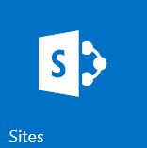
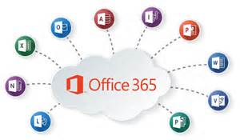
Hybrid - Best of both worlds… Connected
Bringing business values thru cloud innovations to YOU
B2B Sites
…
Search
HYBRID
SharePoint On-premises

Slide 5
What is FastTrack?

Slide 6
SharePoint Hybrid Offering thru FastTrack
Min 50+ user Seats
Free offering
Part of Office 365 On-boarding Benefits
Guidance and assistance to on-board to SharePoint Hybrid
For more information,
FastTrack Center Benefit for Office 365

Slide 7
Hybrid Scenarios and Values thru FastTrack
SharePoint 2016 On-premises
SharePoint 2013 On-premises
Get 1 TB Storage per User, avoid proliferation of non-IT tools
Empower Team Work
External collab simple & secure
Richer Profile Experience
Enterprise Search Experience
Modern Productivity Experience
ALL WITH NO ADDL ONPREM INFRA
Hybrid OneDrive for Business
Hybrid Sites Features
Hybrid Extranet Sites Features
Hybrid Profile Redirect
Hybrid Search
Hybrid Extensible App Launcher
Hybrid OneDrive for Business
Hybrid Sites Features
Hybrid Extranet Sites Features
Hybrid Profile Redirect
Hybrid Search
Get 1 TB Storage per User, avoid proliferation of non-IT tools
Empower Team Work
External collab simple & secure
Richer Profile Experience
Enterprise Search Experience
Modern Productivity Experience
ALL WITH NO ADDL ONPREM INFRA

Slide 8
What are the SharePoint Hybrid Scenarios?

Slide 9
Core business values from SharePoint Hybrid
Expand your Business with Elastic Cloud Storage
No more On-premises Infrastructure
External Collaboration without punching hole in your Firewall
Extranet sites in Cloud, Simple & Secure Collab
Offer Modern Productivity Experiences to your On-premises Users, no migration
Tap onto O365 innovations like Video, Delve etc.,
Empower Team Work with Quick and Modern Sites in Cloud
Low and Medium business impact (LBI & MBI) sites in Cloud

Slide 10
Core Business Values from Hybrid Scenarios – 1 of 4
No more on-premises infrastructure expansion, instead extend to Cloud
Hybrid OneDrive for Business
O365 OneDrive for Business from within on-premises sites
1 TB of storage per user, Seamless navigation for users
No more File Servers on-premises
Hybrid Profile Redirection
O365 Delve richer profile experience from within on-premises sites
Profile redirect from within on-premises
Roll out with ‘selective users’ viz. Hybrid Audience
Simplified Hybrid Configuration through Wizard experience
Expand your business with Elastic Cloud Storage

Slide 11
Core Business Values from Hybrid Scenarios – 2 of 4
Expand your business by extending your Sites experience to Cloud
Hybrid Sites Feature
Start having LBI & MBI sites in Cloud while HBI sites in on-premises
Seamless navigation for all sites, be it on-premises or cloud
SharePoint Home page to navigate across sites
Selective Hybrid Audience
Hybrid Search
Single relevance results regardless of where content is mastered
Get search index to cloud and get rid of on-premises infra
Empower Team Work with Quick and Modern Sites in Cloud

Slide 12
Core Business Values from Hybrid Scenarios – 3 of 4
Grow your external collaborations without expanding on-premise extranet infra
Hybrid Extranet Sites
O365 Cloud for Extranet sites while keeping on-premises intranets
No punching holes in your firewall and opening on-prem for external users
Out of box Auditing of external users activities in O365 SPO
Secure collaboration by restricting to specific partners list
Seamless end-to-end navigation between On-premises to O365 extranets
No customizations required
External Collaboration in O365 without punching holes in your firewall

Slide 13
Core Business Values from Hybrid Scenarios – 4 of 4
Offer your users modern productivity experience, Video & Delve
Tapping to Cloud innovations from within on-premises, no migration required
Single enterprise app launcher with Custom tiles
Hybrid Extensible App Launcher
Tap onto O365 innovations without needing to migrate
Empowers O365 Video, Delve
Add Custom Tiles in O365 Video
O365 Delve
Of course, start with ‘selective users’ only and gradually roll out
Offer Modern Productivity Experiences to your On-premises Users, no migration

Slide 14
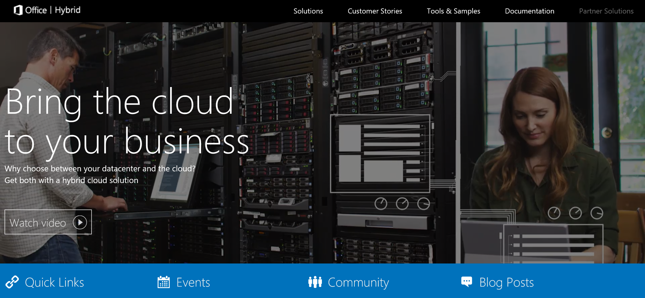
O365 SharePoint Hybrid Evolved To Next-Gen Hybrid
2014
2015
2016
Hybrid Extensible App Launcher 2016
Cloud Search Application (GA)
Hybrid Scenario Picker
Hybrid Profile Redirection
SharePoint 2016 Hybrid
Hybrid OneDrive for Business
Hybrid Team Sites
Hybrid Extranets B2B
Cloud Search Application (Preview)
Hybrid Search
http://hybrid.office.com
http://aka.ms/sphybrid

Slide 15
More Hybrid Scenarios thru FastTrack offering…
Coming soon…

Slide 16
Customer feedback
“Our SharePoint 2013 has heavy customizations and regulatory sites, moving to Cloud is miles away for us, however, wanted to take advantage of modern productivity experiences like Video and Delve to offer my 2013 on-premises users.
Is there an option?”

Slide 17
Announcing “Hybrid Extensible App Launcher for SharePoint 2013” Download SP 2013 Sep’16 CU (Cumulative Update) (Already available in SharePoint 2016 RTM and above)

Slide 18
Customer story & feedback
“Our construction org is heavy users of Taxonomy, we must have single enterprise wide managed metadata across on-premises and cloud.
Ready to move some content to O365 Cloud, but this is a blocker.”

Slide 19
Introducing “Hybrid Taxonomy” (Preview) Available as “Preview” in SharePoint 2016 Feature Pack 1 deployments “Preview” for SharePoint 2013 customers in Sep’16 CU (Cumulative Update) Interested to deploy in Production? Reach out to us at: SPTAPAD@Microsoft.com

Slide 20
Customer Story & Feedback
“We are a financial firm and heavy users of auditrail due to our Clients engagements. Using SharePoint 2016 and low business impact sites in Office 365. Need to have a single unified auditing view of users’ file and folder access activities.”

Slide 21
Introducing “Hybrid Auditing” (Preview) Available as “Preview” for SharePoint 2016 Feature Pack 1 deployments

Slide 22
Thu 9/29 – 4:00 to 5:15 PM BRK3048 Explore NEW SharePoint Hybrid Scenarios – Hybrid Auditing, Hybrid Taxonomy, Hybrid App Launcher Thomas Murphy Ballroom 1

Slide 23
Hybrid - Best of both worlds… Connected
Bringing business values thru cloud innovations to YOU
B2B Sites
…
Search
Hybrid Extensible App Launcher
Hybrid Taxonomy
Hybrid Auditing
HYBRID
SharePoint On-premises

Slide 24
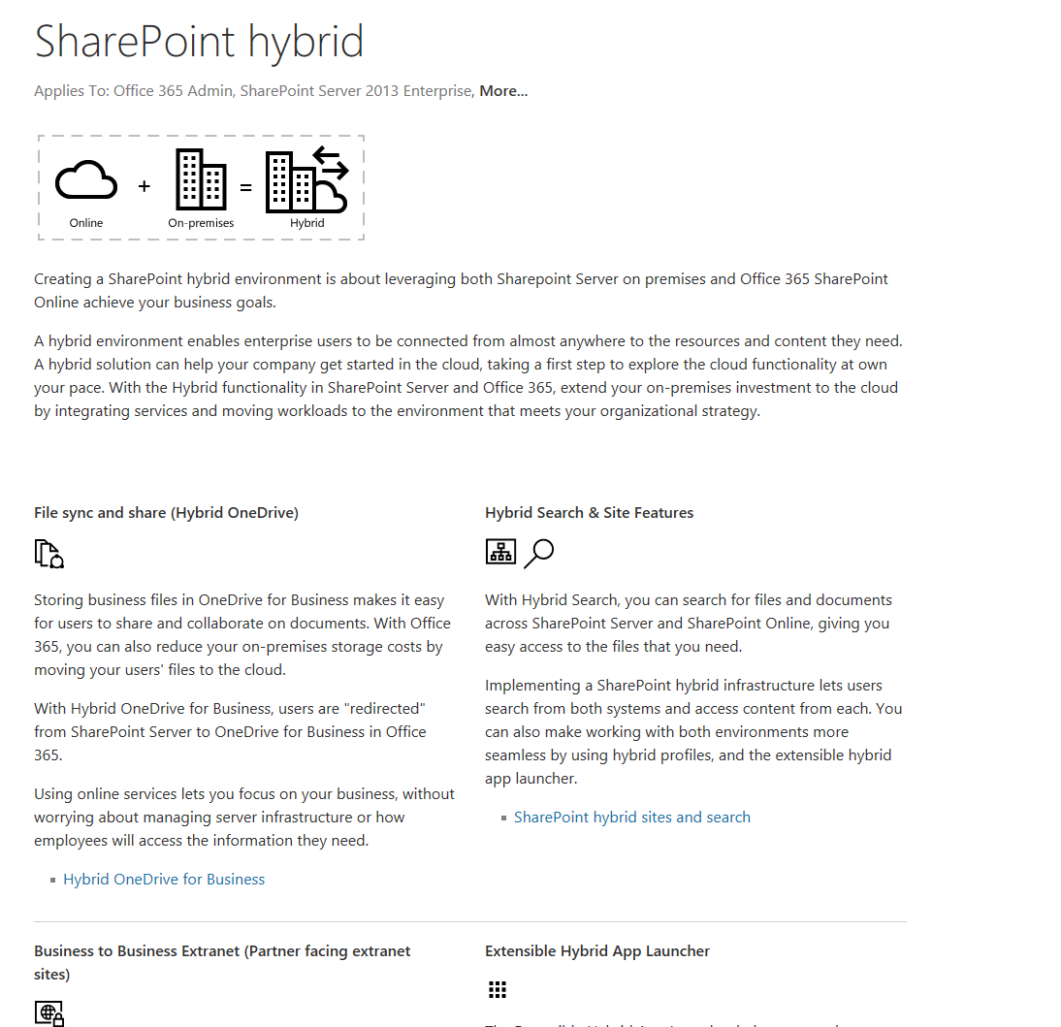
One stop shop for all tech things SharePoint Hybrid…
http://aka.ms/sphybrid
http://hybrid.office.com

Slide 25
Summary
FastTrack SharePoint Hybrid Offering thru On-boarding Benefits
Great opportunity to get guidance and pop on to hybrid journey
SharePoint Hybrid Scenarios evolved to next-generation experiences

Slide 26
Other Ignite Sessions
Day & Time slot | Session Code | Title | Room
Mon 9/26 2:15 – 3:30 PM | BRK1025 | Learn how SharePoint is reinventing content collaboration: vision and roadmap updates | Thomas Murphy Ballroom
Tue 9/27 12:30 – 1:45 PM | BRK3107 | Connect your on-premises directories to Azure AD and use one identity for all your apps | Georgia Ballroom
Tue 9/27 12:30 – 1:45 PM | BRK2047 | Explore Microsoft SharePoint Server 2016 and beyond | Thomas Murphy Ballroom 2&3
Tue 9/27 2:15 – 3:30 PM | BRK2050 | Dive into Microsoft O365 and SharePoint Hybrid Scenarios | B302-B303
Tue 9/27 2:00 – 2:45 PM | BRK1043 | Get started with Hybrid SharePoint Online and OneDrive for Business with FastTrack (this session) | B211-B212
Thu 9/29 4:00 to 5:15 PM | BRK3038 | Explore New SharePoint Hybrid Scenarios – Hybrid Auditing, Hybrid Taxonomy, Hybrid App Launcher | Thomas Murphy Ballroom 1
Thu 9/29 12:30 – 1:15 PM | BRK3003 | Collaborate outside the firewall with Office 365 | B405-B407

Slide 27
Online Resources
Hybrid Extensible App Launcher
Hybrid Auditing for SP 2016 (Preview customers only)
Hybrid Taxonomy for SP 2016 (Preview customers only)
SharePoint Hybrid All-up
Hybrid ODB
Hybrid Sites Features
Hybrid Extranet B2B
Cloud Search Application - Search Hybrid
Plan for Hybrid Profile and Profile Redirection
Custom Profile Properties Import to SPO
Hybrid Scenario Picker - Configuration Wizard
Exchange 2016 integrating with Cloud OneDrive for hybrid scenario

Slide 28
THANK YOU !

Slide 29
Deploy, ramp-up on new services and onboard new users with Microsoft FastTrack: http://fasttrack.microsoft.com/

Slide 30
Join the Microsoft Tech Community to collaborate, share, and learn from the experts: http://techcommunity.microsoft.com

Slide 31
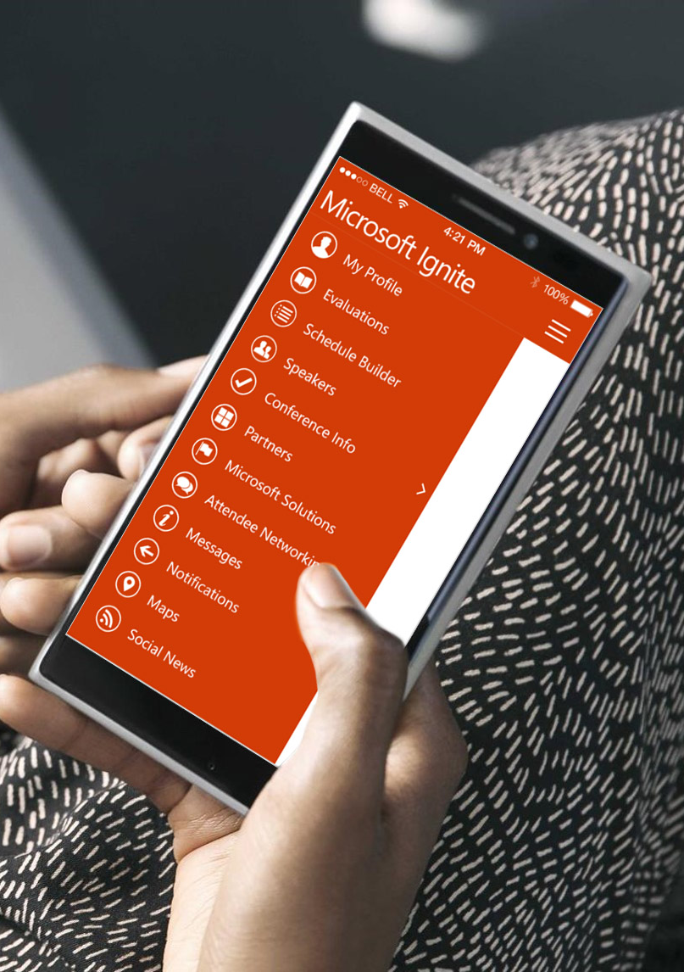
Please evaluate this session
Your feedback is important to us!
From your PC or Tablet visit MyIgnite at http://myignite.microsoft.com
From your phone download and use the Ignite Mobile App by scanning the QR code above or visiting https://aka.ms/ignite.mobileapp

Slide 33
APPENDIX

Slide 34
Hybrid Taxonomy - Introduction
Enabling you with a shared Taxonomy between your SharePoint On-Premises & Online
Terms, Term Sets, and Groups are available in both environments
Update only in SharePoint Online and the changes are automatically replicated to On-premises
Control to only selective term groups are shared between On-Premises and SharePoint Online
Flexibility to continue to keep some term groups as On-Premises only
Local terms (site specific) remain local and are not replicated

Slide 35
Hybrid Auditing - Introduction
Enabling on-premises admins get visibility into users activities in SharePoint environment, with the power of Office 365 Audit Logs capability.
See real-time user file access activity logs* and get insights from your SP 2016 on-premises once you hybrid connected to Office 365.
A hybrid solution for SharePoint 2016 On-premises Admins.
*Office 365 Audit Logs search in Security & Compliance Center offers richer log capability and this feature empowers on-premises admins with that richness. O365 events and activities will be superset of what we capture in on-premises.

Slide 36
Wheel of “Business Values” - SharePoint Hybrid Scenarios – O365 in Customers’ Terms
SharePoint OneDrive Hybrid Scenarios
4. B2B Extranet Sites
8. Modern Attach EXO+ODB
6. Hybrid Profile Redirect
1. Hybrid Scenario Picker
5. Cloud Search App & Delve
7. Hybrid Ext App Launcher
2. Hybrid OneDrive
3. Hybrid Teams Sites
9. Hybrid Taxonomy**
10. Hybrid Auditing
**
All Hybrid Experiences supported in SP 2013 & 2016
**Available only in SharePoint 2016 and in Preview

