Slide 1
Let the transformation begin
BRK1041
Jim Ganthier
SVP, Validated Solutions & HPC

Slide 2


The world’s most value-focused global supply chain providing technology infrastructure for organizations of all sizes
The world’s leading data center innovation engine with cutting-edge enterprise infrastructure for the most demanding environments

Slide 3

The world’s most value-focused global supply chain providing technology infrastructure for organizations of all sizes
The world’s largest privately-held technology company with world-class enterprise sales and support
The world’s leading data center innovation engine with cutting-edge enterprise infrastructure for the most demanding environments

Slide 4
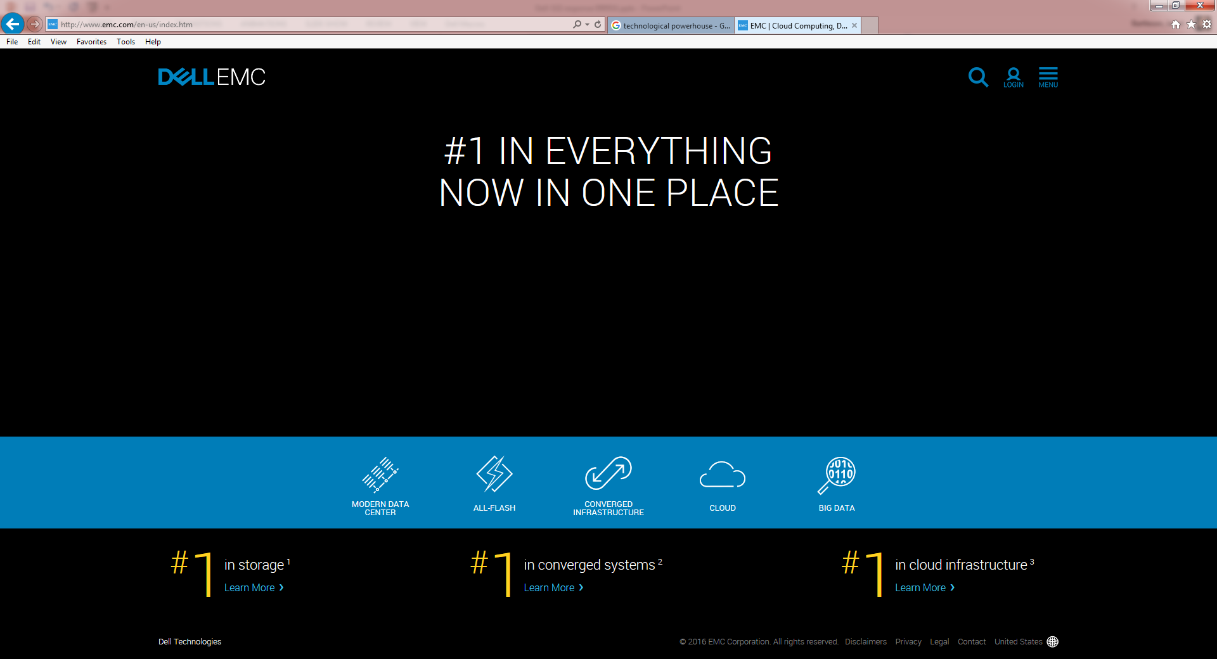
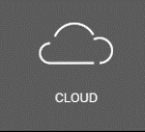

Slide 5

82%
of enterprises are leveraging the cloud.¹
It’s a hybrid cloud world
9 out of 10
37%
ITDMs say hybrid cloud
is important for a
“future-ready” enterprise.²
are concerned about cost of public cloud.¹
78%
want to repatriate apps from public cloud.²
1 Dell Global Technology Adoption Index 2015, http://en.community.dell.com/dell-blogs/direct2dell/b/direct2dell/archive/2015/10/08/global-technology-adoption-index-2015
2 Dell and Penn Schoen Berland Poll 2015
3 Dell Global Technology Index 2015

Slide 6

Delivering cutting-edge innovation for customer results
CAPABILITY
Delivering a superior
long-term
value
Democratizing technology
for the
benefit of all
COST
COMPLEXITY
Driving out
inefficiency everywhere

Slide 7
Microsoft Solutions
John McVay
Director, Validated Solutions

Slide 8

For more than 30 years,
Dell and Microsoft have focused on delivering best in class solutions
that span the entire Microsoft Product Portfolio to organizations all over the world

Slide 9

Azure Cloud Services by Dell EMC
Announcing
Validated System for Microsoft Exchange
Validated System for Microsoft SQL

Slide 10


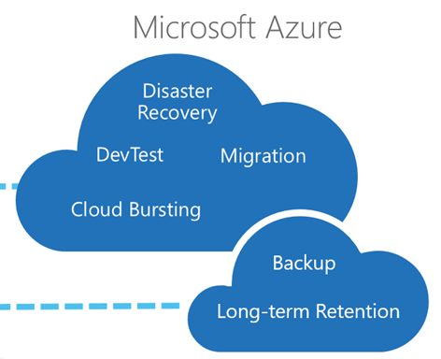
Azure Backup
Azure Dev/Test Labs
Azure Cloud Services from Dell EMC
Azure Business Continuity Solution
Azure Site Recovery
Azure Operations Management Suite
Azure Backup
Azure Express Route
Dell EMC provisioning, consulting, break/fix support, networking pay-as-you-go/short-term pricing
Offered a la carte, with every PowerEdge server, converged system and with software

Slide 11

“We’ve been able to increase insight into global backups and reduce risk with Azure Backup Services from Dell. By choosing a vault closer to where our servers are, we’ve accelerated some backups by 79%. And we can set up a new backup process 3x faster.”
“We’re saving money with Azure Backup from Dell. On our first bill, our costs were nearly 50% less compared with our previous solution.”
− Mike Oreno, System Administrator and IT Support Manager, ARIIX

Slide 12
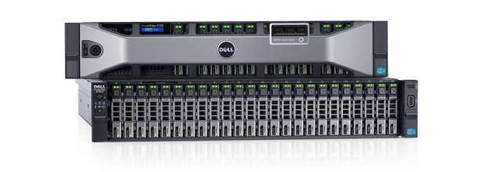
Validated System for Microsoft Exchange
SAVINGS: Lower cost of ownership through optimized storage design and efficient system management
SPEED: 99% reduction in server configuration time with Zero Touch Auto Configuration
SCALE: Easy scale-out and high availability infrastructure
Configured, quoted and ordered in minutes

Slide 13

“We were able to consolidate Exchange servers so they run in only six global data centers instead of 49 data centers by centralizing our messaging service on next-generation Dell PowerEdge servers and Dell Storage. In addition to delivering the compute and I/Os per second we need in a smaller footprint, we also expect to save more than $1 million in capital and operational expenditures over the next two years.”
−Cloyce Yarborough, IT Senior Manager, Global Messaging and Collaboration
Engineering, Dell

Slide 14

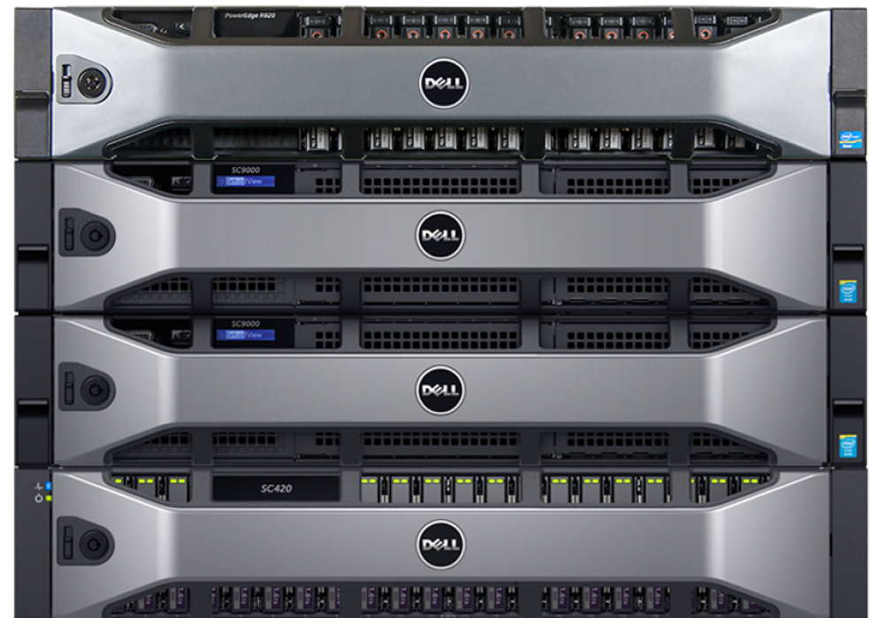
Validated System for Microsoft SQL
Get 5.6x the database performance with under 1ms response time
SAVINGS: Consolidate and save
SPEED: Up to 30x faster transactions
SCALE: Future ready scalability
Source: Dell PowerEdge R830 server with Dell Storage SC9000 all-flash array with Microsoft SQL Server 2016, Principled Technologies, July 2016

Slide 15
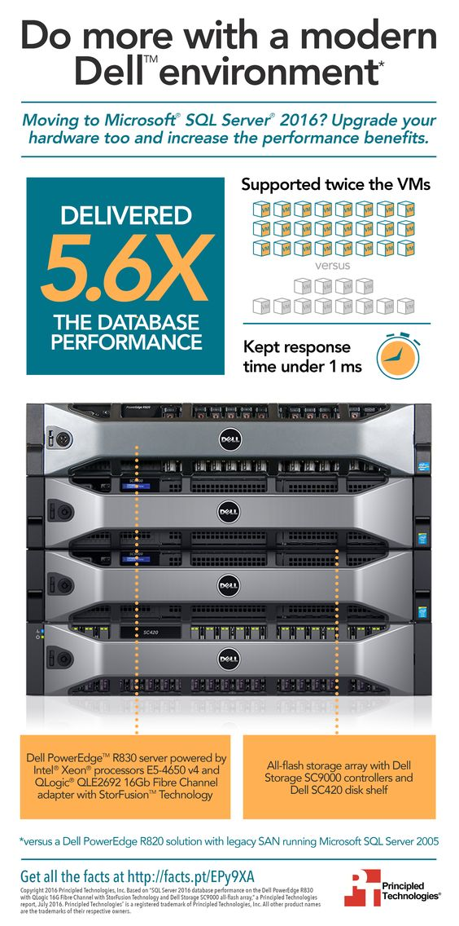
“When we ran the new Dell-based [Microsoft SQL Server SSD appliance] system, we were amazed by the dramatic improvement in performance . . . we could no longer go back to the old system.”
“We have seen that Dell is proactive in proposing new products and technologies. Even if we are one of the first companies to adopt a new technology, we can do so safe in the knowledge that Dell offers outstanding support.”
− Yasumitsu Irimoto, the manager of the Web Solution Development Department at Dynatech

Slide 16


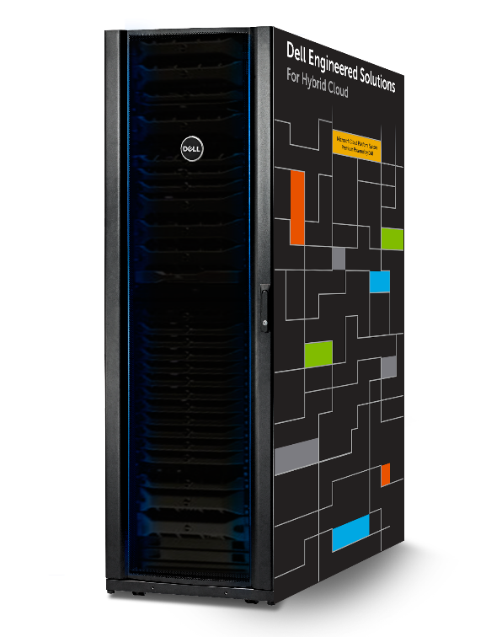
Dell EMC Hybrid Cloud System Momentum

Slide 17
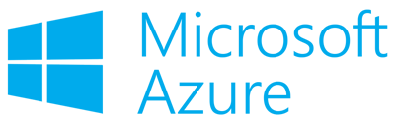
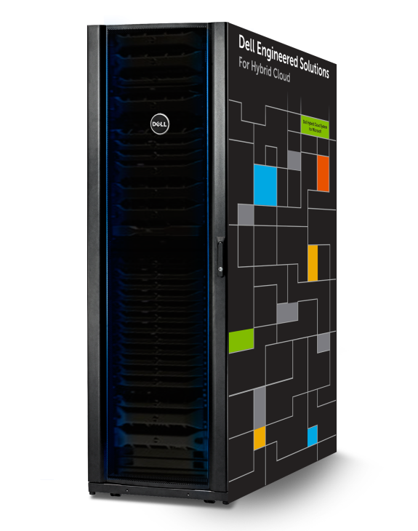
Dell EMC Hybrid Cloud System for Microsoft
Industry’s first integrated system with Microsoft Cloud Platform System Standard
Simplify hybrid cloud & redefine agility
Go from zero to hybrid cloud in under 3 hours
Radically reduce investment risk
Extend utility-based consumption models, be assured with a future-ready solution
Re-assert control
Integrated Azure consistency and Azure services for business continuity
Co-engineered for fast time to value
Control your cloud as a single system
Confidence in native data protection, local to cloud
Near Zero Risk with Cloud Flex Pay
Under 3 hours Based on testing in Dell’s engineering labs and only covers the set up Cloud Platform Systems Standard software

Slide 18








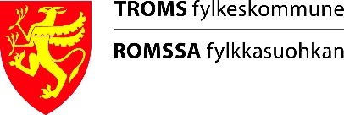


Slide 19
Rogers Communications
Hani Mousa
Sr. Manager, Infrastructure Solutions Architecture

Slide 20

Rogers Communication
Wireless: Largest provider of voice & data reaching 93% of Canadians
Cable: Leading Cable Service Provider
Business Solutions: Carrier-grade business telecom, networking, hosting and managed data services, IP connectivity and solutions
Media: Category-leading sports entertainment, digital media, television and radio broadcasting and publishing properties
Own: Toronto Blue Jays Baseball Club, the Rogers Centre, The Grand Slam of Curling, and partially owns the Toronto Maple Leafs, the Toronto Raptors and Toronto FC
Canada’s dynamic communications and media company

Slide 21
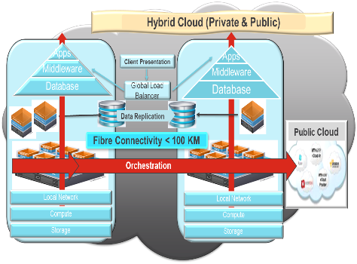
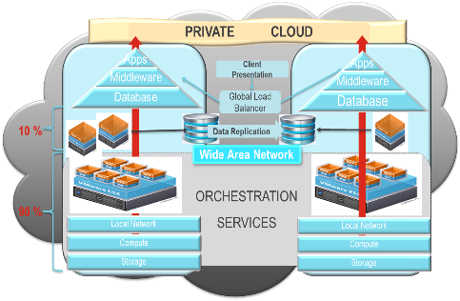
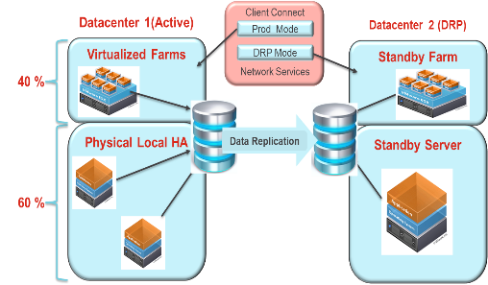
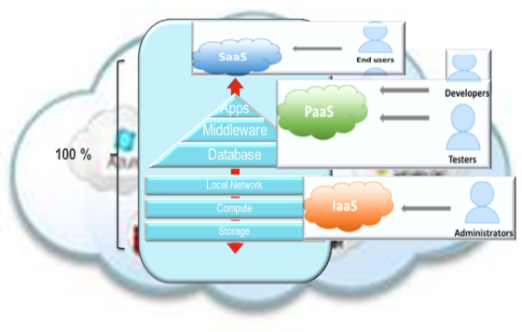
Our Journey to the Hybrid Cloud
  Current State Capabilities
  Infrastructure Transformation Capabilities (IaaS & PaaS)
Capabilities Evolution
PaaS
Integrated Application Systems
VDI
Oracle DBaaS
IaaS
PaaS
MWaaS
Consider
HA/DR
DBaaS
IaaS
PaaS
SaaS
Private Cloud – Specialized Workload
Hybrid Cloud
Business Evolution
Private Cloud – Generic Workload
Cloud & Cloud Bursting
Consolidation
Virtualization
Traditional
Renewal / Re-Platforming
Consolidation & Virtualization
Built for Purpose workloads
Hosting Placement
Technical Evolution

Slide 22
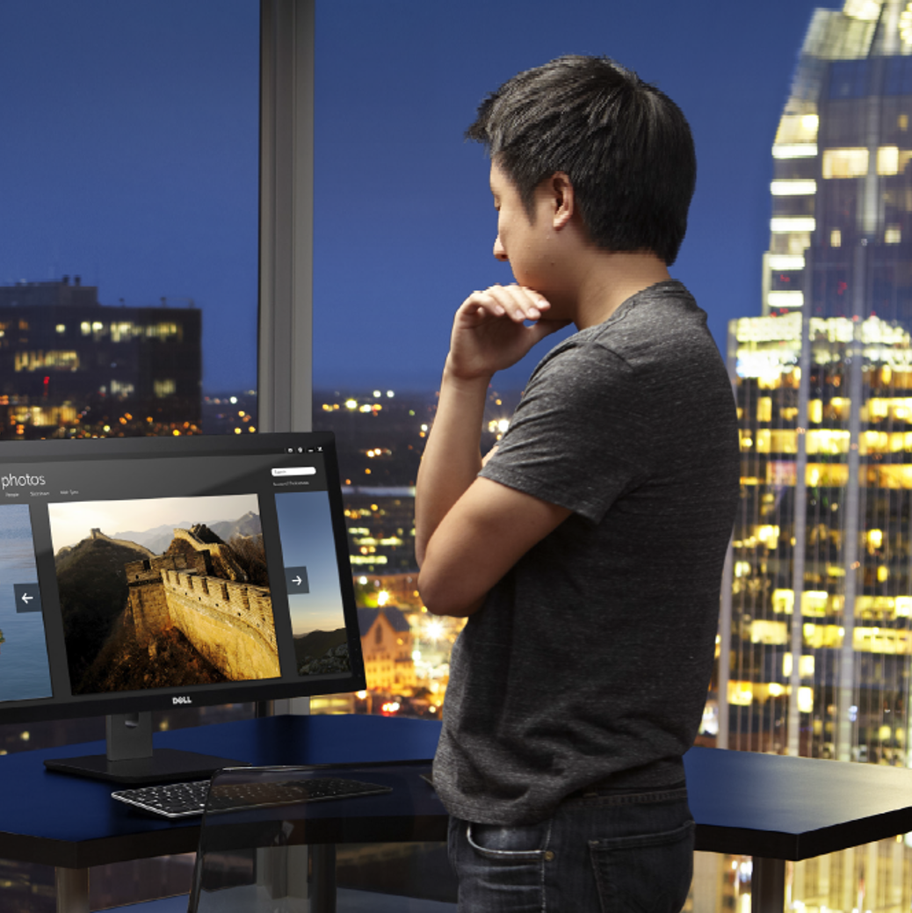
Virtual Desktop Infrastructure (VDI) Proof of Concept

Slide 23
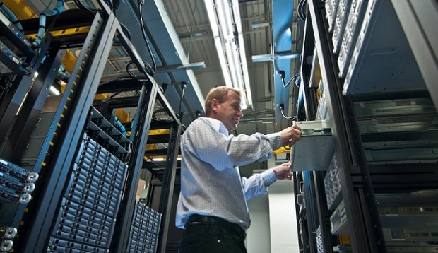
Recommendation: Consider Converged
Decision making factors
Integration with current Microsoft technologies, e.g. Skype for Business, System Center Configuration Manager, Azure and Active Directory
Scalability and cloud bursting to Azure
Citrix VDI solution on Microsoft Hyper-V expected to support 5000 users in the next 2-3 years
Consider Converged, Hyperconverged, Multi-Vendor

Slide 24
Selection: Citrix XenDesktop on Microsoft Cloud Platform System powered by Dell
  1st CPS to ship to Canada
  1st Citrix on CPS globally
  Capacity to support 1800 users
  Azure on-premise with extension to public cloud
  Multi-tenant and self-service private cloud for VDI hosting
  Hardware and solution procurement – 400% faster

Slide 25
Rogers Experience
Very positive with procurement, vendors’ responsiveness and collaboration
Reached capacity in less than a year due to high demand and adoption rate by LoB
Plans to expand either on-premise or to Azure public cloud

Slide 26
Learn more….
Dell EMC booth
  Dell EMC Validated Solution for Exchange Server 2016
  Dell EMC Validated Solution for SQL Server 2016
  Dell EMC Hybrid Cloud System for Microsoft
  Azure Services & CSP with Azure Stack
Microsoft booth
  DHCS at Hybrid Cloud Platform
  Future preview – Azure Stack by Dell EMC
Dell EMC Theater
  sessions every 30 minutes!
Dell.com
  www.dell.com/dhcs
  www.dell.com/exchange
  www.dell.com/sql (Validated Solution Q4 availability)
Contact Dell EMC
  Contact your sales and services representatives about your cloud, unified communications data needs and migration plans
  Azure services: Get_Azure@dell.com
Dell.com/Microsoft

Slide 27


Please evaluate this session
Your feedback is important to us!
From your PC or Tablet visit MyIgnite at http://myignite.microsoft.com
From your phone download and use the Ignite Mobile App by scanning the QR code above or visiting https://aka.ms/ignite.mobileapp

