Slide 1
Create best-in-class customer experiences with digital transformation
BRK1040

Slide 2
Our New World – The Digital Workplace
Pat Bolton
IBM Global Technology Services
CTO of Digital Workplace Services

Slide 3
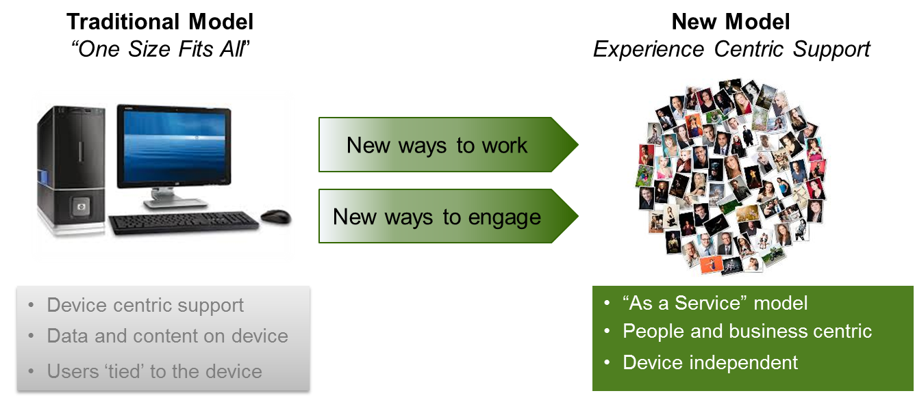
The user is at the center of the new digital workplace
NEW DIGITAL WORKPLACE

Slide 4
Workplace transformation is a work in progress
WORKPLACE TRANSFORMATION
Digital Workplace
Mobile Productivity
Infrastructure is mobile ready
Support for the platforms of choice
Applications leverage mobility
Legacy applications are modernized to exploit mobility
Agile development & secure deployment of apps is enabled
Data and applications are securely accessible where and when needed
Security is integrated across applications, mobile, data and networks
Business Value
Understand employee mobile needs
Develop mobile strategy and integrate into business strategy
Mobile enable existing infrastructure
Evaluate applications for mobile enablement
Establish BYOD Program
Re-evaluate security environment
Enable remote web browsing
Virtualize key applications
Basic Enablement
Establish enterprise policies
Enable mobile access to email and calendars
Enable VPN access to network
Enterprise Maturity Model

Slide 5
Workplace strategies must focus on creating a more nimble and adaptive support capability
WORKPLACE STRATEGY
Technology changes are driving a new approach to end user services in the enterprise
  Applications, productivity suites and collaboration capabilities are increasingly being delivered from the cloud
  Agile and evergreen platform management policies
  Extending the capabilities of device management services, delivered from the cloud
A new vision for End User Services is emerging
  The Digital Workplace will be delivered as a Service
  Services and Applications are being provisioned internally and externally of the Enterprise network.
  Enterprise Software distribution services are transforming to an App Store pull model for the few tools and applications not provisioned from Cloud Services.
  Management of the device platform will shift from the enterprise to system vendors, eliminating the need for traditional enterprise image and patching services.
  Device Management for security, compliance, asset management, and policies enforcement will transform in a unified device management approach, delivered from the cloud.

Slide 6
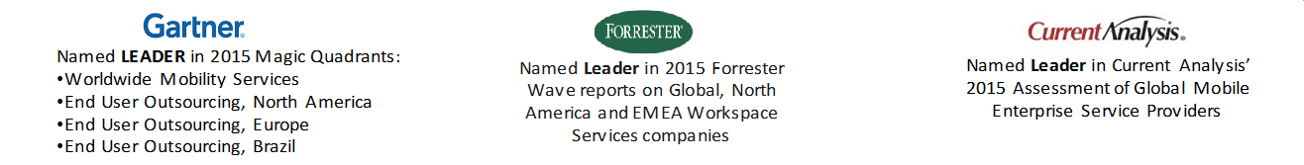
Our goal is to create a “composable” workplace
“COMPOSABLE” WORKPLACE
The essential purpose of Workplace Technology is to securely deliver the appropriate IT and business capability to the end user, on their device of choice, based on the IT policies and the users role in the enterprise.
IT Polices & Users Role

Slide 7
Personas, choice, self-service, and cognitive support
COGNITIVE SUPPORT

Slide 8

Global Oil and Gas Client
CLIENT SUCCESS STORY
Business Challenges
Evolve UC strategy to leverage SfB for traditional PBX features, improved Geo resiliency, site survivability, HA, third party app integration (Call Center, Call Recording), and advanced features
Expand PBX replacement to ensure cost reduction and containment
Customer Solution
150k Global users w/ 120k enabled to leverage Enterprise Voice delivered out of 3 Geographically dispersed datacenters
    Americas – 40k users
    APAC – 39k users
    EMEA – 61k users
Improved Mobile experience, site survivability, enhanced HA and Geo DR, removal of legacy PBXs
Integrated native video with HD to promote adoption
Advanced Features: Call Admission Control, Skype Federation, Client enabled Remote Access, Enhanced 911, Persistent Chat
Third Party Apps - Enhanced Mobile Security, Call Center, Call Recording, Provisioning
Client Benefits
Reduced call costs with on-net P2P calling, least-cost routing for off-net and federated partner calls
Reduced costs by removing legacy telephony and conferencing
Reduced carbon footprint by creating more efficient workplaces, reduction in travel, and less infrastructure

Slide 9

Large Global Auditing and Accounting Firm
CLIENT SUCCESS STORY
Business Challenges
Transform the way the business connects within the internal ecosystem
Enable employees, customers, and partners to perform work unbound by location, at significantly higher quality of experience and lower cost
Provide a UC framework for global convergence of data, voice and video
Customer Solution
Deployment: Initial deployment over 176K Instant Messaging/Presence and Conferencing, 120k Enterprise Voice, 50k Mobility; current deployment is ~240k user/endpoints
Why IBM
IBM offering matched client decision to standardize on Microsoft UC & Voice
Strong SfB, Voice, Network, and application integration experience and expertise
Strong customer references
Close partnership with Microsoft: Technology Adoption Program, MS certified engineers on staff, 15+ years experience with MS platform
Client Benefits
Proven end-to-end customer service model for design, deployment, program management, and ongoing service management
Integration with Cisco, Avaya, Tandberg, Microsoft’s Office 365 Exchange UM
Highly Available/Resilient solution with site survivability in 80+ locations
Enabled remote/mobile workers to take advantage of SfB features
Custom global deployments using regional data centers: US, EMEA, and APAC

Slide 10

Large North America Insurance Firm
CLIENT SUCCESS STORY
Business Challenges
Migrate 8,000 plus users to a common Exchange platform from disparate systems
Consolidate SharePoint environments
Customer Solution
Migrate Customer’s existing on-premise legacy Exchange and SharePoint environments
IBM-provided Private Cloud Hosting and hardware
Manage all platforms during steady-state
Why IBM
Perform version upgrades.
Provide 99.99% SLA
Introduce Disaster Recovery (2nd Data Center)
Alignment with Security and Legal requirements.
Specialization allows for innovation and rapid deployment of new services
Client Benefits
Better currency and stability on being on a common platform
Predictability of costs rather than varied costs from support staff
Stable environment for on going support and version control

Slide 11

Dubai Healthcare Authority
CLIENT SUCCESS STORY
Business Challenges
Consolidate customer records into a single, easy-to-use portal for personalized communications
Enable enhanced analytics and reporting to increase market segmentation potential
Customer Solution
On-premises Microsoft Dynamics CRM deployment
Social Engagement, Unified Service Desk
Why IBM
Extensive public sector experience and understanding of client needs
Seamless language integration with client teams
Strong level of collaboration between IBM and Microsoft
Close partnership with Microsoft: Existing use of Outlook and SharePoint made for efficient integration
Client Benefits
360-degree view of customer between marketing and customer service departments
Enhanced knowledge sharing between employees through knowledge base
Increased quality of service toward customers via instantaneous record lookup

Slide 12
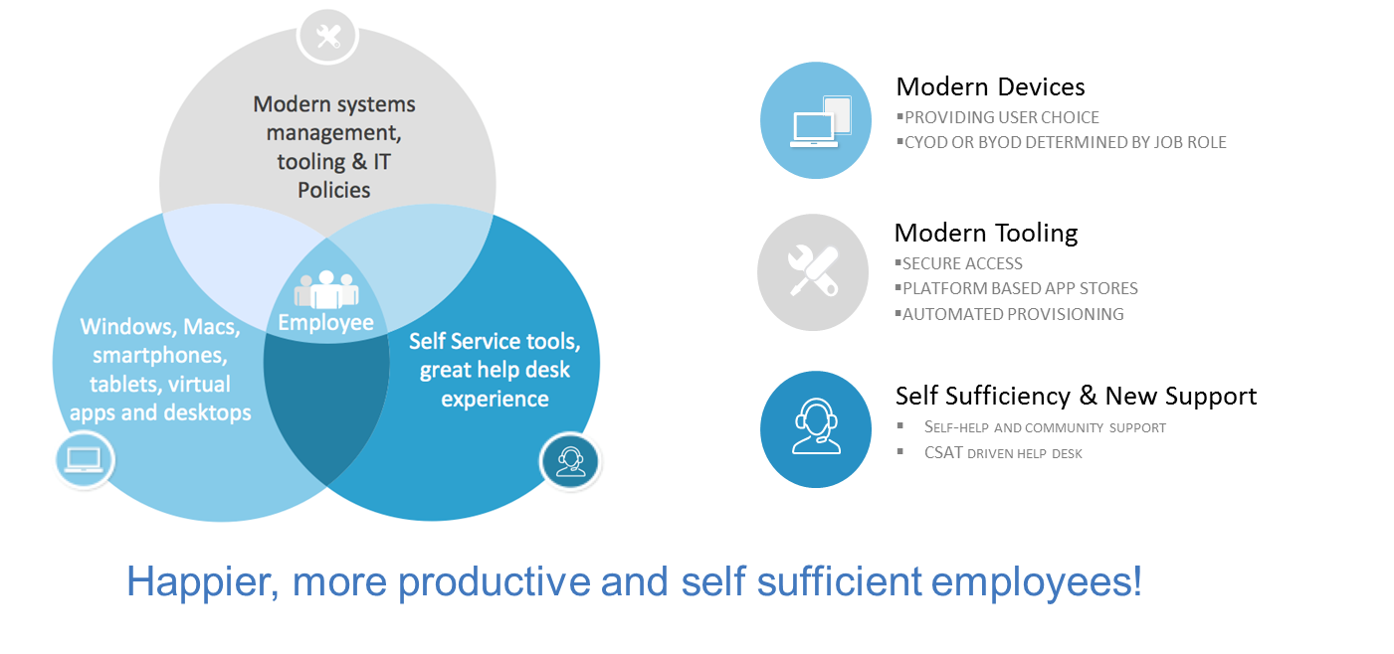
What does the enterprise need to do NOW to become a Digital Workplace?
ENTERPRISE + DIGITAL

Slide 13

Thank you

Slide 14
IBM and Microsoft: Creating best-in-class customer experiences
Murray Mitchell
IBM Global Business Services
Global and North America Microsoft Services Leader

Slide 15



Microsoft technologies are embedded into IBM’s Consulting capabilities and strategic priorities
IBM AND MICROSOFT
IBM Cloud solutions for Microsoft Dynamics applications can be hosted on IBM Softlayer, Azure or a cloud provider of your client’s choice
The Microsoft practice offers a broad range of Cloud Solutions
Dynamics CRM
SharePoint
Office 365
Visual Studio
Dynamics AX
Azure
Cloud
Focus on Cognitive Big Data and Analytics solutions
Innovative solutions that are Cloud based, Cognitive and Industry focused
Cognitive
Power BI
Watson APIs
Azure IoT services
Sector & Industry solution offerings based on
Microsoft applications
Sector & industry
Public Sector, Industrial, Distribution, Financial Services, Communications

Slide 16









Global IBM Services Offerings span multiple Microsoft product categories
PRODUCT OFFERINGS
Application Management Services
Big Data and Analytics
Microsoft
Azure IoT Suite
Web Apps
Power BI
Enterprise Applications
AX
AX7
CRM
CRM Online
Microsoft
Dynamics Marketing
Microsoft
Social Engagement
Mobile Enterprise & Collaboration
Microsoft
Lync Server
Application Development & Cloud
Microsoft
Microsoft
Exchange
BizTalk Server
Microsoft
Microsoft
Microsoft
Windows Server
SQL Server
.NET
Visual Studio

Slide 17




IBM’s Microsoft Consulting Practice offers a substantial range of breadth and depth across multiple geographies
GLOBAL PRESENCE
Canada
United States
Ireland
UK
Nordics
Benelux
France
DACH
CEE
Spain
Middle East
Africa
ASEAN
China
India
Japan
IBM’s Microsoft Global Practice Capabilities
Deep Pool of Microsoft Resources
Multi-year Inner Circle & President’s Club Winners
Deep Microsoft Consulting Experience
10,000+ Resources
1 of 5 Firms
75% Certified
INNER CIRCLE
PRESIDENT’S CLUB
for Microsoft Dynamics
for Microsoft Dynamics

Slide 18











IBM combines deep industry expertise with extensive Microsoft capabilities
INDUSTRY EXPERTISE
Automotive
Chemical and Petroleum
Electronics
Industrial Products
Banking
Retail
Financial Markets
Healthcare
Government
Consumer Products
Insurance
Travel and Transportation
Embedded Cognitive Capabilities
Strong Microsoft
Alliance
Industry Specific
Solutions
Microsoft Center
of Competencies
Global Delivery Capabilities

Slide 19
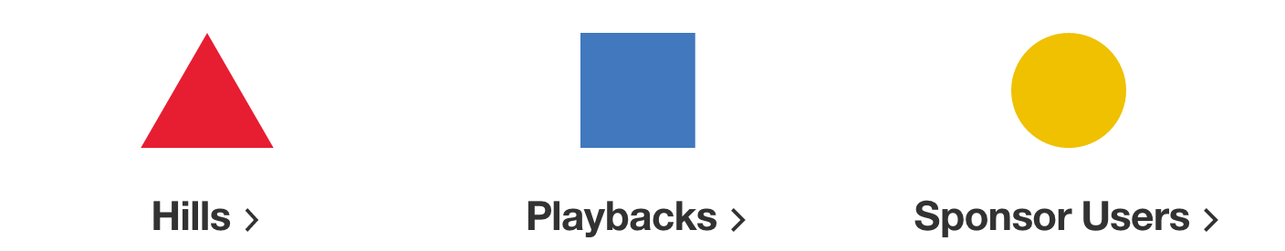
IBM infuses Design Thinking into our Microsoft project engagements
IBM DESIGN THINKING
Continuous delivery of engaging customer experiences
Understand: develop deep empathy for the user
Explore: generate potential solutions for user’s problem
Prototype: render ideas as concrete experiences
Evaluate: decide whether to move forward with an idea
or generate more solutions
IBM Design Thinking:
Helps solve complex problems in complex environment
Focuses everyone’s thinking on the user experience and key stakeholders’ pain points and frustrations
Encourages cross-function collaboration resulting in fast idea generation and iteration

Slide 20




IBM is a Microsoft Cloud Solution Provider (CSP)
CLOUD SERVICE (CSP)
With the Microsoft Cloud Solution Provider program, IBM provides end to end customer service for all Microsoft products sold through Microsoft’s cloud.
IBM has built services offerings in support of Microsoft products that includes bundled offerings on a pay-as-you-go model.
Primary Product Offering
through CSP by IBM

Slide 21



IBM drives successful business outcomes for clients by executing a proven approach to business transformation utilizing a broad set of capabilities
IBM BUSINESS TRANSFORMATION
Strong
global presence
Value
realized with
timely ROI
Proven
implementation
expertise
Effective
organizational change
management
Business
Transformation
experience and
success
Deep
industry and systems
integration expertise
Flexible
methods, solutions,
and deployment
Time-tested
tools, assets,
methodologies
E2E Integration
with leading hardware
and software

Slide 22


Brian Hodges
Sr. Manager
Sales Planning & Performance
American Airlines Cargo
© 2016 INTERNATIONAL BUSINESS MACHINES CORPORATION

Slide 23
Thank you
© 2016 INTERNATIONAL BUSINESS MACHINES CORPORATION

Slide 24
Free IT Pro resources
To advance your career in cloud technology
Plan your
career path
Cloud role mapping
Expert advice on skills needed
Self-paced curriculum by cloud role
$300 Azure credits and extended trials
Pluralsight 3 month subscription (10 courses)
Phone support incident
Weekly short videos and insights from Microsoft’s leaders and engineers
Connect with community of peers and Microsoft experts
Microsoft IT Pro Career Center
www.microsoft.com/itprocareercenter
Get started
with Azure
Microsoft IT Pro Cloud Essentials
www.microsoft.com/itprocloudessentials
Demos and
how-to videos
Microsoft Mechanics
www.microsoft.com/mechanics
Connect with peers and experts
Microsoft Tech Community
https://techcommunity.microsoft.com

Slide 25


Please evaluate this session
Your feedback is important to us!
From your PC or Tablet visit MyIgnite at http://myignite.microsoft.com
From your phone download and use the Ignite Mobile App by scanning the QR code above or visiting https://aka.ms/ignite.mobileapp

