Slide 1
Educate & Excite in Computer Science
BRK1031
Host: Naomi Moneypenny
CTO, ManyWorlds & Microsoft MVP

Slide 2
COMPUTER SCIENCE EDUCATION: Making an Impact Together
Mike McMahon
Senior Director, External Affairs, Microsoft
Jonathan Friebert
Director, External Affairs, Microsoft

Slide 3


Please evaluate this session
Your feedback is important to us!
From your PC or Tablet visit MyIgnite at http://myignite.microsoft.com
From your phone download and use the Ignite Mobile App by scanning the QR code above or visiting https://aka.ms/ignite.mobileapp

Slide 4
Current Situation

Slide 5
Computers and software are changing everything…

Slide 6
…but the majority of schools don’t teach computer science:
9 in10
parents want their child to study computer science
1 in 4
schools teach computer programming
Source: Gallup

Slide 7
Some may think:
Computer science education is on the rise…

Slide 8
Computer science education is on the rise…
Computer science education is recovering from a 10-year decline

Slide 9
Fewer computer science graduates than 10 years ago (and half as many women):
MALE
FEMALE
Source: National Science Foundation, National Center for Education Statistics

Slide 10

Tech’s diversity problem is also in CS
High school computer science
University
computer science
Software workforce
Women who try AP Computer Science in high school are ten times more likely to major in it in college, and Black and Hispanic students are seven times more likely.
Sources: College Board, National Center for Education Statistics, Bureau of Labor Statistics

Slide 11
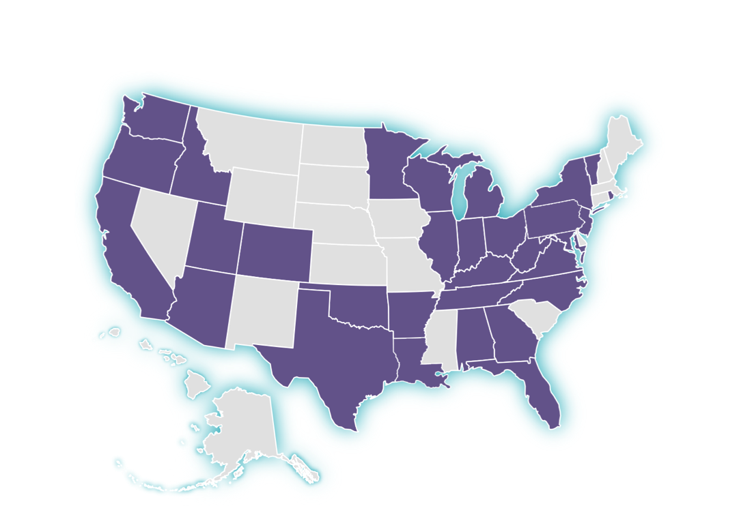
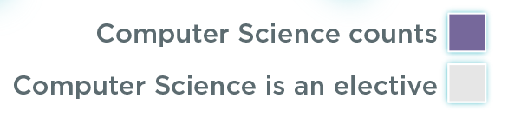
CS can count for graduation in 31 states + DC
In 31 states plus DC, computer science can count towards high school graduation math or science requirements - up from 12 states in 2013.

Slide 12
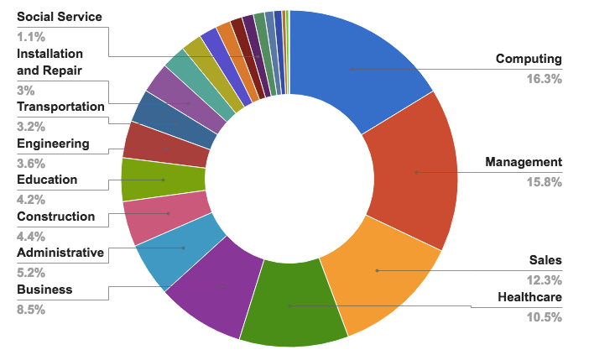
Computing jobs are the #1 source of new wages in the United States
500,000 current openings: These jobs are in every industry and every state, and they’re projected to grow at twice the rate of all other jobs.

Slide 13
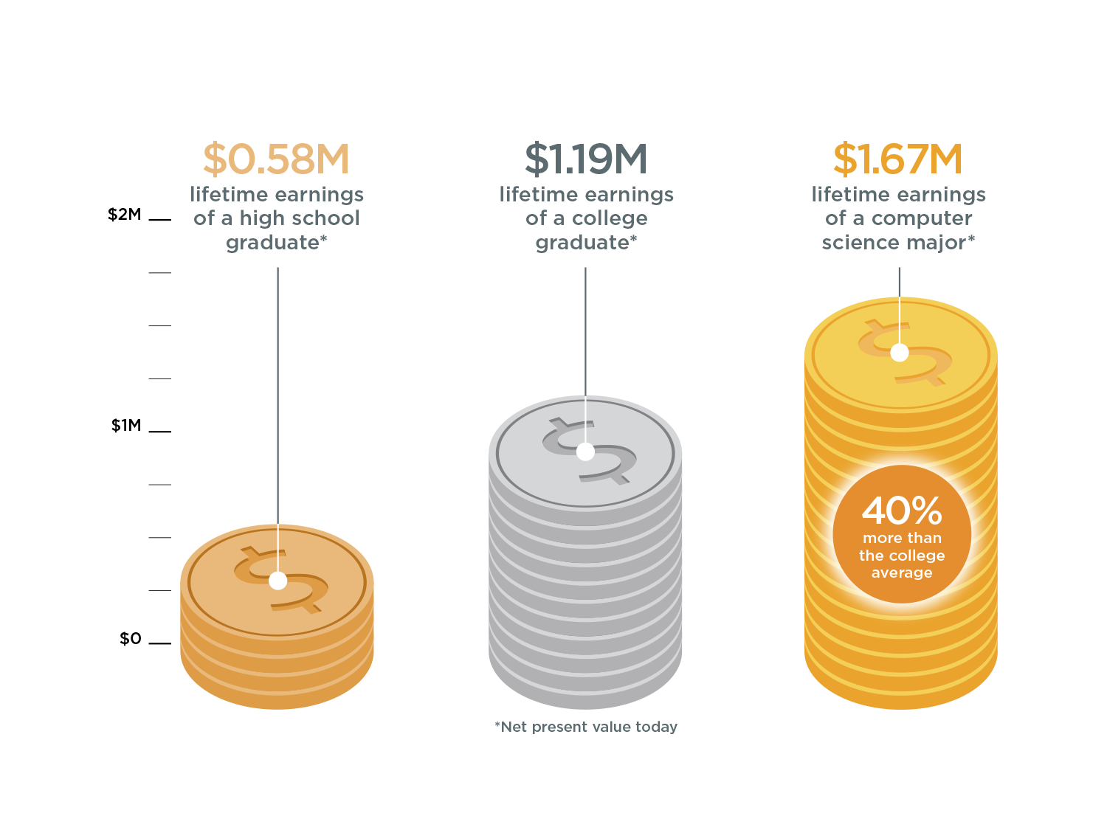
The value of a computer science education
Source: Brookings

Slide 14
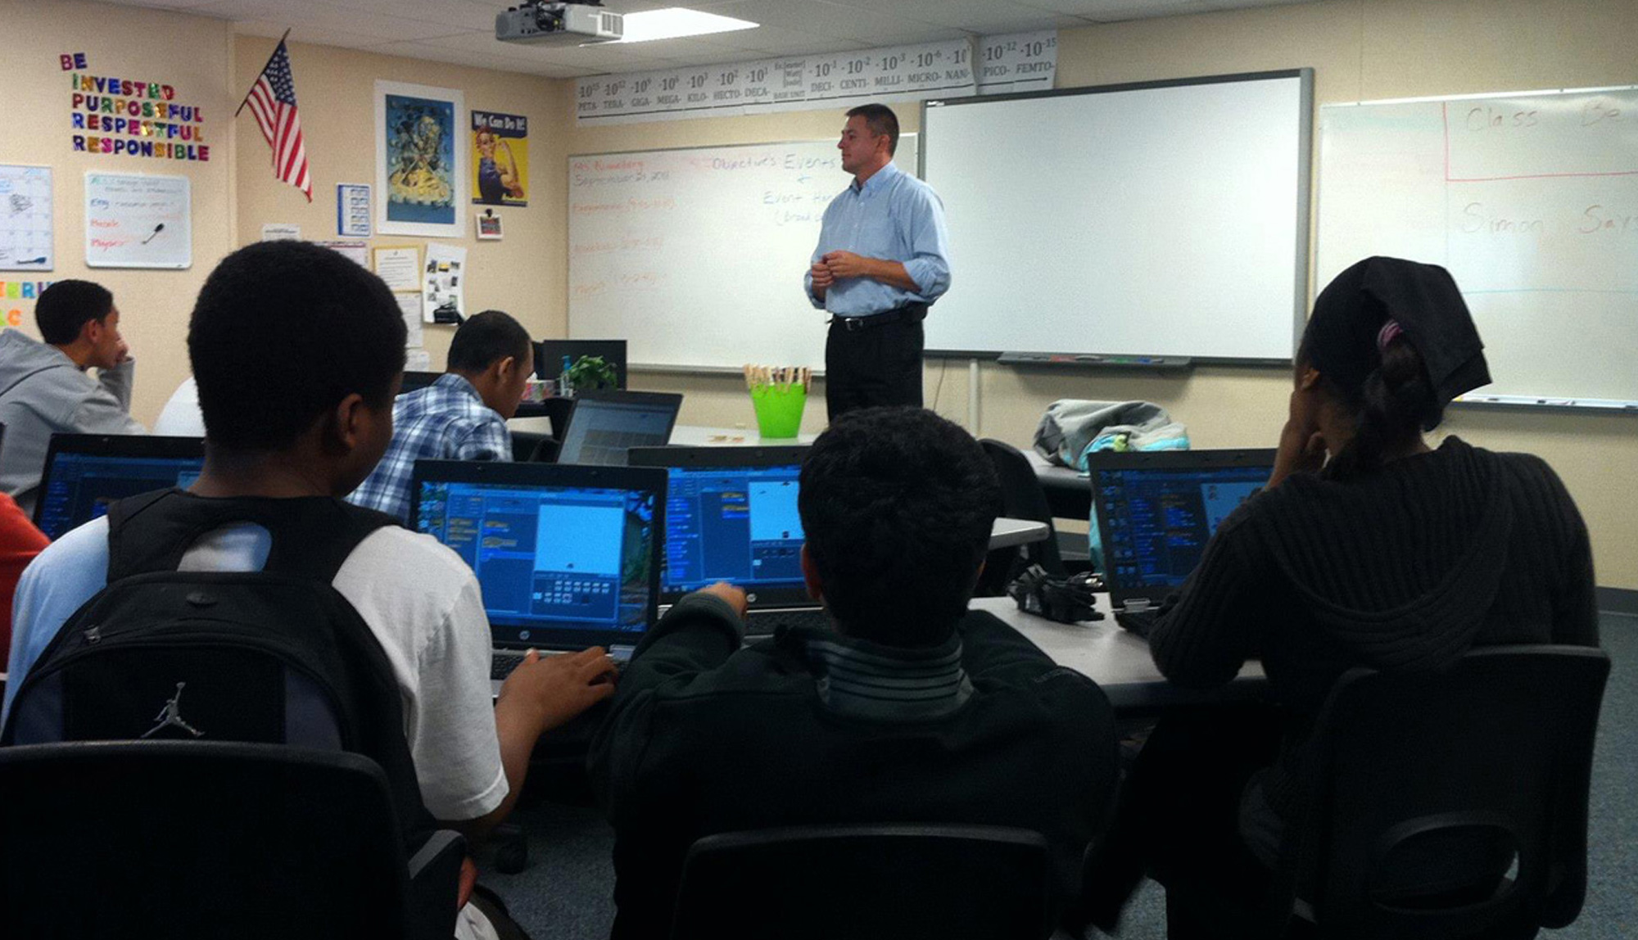
This is a huge challenge
42,000+ high schools in
the US.
16 million+ enrollment.
Policy changes, institutional changes,
heavy lift.
All politics
is local, all education
is local too.
It starts at home, it
starts with you.

Slide 15
What Is Microsoft Doing?

Slide 16

Our Vision:
every school
every student
opportunity

Slide 17
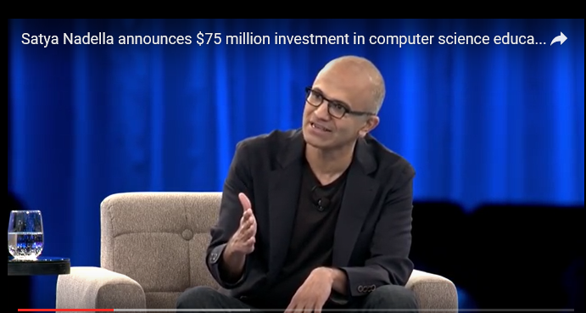
Microsoft’s Commitment
We can’t leave anyone out. We’re proud to make this $75 million investment in computer science education to create new opportunities for students across the spectrum of diverse youth and help build a tech talent pipeline that will spark new innovations for the future.
Satya Nadella September 2015

Slide 18
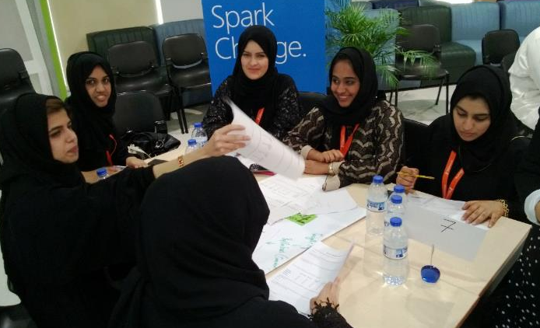



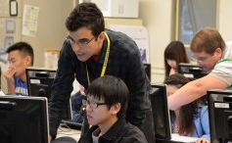
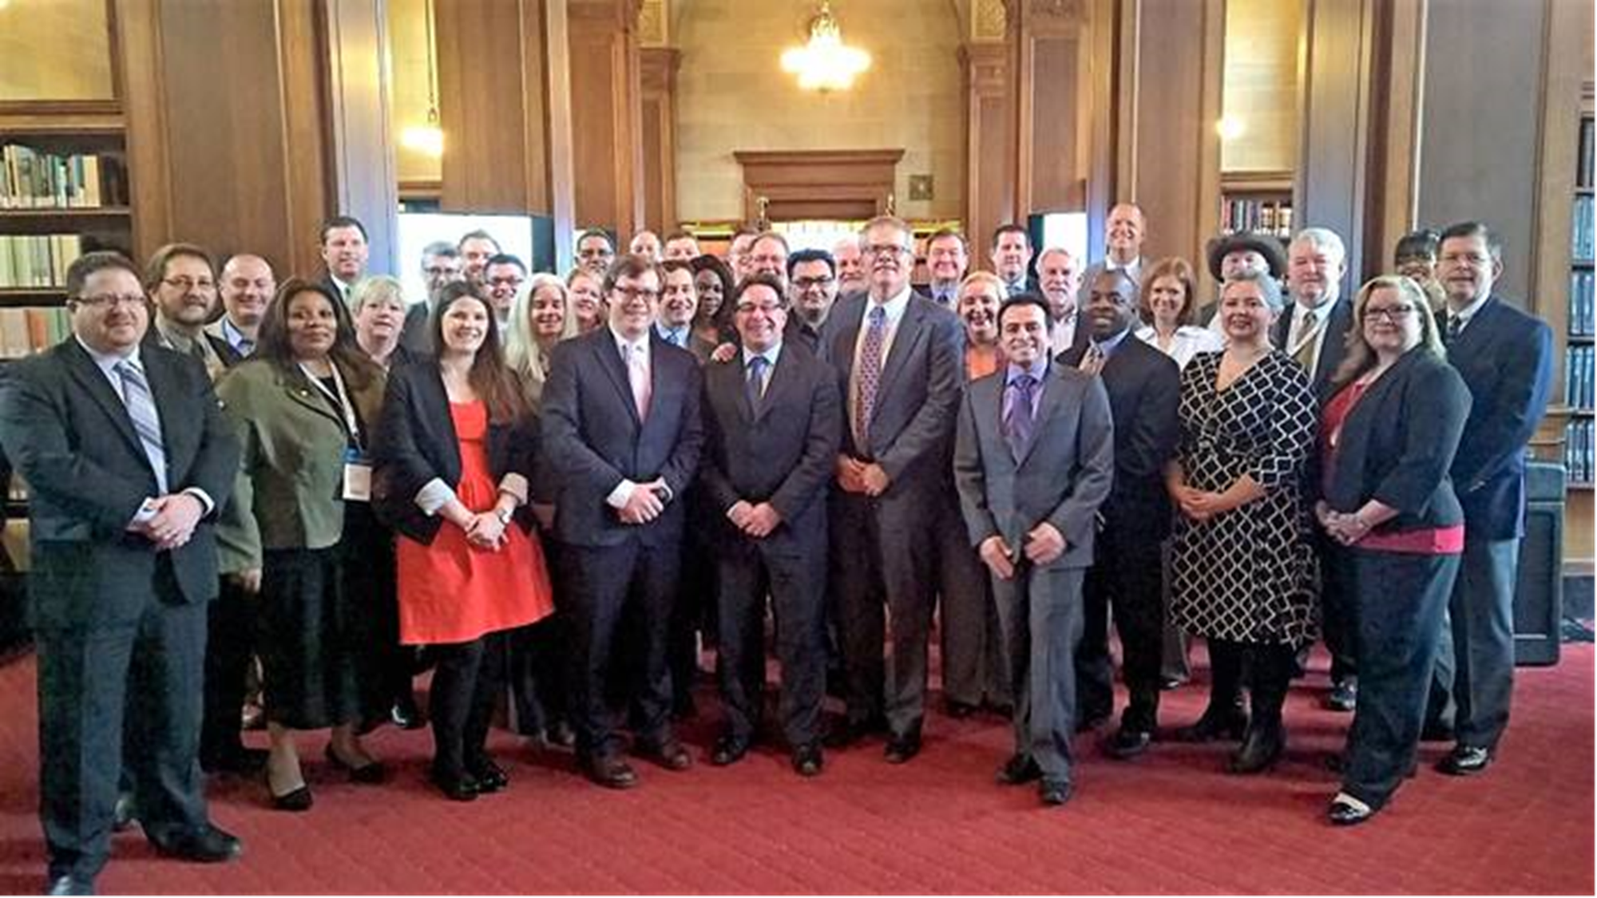

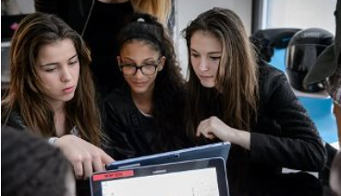
Addressing the challenge: Programmatic and Public Policy
YouthSpark Live
US Hour of Code with Code.org
Lead Industry Coalition
NGO partnerships
TEALS and US education policy
Voices for Innovation
YouthSpark Hub
Congressional Apps Challenge

Slide 19
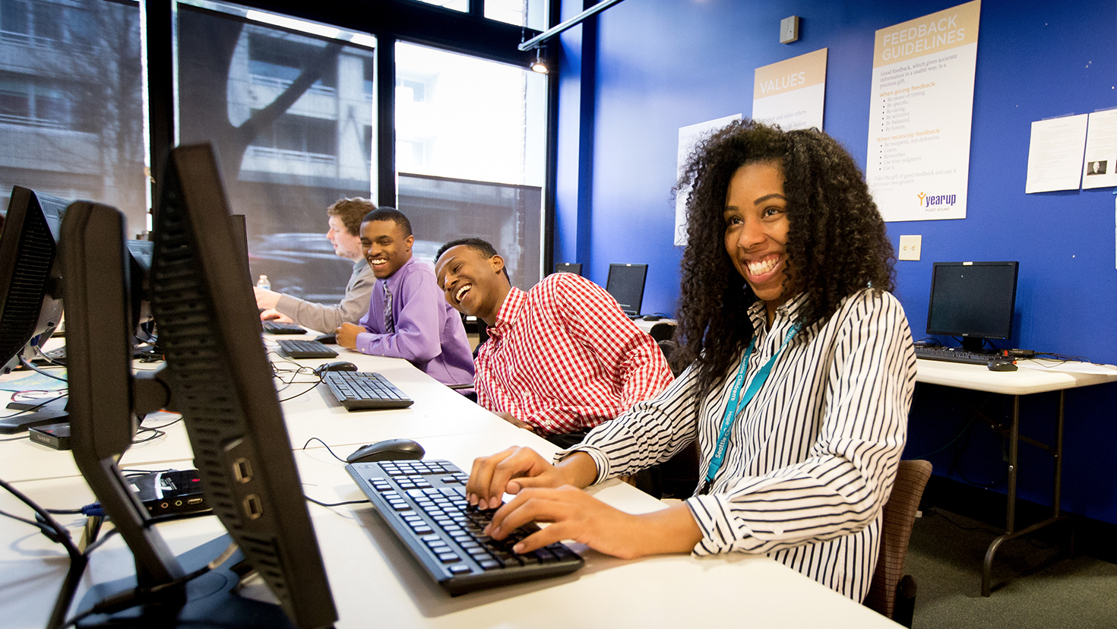
YouthSpark
We’re increasing access to computer science education and opportunities for youth around the globe.

Slide 20
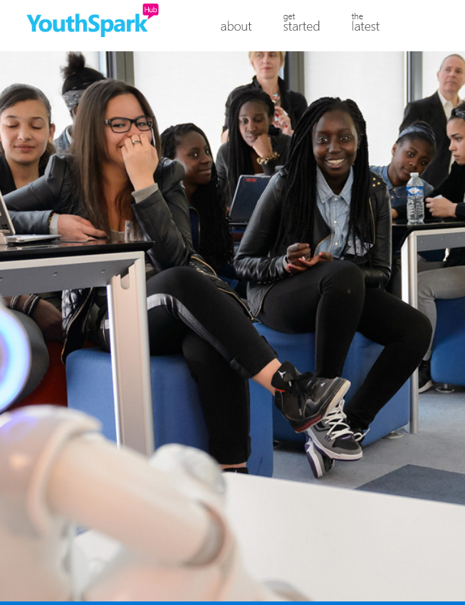
YouthSpark Hub
Free YouthSpark programs to help young people around the world build digital skills and seize opportunities in computer science.
www.youthsparkhub.com

Slide 21
TEALS Facts
We are growing & diverse
  6,000 Students in FY16, 9,000 in FY17, and 17,500 over program lifetime
  29% Girls, 25% Underrepresented
  40% Schools Title I, 10% rural in FY17
We are helping more students learn computer science
  TEALS students represent half of all the WA State CS AP exams taken, 3.5% of national
  TEALS students have higher AP Scores – AP Scores are ~1 standard deviation above national average
Our volunteers are valuable and diverse
  Over the past seven years we’ve logged 450,000 volunteer hours, $107 million value of services
  We have an industry volunteer-base – 75% Of volunteers are non-Microsoft, 200+ companies
We are building CS capacity in schools
  ~90% of teachers are on track to hand off after 2 years in the classroom

Slide 22
Public Policy:
What Can We Do Together?

Slide 23

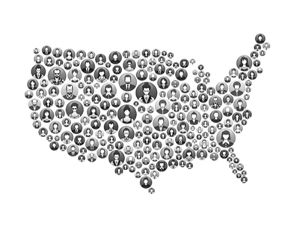

Three Components
⬅
➔
⬅
➔
Members of Congress and
other elected officials
Building a national movement
Traditional and Social Media

Slide 24
Computer Science Education Coalition

Slide 25











Computer Science Education Coalition (CSEC)
A broad based coalition of businesses and NGOs who want to expand access to computer science education in K-12 classrooms across America.
CSEC is represented by over 80 members, including:

Slide 26
Goal
Fixing the computer science skills gap is a national security, economic and social imperative.
Computer science impacts every field, every industry, in
every state.
Initial infusion of $250 million in federal funds could support as many as 52,500 classrooms which can reach 3.6 million students in the coming year.
$250M
Investment
52,500
Classrooms
3.6M
Students

Slide 27
Voices For Innovation
Advancing 21st Century Technology Policies

Slide 28
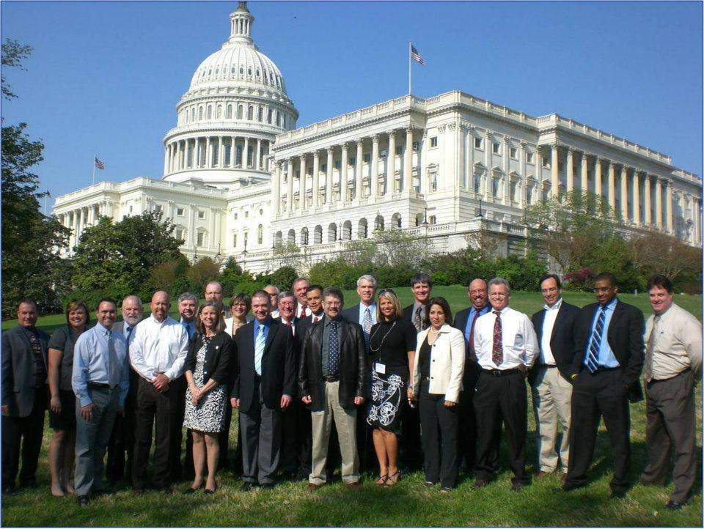
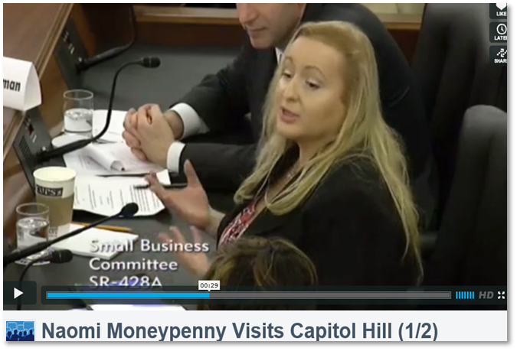
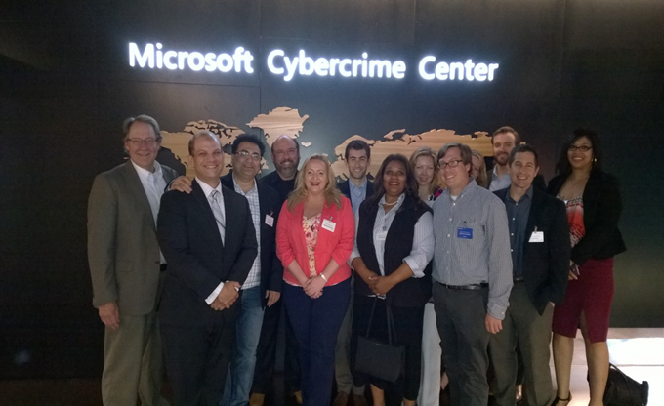

Slide 29
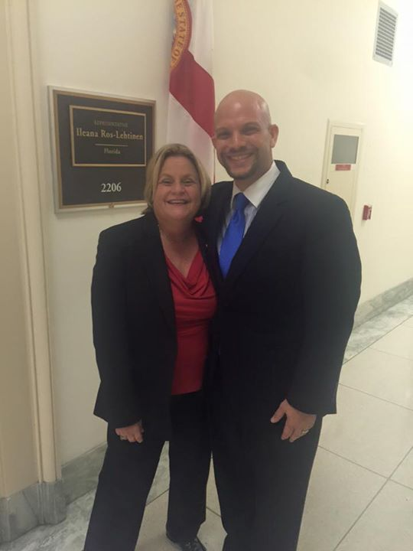
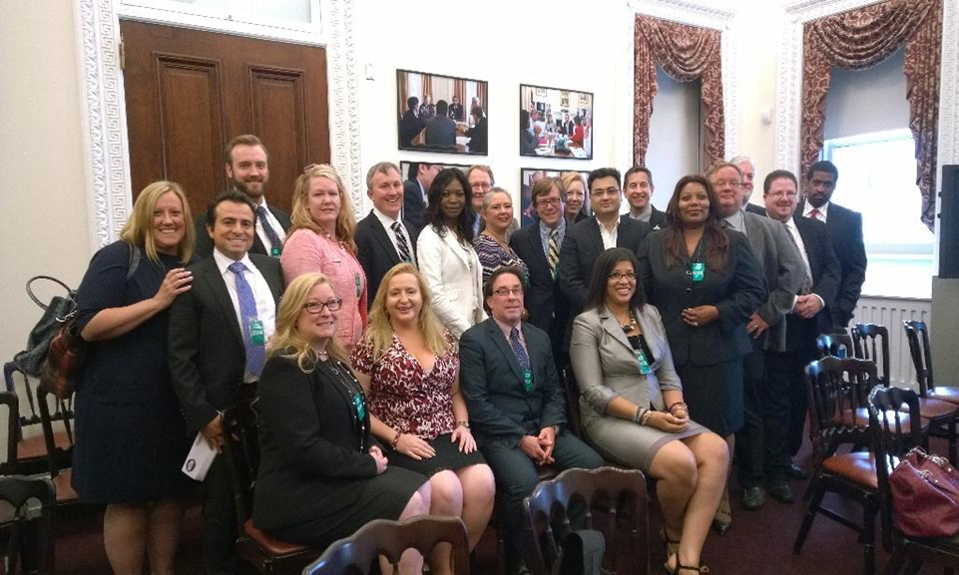
Meet with elected officials and government leaders
VFI Member meeting with Rep. Ros-Lehtinen about Computer Science.
White House summit with VFI Leaders

Slide 30
Go Dos
VFI
Website: http://www.VoicesForInnovation.org/
Facebook: https://www.facebook.com/voicesforinnovation
Twitter: https://twitter.com/vfiorg
CSEC
Website: http://www.csecoalition.org/
Facebook: https://www.facebook.com/csecoalition
Twitter: https://twitter.com/CSECoalition
Other Resources
Youthspark Hub: http://www.youthsparkhub.com
TEALS: http://www.tealsk12.org
Code.org: http://www.code.org

Slide 31
THANK YOU
Mike McMahon: Mikemcm@microsoft.com
Jonathan Friebert: jfrieb@microsoft.com

Slide 32
Please evaluate this session
Your feedback is important to us!
From your PC or Tablet visit MyIgnite at http://myignite.microsoft.com
From your phone download and use the Ignite Mobile App by scanning the QR code above or visiting https://aka.ms/ignite.mobileapp

