Slide 1
Transform and transcend, the modern IT Pro journey
BRK1028
Kim Kischel
Product Marketing Manager
Michael Kophs
Senior Product Marketing Manager

Slide 2
Where did we get all the data?
We talked to >600 IT Pros
1:1 Phone conversations
4 focus groups
Industry | Title | Location | Size | Cloud Products
Healthcare | Technical Architect | US | 10,000+ | O365
Retail | Network Architect | US | 79,000 | O365
Professional Service | IT Collaboration Service Owner | US | 19,000 | O365
Beverage | Market Unit IT Manager Florida | US | 12,000 | O365
Weight Loss | SR. Systems Engineering Lead, Virtual Systems | US | 1,000+ | O365
Construction | Functional Architect | Canada | 500-1,000 | O365, Azure
Software/High Tech | Systems Admin | Canada | 500-1,000 | O365, Azure
Education | Systems Engineer | UK | 2,500-5,000 | O365
Consumer Goods | Integrated Solutions Specialist | Germany | 10,000+ | O365
Manufacturing | Head of Architecture | Denmark | 2,500-5,000 | O365, Google Apps for Work
Leisure & Hospitality | Security Analyst/Architect | US | 10,000+ | AWS, O365
Finance/Insurance | IT Manager | US | 10,000+ | AWS, Azure, O365, Google Apps for Work
Finance/Insurance | VP of Security | UK | 10,000+ | AWS

Slide 3
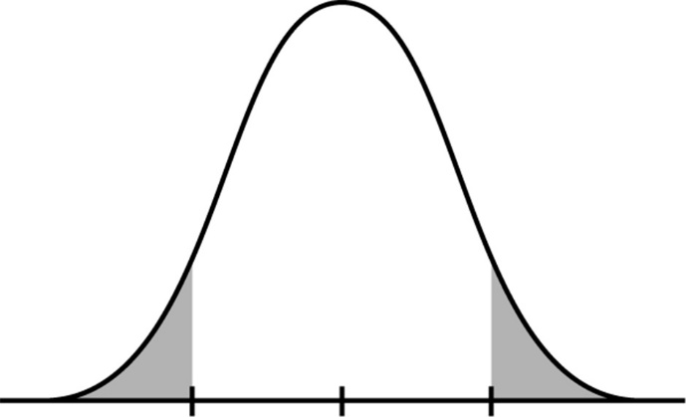
A number of interesting differences start to emerge when looking across all phases of maturity
CLOUD MATURITY
LOW
MEDIUM
HIGH
1-2 cloud products widely used
3-4 cloud products widely used
5+ cloud products widely used
Profile | Mostly Enterprise | Mostly Enterprise | Evenly Distributed: Mid Market and Enterprise
Philosophy | Systems-Orientation | Systems-Orientation with Increasing Agile Orientation | Highest Systems-Orientation AND Highest Agile Orientation (polarized)
Current Initiatives | Security & Application Development | Security & End User Adoption | Security & Application Development
Future Initiatives | Moving more to cloud ERP System Upgrade Machine Intelligence | ERP System Upgrade Machine Intelligence Moving More to Cloud | Deploying SharePoint Modernizing Phone/Message System Single Sign-On
Key Challenges | Skills Gaps | Alignment With BDMs | Org Structure

Slide 4
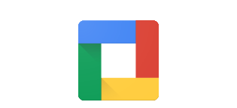
High cloud maturity companies are using an average of 6 cloud products within their organization.
The most common other cloud products include including Google Apps for Work (50%), Slack (29%), and Smartsheet (24%), all arguably more specific solutions for key O365 functions.
~6
Avg # of cloud products used

Slide 5
Main reasons for moving to the cloud
1
2
3
Reduce IT spend (or increase ROI)
Enhance end user productivity
Build a foundation for their digital business*
Companies see the cloud as an opportunity to either spend less on software, hardware, and management or to refocus their IT resources on mission-critical projects– or both.
Enabling an increasingly mobile workforce to access documents and tools anytime/anywhere and, often more importantly, supporting collaboration within and across companies are seen as ways of getting working both faster and smarter than in the past.
Progressive businesses are looking to transition their own offerings and customer experiences digitally, opening up new opportunities. To build for this agility and growth, companies are looking toward the cloud for the foundation of their business.
*Hilgendorf, Kyle. “Building a Solid Foundation for Choosing and Managing Cloud Service Providers” Gartner, 15 June 2015.

Slide 6
Customers are buying Office 365 primarily for IT related reasons…
IT Goal | To simplify IT management/overhead
 | To reduce overall IT costs/capital expenditure on IT
 | It’s part of our corporate IT strategy to move to the cloud
 | To ensure we are always up-to-date with Microsoft productivity solutions
 | To enable our organization to have a more robust platform (better reliability and security)
 | To enable us to replace multiple technologies with a consistent and integrated set of services
 | Microsoft offered us a deal on Office 365 when renewing our Enterprise Agreement
Business Goal | To enable workers to communicate and collaborate better
 | To provide more flexibility for our business to meet changing needs
 | To enable workers to be more productive across devices (PC, tablet, and phone)
 | To enable our own customers to have a better experience working with our organization
 | To enable significant improvement for an important business process
 | Other
IT Goal | 96%
Business Goal | 66%
Source: O365 CAU Customer Research Study, May 2015, Microsoft Corporation

Slide 7
IT departments, are still struggling with how to shift from what they’ve traditionally delivered, to being a services organization driving growth and productivity, structured for rapid adaptability.
While companies are committed to shifting to cloud, many face serious challenges – particularly enterprise companies
Day to day tasks are changing, but still experimenting with how to organize themselves
Skills required are changing – less technical skills and more soft skills
More and more, many cloud products are targeted, consumed and managed by LOB teams
Collaboration channels have been reinvented and many cloud services are targeted toward the user and are sold in via a bottoms-up approach (e.g. Slack)
Still unknown as to how the shift to IaaS will broadly affect team structure

Slide 8
Following deployment, many enterprise companies report they feel unequipped to support O365 with current staff skills
31% of enterprise companies strongly disagree they are staffed to support O365, likely reflecting the extra complexity of deploying and managing cloud services at a large organization
I feel prepared to support O365 with our current staff and skillset (by company size)*
Agree
While some IT Pros see PowerShell as an opportunity to learn a new skill, others find the dependency on PowerShell a barrier (particularly for those things they could do easily on –premises)
“I use PowerShell, but I'm the only one that knows how to do it, so I'm trying to teach my colleagues, but it would be easier if it was just a GUI.
-Montessori Scholengemeenscap Amsterdam, size: 492, location: The Netherlands
*O365 Enterprise Deployment Quant Research – FY15/FY16; Base: 162

Slide 9
…limiting their use of Office 365 to only a portion of what they own
Impact of Purchase Intent on Cross-Workload Utilization
C
ACD
AB
AB
“
“
“The decision [to buy Office 365] was made because our in-house Exchange system was in dire need of work…
[later, post Exchange migration] The IT staff was going around going ‘what’s this SharePoint thing?’ We had an onsite person that said ‘hey I’ve worked with this. This is great. It can do all this stuff.’…
[Still later after implementing custom SharePoint solution]…We thought SharePoint was going to be all we needed but it turns out Lync was definitely value add. We didn’t realize what Lync could do. We just thought it was instant messaging but it was a heck of a lot more than that.”
- IT Decision Maker, Heavy Cross-Workload Utilized EPG Customer
“We really wanted to just reduce the requirement in house to maintain our Email servers. That’s probably the primary driver.”
- IT Decision Maker, Low Cross-Workload Utilized Corporate Accounts Customer
“
“
* Low base size <100
Source: O365 CAU Customer Research Study, May 2015, Microsoft Corporation

Slide 10
WHEN CUSTOMERS DO NOT MAKE A WORKLOAD AVAILABLE TO END USERS ITS OFTEN BECAUSE THEY DO NOT HAVE A BUSINESS CASE FOR ITS USE
We’re already using an alternative solution, which works satisfactorily
Our existing technology infrastructure is not in a ready state for deployment
We have concerns with data privacy
We have concerns with data security
Resources aren’t available to deploy the service and/or train end users
We don’t have a business case for its use in our organization/We don’t know what we would use it for
We aren’t ready to integrate it with other internal systems we have deemed necessary for deployment
It’s not compatible with existing services we are using
There is a lack of executive support for making the service available
We have concerns with slow-down in productivity while end users learn how to use the service
Other
TOP REASONS FOR NOT ENABLING A WORKLOAD
Q: WL9. What are the top reasons why each of the following Office 365 service(s) has not been made available to end users?
Source: O365 CAU Customer Research Study, May 2015, Microsoft Corporation

Slide 11
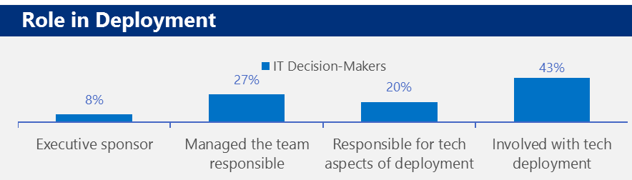
IT Decision-Makers (ITDM)
True Believers” want the latest technology to drive value at their organizations. They place cloud as a strategic priority and driver within the organization. More likely to have a concrete plan in place to roll out all O365 products.
Happy with status quo but will execute top-down decisions. Typically more peer-influenced with new technologies, slow to adopt new tech themselves. Gather information, evaluate, and recommend for hand-off to higher-ups for final selection.
True Believers
Top-down reactors
Challenges
Challenges
Actively seeks new technologies that offer efficiencies for their org; looking for commoditized tasks to outsource
Inherently understand the value of and advocate for the cloud
Stays up to date with innovative products from companies like VMWare, Amazon and Google
Constantly looks for companies that have easy deployment with no hassle support
Can be frustrated with the loss of control and concerned about the dependency on Microsoft
More likely to be worried they will be losing staff as part of the migration
Excited to simplify their environment and reduce the time spent managing email

Slide 12
IT Implementers & Influencers (ITIs)
Ambitious & technical, see cloud as opportunity to expand their knowledge. They focus on cost-effective solutions. They are early tech adopters and more knowledgeable, giving them a higher level of authority in their orgs.
Know their line of work & and are viewed as experts in their roles. They are more change averse, and dislike when new technology or “corporate directives” interrupt their workflow.
Geeky Go-Getters
On-Prem Die-Hard
Challenges
Challenges
Emphasize innovation & incubation projects
Engage them through O365 community & events, not just troubleshooting topics
Opportunity to learn & master new tools & technology, like PowerShell, through self-education; practice and work on new services like SfB and SharePoint
Think about opportunities to put them in the “lime light” or showcase their success
Sometimes discourages their organization from moving to Exchange Online
Fears they will no longer be needed when the servers and infrastructure go away; not as interested in expanding their skillset
Prefers control over their environment and their ability to troubleshoot and reticent to hand over control to Microsoft
How this Role Interacts with O365 Deployment

Slide 13
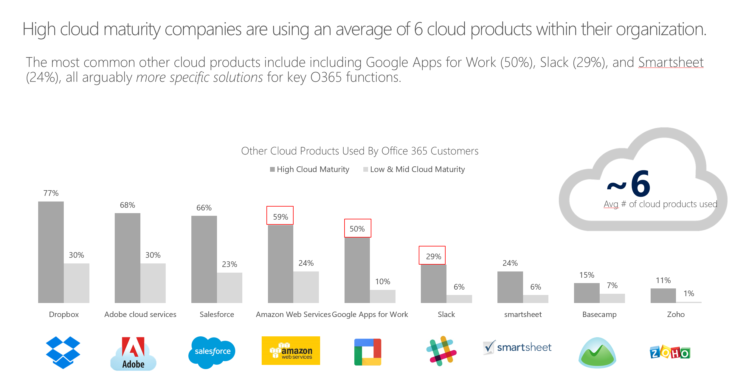
ITDMs and ITIs have shifted across two primary dimensions
Systems Architecture & Service Center
Focus on long-range plan for cost-saving, efficiency, and integration
Focus on serving client (end-user)
Focus on standardizing
Broker between cloud partners and end-users
IT-First
Independent from business units and leadership
Responsible for technical ops
Prioritize projects based on technical value
Traditional IT background
Business-First
Partner directly with business leaders
Responsible for business metrics
Prioritize projects based on business impact
Analytical & enterprising
Dev Ops
Agility & flexibility
Quick-moving
Quick technical learner
Technical learning culture
Right tool for the problem
X-AXIS = PRIMARY OBJECTIVE & ORIENTATION
Y-AXIS = IT APPROACH & CULTURE

Slide 14
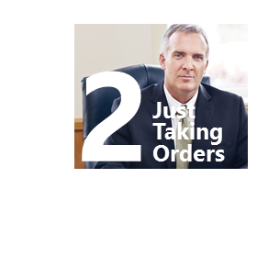
Progressive ITDMs are leading the transformation to business-first IT, while “Just Taking Orders” types are failing to adjust and missing leadership opportunities
Systems Architecture & Service Center
Tech landscape is changing rapidly around them, but they are slow to adapt and take ownership of new trends like business-first mindset or dev ops culture. They are slowly losing their foothold as “leaders.”
3
IT-First
Business-First
Roles and responsibilities more and more directly tie to business peers and leadership. Soft skills like change management and business strategy more valued than traditional IT background. Leading organizations with both strong dev ops and systems/service culture.
X-AXIS = PRIMARY OBJECTIVE & ORIENTATION
Y-AXIS = IT APPROACH & CULTURE
Dev Ops

Slide 15
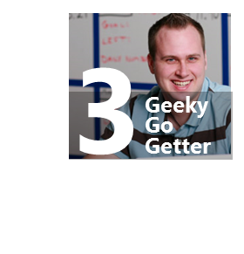
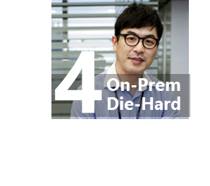
Many ITIs have either adapted to a business-first IT orientation or shifted toward a dev ops, agile-style culture
Systems Architecture & Service Center
Cloud-believers, who quickly pivot to a business mindset, start by understanding business challenges and creating solutions with technology. These ITIs are highly valued and quickly promoted
3
Recommendations
IT-First
Business-First
Other ambitious ITIs take on a dev ops philosophy, focused less on integrated systems and more on agility and a passionate always-learning and iterating culture
Some still believe on-prem has it’s place
X-AXIS = PRIMARY OBJECTIVE & ORIENTATION
Y-AXIS = IT APPROACH & CULTURE
Dev Ops

Slide 16
Most IT Organizations have restructured since shifting to cloud, with three dominant structures
1. Customer-Centric IT
2. Decentralized IT
3. Strategic Steering Arm
Teams serving not only in-bound end-user inquiries but proactively seeking to understand user needs and proactively suggest technology solutions
Use internal metrics like customer satisfaction to measure success
Decentralization to locate IT closer organizationally to internal end-users and business units, closer to customer-facing end-users or closer to the customer
Addition or elevation of a strategy team or role within the IT organization. This role works closely with business leadership to set strategy and consider big picture decisions related to technology
In some cases, organizations transitioned delivery IT roles to external partners

Slide 17
Increasingly, IT organizations act like “services” organizations for internal “customers” and orient change around “customer-centric” philosophies
Many IT Organizations have pivoted ITI roles to generalist “service” roles, that work with outsourced IT or Cloud Services to address internal “customer” issues. These organizations anchor on customer-centric philosophies, expressed as:
IT as “service brokers” between end-users and outsourced service
Culture of “empathy” for the end users
Hiring for “people skills”
1. Customer-Centric IT
“The way technology is headed, the days of 'I'm a nerd' are numbered. With modern cloud tools, there’s more than one way to solve a technical problem. It should be empathy first and then critical thinking, with the geek value to ultimately recommend what they need to do.”
- ITDM, Intervarsity, 1,000
ITI
BU Employees
“What we are doing with the organization structure is collapsing roles. We are taking our people and retraining them to be service brokers. Where they may not be physically racking and stacking machines; instead, they are sitting at a console monitoring services. And when there are issues, they will be the bridge between end users and that third party vendor. ”
-ITDM, Abraham Baldwin Agricultural College, 400
INTERNAL IT ORGANIZATION
OUTSOURCED IT -OR- EXTERNAL CLOUD VENDORS
BUSINESS
ITI
BU Employees
ITI
BU Employees

Slide 18
Decentralization manifests in different ways and connects IT directly with end-users to increase accountability to business results
2. Decentralized IT
IT ORGANIZATION
Enterprise IT distributed to business units in one of following ways:
IT Field Engineer reports to Business Unit Manager, with dotted line to IT Regional Manager (pictured left)
IT relationship managers assigned to different business units and responsible for representing their needs and interests
IT Field reps assigned to visit retail locations and proactively think about how to improve technology used by retail reps
IT Leadership
IT Director
IT Regional Mgr.
IT Regional Mgr.
“We've introduced a role called the BRM, the business relationship manager. They're assigned to different business units. They work directly with assigned business unit to understand their requests, their needs, what they're looking for, and then they help communicate that back to the different service teams.”
ITDM, size: 19,000+, location: United States
BUSINESS UNIT (BU)
BUSINESS UNIT (BU)
BU Manager
BU Manager
BU Employees
IT Field Engineer
IT Field Engineer
BU Employees

Slide 19
Many companies add “strategy” roles or teams to make high-impact decisions and interface with both IT and business. Some such organizations outsource lower ITI delivery roles
3. Strategic Steering Arm
1. Before
IT is split into traditional functions like support, development, and infrastructure
CIO is only IT role involved in larger strategic conversations
2. After
Same teams exist, but a new “strategy” team or role sits more horizontal to the CIO
Strategy works with leadership to define strategic priorities, evaluate major investments, and consider how all projects support the business
“We have a Director of Technology Strategy in our group. It’s a fairly new role. He plays an important role in proactively thinking about how technology can better serve people in the organization and makes sure the IT support team has direction on where to go next.”
- ITDM, InterVaristy, 1,000+
IT ORGANIZATION
IT ORGANIZATION
CIO
CIO
Strategy Team
Support
Development
Infrastructure
Support
Development
Infrastructure

Slide 20
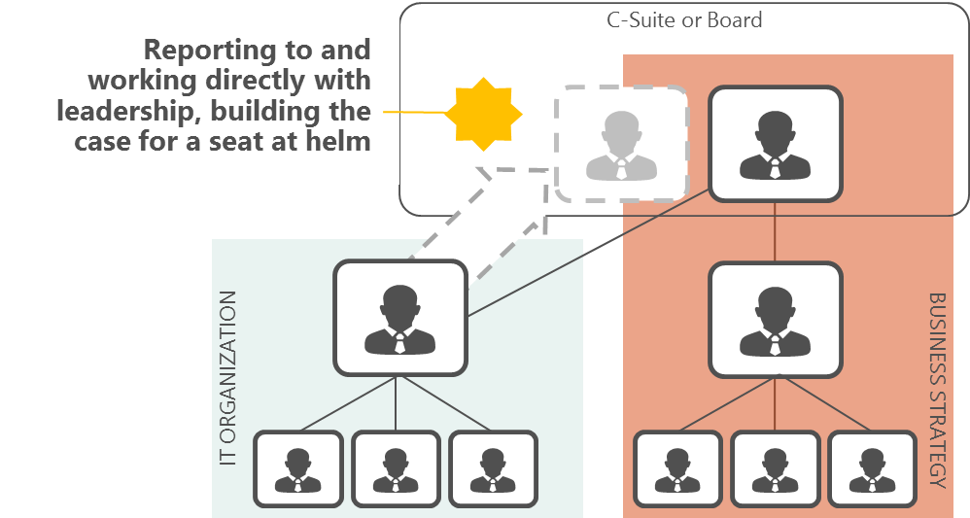
ITDMs who successfully take on business strategy responsibilities are carving a pathway to C-suite and board roles
CAREER TREND
Moving to cloud has enabled ITDMs to take on more direct partnership with business strategy.
Some feel empowered to break into the executive board where a technology seat does not already exist
OPPORTUNITY
Help IT Pros recognize career opportunity
High priority to nurture relationships with ITDMs as they transition into high power BDMs

Slide 21
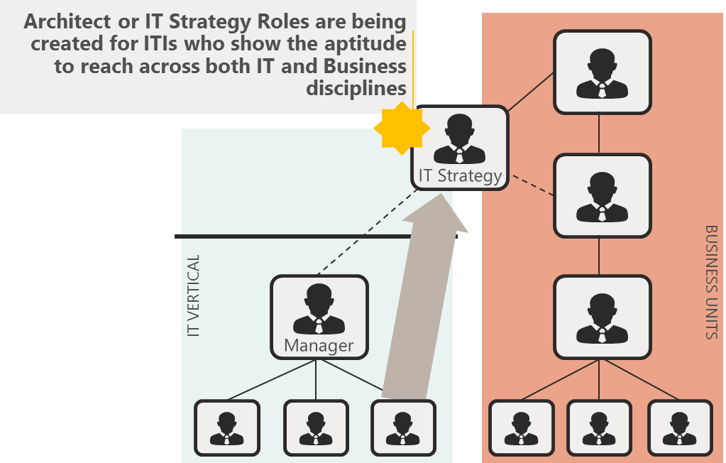
In order to move up ITIs must gain visibility outside their vertical. They can achieve this by stepping outside of role to engage with the rest of the business.
CAREER TREND
ITIs may take on a strategic project for leadership or may proactively go looking for business problems they can solve from their seat in IT. Both require stepping outside their typical role and showing an aptitude for thinking across business, IT, and people.
OPPORTUNITY
Recognize difference between ITIs committed to a vertical and those interested in integrating with the business
Help ITIs understand opportunities to add value to business and break through the ceiling

Slide 22
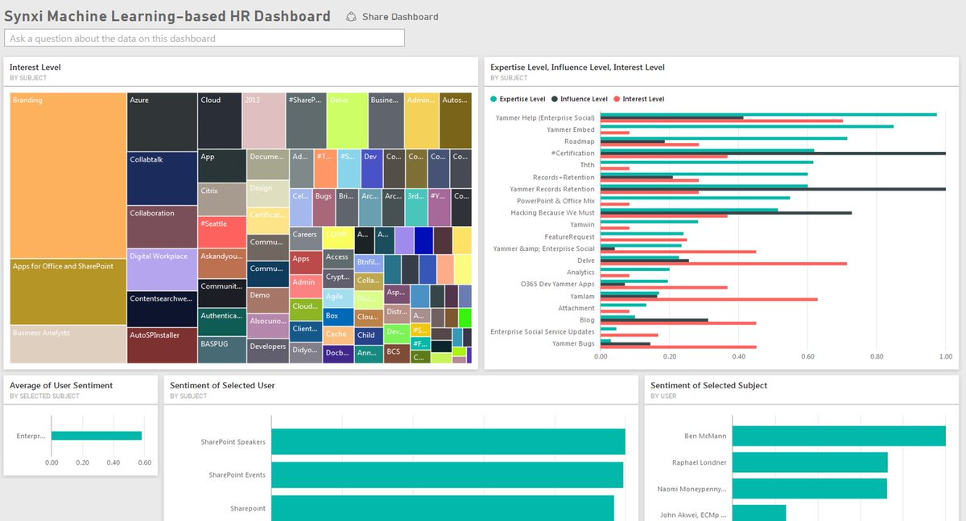
ManyWorlds – High Growth R&D
Last 10 years journey to cloud
Transformation starting with co-locating servers to implementing Yammer
Global move to Office 365 18 months again
Now 100% in the cloud inc. proprietary algorithm processing & DevOps
“At first, the cloud made sense for cost effectiveness, but now it’s essential to our growth”
– Naomi Moneypenny, CTO

Slide 23
Summary
What is your current role in IT, and what type of role would you like going forward?
What type of IT Org are you in?
Is there opportunity for deeper engagement between IT and the business?
What value are you bringing your org around solving productivity challenges?

Slide 24
Demo
Office 365 Admin Center – Usage Reports

Slide 25
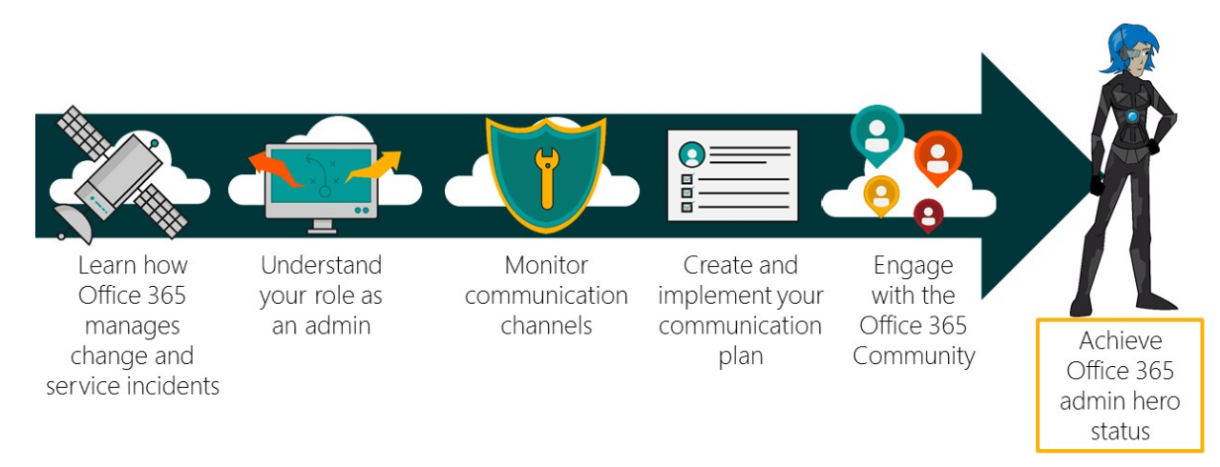
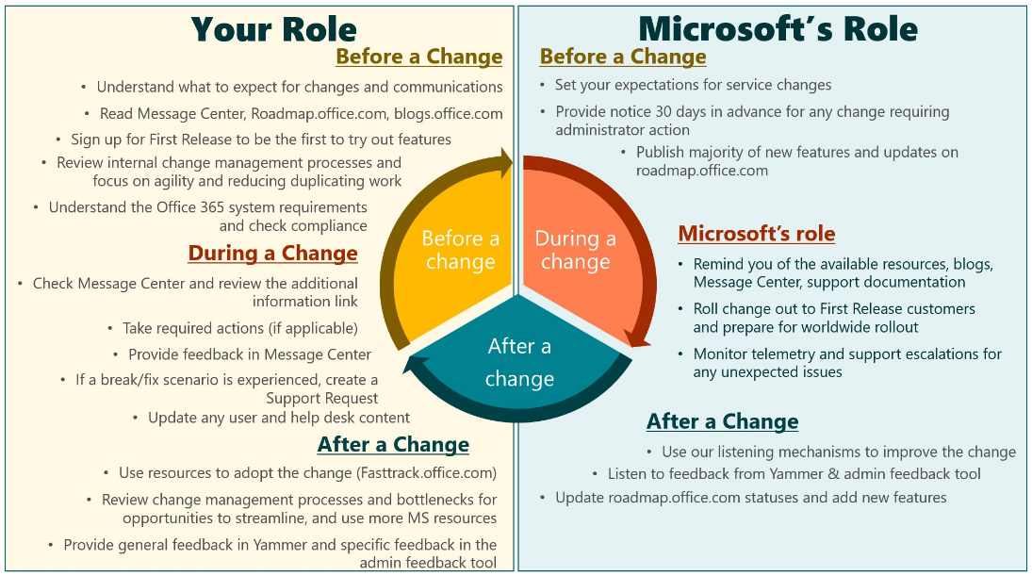
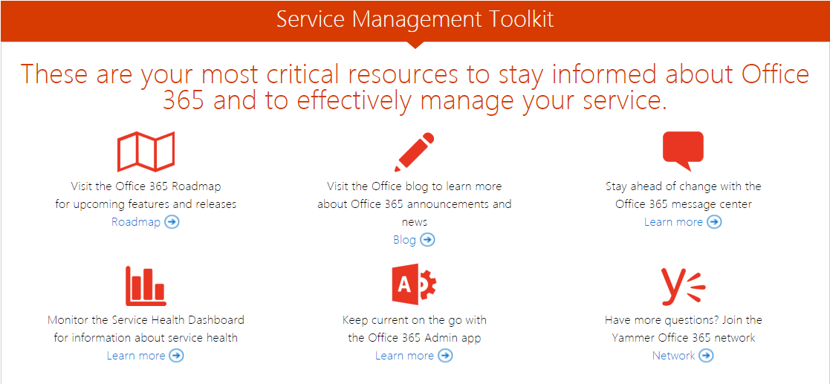
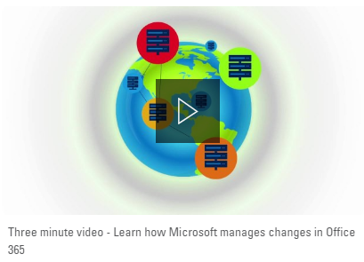
Office 365 Service Management Readiness for Admins
Key Resources for your IT Pros:
Microsoft Virtual Academy O365 courses for IT Pros
Office 365 Admin Learning Center
Office for IT Pros
Office help and training
Microsoft Tech Community
Microsoft Mechanics YouTube channel
Service Management Toolkit
Microsoft Tech Summit FY17

Slide 26
Deploy, ramp-up on new services and onboard new users with Microsoft FastTrack: http://fasttrack.microsoft.com/

Slide 27
Join the Microsoft Tech Community to collaborate, share, and learn from the experts: http://techcommunity.microsoft.com

Slide 28
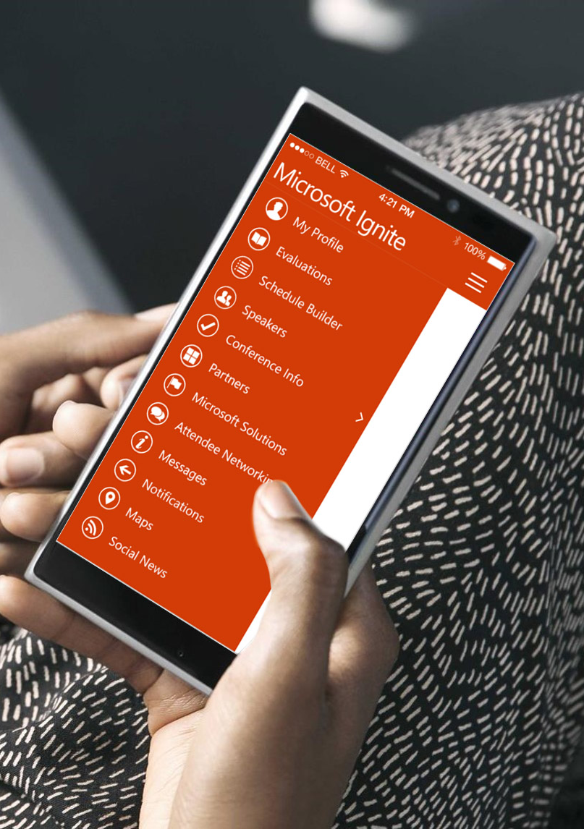
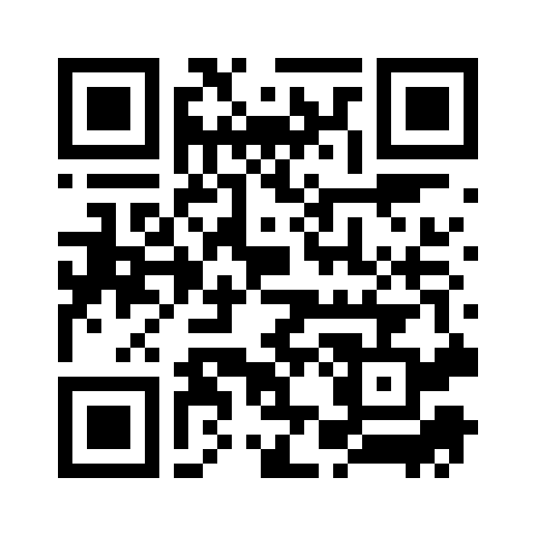
Please evaluate this session
Your feedback is important to us!
From your PC or Tablet visit MyIgnite at http://myignite.microsoft.com
From your phone download and use the Ignite Mobile App by scanning the QR code above or visiting https://aka.ms/ignite.mobileapp

