Slide 1
Transform your business with Azure
BRK1024
Arpan Shah, General Manager
Tanuj Bansal, Director
Azure Product Marketing

Slide 2
Session
Audience target is IT leaders/decision makers
Azure overview 101 focused on value and examples

Slide 3
Engage your customers
Transform your products
Digital transformation
Empower your employees
Optimize your operations

Slide 4


GOING DIGITAL
1 million/hour
new devices coming online
by 2020
12 years
average age of S&P 500 corporations
by 2020
60% computing
in the public cloud by 2025

Slide 5
Application innovation
Accelerate innovation with the cloud
Data and intelligence
Power decisions & apps with insights
Microsoft Azure
Openness and flexibility
Build freely, deploy anywhere
Trust
Protect your business

Slide 6
Application innovation
Accelerate innovation with the cloud
Build apps faster and easier
Manage applications proactively
Deliver native mobile apps seamlessly

Slide 7
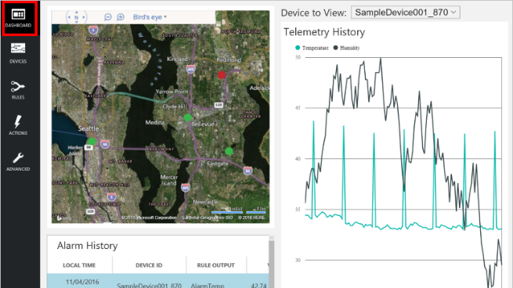
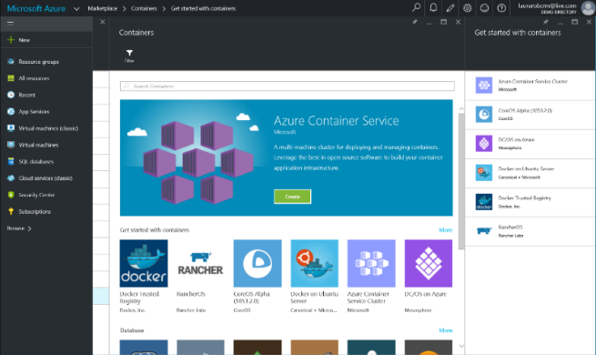
Build apps faster and easier
Build on PaaS
Azure
Internet of Things
Azure
Marketplace
Existing
frameworks
Web
and mobile
Microservices
Serverless
Compute
Build on IaaS
Virtual
machines
Storage
Networking

Slide 8
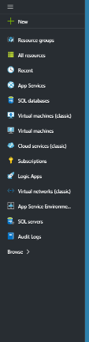

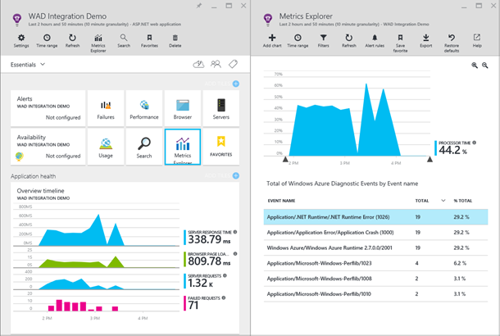
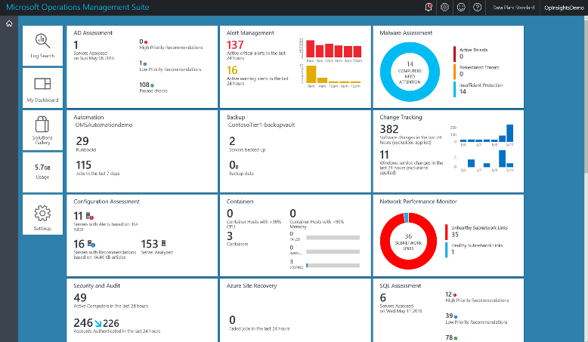
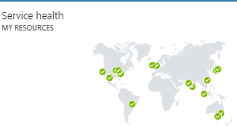
Manage applications proactively
Azure Portal
Application
Insights
Operations Management Suite

Slide 9

Deliver native mobile apps seamlessly
Mobile DevOps
Mobile Back-end Services
Code Repository
Build + Deploy
Automated Testing
User Testing
Cloud and Offline Data
User Authentication
Backlog
Push Notifications
Monitor and improve

Slide 10

Application innovation

Slide 11
Demo
Tanuj Bansal

Slide 12
Application innovation
Accelerate innovation with the cloud
Data and intelligence
Power decisions & apps with insights
Microsoft Azure
Openness and flexibility
Build freely, deploy anywhere
Trust
Protect your business

Slide 13
Data and intelligence
Power decisions & apps with insights
Support business strategy with any data
Predict and respond proactively
Learn and engage with artificial intelligence

Slide 14
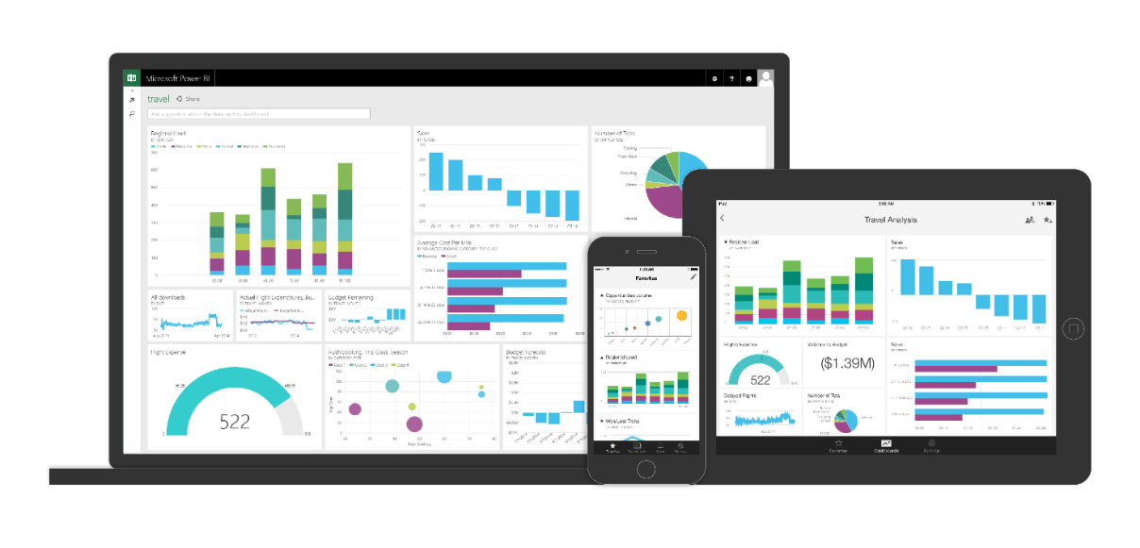
Support business strategy with any data
Back-end power
Front-end insights
Big data
Web data
Traditional data
OLTP
ERP
CRM
LOB

Slide 15
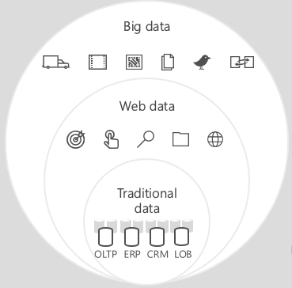
Predict and respond proactively
Azure Machine
Learning templates
Azure Machine
Learning service
Demand forecasting
Predictive maintenance
Vehicle telemetry
Data
Modeling & APIs
Clients
ML STUDIO
API

Slide 16
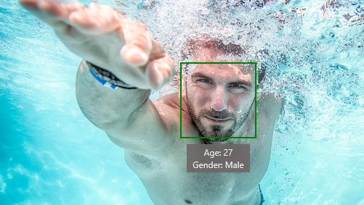
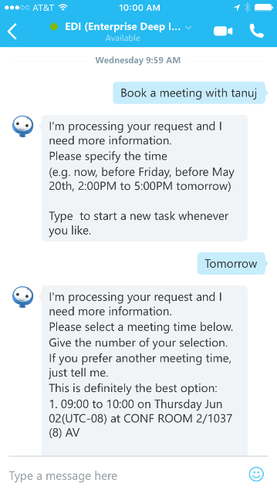
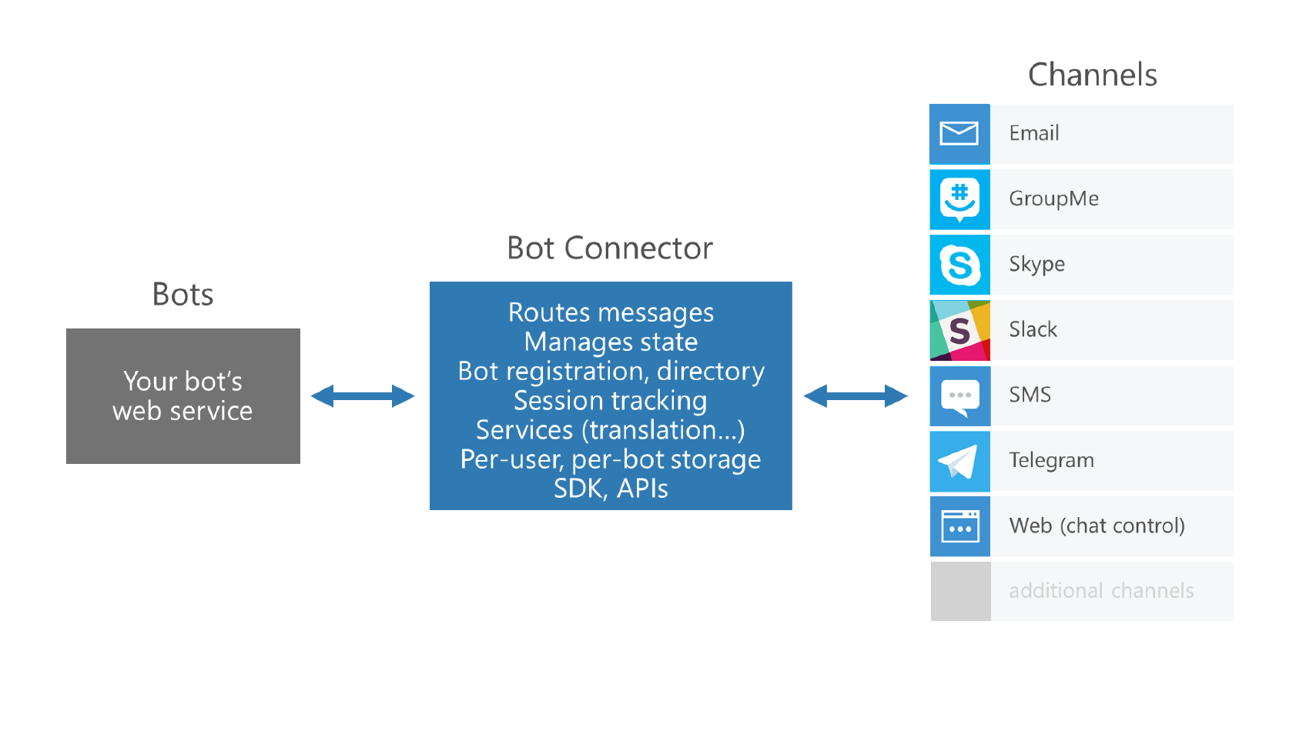



Learn and engage with artificial intelligence
Cognitive services
Bot framework
Is Adult Content: False
Categories: people_swimming

Slide 17


Data and intelligence

Slide 18
Demo
Tanuj Bansal

Slide 19
Application innovation
Accelerate innovation with the cloud
Data and intelligence
Power decisions & apps with insights
Microsoft Azure
Openness and flexibility
Build freely, deploy anywhere
Trust
Protect your business

Slide 20
Openness and flexibility
Build freely, deploy anywhere
Build and run open source solutions
Extend on-premises data and apps
Deploy the cloud on-premises

Slide 21





























Build and run open source solutions
Any tool, application, framework
Applications
DevOps
Frameworks
Databases & middleware
Containers
Infrastructure

Slide 22
Extend on-premises data and apps
Hybrid Use Cases
Seamless & secure across
Application Availability
Bottomless Storage
Identity Management
Full hybrid applications
INFRASTRUCTURE
Azure Backup
Azure Site Recovery
DATA
Azure StorSimple
SQL Server Stretch DB
USERS
Azure Active Directory
APPS
App Service
Web | Mobile | Logic Apps | API Apps
MANAGEMENT
Operations Management Suite

Slide 23
Deploy the cloud on-premises
Azure Stack
Portal | PowerShell |
Dev-ops tools
Portal | PowerShell |
Dev-ops tools
One Azure
ecosystem
Azure Resource Manager
Azure Resource Manager
Unified app development
Azure IaaS | Azure PaaS
Azure IaaS | Azure PaaS
Compute | Networking | Storage
App Service | Service Fabric
Azure services in
your datacenter
Cloud infrastructure
Cloud-inspired
infrastructure
Microsoft Azure
PUBLIC
Microsoft Azure Stack
PRIVATE | HOSTED

Slide 24


Openness and Flexibility

Slide 25
Demo
Tanuj Bansal

Slide 26
Application innovation
Accelerate innovation with the cloud
Data and intelligence
Power decisions & apps with insights
Microsoft Azure
Openness and flexibility
Build freely, deploy anywhere
Trust
Protect your business

Slide 27
Trust
Protect your business
Detect and mitigate threats
Achieve global scale, in local regions
Benefit from relentless business commitment

Slide 28
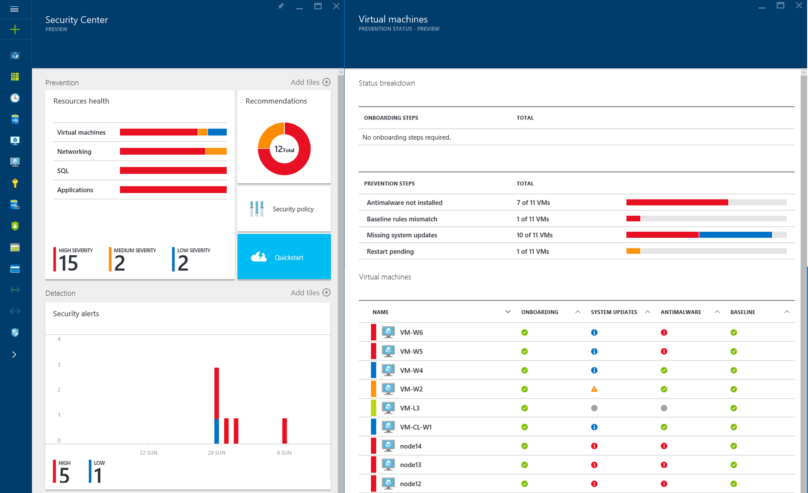
Detect and mitigate threats
Securing the platform with
Innovation and transparency
Empowering you with
Azure Security Center
RED TEAM
BLUE TEAM

Slide 29



Achieve global scale, in local regions
34
regions

Slide 30




























Benefit from relentless business commitment
ISO 27001
SOC 1 Type 2
SOC 2 Type 2
PCI DSS Level 1
Cloud Controls
Matrix
ISO 27018
Content Delivery and
Security Association
Shared
Assessments
FedRAMP
JAB P-ATO
HIPAA/
HITECH
FIPS 140-2
21 CFR
Part 11
FERPA
DISA Level 2
CJIS
IRS 1075
ITAR-ready
Section
508 VPAT
European
Union Model Clauses
EU Safe
Harbor
United Kingdom
G-Cloud
China Multi
Layer Protection
Scheme
China
GB 18030
China
CCCPPF
Singapore
MTCS Level 3
Australia
Signals
Directorate
New
Zealand
GCIO
Japan
Financial Services
ENISA
IAF

Slide 31
Application innovation
Accelerate innovation with the cloud
Data and intelligence
Power decisions & apps with insights
Microsoft Azure
Openness and flexibility
Build freely, deploy anywhere
Trust
Protect your business

Slide 32
Microsoft Cloud
Secure Productive Enterprise &
Operations Management + Security
Cortana Intelligence Suite
Office 365
Dynamics
Azure
PRODUCTIVITY
BUSINESS
APPS
SECURITY &
MANAGEMENT
DATA &
INTELLIGENCE
APPLICATION
INNOVATION

Slide 33
Thank you

Slide 34
Free IT Pro resources
To advance your career in cloud technology
Plan your
career path
Cloud role mapping
Expert advice on skills needed
Self-paced curriculum by cloud role
$300 Azure credits and extended trials
Pluralsight 3 month subscription (10 courses)
Phone support incident
Weekly short videos and insights from Microsoft’s leaders and engineers
Connect with community of peers and Microsoft experts
Microsoft IT Pro Career Center
www.microsoft.com/itprocareercenter
Get started
with Azure
Microsoft IT Pro Cloud Essentials
www.microsoft.com/itprocloudessentials
Demos and
how-to videos
Microsoft Mechanics
www.microsoft.com/mechanics
Connect with peers and experts
Microsoft Tech Community
https://techcommunity.microsoft.com

Slide 35
Free IT Pro resources
To advance your career in cloud technology
Plan your
career path
Cloud role mapping
Expert advice on skills needed
Self-paced curriculum by cloud role
$300 Azure credits and extended trials
Pluralsight 3 month subscription (10 courses)
Phone support incident
Weekly short videos and insights from Microsoft’s leaders and engineers
Connect with community of peers and Microsoft experts
Microsoft IT Pro Career Center
www.microsoft.com/itprocareercenter
Get started
with Azure
Microsoft IT Pro Cloud Essentials
www.microsoft.com/itprocloudessentials
Demos and
how-to videos
Microsoft Mechanics
www.microsoft.com/mechanics
Connect with peers and experts
Microsoft Tech Community
https://techcommunity.microsoft.com

Slide 36


Please evaluate this session
Your feedback is important to us!
From your PC or Tablet visit MyIgnite at http://myignite.microsoft.com
From your phone download and use the Ignite Mobile App by scanning the QR code above or visiting https://aka.ms/ignite.mobileapp

