Slide 1
Take back your time with MyAnalytics
BRK1020
Nick Robinson, Sr Product Marketing Manager, MyAnalytics
Bill Diekmann, Director, Information Technology at Cupertino Electric Inc
Peter Mabee, Group Program Manager, MyAnalytics

Slide 2
Objectives
Welcome to MyAnalytics
Customer success story
MyAnalytics futures
Inspire you to re-invent your own productivity

Slide 4
Work today
13%
47%
28%
of employees
engaged at work
of meeting time is
unproductive
spent managing email
3 min
8
30x
per
hour
Interruptions every
windows open
on average
Check inbox

Slide 5
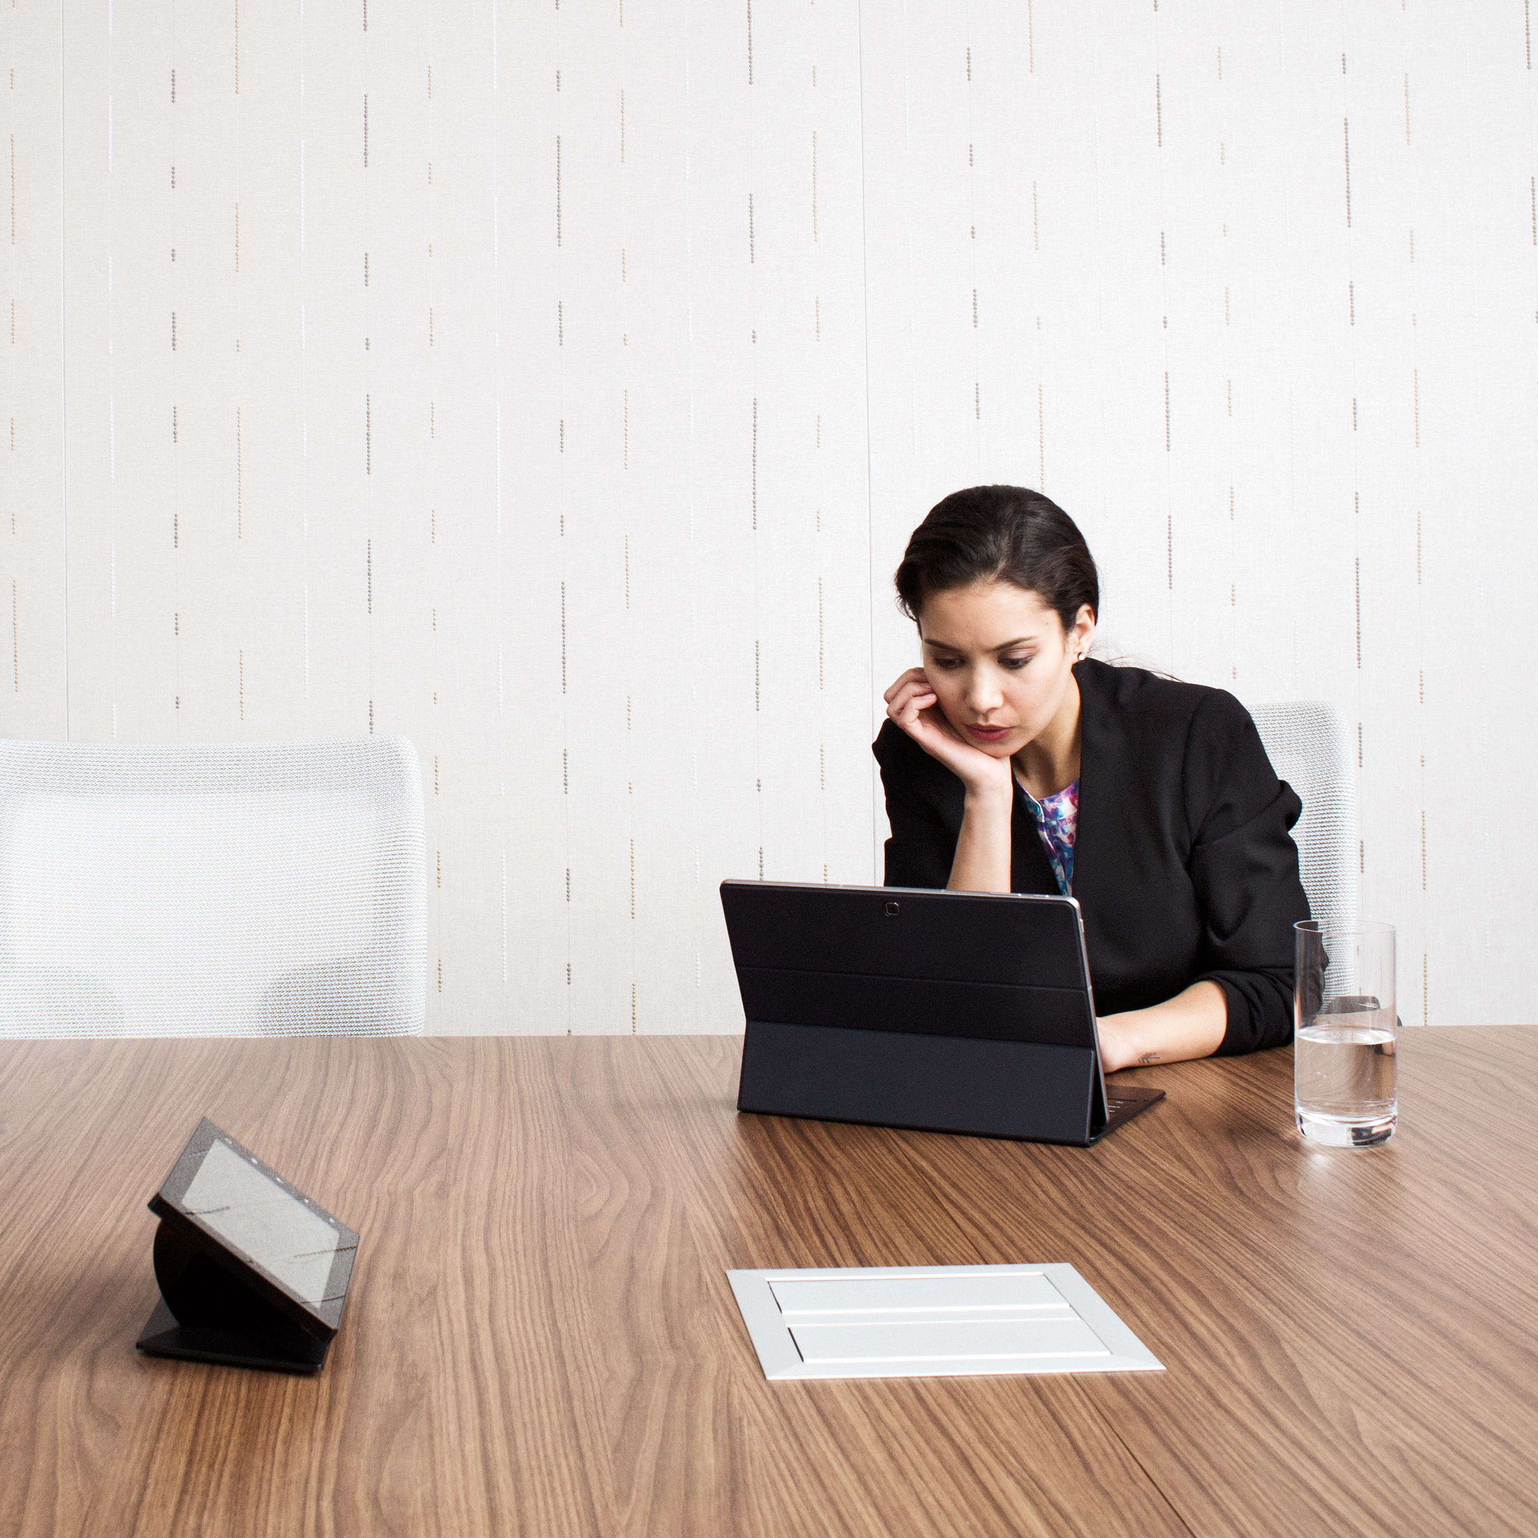
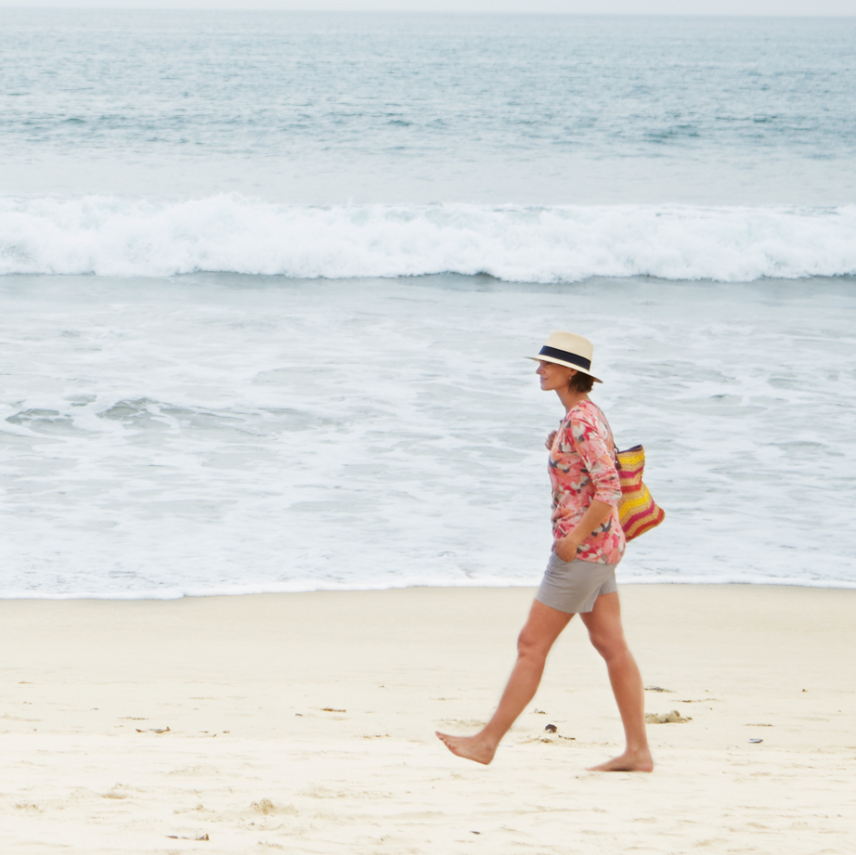
It can feel hopeless
71% of millennials “mentally checked out”
100 emails
per day by 2019
Only 70%
earned vacation days taken

Slide 6
New possibility
Insights into how time is actually spent
Meaningful personal insights to target problem areas and track progress
Increase productivity, efficacy and sense of control

Slide 7
Demo
Nick Robinson

Slide 8
MyAnalytics delivers…
4 hours per week per employee recovered from email and meetings
= 100 more FTEs*
Improved employee
engagement & satisfaction
Reduction in wasted
time & effort
Focus on what
matters most

Slide 9
Video
your email is yours

Slide 11
Customer snapshot
Bill Diekmann, Director of IT Architecture and Security, Cupertino Electric Inc

Slide 12
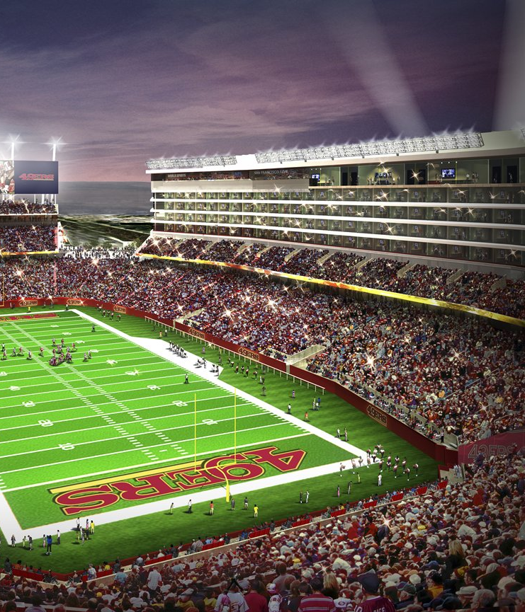
Founded 1954
$750M+ in Revenue
5M man-hours of labor in 2015
$1B+ of data centers constructed
Our mission: To deliver power and possibilities
– www.cei.com
1+ GW of solar installed

Slide 13
Problem statement
TRIGGERED BY SUSPECTED HIDDEN INEFFICIENCIES (validated by MyAnalytics)
“We were good, but discovered
we could be better”
Meeting time and after hours work was trending up across the team
Up to 60% of work time spent in meetings
Load balancing
Meeting inefficiencies
“I’ve always had a gut feeling about how my team works. Now, I can actually verify, take action and track progress.”
Slow collaboration
Work life balance

Slide 14
Solution
1
TEAM COACHING
2
BEST PRACTICES
3
FEEDBACK LOOP
Sharing analytics with manager
Coaching of best practices
Cross team priorities and work load
Establish meeting best practices
New norm for meetings reduced from 60m to 20m
New scrutiny for meeting invites
Tangible insights empowered with data
Accountability – team mandate to reduce multi-tasking in meetings
“You get what you measure”

Slide 15
Impact
“GUT FEEL”
“KNOWING”
I HAVE A FEELING ...
We are spending too much time in meetings
Employees are spending too much time working after hours
We could be more efficient
NOW I AM ABLE TO:
Validate, verify and take action
Ensure meeting habits and after hours are within expected norms
Experiment with new productivity tricks

Slide 16
What’s next at Cupertino Electric ...
Roll out to executives and senior managers
Engage with power users and land best practices
Transform the way we work

Slide 17
A look ahead
Peter Mabee

Slide 18
Local change with global impact
Band together
Harness feedback loop
Improve effectiveness

Slide 19
Demo
Peter Mabee

Slide 20
Video
Your calendar is yours

Slide 22
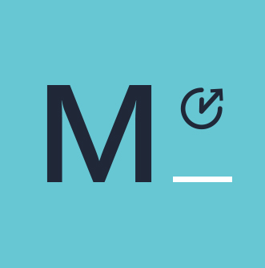
What’s next?

Slide 23
Q&A

Slide 24
Q&A

Slide 25
Deploy, ramp-up on new services and onboard new users with Microsoft FastTrack: http://fasttrack.microsoft.com/

Slide 26
Join the Microsoft Tech Community to collaborate, share, and learn from the experts: http://techcommunity.microsoft.com

Slide 27
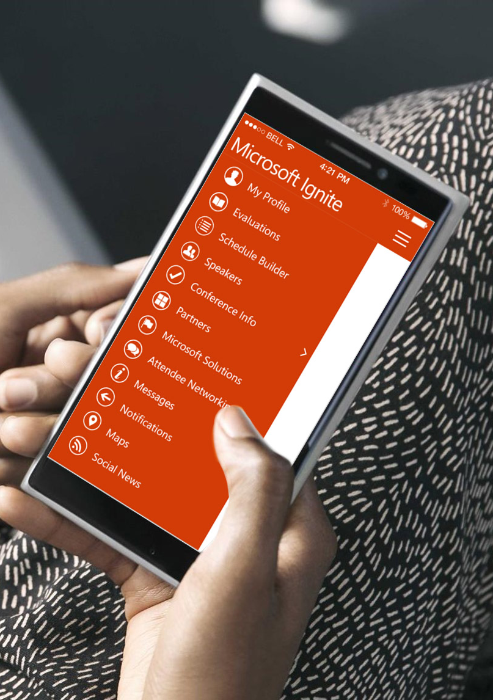
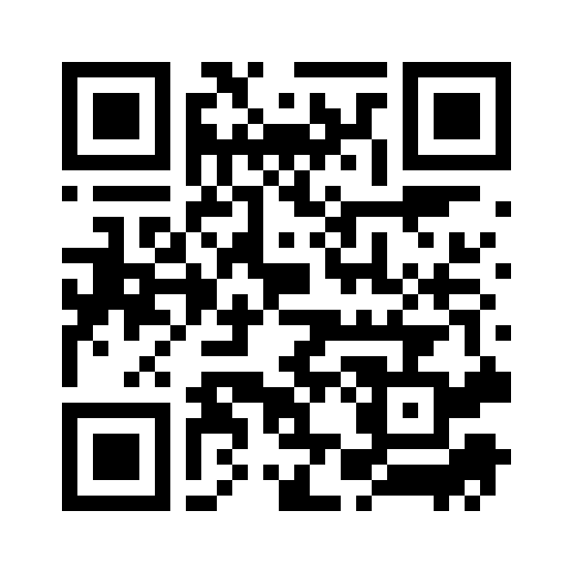
Please evaluate this session
Your feedback is important to us!
From your PC or Tablet visit MyIgnite at http://myignite.microsoft.com
From your phone download and use the Ignite Mobile App by scanning the QR code above or visiting https://aka.ms/ignite.mobileapp

