Slide 1
Harness the power of the Internet of Things
BRK1014
Jim Bailey
Senior Managing Director, Accenture Mobility
Fabio Mungo
Managing Director, Accenture Mobility – Microsoft IoT Relationship Lead

Slide 2
Agenda
Welcome Jim Bailey
Market Trends Jim Bailey
IoT in the Enterprise
The Platform Economy
IoT Platforms & the Ecosystem Fabio Mungo
Industry Examples Fabio Mungo
Case Studies
Solution Demonstration
  Q&A All
3

Slide 3
IoT in the Enterprise

Slide 4

What is IoT?
Internet of Things: Connect, Compute, Communicate
Copyright © 2016 Accenture All rights reserved.

Slide 5








Dramatic evolution in the Mobility stack
2010
2016
Apps
Enterprise Mobility
Consumer Apps
Vertical Solutions
Banking
Media
Automotive
Industrial Eq.
Retail
Energy
Comms
Consumer Goods
Public Service
Utilities
…
Security
Data
AI
Aggregator
Visualization
Cloud
Cloud
OEM
Infra
Semico
Enterprise SW
Platforms
Connectivity
Devices
Connectivity
Devices
6

Slide 6
Billions of devices are coming online
In 2020…
25-50B
Connected Devices
250M
410M
500-700M
9.7B
400M
Connected Vehicles on
the road
Wearable devices sold
Connected homes
Connected “things” within cities
Source: 3rd Party Research Firms
7

Slide 7
Executives believe the IoT will impact many areas of their business in the next three years
In 2020…
87%
87%
86%
85%
83%
…enable us to enhance our products and services
…increase levels
of engagement with
our solutions
…improve our
supply chain
…allow us to
develop new
revenue streams
…empower
employees
Source: Accenture Research
8

Slide 8
Companies are investing in IoT as a way to pursue three main business objectives
DRIVE
OPERATIONAL
EFFICIENCIES
IMPROVE PRODUCT PERFORMANCE AND USER EXPERIENCE
ENABLE
DISRUPTIVE BUSINESS MODELS
9

Slide 9
Accenture in IoT:
Providing transformative capabilities for enterprises through horizontal and industry-specific IoT solutions
Connected Transport
Connected Spaces
Connected Operations
Connected Health
Connected Commerce
Use Case Categories
Use Case Categories
Use Case Categories
Use Case Categories
Use Case Categories
Connected Vehicle
Connected Home
Connected Manufacturing
Remote Patient Monitoring
IoT Payment & Data Security
Connected Fleet
Connected Buildings
Connected Asset Mgmt
Wellness & Prevention
Blockchain & Cryptocurrency
Connected Transit Systems
Connected Cities
Connected Worker
Connected Pharma
Connected Contextual Commerce
Connected Insurance
Connected Agriculture
Intelligent Health Enterprise
Connected Freight
10

Slide 10
The Platform Economy

Slide 11

New technology platforms are driving business innovation, everywhere
Driving a geographic dispersion of technology innovation hubs
12

Slide 12

Platforms offer
growth:
By 2018, more than 50% of large enterprises will create or partner with industry platforms¹
US$20B was invested globally in
1,053 deals in digital platforms with pace intensifying in 2015²
Platforms’ total market value
US$4.3T³
Source: IDC
Source: Accenture Research
Source: The Center for Global Enterprise
Copyright © 2016 Accenture All rights reserved.

Slide 13



Digital platforms have 3 sources of power:
Network Effect:
More customers attract more suppliers and vice-versa, creating more value
Concurrence of Technologies:
Digital technologies are a catalyst for the ‘as-a-service’ economy
Data:
Shared data between innovators and partners can add new services
Copyright © 2016 Accenture All rights reserved.

Slide 14
Building these types of platforms requires starting from the ground up
Open standards and APIs
for ecosystem partners
Cloud foundation with scalability
Back office systems enabled
for real-time processing
Technical Architecture
  Governance
  Security
However having a platform strategy and the business know-how to exploit it is more important than “owning” an ecosystem.
Copyright © 2016 Accenture All rights reserved.
15

Slide 15
Once in place, enterprises will use these platforms as new types of business models
Platform business models are:
  Connected
  Collaborative
  Scalable
…business strategies based on creating value externally with communities of users, partners, and developers.
Copyright © 2016 Accenture All rights reserved.
16

Slide 16
This is a big picture change
Traditional Value-Chain Business Models
Platform-Driven Business Models
Developers
Publishers
Content
owners
Retail
Services
Platform
Ecosystem
Production
Distribution
Marketing
Consumer
Value creation is linear and one-way
Value creation is two-way
and continuous
Copyright © 2016 Accenture All rights reserved.
17

Slide 17
IoT Platforms and the Ecosystem

Slide 18
Accenture IoT Platform Architecture
IoT solutions enabled by Accenture Connected Platforms as a Service (CPaaS)
Connected
Transport
Connected
Spaces
Connected
Operations
Connected
Health
Connected
Commerce
CPaaS
Provides…
To Manage…
Infrastructure
Operations Services
Full Software Stack
Devices
Networks
Analytics
Applications
Copyright © 2016 Accenture All rights reserved.
19

Slide 19

Role of the Ecosystem
In an evolving ecosystem, Accenture delivers complete IoT solutions with CPaaS by leveraging multiple partners – including Microsoft.
IoT Value Chain
Representative Partners*
BUSINESS DOMAIN
Application
Domain
Industry Applications
API Platform / Industry Enabler
App Development Platform
Information
Domain
IoT Analytics
Cloud & Data Platform
Operations
Domain
Security
Connectivity
Control
Domain
Edge Gateway
Area of collaboration
Devices & Sensors
Partial
*List not exhaustive
20
Copyright © 2016 Accenture All rights reserved.

Slide 20
Partnering with Microsoft
Ready-to-deploy solutions powered by CPaaS integrated with the Microsoft Azure IoT Suite
People & Services
Azure IoT Suite and other services
Prebuilt IoT Industry Apps
IoT
Event Hub
Data
Stream Analytics
Machine Learning
CPaaS Platform
Active Directory
App
Insights
Devices
Copyright © 2016 Accenture All rights reserved.
21

Slide 21
IoT Industry Solutions with Microsoft
Helping enterprises harness the power of IoT and advanced analytics with
complete solutions, including the software stack, cloud infrastructure, and services
Track an entire fleet in real-time, manage logistics, improve driving behaviors, increase operational efficiency, and help maximize the total value of the fleet lifecycle
Proactively manage assets, make quicker decisions, and optimize business processes
Connected Asset Management
Connected Fleet
Connect operations from mine-to-market, maximize existing assets and investments, and reducing operating costs
Improve campus facility management processes with an integrated solution and preconfigured digital services
Connected Mine
Connected Campus
Copyright © 2016 Accenture All rights reserved.
22

Slide 22
Industry Examples

Slide 23
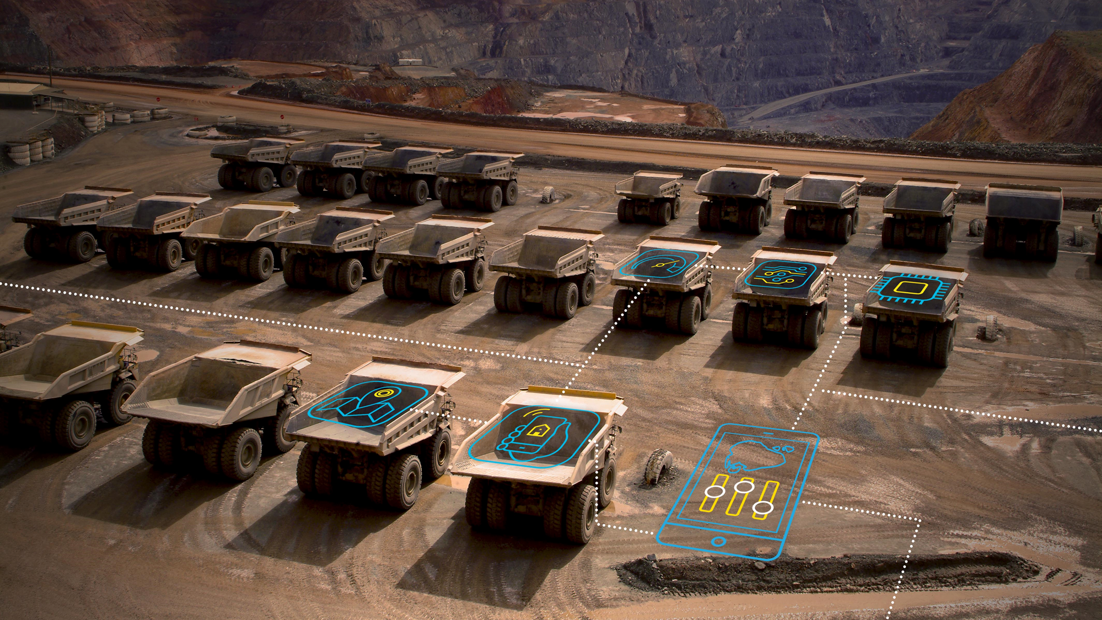
Global Mining Co.
A large, global mining company
engaged Accenture and Avanade to help operationalize dozens of distinct, siloed,
on-premise solutions from various
vendors at one of their large mines.
We developed an Azure based solution to aggregate all the mine data in real-time into a cloud-based platform to enable actionable insights and alerts.
With the solution, issues can now be anticipated and gains in production throughput, asset utilization and operator performance can be achieved.
Copyright © 2016 Accenture. All rights reserved.
23

Slide 24

Public Transportation
We are working with a metro transit organization to design a new operational model and scalable digital architecture to allow for better control of station equipment, security, and passenger information management.
The program will result in enhanced operations and greater passenger satisfaction, in addition to the introduction of new IoT-enabled services.
Copyright © 2016 Accenture. All rights reserved.

Slide 25

Large Manufacturing Company
We are helping a leading multinational woodworking company implement
a comprehensive Connected Asset Management solution to better manage their mission critical equipment and other assets.
The solution will enable the company to improve its internal operational costs and extend the set of services provided to customers.
Copyright © 2016 Accenture. All rights reserved.

Slide 26

Connected Asset Management – Solution Demonstration
Empowers enterprises across multiple industries – including large industrial and manufacturing companies, oil & gas facilities, and OEMs – to proactively manage their assets, make quicker and more informed decisions, and optimize business processes through the enablement and unlocking
of digital content, specialized analytics,
and prescriptive actions and insights.
Copyright © 2016 Accenture. All rights reserved.

Slide 27
Now we want to
hear from you!
What questions do you have for us?

Slide 28


Accenture CPaaS with Microsoft Azure
Visit us at the Accenture - Avanade booth #1600 to learn more and see our solution demonstrations
Copyright © 2016 Accenture. All rights reserved.

Slide 29
Free IT Pro resources
To advance your career in cloud technology
Plan your
career path
Cloud role mapping
Expert advice on skills needed
Self-paced curriculum by cloud role
$300 Azure credits and extended trials
Pluralsight 3 month subscription (10 courses)
Phone support incident
Weekly short videos and insights from Microsoft’s leaders and engineers
Connect with community of peers and Microsoft experts
Microsoft IT Pro Career Center
www.microsoft.com/itprocareercenter
Get started
with Azure
Microsoft IT Pro Cloud Essentials
www.microsoft.com/itprocloudessentials
Demos and
how-to videos
Microsoft Mechanics
www.microsoft.com/mechanics
Connect with peers and experts
Microsoft Tech Community
https://techcommunity.microsoft.com

Slide 30


Please evaluate this session
Your feedback is important to us!
From your PC or Tablet visit MyIgnite at http://myignite.microsoft.com
From your phone download and use the Ignite Mobile App by scanning the QR code above or visiting https://aka.ms/ignite.mobileapp

Slide 31
This document makes descriptive reference to trademarks that may be owned by others. The use of such trademarks herein is not an assertion of ownership of such trademarks by Accenture and is not intended to represent or imply the existence of an association between Accenture and the lawful owners of such trademarks.

