Slide 1
Office 365 security & compliance
Leveraging intelligence in a cloud first world
BRK1009
Rudra Mitra
Partner Director PM
Office 365 Information Protection

Slide 2
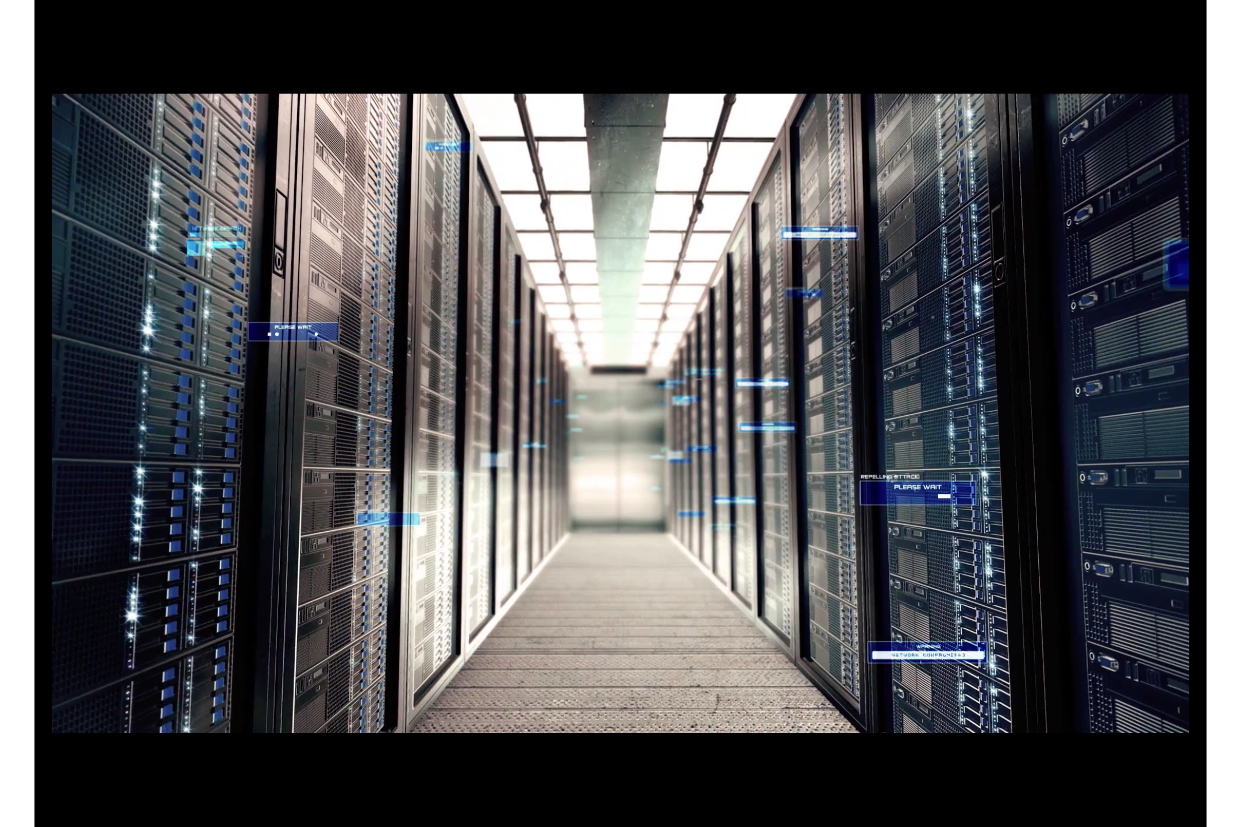
Office 365
Security & Compliance
Leveraging intelligence in a cloud first world
Rudra Mitra
Partner Director PM
Office 365 Information Protection

Slide 3

VIDOE

Slide 4
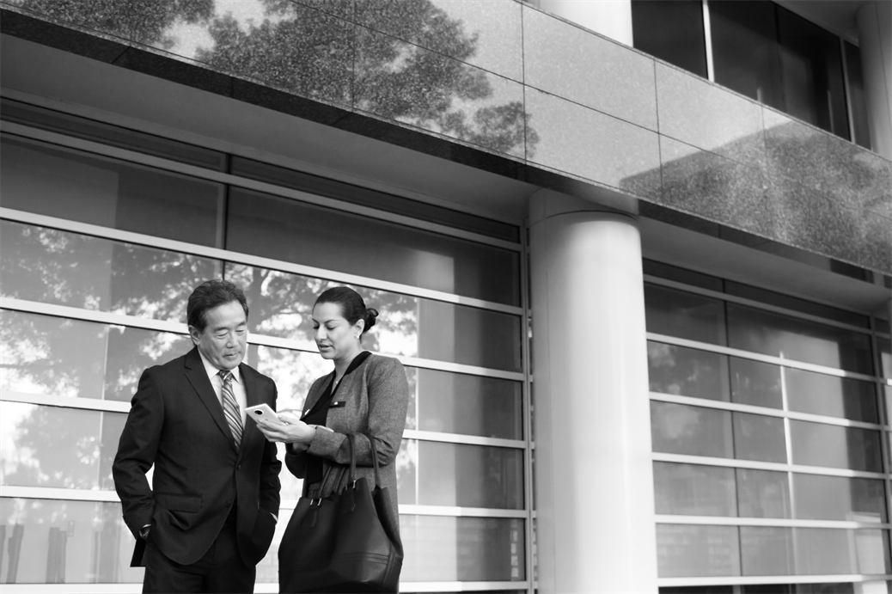
Top 3 cloud concerns
SECURITY
73% orgs indicated security as a top challenge holding back SaaS adoption
COMPLIANCE
89% of orgs required to govern content for compliance or business continuity purposes
TRANSPARENCY
63% of orgs state transparency challenges restrict them from growing their cloud usage

Slide 5

Security challenges are everywhere
160M
customer records were compromised in 2015
75%+
of all network intrusions are due to compromised user credentials
80%+
of employees admit to using non-approved SaaS apps in their jobs
229
days between infiltration and detection
87%
Of senior managers admit to regularly uploading work files to a personal email or cloud account

Slide 6
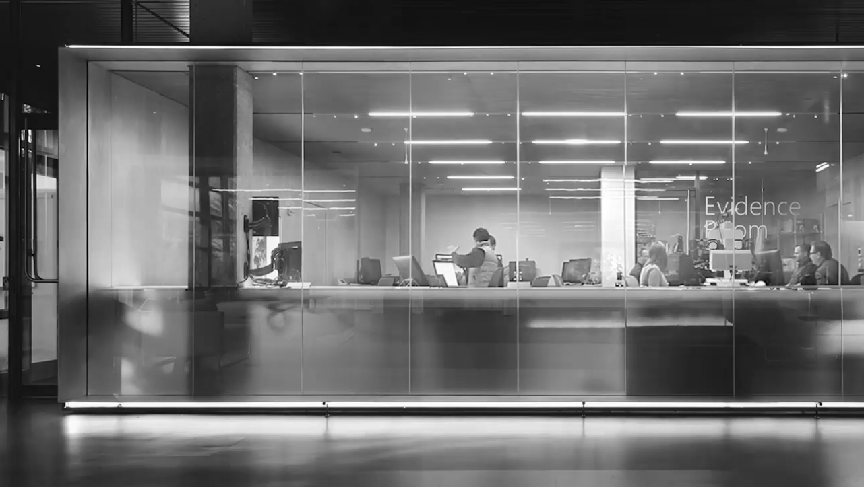










Electronic data is exploding
Achieving organizational compliance is challenging
50%
year over year growth rate in electronic data
41%
of orgs state enforcing a governance policy is their biggest issue
45%
of orgs state lack of governance opens them to security & compliance risks
Volume and complexity of data is increasing

Slide 7
Integrated
Unified
Adaptive
Proactive
Office 365 Information Protection
We take seriously our commitment to safeguard our customers’ data, to protect their right to make decisions about that data, and to be transparent about what happens to that data
Security
Compliance
Transparency
Built into the Office 365 suite and can be enhanced by partners
Unified across Office 365 workloads and clients, and can be extended to data outside of Office 365
Broad applicability for organizations of all sizes and individuals with various specialized roles
Leverages service and machine based insights to assist you in staying protected and compliant
Microsoft Intelligent Security Graph
Data insights from signals are gathered across Office 365, Microsoft, and Partners

Slide 8
Innovation Delivered
Security and Compliance Center
Office 365 Service Assurance
Anti-SPAM ZAP
Anti-Spoof Protection
Advanced eDiscovery
Archiving SEC 17a-4 compliance
Management Activity API
Data Loss Prevention in SharePoint and OneDrive
Advanced Security Management
eDiscovery Search scale
Unified auditing across Office 365
Archiving 3rd party data ingestion
Customer LockBox
Large email archives
MDM with Intune
Advanced Threat Protection
Archive Preservation Lock

Slide 9
Multi-factor authentication
Data encryption
User accounts
Device log-ins
Malware
Unauthorized data access
INTELLIGENCE
Attacks
Microsoft Intelligent
Security Graph
User log-ins
Phishing
Denial of service
Spam
System updates
Enterprise security

Slide 10
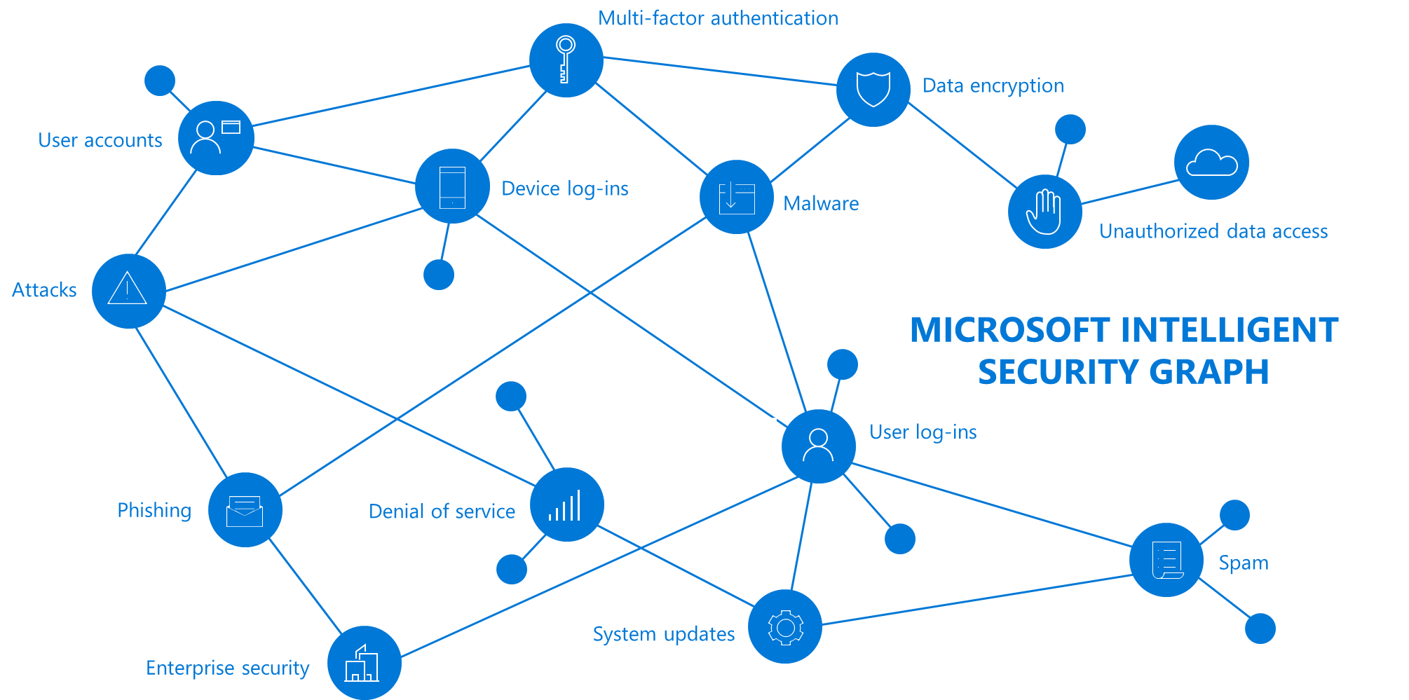
300B
User authentications each month
1B
Windows devices updated each month
200B
Emails analyzed for spam and malware
Our unique perspective
Customized recommendations based on customer profile
Intelligence on evolving threats across broader service
Insights derived from industry baseline comparisons

Slide 11
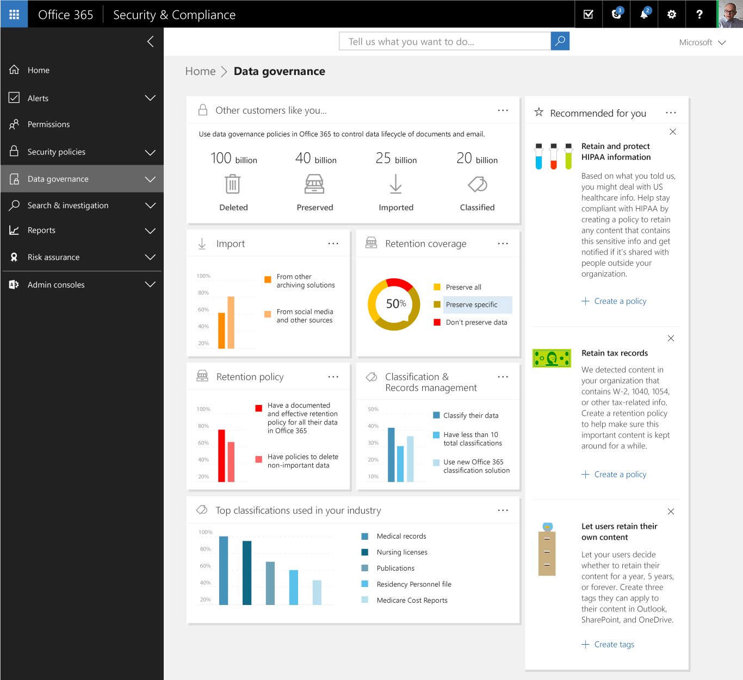
Profile customized recommendations
Role
Configuration
Microsoft Intelligent Security Graph
Industry
Size
Geography
Actions

Slide 12








Evolving threat recommendations
Locky
Malware
Read
Changed
Linda
Manager
Read
Finance
Gopi
Important
Infected
Credit cards
Edited
Forwarded
Sensitive
Read
Received
Targeted
Phish
Infected

Slide 13
Security and Compliance Center
Foundational, core services - to high-value information protection solutions
Office 365 Security and Compliance Center
(Admin UX)
Office 365 Workload Portals
(Web UX)
Office 365 ProPlus
(Rich Clients)
Office 365 Mobile
(iOS, Android, Universal apps)
3rd Party Solutions
User Experience Surfaces
Data Loss Prevention (DLP)
Advanced Threat Protection (ATP)
Threat Intelligence
(TI)
Advanced eDiscovery
(AED)
Information Governance
(IG)
Office 365 information protection
solutions
Information protection Kernel
Encryption
Anti-Spam/Anti-Phishing
Classification
MDM
Policy Engine
Audit Stream
Indexing and Search
Reporting
Alerting
Investigate
Azure common services and Office 365 substrate

Slide 14
Security and Compliance Center
Built in information protection. Powerful for experts, and easier for generalists to adopt
Scenario oriented work flows. With cross-cutting policies, that span feature boundaries
Quick discovery. With default protections. And quick enablement of new protections
Deeper engagement with customers. And proactive suggestions based on cloud intelligence

Slide 15
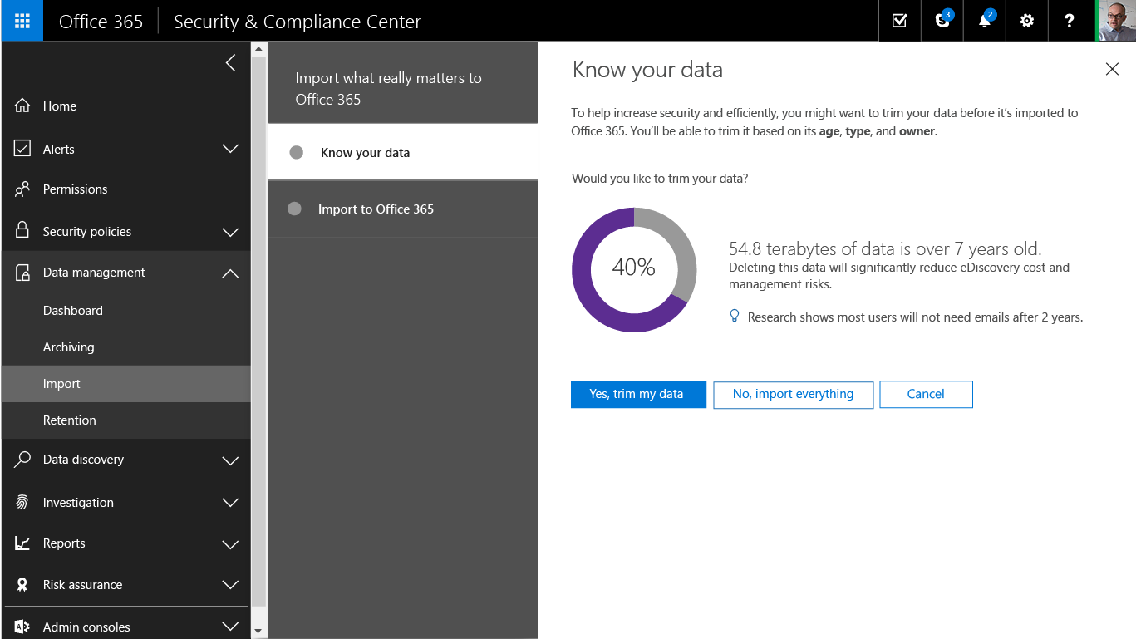
Data Governance
Leveraging machine assisted insights to help organizations stay compliant and reduce risk by finding and keeping what’s important while leaving behind what’s obsolete
Import
Intelligent import for the data you need
Policies
Classifications and Insights to recommend policies for you
Retention
Preserve what’s important with classification and event triggers

Slide 16
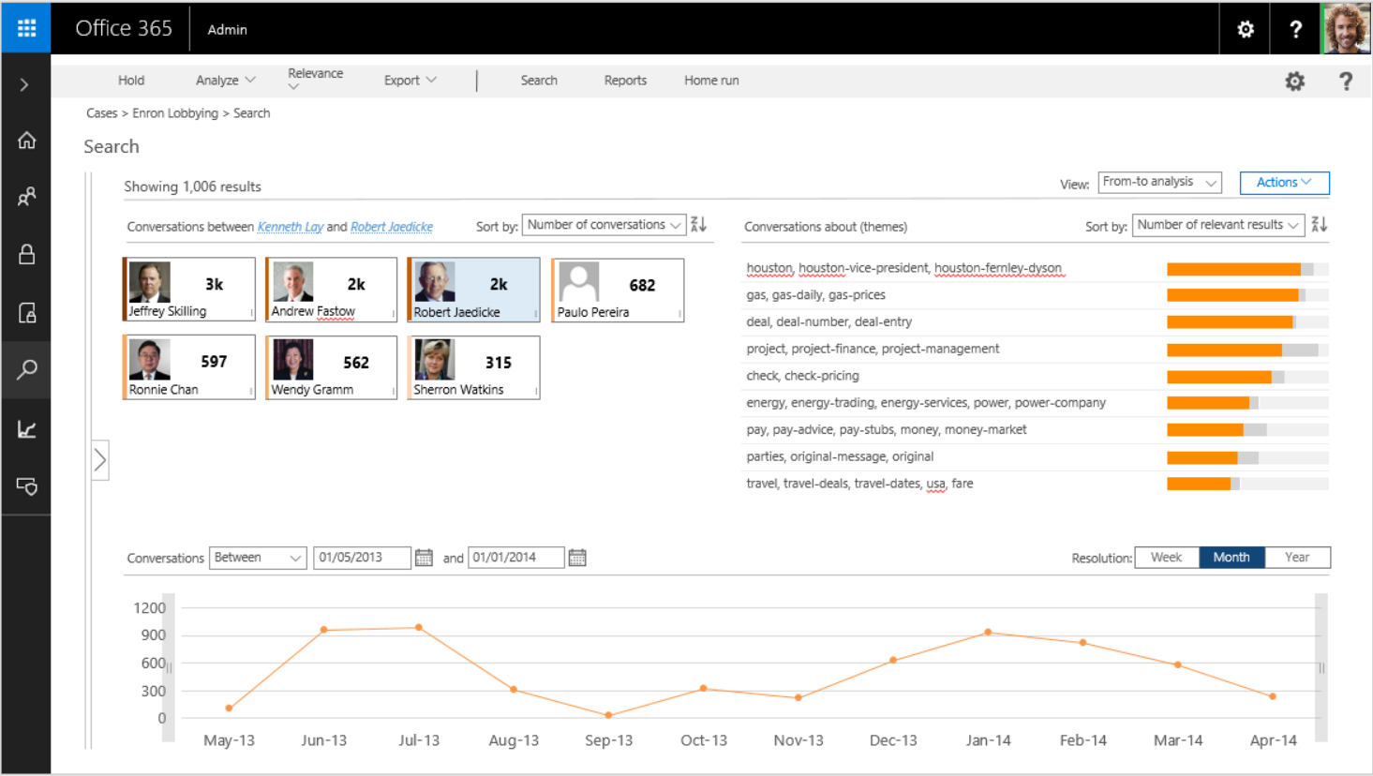
EDiscovery
High scale, machine assisted tenant wide discovery of content, to help organizations stay compliant
Broader
External litigations, regulatory requests and internal investigations related to compliance
Intelligent
Advanced eDiscovery enables predictive analytics and reduces the volume of data for review
Insightful
Query and custodian statistics, thematic analysis and more

Slide 17

Office 365
Admin
Search & Investigation > Content search
Edit query 
Previewing 1-30 out of 1000 results; total: 18,981 results
View: Individual results  Sort by: Best match  Actions 
Run query
Switch to advanced
Re: Enerfin meter 980439 for 10/00
Date: Dec 20 2000, 11:46 PM | Custodian: farmer-d
Read %: | Score:
Date: Sun, 12 Nov 2000 23:51:00 -0800 (PST)
From: Steven J Kean
To: Mary Hain
Cc: Richard Shapiro, Jeff Dasovich, Susan J Mara, Joe Hartsoe, Sarah Novosel, Donna Fulton, Paul Kaufman
Subject: Re: Comments on FERC November 1 order
There are a few other issues we need to look into:
Larcamp told Hartsoe and I after the meeting that FERC may clarify that the price caps and reporting obligations apply only to bids into the PX and ISO -- ie no bilateral transaction will be subject to the requirements. He asked if knowing this would change any of our views (esp peaking plants, though I
suspect it‘s already too late for that). My gut reaction is that so long as the market continues to clear through the centralized exchanges this
”exemption” for bilateral transactions won‘t matter much, but let‘s think it through. Is EOL or APX an alternative?
Massey specifically asked us to address forward markets in our comments.
Specifically, ”has FERC done everything it can to encourage forward market development?” In addition to any other points we might make, I think we should argue that ”PJMing” the market won‘t facilitate and may even hinder forward market development. Also, we should advocate actions by FERC that
take away second-guessing by the CPUC in order to reduce utility fears about contracting forward.
We have to give the Commission a way out on price caps. We need to think through whether there is something we can live with here, or we should take
the approach I took in my testimony: FERC should encourage the state to provide rate protection for selected customer classes by putting those
requirements up for bid (ie get the utility out of the commodity business as much as possible).
Finally, on governence issues we should argue for a narrowe role for the ISO as a way of diffusing the emotional governence debate. Analogy: if the ISO is simply the air traffic controller all parties will simply be interested in
These keywords
Lobbying
Re: HPL Meter #980070 R U S K D/P – LONE STAR…
Date: Dec 20 2000, 11:46 PM | Custodian: farmer-d
Read %: | Score:
Date is before 
08/01/2016
 Add condition
 Locations
 Status
Last run on 09/01/2016 12:03pm
RDI Electric Atlas – North American Edition $500…
Date: Dec 20 2000, 11:46 PM | Custodian: farmer-d
Read %: | Score:
Invitation: An Evening of Hope and healing
Date: Dec 20 2000, 11:46 PM | Custodian: farmer-d
Read %: | Score:
Save

Open…
New query
Managing Director and Vice President Elections
Date: Dec 20 2000, 11:46 PM | Custodian: farmer-d
Read %: | Score:
Enron Conference Call – Rescheduled for 5pm CST…
Date: Dec 20 2000, 11:46 PM | Custodian: farmer-d
Read %: | Score:
RDI Electric Atlas – North American Edition $500…
Date: Dec 20 2000, 11:46 PM | Custodian: farmer-d
Results per page:
Page
1
of 34 Pages
10
30
60
Reading pane

Slide 18
Office 365
Admin

Edit query:
New query*
Define conditions
x

Select locations
Define conditions
Save query (optional)
Conditions:
These keywords

 Common
 Mail
Lobbying
More 

Participant
And 
Sender
Date is before 

09/01/2016
More 
Recipient

Sender domain
And 
Recipient domain
Sender domain is any of 
Message Type
enron.com;

More 
Importance
 Sites
Or 
Recipient domain is any of 
enron.com;

More 
Drag & Drop a condition from the left to refine query, or Select 
Include family files
Include unsearchable files
Clear conditions
Back
Next
Run query
Cancel

Slide 19
Office 365
Admin
Hold
Analyze 
Relevance 
Export 
Search
Reports
Home run
Cases > Enron Lobbying > Search
Search
27,656 results
View: Pivot bar  Sort by: Number of results  Actions 
Field: Themes  Display ‘No info’ bar Legend: Results, Relevant results


Slide 20
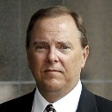
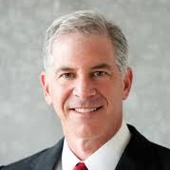



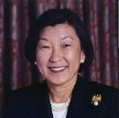
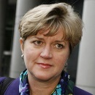
Office 365
Admin
Hold
Analyze 
Relevance 
Export 
Search
Reports
Home run
Cases > Enron Lobbying > Search
Search
Showing 1,006 results
View:
From-to analysis
Actions 

Number of conversations
Number of relevant results
Conversations between Kenneth Lay and Robert Jaedicke
Sort by:

Conversations about (themes)
Sort by:

houston, houston-vice-president, houston-fernley-dyson
gas, gas-daily, gas-prices
deal, deal-number, deal-entry
project, project-finance, project-management
check, check-pricing
energy, energy-trading, energy-services, power, power-company
pay, pay-advice, pay-stubs, money, money-market
parties, original-message, original
travel, travel-deals, travel-dates, usa, fare
3k
2k
2k
682
Jeffrey Skilling
…
Andrew Fastow
…
Robert Jaedicke
…
Paulo Pereira
…
597
562
315
Ronnie Chan
…
Wendy Gramm
…
Sherron Watkins
…
01/01/2014
Week
Month
Year
Conversations and
Resolution:
Between
01/05/2013


Slide 21
Office 365
Admin
Hold
Analyze 
Relevance 
Export 
Search
Reports
Home run
Cases > Enron Lobbying > Search
Search
27,656 results
View: Search profile  Actions 
Profile 1: Custodians 
Sort by: Number of results 
Profile 2: Themes 
Sort by: Number of results 
Michael Kopper
Kenneth Lay
Jeffrey Skilling
Andrew Fastow
Rebecca Mark Jusbasche
Robert Jaedicke
John Mendelsohn
Wendy Gramm
houston, houston-vice-president, houston-fernley-dyson
gas, gas-daily, gas-prices
stock, stock-market, stock-price, asp, fool
deal, deal-number, deal-entry
project, project-finance, project-management
check, check-pricing
energy, energy-trading, energy-services, power, power-company
pay, pay-advice, pay-stubs, money, money-market
Sort by number of relevant files
Sort by number of relevant files
Profile 3: Target population 
Profile 4: Timeline 
Resolution
Week
Month
Year
Documents: 28,187 (24.1% of results)
Pivots: 6.8k (24.1% of docs)
Unique near-duplicates: 13.6k (48.5% of docs)
Exact duplicates: 7.7k (27.4% of docs)
Emails: 56,724 (48.5% of results)
Inclusive: 7k (12.3% of emails)
Inclusive minus: 8.2k (14.5% of emails)
Inclusive copy: 3.5k (6.2% of emails)
The rest: 38k (67% of emails)
Attachments: 32,046 (27.4% of results)
Unique (email set level): 23.7k (12.3% of attachments)
Duplicates: 8.3k (25.9% of emails)

Slide 22
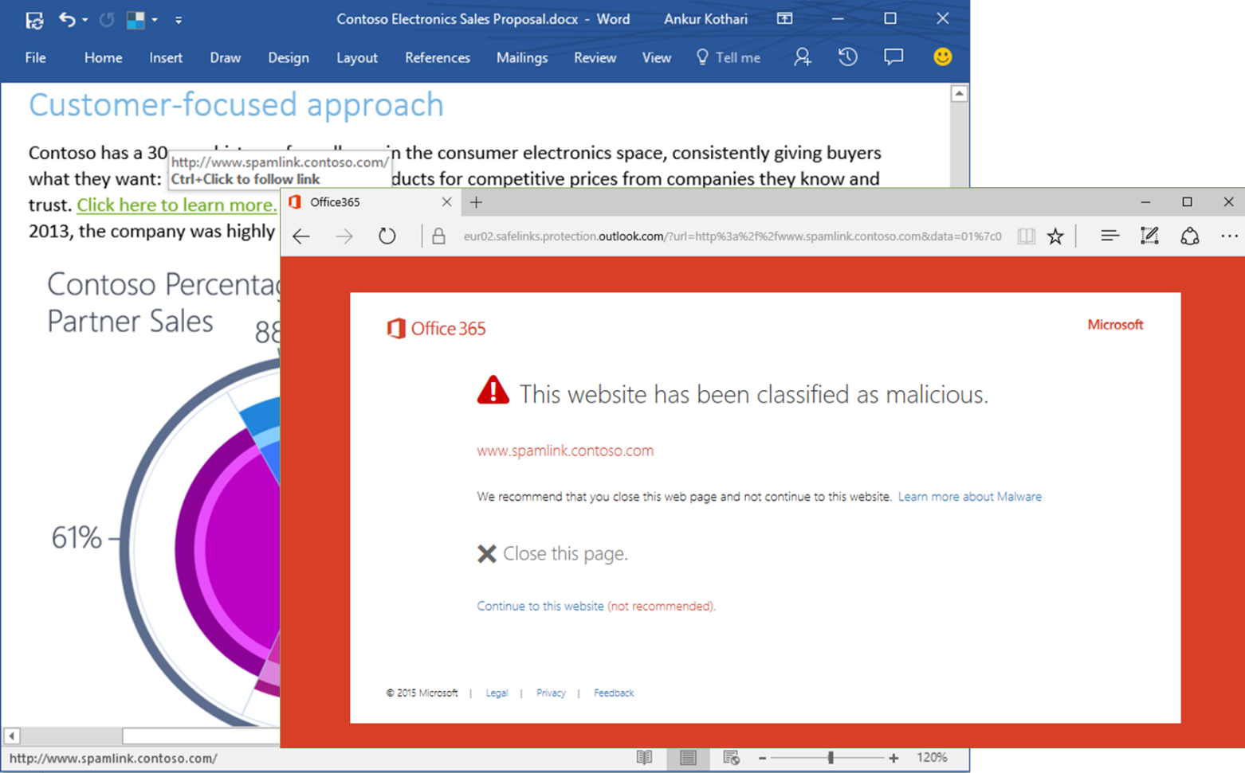
Advanced Threat Protection
Safeguard users against new and evolving attacks
Built in protection
Natively built in to Exchange Online Protection to allow deployment in seconds. Manage policies for Safe Attachments and Safe Links from a single cloud console for faster remediation for issues that are detected.
Accelerate Productivity
Dynamic Email Delivery and Linked Content Detonation keep productivity high by delivering all emails instantly.
Protection everywhere
Safe Attachments and Safe Links are expanding their protection beyond email, to other Office 365 workloads and Office Clients.

Slide 23
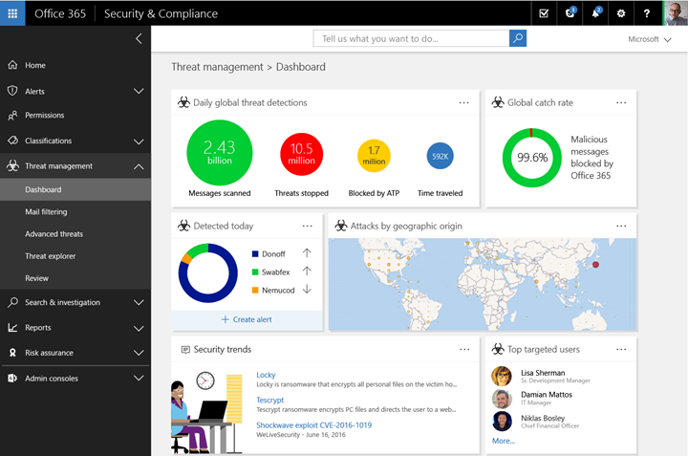
Threat Intelligence
Get control of your cloud infrastructure security
Threat awareness
Learn about the threat landscape and the main risks for your organization
Cloud scale
Leverage Microsoft’s cloud infrastructure to smartly cluster attacks and correlate signals across applications
Rich investigation
Use the intersection of threat intelligence and the Microsoft graph to investigate threats and remediate

Slide 24
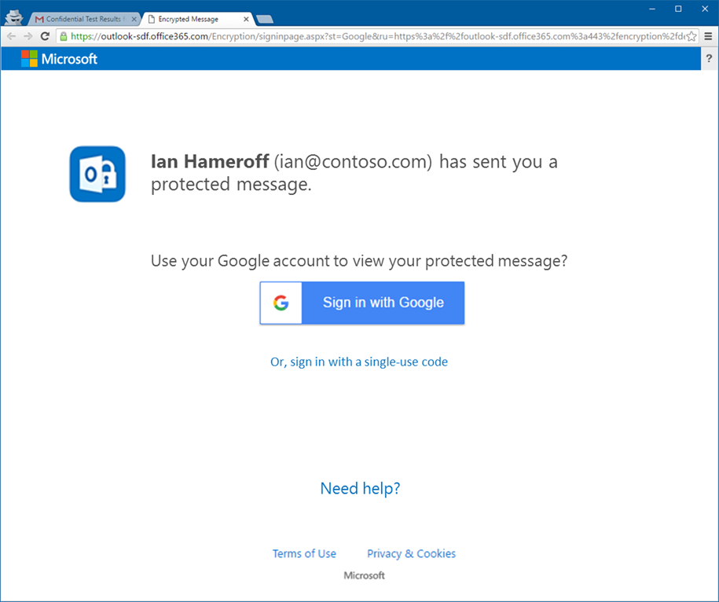
Sensitive Content Encryption
Secure email that works across organizations and with anyone you wish to reach
Remove the complexity of getting started
Simplify manual or automatic protection
Ensure that all recipients can read and respond

Slide 25
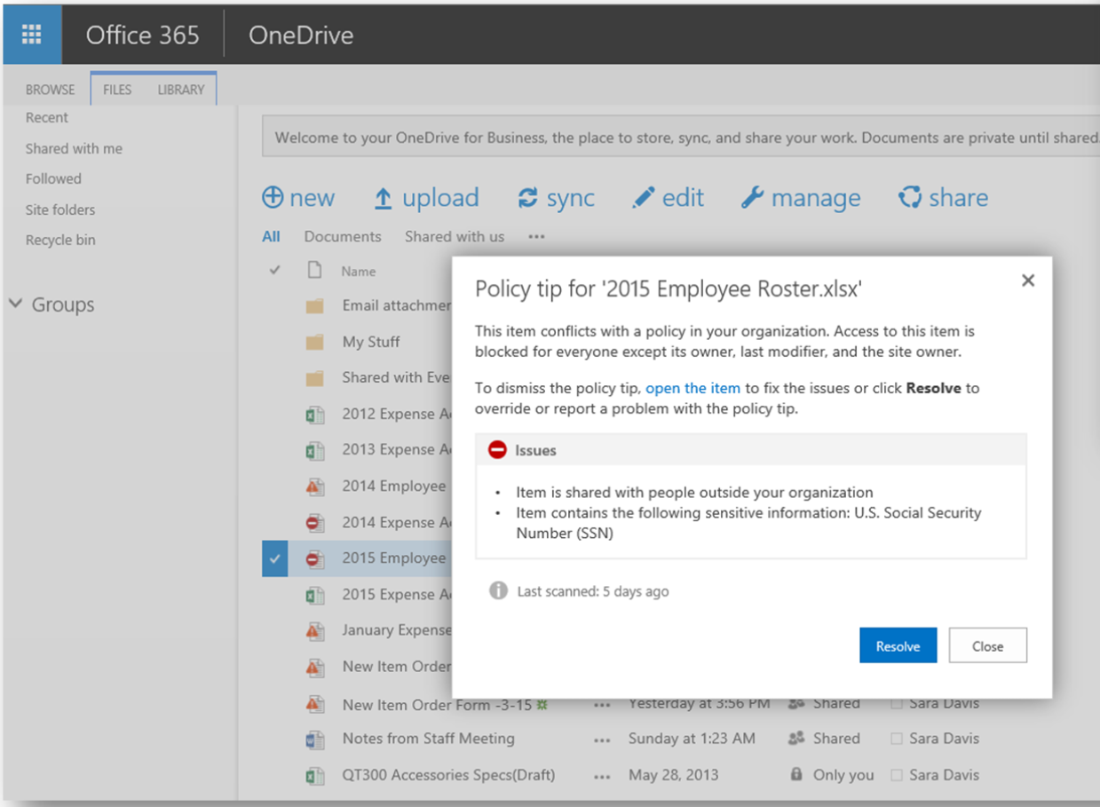
Data Loss Prevention
Protect sensitive information taking into account content, users, and the dynamic operating environment
Sophisticated, built-in content protection across O365
Insights and automatic safeguards
End user empowerment to maintain productivity and enforcement

Slide 26
Next Steps
Follow up Ignite sessions to deep dive into capabilities
Visit the Office 365 Security and Compliance Center
Start with email archives to trial compliance capabilities
Start with Advanced Threat Protection to trial security capabilities

Slide 27
Office 365 Information Protection Sessions
CODE | SESSION | Day, Time
THR2190 | Secure your sensitive email with Office 365 message encryption | Mon, 1:30-1:50 PM
THR1003 | Take control of your security and compliance with Office 365 | Mon, 12:30-12:50 PM
THR2007 | Fight back with Office 365 Advanced Threat Protection and Threat Intel | Mon, 5:40-6:00 PM
BRK3018 | Take control of your security and compliance with Office 365 | Tue, 11:30-12:15 PM
THR3007 | Protect your sensitive information with Office 365 Data Loss Prevention | Tue, 3:35-3:55 PM
BRK3249 | Gain visibility and control with Office 365 Advanced Security Management | Tue, 4:00-5:15 PM
BRK3016 | Take control of your data with intelligent data governance in Office 365 | Tue, 4:00-5:15 PM
BRK2035 | Learn about Office 365 Advanced Threat Protection | Tues, 12:30-1:45 PM
BRK3021 | Protect your sensitive information with Office 365 Data Loss Prevention | Wed, 12:30-1:45 PM
THR2006 | Get an edge over attackers – what you need to know about email threats | Wed, 2:50-3:10 PM
BRK4001 | Customize and tune Microsoft Office 365 Data Loss Prevention | Wed, 3:15-4:00 PM
BRK3015 | Reduce costs and challenges with Office 365 eDiscovery and Analytics | Wed, 9:00-10:15 AM
THR3009 | Understand how Microsoft protects you against Spoof, Phish, Malware, and Spam emails
BRK3017 | Monitor and investigate actions taken on your data with Office 365 Auditing and Insights | Thu, 10:45-12:00 PM
THR3008 | Gain visibility and control with Office 365 Advanced Security Management | Thu, 12:40-1:00 PM
BRK3023 | Understand how Microsoft protects you against Spoof, Phish, Malware, and Spam emails | Thu, 2:15-3:30 PM
BRK3024 | Build security and compliance solutions using Office 365 security and compliance APIs | Thu, 9:00-9:45 AM

Slide 28

Deploy, ramp-up on new services and onboard new users with Microsoft FastTrack: http://fasttrack.microsoft.com/

Slide 29

Join the Microsoft Tech Community to collaborate, share, and learn from the experts: http://techcommunity.microsoft.com

Slide 30


Please evaluate this session
Your feedback is important to us!
From your PC or Tablet visit MyIgnite at http://myignite.microsoft.com
From your phone download and use the Ignite Mobile App by scanning the QR code above or visiting https://aka.ms/ignite.mobileapp

