Slide 1
Learn how to establish a successful Project & Portfolio Practice, First Hand
BRK1005
Bill Allars – AGL
Keith Rigoni – Stryker
Rob Hirschmann – Projility
Yuval Stern – Microsoft (Facilitator)

Slide 2
Agenda
The AGL Experience
The Stryker Experience & Words of Wisdom from Projility
Q&A

Slide 3
Benefits of PPM
Project Management
Resource Management
Portfolio Management
Project Collaboration
Project planning
Project tracking
Out-of-the-box reports
Systematic resource requests
Visualized heat maps
Robust resource analytics
Portfolio optimization
Out-of-the-box reports
Seamless BI integration
Office 365 communications
Document management
Risks and issue management
ROI
301%
NPV
$12,546 per user
Payback period
6.7months
Total benefits
$8,359,959
A Forrester Total Economic Impact™ Study
Commissioned By Microsoft
Sean McCormick, December 2015
EXCELLENT PROJECT
& PROGRAM EXECUTION
EFFECTIVE RESOURCE MANAGEMENT
STRATEGIC ALIGNMENT & ORGANIZATIONAL AGILITY
INCREASED PRODUCTIVITY
Productivity will become the primary source of competitiveness and profitability for most companies
-The Conference Board
14%
increase in project throughput
-Forrester *
14%
increase in resource utilization
-Forrester *
75% saw better alignment of strategic priorities and projects
-Forrester *
* The Total Economic Impact(TM) Of Microsoft Office 365 PPM, a commissioned study conducted by Forrester Consulting on behalf of Microsoft, December 2015

Slide 4
Benefits of PPM
Project Management
Resource Management
Portfolio Management
Project Collaboration
Project planning
Project tracking
Out-of-the-box reports
Systematic resource requests
Visualized heat maps
Robust resource analytics
Portfolio optimization
Out-of-the-box reports
Seamless BI integration
Office 365 communications
Document management
Risks and issue management
EXCELLENT PROJECT
& PROGRAM EXECUTION
EFFECTIVE RESOURCE MANAGEMENT
STRATEGIC ALIGNMENT & ORGANIZATIONAL AGILITY
INCREASED PRODUCTIVITY
Productivity will become the primary source of competitiveness and profitability for most companies
-The Conference Board
14%
increase in project throughput
-Forrester *
14%
increase in resource utilization
-Forrester *
75% saw better alignment of strategic priorities and projects
-Forrester *
* The Total Economic Impact(TM) Of Microsoft Office 365 PPM, a commissioned study conducted by Forrester Consulting on behalf of Microsoft, December 2015

Slide 5
Attend the Project sessions
Theme | Session Title | Session Date & Time | Location
Best Practices | Create powerful reports in Microsoft PPM | Friday, September 30 10:45am - 12:00pm | B207 - B208
Best Practices | Manage projects and portfolios in the cloud | Friday, September 30 12:30pm - 1:45pm | C302
Best Practices | Satisfy custom needs with Microsoft PPM | Friday, September 30 12:30pm - 1:45pm | A402 - A403
and, visit our booths in the expo area

Slide 6
The AGL Experience

Slide 7
AGL
Overview
One of Australia’s Leading Integrated Energy Companies
Largest owner, operator and developer of renewable energy generation in Australia
More than 3.7 million customers across Australia
MS Project Online
First production instance went live in August 2014 (Subsequent instances went live in January and May 2015)
Over 800 users across the three instances
System has been integrated with MS Power BI to produce customer dashboards for IT Executive Management
Project Portfolio
Within the domain I am involved with, there may be 20-30 active projects at any time with up to 100 being delivered in a single year
MS Project Online is used to manage projects from first thoughts through to benefits realisation

Slide 8
AGL Solution Objectives A road with no destination is always long – Ash Grunwald
What is the problem you are trying to solve?
Operational optimisation and the payment of an efficiency dividend?
Transitioning from the transactional to the transformational?
Moving from providing information to management to providing insights?
Improving the project delivery culture?

Slide 9
AGL Solution Objectives ”If you don’t know where you are going, any road will get you there” – Lewis Carroll
What did AGL want to achieve from Project Online?
A single source of truth for all project related data
Visibility of project costs across all portfolios
Consolidated data to support enhanced reporting of project, program and portfolio health
A mechanism for tracking Benefits Realisation
Insights into Resource Allocation and Utilisation
Real-time Project Status and Health Indicators
Simplified portfolio reporting (Turn a 2-day activity into a 20 minute activity)

Slide 10
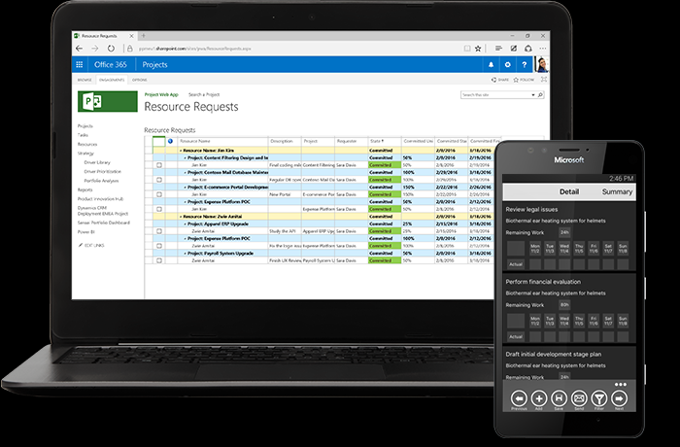
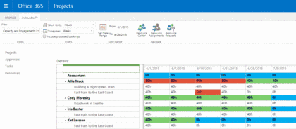
Why Microsoft PPM? Moving from the Dark Ages to the Age of Enlightenment
Cloud-based solution that aligned with the AGL IT Strategy
License-based model
Portfolio & Project Management capabilities
Capture of metadata, documents and registers in a single location
Access to functionality upgrades as they become available
Available as part of our existing Office365 subscription
Links easily to MS Power BI for Dashboarding

Slide 11
Solution Lifecycle & Process PPM in 3 months (It can be done, for less than you think)
Date | Milestone
April 2014 | Initial PoC of MS PPM Completed
May 2014 | Approval to implement MS PPM Received
May 2014 | EPM Partners selected as Delivery Partner
August 2014 | MS PPM Rollout
November 2014 | MS PPM Rollout to AGL Energy Services
May 2015 | MS PPM Rollout to AGL Group Operations
Key Lessons Learned
Change Management effort is significant and is easy to under-estimate (particularly if you change processes or remove Project Manager discretions)
You will underestimate the number of licences that you require (we estimated 250, it is now over 800)
Build it and they will come – We started with one instance, we now have three
Don’t try to boil the ocean at the first attempt – Develop a roadmap for the product implementation and execute against it

Slide 12
PPM Methodology Waterfall, Agile & Hybrids
Having robust methodologies at the outset of your journey will stand you in good stead as they can be automated as part of the implementation
Standardise as much as you possibly can – if two workflows are similar, can you make them the same?
You define the workflows you want – the tool implements them
While there is limited “out of the box” support for Agile, you can support Agile projects in MS PPM with a little bit of imagination (Hint: Track sprints rather than backlogs)
You don’t have to automate everything at once
Our initial workflows reflected only the key project phases
We have subsequently automated the work management processes with our key delivery partners and are currently looking to automate the development of agendas, actions and decisions from our project governance (Approval) forums

Slide 13
Tool Implementation (Or Tips for Young Players)
Utilise a partner when implementing MS PPM
They will have a standard product offering that will meet most of your needs
Leverage their knowledge of other installs and tool capabilities
They will ask you why you do certain things (save you from yourself)
Develop internal administration skills for the system
MS PPM Administration
SharePoint
MS Power BI for dashboarding and reporting
Utilise your partner for strategic developments, not the day-to-day tasks
Start small but think big
Almost anything can be a resource
We use MS PMM to track the use of development landscapes and test environments
Make sure you have Executive support for the changes being made to help enforce the new way of doing things
Regularly review the product roadmap
http://fasttrack.microsoft.com/roadmap
Consider the use of Office365 Planner and Wunderlist Functionality as it becomes available

Slide 14
The Stryker Experience & Words of Wisdom from Projility

Slide 15
Stryker at a glance
S&P
500
included in the Standard & Poor’s 500 Index
#287
on FORTUNE 500
$9.9B
in annual global sales in 2015
27,000+
employees worldwide
36
straight years of sales growth
100+
countries where Stryker products are sold
44
manufacturing
and research & development locations worldwide
4,898
patents owned globally in 2015

Slide 16
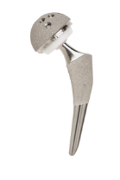
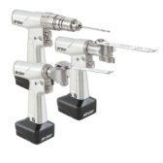
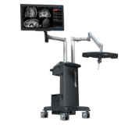
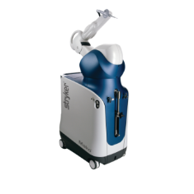
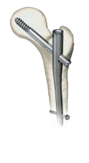
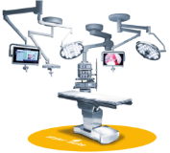
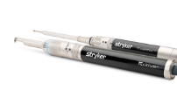
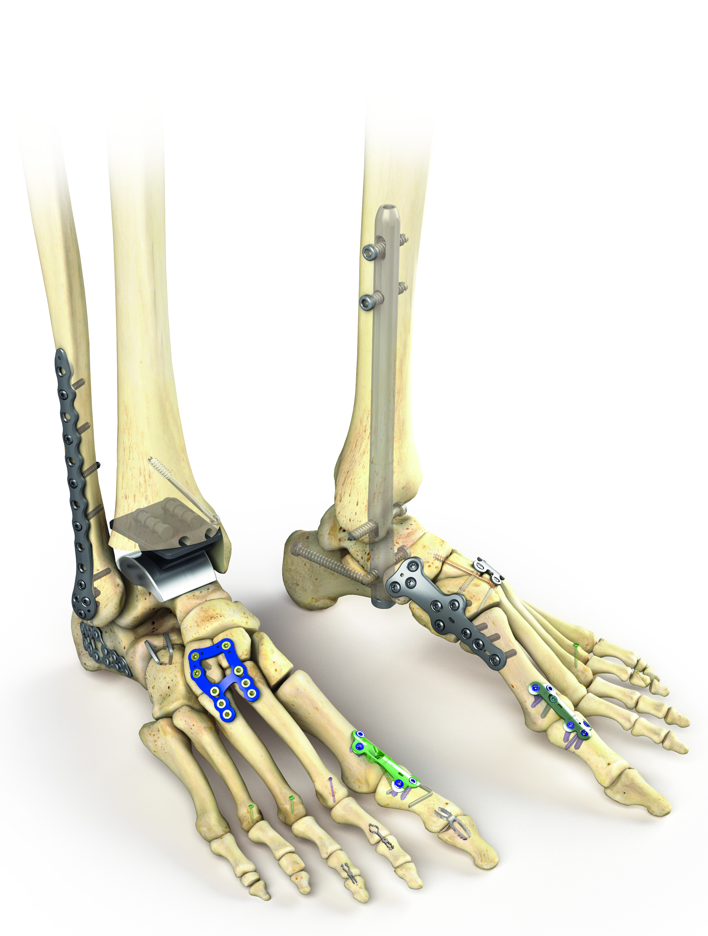
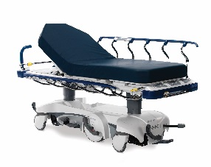
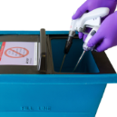
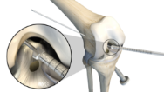
Depth and specialization
75+ years of innovation have led to a portfolio of more than 60,000 products.
Orthopaedics
Medical and surgical equipment
Neurotechnology and spine
Sports Medicine
Hips
Knees
Power Tools &
Surgical Equipment
Computer Assisted Surgery
Craniomaxillofacial
Interventional Spine
Reprocessing & Remanufacturing
Robotic-Arm Assisted technology
Trauma & Extremities
Minimally Invasive Surgical Solutions
Infrastructure & Integration
Neurosurgical, Spine & ENT
Neurovascular
Patient Care, Patient Handling & EMS Equipment
Reprocessing & Remanufacturing
Spinal Implants
and Biologics
Foot & Ankle
Sports Medicine
Note: Not all products and services are available in all global markets.

Slide 17
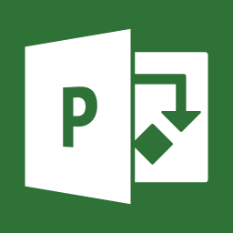
Project Background

Slide 18
Objectives
Implement a centralized PPM Tool
Established a Global Project Management Methodology
Grow in Project Management Maturity
Expand Business Intelligence & Reporting

Slide 19
The decision to use Microsoft PPM
White Papers
Demos
Secondary Tool Usage
Trial Division Local
Trial Division Enterprise
O365 Rollout/Integration
Past Experience

Slide 20
Solution Lifecycle:
Processes
PPM Steering Committee formed
Work on PPM Standard Began
PPM Standard V1 published
Vendor selection process Started
ST Selects MSPO, Lighthouse Chartered
PPM Standard V2
CER Approved,
PowerBI selected as PPM BI platform standard
PPM Standard V3
2011
2012
2013
2014
2015
2016
2017
Various legacy single division PPM platforms
First cross-divisional PPM tool launched
First use of Interdivisional Reporting used showing need for Enterprise type system
First mini trial, Projility chosen as Stryker Strategic Partner
Larger Enterprise type trial launched
Launched Nine Divisions on MSPO
2.0 Budgeted
Technology

Slide 21
Methodology for PPM implementation
PPM Steering Committee
PMO Network
Divisional Connect Sites
PPM Standard Implemented
PPM Standard Revised
Workstream Committee
Implementation Documentation
Detail Low; Strategic: High
Detail High; Strategic: Low

Slide 22
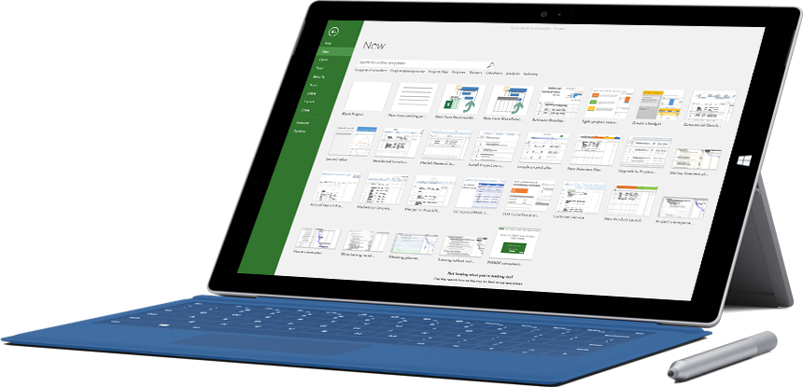
Tool Implementation
Expect
Ease of use
High user adoption
Integration (O365 and adjacencies)
Ease of Access
Don’t Expect
Full access to the backend
Full depth of capabilities (does everything well, nothing great)
Out of the Box Reporting
Approach
Have strong Project Management Processes before starting
Customization is bad
Simpler is Better
Start OOB, grow in Stages

Slide 23
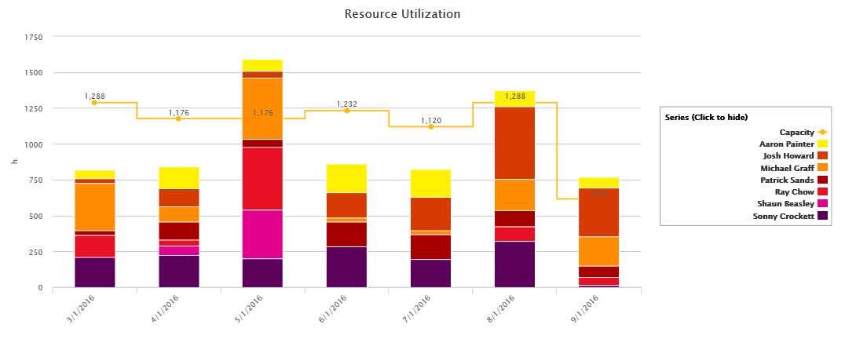
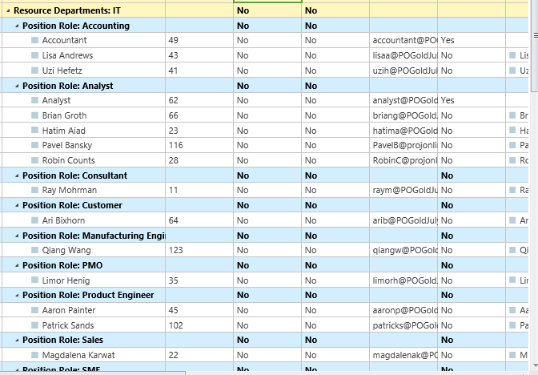
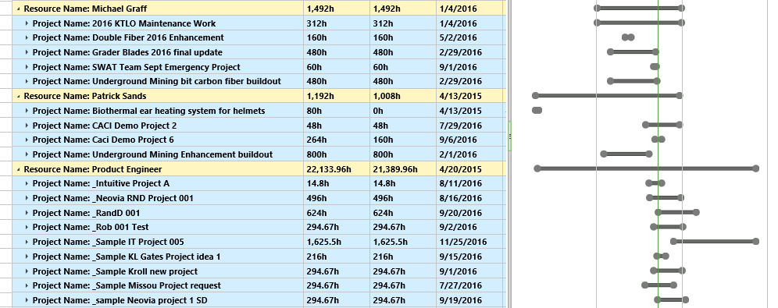
PPM Deployment
Resource Center Analysis and Reporting - enterprise
Generic and Named Resource Grouping
Organized by Department/Business Unit
Ability to analyze and track forecasting, workload and utilization across the Resource Pool

Slide 24
PPM Deployment
Project Center Aggregation – multi-unit portfolio
Hierarchies
Business Units
Portfolios
Projects
Lifecycle Phases

Slide 25
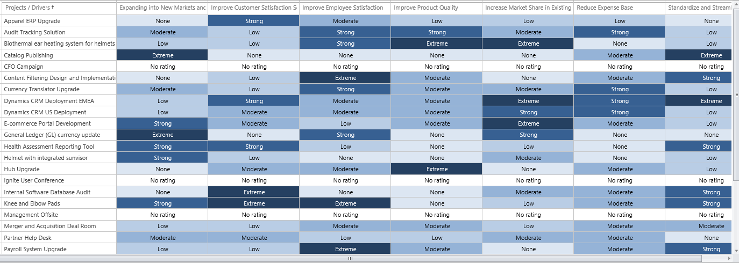
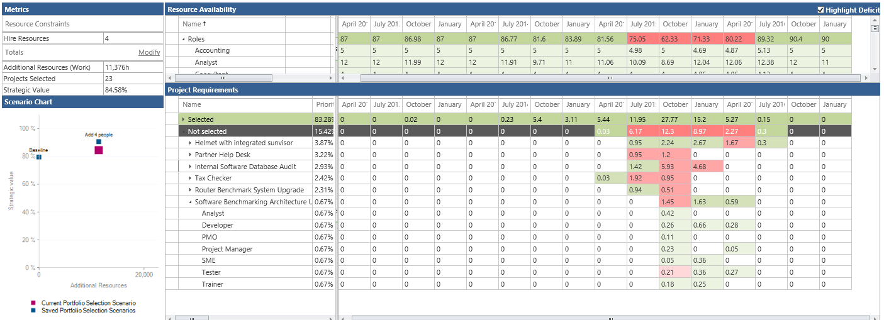
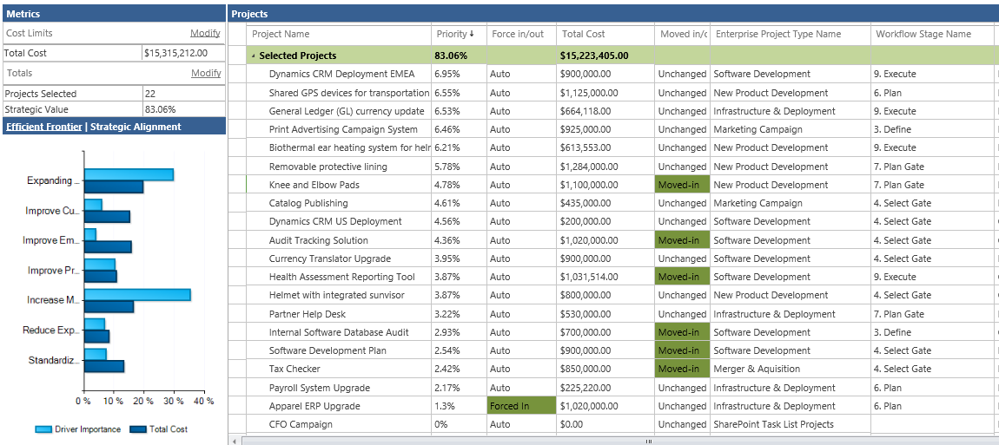
PPM Deployment
Portfolio Selection and Optimization
Several business units planning use in near future

Slide 26
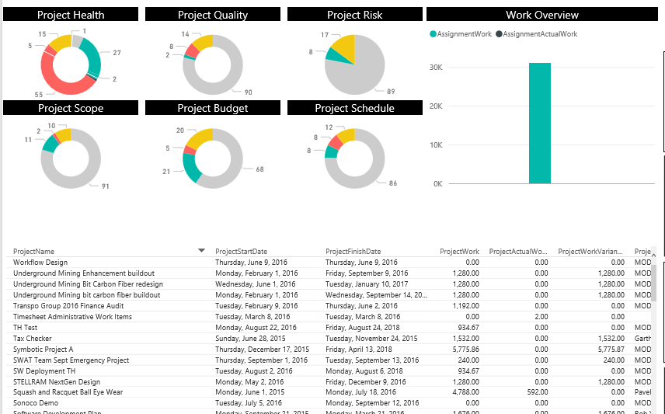
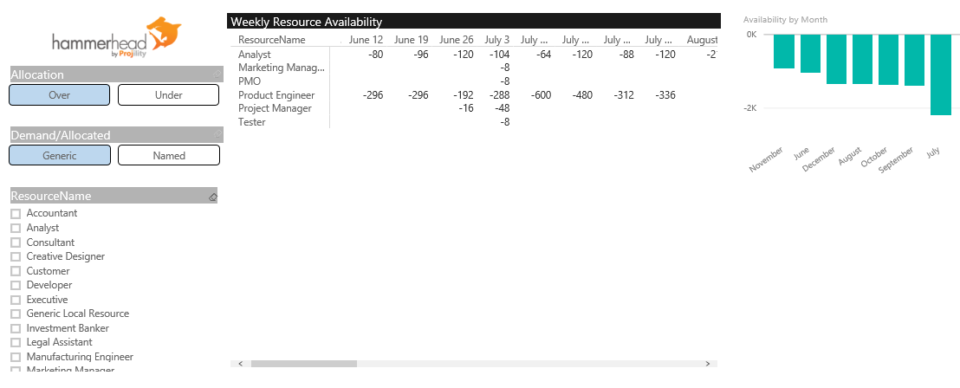
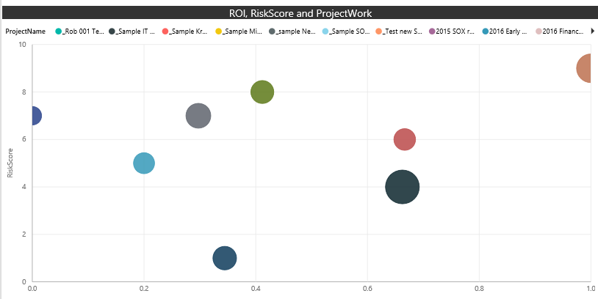
PPM Deployment
Power BI Enterprise Reporting
Enterprise (beyond PPM) reporting approach leveraging Power BI

Slide 27
Lessons Learned
Understanding Target Business Processes & Impact
People
Process
Technology
Project Intake
Demand Management
Schedule Management
Resource Management
Project Team Collaboration
Project Lifecycle Governance
Portfolio Selection
Reporting & Dashboards
Systems Integration
Automate Change
Drive Change
Critical: each business unit may have different requirements. Agree on the 80%, allow for the ‘unique 20%’ as a compromise to support enterprise reporting and aggregation.
Implement Change

Slide 28
Best Practice
Business/IT partnership alignment
Business Project manager
IT Support resources
Stakeholders from each group (IT and business units)
Helps ensure business value driving the solution

Slide 29
Contact Information
Rob Hirschmann
Partner, Projility
rob@Projility.com
Twitter: Robh_Projility
www.Projility.com/blog/ for useful articles
www.projility.com

Slide 30
Q&A

Slide 31
Deploy, ramp-up on new services and onboard new users with Microsoft FastTrack: http://fasttrack.microsoft.com/

Slide 32
Join the Microsoft Tech Community to collaborate, share, and learn from the experts: http://techcommunity.microsoft.com

Slide 33
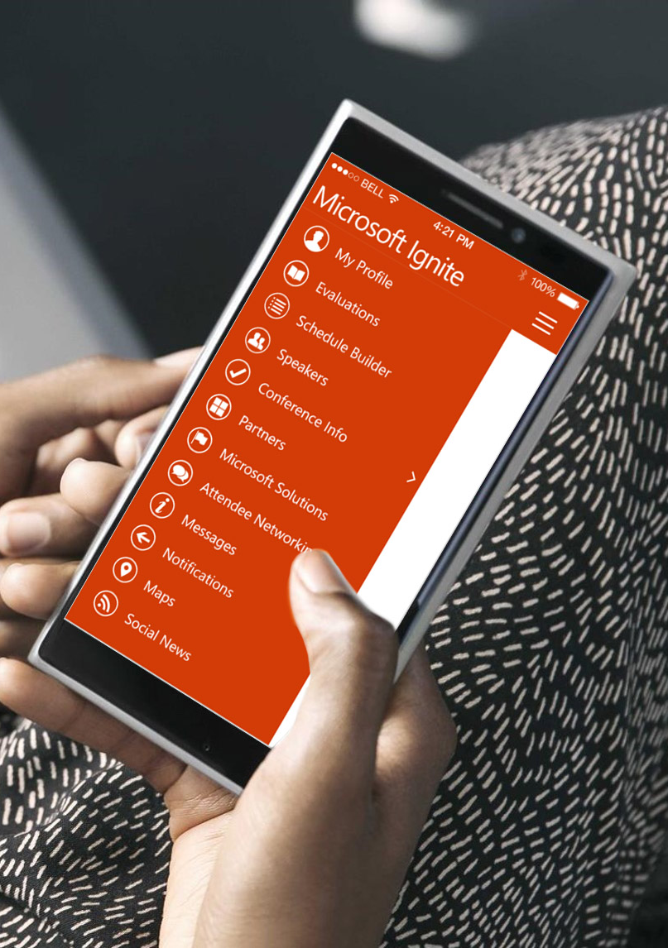
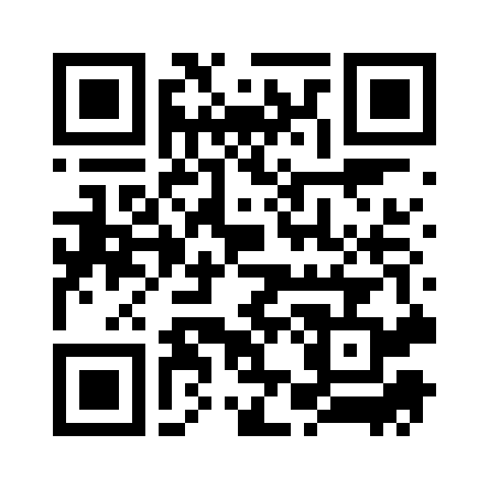
Please evaluate this session
Your feedback is important to us!
From your PC or Tablet visit MyIgnite at http://myignite.microsoft.com
From your phone download and use the Ignite Mobile App by scanning the QR code above or visiting https://aka.ms/ignite.mobileapp

