Slide 1
Introducing C# Developers to Building Games with Unity - For the Hobby Developer
Stacey Haffner

Slide 2
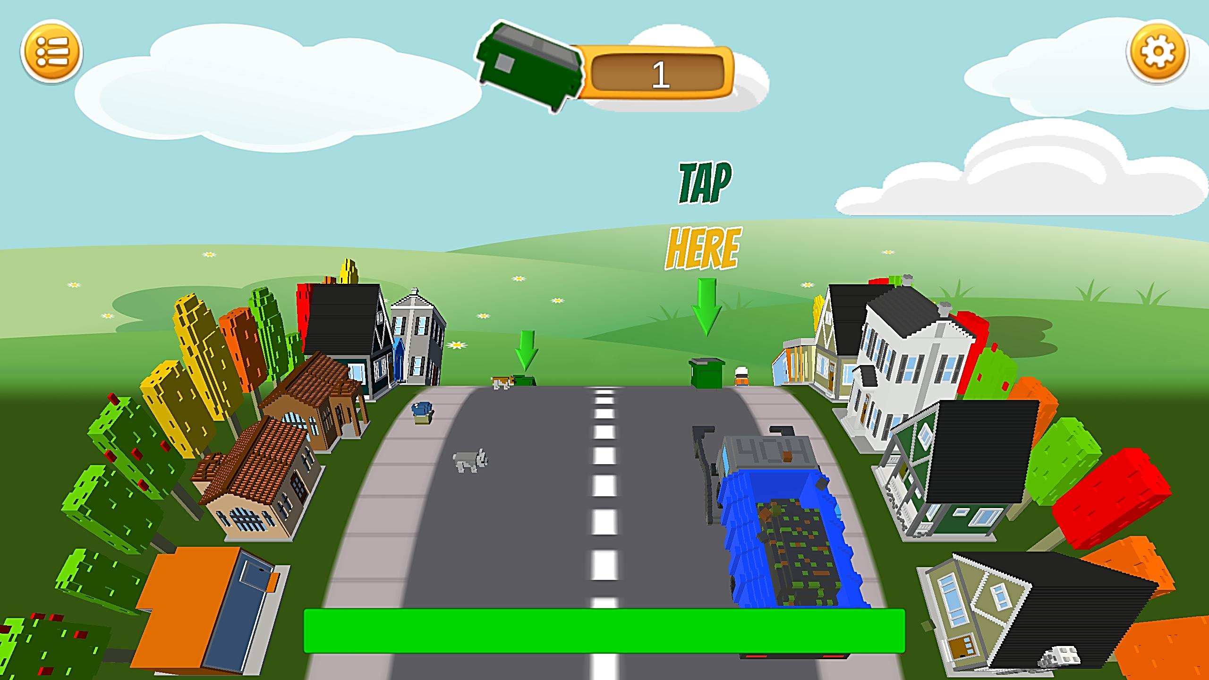
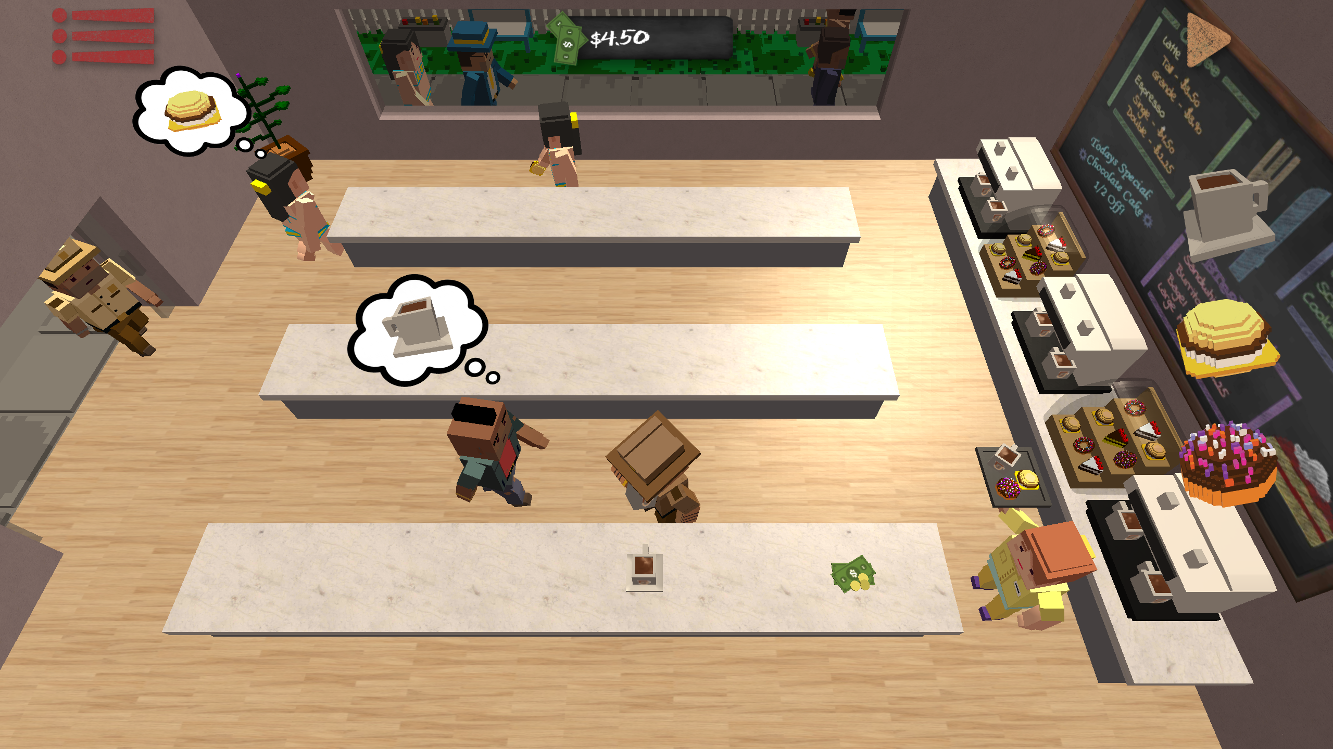
Hello!
Dumpster Dash (Android/PC)
Java Tapper(Android/PC)
Twitter: @yecats131

Slide 3
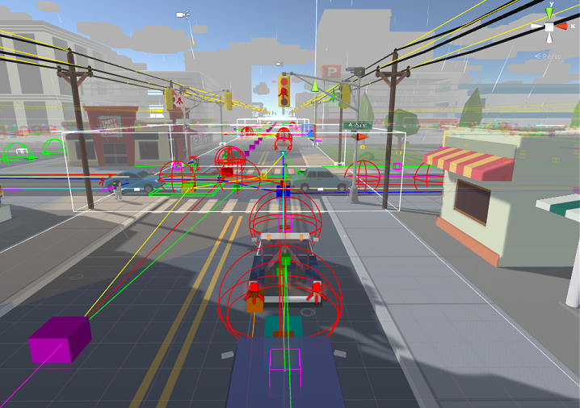
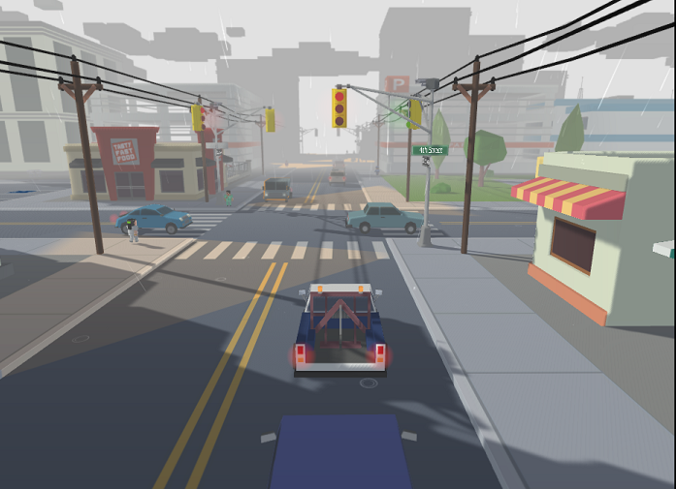
Hello!
Operation Brasnodar (PC)
Twitter: @yecats131

Slide 4
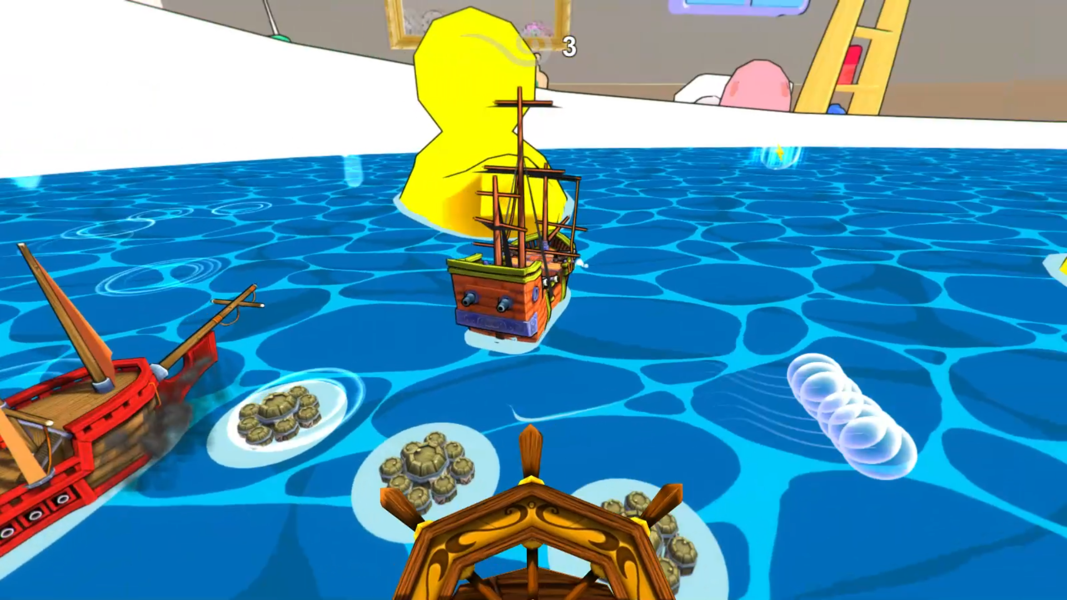
Hello!
Battle Tub (PC)
Twitter: @yecats131

Slide 5
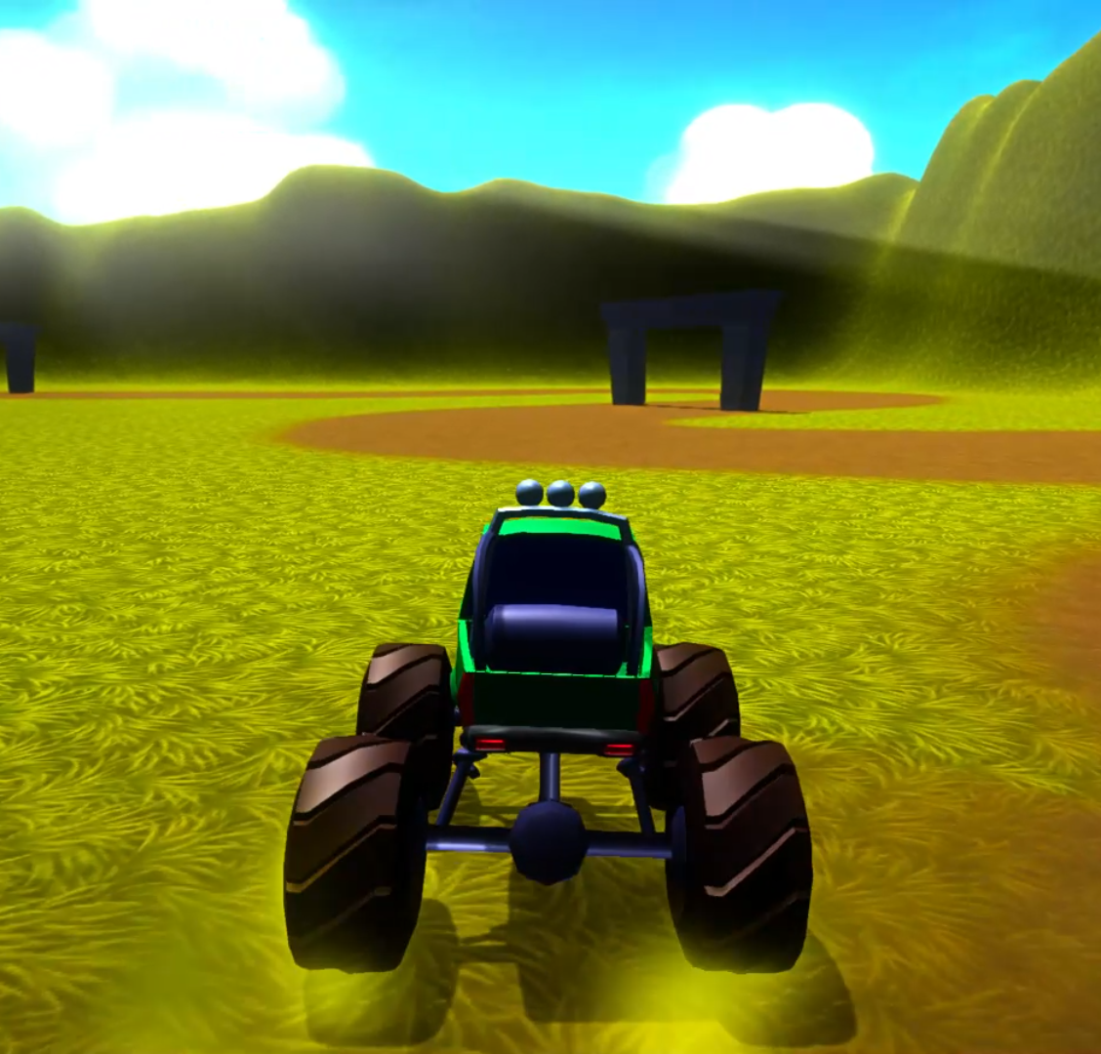
Case Study: Extreme Monster Truck

Slide 6
Unity Engine - The Basics

Slide 7
Awake
Initialization
OnEnable
Start
FixedUpdate
Physics
yield WaitForFixedUpdate
May happen more than one time per frame if fixed time step is < the actual frame update time.
OnTriggerXXX
OnCollisionXXX
Input Events
OnMouseXXX
Update
yield null
yield WaitForSeconds
yield WWW
yield StartCoroutine
Game Logic
Previously yielded coroutines will take place as part of the update.
Yield Calls
LateUpdate

Slide 8
Resources
Engine/IDE:
Unity Engine: www.unity3d.com
Visual Studio Code: https://code.visualstudio.com/Docs/runtimes/unity
Visual Studio Community Edition: visualstudio.com
Other:
Extreme Monster Truck Source: github.com/staceyhaffner/ExtremeMonsterTruck
Full Execution Order: http://docs.unity3d.com/Manual/ExecutionOrder.html

Slide 9
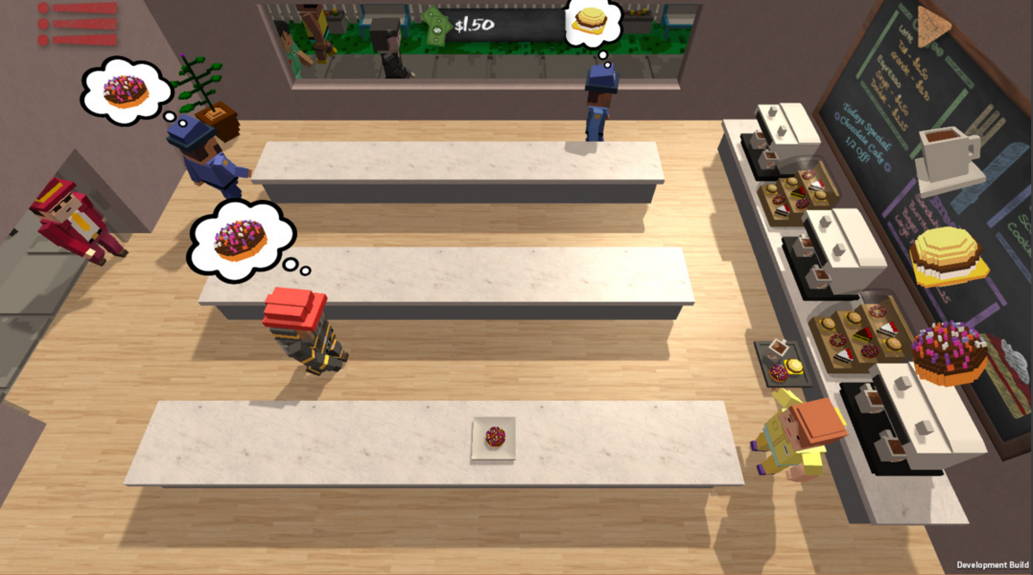
Thanks!!
Any questions?
You can find me at @yecats131

