Slide 2
Welcome to dotnetConf 2016!
Miguel de Icaza
Xamarin
@migueldeicaza
Notes:
Does anyone read these notes?
Hello? Is this thing on? Anyone out there?

Slide 3
The Story So Far
Xamarin Joins Microsoft
Xamarin free with Visual Studio
Including Community Edition
On Mac and Windows
Open Sourced under MIT license
Mono Runtime and Tools
Xamarin’s Android, iOS, Mac, tvOS and watchOS SDKs
Xamarin.Forms
Xamarin Components: Bindings, NuGet (nu ǰe), Plugins

Slide 4
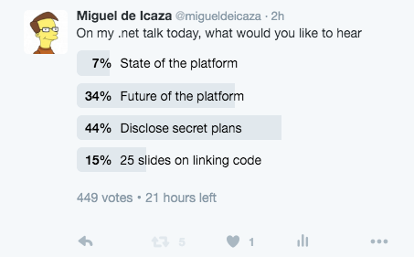
Agenda

Slide 5
Xamarin Product Releases
Major Releases – Features and Platform Updates
SDKs and Tooling driving by Android and iOS releases
On Stable Channel, with Alpha, Beta and Release Candidate Releases
Service Releases
On Stable Channel, previewed in Beta Channel
Previews
For long-term projects, give early access to tools to developers
Gather feedback, watch projects evolve into products.
Notes:
I am trapped in this box, if you are reading this, I need your help.

Slide 6
Cycle 7
Notes:
We just released it today.

Slide 7
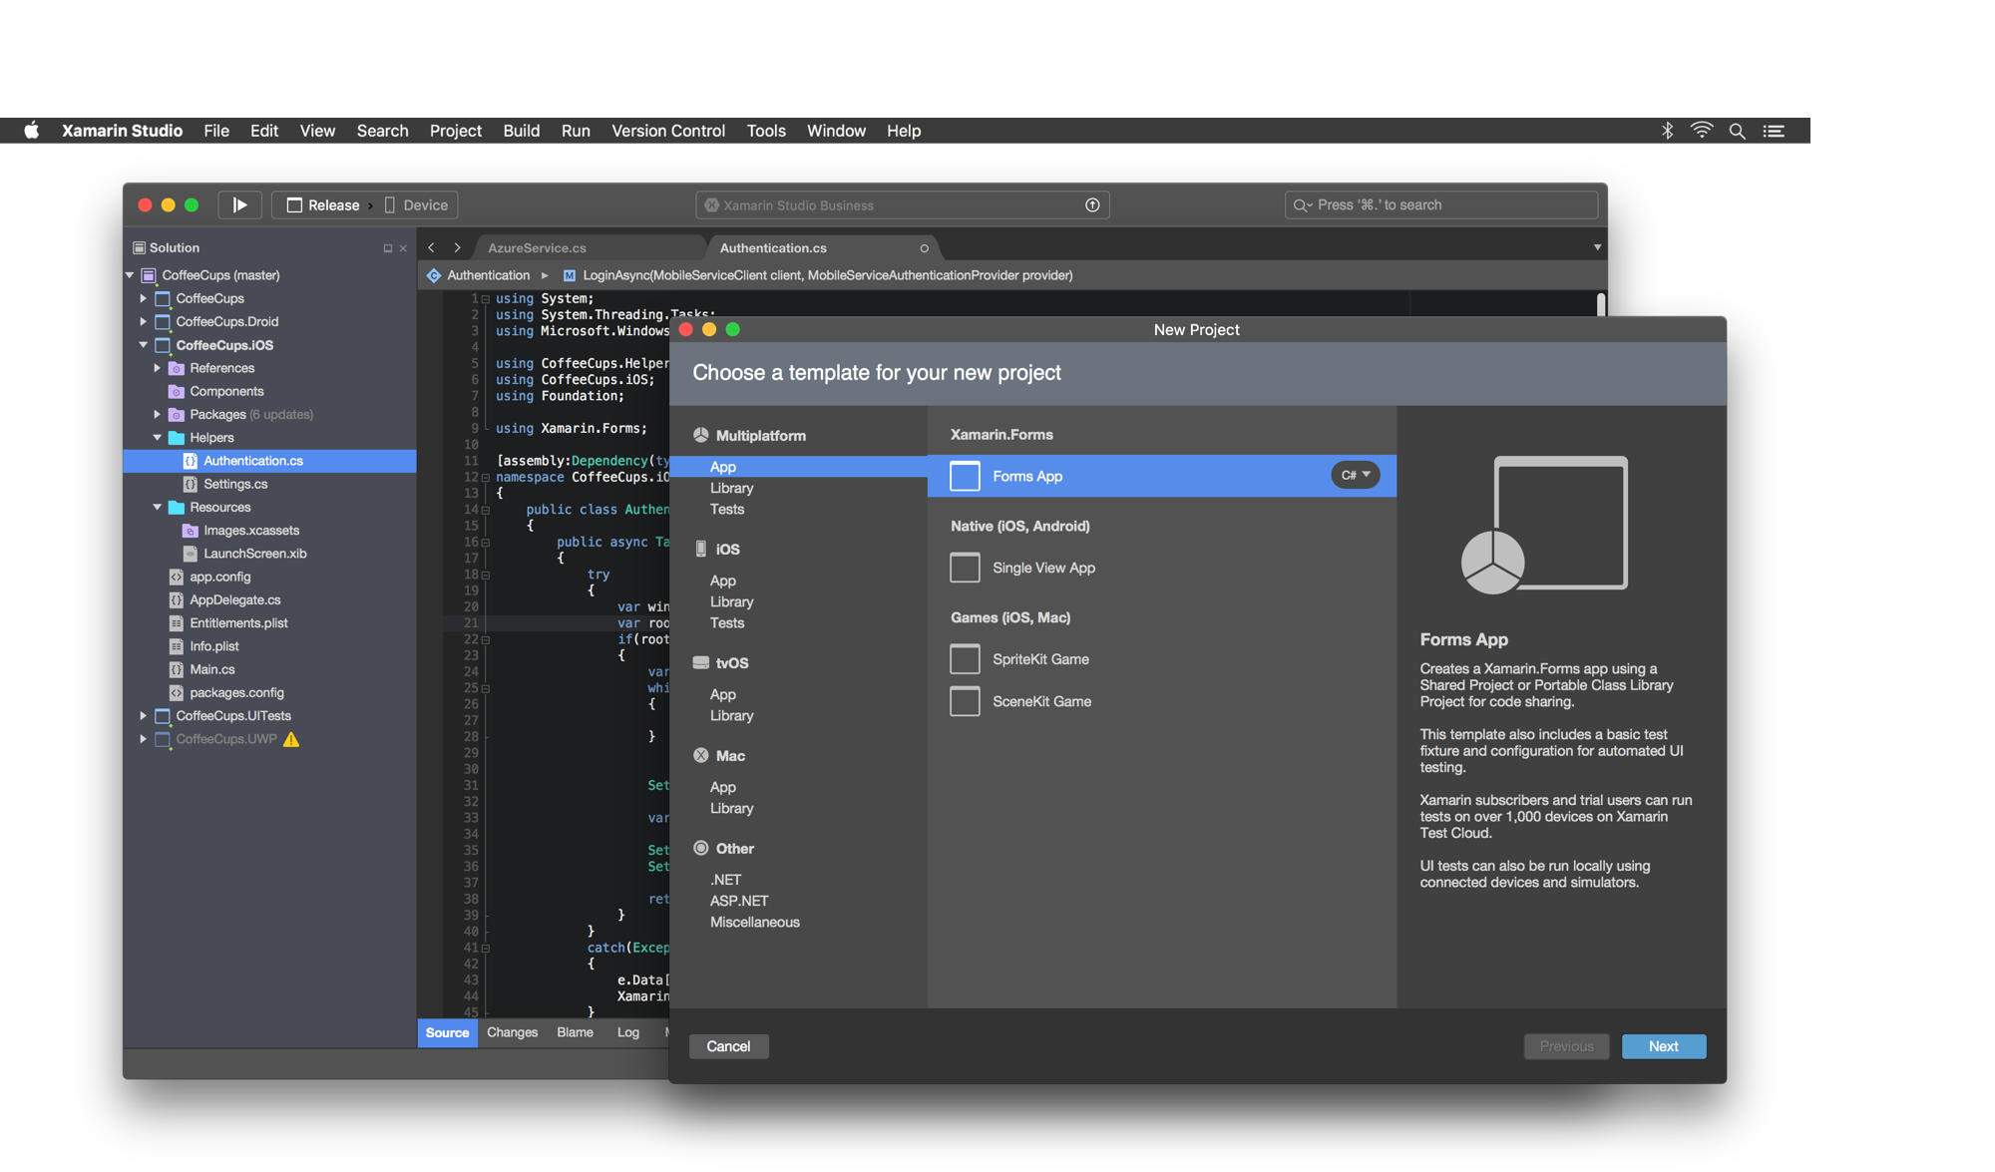
Notes:
Roslyn
Light and Dark Themes
tvOS
Details are at https://blog.xamarin.com/live-from-dotnetconf-cycle-7-xamarin-studio-6-and-more/

Slide 8
Previews

Slide 9
Skia Sharp - 2D Graphics Library
Skia
The 2D graphics engine
Powers Google Chrome and Android.
Cross platform: Android, iOS, Mac, Windows, UWP, tvOS
Comprehensive
Display Postscript image model
Image loading and saving
Immediate composited rendering mode
GPU accelerated
Custom effects and shaders
Actively Developed
Shapes
Bézier Curves
Translations & Rotations
Text rendering
Discrete Path Effects
Composed Path Effects
Sum Path Effects
Shaders
Notes:
If we have time, we can cover features like convolution matrix, give some details on speed.

Slide 10
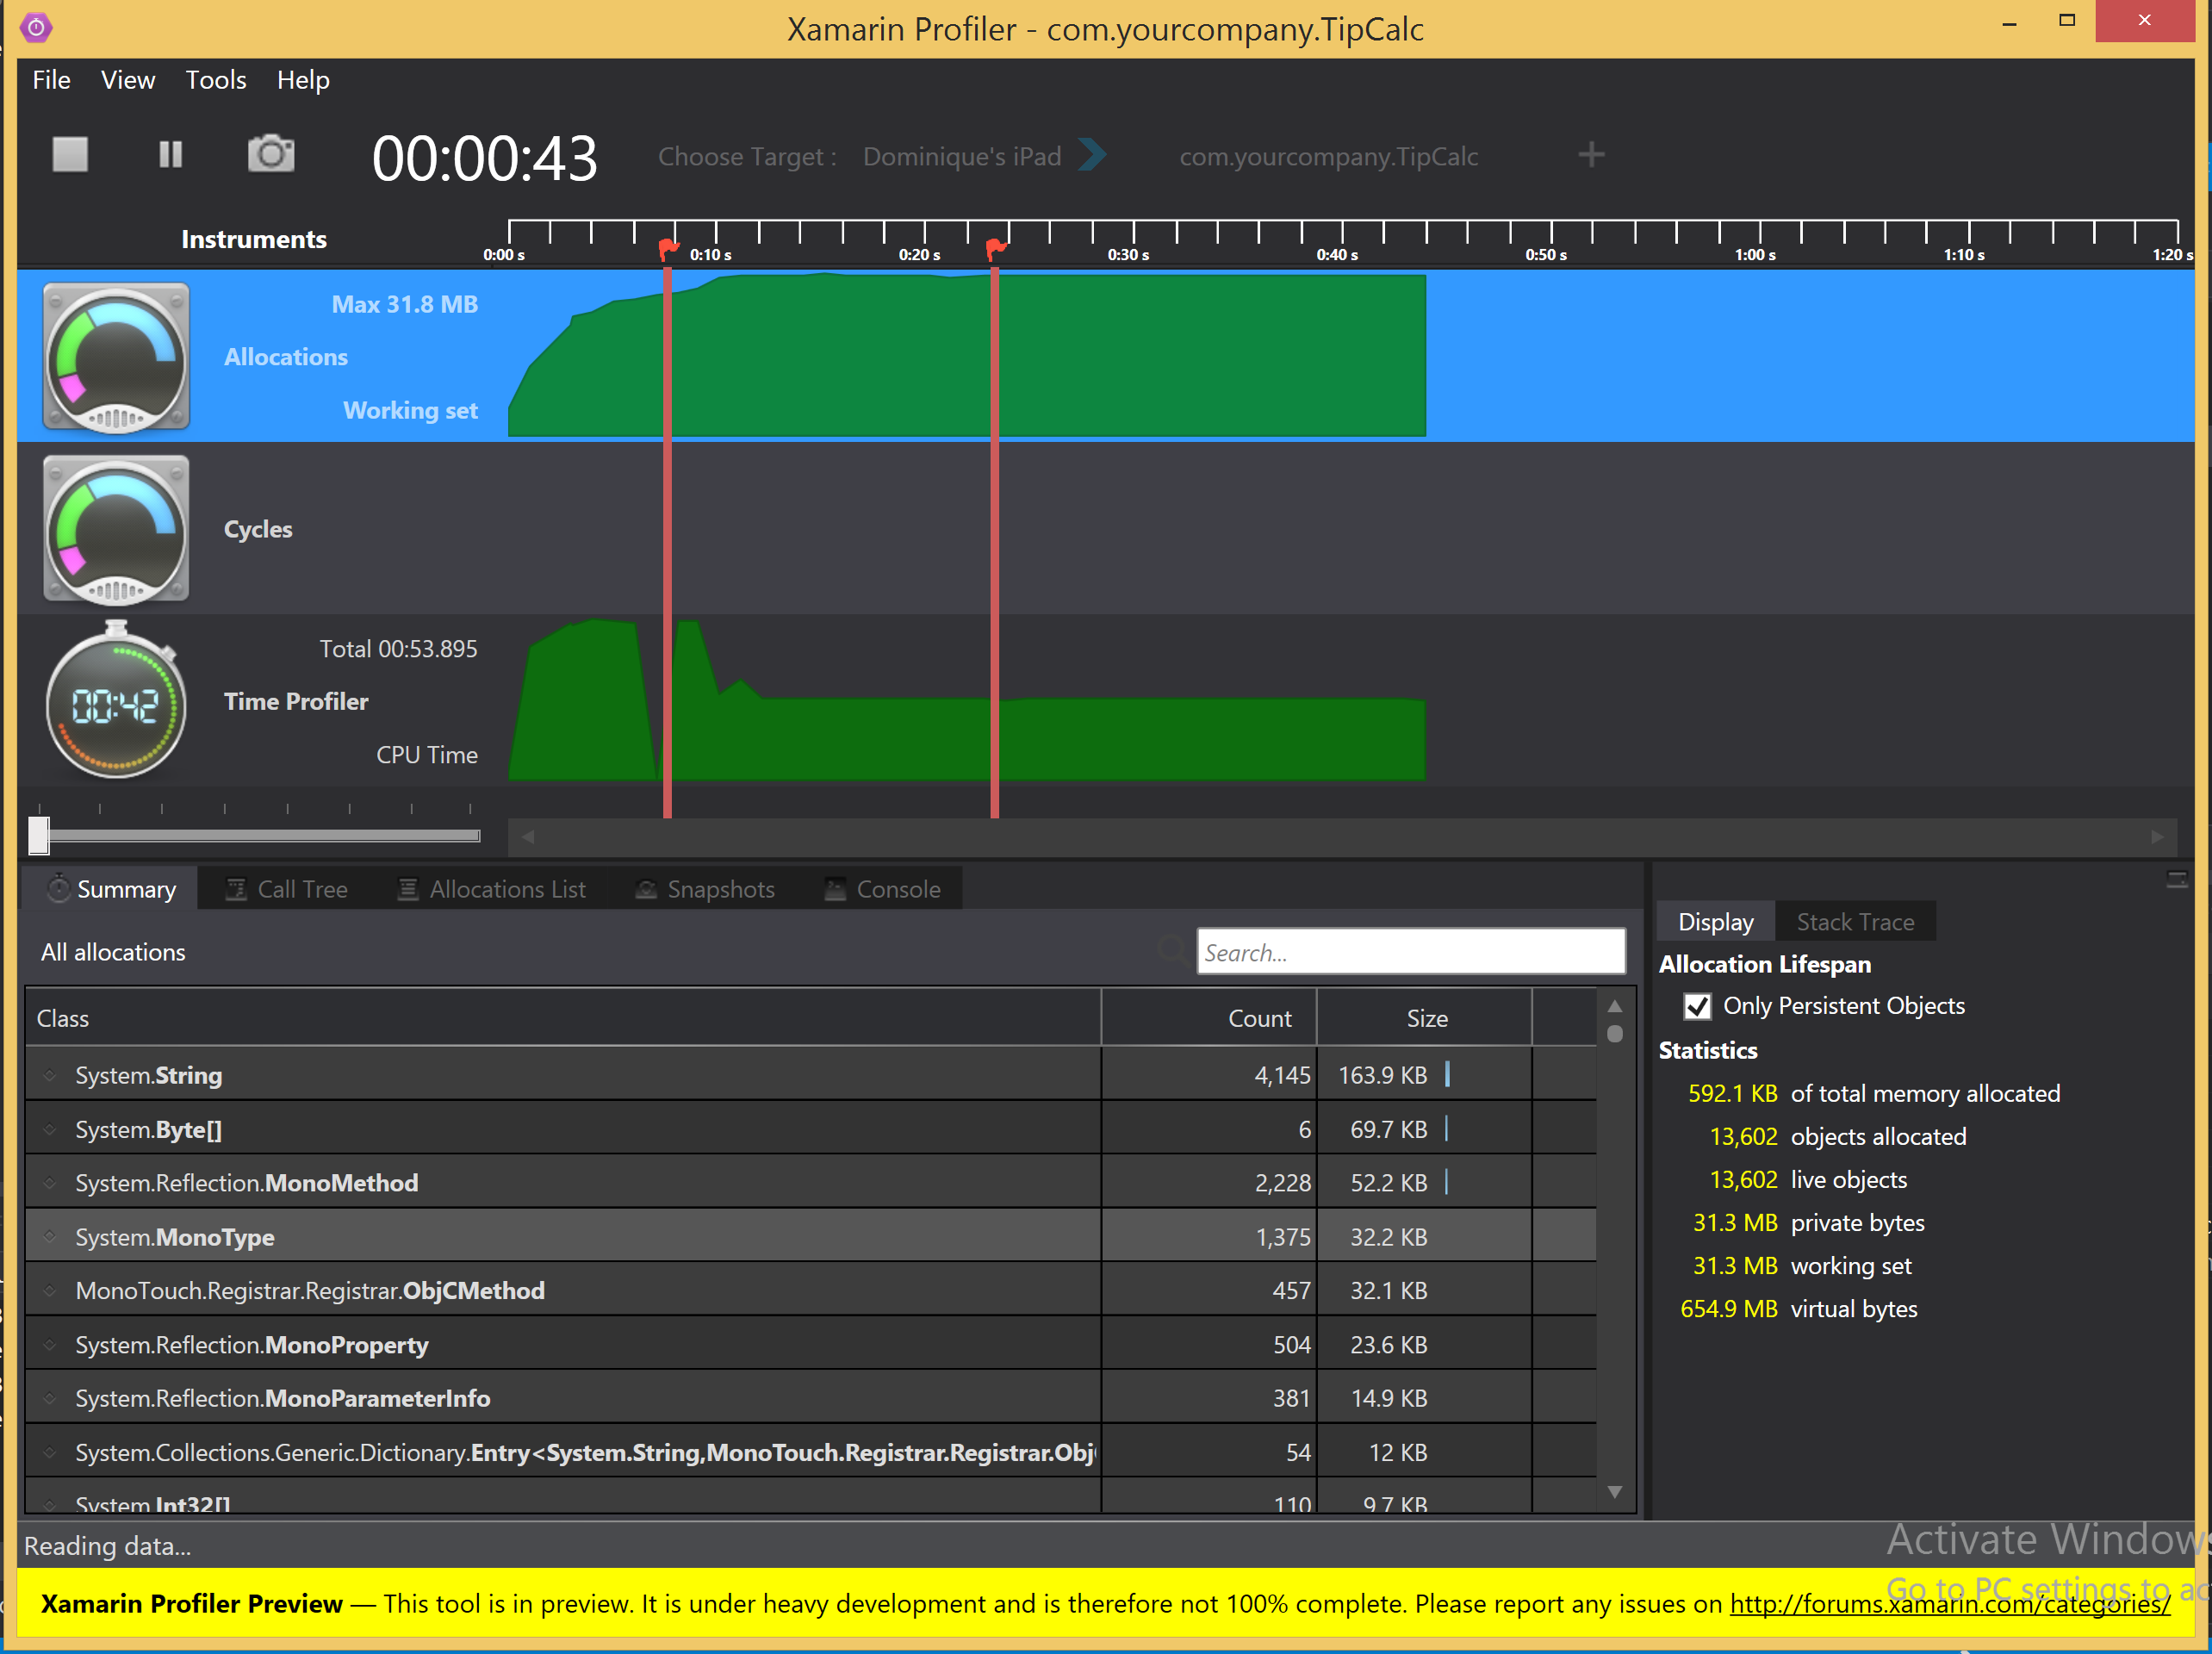
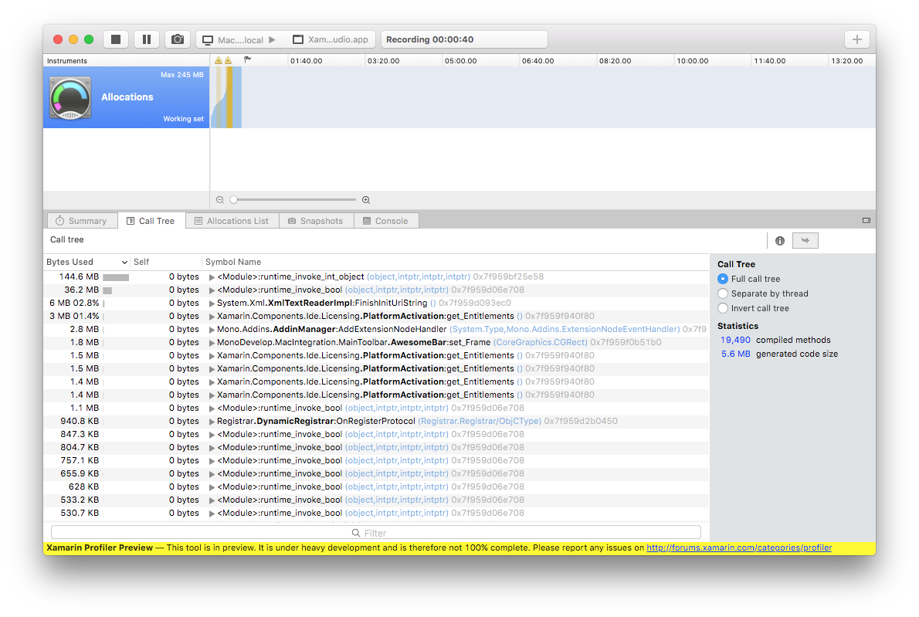
Xamarin Profiler
Notes:
Android/iOS/Mac
All features now complete, now testing and making it scale to larger projects
Mention Cycle Detection

Slide 11
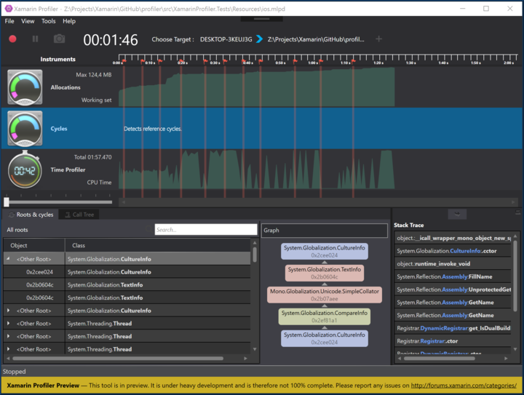
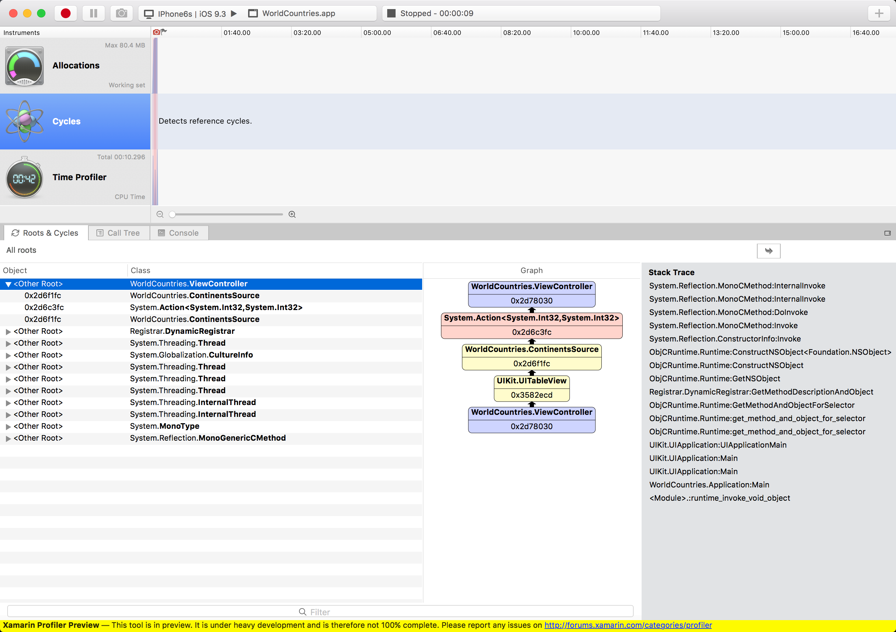
Xamarin Profiler – Cycle Detection
Notes:
New feature to help Android/iOS developers find strong cycles on their applications without having to manually instrument code.

Slide 12
iOS Simulator for Windows
Notes:
We route touches from Windows
The best simulator experience for iOS

Slide 13
Xamarin Workbooks – Interactive C#
Notes:
Learning and Exploring
Creating Live Documentation
Coming to every supported platform where C# runs
Coming to UWP and HoloLens.

Slide 14
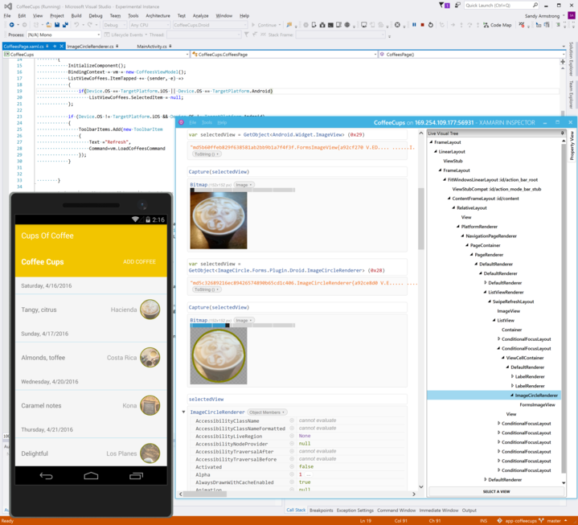
Xamarin Inspector
Notes:
Extends workbooks with web-inspection capabilities
Embeddable, so if you are embeedding .NET in your app in any form, you can also inspect your app live. Rich Debugger in a library basically.

Slide 15
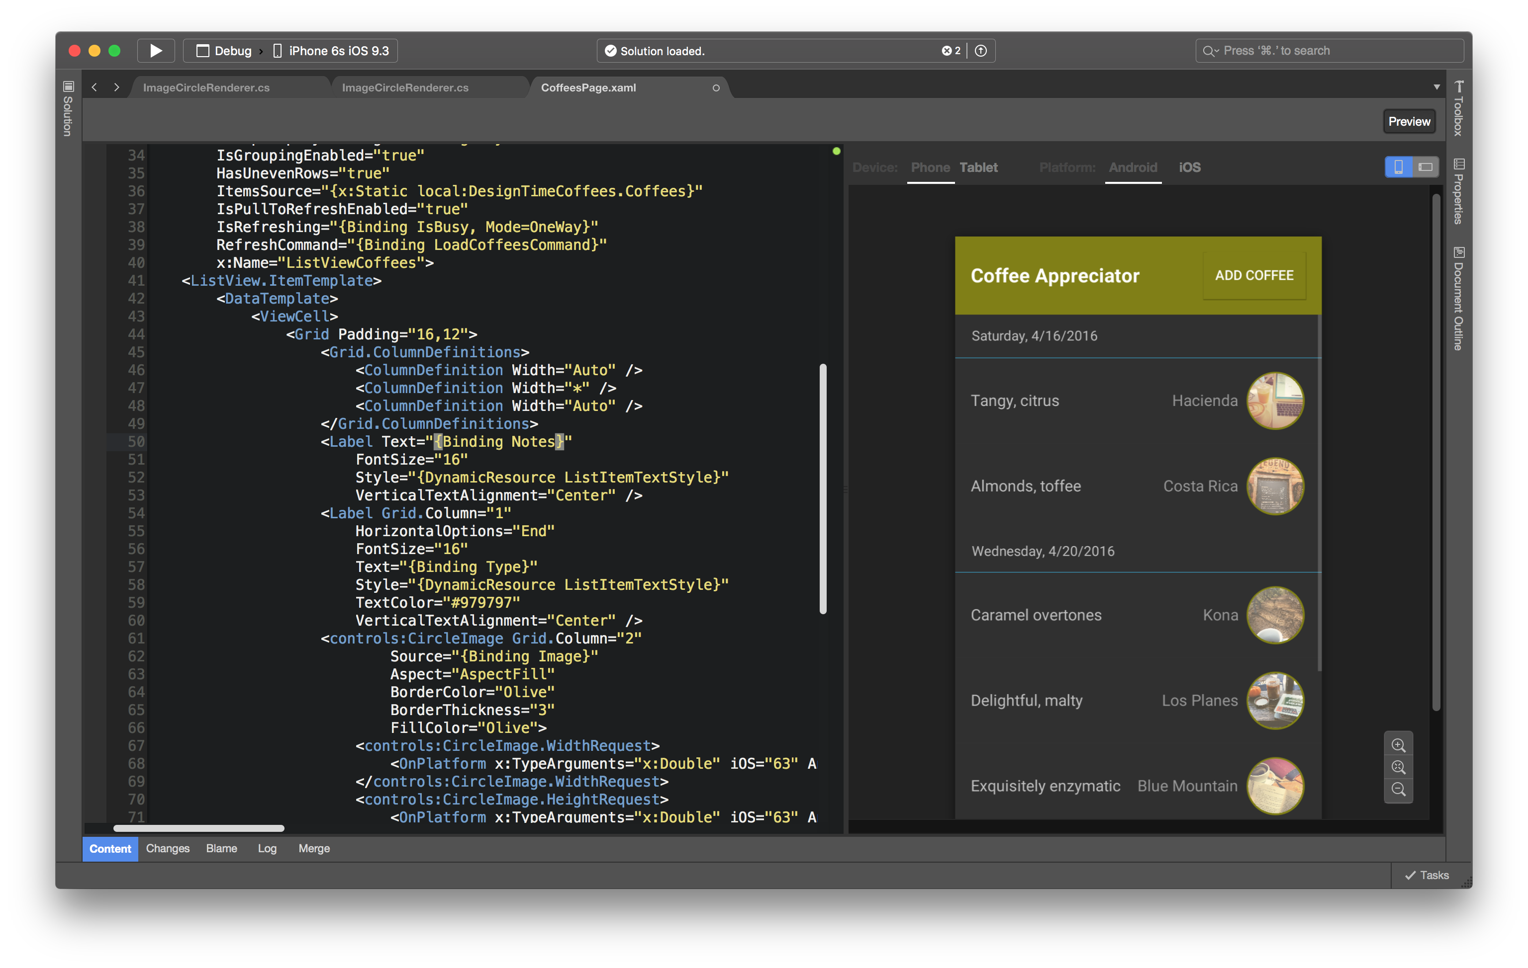
Xamarin.Forms XAML Previewer
Notes:
It is me again. I am trapped! Can you turn on the lights?

Slide 16
This Fall

Slide 17
Fall Themes
iOS 10 and Android N
Xamarin.Mac on Visual Studio
Develop for all platforms in a single solution
ASP.NET Core in Xamarin Studio
Localization and Accessibility
Adding support for 13 languages to Xamarin’s products
Notes:
Addin for now on ASP.NET Core debugging

Slide 18
Microsoft’s IDEs
Visual Studio
Visual Studio Code
Xamarin Studio

Slide 19
Xamarin Studio - Sharable Components
Roslyn
C# Code completion, refactoring, analysis, workbooks, compiler
MSBuild
Taking the place of Mono’s existing xbuild
Debug Engines
Reuses VS Code Debug Protocol
Enables CoreCLR/ASP.NET Core debugging with Xamarin Studio
Language Services
VS Code Language Packs - TypeScript, JavaScript, Go, Python

Slide 20
Improving Cross Platform .NET

Slide 21
Windows
ASP.NET
WPF
Winforms
.NET
Framework
.NET 1.0

Slide 22
Windows
ASP.NET
WPF
Winforms
.NET
Framework
.NET 2.0

Slide 23
Windows
ASP.NET
WPF
Winforms
.NET
Framework
.NET 4.5

Slide 24
Windows
Browser
ASP.NET
WPF
Silverlight
Subset of WPF
Browser specific APIs
Winforms
.NET
Framework
Silverlight
CoreCLR
Subset of the Runtime Engine
Subset of the Base Class Library APIs

Slide 25
Windows
Browser
Phone
ASP.NET
WPF
Silverlight
Silverlight
WinPhone
Winforms
.NET
Framework
Silverlight
CoreCLR
WinPhone
CoreCLR

Slide 26
Windows
Browser
Phone
UWP
.NET Core
ASP.NET
UWP
WPF
Silverlight
Silverlight
WinPhone
ASP.NET
Core
Winforms
.NET
Framework
Silverlight
CoreCLR
WinPhone
CoreCLR
.NET
Native
CoreCLR
Notes:
This slide is hidden, perhaps this is my way out to freedom?
Unhide this slide to unlock the secrets of the universe.

Slide 27
Windows
UWP
ASP.NET
UWP
WPF
Winforms
.NET
Framework
.NET
Native
Notes:
Dear reader – you are my only hope!

Slide 28
Windows
UWP
.NET Core
ASP.NET
UWP
WPF
ASP.NET
Core
Winforms
.NET
Framework
.NET
Native
CoreCLR

Slide 29
Windows
UWP
.NET Core
Unity
ASP.NET
UWP
Unity
WPF
ASP.NET
Core
Winforms
.NET
Framework
.NET
Native
CoreCLR
Unity Mono

Slide 30
Windows
UWP
.NET Core
Unity
Xamarin
ASP.NET
UWP
Unity
Mac
WPF
Android
ASP.NET
Core
Winforms
iOS
.NET
Framework
.NET
Native
CoreCLR
Unity Mono
Xamarin
Mono

Slide 31
Windows
UWP
.NET Core
Unity
Xamarin
ASP.NET
UWP
Unity
Mac
WPF
Android
ASP.NET
Core
Winforms
iOS
Portable Class Libraries
Intersections of APIs

Slide 32
Windows
UWP
.NET Core
Unity
Xamarin
ASP.NET
UWP
Unity
Mac
WPF
Android
ASP.NET
Core
Winforms
iOS
.NET
Framework
.NET
Native
CoreCLR
Unity Mono
Xamarin
Mono
.NET Standard

Slide 33
Sharing Code Beyond .NET Standard

Slide 34
Complementing .NET
Libraries with Platform Specific Capabilities
Example: Barcode Scanners (third party)
Xamarin.Forms (Cross platform toolkit)
Authenticate with specific services
Geolocation
Accessing Contacts
…
Or With Native Requirements
Sqlite (Portable Database)
SkiaSharp (2D graphics API)
Urho (3D Scenes)
…

Slide 35
Sharing Code Beyond .NET Standard
SkiaSharp
ASP.NET
UWP
WPF
ASP.NET
Core
Winforms
iOS
Android
Mac

Slide 36
Sharing Code Beyond .NET Standard
SkiaSharp
Win32
Implementation
WinRT
Implementation
ASP.NET
UWP
Win32
Linux
MacOS
Implementation
WPF
CocoaTouch
Implementation
Android
Implementation
Cocoa
Implementation
ASP.NET
Core
Winforms
iOS
Android
Mac
Notes:
Build your implementations on the IDE
Easy, one solution per project
Assemble NuGet package by hand
Carefully put files in the proper locations
Try, Test, Repeat until it works
Create intersection API by hand
Edit by hand
Or butcher by hand
Write error prone tool by hand

Slide 37
Xamarin Components and Plugins
Many done for you, ~50
https://github.com/xamarin/XamarinComponents
Or pre-packaged:
https://components.xamarin.com
Notes:
It is easy, but tedious to do this work

Slide 38
Plugin Development
Bait and Switch
Great technology
Manual Process
Tedious
Dedicated Staff
Notes:
It is easy, but tedious to do this work

Slide 39
Nugetizer-3000 to the Rescue!
Streamline the process of creating Xplat Nugets
Create Nugetizer-3000 Project
Reference the native projects
Build and ship
Nugetizer computes the API intersection for you
Packages your NuGet

Slide 40
From Framework To Library

Slide 41
Linked .NET
MyApp.exe
mscorlib.dll
System.dll

Slide 42
Linked .NET
MyApp.exe
mscorlib.dll
System.dll

Slide 43
Linked .NET
MyApp.exe
mscorlib.dll
System.dll

Slide 44
Linked .NET
MyApp.exe
mscorlib.dll
System.dll

Slide 45
Linked .NET
MyApp.exe
mscorlib.dll
System.dll

Slide 46
Linked .NET
MyApp.exe
mscorlib.dll
System.dll
Notes:
Have your cake and eat it too.

Slide 47
Mono Linker – The Basics
Garbage Collector for Code
Works like you expect it to
Traces used code, keeps it. Everything else is removed.
Unused Code is Removed
XML Configuration
Teaches the linker about internal dependencies
Things to remove, things to keep
Augments the roots
Constant Folding
Assumes a public static variable is true/false, removes dead code
Example: “Environment.RunningOnWindows”

Slide 48
Linker – Advanced Uses
Custom Steps
When you need more smarts
To remove code
To instrument code
To generate code
iOS has over 26 custom steps to optimize, remove code, fields, data, assist code generation
Examples: http://github.com/xamarin/xamarin-macios/tree/master/tools/linker
How
Create a subclass of Mono.Linker.Steps.BaseStep
Plenty of samples in the link above

Slide 49
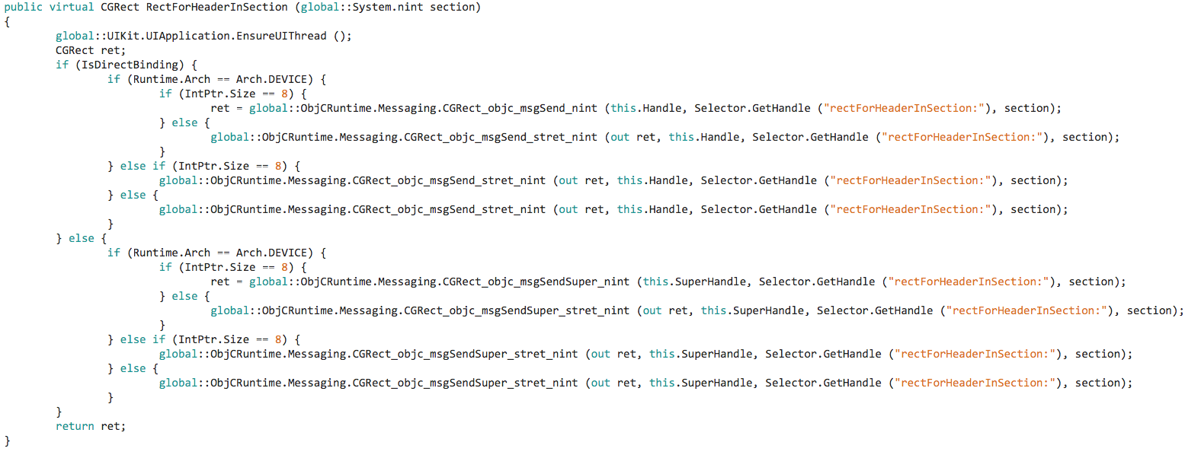
Linking 2.0 – beyond the basics

Slide 50
Linking 2.0 – beyond the basics
For cases without subclassing

Slide 51
Linking 2.0 – beyond the basics

Slide 52
Linking 2.0 – beyond the basics
Externally configured static global
Device vs Simulator.
Assume device.

Slide 53
Linking 2.0 – beyond the basics

Slide 54
Linking 2.0 – beyond the basics
32 vs 64 bit build

Slide 55
Linking 2.0 – beyond the basics

Slide 56
Linking 2.0 – beyond the basics
Debug or Release?
Release – remove debugging aids.

Slide 57
Linking 2.0 – beyond the basics

Slide 58
Linking 2.0 – beyond the basics
Built-in Selector to Constant mapping

Slide 59
Linking 2.0 – beyond the basics

Slide 60
Next Steps
Update Xamarin Today – Cycle 7 is here
Watch the rest of .NET Conf
Hands on

