Slide 2
.NET Universal Windows Platform Development
Daniel Jacobson
Program Manager Visual Studio
@pmatmic

Slide 3
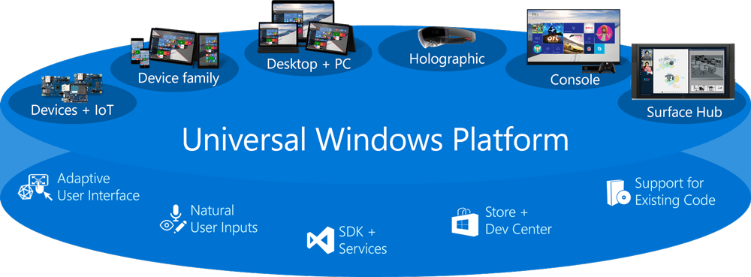
Windows 10 and UWP

Slide 4
A Brief History of .NET
.NET
Windows Desktop
Windows Store
Windows Phone
ASP.NET 4
ASP.NET 5
App Model
App Model
App Model
App Model
App Model
Framework
Framework
Framework
Framework
Framework
Runtime
Runtime
Runtime
Runtime
Runtime

Slide 5
.NET today
.NET FRAMEWORK
.NET CORE
XAMARIN
Platform for .NET applications on Windows
Cross-platform and open source framework optimized for modern
app needs and
developer workflows
Cross-platform and open source Mono-based runtime for iOS, OS X,
and Android devices
Distributed with Windows
Distributed with app
Distributed with app
Notes:
Notes: Focus on the great additions to the .NET Framework, enabling developers to target the latest applications in the cloud and devices.
.NET Core: “Cross-platform and open source framework optimized for modern app needs and developer workflows” - Allows you to talk about the motivation for app local/side by side, native compilation & modularity in the context of the demands of the application and DevOps.
Xamarin – “Cross-platform and open source Mono-based runtime for iOS & Android devices” – does that convey what we want. Xamarin SDK will be announced as open by the time this presentation happens.

Slide 6
.NET today—app models and libraries
.NET FRAMEWORK
.NET CORE
XAMARIN
APP
MODELS
WPF
Windows Forms
UWP
iOS
Android
ASP.NET
ASP.NET Core
OS X
BASE
LIBRARIES
Base Class Library
Core Library
Mono Class Library
COMMON INFRASTRUCTURE
Compilers
Languages
Runtime components
Notes:
Notes: Even if we are reusing a lot across components (especially with the open sourcing last year), the reality is that each platform has its own implementation of the base libraries.
Note: .NET Framework BCL and Mono BCL are the same APIs, different implementation. .NET Core “Core Library” is a similar set of APIs, but different.

Slide 7
.NET today—reusing code
.NET FRAMEWORK
.NET CORE
XAMARIN
APP
MODELS
My code
BASE
LIBRARIES
PCL reference assemblies
Implementation 3
Reference implementation
Implementation 2
Implementation 1
COMMON INFRASTRUCTURE
Compilers
Languages
Runtime components
Notes:
Notes: To address this, we introduced portable class libraries, which allow abstracting over each platform’s libraries with reference implementations.

Slide 8
.NET tomorrow
.NET FRAMEWORK
.NET CORE
XAMARIN
WPF
Windows Forms
UWP
iOS
Android
ASP.NET
ASP.NET Core
OS X
.NET STANDARD LIBRARY
One library to rule them all
COMMON INFRASTRUCTURE
Compilers
Languages
Runtime components
Notes:
More apis available to you as a UWP developer that is consistent with all of our .NET platforms

Slide 9
.NET tomorrow—reusing code
.NET FRAMEWORK
.NET CORE
XAMARIN
BENEFITS
Reuse skills
Master one library, not a platform
Reuse code
Big surface area - no small common denominator
Faster innovation
.NET Standard can grow without updating platforms
Reference implementations
My code
Full implementations
COMMON INFRASTRUCTURE
Compilers
Languages
Runtime components
Notes:
Notes: Reusing code is dramatically better with the .NET Standard Library. It includes reference implementations, just like the PCL but it also can be extended with full implementations shared across all platforms.

Slide 10
.NET and UWP

Slide 11

What about delivery?

Slide 12
.NET Native
No JIT + lean runtime means startup is lighting fast
  60% faster startup
  Xbox dashboard ~300ms startup times
  “Saved us 3 months of performance work”
Lower Memory Usage (~40% lower)
Store Compile
App Local .NET*

Slide 13
.NET Native Workflow
Edit-Build-Run loop
Debug | x86 | Local Machine
File > New > C#/VB > Windows Universal
UWP app
Test on target devices
Test Release build (.NET Native)…
Project > Store > Create and Publish Appxupload

Slide 14
Building an App

Slide 15
Questions To Be Answered
How many people are currently in my store?
How can I tell when someone enters if I’m not around?
How many people enter throughout the day?
What is the busiest day of the week?
When I run promotions, how successful are they?

Slide 16
App Design

Slide 17
Sensor Map
Entry
Entry
Exit
Exit

Slide 18

Sensor Map
_enter = true;
_exit = false;
No event has happened yet.
Entry
Entry
Exit
Exit

Slide 19
Sensor Map
_enter = true;
_exit = true;
The customer has fully entered the shop.
Entry
Entry
Exit
Exit

Slide 20
Sensor Map
_enter = true;
_exit = true;
At this point, trigger the event, and reset the state.
Entry
Entry
Exit
Exit

Slide 21
Sensor Map
TriggerEvent(true);
_enter = false;
_exit = false;
Entry
Entry
Exit
Exit

Slide 22
App Design

Slide 23
.NET Universal Windows Platform Development
Daniel Jacobson
Program Manager Visual Studio
dajaco@microsoft.com
@pmatmic

