Slide 2
Innovate and get your apps in front of 100 million business users with AppSource, PowerApps, Microsoft Flow, and the Common Data Service
B8120
@SatishThomas, Group Program Manager – Microsoft AppSource
Theresa Palmer, Senior Program Manager – Connectors
Jono Luk, Group Program Manager – CDS
Peter Villadsen, Principal Program Manager – CDS

Slide 3
PPT REM 16
Enable enterprise SaaS ISVs to
connect with 100 Million users

Slide 4
Value
Onboard onto AppSource (and AAD) to enable discovery and trials to Microsoft’s business users
Deeply integrate your app with Microsoft users through Power BI, PowerApps and Flow
Enrich your app experience by embedding Power BI, PowerApps or Flow
Make your apps smarter with customer data by using the CDS

Slide 5
Value
Onboard onto AppSource (and AAD) to enable discovery and trials to Microsoft’s business users
Deeply integrate your app with Microsoft users through Power BI, PowerApps and Flow
Enrich your app experience by embedding Power BI, PowerApps or Flow
Make your apps smarter with customer data by using the CDS

Slide 6
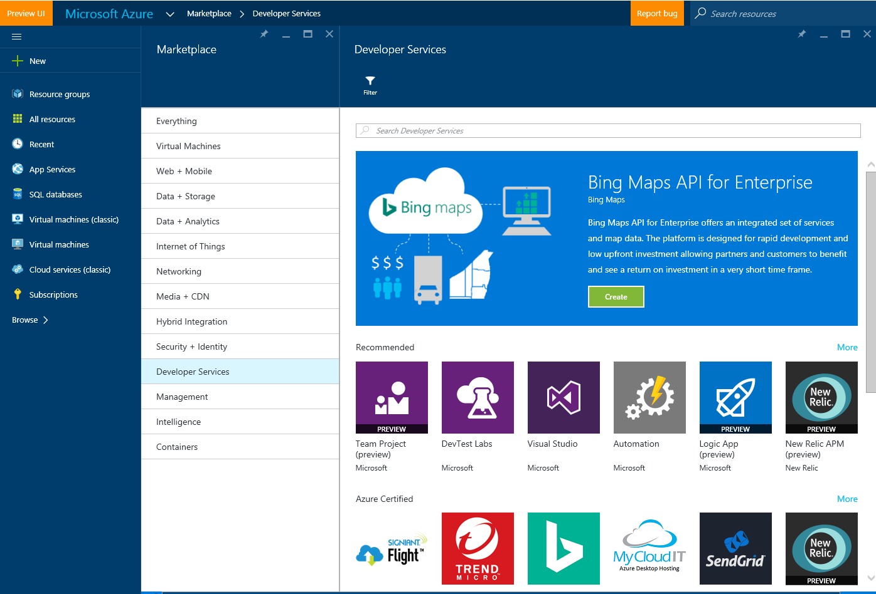
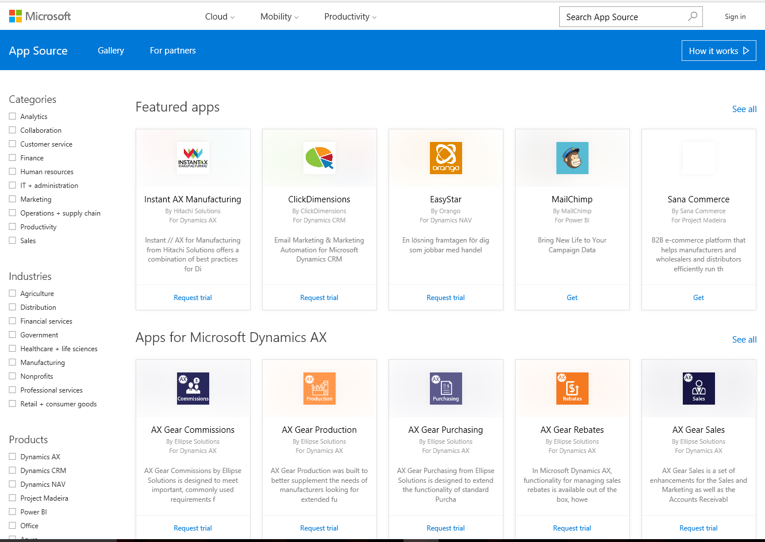

Microsoft Cloud Ecosystem – Catalyst for Enterprise adoption
Audience
Business Audience
Dev / IT Audience
Dev / IT Audience
Business Audience
AZURE
Business Cloud
Customers
Trusted Advisors for your Cloud journey
Connecting customers & ISVs with Qualified Leads
www.azure.com/marketplace/
appsource.microsoft.com.com/
Microsoft Cloud Ecosystem
Key Players
Solution Integrators
Microsoft Field
ISV Field
Enablers
Developers
Publishers
IaaS, PaaS, SaaS solutions
Connecting ISVs & Enablers with match-making

Slide 7
Business Application Platform
Microsoft AppSource
Office 365
Power BI
Cortana Intelligence
Azure IoT
Dynamics 365
Third Party Business Applications
Sales
Customer Service
Field Service
Project Service Automation
Financials
Operations
PowerApps, Power BI Embedded, Flow & Common Data Service
Azure

Slide 8
Microsoft AppSource
PARTNERS
Business user
ISV
System integrator
Discover, try, acquire
through an
end-to-end experience
Build innovative apps
and connect with
qualified customers
Accelerate
time to value

Slide 9

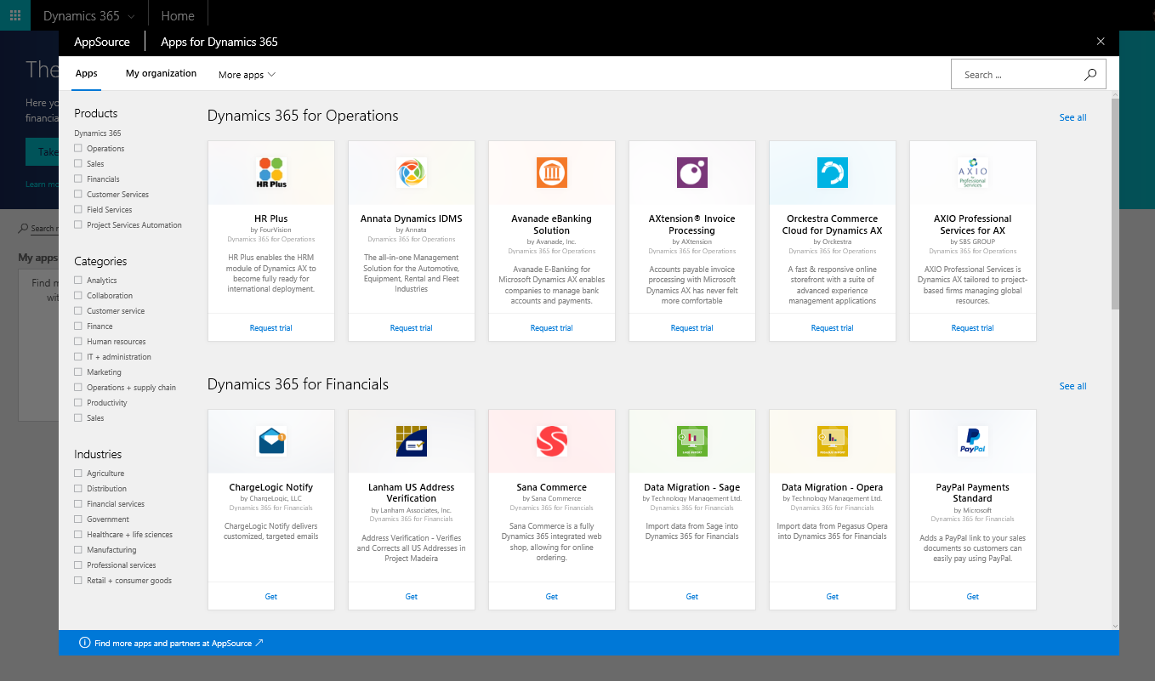
Easily discover third-party business apps
Relevant apps are
displayed within
context of your
business app
OR
AppSource.com

Slide 10
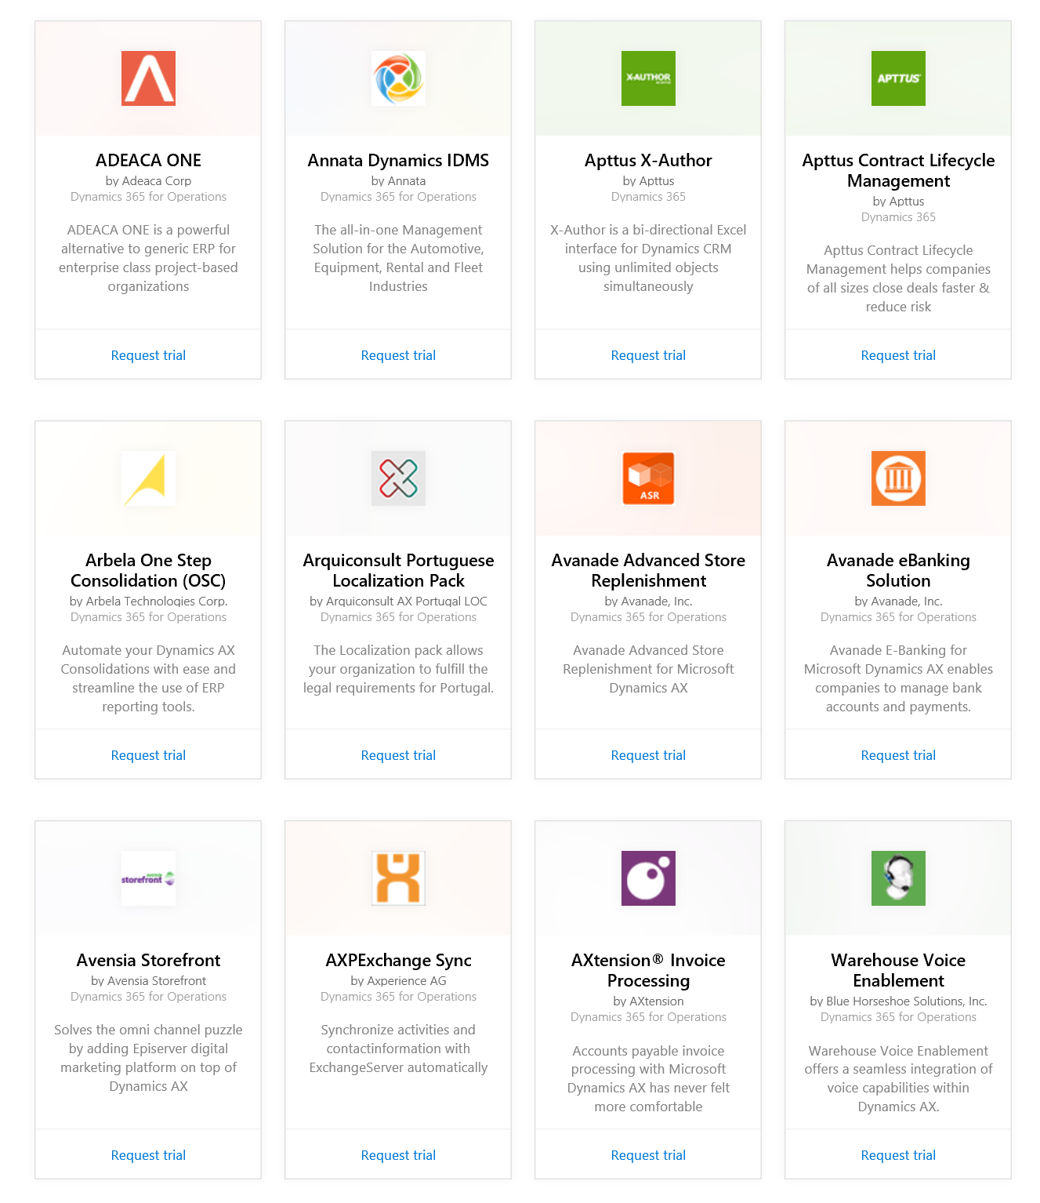
2,300+ apps for
Microsoft Dynamics 365
Power BI
Office 365
Cortana Intelligence

Slide 11
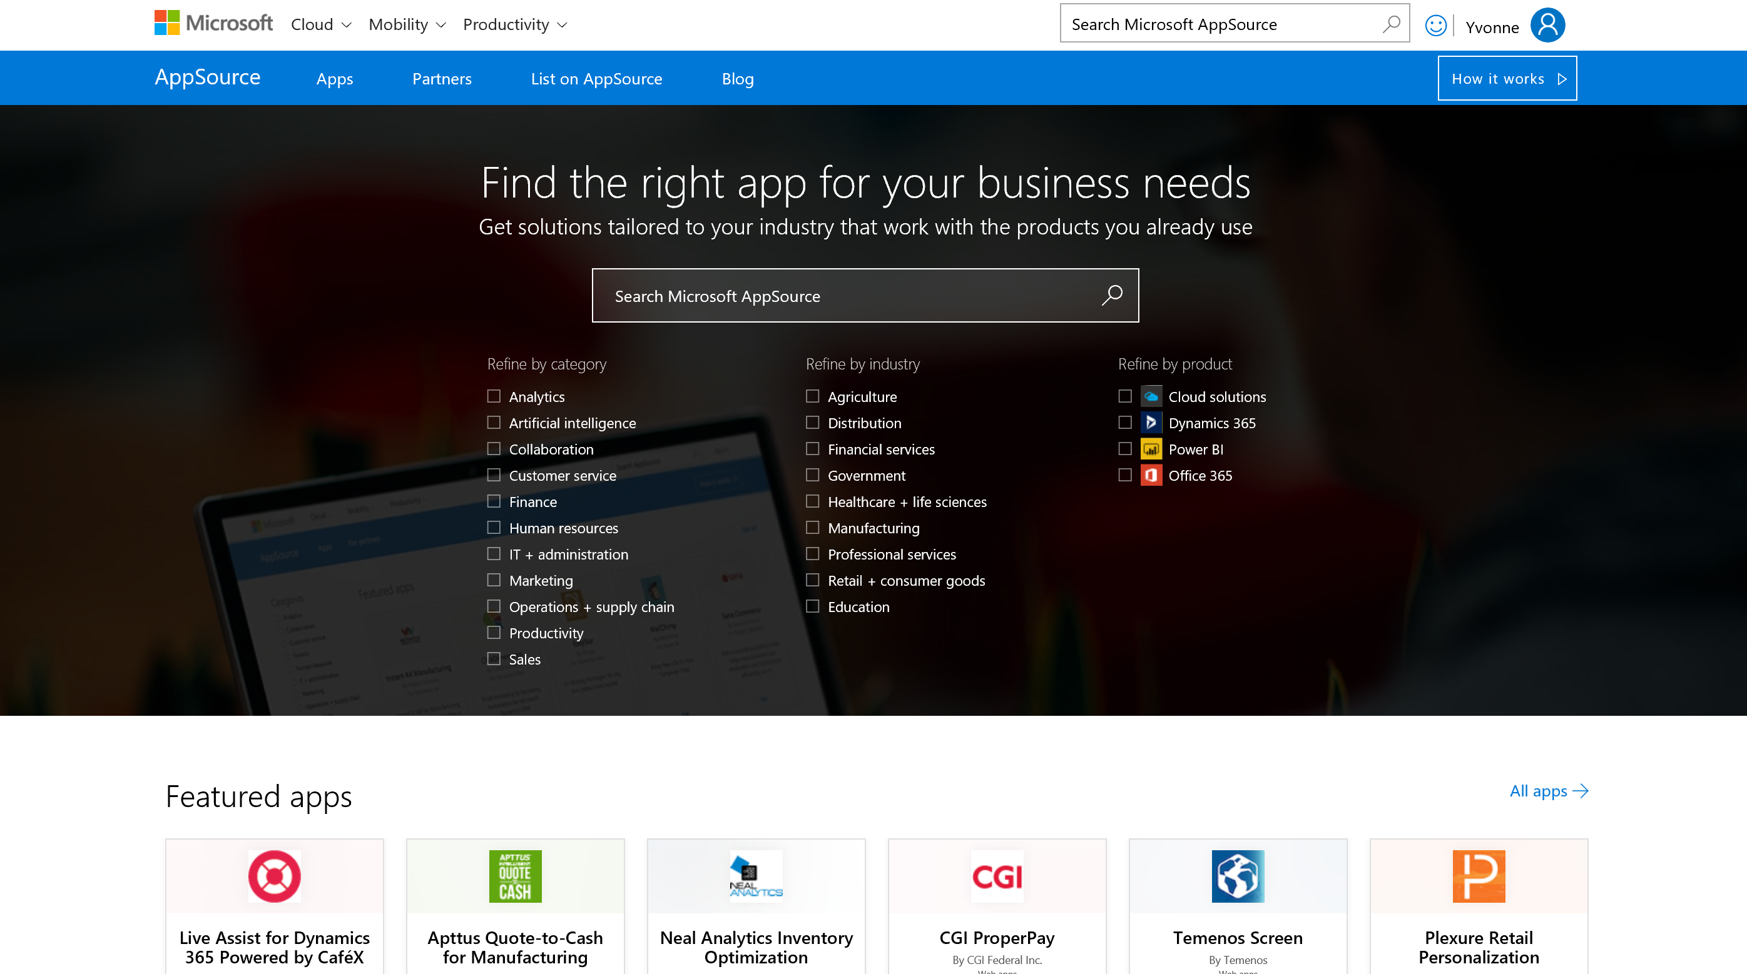
Demo
Easily discover and
try business apps

Slide 12
Demo: Next Best Action // Financial services
Relevant offers all the time,
every time
Branch
BANK
Contact
Center
ATM/
Kiosk
Online or
Mobile
Email
Send the right offers
at the right time
Engage in natural conversations in a personal
Ensure transaction continuity
Boost customer loyalty
and profitability
Streamline operations

Slide 13
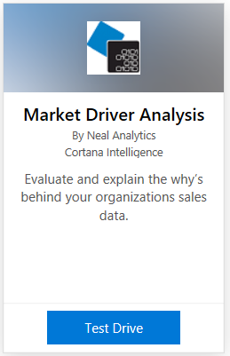
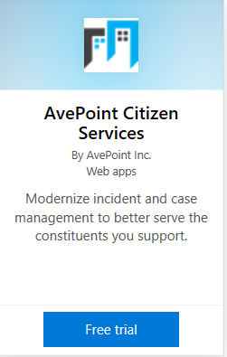
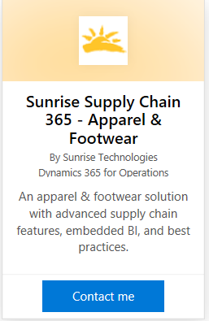
Trial experience
CUSTOMER LED TRIAL
Low friction end user experience
<“5 seconds to try, 5 minutes to ‘Wow’”
Utilize AppSource test drive framework
CUSTOMER LED TRIAL
Low friction end user experience
<“5 seconds to try, 5 minutes to ‘Wow’”
Hosted and managed by ISV – utilize templates provided by AppSource
PARTNER LED TRIAL
Submit contact information
Partner works directly with customer

Slide 14
How to enable a customer trial experience
START
Requirement – enable Azure Active Directory Single sign-on
Support for SaaS apps and add-ons for business applications from Microsoft
Option to utilize test drive template or test drive framework
Hands-on session now live on Channel9. “Learn how to deliver a compelling test drive experience on Microsoft AppSource“
  https://channel9.msdn.com/Events/Build/2017/P4077
Blog post:
  https://appsource.microsoft.com/blogs/public-preview-of-appsource-test-drive-framework-delivers-compelling-experiences-for-business-app-users
Enable AAD SSO
CONNECT
SAAS APPS
ADD-ONS
Deploy extensions
to business applications?
NO
YES
Deploy components
to customer tenant (Azure)
Deploy components
to customer tenant (Azure)
Start with a template and host a trial experience
YES
YES
YES
ASSEMBLE
NO
NO
Review and meet publish criteria
Integrate your ARM template with AppSource test drive framework
Integrate with AppSource provisioning and user management framework to enable test drives
Integrate with AppSource provisioning and user management framework to enable test drives
Publish to AppSource
with a trial
experience
PUBLISH
END

Slide 15
Value
Onboard onto AppSource (and AAD) to enable discovery and trials to Microsoft’s business users
Deeply integrate your app with Microsoft users through Power BI, PowerApps and Flow
Enrich your app experience by embedding Power BI, PowerApps or Flow
Make your apps smarter with customer data by using the CDS

Slide 16
Business Application Platform
Microsoft AppSource
Office 365
Power BI
Cortana Intelligence
Azure IoT
Dynamics 365
Third Party Business Applications
Sales
Customer Service
Field Service
Project Service Automation
Financials
Operations
PowerApps, Power BI Embedded, Flow & Common Data Service
Azure

Slide 17
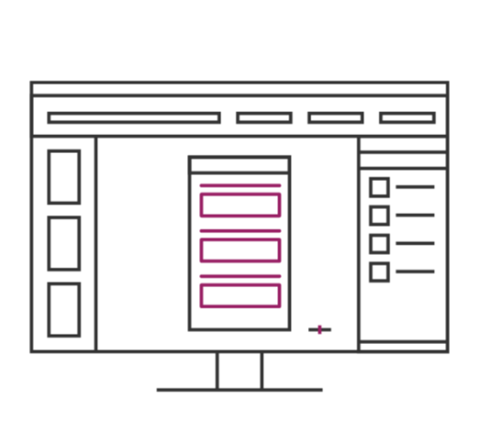
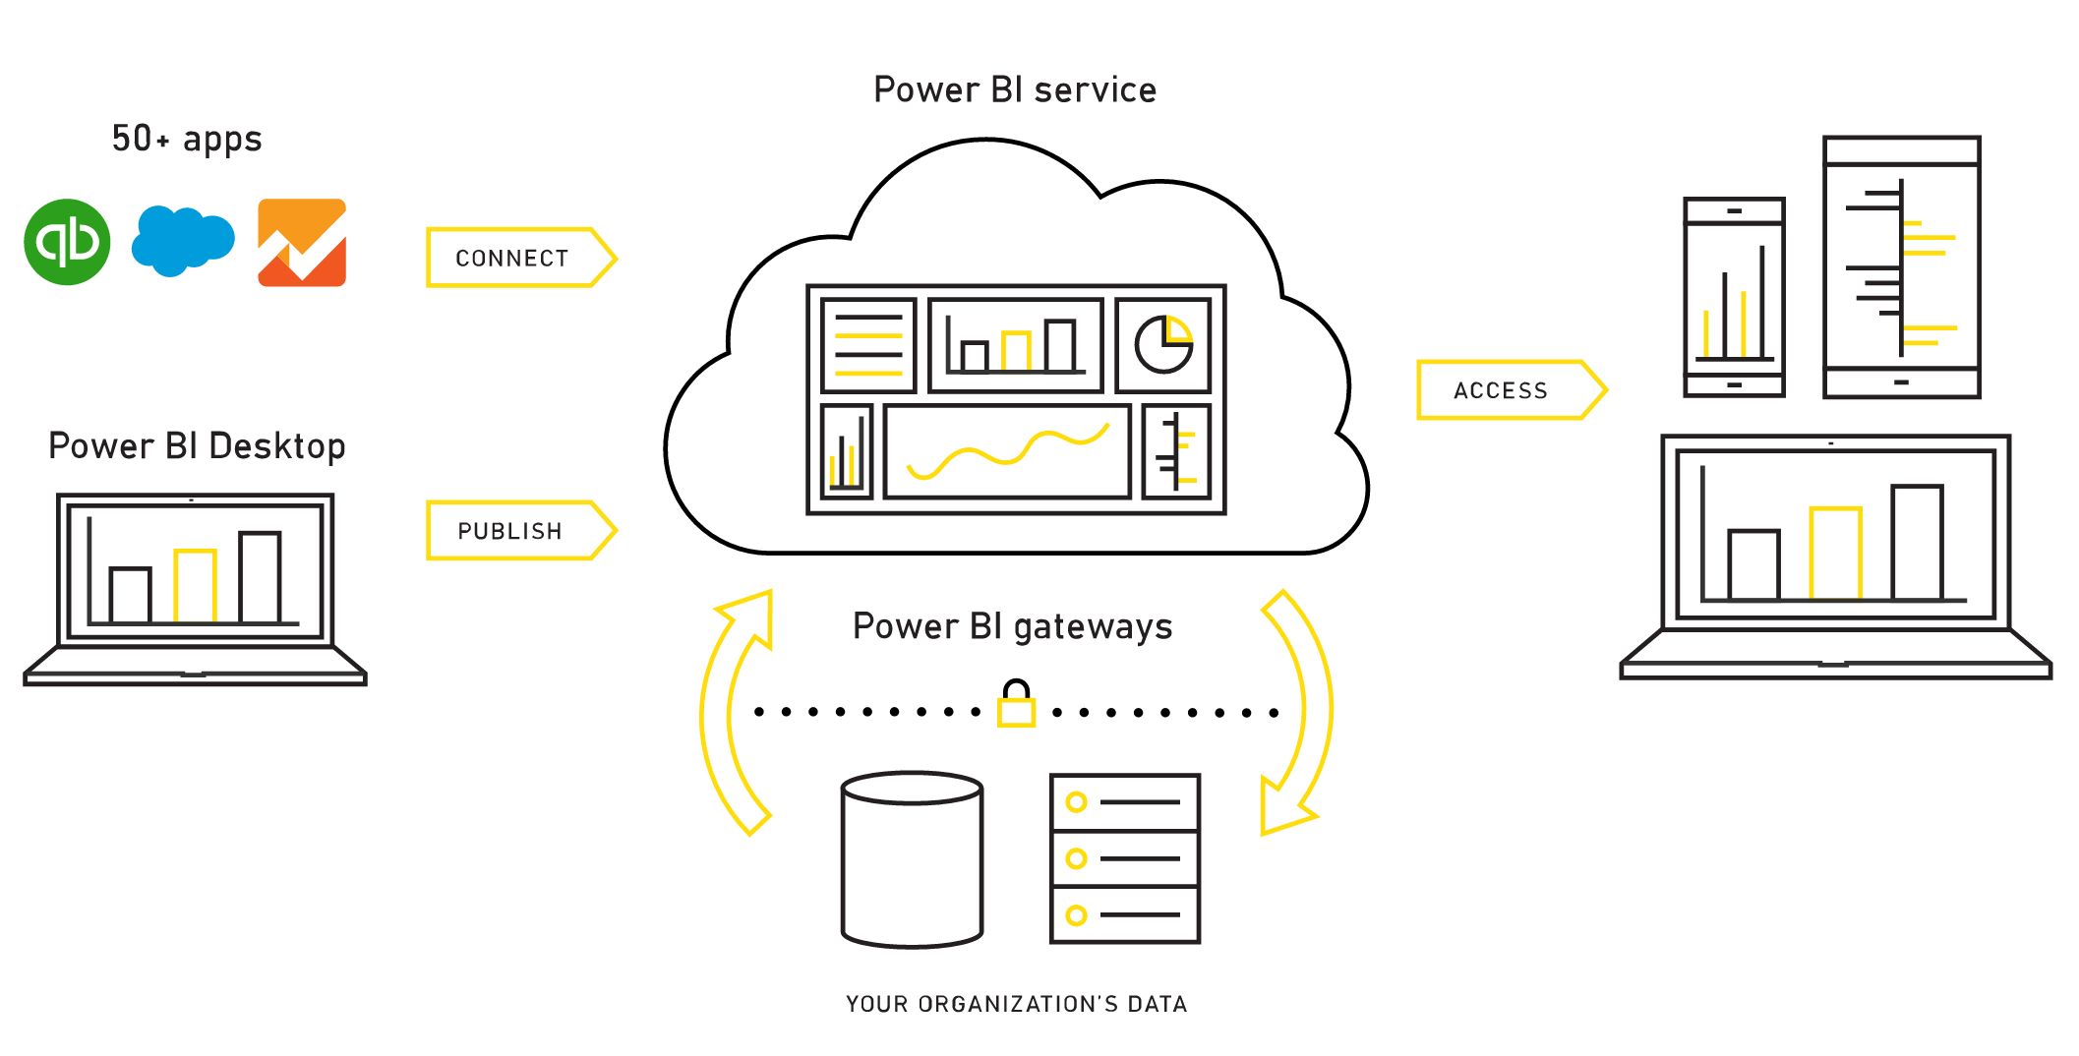
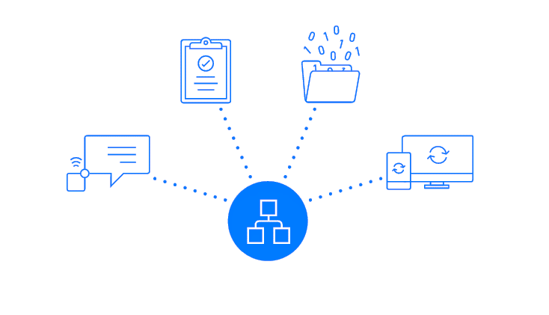
Power BI
PowerApps
Flow
Bring your data to life with live dashboards and interactive reports
Create apps, forms, and workflows without writing code
Build workflows using triggers & actions without code or scripts

Slide 18
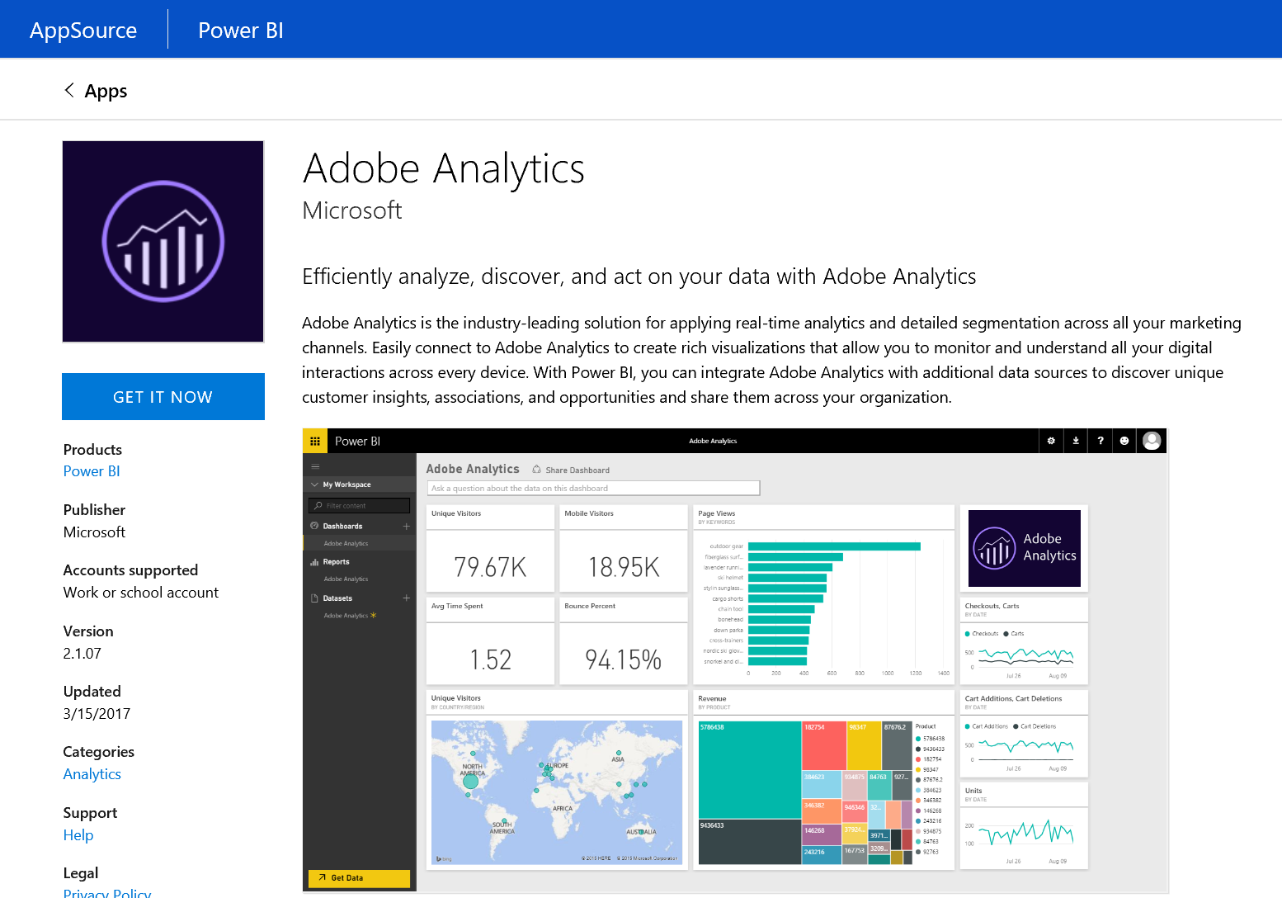
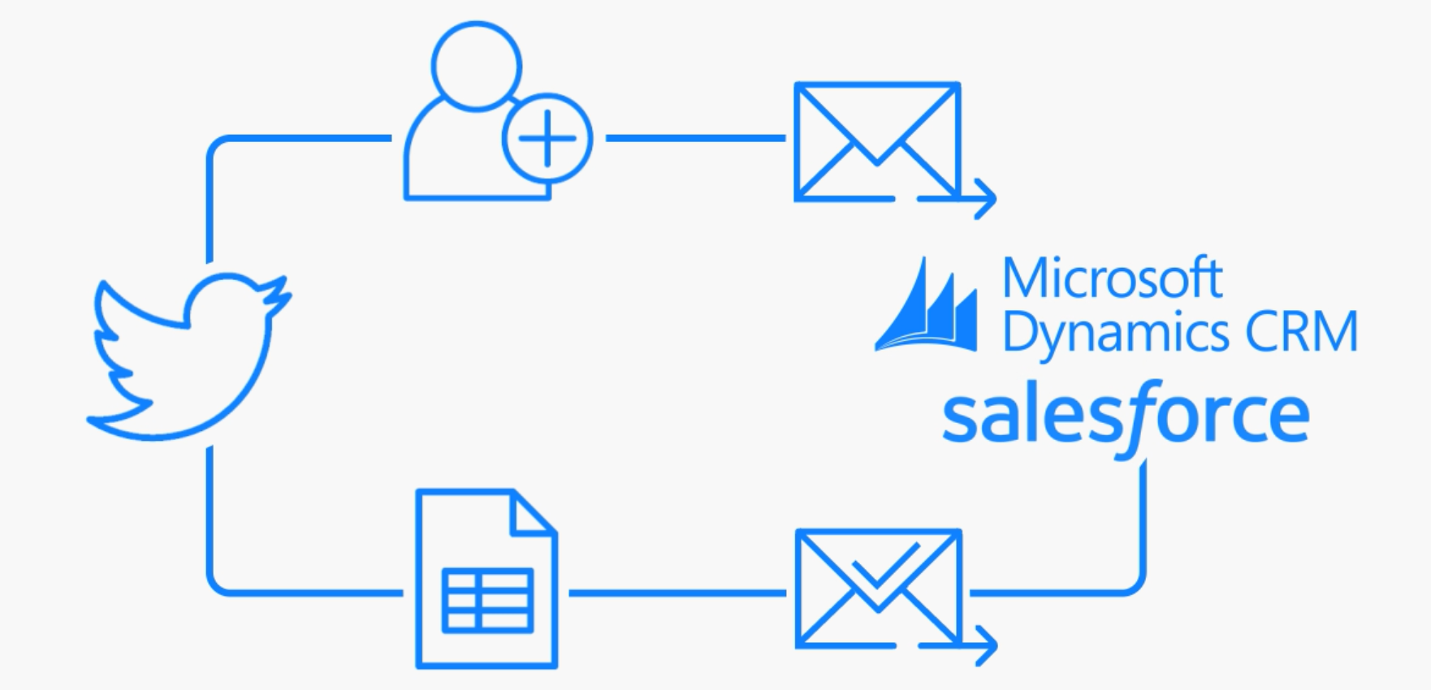



Integrate with Power BI, PowerApps and Flow
Build a Power BI Content Pack
Build a Connector

Slide 19
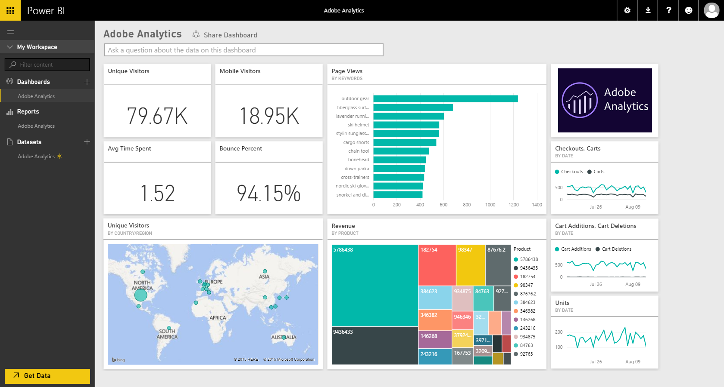
Power BI Content Packs
A set of out-of-box content offers immediate insights without all the hard work
Provides rich interactive visuals for a specific role, domain, or workflow
All service content packs are listed on the AppSource marketplace
95+ content packs today

Slide 20


















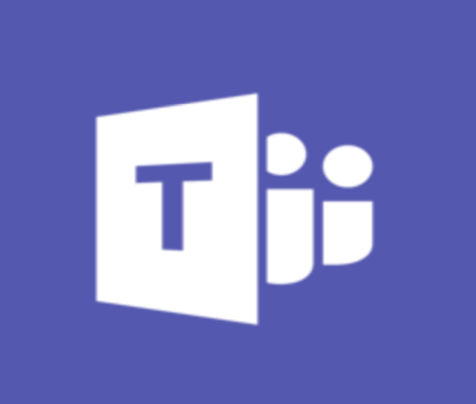








Connectors in Flow, PowerApps and Power BI
Connect to all the services they’re already using without native integration.
API and data connectors have a full spectrum of capabilities from simple actions to rich tabular experiences.
On premises data is also accessible using the Data Gateway.
Your product here!
130+ connectors today

Slide 21
Developing Power BI Content Packs
Build using existing Power BI capabilities
  Power BI Desktop for queries, parameters, model and reports
  PowerBI.com for dashboard, template content pack, scheduled refresh
  Data Connector SDK for additional connectivity
Submit for certification through AppSource
https://aka.ms/cpDevDocs

Slide 22
Developing Data Connectors
Allows development of Power BI extensions
Preview of the Data Connectors SDK on GitHub
Make it easy for power users to query, shape and mashup data from your service
https://aka.ms/dataconnectors

Slide 23
Developing API Connectors
Easy to get started using Custom Connectors
Requirements:
  Own a service with a publicly accessible REST API
  Use a supported authentication type
Once developed, submit to Microsoft for certification
https://aka.ms/apiconnectors

Slide 24
Demo –
Content Packs and Connectors
Theresa Palmer

Slide 25
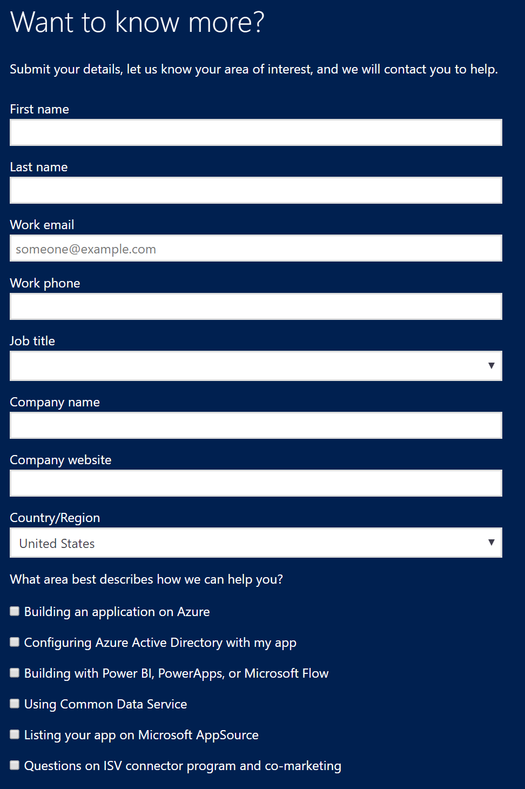
Certify your API Connector
Export tested custom connector as a swagger file
Reach out through ISV website
  Connects you with the team for certification
  Once reviewed will be publicly deployed
https://aka.ms/apiconnectors

Slide 26
Value
Onboard onto AppSource (and AAD) to enable discovery and trials to Microsoft’s business users
Deeply integrate your app with Microsoft users through Power BI, PowerApps and Flow
Enrich your app experience by embedding Power BI, PowerApps or Flow
Make your apps smarter with customer data by using the CDS

Slide 27
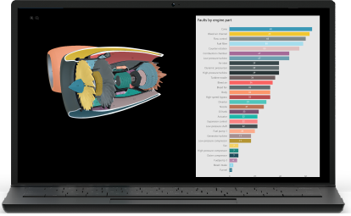
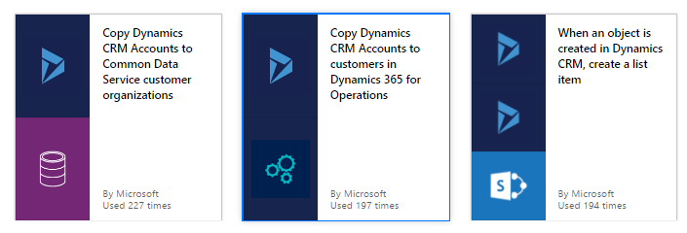
Enrich your app experience with embedding
Empower more insights with Power BI Embedded
Streamline automation with Flow templates
Add analytics to your apps with Power BI, and provide data visualizations and insights in context.
Make it easy for your customers to automate tasks by embedding capabilities from Flow into your app.

Slide 28
Value
Onboard onto AppSource (and AAD) to enable discovery and trials to Microsoft’s business users
Deeply integrate your app with Microsoft users through Power BI, PowerApps and Flow
Enrich your app experience by embedding Power BI, PowerApps or Flow
Make your apps smarter with customer data by using the CDS

Slide 29


Smarter apps, simpler work
Connectors are great for building apps that work against just your data!
What if you’re building apps that need to
use data from multiple sources?
HR
Finance
Build & maintain syncs to move data?
Dangers:
stale/incomplete data
hard to maintain security
BI
Travel

Slide 30
Common Data Service
We do the heavy lifting to bring together your Dynamics 365, Azure AD, and soon other data sources into one place
Your apps can act on a complete, consistent view in a single place
Your customers can easily extend w/ Power BI, PowerApps, and Flow

Slide 31





The Common Data Service
The Focal Point for your data
A great place to build and manage apps
Just works with the rest of Microsoft
Building or integrating with CDS means your apps automatically work with other Microsoft apps and services
CDS does the heavy lifting to bring together all your data
We have the tools to let all users build apps and intelligence on their data

Slide 32
Building apps with CDS
PowerApps
PowerApps,
Powered-up
Rich Client Apps
Web/SaaS Apps
It just works!
How?
Choose the ‘Common
Data Service’
Find the entities you want to use!
Build your app with PowerApp!
PowerApps w/Azure
Functions via Custom APIs
How?
Register your Custom API with Azure AD
Build your Azure Function
Build your app with PowerApps!
Build your logic w/ the CDS C# SDK
How?
Deploy a middle tier that uses the C# SDK
Build your App!
Build your Web App with the CDS C# SDK
How?
Get the C# SDK
Build your App!

Slide 33
Build apps with the CDS SDK
Preview of the CDS SDK for developer scenarios in progress!
SDK facilitates CRUD and queries of the Common Data Model
Same SDK that our 1st party apps are using

Slide 34
Demo – CDS SDK
Peter Villadsen

Slide 35
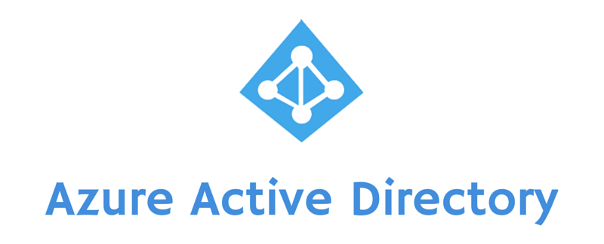

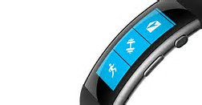
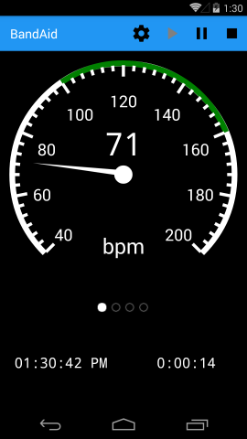



HTTP / JSON
Azure Function / CDS SDK
Microsoft Band
Azure Cloud

Slide 36

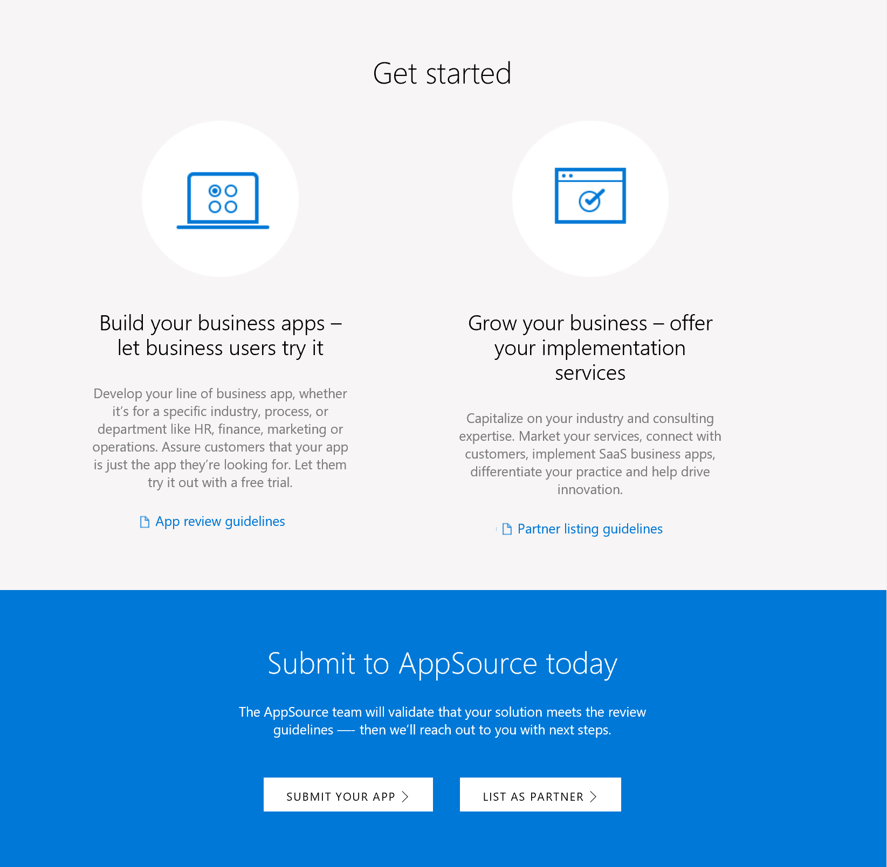
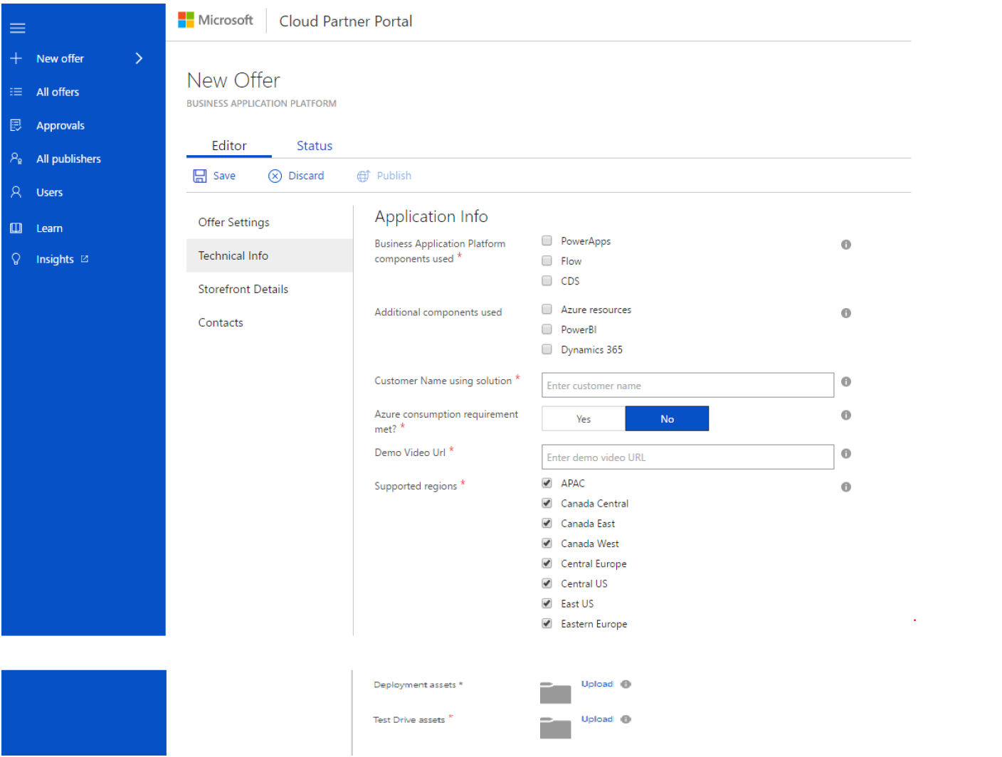
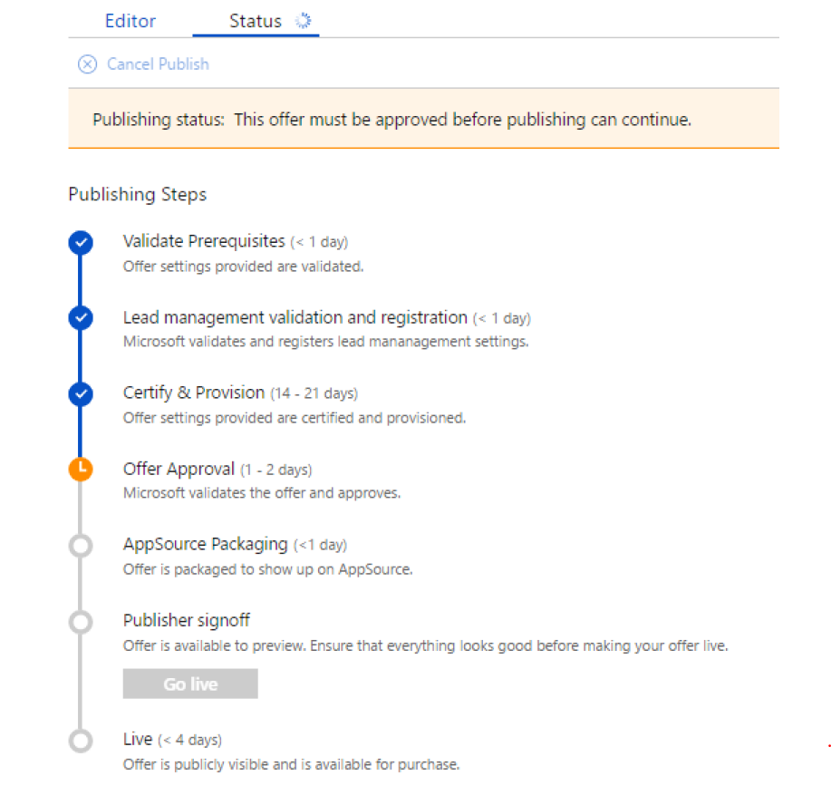
How to onboard your app onto AppSource
Submit your app for evaluation
  AppSource.com/Partners

Slide 37
Value
Onboard onto AppSource (and AAD) to enable discovery and trials to Microsoft’s business users
Deeply integrate your app with Microsoft users through Power BI, PowerApps and Flow
Enrich your app experience by embedding Power BI, PowerApps or Flow
Make your apps smarter with customer data by using the CDS

Slide 38
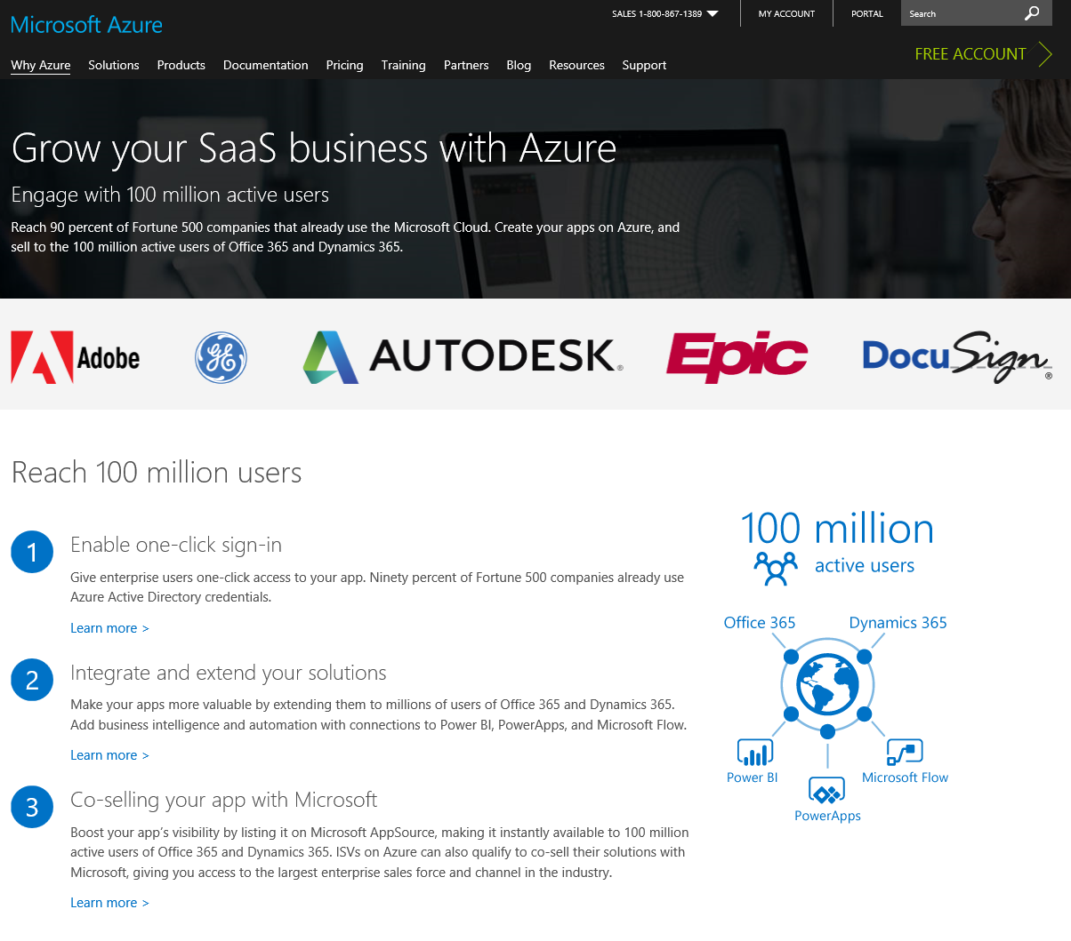
Call to Action – Azure for SaaS Apps
https://azure.microsoft.com/overview/saas-apps/

Slide 39
Q&A

