Slide 2

The keys to the cloud
Use Microsoft identities to sign in and access API from your mobile and web apps
B8084
Vittorio Bertocci
Principal Program Manager
@vibronet
www.cloudidentity.com

Slide 3
Agenda
Developing with Microsoft Identities
Working with businesses
Working with consumers and customers

Slide 4
Developing with Microsoft identities

Slide 5
…The BEST identity system for ALL developers.

Slide 6

Our vision
HYBRID
An ideal identity system…
Reaches the audience you want
ON PREMISES
CLOUD
Organizations
Individuals
Awesome cloud
infrastructure
Has great fundamentals
Deflect 1.5M attacks per day in the consumer space
Identify 30K potentially compromised users per day
Every day the identity ML system processes 10TB of data
Open standards
Works great with your solution
MOBILE APP
CLIENT SDK
RESOURCE SDK
WEB APP

Slide 7
Developing with Microsoft identities
PORTAL
AZURE AD
MOBILE APP
MOBILE APP
CLIENT SDK

Slide 8
Working with businesses

Slide 9
Business and Azure AD
90% of Fortune 500 use Azure AD
May 2016
85M MAU
AZURE AD

Slide 10
Business and Azure AD
90% of Fortune 500 use Azure AD
May 2016
85M MAU
3.5x around Earth…
AZURE AD

Slide 11
Business and Azure AD
90% of Fortune 500 use Azure AD
May 2017
123M MAU
AZURE AD

Slide 12
Business and Azure AD
90% of Fortune 500 use Azure AD
May 2017
123M MAU
More than half way
to the Moon!

Slide 13
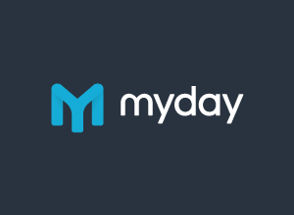
Business and Azure AD
90% of Fortune 500 use Azure AD
May 2017
123M MAU
BROWSER
AZURE AD
MYDAY

Slide 14
Using Microsoft identities in a web app
AZURE AD
BROWSER
Auth MW
WEB APP

Slide 15
Demo
Use Microsoft identities in your web app

Slide 16
Using Microsoft identities in mobile apps
AZURE AD
A
Azure
SQL
A
MICROSOFT API
MOBILE APP
CLIENT SDK
R

Slide 17
Production-ready MSAL previews
NEW
SDK for gaining access to API protected by Microsoft identities
  Fully OSS, easy to use, full-featured, production-ready
  Works with Azure AD v2 (work & school accounts, personal accounts) and B2C
Available on
  .NET 4,5x, .NET Core, Xamarin (iOS, Android, UWP)
  iOS (ObjC/Swift)
  Android (Java)
  Javascript
SafariViewController on iOS, Chrome custom tabs on Android

Slide 18
Demo
Use Microsoft identities in your mobile app – with MSAL

Slide 19
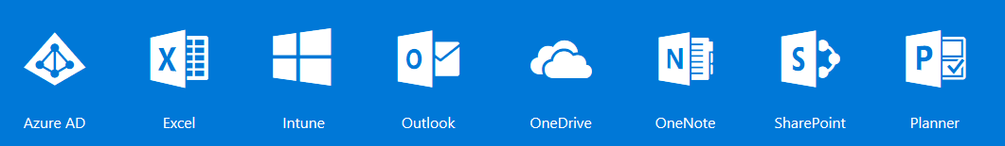
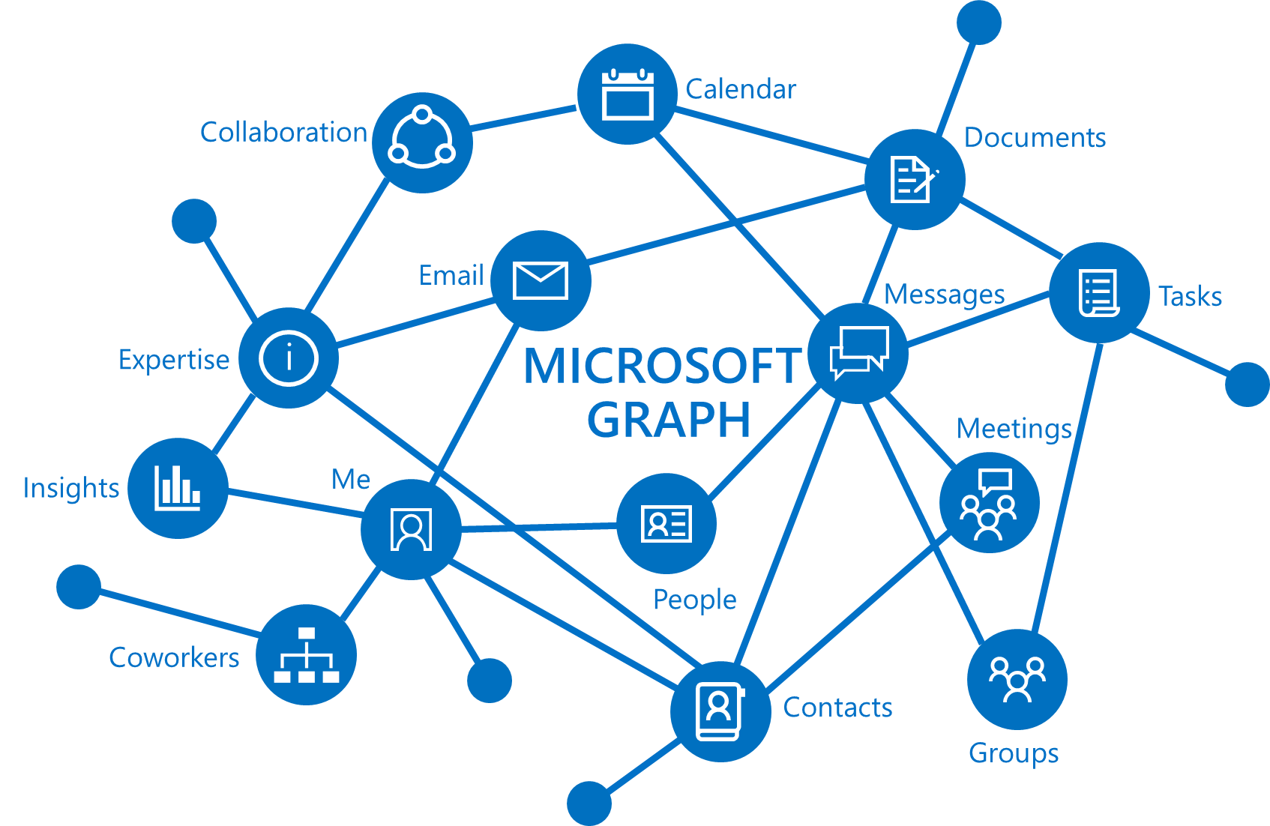
Microsoft Graph
HTTPS://GRAPH.MICROSOFT.COM
    Single API that proxies multiple Microsoft services
    Allows for easy traversal of objects and relationships
    Eliminates the need to discovery endpoints
    Only one OAuth access token needed
    For both personal and work and school accounts
    Exposing User data, Group data and Organizational data

Slide 20

With Microsoft Graph
GET: …/v1.0/users/yina
{
"id": “a8d4f951-709d-4c13-81da-a123afbdcda2",
"displayName": "Yina Arenas",
"jobTitle": "PRINCIPAL PM MANAGER",
"officeLocation": "36/0",
"userPrincipalName": yinaa@microsoft.com
"aboutMe": "Awesome PM transforming Office dev Platform"
}
You can know who the user is based on profile and directory data in Office 365
GET: …/v1.0/users/yina/photo/…
{}
Tristan
Groups
GET: …/v1.0/users/yina/manager
{…"displayName": “Tristan Davis",…}
manager
memberOf
GET: …/v1.0/users/yina/directReports
"value" : [
{…"displayName": “Matt Geimer",…},
{…"displayName": “Dmitry Pimenov",…},
]
Yina
directReports
GET: …/v1.0/me/memberOf/…
"value" : [
{…"displayName": “Office platform engineering",…},
{…"displayName": “Women in tech",…},
]
Dmitry
Matt
Sudhi

Slide 21
Demo
Using the Microsoft Graph

Slide 22
Working with consumers and customers

Slide 23
Azure Active Directory B2C
For app devs: Add registration and sign in to your app in minutes
Reach any user, on any platform
Select from a set of built-in, self-service identity experiences
Customize each pixel. It’s your brand, your HTML and CSS
Scale to 100s of millions of user accounts
Run on the same secure, highly available infrastructure that powers O365 authentications

Slide 24
MSAL, Middleware & Visual Studio Templates
NEW
MSAL works with B2C, on all available platforms
The ASP.NET middleware works with B2C (all versions)
  It’s just OpenId Connect!
New web app templates in Visual Studio
  New ASP.NET Core apps can use Azure AD B2C from the get–go
  New individual auth projects also use OIDC, easy to migrate

Slide 25
Demo
Connect to a B2C app via Visual Studio

Slide 26
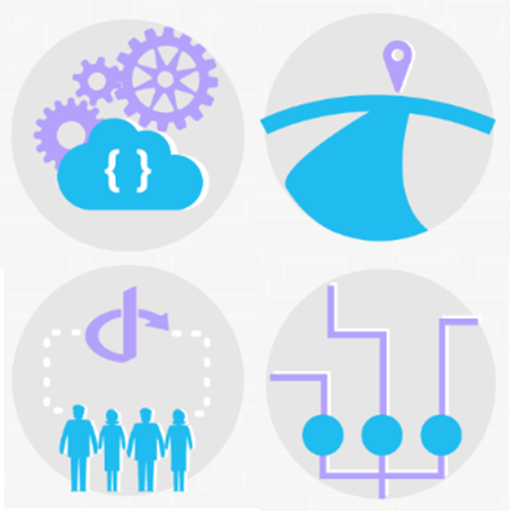
NEW
Azure Active Directory B2C
For identity pros: Build custom identity solutions
Define user journeys step by step, add conditions and branches
Migrate from or integrate with existing user stores
Integrate with other tools you use (e.g. CRM, Marketing)
Integrate any OIDC or SAML identity providers

Slide 27
Demo
Authenticate business users in a B2C application

Slide 28
Get your hands dirty!
Start here: https://azure.microsoft.com/develop/identity/
At Build 2017
  Check out the Azure AD B2C T6068 session & Microsoft Graph recordings
  Do the code challenges
  Find us at the booth
Companies at Build using Azure AD
>80%

Slide 29
Our vision, our mission
HYBRID
USERNAME
& PASSWORDS
STORE
ON PREMISES
CLOUD
Organizations
Individuals
Awesome cloud
infrastructure
Open standards
MOBILE APP
CLIENT SDK
RESOURCE SDK
WEB APP
…The BEST identity system for ALL developers.

