Slide 2
How to use R, Python, and machine learning with Microsoft SQL Server 2017
B8076
Umachandar Jayachandran
Principal Program Manager

Slide 3
Agenda
Machine Learning
Intro
Operationalization
SQL Server Machine Learning Services
Demo
Intro
Customer Learnings
Product Review Classification
Campaign Optimization
Fraud Detection using Native Scoring

Slide 4
Machine Learning Introduction
Predict properties of new data by learning from a sample
Predict sales of stores in a region based on historical sales
Predict probability of fraud on a new credit card transaction
Predict default of a new loan based on loan / transaction history
Predict sentiment of a new tweet or review
Classify new image(s) based on sample images & attributes
Classify data into groups or clusters
Popular ML technologies
R & Python

Slide 5
Machine Learning Operationalization
Separate Service or Embedded Logic
Analytic Server
SQL Server
New Data
Scoring
Model
Model Training
Predictions
Data
Application(s)
Transactions
Easy Operationalization
Performance
High Availability
Resource Governance
SQL Server
Predictions
Application(s)
Model Training
Scoring
Transactions

Slide 6
Demo: SQL Server ML Services

Slide 7
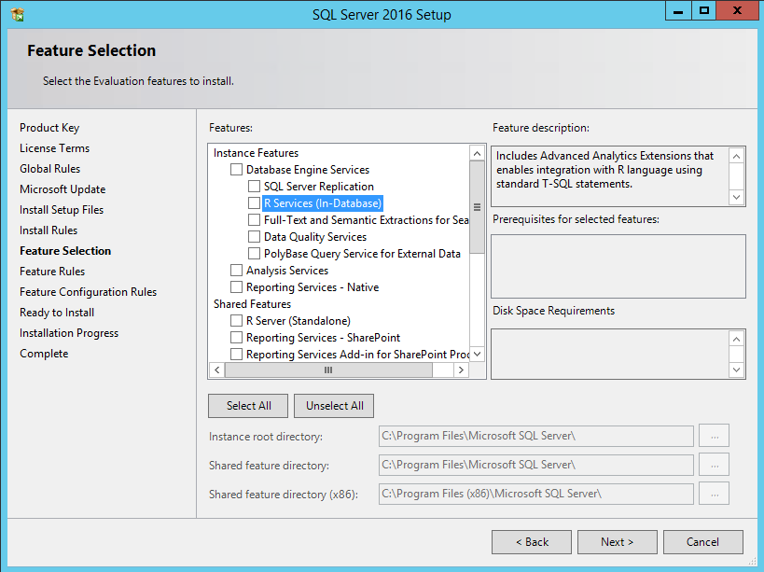
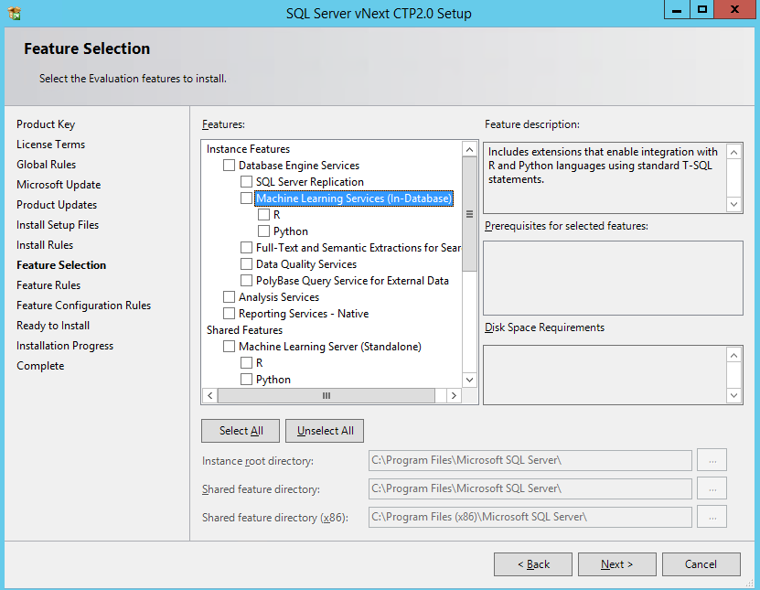
SQL Server Machine Learning Services
SQL Server ML Services
SQL Server R Services

Slide 8
Custom Reports for SSMS
Use SSMS custom reports from SQL Server Samples github

Slide 9
SQL Server Extensibility Framework
Host external runtimes securely on SQL Server machine
Resource governance on external processes
EXTERNAL RESOURCE POOL to control CPU, Memory, CPU Affinity
Integrate with SQL query execution
New external script operator to exchange data / parameters
Parallel query pushing data to multiple external processes / threads
Streaming mode execution
Batch mode execution (in SQL Server 2017)
Implied Authentication
Impersonation for loopback connections from external scripts
Just use trusted connection in connection string

Slide 10
Customer Learnings

Slide 11
Don’t
Do
Run R / Python script as-is
Embed secrets in scripts
Do data transformations that can be achieved in SQL
Access network resources
Process/transform files as part of the stored procedure call
Embed the R/Python code directly in applications
Develop/Test from RTVS, PTVS, RStudio or other IDE
SQL Compute Context from client
Data processing & transformations in SQL Server
Data integration using SQL Server features
Model management in database
Leverage best of T-SQL & R / Python. Use the right tool!

Slide 12
Product Review Classification
Scenario: Website that sells products. Classify new reviews based on rating of old reviews
Input Data: Product reviews with rating
Training: Build model to learn classification of input data
Prediction: Rate new product reviews using the text classification model

Slide 13
Demo: Product Review Classification

Slide 14
Campaign Optimization
Scenario: Learn patterns from customer data to design campaigns & convert highest possible number of customers
Input Data: Campaign leads, demographic information, channel information, product category, conversion outcomes from previous campaign(s)
Training: Build models that will learn patterns for conversion of campaign leads. Evaluate decision tree models & pick the best one
Prediction: Recommend best channel for campaign to optimize the conversion rate

Slide 15
Demo: Campaign Optimization

Slide 16
Fraud Detection using Native Scoring
Scenario: Detect potentially fraudulent transactions with low latency
Input Data: Historical labelled credit transactions, risk factors for IP address/geographical data, transaction characteristics, account information
Training: Build a model to learn patterns of fraudulent transactions
Prediction: Probability of fraud for new transactions. Operationalize model using native scoring capability

Slide 17
Demo: Fraud Detection using Native Scoring

Slide 18
What’s coming?
Native Scoring for Microsoft R Server Models
T-SQL PREDICT function
In-database Package Management
CREATE EXTERNAL LIBRARY DDL
R Services in Azure SQLDB
Future release
ML Services in SQL Server on Linux (Not 2017)
Failover cluster support

Slide 19
Call to action
Resources
SQL Server Samples – R Services & ML Services
SSMS Reports for R Services
SQL Server Machine Learning Services – Getting started ML tutorials
SQL Server Developer Tutorials – Getting started SQL tutorials
Expo
Machine Learning for Developers kiosk
Re-visit Build session recordings on Channel 9.
Continue your education at Microsoft Virtual Academy online.
#MSBuild

Slide 20
Related sessions
B8068: Machine Learning for developers, how to build even more intelligent apps and services
B8065: How to run AI at Petabyte Scale with cognitive functions in the Azure Data Lake
B8038: Deep learning with Microsoft Cognitive Toolkit
T6067: Built-in machine learning in Microsoft SQL Server 2017 with Python
#MSBuild

Slide 21
Questions?
umajay@microsoft.com

