Slide 2
How containers transform operations and development
B8067
Brendan Burns
Gabe Monroy

Slide 3
Overview
What is…
  A container?
  A container orchestrator?
  A container service?
How containers change operations
Orchestration as the foundation for new platforms
Some glimpses of the future

Slide 4
What is a container?

Slide 5
What is a container?
Application packaging and deployment mechanism
Operating
System
Shared Library.v2
Shared Library.v1

Slide 6
What is a container?
Application packaging and deployment mechanism
Shared Library.v1
Shared Library.v2
Operating
System

Slide 7
What is a container?
Package distribution mechanism – Shout out to acr here
MyApp.v2
MyApp.v2
Laptop/Dev Image Here
Azure Container Registry
Push
Pull

Slide 8
What is a container?
A clear boundary for your stuff
Operating
System
Web Server
Monitoring Agent
Log Roller
SSH Daemon

Slide 9
What is a container?
A clear boundary for your stuff
Operating
System
Web Server
Log Roller
SSH Daemon
Monitoring Agent

Slide 10
What is a container?
Runtime isolation
Production Web Server
Intern’s Minecraft Server

Slide 11
What is a container orchestrator?
Manage a bunch of machines
Homogenous Machine Fleet (Virtual or Physical)

Slide 12

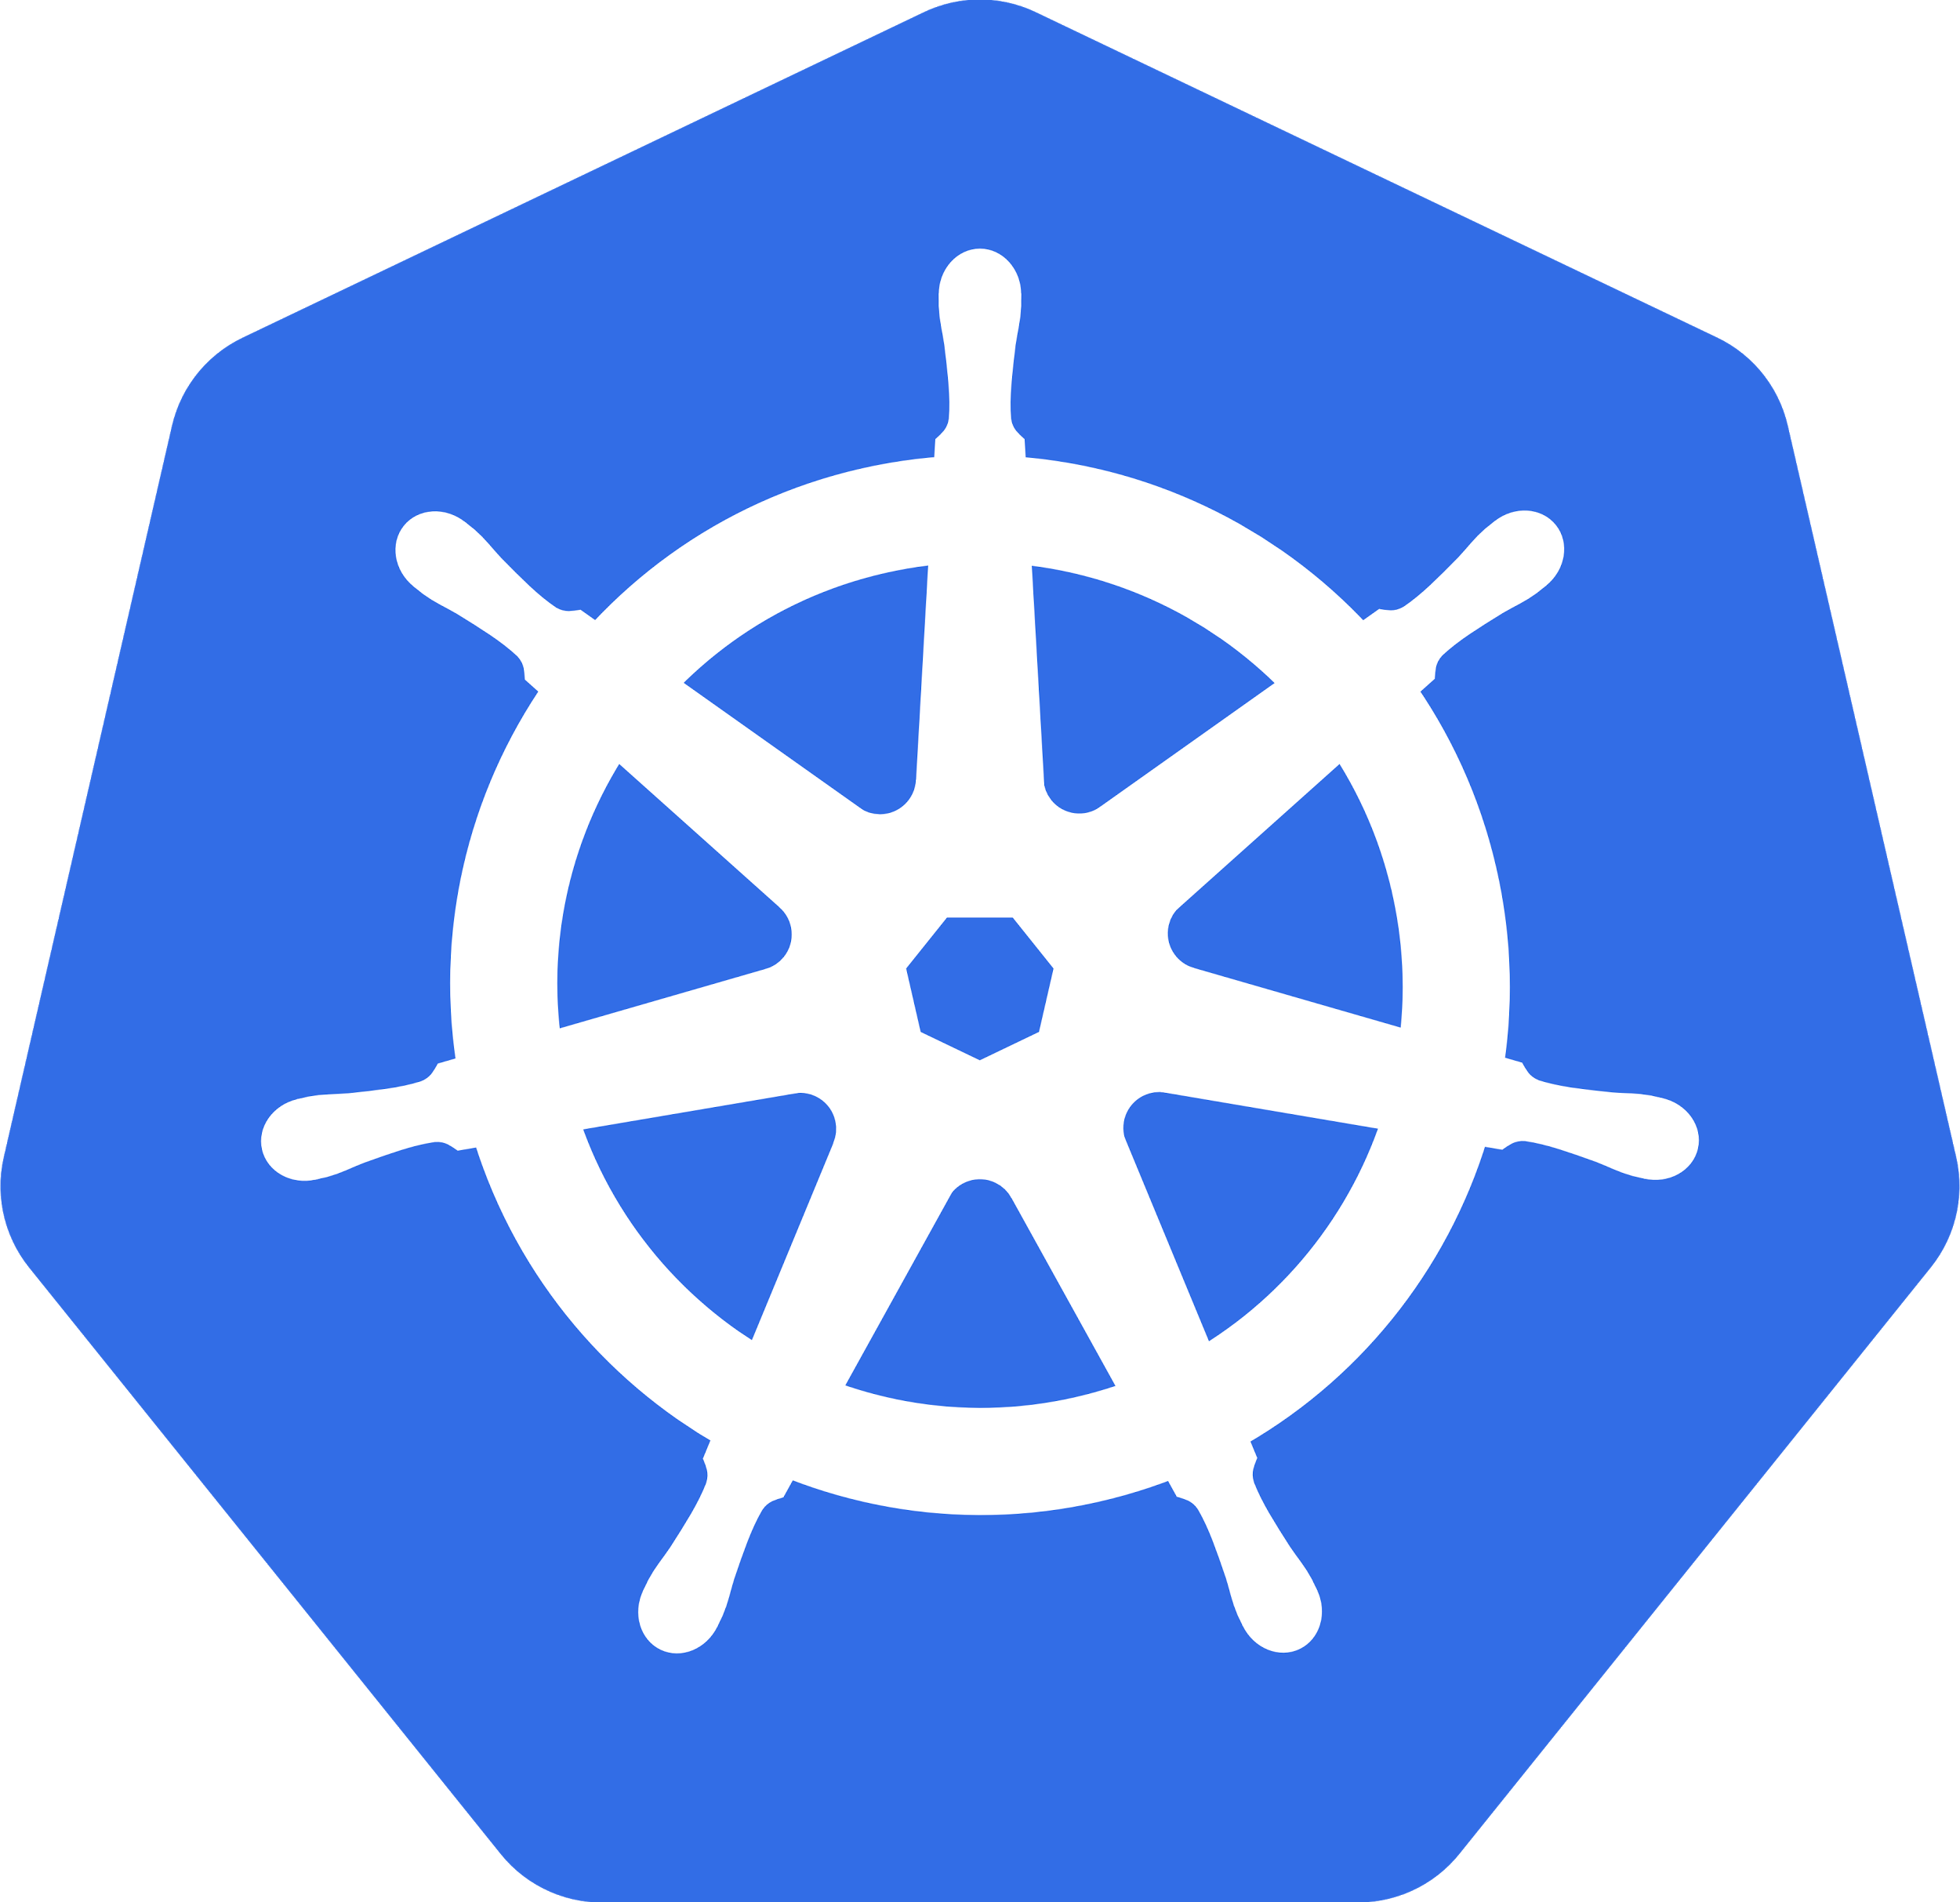
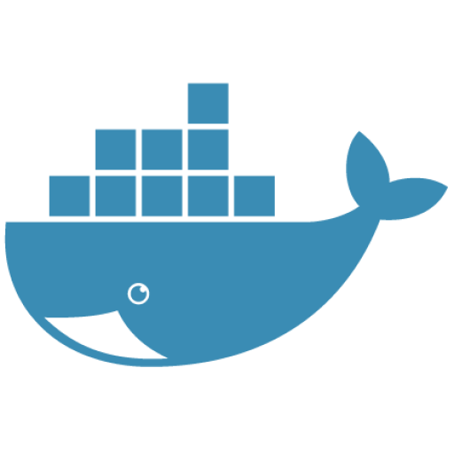
What is a container orchestrator?
Decouple machines from applications
Container API: Unified Compute Substrate
Homogenous Machine Fleet (Virtual or Physical)

Slide 13
What is a container orchestrator?
?
Container API: Unified Compute Substrate
Standardize application support services
  Restart
  Logging
  Monitoring

Slide 14
What is a container orchestrator?
?
Container API: Unified Compute Substrate
Standardize application support services
  Restart
  Logging
  Monitoring

Slide 15
What is a container orchestrator?
?
Container API: Unified Compute Substrate
Standardize application support services
  Restart
  Logging
  Monitoring

Slide 16
What is a container orchestrator?
Container API: Unified Compute Substrate
Homogenous Machine Fleet (Virtual or Physical)
Target for CI/CD

Slide 17
What is a container service?
Make all of this stuff easier
Container API: Unified Compute Substrate
Homogenous Machine Fleet (Virtual or Physical)

Slide 18
What is a container service?
Make all of this stuff easier
Container API: Unified Compute Substrate
Homogenous Machine Fleet (Virtual or Physical)

Slide 19
What is a container service?
Make all of this stuff easier
Container API: Unified Compute Substrate
Homogenous Machine Fleet (Virtual or Physical)

Slide 20
Demo:
Turn up an ACS cluster

Slide 21
Overview
What is…
  A container?
  A container orchestrator?
  A container service?
How containers change operations
Orchestration as the foundation for new platforms
Some glimpses of the future

Slide 22
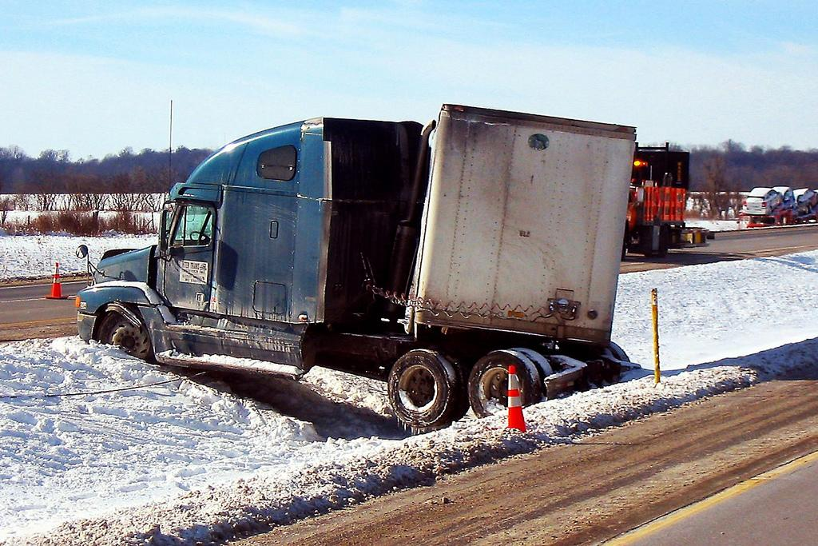
https://www.flickr.com/photos/greeblie/2224507899

Slide 23
Most outages are self inflicted.

Slide 25
The job is too hard.

Slide 27
Decoupling SRE
Application SRE
Cluster SRE
Kernel/OS SRE
Hardware SRE

Slide 28
DevOps
Application SRE
Cluster SRE
Kernel/OS SRE
Hardware SRE

Slide 29
Also DevOps
Cluster SRE
Kernel/OS SRE
Hardware SRE

Slide 30
Decoupling
Application SRE
Cluster SRE
Kernel/OS SRE
Azure Virtual Machines
Hardware SRE

Slide 31
Decoupling
Application SRE
Cluster SRE
Container Runtimes / Images
Kernel/OS SRE
IaaS / Virtualization
Hardware SRE

Slide 32
Decoupling
Application SRE
Container Cluster Managers
Cluster SRE
Container Runtimes / Images
Kernel/OS SRE
IaaS / Virtualization
Hardware SRE

Slide 33
Decoupling
Application SRE
Container Cluster Managers
Cluster SRE
Container Runtimes / Images
Kernel/OS SRE
IaaS / Virtualization
Hardware SRE

Slide 34
Demo:
Demo rolling update under load.

Slide 35
But really, this is still too hard

Slide 36
Overview
What is…
  A container?
  A container orchestrator?
  A container service?
How containers change operations
Orchestration as the foundation for new platforms
Some glimpses of the future

Slide 37
But really, this is still too hard
I have a Kubernetes cluster, now what do I tell my developers?
We can't force developers to learn Docker, Kubernetes, etc.
Introducing Draft...

Slide 38
Container orchestration as a new foundation
Vertical Platform as a Service
(e.g. parse-server)
Big Data Frameworks
Custom Applications
Container API: Unified Compute Substrate

Slide 39
Container orchestration as a new foundation
Demo of Helm

Slide 40
GitLab on Kubernetes
GitLab now has an official Helm chart: GitLab with auto-scaling CI/CD on Kubernetes: charts.gitlab.io
  helm repo add gitlab https://charts.gitlab.io
  helm install gitlab/gitlab
From idea to production on Kubernetes…

Slide 41
GitLab on Kubernetes
From zero to application with review apps, continuous deployment, multiple environments AND monitoring in under 5 minutes

Slide 42
Overview
What is…
  A container?
  A container orchestrator?
  A container service?
How containers change operations
Orchestration as the foundation for new platforms
Some glimpses of the future

Slide 43




The future

Slide 44




The future
Distributed systems are becoming modular

Slide 45
The future
Distributed systems are becoming modular
Kube Lego
HTTP Service

Slide 46
The future
Distributed systems are becoming modular
Kube Lego
HTTP Service

Slide 47
The future
Distributed systems are becoming modular
Kube Lego
HTTP Service
Certificate

Slide 48
The future
Distributed systems are becoming modular
Kube Lego
HTTP Service
Certificate
HTTP Service
Certificate

Slide 49
The future
Distributed systems are becoming modular
Demo Lego

Slide 50


The future
We’ve lost the ‘I’ in IDE

Slide 51
The future
We’ve lost the ‘I’ in IDE
Demo vs-code + kubernetes

Slide 52



The future
We’re going back to the world of patterns

Slide 53
The end

