Slide 2
How to run AI at Petabyte Scale with Cognitive Functions in the Azure Data Lake
B8065
Wee Hyong Tok
Principal Data Scientist Manager
@weehyong

Slide 3
Using AI to help measure tumors in ways that doctors cannot

Slide 4
Using AI for Realtime ID Check

Slide 5
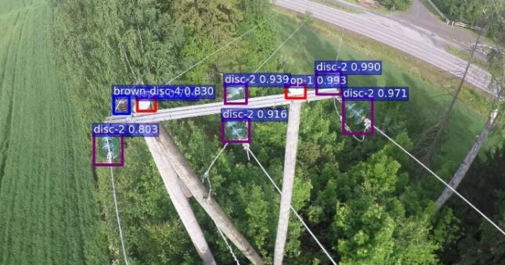
AI for Automated Inspections

Slide 6
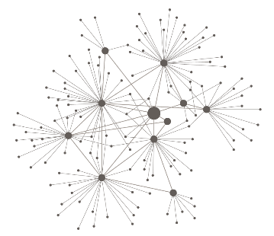
Why does AI matter to the Developer Community?

Slide 7
2 – 40 EB/year
Major Generators
of Big Data
1-2 EB/year
1 EB/year
1.4 PB/year
Twitter
Astronomy
YouTube
Genomics
* Not to scale
Projected Annual Storage (2025)
Src: “Big Data: Astronomical or Genomical?”, PLOS | Biology, July 2015

Slide 8
My Data
Organization’s Data
……
Database / Data Warehouse
Web logs
Call Logs Data
Images
Video
My Company

Slide 9
Train Model
Doing ML/AI
Score Model
Examples
Decision Trees / Random Forests
Support Vector Machine
Convolution Neural Networks (CNN)
Recurrent neural network (RNN) /LTSM
Examples
What are the key phrases in the text?
What is the sentiment?
Given a scanned image, preform OCR on it

Slide 10
How can I get started?
AI
Train/Create New Models
Building AI Apps
AI APIs
Leverage AI APIs
Building AI Applications
Data + AI
Doing AI where the data is

Slide 11
Microsoft Cognitive Services
Easy
Flexible
Tested
Roll your own with REST APIs
Simple to add: just a few lines of code required
Integrate into the language and platform of your choice
Breadth of offerings helps you find the right API for your app
Built by experts in their field from Microsoft Research, Bing, and Azure Machine Learning
Quality documentation, sample code, and community support
GET A KEY
BUILD

Slide 12
What if you have GB/TB/PB of data?

Slide 13
Azure Data Lake services
HDInsight
Data Lake Store
Data Lake Analytics
YARN
HDFS
YARN
U-SQL
Managed clusters
No-limits Data Lake
Analytics job service

Slide 14
DEMO - Create your Data Lake

Slide 15
Scenario – Getting a 360 view of Products
Real-time Insights and Alerts
Event Hubs
Stream Analytics
Power BI
Intelligence @ Scale Built-in Cognition Capabilities
PolyBase over Azure Data Lake Store
Federated U-SQL Join Query (Reference Data)
Azure Data Lake Store and Analytics
Azure SQL
Data Warehouse
Azure Analysis Services
Azure SQL Database
Support Call Logs
Service Telemetry Data
Social Data
Ingest
Process
Store
Serve and
Consume

Slide 16
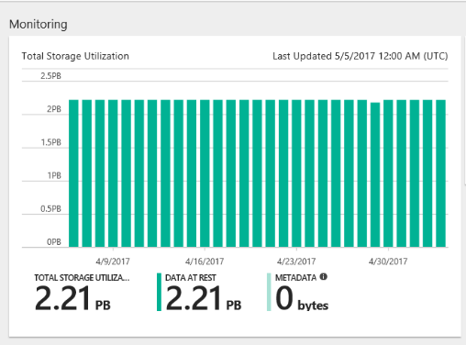
Scenario – Getting a 360 view of Products
Real-time Insights and Alerts
Event Hubs
Stream Analytics
Power BI
Intelligence @ Scale Built-in Cognition Capabilities
PolyBase over Azure Data Lake Store
Federated U-SQL Join Query (Reference Data)
Azure Data Lake Store and Analytics
Azure SQL
Data Warehouse
Azure Analysis Services
Azure SQL Database
Support Call Logs
Service Telemetry Data
Social Data
Ingest
Process
Store
Serve and
Consume

Slide 17
Bing image search
Speech API
Entity linking
Customer feedback analysis
Bing news search
Speech
Text to speech
Custom recognition (CRIS)
Forecasting
Language
Recommendation API
Machine Learning
Text analytics
Thumbnail generation
Big Cognition
Academic knowledge
Spell check
Web language model
Computer vision
Knowledge
Bing autosuggest
Vision
Emotion
Anomaly detection
Sentiment scoring
Search
ORC, tagging, captioning
Bing web search
Machine Learning
Vision
Speech
Language
Knowledge
Search
Text analytics API
Recommendation API
Anomaly detection
Customer feedback analysis
Forecasting
Computer vision
OCR, tagging, captioning,
Celebrity recognition model
Thumbnail generation
Emotion
Face detection, verification, similar face detection, grouping
Video—motion detection, face detection and recognition
Speech API
Speech to text
Text to speech
Custom recognition (CRIS)
Speaker recognition
Spell check
Language understanding (LUIS)
Linguistic analysis
Text analytics
Key topic extraction
Sentiment scoring
Language detection
Web language model
Academic knowledge
Entity linking
Knowledge exploration
Recommendation API
Bing autosuggest
Bing image search
Bing news search
Bing video search
Bing web search

Slide 18
Cognitive Functions in Azure Data Lake
Face API
Image Tagging
Emotion Analysis
OCR
Text Key Phrase extraction
Text sentiment analysis

Slide 19
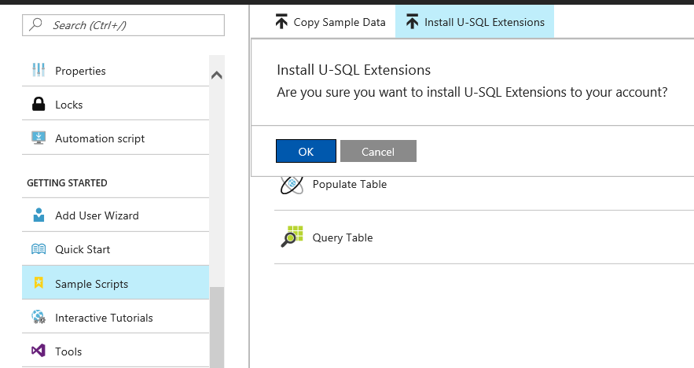
Azure Data Lake U-Sql Extension
Built-in Cognitive Functions
Support for R and Python

Slide 20
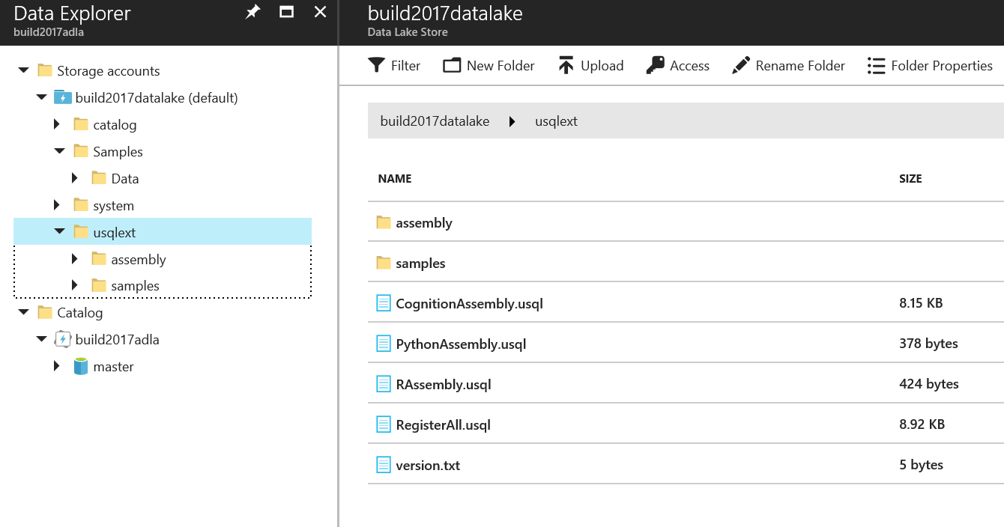
Azure Data Lake U-Sql Extension
After U-SQL
extensions
are installed

Slide 21
3 Steps to Leveraging Big Cognition
Install the U-SQL extension (Cognitive, R, Python)
Write your U-SQL code
Submit the job

Slide 22
DEMO – Run AI at Petabyte scale

Slide 23
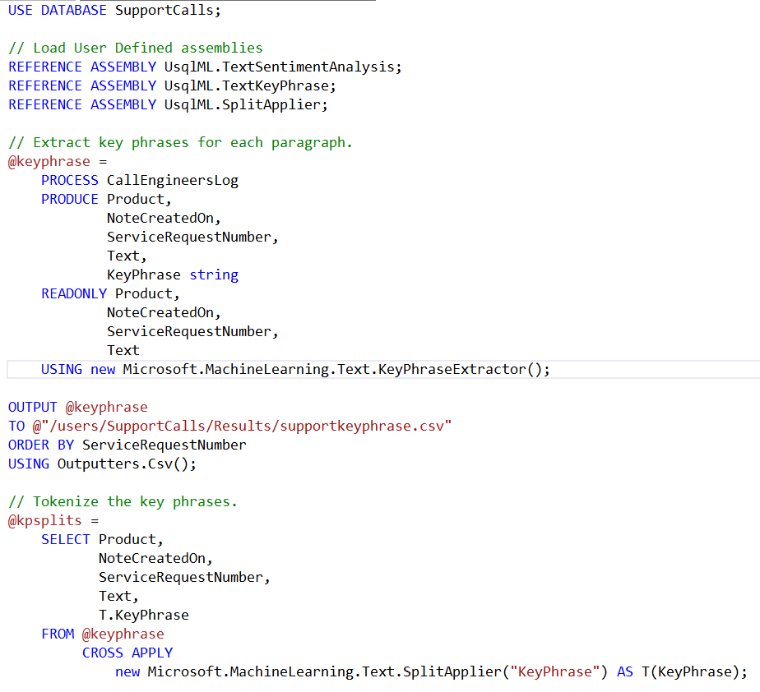
Example: U-SQL / Cognitive Functions
Reference assembly
for Cognitive Function
Using Cognitive Function Key Phrase Extraction
Using Cognitive Function
Tokenization

Slide 24
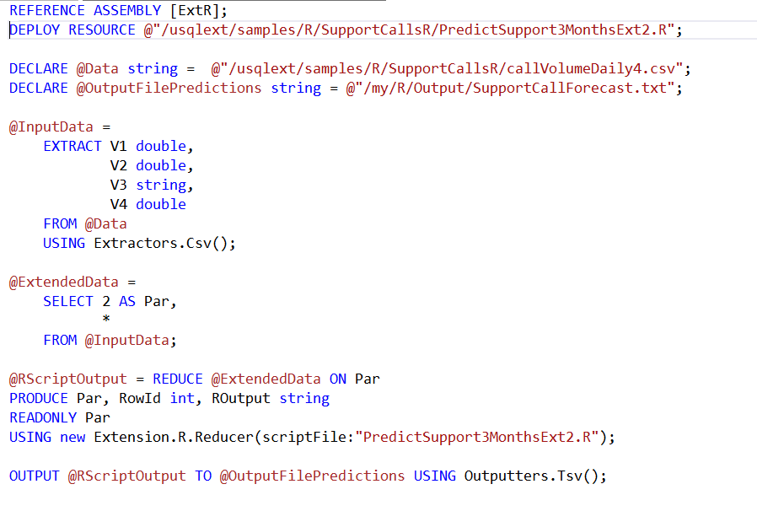
Example: U-SQL / R
Reference assembly
for R support
Specify the data
that will be used
by the R script
Invoke the R Code Using REDUCE to partition the input data on a key

Slide 25
Recap
Real-time Insights and Alerts
Event Hubs
Stream Analytics
Power BI
Intelligence @ Scale Built-in Cognition Capabilities
PolyBase over Azure Data Lake Store
Federated U-SQL Join Query (Reference Data)
Azure Data Lake Store and Analytics
Azure SQL
Data Warehouse
Azure Analysis Services
Azure SQL Database
Support Call Logs
Service Telemetry Data
Social Data
Ingest
Process
Store
Serve and
Consume

Slide 26
Resources
Sample code – Using Cognition Functions in ADL https://aka.ms/getstartedadlcognition
Develop today: https://azure.github.io/AzureDataLake/
#MSBuild

Slide 27
Related sessions
B8081 How to serve AI with data: The future of the Microsoft Data Platform
B8904 Open Q&A: Maximizing the value of your DATA and leveraging the power of AI to build Intelligent applications
T6040 Image processing at scale using U-SQL in Azure Data Lake
#MSBuild

