Slide 2
Introducing the Microsoft Teams Developer platform: Integrate your app to enable higher performing teams
B8059
Bhrighu Sareen
General Manager
Jigar Thakkar
Director of Eng.
Larry Jin
Program Manager

Slide 3
Chat-based workspace in Office 365
Chat for today’s teams
A hub for teamwork
Customizable for each team
Security teams trust
Communicate in the moment and keep everyone in the know
Give your team quick access to information they need right in Office 365
Tailor your workspace to include content and capabilities your team needs everyday
Get the enterprise-level security and compliance features you expect from Office 365
Extensible platform
Build apps with a rich set of capabilities to enable these higher-performing teams

Slide 4
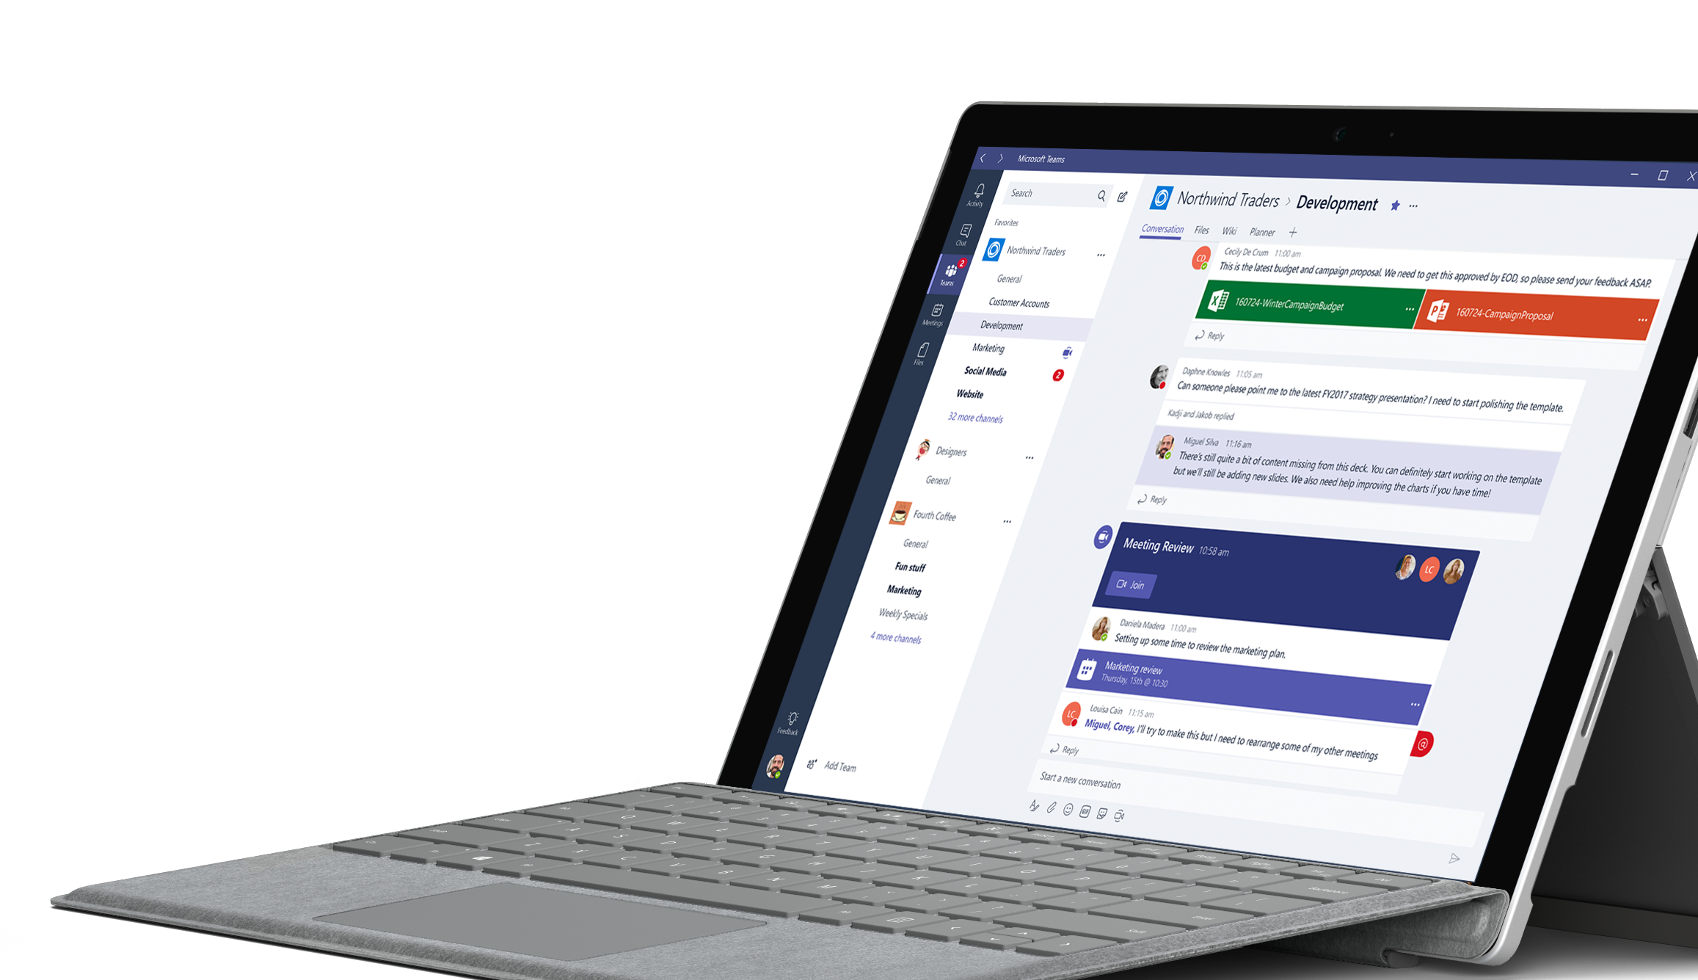
Tap into the global availability of Microsoft Teams
181
19
Markets
Languages

Slide 5
More than 150 integrations available and coming soon
VSTS

Slide 6
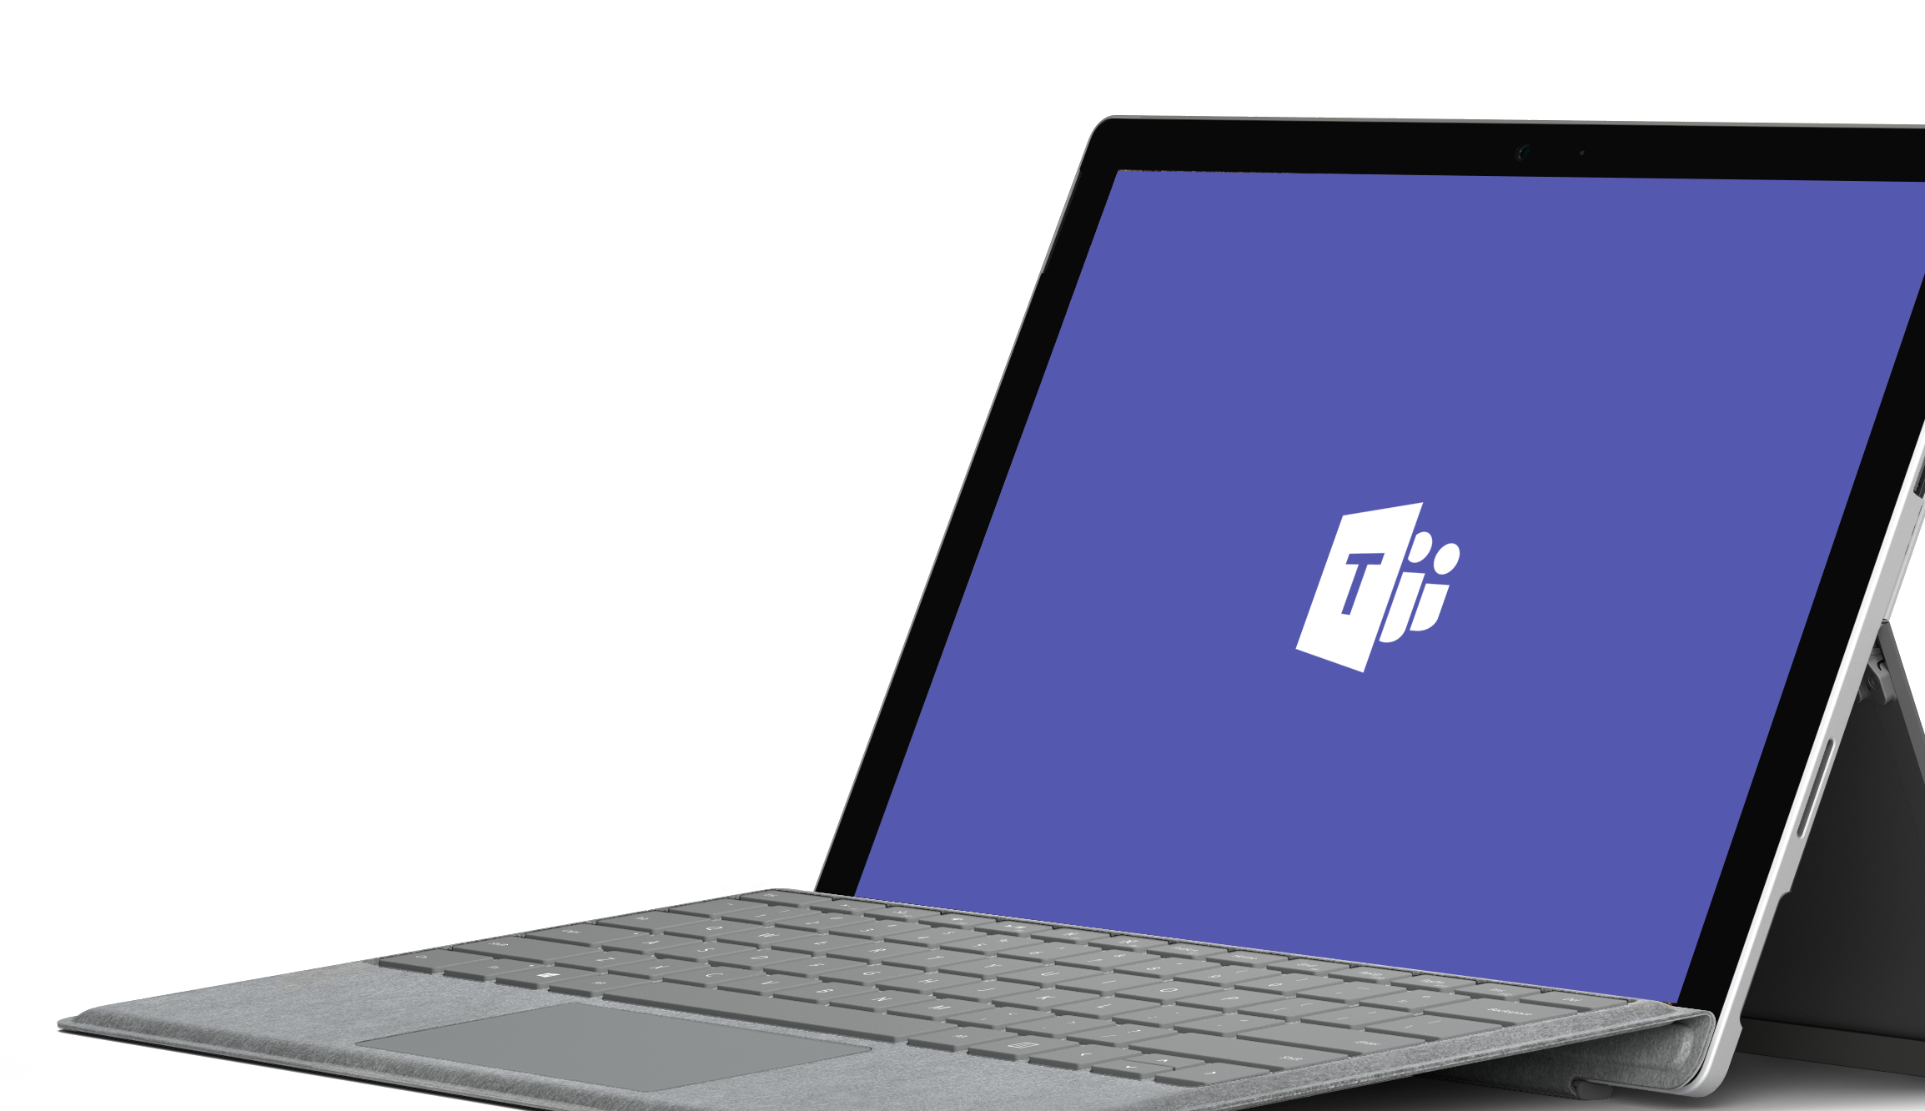
Demo

Slide 7
Introducing the Microsoft Teams App Platform
Jigar Thakkar
Director of Engineering
Larry Jin
Program Manager

Slide 8
Introducing the Microsoft Teams App Platform
Tabs
Surface rich content within Teams
Bots
Help users get tasks done in conversations
Connectors
Post rich updates to channels
Actionable Messages
Add rich interaction to your connector cards
Activity Feed
Engage users via feed notifications
Compose Extensions
Allow users to query and share rich cards in conversations
Office Store
Drive engagement by submitting your app to the Office Store
Available now
Available in Developer Preview
Reach your users in their chats, channels, notifications, and personal workspace

Slide 9
Tabs
Rich surface area for your app
As simple as hosting your existing web app
Team productivity: within channels
Personal productivity: app flyout
Your services, experience, & users

Slide 10
Connectors with Actionable Messages
Push rich interactive cards into channels
Users can take quick actions like comment, select options, set a date
Uses incoming webhook API
Fully supported in both Teams and Outlook

Slide 11
Activity feed
Notify users personally via the activity feed
Same API as sending bot messages
Deep link straight into tabs

Slide 12
Bots
Bots make it easy for users to interact with your app in Team conversations or 1:1
Built using Microsoft Bot Framework
Complete tasks via basic commands, menu or natural language
Rich Microsoft Teams features, e.g.
Input menus
Dynamic message updates
Integrate with tabs

Slide 13
Compose Extensions
Personalize Teams Compose box with your App & Services content
Users can query and insert your app content into conversations
Bug details from VSTS
Sales opportunities from CRM
You can reuse services you built for Bots or Tabs

Slide 14
Microsoft Teams is open!
Register and submit your app today to the Office Store
Microsoft Teams App = Tabs, Connector, Actionable Messages, Activity Feed, Bots & Compose Extensions
Your app will be ready in the Developer Preview once approved
New in-product store will be available in June for end users

Slide 15
Learn more about Microsoft Teams
Office 365 Booth
Talk to the experts
Thursday, May 11
12:00pm Tech Talk | Adobe Creative Cloud and Adobe Document Cloud in Microsoft Teams
4:00pm Breakout | Open Q&A: Hear from experts from Office 365
2:30-6:30pm Solution Spotlights | Wrike, Sapho, Adobe
Friday, May 12
11:30am Tech Talk | Microsoft Teams Developer Tool Integrations
2:00pm Tech Talk | Sapho connects legacy systems with Microsoft Teams

Slide 16
Office @ Build Track
Visit our booths and quick start challenges!
Breakout Sessions
20-min Tech Talks @ Tech Talk A
When | Title | Speaker | Where
Wed 11:30 AM | B8086: Office 365 as a platform: Reach 100 million Microsoft Office users with your web applications | Rob Howard Tristan Davis | WSCC Room 608 (614)
Wed 02:00PM | B8059: Introducing the Microsoft Teams Developer platform: Integrate your app to enable higher performing teams | Bhrighu Sareen Jigar Thakkar | WSCC Hall 6C (740)
Wed 03:30PM | B8015: Microsoft Graph: Build better apps with the API to your organization | Yina Arenas | WSCC Room 612 (359)
Wed 05:00PM | B8016: Build file collaboration and sharing experiences with OneDrive, SharePoint and Microsoft Graph | Martin Alonso Rob Maguire Ryan Gregg | TCC L3 Tahoma 3 (639)
Thu 01:00PM | B8032: Create the modern workplace with the SharePoint Framework | Daniel Kogan Vesa Juvonen | WSCC Room 612 (359)
Thu 02:30PM | B8053: Engage more users by bringing your apps to Microsoft Outlook web, mobile, and desktop | Jyoti Pal Wey Love | TCC L3 Tahoma 2 (378)
Thu 04:00PM | B8905: Open Q&A: Hear from experts from Office 365, SharePoint, Microsoft Teams, and Microsoft Graph | Yina Arenas Pedro DeRose Rob Howard Tristan Davis Vesa Juvonen | WSCC Hall 4C-4 (385)
Thu 05:30PM | B8064: Integrate presence, chat, audio, and video into custom apps with Skype for Business | Andrew Bybee | TCC L3 Tahoma 3 (639)
Fri 09:00AM | B8079: Slice, dice, and route your SharePoint documents with Microsoft Flow, Azure Logic Apps and Microsoft PowerApps | Kerem Yuceturk Merwan Hade | TCC L3 Tahoma 5 (200)
Fri 10:30AM | B8033: Give Your Conversations Superpowers – Building Intelligent Bots for Skype | Steven Abrahams Oren Jacobs | WSCC Room 612 (359)
When | Tech Talk | Speaker
Wed 11:30 AM | Integration with Microsoft Office 365 Data Loss Prevention with Remedy by BMC | Darius Wallace Jeff Desroches Rick Nelson
Wed 01:00PM | What's New in Office UI Fabric | Micah Godbolt
Wed 03:00PM | Build data driven solutions using Microsoft Visio | Kulo Rajasekaran Rishabh Agrawal
Wed 06:30PM | New Virtual Health Templates extend Skype for Business as platform for developers | Daniel Canning David Newman
Wed 08:00PM | Microsoft Teams Developer Tool Integrations | Bill Bliss Mansoor Malik
Thu 10:30AM | Deploy, manage, and customize with SharePoint Patterns and Practices tools and guidance | Vesa Juvonen
Thu 11:00AM | Script Lab, a Microsoft Garage project | Michael Saunders
Thu 12:00PM | Adobe Creative Cloud and Adobe Document Cloud in Microsoft Teams | Ashwani Chandil Rajeev Sharma Ram Prasad
Thu 03:30PM | Writing an awesome Mobile Outlook add-in | Dwight Foster; ergey Shvets
Thu 05:30PM | DocuSign and Microsoft Office.js APIs integration | Kiah Jones
Fri 09:30AM | From Zero to Hero: Building an Office add-in in one day | Clive Goodinson Mike Ammerlaan
Fri 11:30AM | Building a Better Bot: How Pullstring built the Doctor Who Bot | PullString Team
Fri 12:00AM | Dun & Bradstreet powers data driven insight in Microsoft Teams and Excel | Chris Pardo
Fri 12:30AM | Using Microsoft Graph to connect to Office 365 data | Yina Arenas
Fri 02:00PM | Sapho connects legacy systems with Microsoft Teams | Peter Yared
Fri 02:30PM | Deep Dive: Office Add-in Single Sign On | Tim McConnell

Slide 17
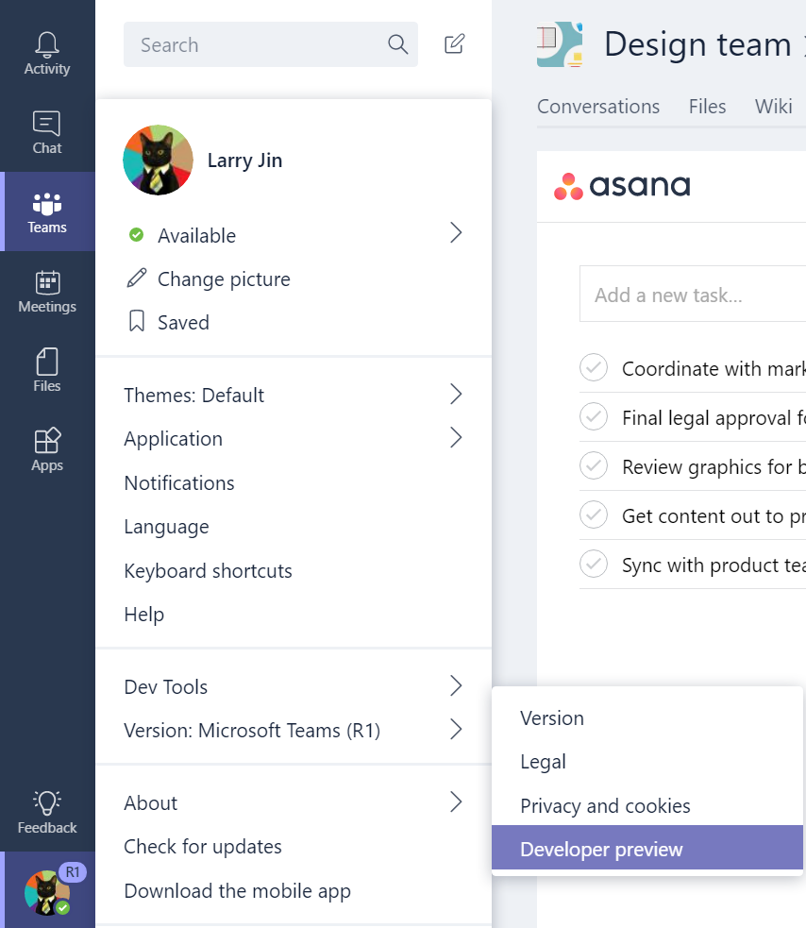
Call to action
→
Enable Dev Preview features
Go to Dev.Office.com/Microsoft-Teams
Check out our starter project
Design guidelines available today
Join the Office Developer Program
Thank you!

