Slide 2
Learn how ASOS built its ecommerce platform using microservices on Microsoft Azure and had a record-breaking holiday season
B8057
Bob Strudwick
Chief Technology Officer

Slide 3
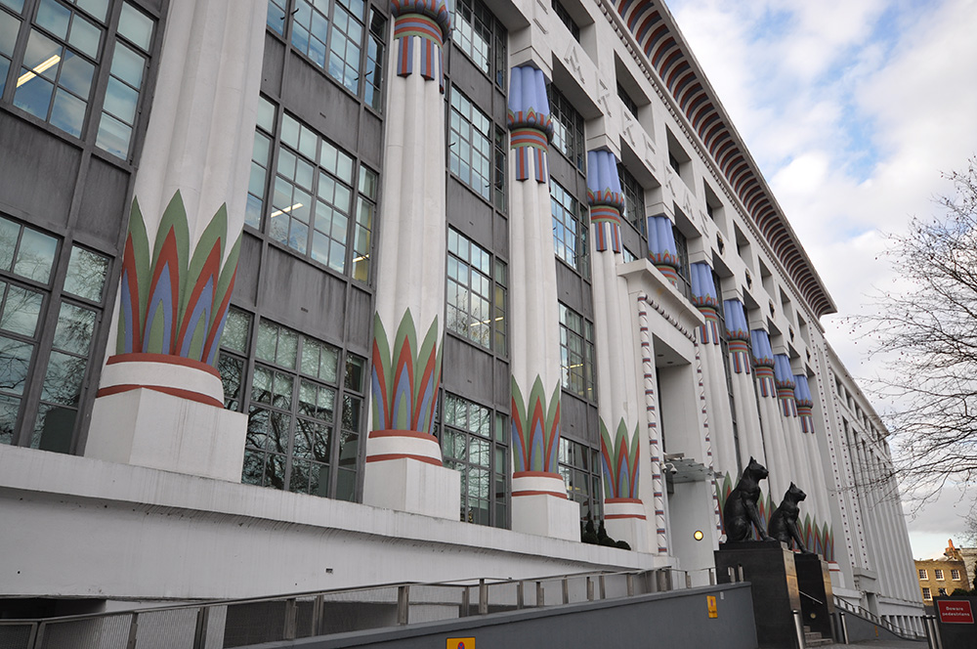
What is ASOS?
Established on 3 June 2000
$2bn turnover in 2015/16
More than 3,000 employees
UK's largest independent online fashion retailer
On a mission to be the World’s Number 1 fashion destination for 20 somethings

Slide 4

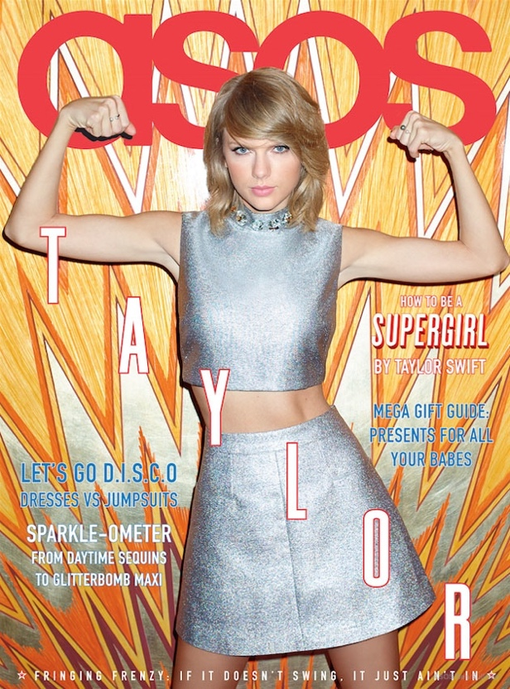


ASOS by numbers
85,000 products
14m+ active customers
21m+ social media followers
8m+ active mobile app downloads
100m+ page requests a day
125m+ unique visits a month

Slide 5
ASOS high level architecture

Slide 6
Establishing the re-platform programme
Making the first few big calls
Kicking off the re-platforming programme
  Launched formally in Q4 2014
  Rollout complete by Black Friday 2016

Slide 7
The essentials of landing a microservice platform
We gained experience of the cloud and hired in specialists
We made a few big bets and stuck to them
We tried to be pragmatic and recognise our weaknesses
We built a deep relationship with the Azure CAT team
We invested heavily in managing emergent design
We invested heavily in build and deploy automation

Slide 8
Introducing the team
Dave Green: Enterprise Architect, Digital Domain
Owain Wragg: Principal Engineer, Core Commerce
Ian Margetts: Platform Lead, DevOps

Slide 9
Dave Green - Architect

Slide 10


ASOS 2014
Customer
Device
(Anywhere)
Technology constraints
  Monolithic Application
  Slow to change
  Presentation & Logic intertwined
  Unstable
  3rd Party Proxies hacked in
  No resiliency
Business constraints
  Single language
  Single currency
  Single channel (Web)
Content Delivery Network
(Globally Deployed)
Mobile Web Optimisation Proxy
(In Italy)
Up to 7 seconds
Language Translation Proxy
(In Florida, USA)
ASOS Webservers
(In London, UK)

Slide 11

5 Design Goals
Globally Deployed
Internationalisation
Resilient
Scalable
Future Proof

Slide 12
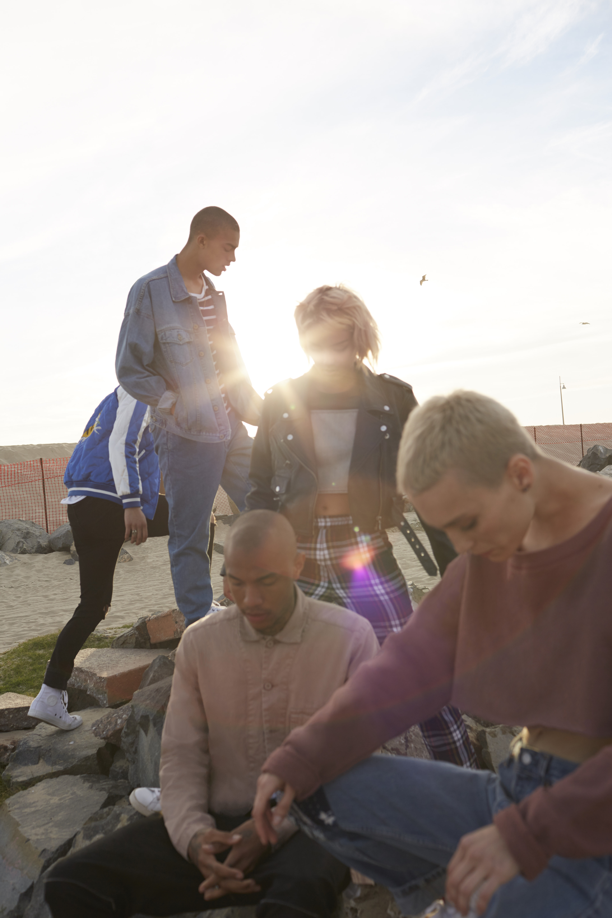
7 Re-platforming Principles
PaaS over IaaS
Control Diversity
Design for Failure
Simplest Operational Model
Monitor Everything
Constrained Scope
Autonomous Services

Slide 13
Design approach
Just enough blueprint upfront
  Big box architecture
  Agree the component responsibilities
  Lets you scope and plan
Detailed design emergent
Enables autonomous teams

Slide 14
ASOS Microservice Architecture
Anatomy of a Microservice

Slide 16
Black Friday on a new stack…
Microsoft Customer Advisory Team partnership
  Architecture reviews
  Code reviews
  Joint performance workshops
  Hyperscale experience
Focus on Monitoring and Alerting
Phased rollout to customers
Production testing
Extra promotional event to drive customer load early

Slide 17
Owain Wragg - Engineer

Slide 18
Challenges
Rebuilding most of our estate
40+ Teams Involved
Team comms
Complex dependencies
Engineering quality
Roll out

Slide 19

Engineering at scale
Autonomy
Dependency Management
Bringing it together
Minimise customer impact

Slide 20
Autonomy
There will be pain…
… so go early
Communication …
… force until it sticks…

Slide 21
Dependencies
Boundaries and contracts
Stubs
Integrate early

Slide 22
Breaking it in to Chunks

Slide 23
Bringing it together
End to end testing
Performance testing
CI/CD
CAT Engagement

Slide 24
Minimise customer impact
Plan your rollout…
…and your rollback
Feature switches
Coding for failure

Slide 25
Summary
Agile at scale
Communication is key
Give teams autonomy early

Slide 26
Ian Margetts- DevOps

Slide 27
The Background
A Centralised Framework
  Used by everyone to push code from test to production
  Build once, deploy many
  Shared ownership (anyone can develop)
  Custom to the needs of ASOS
Centralised ALM / DevOps
  ‘Own’ deployments and path to live to ensure consistency
  Make core changes to framework
  Support teams on making extensions
  ‘Own’ environment management to ensure consistency

Slide 28

Aligning DevOps to Re-Platforming
Re-architecture of the code base
  From one code base to hundreds
  Truly decoupled micro-services architecture
  Move to Azure
Emergence of the Platform Teams
  From project to platform based
  More responsibility for code and infrastructure
  Both development and support responsibilities
Release Demand
  Business hunger for more regular features

Slide 29
What did we do?
Goals
  Empower teams
  Improve team competency
  Devolve team support
  Support cloud
How
  Tooling
  Rollout of competency model
  Platform engineering – central and devolved

Slide 30

Did it work?
  Teams taking ownership
  Reduction in release effort
  Resolving challenges more quickly (and earlier)
  Metrics based conversations
  All components released prior to Black Friday

Slide 32
Bob Strudwick - CTO

Slide 33
Black Friday by numbers
547,839 orders
33 orders per second
3,089 product API requests per sec
167,000,000 total API requests
48 ms average response time

Slide 34
Questions?

