Slide 2

How to get started with Azure Database for MySQL
B8045
Gebi Liang
Partner Director
Jason Anderson
Principal PM Manager
Matt Williams
Systems Analyst
School Dist. 42
Kevin Lisota
Web Developer
Geekwire.com

Slide 3
Agenda
Service Overview
Application Integration
Customer Stories
Call to Action

Slide 4
Azure Database Services Platform
Power BI, App Services, Data Factory, Analytics, ML, Cognitive, Bot…
SQL Data Warehouse
SQL Database
MySQL ^{PREVIEW}
PostgreSQL ^{PREVIEW}
Azure Database
Services Platform
Intelligent: Advisors, Tuning, Monitoring
Flexible: On-demand scaling, Resource governance
Trusted: HA/DR, Backup/Restore, Security, Audit, Isolation
Azure Compute
Azure Storage
Global Azure with 38 Regions
Intelligent // Trusted // Flexible

Slide 5
Azure Database for MySQL
Managed MySQL database service for app developers
Provision in minutes with built-in high availability
Predictable performance, inclusive pay-as-you-go pricing
Scale on the fly without application downtime
Secured to protect sensitive data at-rest and in-motion
Automatic backups and Point-In-Time-Restore for up to 35 days
Deep integration with Azure Web Apps

Slide 6
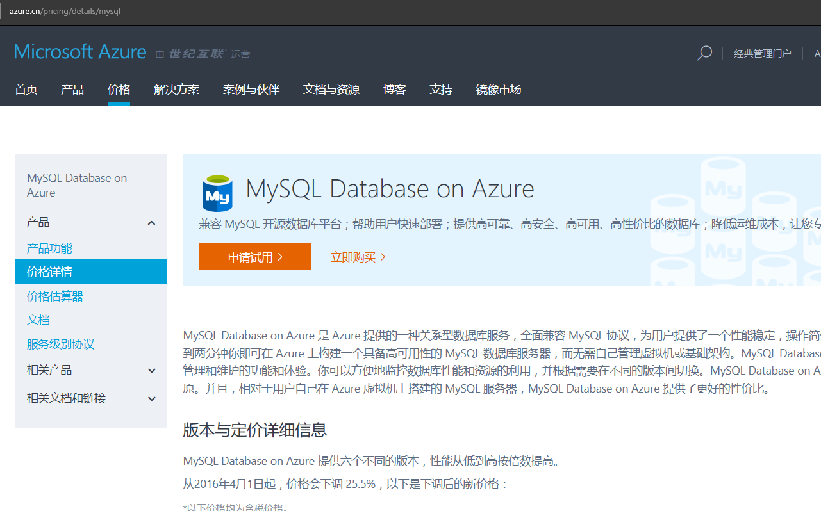
We’re Not Exactly “New” to MySQL
MySQL Database on Azure China
Launched in September 2015
No partner-based MySQL PaaS solution in China
Among top 10 utilized Azure services in China
Based on different managed service architecture
New service will replace the Azure China solution

Slide 7








Some of our customers in China
~900 customers, >2000 servers

Slide 8
Service Overview

Slide 9




Conceptual Model
Account
Subscription
  Logical, not bound to server instance
  Connection endpoint for MySQL server.
  Can create one to many user databases.
  Highly available with automatic failover.
  Pinned to a region
  Policy scope, e.g. firewall rules, recovery,
  monitoring and management.
Resource Group
Azure
Server
Azure Database
for MySQL
Database

Slide 10




Create, Connect and Manage
Azure CLI
Azure Portal
Custom Mgt. App
REST API
Common solution for access control, identity, deployment notifications, metrics, billing…
Azure Resource Manager
Server provisioning and management
Azure Database Services Platform
US West
Database Tools
(MySQL Workbench,
phpMyAdmin)
Application
MySQL Client
MySQL Client
MySQL Server

Slide 11
Security built in
Identity
Native authentication
Control access
Secure SSL connectivity
Server firewall rules
Protect data
Built-in encryption for application data and backups

Slide 12
Performance Tiers

Slide 13
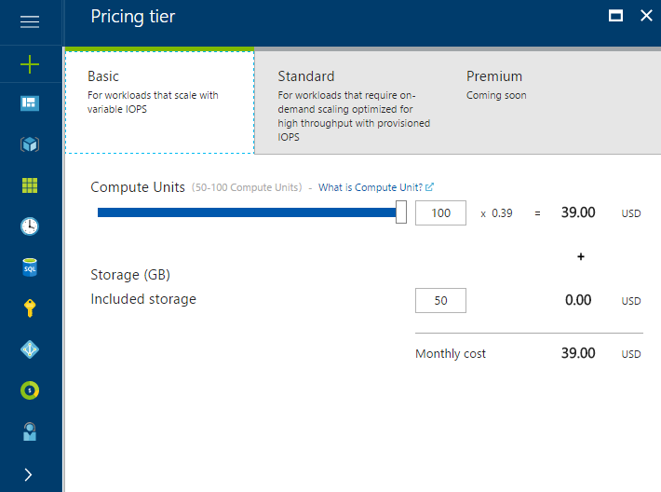
Performance Levels Measured in Compute Units
A Compute Unit is a measure of CPU processing throughput
Pre-configured with a fixed amount of memory, optimized for the Basic and Standard service tiers.
100 Compute Units equate to ~1 full core
Ratios may be adjusted to ensure consistent performance across different hardware generations
Enables workloads that require high I/O performance and lower CPU/RAM to be achieved without having to upgrade to higher SKU

Slide 14
Flexible Service Tiers for any Workload
Service Tier |  | Basic | Standard Balanced IO and Compute | Premium IO and Memory Optimized
Intended Use Case |  | For workloads that scale with variable IOPS
Compute Units |  | 50, 100
Storage (included) |  | 50GB Magnetic Media
IOPS (included) |  | Variable
Additional Options
Storage |  | Scale up to 1 TB | Scale up to 10TB | Scale up to 4 TB
IOPS |  | NA | NA | Scale up to 40K IOPS

Slide 15
Flexible Service Tiers for any Workload
Service Tier |  | Basic | Standard Balanced IO and Compute | Premium IO and Memory Optimized
Intended Use Case |  | For workloads that scale with variable IOPS | For workloads that require on-demand scaling optimized for high throughput with provisioned IOPS
Compute Units |  | 50, 100 | 100, 200, 400, 800,1600, 2000
Storage (included) |  | 50GB Magnetic Media | 125GB Remote SSD
IOPS (included) |  | Variable | 375 Scales 3:1 (IOPS:GB)
Additional Options
Storage |  | Scale up to 1 TB | Scale up to 10 TB | Scale up to 4 TB
IOPS |  | NA | Through increasing storage | Scale up to 40K IOPS
Scale up to 10 TB
Scale up to 10 TB

Slide 16
Flexible Service Tiers for any Workload
Service Tier |  | Basic | Standard Balanced IO and Compute | Premium IO and Memory Optimized
Intended Use Case |  | For workloads that scale with variable IOPS | For workloads that require on-demand scaling optimized for high throughput with provisioned IOPS | For workloads that require on-demand scaling optimized for lowest latency with provisioned IOPS
Compute Units |  | 50, 100 | 100, 200, 400, 800,1600, 2000 | 100, 200, 400, 800, 1600, 2000
Storage (included) |  | 50GB Magnetic Media | 125GB Remote SSD | 125GB Local SSD
IOPS (included) |  | Variable | 375 Scales 3:1 (IOPS:GB) | 1250 Scales 10:1 (IOPS:GB)
Additional Options
Storage |  | Scale up to 1 TB | Scale up to 1 TB | TBD
IOPS |  | NA | Through increasing storage | Provisioned Directly
99.99% SLA | fully managed | built-in HA | online performance scaling

Slide 17
Public Preview Service Tier Availability
Offers |  | Basic | Standard Balanced IO and Compute | Premium IO and Memory Optimized
Intended Use Case |  | For workloads that scale with variable IOPS | For workloads that require on-demand scaling optimized for high throughput with provisioned IOPS | Workloads that require low latency and high performance with large number of concurrent users or multiple databases
Compute Units |  | 50, 100 | 100, 200, 400, 800,1600, 2000 | 100, 200, 400, 800, 1600, 2000
Storage (included) |  | 50GB Magnetic Media | 125GB Remote SSD | 125GB Local SSD
IOPS (included) |  | Variable | 375 Scales 3:1 (IOPS:GB) | 1250 Scales 10:1 (IOPS:GB)
Additional Options
Storage |  | Scale up to 1 TB | Scale up to 1 TB | Scale up to 4 TB
IOPS |  | NA | Through increasing storage | Scale up to 40K IOPS
Scale up to 1 TB
Scale up to 10 TB
99.99% SLA | fully managed | built-in HA | online performance scaling

Slide 18

11
Azure regions available today
West US, North Central US, East US, East US2, South Central US, West Europe, North Europe, Japan West, Japan East, East Asia, SE Asia
More coming soon!
Azure Database for mysql
Region availability today

Slide 19
It’s all about the apps, though

Slide 20










No need to learn new tools or frameworks
Simplify and optimize with the support of all major tools, frameworks, and languages you already use
Frameworks
Languages

Slide 21


Integration with Azure Web Apps
Azure Database for MySQL is now tightly integrated with Azure Web Apps as a DB Provider
Deploy a new Web App + MySQL and add your own app
Pre-configured Web Apps –
Deploy through CLI using your own customized ARM deployment template
+
+

Slide 22
Demo
+
+

Slide 23
But don’t take our word for it…

Slide 24
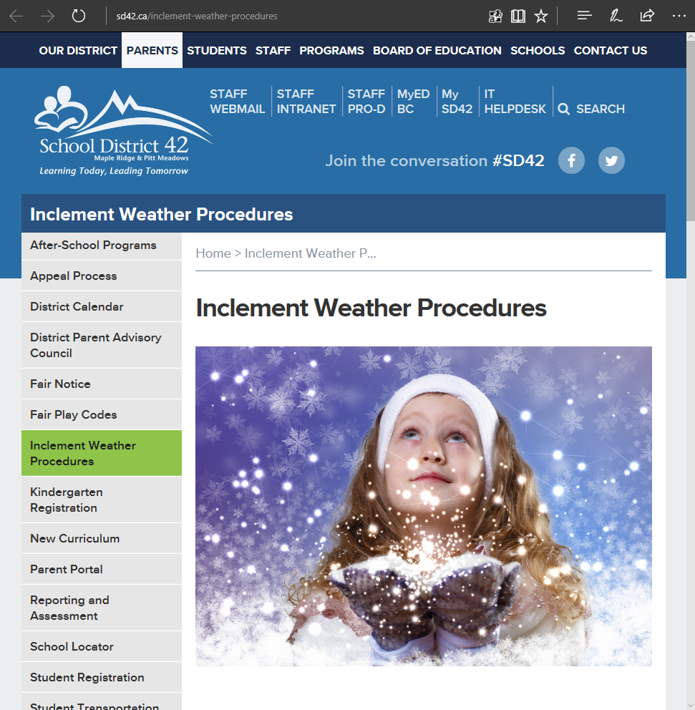
School District 42
Matt Williams
Systems Analyst

Slide 25


School District No. 42
Maple Ridge – Pitt Meadows
Located 40km east of Vancouver, BC (132 miles north of Seattle)
21 Elementary (K-7) and 6 Secondary (8-12) Schools
Population of approximately 100,000 people
15,000 Students
2,200 Employees

Slide 26
Before the move to Azure
On-Premises Website
Very overprovisioned front end and database server
Daily traffic was mostly low ~15,000 pv/day
‘Snow Day’ spike to ~80,000 pv/hour

Slide 27
Move to Azure
Wordpress + MySQL
  S1 App Service IIS
  D2_V2 IAAS VM for MySQL
Still had to fully Manage the MySQL VM
  Tracked back website slowness to MySQL issues
  Over provisioned VM to ensure performance for snow days
  Couldn’t easily scale the VM

Slide 28
Migration to Azure Database for MySQL
Load testing on test/dev showed improved speeds
MySQL VM to MySQL PaaS data migration was painless
  MySQL Workbench
Azure SQL to MySQL PaaS was more challenging
  Datatypes and Keys did not line up
  WordPress transient records would not
Moved App Service to US-West DC
  FTP copy of files was far longer than complete database move

Slide 29
Demo
Scale on the fly

Slide 30
And that’s not all…

Slide 31

Kevin Listor
Web Developer, Geekwire.com

Slide 32
To Recap…
Azure Database for MySQL…
Is built on the same Database Services Platform that powers SQL DB, SQL DW and PostgreSQL
Built-in High Availability, at no extra cost
Can scale performance on the fly with no application downtime
Allows you to use the tools, languages and frameworks you already use

Slide 33
Call to action
Try it today using the Quick Start Tutorials
  https://docs.microsoft.com/en-us/azure/mysql/quickstart-create-mysql-server-database-using-azure-portal
Check out the new Web Apps integration experience
Get the template from the demo here
  https://github.com/JasonMAnderson/azuredbmysql
Visit us in the exhibit hall to see more demos, ask questions and get a cool sticker!
Re-visit Build session recordings on Channel 9.
#MSBuild

Slide 34
Related sessions
Session B8081: How to server AI with data: The future of the Microsoft Data Platform
  Happened early today – review the session on Channel 9
Session B8044: Getting started with Azure Database for PostgreSQL
  Happened early today – review the session on Channel 9
Session B8026: Container apps on Azure App Service are like peanut butter and chocolate
  Thursday @ 2:30
#MSBuild

Slide 35

Azure

