Slide 2
How to migrate your databases to the cloud and future-proof your applications
Session B8044
Nikhil Patel
Pavel Trnecka
Geoff Dalgas
Stack Overflow

Slide 3
AGENDA
Cloud Migration
Database Migration Lifecycle
Migrating Enterprise Apps
Q & A

Slide 4





Cloud Migration Phases
CLOUD ASSESSMENT
PROOF OF CONCEPT
DATA MIGRATION
APPLICATION MIGRATION
OPTIMIZATION
TCO – ROI
Security & Compliance
Technical
Migration Tools
Deploy at Smaller Scale
Estimate Effort
Build Confidence
Assess & Plan
Migrate Schema & Data
Migrate Server Objects
Application Compat
App Security
App Dev Ops
Auto Scaling
Elasticity
High Availability

Slide 5

Data Migration Phases
ASSESS
MIGRATE
Platform readiness (e.g compat issues, breaking changes)
Platform enhancements
(e.g. scale, perf, capability)
Perform schema and data movement
Migrate uncontained objects
Execute post migration fixes

Slide 6



Database Migration frictions
Migration planning is tedious
  Data Estate migration planning
  Data and application reengineering
  Database and application tuning
Assessments for new platform
  Compatibility Issues
  Feature Gaps
  Feature regressions
Lack of comprehensive tools
  10s of scripts.
  Unreliable and unscalable solutions

Slide 7


Migration Tools & Services
Assess
Migrate
Data Migration Assistant
  Rich Assessments at scale
  Feature recommendations
  Sizing guidance
Azure Database
Migration Service
  MS and Non MS Source support
  Built for scale and reliability
  Built with enterprise security and privacy

Slide 8
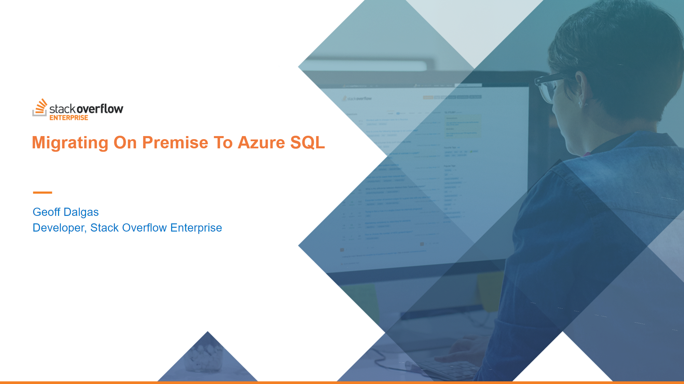

Slide 9

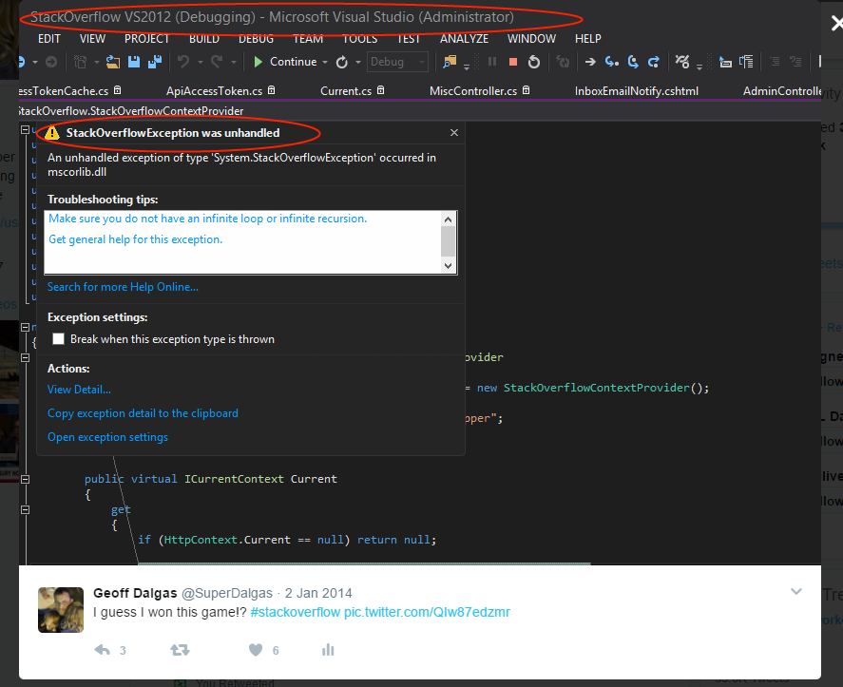
Exception in
Yep.

Slide 10







Current Mission - Stack Overflow Enterprise
Behind The Firewall
Limit Access to Your Site To Users on Your Network Only
End to End Encryption
Data is Encrypted At-Rest in the Database and In Transit Using Your Own Certificate
Rigorously Tested Code
The Same Codebase as StackOverflow.com - used and test by 50M people each month
Isolated, Single Tenant Data Model
We Host Your Site In a Dedicated and Isolated Instance in the Most Certified Cloud Provider - Microsoft Azure
Enterprise Authentication
SSO via LDAP or SAML
New Features & Updates
Security Updates and New Features Made Monthly

Slide 11

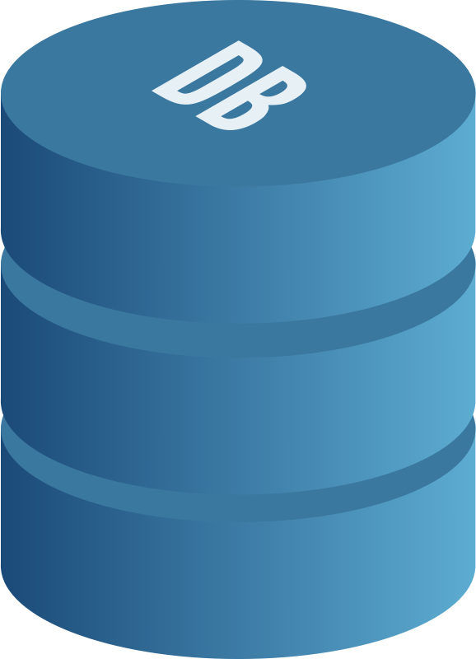
Database Architecture
SitesEE
StackOverflowEE
Site metadata
Aggregated user content
Network wide metadata
Q&A Content
Votes
Users
Comments

Slide 12
Migrating from SQL on premise to Azure SQL
Walk through the Data Migration Assessment (DMA)
Fix issues pointed out with DMA
Walk through the Data Migration Services (DMS)
Ask for a raise

Slide 13

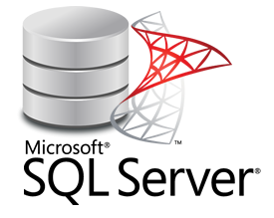
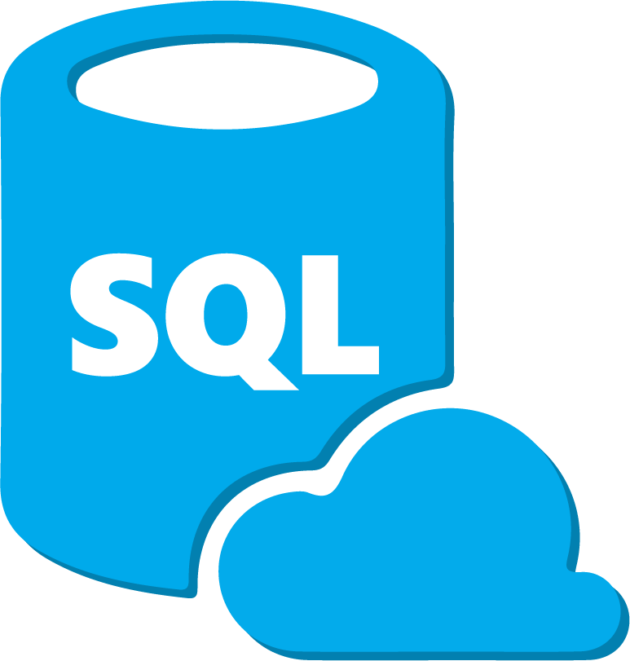
Azure Database Migration Service
Migrate
Azure Portal
Azure Subscription
On-premises network
Virtual Network 1
Azure Database Migration Service
VPN/Express Route
Virtual Network 2

Slide 14
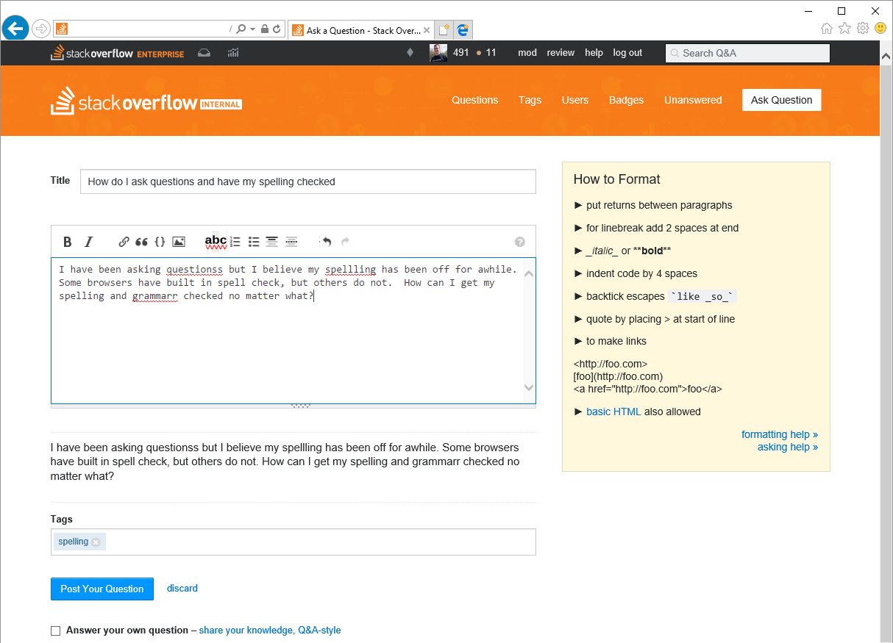
Azure Cognitive Services Grammar and Spell Check
https://www.microsoft.com/cognitive-services/en-us/bing-spell-check-api

Slide 15
Data Migration Assistant (DMA)
Assess
Migrate
Step 1: Perform Assessment
Step 2: Assessment Results
Data Migration Assistant

Slide 16
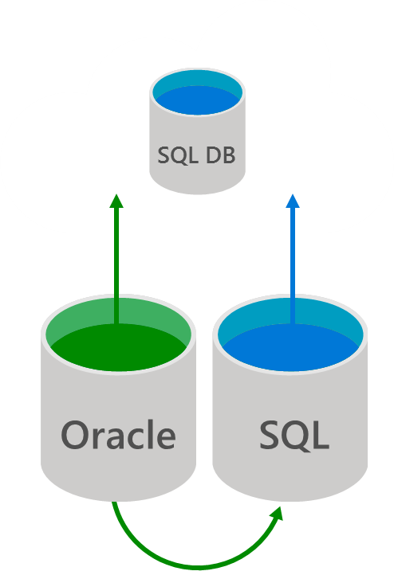
Azure Database Migration Service
Migrate your data from on-premise to Cloud
Migrate
Seamless
Managed Azure Service
End-to-end
Minimal Downtime
Recommend Target Optimization
Multiple Sources & Targets

Slide 17





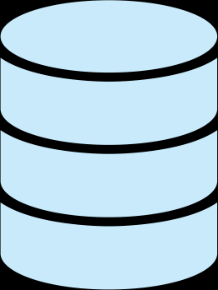

Let Azure Optimize:
You can focus on the app
Scale Out
Intelligent DBaaS capabilities
Backups
Scale Up/Down
Patching
Easy to achieve the performance I need
I’m efficiently using my cloud resources
I can easily manage hundreds of DBs
Index/Schema Mgmt.
Monitoring
HA/DR
In Memory
Azure SQL Database Service
Hardware
Intelligent Database Service
Platform manages all aspects of running and tuning the DB

Slide 18
Call to action
Sign-up for DMS private previews
  aka.ms/sqldatabase-migrationpreview
Data migration Assistant (DMA)
  https://blogs.msdn.microsoft.com/datamigration/dma/
Available on demand
  P4008: Get to the Cloud Faster with Azure SQLDB Managed Instance and Database Migration Service
  P4182: Migrating your Oracle databases to cloud made easy
https://www.stackoverflowbusiness.com/enterprise
#MSBuild

