Slide 2
Design for Serverless Success
B8039
Daria Grigoriu
Yochay Kiriaty

Slide 3

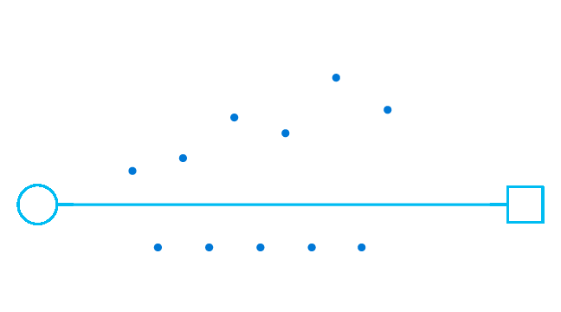

Slide 4
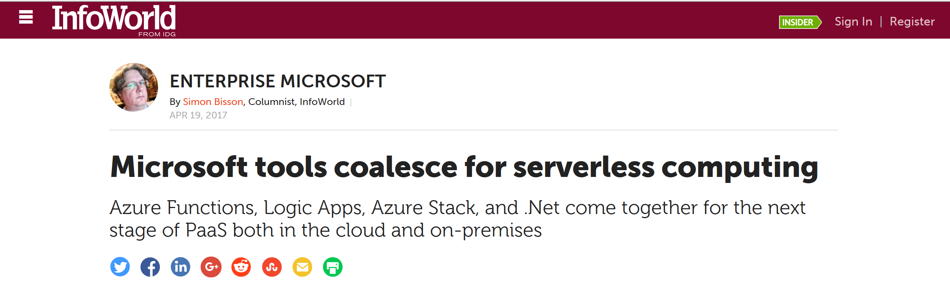
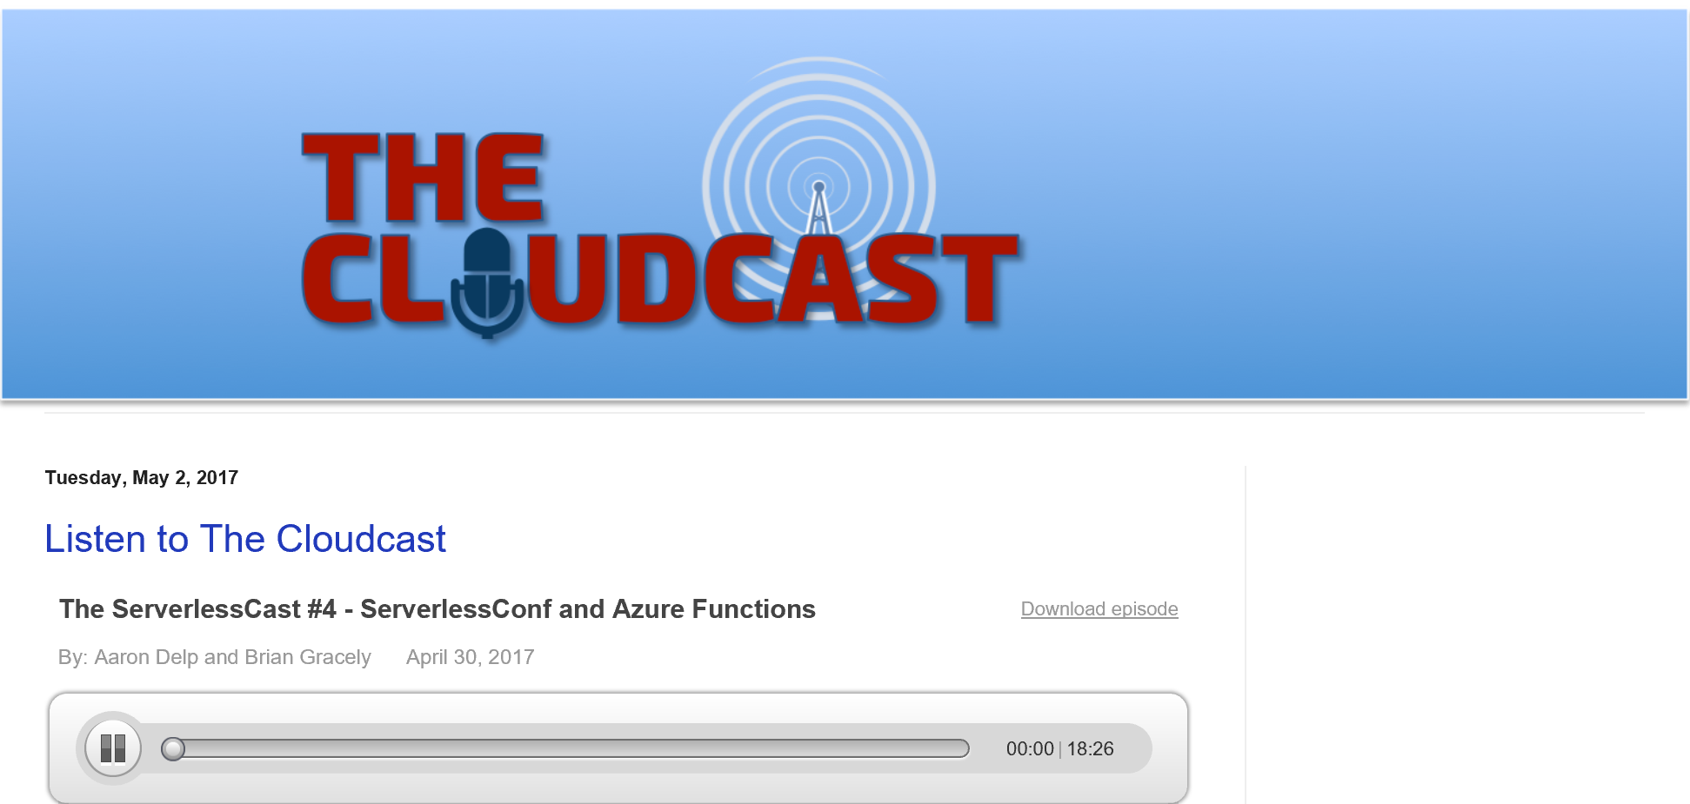
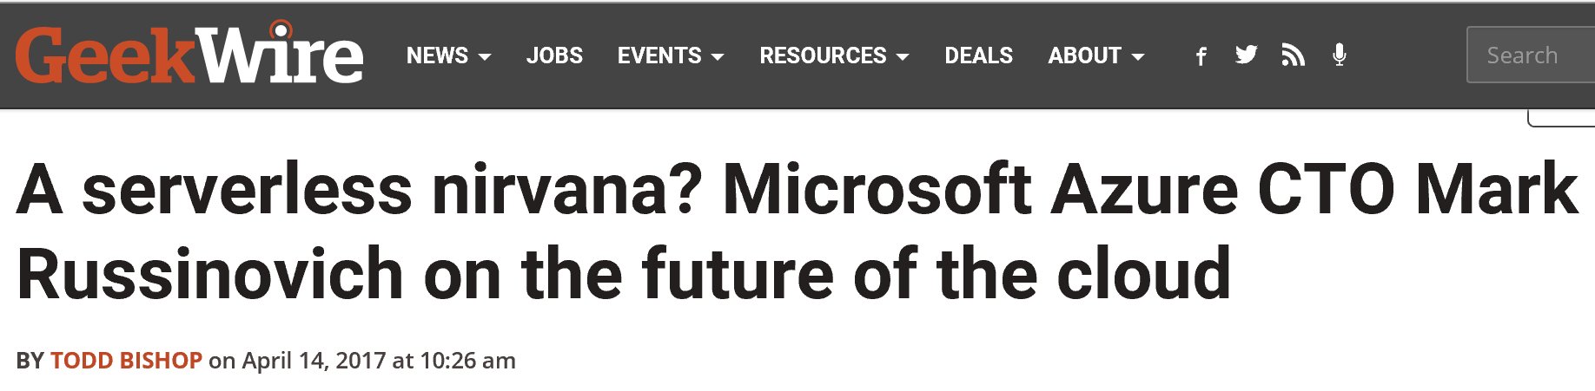
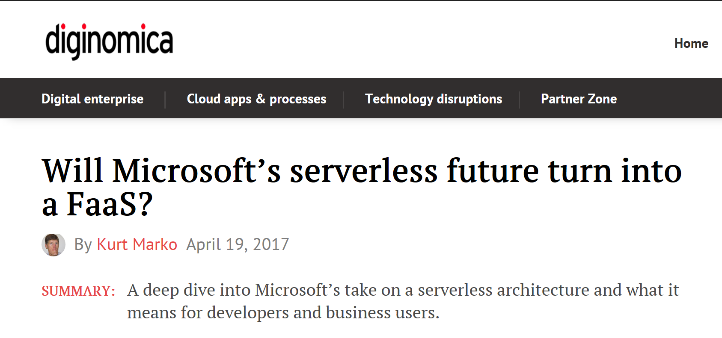
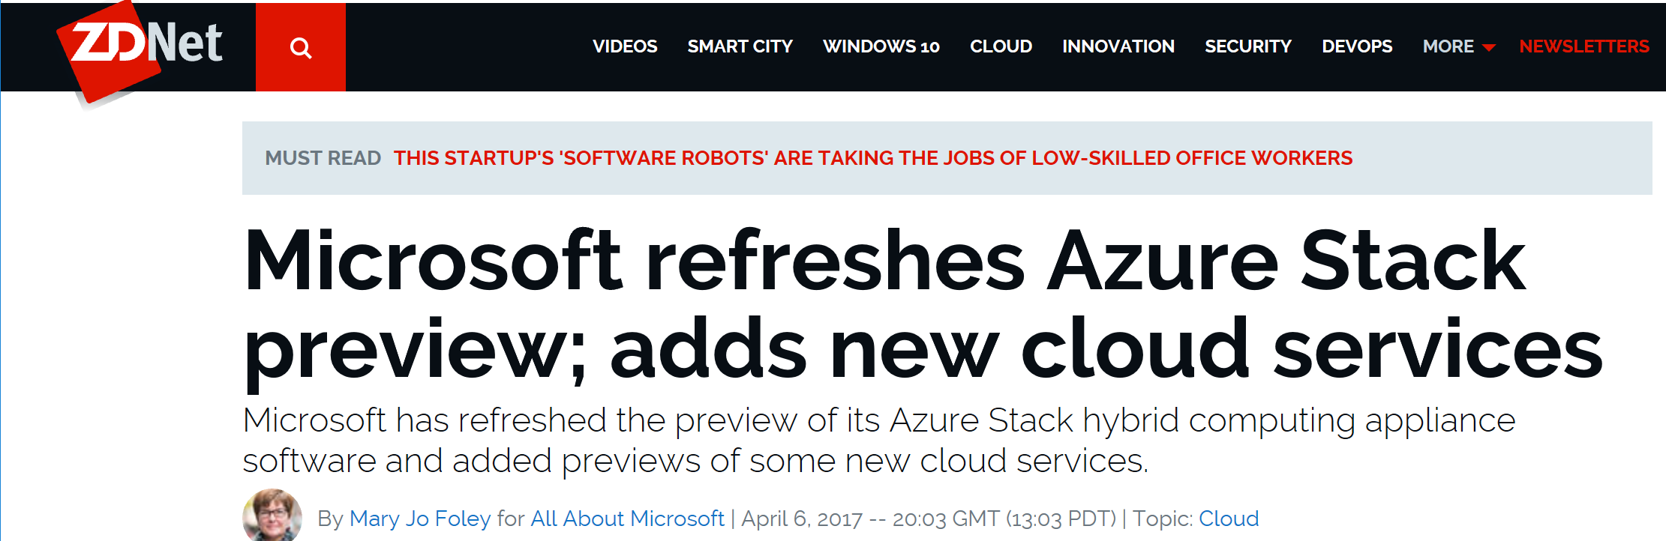
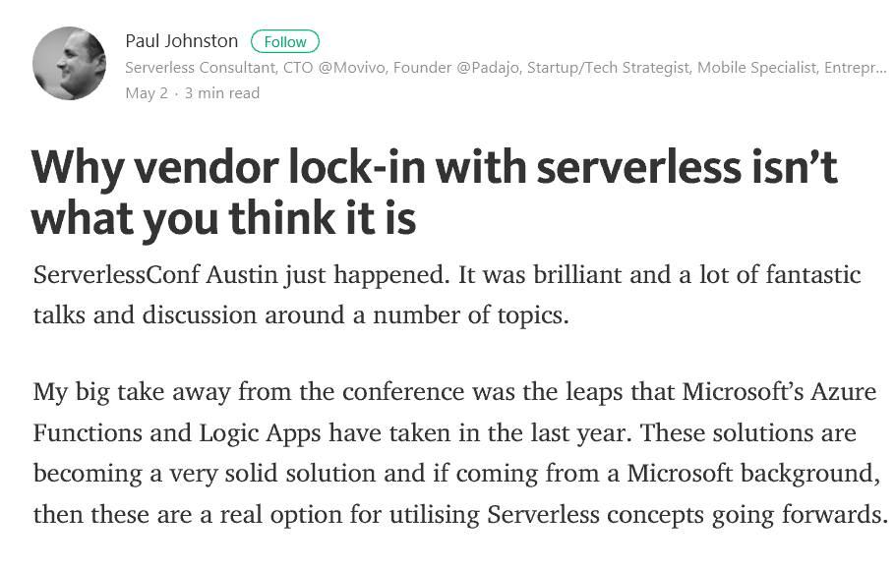
Azure Serverless in the News

Slide 5
Agenda
Azure Serverless overview
Azure Serverless application lifecycle
  Design
  Develop
  Deploy
  Monitor
Summary and next steps

Slide 6

Daria Grigoriu
Senior Program Manager @ Microsoft
Azure App Service
Azure Functions
dariac@microsoft.com

Slide 7

Yochay Kiriatry
Principal Program Manager @ Microsoft
Azure Functions/ App Service
Technical Evangelist / Advocate
Bunch of startups
https://blogs.msdn.microsoft.com/appserviceteam
@yochayk
yochay@microsoft.com

Slide 8
The “Evolution” of Application Platforms
On Premises
IaaS
PaaS
Serverless

Slide 9
What is Serverless?
$
Abstraction
of servers
Event-driven/ instant scale
Micro-billing

Slide 10
Serverless is Great!
DevOps Productivity
Focus on business logic
Faster time to market

Slide 11


Serverless Application Platform Components
Development
Platform
IDE support
Functions
Logic apps
Developer tooling
Bindings and triggers
Open source
Visual designer
100+ connectors
Functions orchestration
Visual
debug history
Local development
Data/storage
Messaging
Gateway Connectors
Intelligence
Bots
Verbose debugging

Slide 12
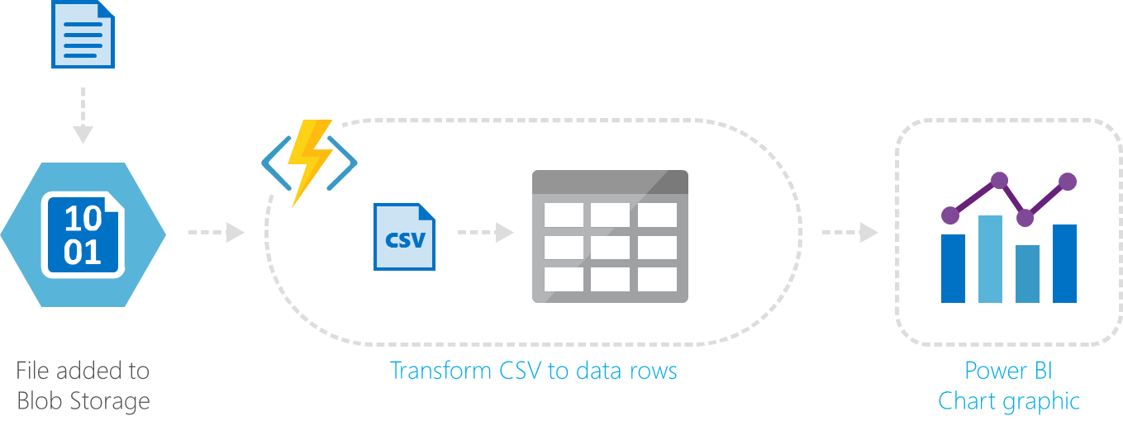
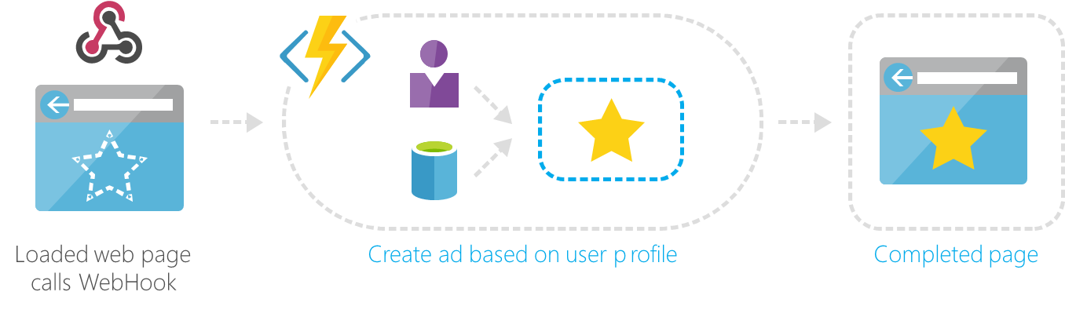
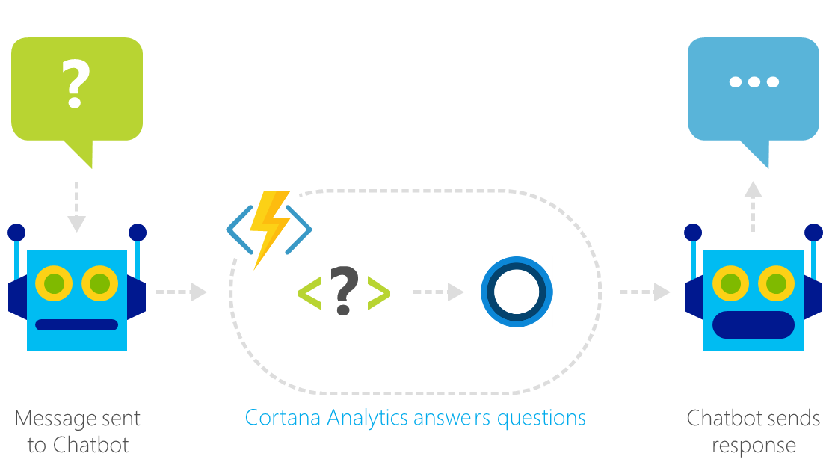
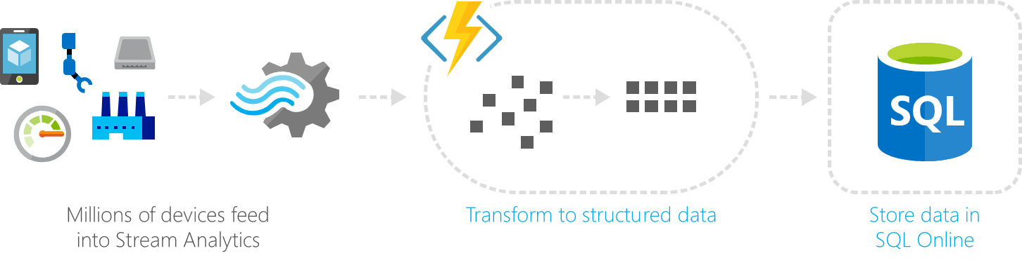
Common Scenarios
Web | Glue
Bots | IoT

Slide 13
Domino’s

Slide 14

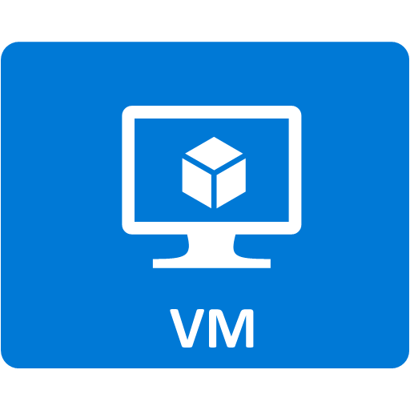
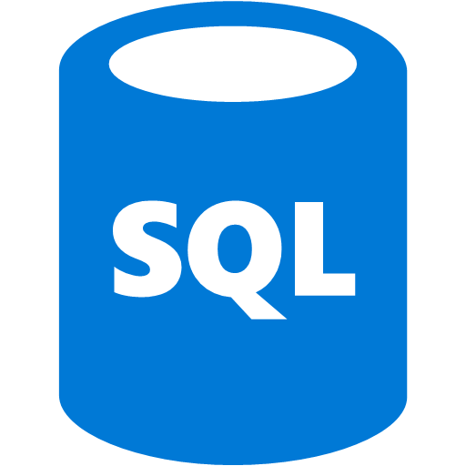







IN- AND EXTERNAL DATA SOURCES
Key Vault
SSIS
SSRS
KEMP
FRANCHISEE
SSDE
Azure Active Directory
Azure Files
Azure Function
AZURE WEST EUROPE
DOMINOS STORES

Slide 15
Demo
End to end coupon processing

Slide 16




Serverless Architecture
Azure Functions Proxies
/index.html
App Insights
/orderprocessing
/couponprocessing
O365

Slide 17
Serverless Apps Lifecycle
Design
Develop
Deploy
Monitor

Slide 18
Design
Design
Develop
Deploy
Monitor

Slide 19
Azure Serverless Apps Design
  Distributed Architecture
  Design stateless and ASync solutions to enable scaling.
  Connect with other Azure Services via triggers and bindings.
  Leverage proxies for API abstraction and composition.
  Use Logic Apps to orchestrate workflows
  Use managed connectors to abstract calls to cloud and on-premises services.
  Cloud DevOps
  Design for automation. Use ARM templates.
  Design DevOps for the cloud: safe deployment with test/development and production environment separation and test on the target platform.
  Monitor the running apps with App Insights and tune for best experience.

Slide 20
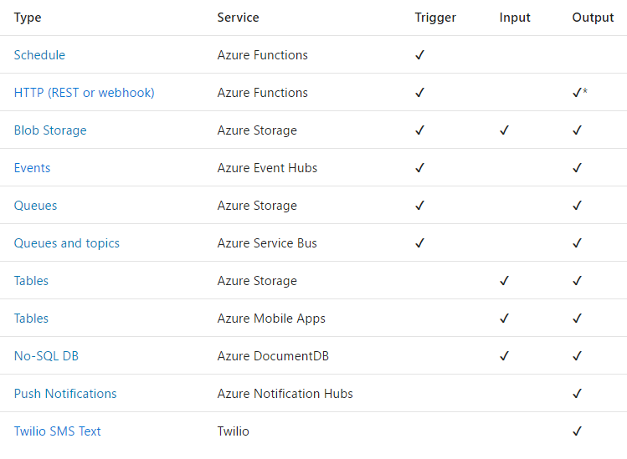
Triggers and Bindings
Triggers
and
Bindings

Slide 21
Use Bindings in Your Code
function.json
public static class OrderHandler
{
[FunctionName("OrderWebhook")]
public static async Task<HttpResponseMessage> Run(
[HttpTrigger] HttpRequestMessage req,
[Queue("aievents1", Connection = "AiStorageConnection")] IAsyncCollector<String> eventOutput,
TraceWriter log)
{
log.Info($"Webhook was triggered!");
string jsonContent = await req.Content.ReadAsStringAsync();
dynamic data = JsonConvert.DeserializeObject(jsonContent);
await eventOutput.AddAsync(
JsonConvert.SerializeObject(GetLogData(data)));
int orderId = PlaceOrder(data);
return req.CreateResponse(HttpStatusCode.OK,
new {orderNumber = orderId });
}
. . .
}
"bindings": [
{
"type": "httpTrigger",
"direction": "in",
"webHookType": "genericJson",
"name": "req"
},
{
"type": "http",
"direction": "out",
"name": "res"
},
{
"type": "queue",
"name": "eventOutput",
"queueName": "aievents1",
"connection":"AiStorageConnection",
"direction": "out"
}
]

Slide 22
Design: API Abstraction and Composition
Function App B
/FB
Function B
Function App A
/FA
Function A
/FB
/FC
Function App C
/FC
Function C
Key:
HttpTrigger function endpoints
API proxy endpoints

Slide 23
Demo
Proxies

Slide 24
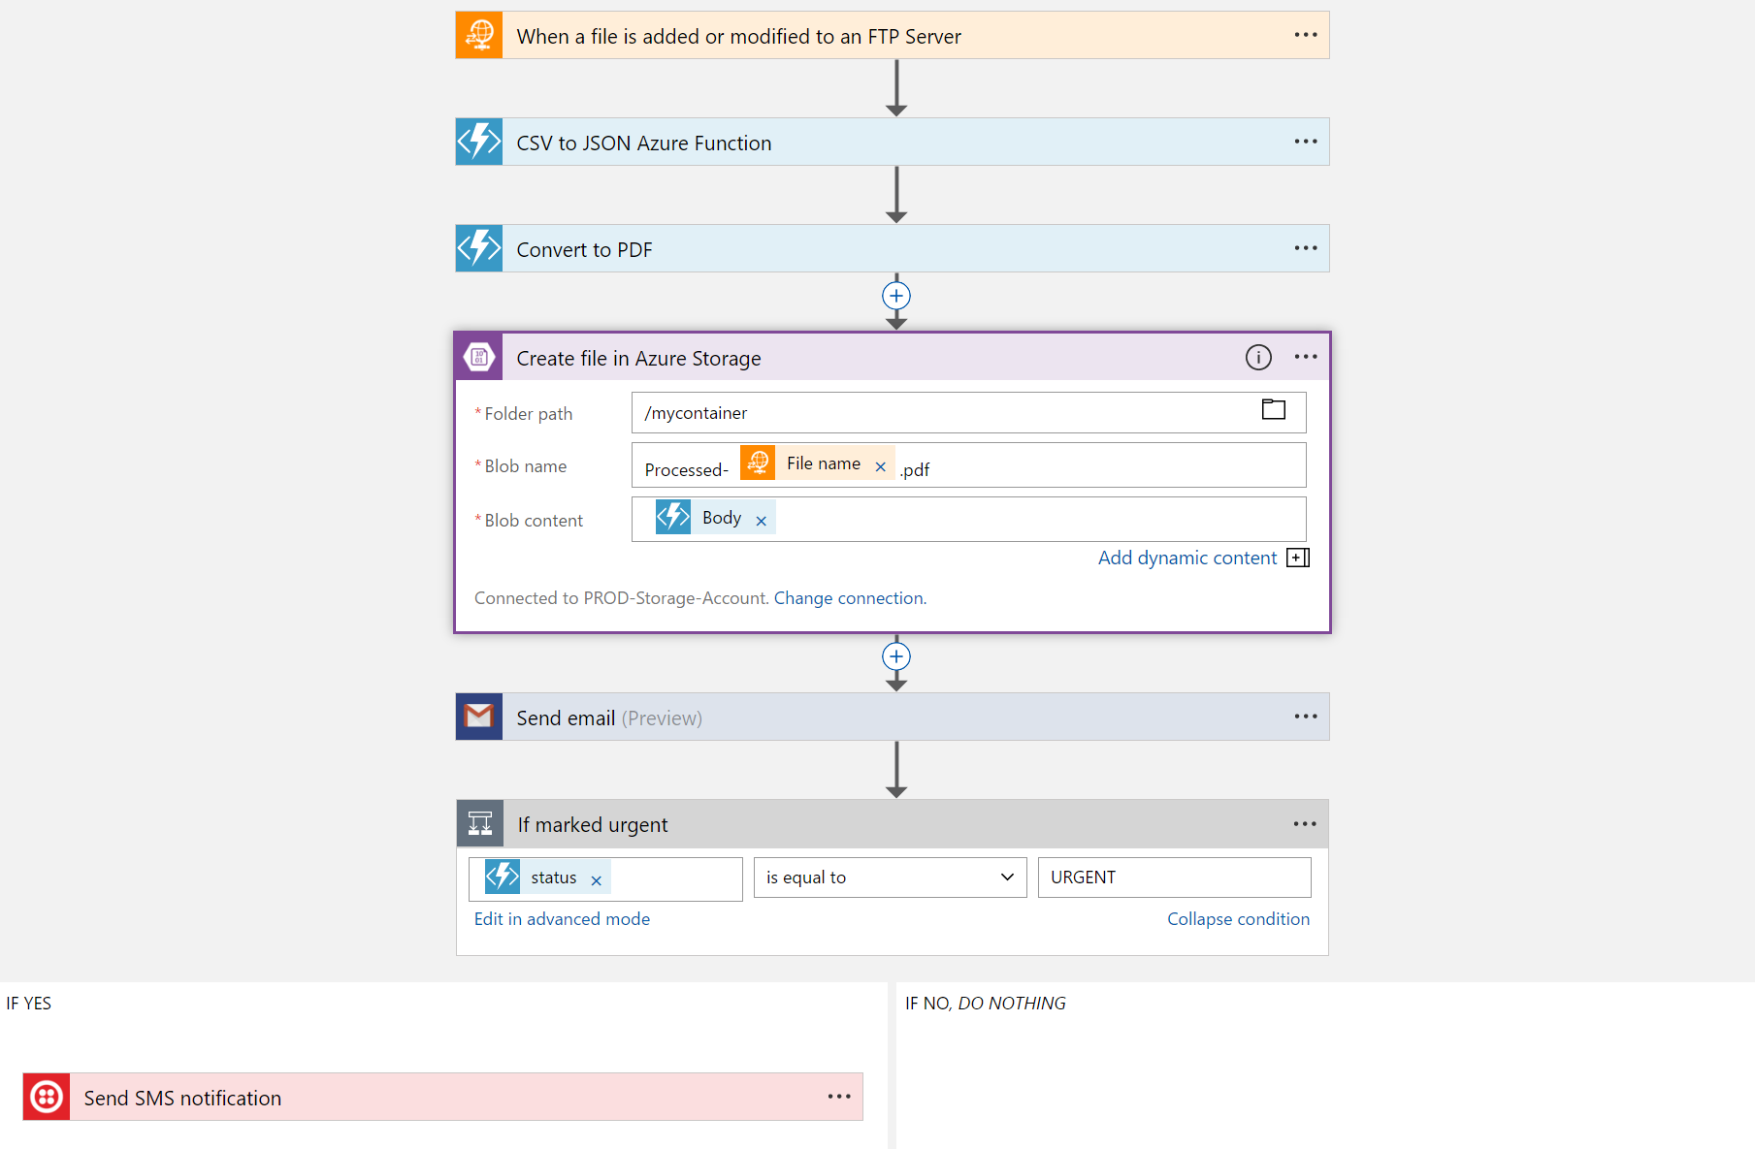
Logic Apps Workflow Designer
Workflow in the cloud
Powerful control flow
Connect functions and APIs
Declarative definition to persist in source control and drive deployments

Slide 25
Logic Apps
Logic Apps
SaaS
Protocols/Native
appFigures
Asana
Azure API Management
Azure App Services
Azure Automation
Azure Cognitive Face API
Azure Cognitive LUIS
Azure Cognitive Text Analytics
Azure Cognitive Vision
Azure Data Lake Store
Azure Document DB
Azure Event Hub
Azure Functions
Azure Machine Learning
Azure Resource Manager
Azure Service Bus
Azure SQL
Azure Storage Blob
Azure Storage Queues
Basecamp
Bing Search
BitBucket
Bitly
Blogger
Box
Buffer
Campfire
Chatter
Common Data Service
Disqus
DocuSign
Dropbox
Dynamics AX Online
Dynamics CRM Online
Dynamics CRM Service Bus
Dynamics Financials
Dynamics Operations
Easy Redmine
Eventbrite
Facebook
FreshBooks
Freshdesk
GitHub
Gmail
Google Calendar
Google Contacts
Google Drive
Google Sheets
Google Tasks
GoTo Meeting
GoTo Training
GoTo Webinar
Harvest
HelloSign
Infusionsoft
JIRA
Insightly
Instagram
Instapaper
MailChimp
Mandrill
Medium
Microsoft Project Online
Microsoft Translator
MSN Weather
Muhimbi PDF
Office 365
Office 365 Users
Office 365 Video
OneDrive
OneDrive for Business
OneNote
Outlook.com
Outlook Tasks
PagerDuty
Pinterest
Pipedrive
Pivotal Tracker
Power BI
Project Online
Redmine
Salesforce
Salesforce Chatter
SendGrid
SharePoint Online
Slack
SmartSheet
SparkPost
Stripe
Survey Monkey
Todoist
Toodledo
Trello
Twilio
Twitter
Typeform
UserVoice
VS Team Services
Webmerge
Wordpress
Wunderlist
Yammer
YouTube
Zendesk
HTTP, HTTPS
HTTP Webhook
FTP, SFTP
SMTP
RSS
Compose, Query,
Parse JSON
Wait
Terminate
Workflow
Cloud APIs and platform
  Supports over 125 built-in connectors
  Scales to meet your needs
  Enables rapid development
  Extends with custom APIs and
  Functions
API connections
  Authenticate once and reuse
XML and EDI
XML Validation
Transform XML (+Mapper)
Flat File Encode
Flat File Decode
X12
EDIFACT
AS2
Integration Account Artifact Lookup
Hybrid
BizTalk Server
File System
IBM DB2
Informix
Oracle DB
SharePoint Server
SQL Server
SAP
Websphere MQ

Slide 26

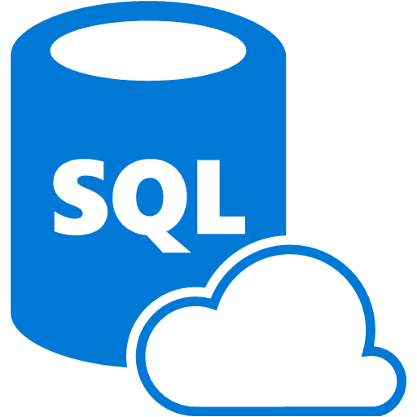

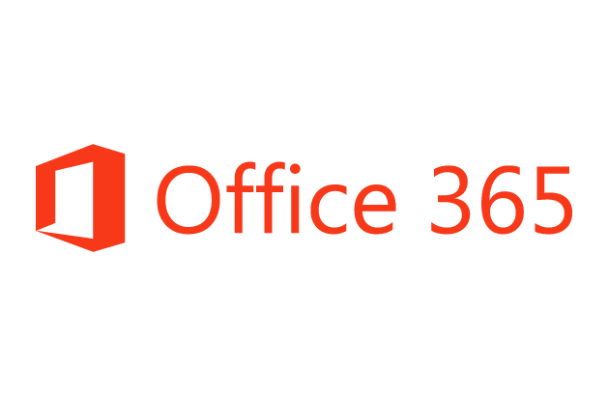


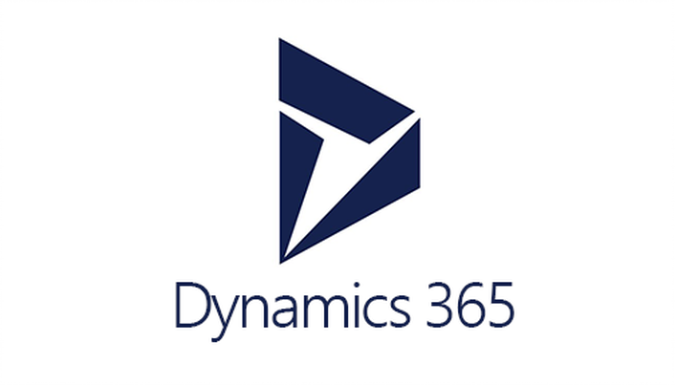





Logic Apps connects everything
Logic Apps Connect Everything
Azure Functions
Service bus
Cognitive services
Logic Apps
Machine learning
On-premises data gateway
BizTalk
server

Slide 27
Demo
Orchestrating workflows with Logic Apps

Slide 28
Develop
Design
Develop
Deploy
Monitor

Slide 29
Local Development Tooling Options
Azure Functions Core Tools
Provides the entire Functions runtime
Trigger off of Azure events and debug locally
JavaScript
Use Visual Studio Code or any Node debugger
C#
Use Visual Studio 2015 or 2017
Use class libraries with attributes in Visual Studio 2017

Slide 30
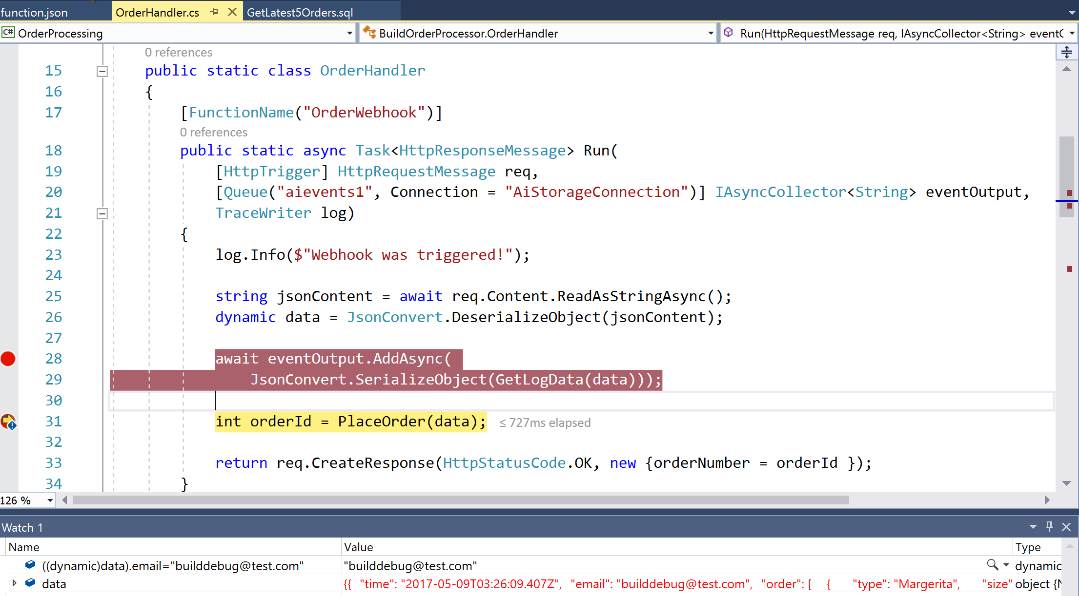
C# and Visual Studio
Based on class libraries
Get the full power of IntelliSense, unit testing, and local debugging
Use WebJobs attributes to define triggers and bindings
Learn more at https://aka.ms/vs2017functiontools

Slide 31
Demo
Local development and debugging

Slide 32
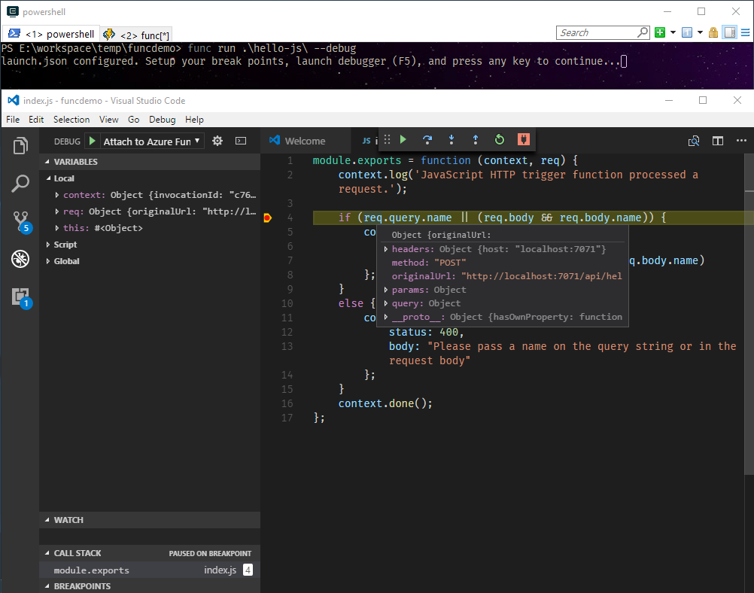
Node.js and Visual Studio Code
Supports Node.js v6.5.0
Supports JS and TypeScript
You can use the callback or return a Promise
VS Code support for local debugging via CLI
VS Code supports rich Node.js debugging

Slide 33
Deploy
Design
Develop
Deploy
Monitor

Slide 34
Deployment Options
Resource deployment
Azure Resource Manager (i.e. ARM)
Content deployment
Visual Studio
Azure CLI (Logic App)
Azure Functions Core Tools (Function App)
CI/CD
Safe deployment practices
Use Azure Functions deployment slots for environment separation and swap deployments

Slide 35
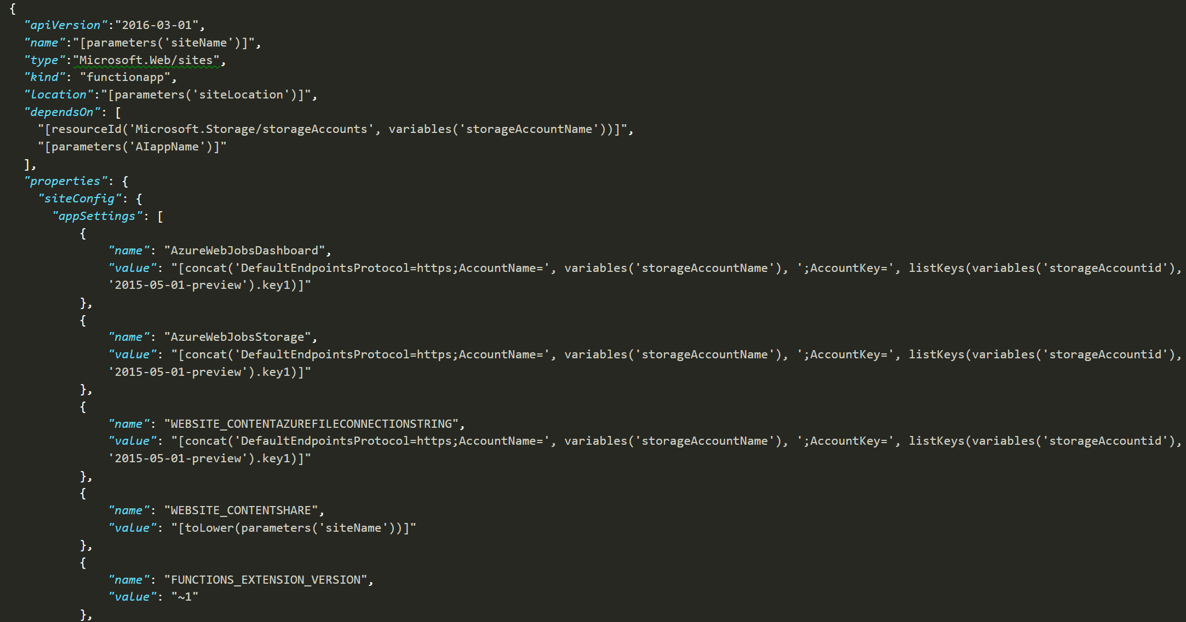
Function Apps as ARM Resources
https://management.azure.com/subscriptions/<subscription ID>/
resourceGroups/<resource group>/providers/Microsoft.Web/sites/<function app>

Slide 36
Demo
Deploy to the Cloud

Slide 37
Function Apps Publishing

Slide 38
Demo
Azure Functions Deployment Slots

Slide 39
Monitor
Design
Develop
Deploy
Monitor

Slide 40
Key Scenarios for Monitoring
Alert
Monitor
Learn
Optimize

Slide 41
Azure Application Insights
Extensible Application Performance Management (APM)
Rich data: Metrics, Traces, Exception tracking, Dependencies, Page Views, User data, custom events
Easy to use graph/alerts, powerful analytics portal, integration with PowerBI and other analytics services

Slide 42
Demo
Monitor

Slide 43
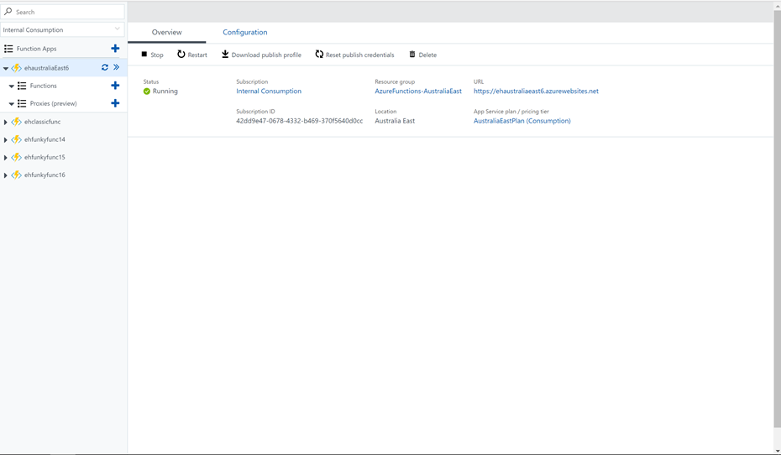
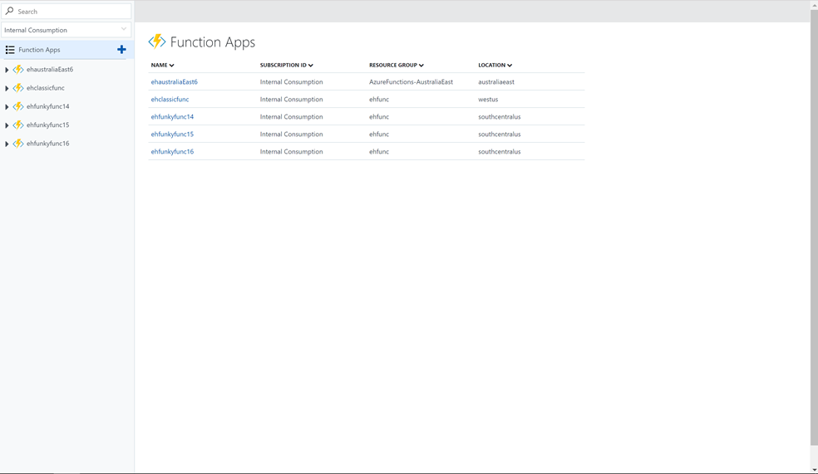
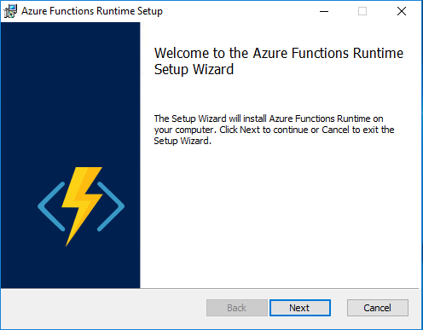
Azure Functions Runtime Preview
Learn more at https://aka.ms/azafr

Slide 44
Azure Functions Runtime
Developer experience
Same consistent Programming Model
Same Azure Functions portal
Publish directly from Visual Studio tooling
Leverage triggers: timer trigger and new SQL Service Broker trigger
Administrator features
Take advantage of Azure Functions on premises
  Workers can run in spare compute – i.e. desktops left on overnight within orgs
Only provision two types of roles
  Management Role – Hosts Portal, Publishing Endpoint and
  Worker Role – Runs Function in Windows Server Containers

Slide 45
Demo
Azure Functions Runtime

Slide 46
Summary
Azure offers a comprehensive Serverless Application Platform
Azure Functions bindings and local DevEx optimize time to market
Azure Logic Apps provide orchestration and integration with 125+ connectors
Try Azure Functions and Logic Apps: http://aka.ms/TryFunctions
Join the Azure Functions Community https://aka.ms/func-github
#MSBuild

Slide 47
Related sessions
Session | Code | Type | Time | Location
Container apps on Azure App Service are like peanut butter and chocolate | B8026 | Breakout | Thursday, 5/11 2:30-3:30 | WSCC Room 608 (614)
How to build serverless business applications with Azure Functions and Logic Apps for PowerApps | B8061 | Breakout | Friday, 5/11 10:30-11:30 | WSCC Hall 6B (1040)
When bad things happen to good apps: Azure App Service Support Center | T6082 | Theater | Thursday, 5/11 11:30-11:50 | Tech Talk A
A day in the life of an Azure serverless developer | T6003 | Theater | Friday, 5/12 10:00-10:20 | Tech Talk A
#MSBuild

Slide 48
Questions?

