Slide 2
Universal Windows Platform XAML Custom Controls start to finish
B8035
Nikola Metulev
Program Manager - Microsoft
@metulev
John Bristowe
Developer Relations - Progress
@JohnBristowe

Slide 5
open.nasa.gov | neo.ssa.esa.int

Slide 6
open.nasa.gov | neo.ssa.esa.int

Slide 12
PRISM
ReactiveUI
Adaptive Trigger Library
Composition Surface
Factory
UI for UWP
MVVM Light
Windows UI
Dev Labs
Catel
Template10
WinRT XAML
Toolkit
Monolith
Caliburn.Micro
Composition Pro Toolkit
WinUX
UWP Community
Toolkit
Akavache
XAML Behaviors
Cimbalino-Toolkit

Slide 15
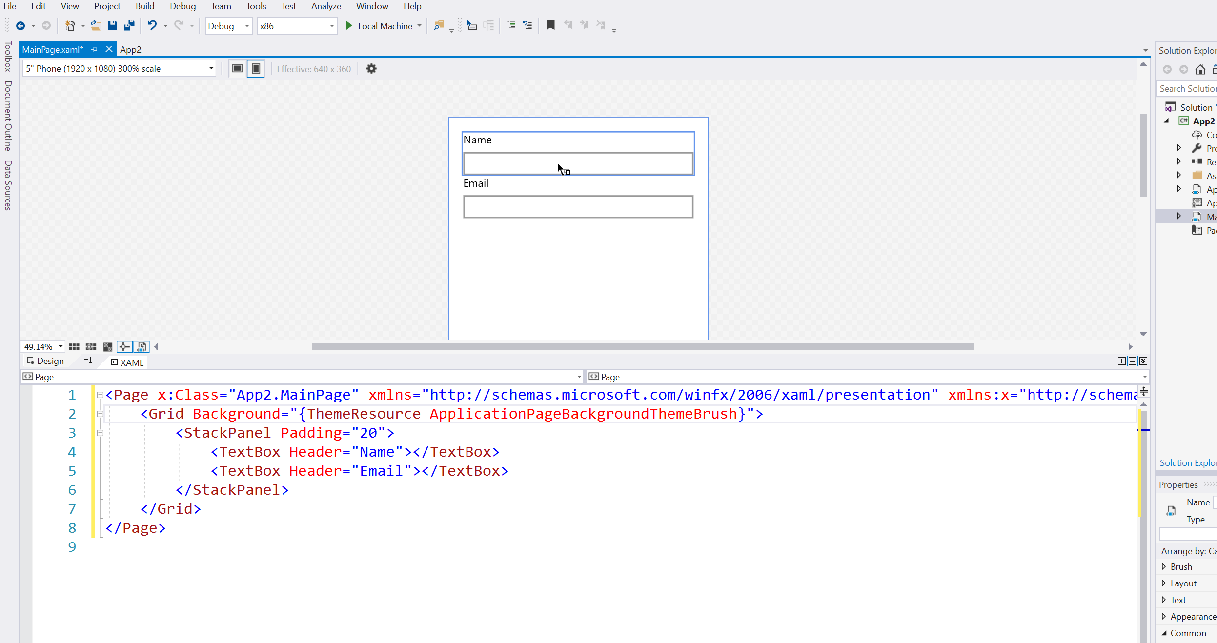

Slide 16
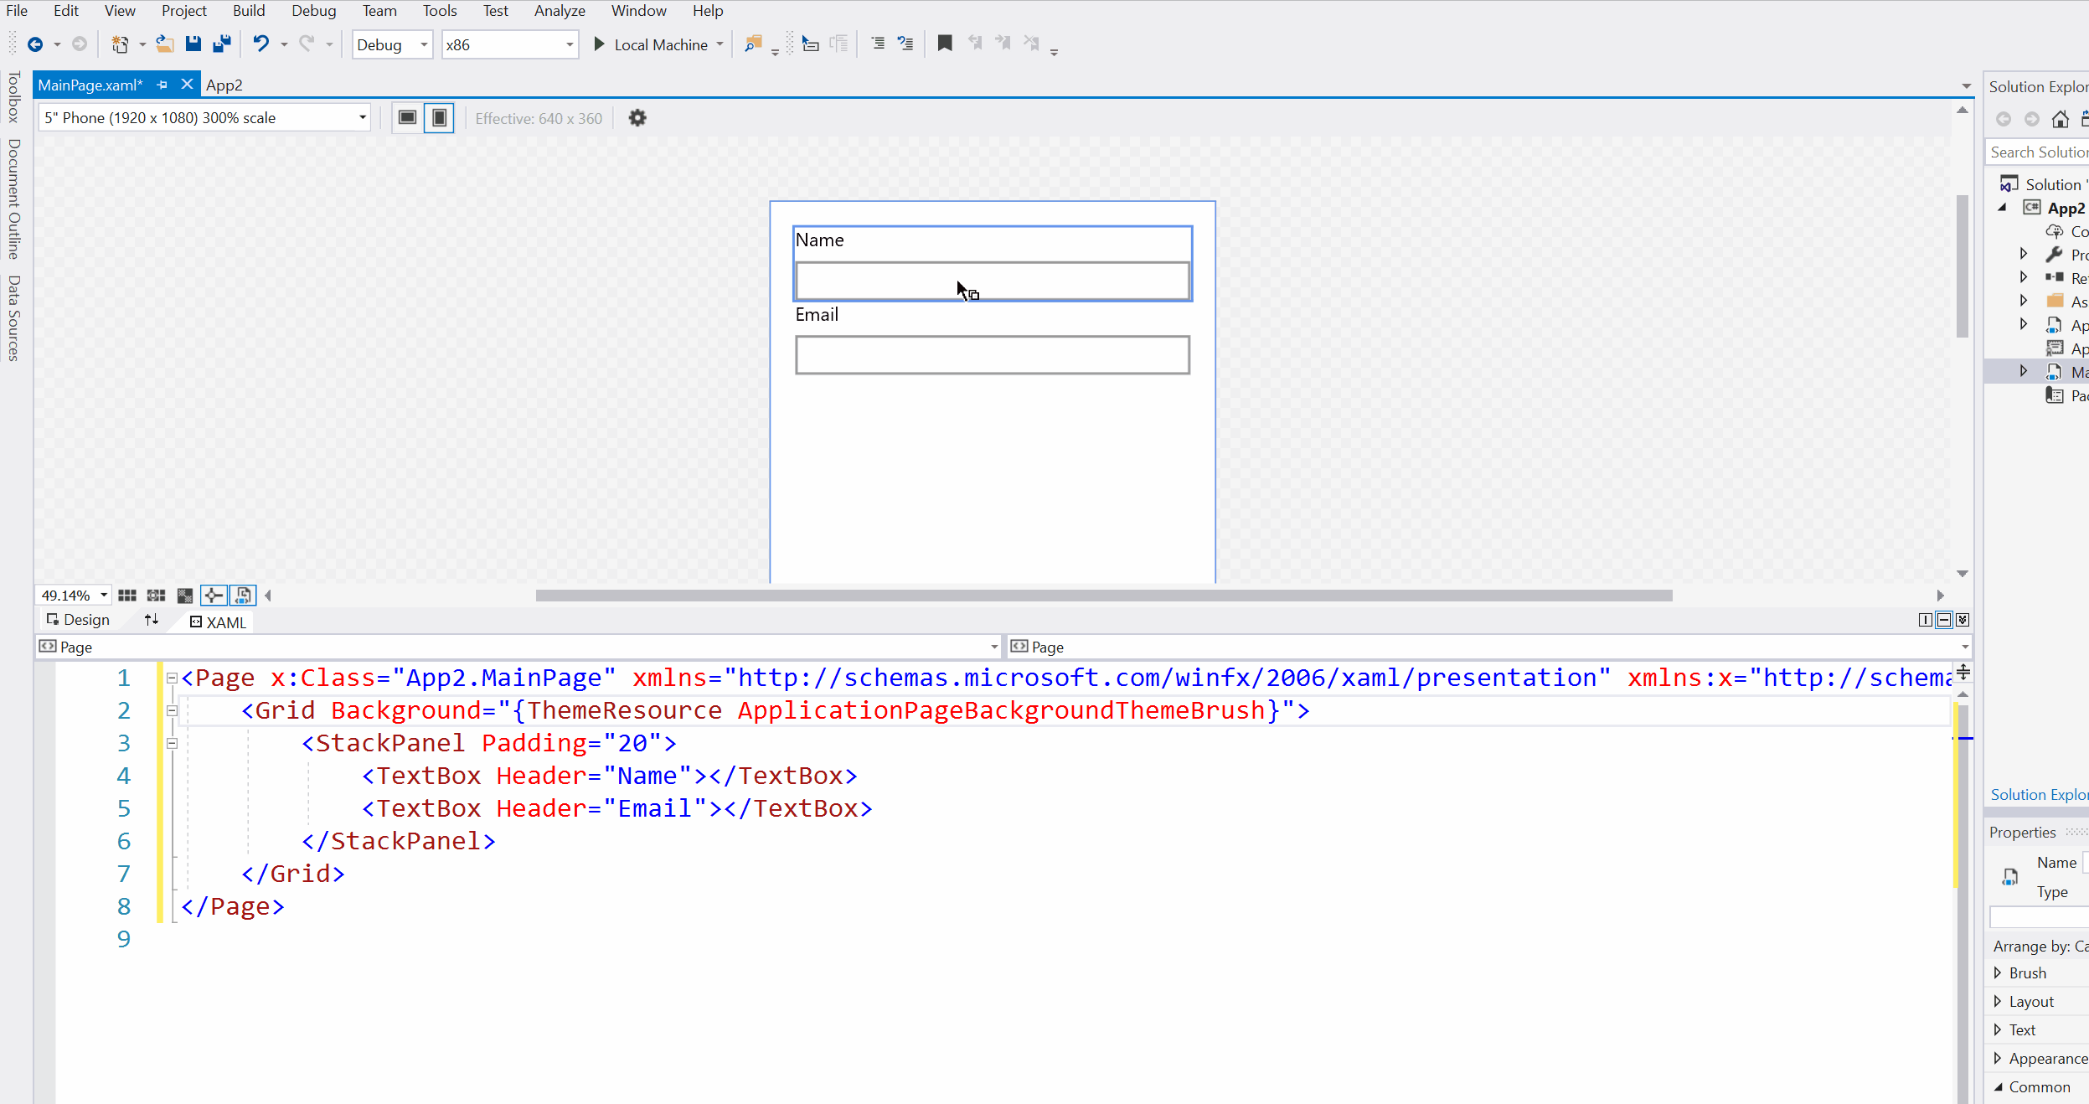

Slide 17
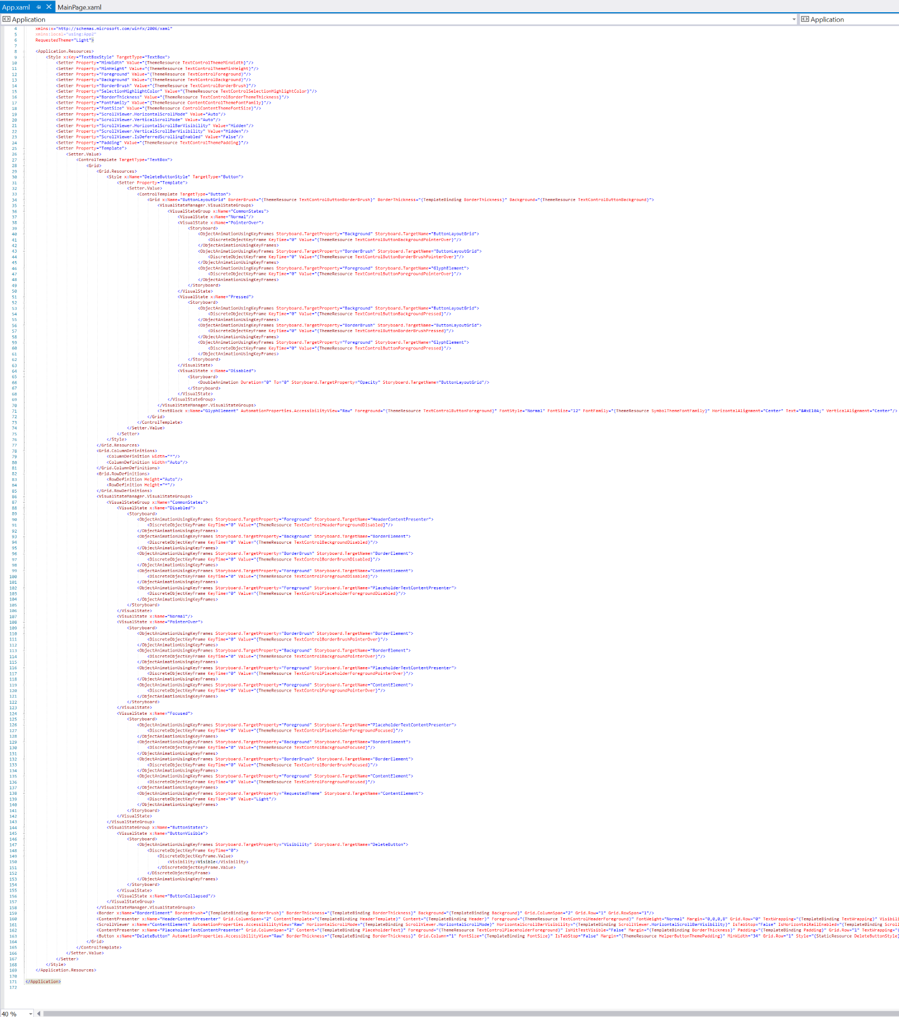

Slide 18
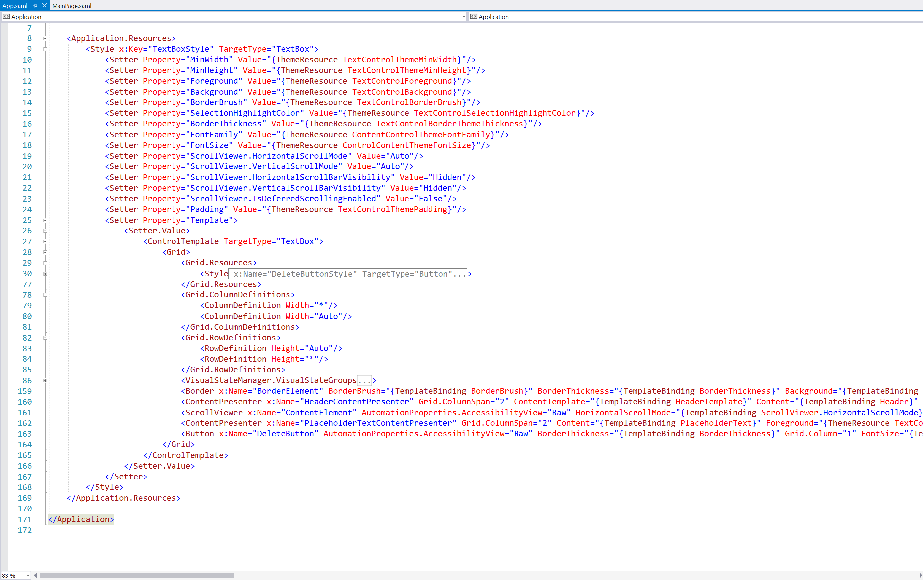

Slide 21
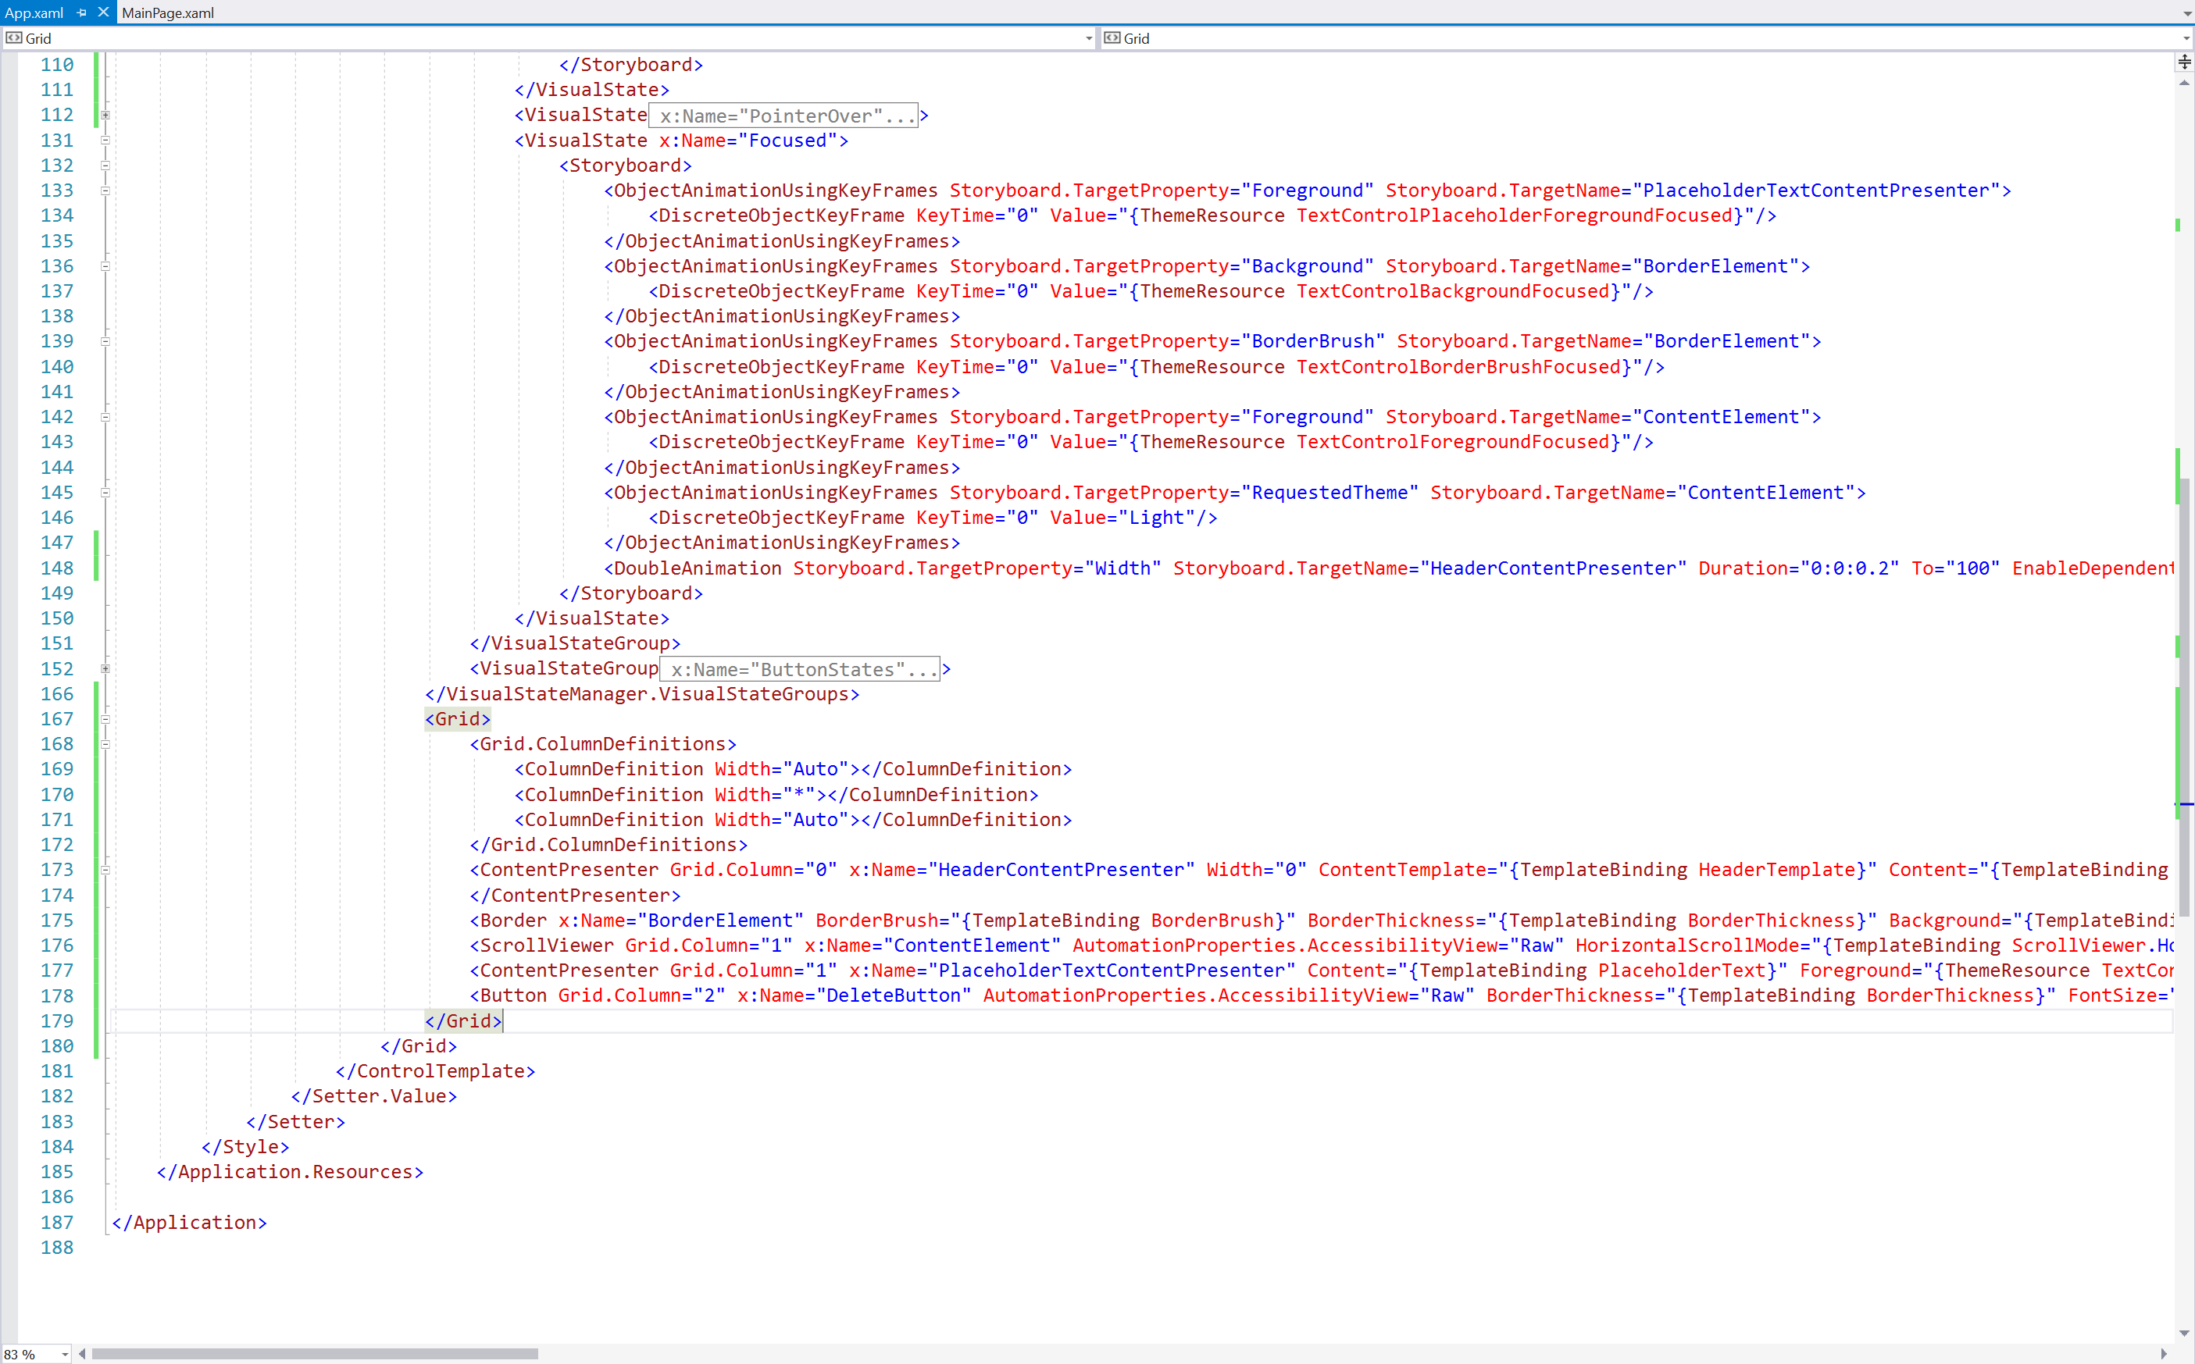

Slide 24
MasterDetailsView + DataGrid

Slide 27
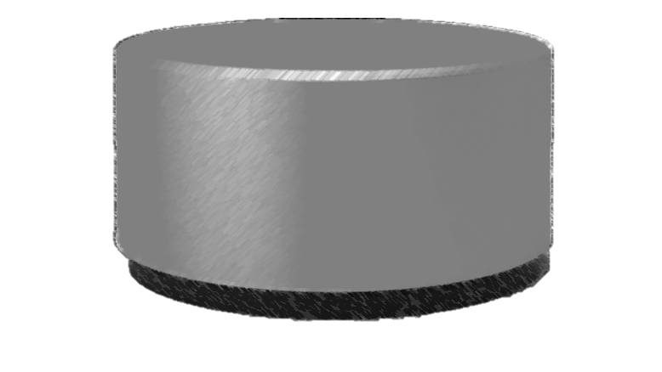
Attached Properties
Extending Controls

Slide 30
demo

Slide 31
demo
Checklist for creating custom controls
Check if someone else has created one
Extend existing controls if possible to get a lot for free
Use system styles and resources whenever possible
Consider all input modalities
Test for accessibility
Don’t forget the designer
Make it simple and reusable
Play well with others

Slide 32
distribute
nuget
open source

Slide 33
Start from platform controls
Use 3rd party controls
Re-template and re-style controls
Extend existing controls
Build custom controls
Distribute
What does the future hold?

