Slide 2
Continuous Delivery on Microsoft Azure
B8028
Martin Woodward
Principal Group Program Manager

Slide 3

Martin Woodward
martinwo@microsoft.com
@martinwoodward
https://visualstudio.com

Slide 4

I work here

Slide 5


Slide 6


Slide 7
I work here

Slide 8

#SpringIntoDevOps
https://aka.ms/SpringIntoDevOps

Slide 9




Continuous Delivery
SOURCE CONTROL
BUILD
TEST
PACKAGE
DEVELOPMENT
TFVC
STAGING
DEV
OPS
PRODUCTION

Slide 10
Continuous Delivery
SOURCE CONTROL
BUILD
PACKAGE
DEVELOPMENT
TFVC
STAGING
DEV
OPS
PRODUCTION

Slide 11
Continuous Delivery
SOURCE CONTROL
CI
PACKAGE
DEVELOPMENT
TFVC
STAGING
DEV
OPS
PRODUCTION

Slide 12

Some CI Options with Azure
TFS with Private Agents
VSTS with Hosted or Private Agents
TeamCity
Jenkins
AppVeyor
TravisCI

Slide 13



CI Using Azure VM Agents
Jenkins Master

Slide 14
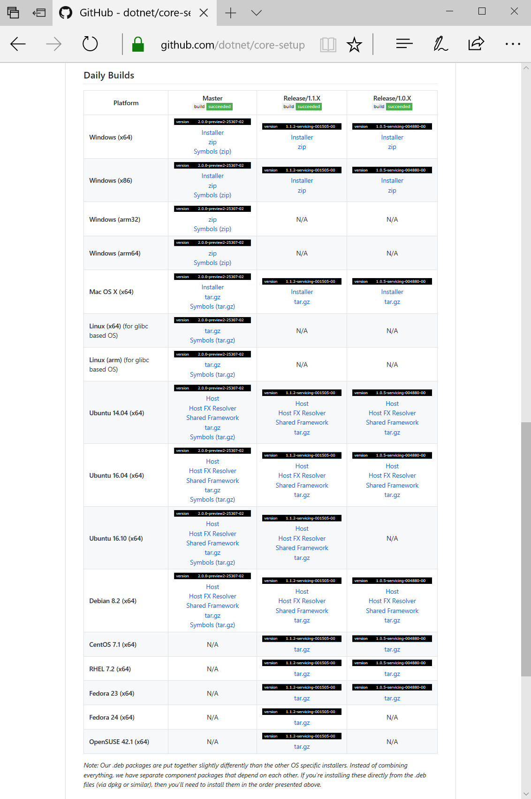
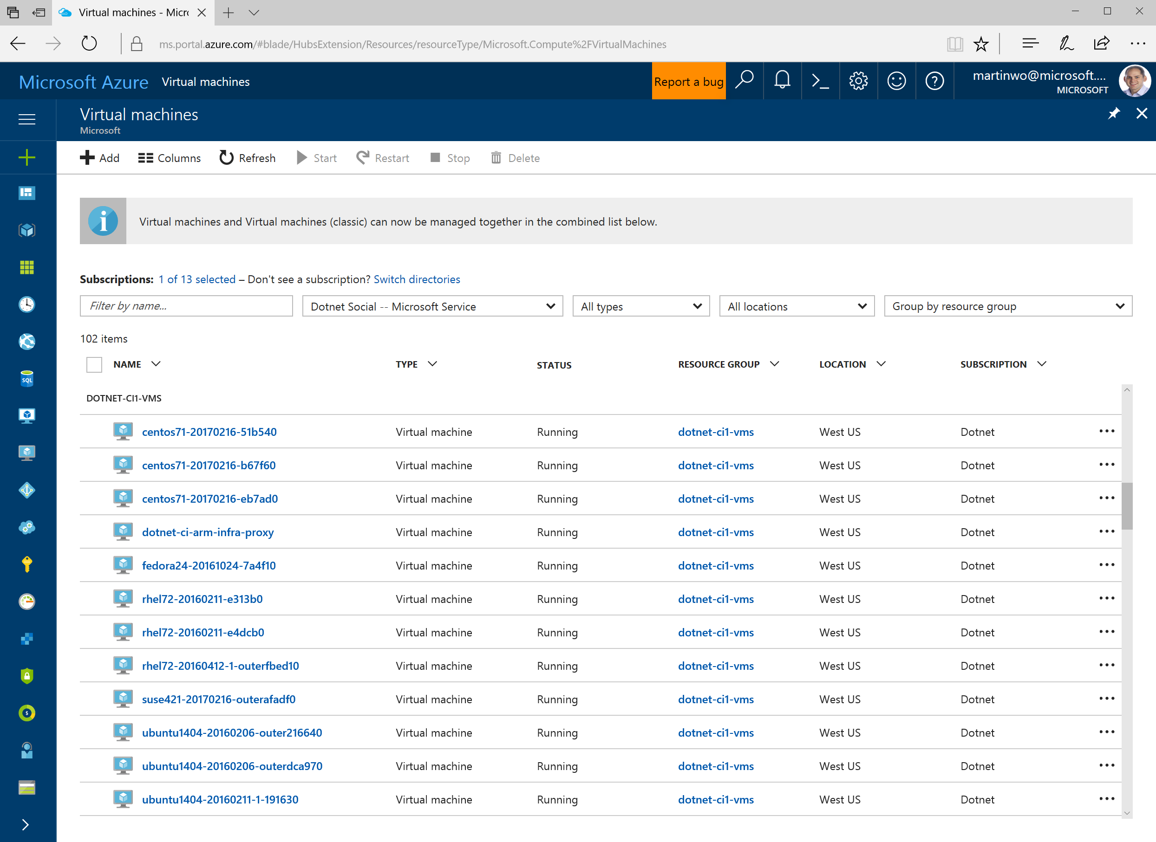

Slide 15
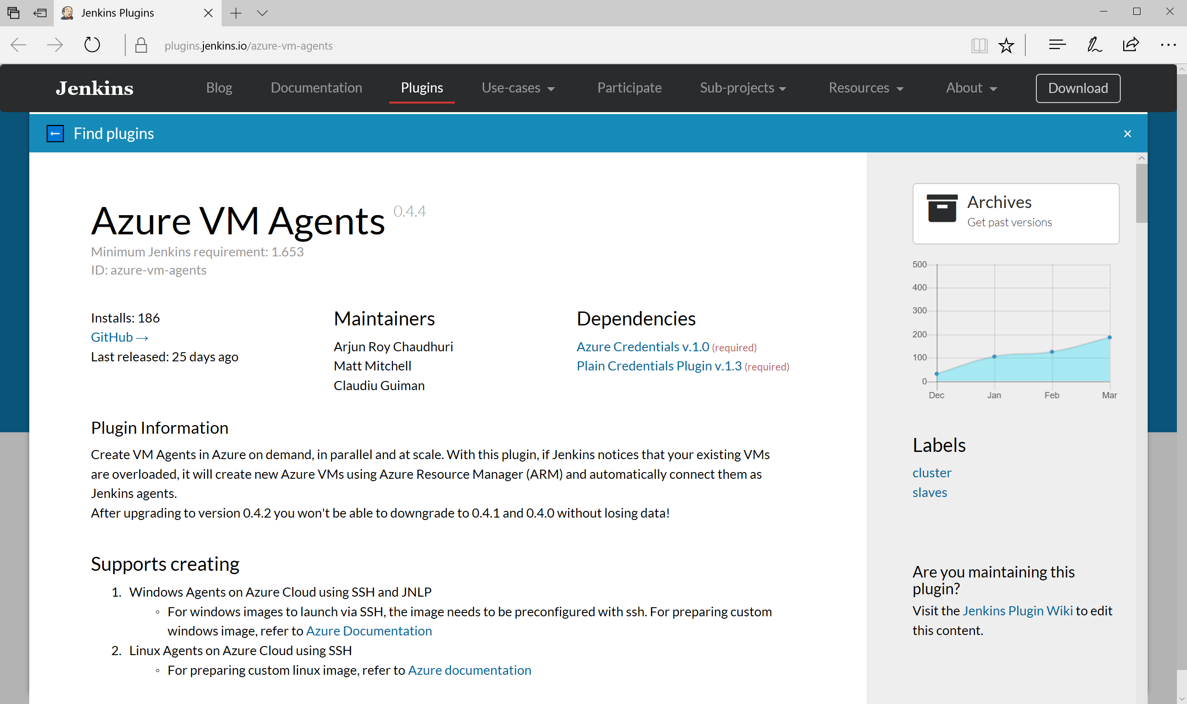
Jenkins Azure VM Plugin
http://aka.ms/azjenkinsagents

Slide 16
Continuous Delivery
SOURCE CONTROL
CI
PACKAGE
DEVELOPMENT
TFVC
STAGING
DEV
OPS
PRODUCTION

Slide 17
Continuous Delivery
SOURCE CONTROL
CI
PACKAGE
PIPELINE
DEPLOYMENT

Slide 18



Continuous Delivery
SOURCE CONTROL
CI
PACKAGE
PIPELINE
DEPLOYMENT
OctoPack
Octopus Deploy ASP.NET Web App

Slide 19

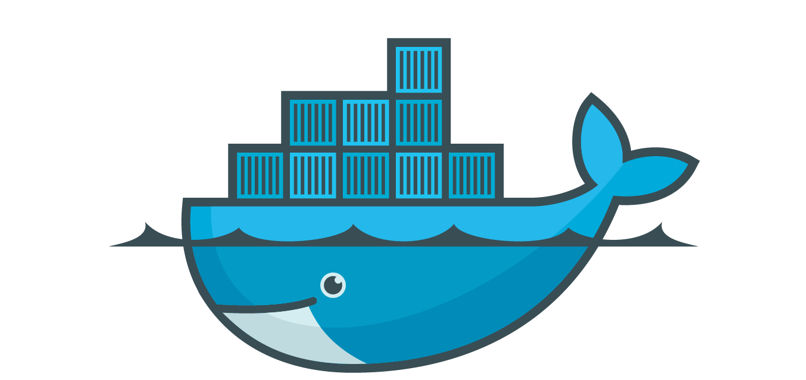


Continuous Delivery
SOURCE CONTROL
CI
PACKAGE
PIPELINE
DEPLOYMENT
Azure Container Registry to Azure Container Service with Kubernates

Slide 20

Continuous Delivery
SOURCE CONTROL
CI
PACKAGE
PIPELINE
DEPLOYMENT
Azure VM Scale Sets with Packer

Slide 21

Continuous Delivery with VSTS

Slide 22
Continuous Delivery with VSTS
Azure has CD built-in with VSTS
Any app, any developer, any platform
Lowers the barriers to entry
Enterprise class – grows with you
Broad support for Azure services & on-premises
NEW ANNOUNCEMENTS

Slide 23
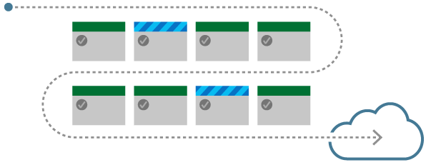
Demo
Continuous Delivery of
Azure Web Apps

Slide 24
Azure WebApps CI/CD with VSTS
Azure portal enhancements
  Apps: Core, NodeJs, PHP, Python, Java
  Repos: Git, TFVC, BitBucket, GitHub External Git
  Unified experience with Kudu
AZ CLI Support
  Built into the Azure CLI
  Feature parity w/ Ibiza experience
Linux (Docker) support
VS Integration
  Integrated into VS 15.3
  ASP.NET, .NET Core
  Linux (Docker)
VS Code Integration
IntelliJ Integration
  Support for all flavors
//Build
//Build
Upcoming
Upcoming
Upcoming
//Build
Upcoming
//Build

Slide 25
VSTS Deployment Groups Preview
In public preview
Define a group of tagged VM’s for release
Deploy to machines with a particular tag in each environment e.g.
  Deploy ASP.NET app to all “web” machines
  Deploy DB to all “db” machines
Deployment Group
Machine
Machine
X tag
X web
Machine
X tag
X db
Machine
X tag
X web
Machine
X tag
X db
X tag
X web

Slide 26
Deployment Agent
Uses the same cross-platform agent used for VSTS Build
Can mix & match on-prem / cloud, physical / VM
Define the security context at the deployment group level
Ability to identify which release is on which machine
and why
Ability to configure rolling deployment
ARM task for agent install
Can dynamically build out environments

Slide 27
Demo
Continuous Delivery for IaaS

Slide 28
Azure IaaS DevOps with VSTS
Deployment Groups
  First class IaaS based deployment model
  Agent based app deployment support for VMs
  Support for rolling deployments
VM Scale Set deployment
  VHD based deployments using Packer
  Integration into the Azure portal
ARM provisioning enhancements
Azure Key vault
  Seamlessly consume keys in your deployments
Service Fabric Improvements
//Build
//Build
Upcoming
//Build
Upcoming
Upcoming

Slide 29
Demo
Continuous Delivery
with Containers

Slide 30
Container DevOps with VSTS
Container Fundamentals
  Windows container support in hosted pool
  Provide your own container to update
  Docker tasks in the box
  Docker task improvements
App Service Linux Container
  CD support in VSTS - //build
  CD configure in Azure portal - //build
  CD configure in VS - //build
  CD configure in AZ CLI - //build
  CD configure in Intellij
  CD configure in VS Code
Service Fabric Containers
  CD support in VSTS
  CD configure in VS
  CD configure in AZ CLI
  CD configure in Azure portal
ACS - Kubernetes
  CD support in VSTS
  CD configure in VS
  CD configure in AZ CLI
  CD configure in Azure portal
//Build
//Build
//Build
Upcoming
//Build
Upcoming
Upcoming
Upcoming
//Build
//Build
//Build
Upcoming
//Build
Upcoming
//Build
Upcoming
Upcoming
Upcoming

Slide 31
Looking Ahead

Slide 32
Key Trends in CD
Deep support for container based deployment
Focus on simple light weight experiences
E2E Pipeline support
Configuration as Code

Slide 33




Configuration as Code
Rise in popularity of configuration as code approach
  Puppet
  Chef
  ARM Templates
  PowerShell DSG
Need Pipeline as code

Slide 34
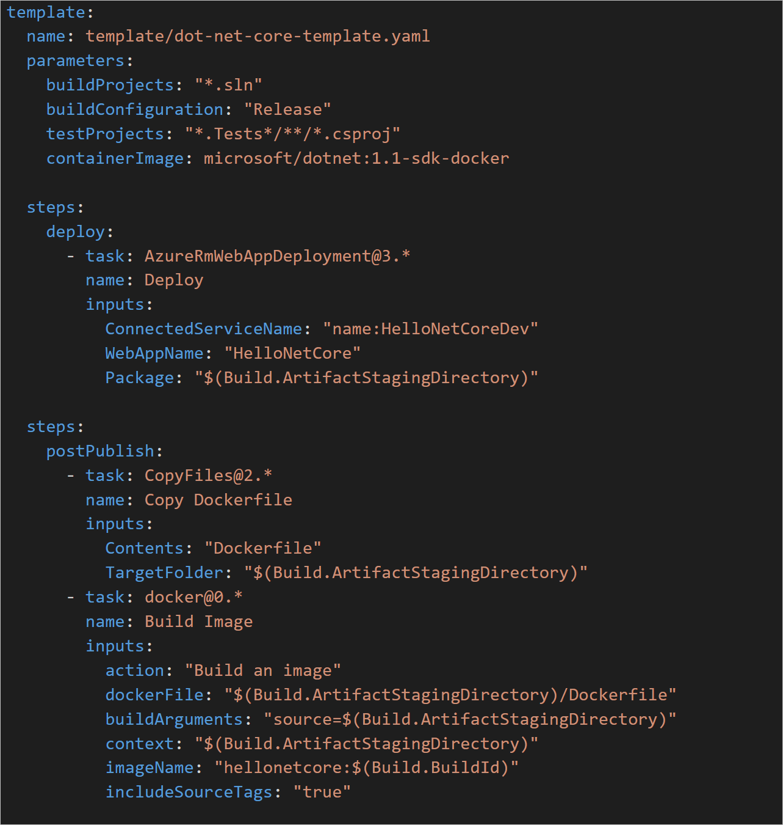

Pipeline as Code
YAML Based
Build on existing VSTS Build & Release model, including extensions
Support templating via Mustache
Makes it easy to share examples, samples etc
Scales from very simple to very complex
Design Notes: https://git.io/v9oM4

Slide 35
Summary
Automate your deployments!
Flexible, composable, mechanisms to deploy to Azure
Fully integrated with popular open source tools
Rich E2E pipeline support in VSTS
Power to grow with your app
Any App, Any Developer, Any Platform

Slide 36
Thank you!
martinwo@microsoft.com
@martinwoodward

