Slide 2
Connected Intelligent Things with Windows IoT and Azure IoT
B8024
Sam George / Partner Director of Program Management, Azure IoT
Rushmi Malaviarachchi / Partner Group Program Manager, Windows IoT

Slide 3
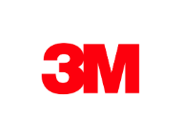
Accelerating Digital Transformation for large customers and partners

Slide 4
A simple view of an IoT solution
Things
Insights
Actions

Slide 5
A more realistic view…
Deployment
Fault tolerance
Solution scale
Data storage
Business process integration
Enterprise integration
Cold path analytics
Provisioning devices
Cost management
Operations monitoring
Device recovery
Internationalization
High availability
Updating devices
Cloud-to-device commands
Device lifecycle
Transport protocols
Warm path analytics
Drivers
Things
Disaster recovery
Insights
Actions
Hot path analytics
Device updates
Data ownership
< ---- END-TO-END SECURITY ---- >
On device analytics
Data visualization
Manufacturing scale
Industry and government compliance
HW certification
Securing data
… and why IoT needs simplifying
Device commercialization

Slide 6
Microsoft is simplifying IoT
Easier to build secure, scalable solutions from device to cloud
Easier to provision devices at scale
Easier to manage devices at scale
Easier to find insights from your IoT devices
Easier to infuse devices with intelligence
Easier to benefit from IoT

Slide 8
Easier to build secure, scalable solutions from device to cloud
Azure IoT Hub
Azure IoT Suite
Microsoft IoT Central
Windows 10 IoT Core
Secure, scalable PaaS
For connecting any device running any OS
Remote monitoring
Predictive maintenance
Connected factory
Fully managed and hosted by Microsoft
Coming soon
Supports the languages and frameworks you already know
Management
NUI
Edge compute
Security and servicing

Slide 9
IoT offers new frontiers for innovation — for the enterprise and the attacker
1
2
3
4
5
6
7
8
9
10
11
12
13
14
15
16
17
18
19
20
21
22
23
24
25
26
27
28
29
30
31
32
33
34
35
36
37
38
39
40
41
42
43
44
45
46
47
48
49
50
1
2
3
4
5
6
7
8
9
10
1
2
3
4
5
6
7
8
9
10
11
12
13
14
15
16
17
18
19
20
21
22
23
24
%
%
25
>
>
>
%
Percentage of large IoT implementations for which cloud-based security services will be essential to functioning safely by the year 2020.
Percentage of IT security budgets spent on IoT in 2020.
Percentage of cyber attacks targeting IoT in 2020.

Slide 10
IoT protection stack
Device protection
Threat resistance
Data protection in-motion
Cloud security
Response
Trusted Platform Module (TPM)
Windows Device Health Attestation*
Secure Boot
BitLocker
Windows as a Service
Device Guard
Windows Firewall
Windows Defender*
X.509/TLS-Based Handshake and Encryption
Encryption at Rest
Azure Active Directory
Key Vault
Policy-Based Access Control
IP- based blocking
Secure Device Registration
Standards-based best practices
Device Management
Device Recovery
Device-specific repudiation
*Only available on Windows IoT Enterprise

Slide 11
Azure IoT Suite
Device Connectivity & Management
Data Ingestion and Command & Control
Stream Processing & Predictive Analytics
Workflow Automation and Integration
Dashboards and Visualization
Preconfigured Solutions
Remote monitoring
Predictive maintenance
Connected factory

Slide 12
Demo
Getting started with Azure IoT Suite and Windows 10 IoT Core
Azure IoT Suite

Slide 13
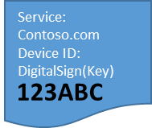
Easier to provision devices at scale
IoT Hub Device Provisioning Service
Enables IoT devices to receive provisioning
information automatically
without manual interaction
when the device
first connects
to a network.
Azure IoT Hub Device Provisioning service
Azure IoT Hub
Service: Contoso.com
HW ID:
Device ID:
DigitalSign(Key)
3
123ABC
HW with ID “123ABC”
was produced
URL, Device Name, SymKey
4
I am “DigitalSign(Key)”:
[Data] & [DM]
I am device “123ABC”
1
2
123ABC
123ABC
Manufacturer
Shipping
Customer

Slide 14
Demo
Easier to provision devices at scale
Azure IoT Device Provisioning Service
& Windows 10 IoT

Slide 15
Easier to find insights from your IoT data
Cold Path: Azure Machine Learning
Build powerful, cloud-based machine learning applications
Quickly create and deploy analytics models with ready-to-use algorithms libraries
Includes hundreds of R and Python build-in packages in addition to supporting custom code.
Hot Path: Azure Stream Analytics
Analyze real-time and on demand data to power intelligent actions
Easy to set up with SQL-like language
Connects directly to Azure IoT Hub for stream ingestion and hot path analysis
Warm Path: Azure Time Series Insights
Visualize IoT time series data in near real time
Easy to get started with no up-front data modeling required
Customize your own solution via REST query APIs

Slide 16
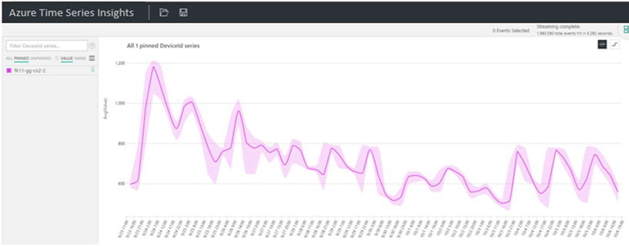
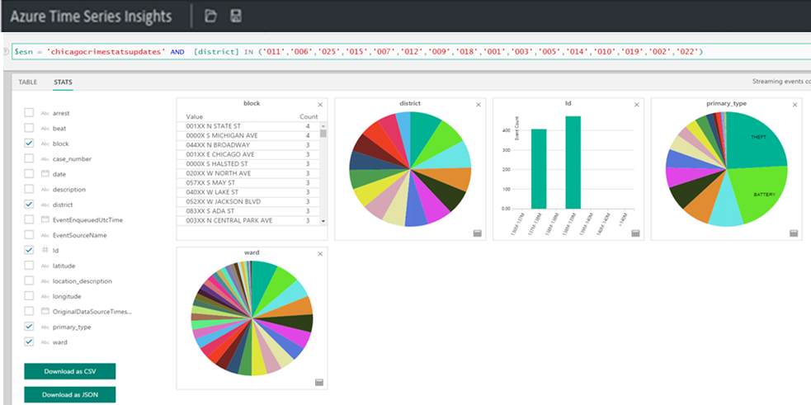
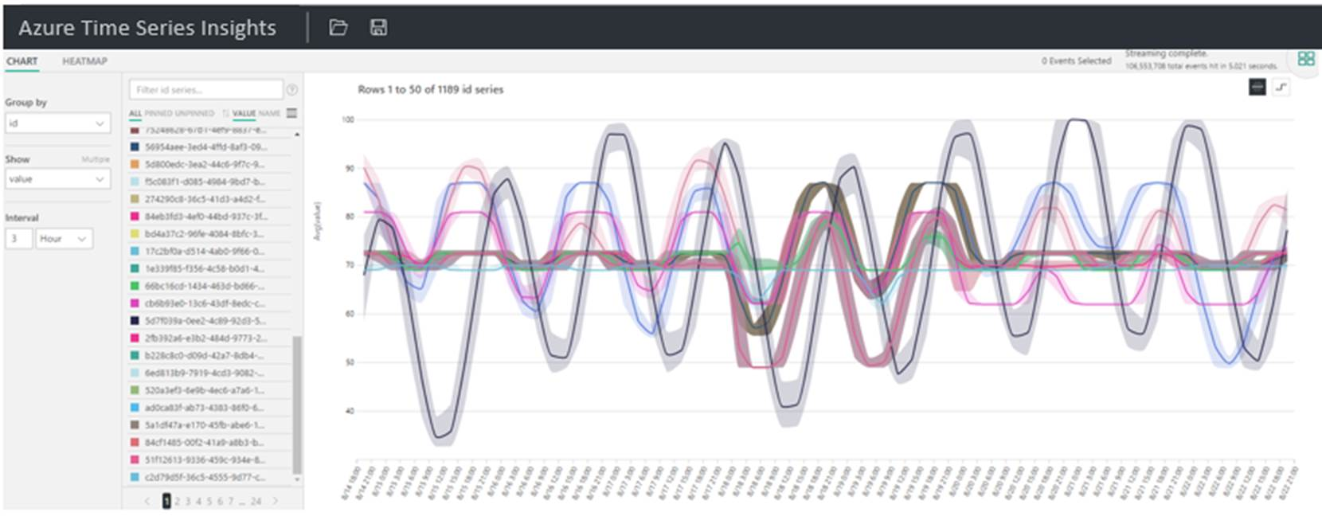
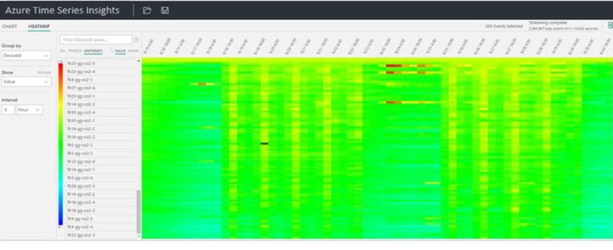
Introducing: Azure Time Series Insights

Slide 17
Demo
Easier to find insights from your IoT devices
Azure Time Series Insights

Slide 18
Easier to manage devices at scale
Replace or decommission devices after failure, upgrade cycle or service lifetime
Group devices and control access according to your organization's needs
retire
plan
monitor
provision
Monitor device inventory, health & security while providing proactive remediation of issues
Securely authenticate devices, on-board for management and provision for service
configure
Provide updates, configuration & applications to assign the purpose of each device

Slide 19
Easier to manage devices at scale
Azure IoT Hub Device Management
IoT Hub
Telemetry
Telemetry channel
IoT Device
Device Twin
Device Twin
Properties
Properties
Desired
Desired
Cloud owned, device visible
Reported
Reported
Device owned, cloud visible
Tags
Cloud only,
device metadata
Methods
Methods
Cloud initiated C2D with response
Commands
Cloud initiated C2D message

Slide 20
Easier to manage devices at scale
Azure IoT Hub Device Management
Support any OS
Windows 10 IoT Core libraries make this easy
IoT Hub
Jobs
Schedule and Broadcast Device Twin Changes
Set Desired Properties, Tags, Call Methods
Device Twin
Device Twin
Device Twin
Device Twin
Device Twin
Device Twin
Device Twin
Device Twin
Device Twin
Queries
Query Across
Device Twin State
For Business Logic, Reporting and Compliance
Device Twin
Device Twin
Device Twin
Device Twin
Device Twin
Device Twin
Device Twin
Device Twin
Device Twin
Device Twin
Device Twin

Slide 21
Demo
Easier to manage devices at scale
Azure IoT Suite Remote Monitoring + configuration service providers in Windows 10 IoT Core.

Slide 22
What if… ?

Slide 23
(╯°□°)╯︵ ┻━┻

Slide 24
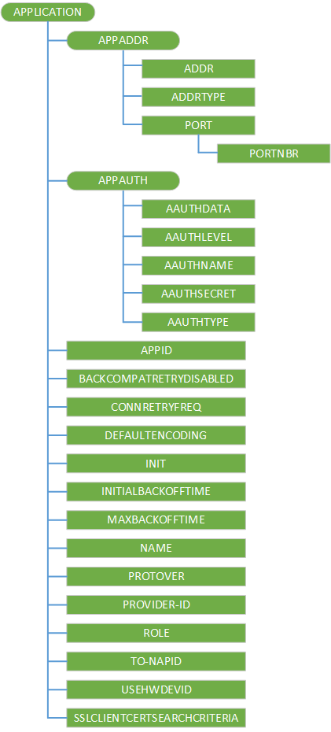
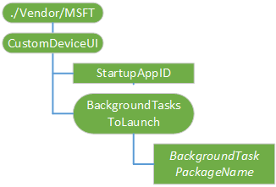
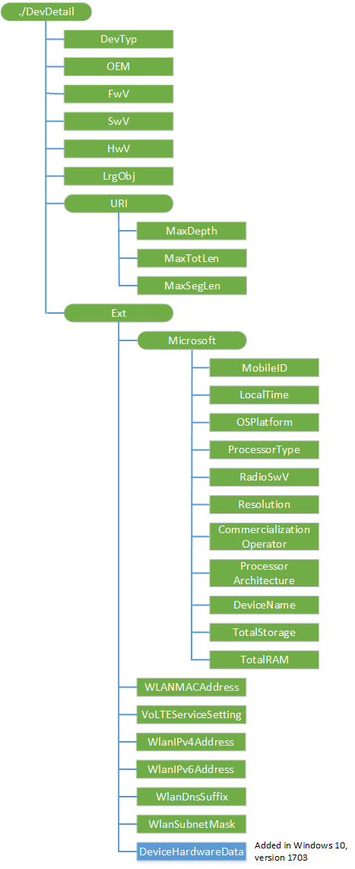
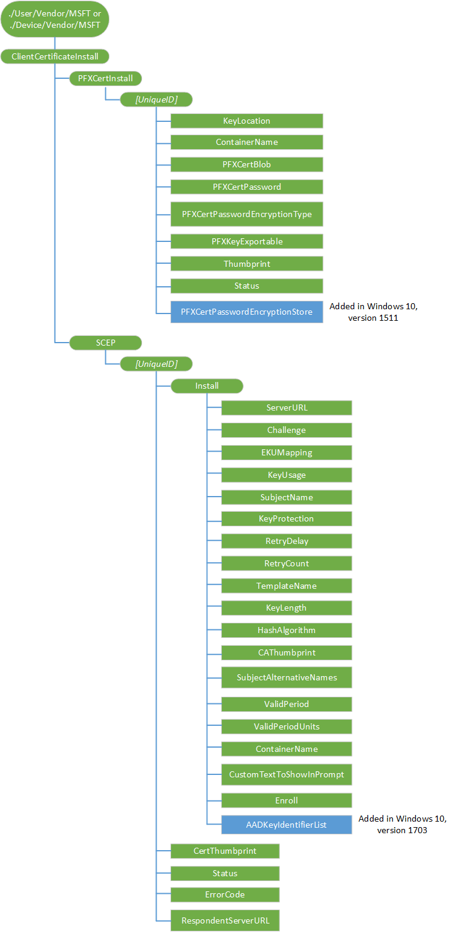
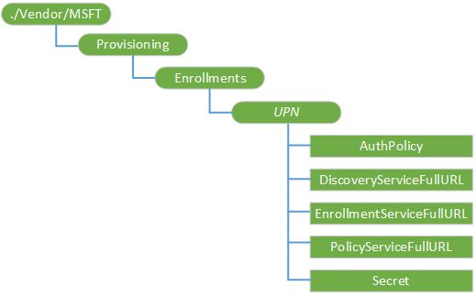
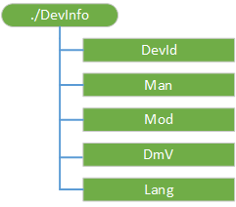
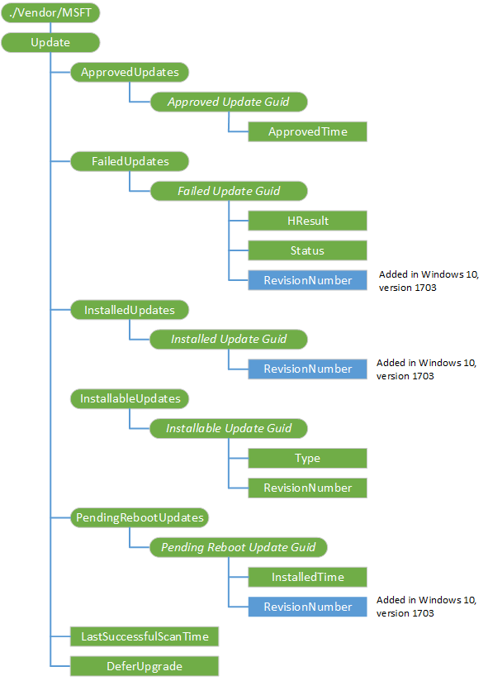
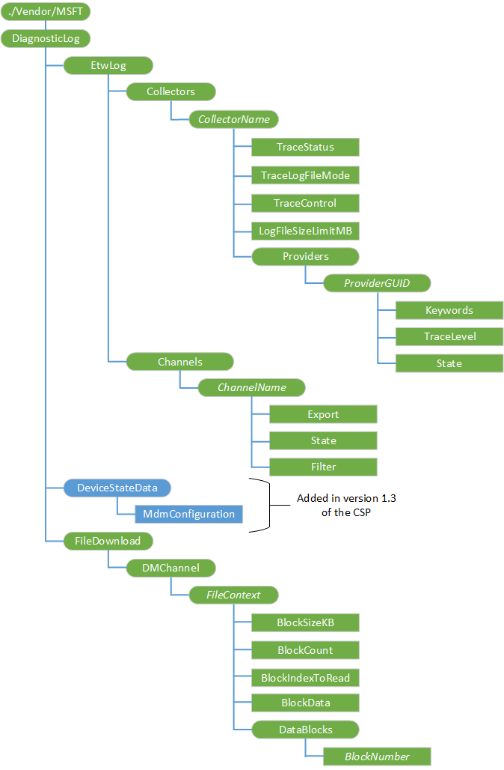
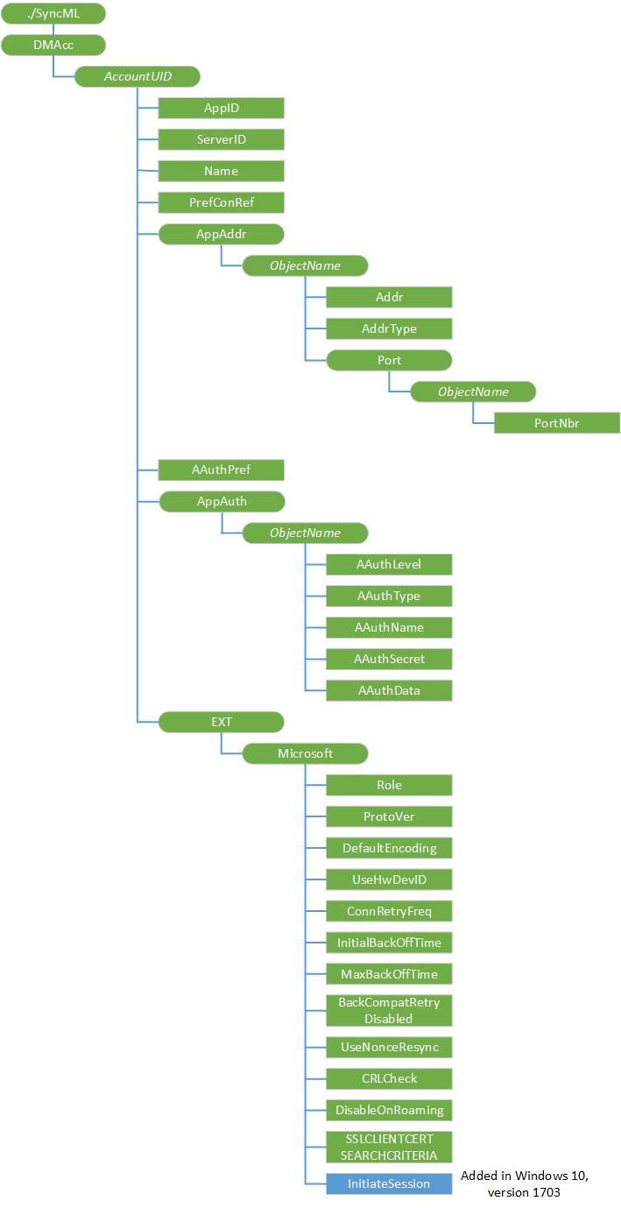
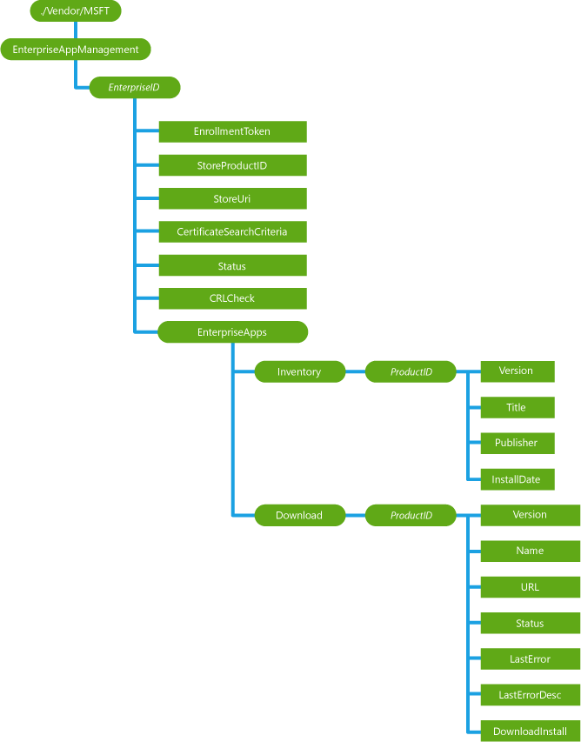
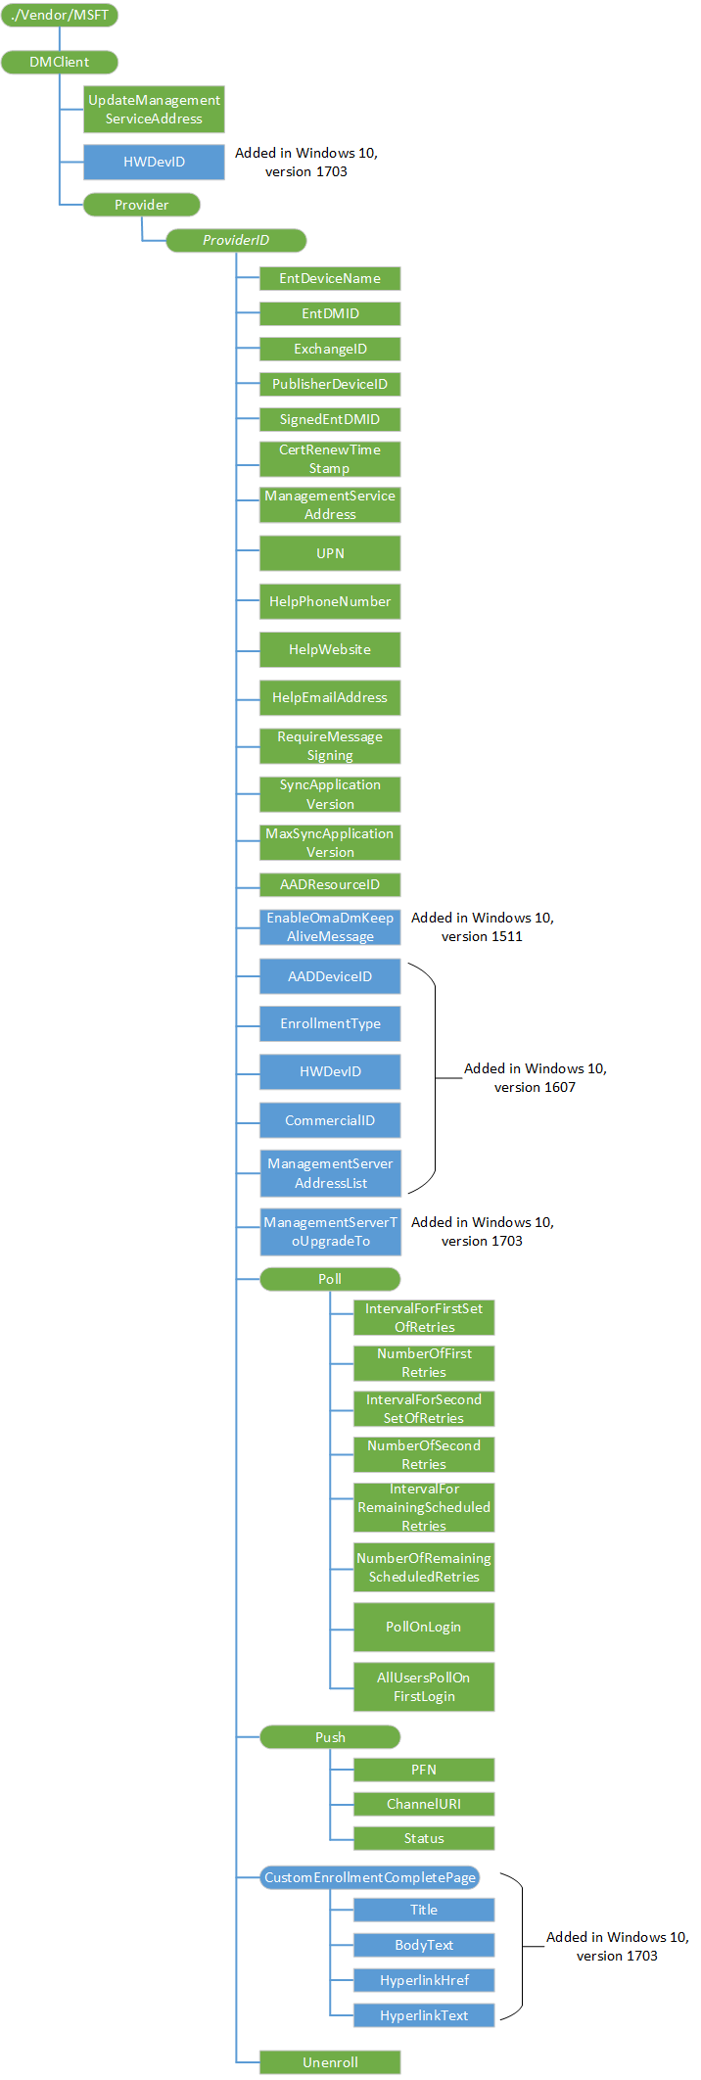
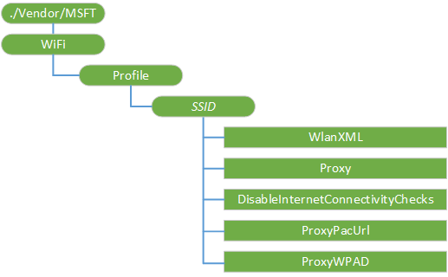
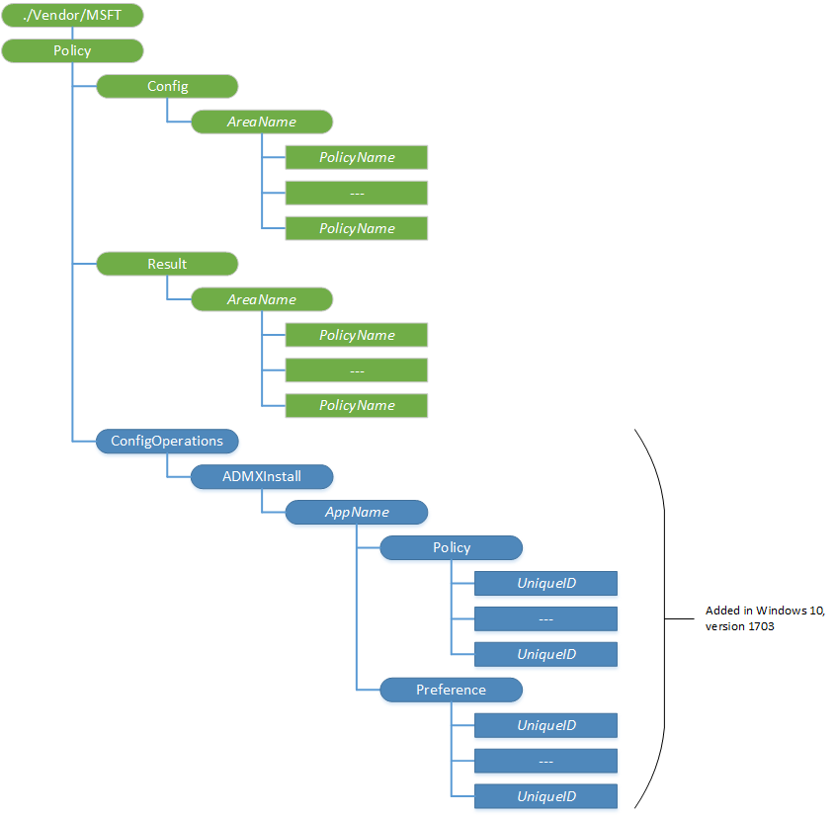
Properties
Here are some of the management properties that Windows 10 IoT Core exposes for you.
You can remain focused on your app.

Slide 25
Demo
Easier to infuse devices with intelligence
Edge computing with cloud machine learning, computer vision, and Cognitive Toolkit

Slide 26
IMAGE
PROCESSING
GAME
PLAY
GAME MODEL
TRAINING
GAME MODEL EVALUATION
INPUT
OpenCV
UWP
Cognitive Toolkit
Camera
Cognitive
Toolkit
Edge device
Azure
Web Dashboard
✊ ✋ ✌️

Slide 27
Azure IoT Recent Innovations
Security Program for Azure IoT
Azure IoT Hub Device Mgmt.
Azure IoT Hub Device Provisioning
Azure IoT Edge
Microsoft IoT Central
Matchmaking with IoT security auditors
Cross platform and fully extensible at scale
Cross platform and fully extensible at scale
Cross platform and open source
Fully managed and hosted IoT SaaS
Security Partnerships /DICE
Azure IoT Hub message routing
Azure IoT Suite connected factory
Azure Stream Analytics for Edge
Azure Time Series Insights
Secure hardware attestation for constrained devices
Simple, powerful, declarative
Pre-configured Solution for Insights from OPC installations
Complex event processing on Azure IoT Gateway SDK
Fully managed Time Series Store and UX

Slide 28
Windows 10 IoT Core Recent Innovations
Turn-key Security
Azure IoT Hub Device Mgmt.
Azure IoT Hub Device Provisioning
Azure IoT Edge
Productization Resources
Device Guard for IoT, Bitlocker, & Secure Boot
Integrated support and fully extensible at scale
Integrated support and fully extensible at scale
Integrated and open source
Mfg Guide, Recovery solution, Packaging tools
Project “Rome”
Cortana
New Controls & Embedded Features
App Servicing via Store
New Platforms & SoCs
Remote device communication
Now available
Modern Connected Standby, on-SoC PWM, NFC, and more
Service your apps with Microsoft Store
Intel Joule, Intel Apollo Lake, & RPi3 SOMs

Slide 29
Call to action
Visit the IoT exhibits in the Expert Zone
Try out device management with Windows IoT & Azure IoT
Experiment with NUI, OpenCV, and Cognitive Services on Windows IoT Core
Visit www.internetofyourthings.com and www.windowsondevices.com to learn more about Windows and Azure IoT
Build great things with Windows 10 IoT and Azure IoT Suite

Slide 30
Related IoT //Build Sessions
B8085 | The road to commercialization for your Windows IoT solution | Jason Farmer
T1E6B | How to build global-scale IoT applications with Microsoft Azure SQL Database | Rohan Kumar
T44E8 | Configure, control, and manage IoT devices from the cloud | Ernesto Cantone; Juan Perez; Nicole Berdy
TEF2A | Enabling intelligence at the edge with Azure IoT Edge | Arjmand Samuel; Briton Zurcher; Sam George
T0A5B | How to build IoT analytics in the real world | Santosh Balasubramanian; Shweta Gupta
TF434 | How to serve AI with data: The future of the data platform | Joseph Sirosh
P4047 | IoT Studio: Development of apps that can control OCF devices | Luiz Felipe Lage Campos Tenaglia; Srikrishna Gurugubelli
B8025 | Cross-device and cross-platform experiences with Project Rome and Microsoft Graph | Vikas Bhatia; Carmen Forsmann

Slide 31
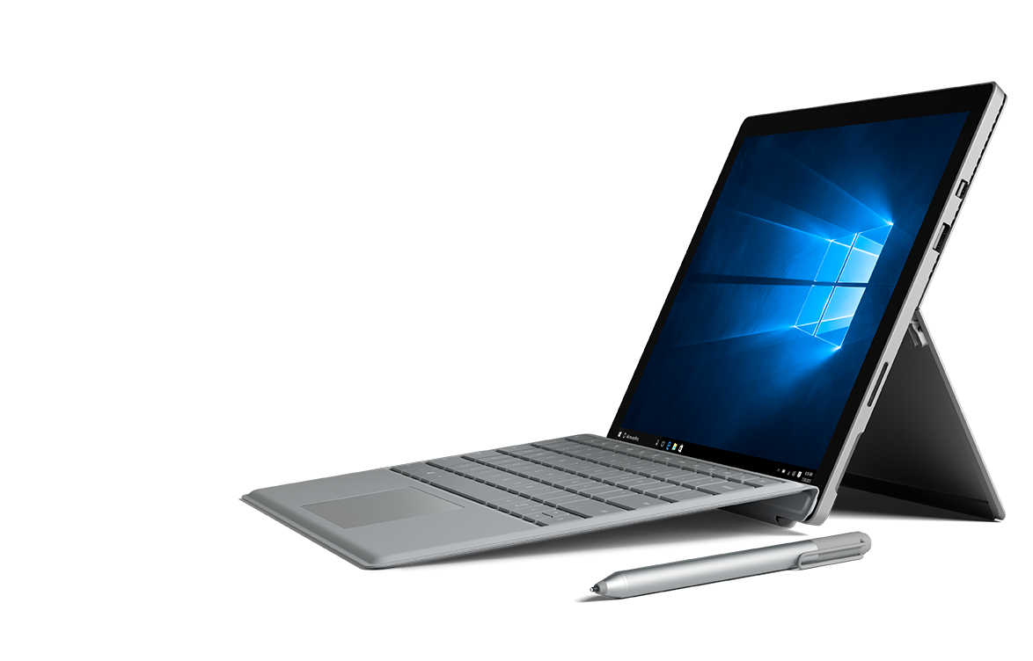
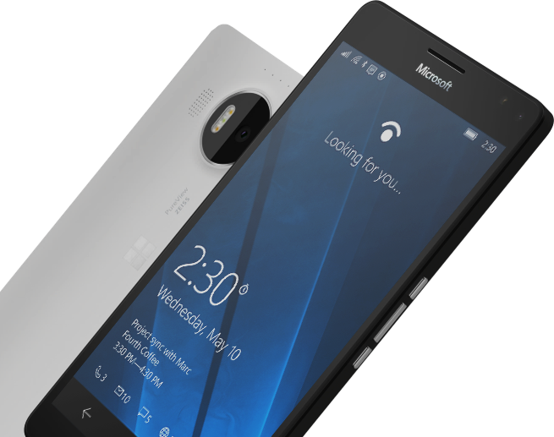
Please complete an Evaluation Form for every session you attend.
Your input is important!
#MSBuild

