Slide 2
Bot capabilities, patterns and principles
B8010
Mat Velloso @matvelloso
Ryan Volum @notabotryan
We are devs

Slide 3
What we will cover
New documentation
General architecture of bots
Using dialogs
Best practices and lessons learned
Knowledge Base bots
Backchannel in bots
Handoff to human
Authentication and web flows
“App” Bots
Proactive Messages
Global Handlers
Analytics
#MSBuild

Slide 4
Behold! The new docs: https://docs.microsoft.com/en-us/bot-framework/ Better details, based on real feedback and actual projects built with our partners

Slide 5
An x-ray of a typical bot
Conversation Canvas/Channels
Your bot code goes here
Web Chat
Bot Connector Service
Email
Message input <> output
State Management
Facebook
Bot web service
GroupMe
Your bot code
Bot Builder SDK
Kik
Skype
Bot Builder SDK
API, SDK calls
Slack
+ Microsoft Cognitive Services
Telegram
Other services, APIs,
Databases, Azure Machine Learning, Azure Search, etc…
Natural Language
Translation
Vision/Face
Emotion
Twilio (SMS)
…
Direct Line…
Speech
Entity Extraction
Search
Knowledge API
…
…
…

Slide 6
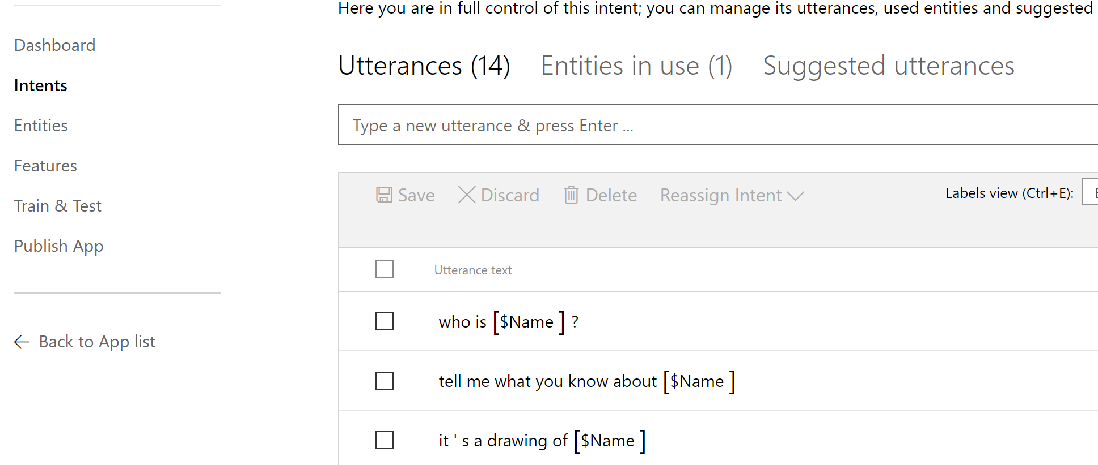
LUIS and Bots
Language Understanding Intelligence Service
Trains utterances (examples) into a REST API
Maps utterances to intents (verbs) and extracts entities

Slide 7
Dialogs are for bots like screens are for apps
They separate concerns and organize flows, exactly the same way:
Traditional Application
Bot
Main Screen
Root Dialog
New Order Screen
Product Search Screen
New Order Dialog
Product Search Dialog

Slide 8
Dialogs are serialized into stacks
This is how we know how to navigate “back”
(Users won’t necessarily think that way)
So careful with too much “modality”: Things can get complex quickly
Read more
Root Dialog
Dialog 1
Dialog 2
…

Slide 9
Best Practices

Slide 10
Anti-pattern: Overuse of NLP
A bot with a single dialog using 100 LUIS intents is a bad design:
1 question
100 different things your bot can do (intents)
100 different utterances (examples) per intent
= 10,000 different things users may say (plus the other N possibilities you didn’t predict)
Users will only guess 3 or so things from 100
So you might have wasted 97% of your code
Hello user! How can I help you?

Slide 11
Pattern: Menu breakdown
So instead:
Hello user! How can I help you?
What events are you interested in?
What music would you like? (by the way, next time you could just type “I’m looking for a song named xyz” and I will know what to do)
Events
Music
Stages
Comedy
Amenities
Film
Laser Dome
Spectacles
Theater
Guide the user
Channels often offer specialized menus, quick actions, etc.
Help the user discover what your bot can do
Read more

Slide 12
Anti-pattern: Canvas/input mismatch

Slide 13
Anti-pattern: Canvas/input mismatch

Slide 14
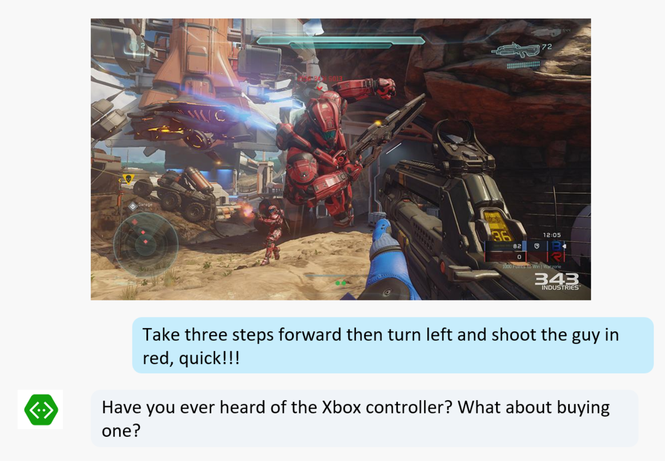
Anti-pattern: Canvas/input mismatch

Slide 15
Anti-pattern: Canvas/input mismatch
The world is made of images, movement, sounds, text, symbols, objects… Isolate one and it becomes “unnatural” very quickly.
Again: Focus on the actual user experience. If it feels like it doesn’t make sense, then it probably doesn’t
Read more

Slide 16
Pattern: Knowledge Base Bots
Bots that can reason over a corpus of data to find and return a piece of information
Event bots, Help Desk bots, Contact bots, etc
Read more
#MSBuild

Slide 17
Pattern: Knowledge Base Bots
Fuzzy Searching
Faceting/Filtering to guide a conversation
Generating search queries from natural language
#MSBuild

Slide 18
Azure Search + Bumberbot
Ryan Volum

Slide 19
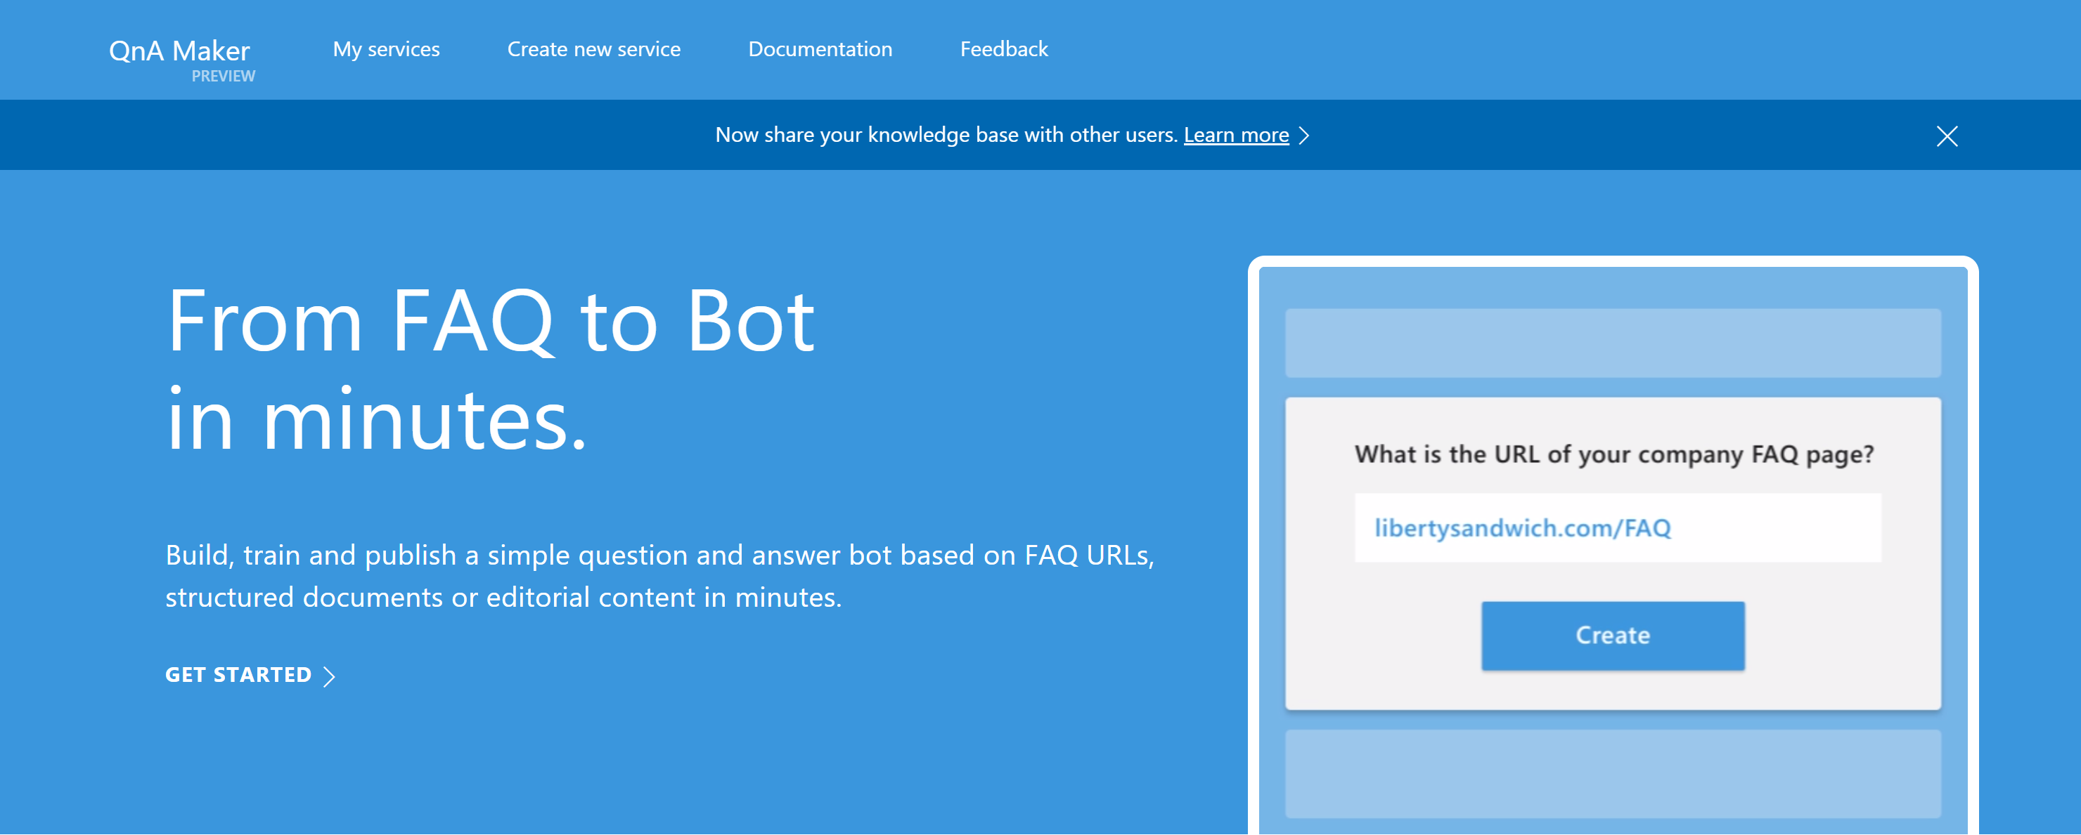
Knowledge Base Bots and QnA Maker
#MSBuild

Slide 20
Knowledge Base Bots and Bing Knowledge Graph
#MSBuild

Slide 21
Knowledge Base Bots
Read more: https://docs.microsoft.com/en-us/bot-framework/bot-design-pattern-knowledge-base
#MSBuild

Slide 22
Pattern: Handoff to Human
Every company deals with this:
First triage/data collection
Simple and repetitive solutions
Customer call
Complex cases and escalation

Slide 23
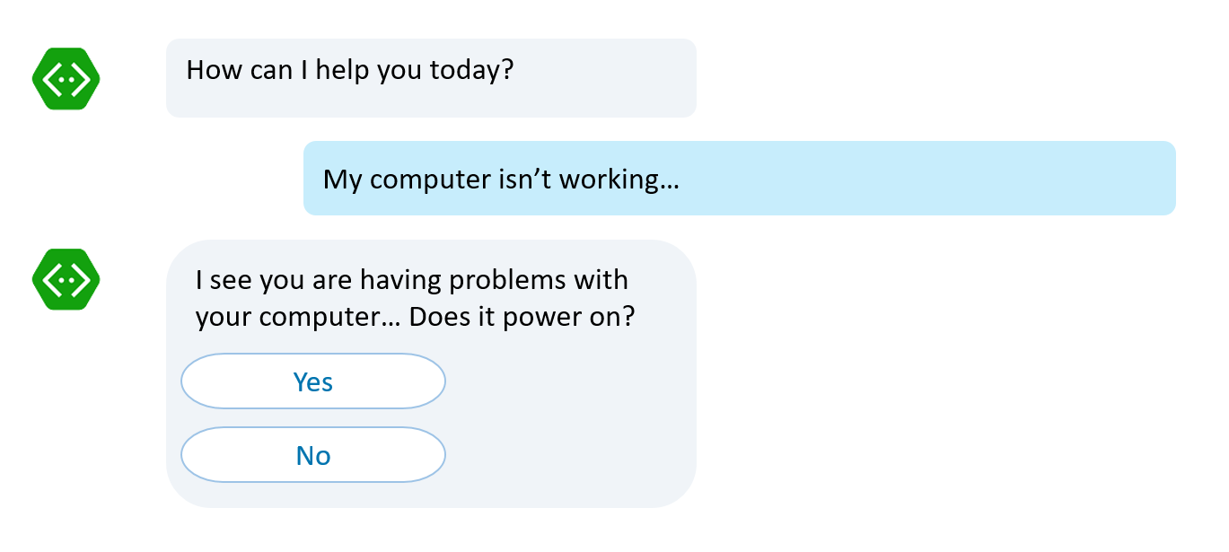
Pattern: Handoff to Human
First triage/data collection
Simple and repetitive solutions
Customer call
No waiting in line to be helped Bots handle it
Complex cases and escalation

Slide 24
Pattern: Handoff to Human
If it is simple and repetitive, it can be coded. Bots can accelerate it
First triage/data collection
Simple and repetitive solutions
Customer call
Complex cases and escalation

Slide 25
Pattern: Handoff to Human
Bot to human hand off: Complete or supervised
Complex cases and escalation

Slide 26
Pattern: Handoff to Human
Complete bot to human hand off
Thank you for providing all this information. I have John with me now who will take from here and help you out
Hello, this is John. I understand your computer won’t power on. Let’s take a look at some service options

Slide 27
Pattern: Handoff to Human
Supervised bot to human hand off
I’ve tried these steps, my computer still won’t turn on
Note to operator: It sounds like the user will need hardware replacement, what next step should I take?
Apologize to user
Suggest hardware service
Let me type
I suggest us to request a hardware service. We can have one of our service engineers look at your computer
Sounds lovely, thank you

Slide 28
Pattern: Handoff to Human
Read more: https://docs.microsoft.com/en-us/bot-framework/bot-design-pattern-handoff-human

Slide 29
Pattern: Backchannel
Backchannel is the practice of using maintaining a real-time online conversation alongside the primary group activity or live spoken remarks
#MSBuild

Slide 30
Pattern: Backchannel in websites/apps
Communicate clickstream/user behaviors to bot
Have bot communicate changes to be made to the host
Pass auth tokens back and forth
#MSBuild

Slide 31
Backchannel in a Website
Ryan Volum

Slide 32
Pattern: Backchannel in Devices and Robots
Communicate visual context
Communicate sensor data
Heart rate, speed, etc.
#MSBuild

Slide 33
Pattern: Backchannel
Read more: https://docs.microsoft.com/en-us/bot-framework/bot-design-pattern-embed-web-site
Node: https://docs.microsoft.com/en-us/bot-framework/nodejs/bot-builder-nodejs-backchannel
#MSBuild

Slide 34
Pattern: Bot to Web
Web flows start from the bot, continue on a web interface and then back to the bot. Custom auth is a typical case.
Read more
Bot
Web browser
#2 User click/
Browser launched
#1 Dialog
#4 Website flow
<Hyperlink>
#3 Bot enters a waiting state until it receives a signal from web site
#7 magic number validation
#5 “magic number”
#6 website signals the bot
with completion of the flow
#MSBuild

Slide 35
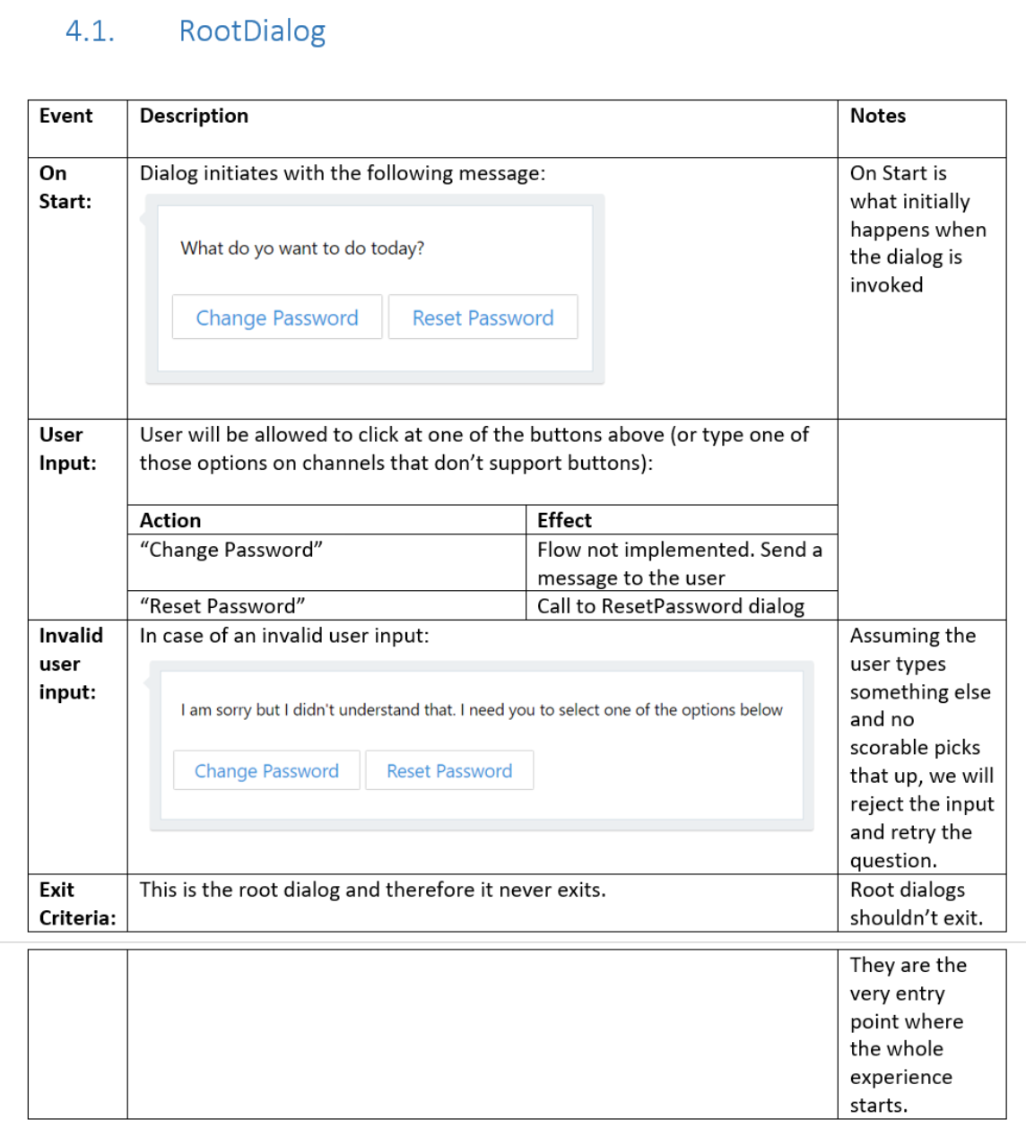
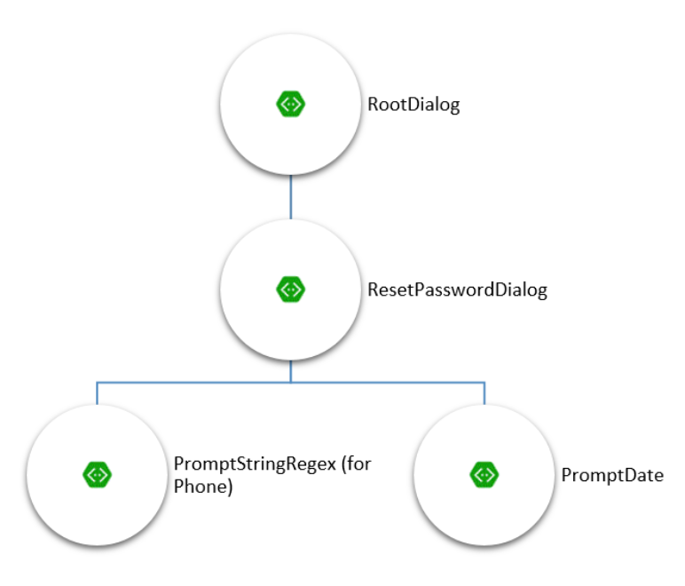
Pattern: “App” bots
Some bots are pretty much just apps, with some rich UI and little to no conversation
Read more

Slide 36
Azure Bot
Mat Velloso

Slide 37
Pattern: Proactive Messages
Typically bots react (respond) to messages.
In some cases, they need to proactively send a message (e.g. a reminder or some async activity that triggers a notification).
Bot needs to keep track of user addresses trigger when to send out new messages
#MSBuild

Slide 38
Pattern: Proactive Messages - Node
var bot = new builder.UniversalBot(connector);
function sendProactiveMessage(address) {
var msg = new builder.Message().address(address);
msg.text('Hello, this is a notification');
msg.textLocale('en-US');
bot.send(msg);
}

Slide 39
Pattern: Proactive Messages
Read more (C#): https://docs.microsoft.com/en-us/bot-framework/dotnet/bot-builder-dotnet-proactive-messages
Read more (Node): https://docs.microsoft.com/en-us/bot-framework/nodejs/bot-builder-nodejs-proactive-messages
#MSBuild

Slide 40
Pattern: Global Handlers
People don’t communicate in “stacks”: They change topics all the time
Handling modality can be very difficult
Example: At any point, the user can say “Help?”
Read more (.Net) : https://docs.microsoft.com/en-us/bot-framework/dotnet/bot-builder-dotnet-global-handlers
Read more (Node): https://docs.microsoft.com/en-us/bot-framework/nodejs/bot-builder-nodejs-global-handlers
#MSBuild

Slide 41
Analytics
You can only manage what you can measure
Your bot can only learn from the data you collect
Tools: App Insights, Power BI, Azure Storage, SQL, Azure Machine Learning… (hint: everything you have already been using in cloud apps)
#MSBuild

Slide 42
Robots and bots
Mat Velloso

Slide 43
Call to action
Come watch our code theater story on the Zenbo prototype at 3:30pm
Visit botframework.com and try building a bot!
Check the new developer documentation: https://docs.microsoft.com/en-us/bot-framework/
#MSBuild

Slide 44
Related sessions
B8903 - Open Q&A: Artificial intelligence tools for developers
B8092 - Using Microsoft Cognitive Services to bring the power of speech recognition to your apps
B8020 - Computer vision made easy: From pre-trained models to custom ones, Microsoft Cognitive Services has you covered
B8090 - How Microsoft Cognitive Services can help your apps communicate with people
B8097 - Preview Microsoft Azure Bot Service v2
#MSBuild

