Slide 2
Three Runtimes, one standard… .NET Standard: All in Visual Studio 2017
B8001
Scott Hunter – @coolcsh
Scott Hanselman – @shansleman
Kasey Uhlenhuth – @kuhlenhuth

Slide 3






Open source momentum
Community PRs by month
“Samsung is embracing .NET because it is
a completely open source project.”
"ASP.NET is open source, that allows us
to contribute back to it if we have any performance issues which Microsoft review and together we make a better product.“
— Illyriad Games

Slide 4

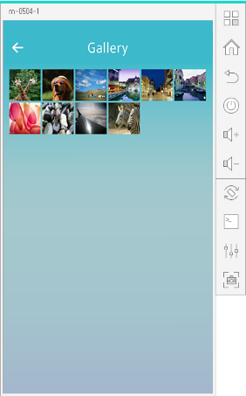
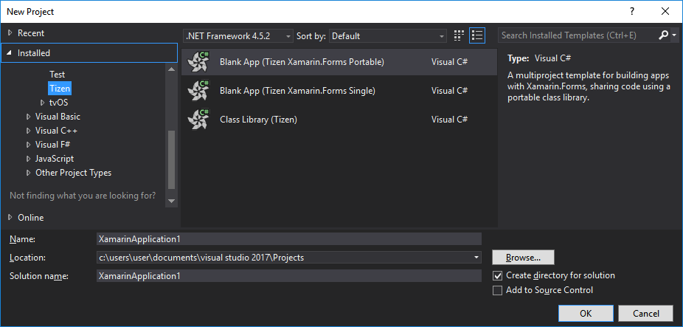
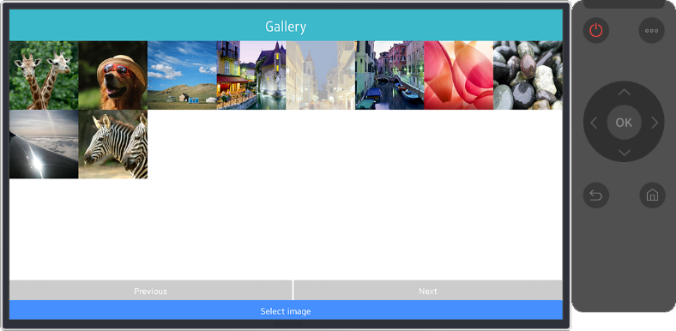
.NET Core Support on Tizen
Build Tizen apps for mobile devices and TVs with .NET Core and Xamarin.Forms
Preview #1
Preview #2
Preview #3
Preview #4
Official Release
Mobile
Nov 2016
Mobile/TV
Jan 2017
Mobile/TV
Mar 2017
Mobile/TV
June 2017
Mobile/TV
End of 2017
Visual Studio Tools for Tizen
  Supports everything you need to
  develop Tizen apps with .NET
  https://developer.tizen.org/development/tizen-.net-preview/

Slide 5
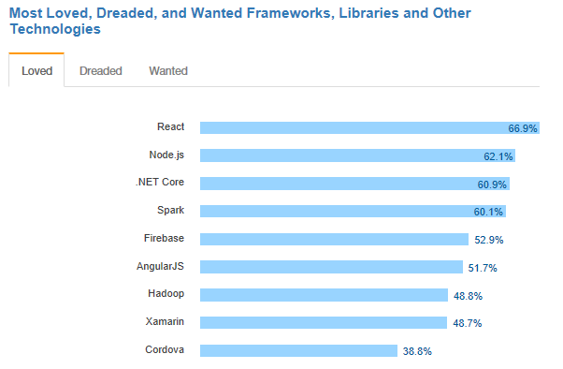
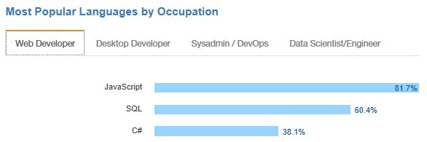
.NET is active and growing
.NET Core debuts at #3 most loved Framework on Stack Overflow Technology Survey 2017
C# is #3 most popular language for desktop and web developers on Stack Overflow Technology Survey 2017
Source: http://stackoverflow.com/insights/survey/2017

Slide 6
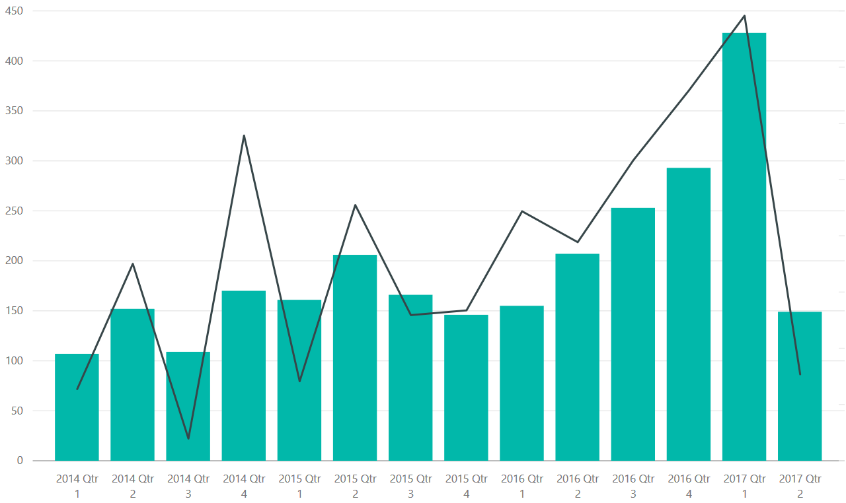
Customers and the community are talking about .NET
Hacker News appearances of .NET or
Visual Studio products (bars are count of articles,
line is total votes)
“Using the same-size server, we were able to go from 1,000 requests per second per node with Node.js to 20,000 requests
per second with .NET Core.“
— Raygun
“Developers can reuse their C# skills to build native Android,
iOS, and Windows applications that deliver the right information to the right person at the right time.“
— Alaska Airlines
“We believe .NET elegantly handles the trade-off between developer productivity and application performance.“
— National Instruments
“The Microsoft technology made it easy for us. It just works.
We saved months of development time in the process.“
— Stackoverflow.com

Slide 7
Building your .NET

Slide 8

“I want Guidance.”

Slide 9
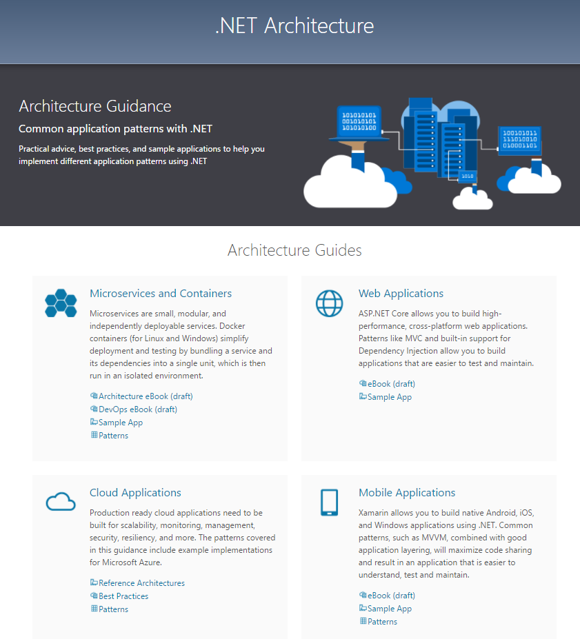

Slide 10
.NET Architecture
Available now at: https://dot.net/architecture
eBooks & samples: Web, Containers, mobile
Patterns: Health checks, queueing
More books and patterns coming…

Slide 11

Announcing .NET Conf 2017
September 19–21
Immerse yourself in the world of .NET
Join us for 3 days of free online content, brought to you by the .NET community and Microsoft product teams
For more information: http://www.dotnetconf.net

Slide 12
“I want to share .NET code across all the .NET flavors.”

Slide 13
.NET Standard library
One library to rule them all
  Learn one API across ALL .NET platforms
  Reuse your code across ALL .NET platforms
  Easily consume third-party/OSS libraries across ALL .NET platforms
.NET Standard 1.x
  Evolution of Portable Class Libraries (PCLs) with a much simpler model
  Two constraints:
    API surface relatively small, because .NET Core was small
    Can’t reference the vast number of libraries already available for .NET Framework

Slide 14


.NET Standard
WINDOWS
DESKTOP
CLOUD MICROSERVICES
WINDOWS
UWP
IOS,
ANDROID
GAMES/
3D
Visual Studio
.NET STANDARD
Visual Studio for Mac
INFRASTRUCTURE
COMPILERS
LANGUAGES
RUNTIME COMPONENTS
Visual Studio Code
.NET Standard allows sharing code, binaries, and skills between .NET client,
server, and all flavors
.NET Standard provides a specification for any platform to implement
All .NET runtimes provided by Microsoft implement the standard

Slide 15
Nothing changes
MY
.NET FRAMEWORK
APP
MY
.NET CORE
APP
MY
XAMARIN
APP
MY STANDARD LIBRARY
EXISTING
.NET STANDARD LIBRARY
EXISTING
PORTABLE CLASS LIBRARY
EXISTING
.NET FRAMEWORK LIBRARY

Slide 16
How does .NET Standard work?
.NET Standard is represented by:
  The NuGet package NetStandard.Library which contains
  The reference assembly netstandard.dll
At build time
  .NET Standard bridges references to existing .NET Framework and PCL
  assemblies via type forwarding
At runtime
  Each platform provides an implementation for netstandard.dll that type
  forwards to its implementation

Slide 17
Demo: .NET Standard

Slide 18
Announcing .NET Standard 2.0 (Preview)
Has much bigger API surface
  Extended to cover intersection between .NET Framework and Xamarin
  Also makes .NET Core 2.0 bigger as it implements .NET Standard 2.0
+20K
More APIs than
.NET Standard 1.x
Can reference .NET Framework libraries
  Compatibility shim allows referencing existing .NET Framework binaries
  No recompile required – also covers existing NuGet packages
  Limited to libraries that only use APIs that are available for .NET Standard
~70%
of NuGet packages
are API compatible

Slide 19
APIs in .NET Standard 2.0
XML
XLinq • XML Document • XPath • Schema • XSL
SERIALIZATION
BinaryFormatter • Data Contract • XML
NETWORKING
Sockets • HTTP • Mail • WebSockets
IO
Files • Compression • MMF
THREADING
Threads • Thread Pool • Tasks
CORE
Primitives • Collections • Reflection • Interop • Linq

Slide 20
“I want to use existing code with .NET Core.”
“I want to reference .NET Core like .NET Framework.”
“.NET Core versioning is complicated.”

Slide 21
Announcing .NET Core 2.0
Preview available today

Slide 22
.NET Core 2.0
.NET Standard 2.0
Reference Framework as single package
Simplified packaging
  ASP.NET Core and Entity Framework Core included
ASP.NET Core 2
  Automatic diagnostics
  Razor Pages
Entity Framework Core 2

Slide 23
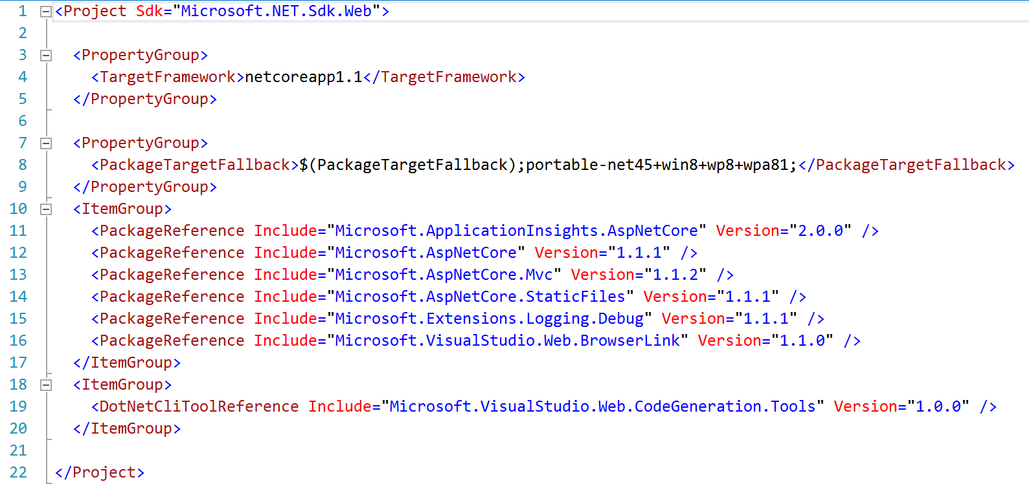
Example: .NET Core 1.0 references

Slide 24
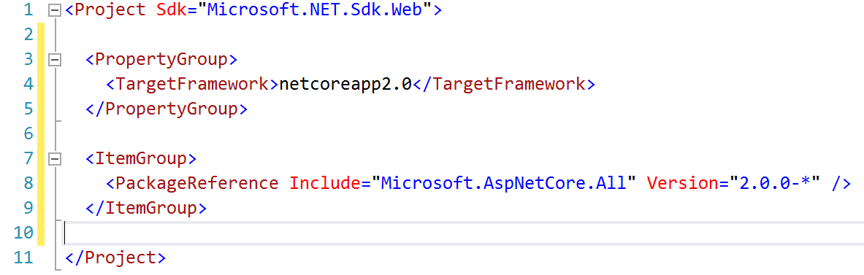
Example: .NET Core 2.0 references

Slide 25
Demo: .NET Core and API’s

Slide 26
“I would like more refactoring features
built in.”
“I want Live Unit Testing for .NET Core.”

Slide 27
Visual Studio 2017 – RTM March 7
Improved performance, new install experience
Faster navigation
Code style configuration and enforcement
Live Unit Testing
IntelliSense improvements
New exception helper
More refactorings and quick fixes
C# 7.0

Slide 28
Coming in Visual Studio 2017 Update 3
Additional polish to navigation and IntelliSense
.NET Core support for Live Unit Testing
Code style enforcement on builds
More live diagnostics on API design, security, etc.
Even more refactorings and quick fixes
C# 7.1

Slide 29
Demo: .NET Tooling

Slide 30
“I want full .NET Core Tooling on the Mac.”
“I want to round trip projects between
all VS’s.”

Slide 31
Announcing Visual Studio for Mac
RTM Today

Slide 32
.NET Core and Visual Studio for Mac
Provide the SAME experience across Windows and Mac
Sharing components with Visual Studio
  .NET Core Project Templates
  HTML, CSS, JSON editors
  Backend debugger
  Azure Publish infrastructure
Future
  Javascript, Razor editors

Slide 33
.NET Core and Visual Studio for Mac
Full .NET Core Tooling including round tripping
between Windows and Mac
  Docker Containers with debugging
  Publish to App Service
  Publish to App Service Containers
  Azure Functions

Slide 34
Demo: Visual Studio for Mac

Slide 35
“I want easy diagnostics and monitoring
in Azure.”
“I want great Tooling for serverless code
in Azure.”

Slide 36
Azure diagnostics
Should be simple
  No modifications to your app
  No republishing of your app
From the Portal
  Enable/Disable analytics and diagnostics
  See common crashes and performance problems including seeing code
From Visual Studio
  See analytics data from portal in real time
  Use “snap points” to debug a running application

Slide 37
Demo: Azure diagnostics

Slide 38
Azure Functions
.NET is great for event driven serverless computing
  Scale without constraints
  Pay for only the resources your application uses
Now based on .NET class libraries
  IntelliSense, project to project references, unit testing, code analysis, third-party extensions,
  and more just work
  Supports .NET Framework and .NET Core
Publish from Visual Studio to Azure
Local and remote debugging

Slide 39
Demo: Azure Functions

Slide 40
What we are thinking about next
Performance and size improvements
  Faster inner loop
  Small standalone apps
  Native
Tooling and libraries
  UI
  Global tools (“aka npm install –g”)
  Machine learning and artificial intelligence
Platforms
  Linux diagnostics
  IOT/ARM32

Slide 41
Resources
Try out new bits today
  .NET Core 2 SDK
  https://www.microsoft.com/net/core/preview
  VS 2017 Update 3 Preview
  https://www.visualstudio.com/vs/preview/
  .NET Architecture
  https://www.microsoft.com/net/architecture
  Editor Productivity & Refactoring Cheat Sheet
  https://www.visualstudio.com/vs/net-productivity/

Slide 42
Other .NET talks
Introducing ASP.NET Core 2.0
Modern front-end web development in Visual Studio 2017
Entity Framework Core 2.0
The future of C#
SignalR .NET Core: Realtime cross platform open web communication
Open Q&A: .NET panel

