Slide 2
Introduction to Logic Apps
Kevin Lam
Principal Program Manager

Slide 3

Agenda
Modernization of Integration
API Connections
Logic app concepts
Management
Demo

Slide 4
Democratize
Integration
Vision
iPaaS
Leader
Rich
Ecosystem

Slide 5
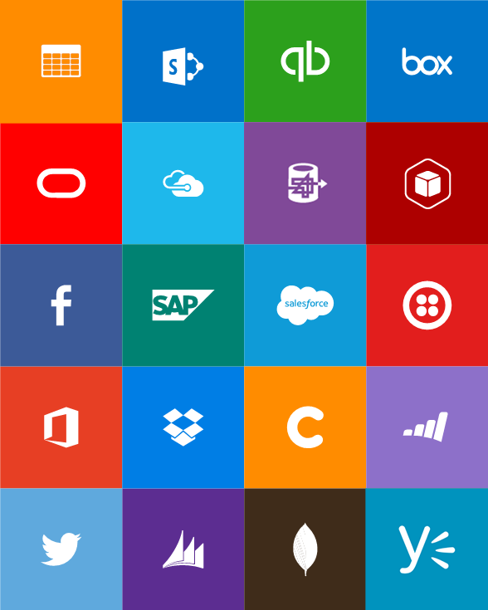
Connect and automate common tasks with Logic Apps
Use simple, intuitive tools
Create crucial, reliable tasks without coding
Integrate your mobile and web-based apps
Connect existing apps to SaaS services
BizTalk APIs for expert integration scenarios

Slide 6
API Connections

Slide 7

Easily use cloud or custom APIs:
  Dozens of built-in APIs for popular SaaS
  An ecosystem of APIs for any need
  Create and publish custom, reusable APIs
  Easily connect to existing APIs in the cloud
  Visual Studio tooling with one click publish and remote debugging
Api’s
Create, consume and
host APIs more easily

Slide 8
Connecting to APIs
Managed APIs
  OOB APIs hosted by Logic Apps
  Serviced by the product team
  First class designer experience
  Rapid development
Custom and External APIs
  First class designer experience using Swagger
    Auto discovery of Azure hosted APIs
    Declaratively reference an External API
  Raw HTTP request for all other API
API Connections
  Authenticate once and re-use
  Differentiate connection configuration
  Simple to deploy

Slide 9
Built-in API Connectors
SaaS
Hybrid
Box
Chatter
Dropbox
Azure HD Insight
Slack
Azure Media Services
OneDrive
SharePoint
SQL Azure
Office 365
QuickBooks
SalesForce
Sugar CRM
Dynamics CRM
Azure Service Bus
Azure Storage
Timer / Recurrence
Twilio
Twitter
Azure Web Jobs
Yammer
IBM DB2
Informix
Websphere MQ
SQL Server
SharePoint Server
Oracle
SAP
Hybrid Connectivity
BizTalk Messaging & B2B
Protocols
Batching / Debatching
Validate
Extract (XPath)
Transform (+Mapper)
Convert (XML-JSON)
Convert (XML-FF)
X12
EDIFACT
AS2
TPM
Rules Engine
Flat file
HTTP, HTTPS
FTP, SFTP
POP3/IMAP
SMTP
File
Delay

Slide 10
Workflow Definition Language

Slide 11
Logic Apps Workflow definition concepts
{
"parameters": {
...
},
"triggers": {
...
},
"actions": {
...
},
"outputs": {
...
}
}

Slide 12
Parameters
Re-using values, or even complex objects, throughout the definition, which makes it easier to comprehend.
Separate out config from the definition itself, making sharing easy, as well as across different environments.
DEV WORKFLOW
PROD WORKFLOW
Parameters
Provides DEV configuration
Endpoint: “http://int.mysite.net”
Definition
Declares parameters
Uri:
@parameters (‘endpoint’)
Parameters
Provides PROD configuration
Endpoint: “http://mysite.net”
Definition
(identical)
Declares parameters
Uri:
@parameters (‘endpoint’)

Slide 13
Triggering a Logic app “Run”
Recurring schedule – “every X hours”
Polling an API for a response
A 200 response means “run” – a 202 response means “wait”
Can use trigger state to get information on the previous execution
Manual Webhook
Every workflow has an endpoint you can POST to using a SAS URL
Webhook subscription
Subscribe to a web services webhook
On Demand
User can click the “Run Now” button in the portal

Slide 14
Actions can…
Call out
  API Apps, Direct HTTP endpoints, Other Workflows, send a response
Honor asynchronous pattern
  Continues on 202 status code
  Follows location header
  Waits for retry after interval
Wait for events
  Wait for a period of time
  Wait for a Webhook to be called
Have conditions and looping
  Conditions determine whether the action should execute
  For each executes an action for each item in a collection
  Do-while will continually execute an action until a condition is met
Have custom retry policy
  By default retries 4 times separated by 20 seconds

Slide 15
Control flow
Response
For Each
Split On
Do Until
Conditions

Slide 16
Management

Slide 17
Debugging and History
Trigger history shows polling results
Run history shows details for each logic app run
  Run statistics
  Action execution log
    All of the inputs to the action
    All of the outputs from the action
    Status and errors
Azure

Slide 18
Demo: Create a new API as a Logic App
Kevin Lam

Slide 19
Call to Action
Blog: https://blogs.msdn.microsoft.com/logicapps/
Webcast: http://aka.ms/logicappslive
Twitter: @logicappsio
Re-visit Build on Channel 9.
Continue your education at
Microsoft Virtual Academy online.

