Slide 2
Overview of the Azure IOT and Mobile Sample Application (MyDriving) shown in the ScottGu Keynote
T673
Harikrishna Menon
Senior Program Manager, Visual Studio

Slide 3
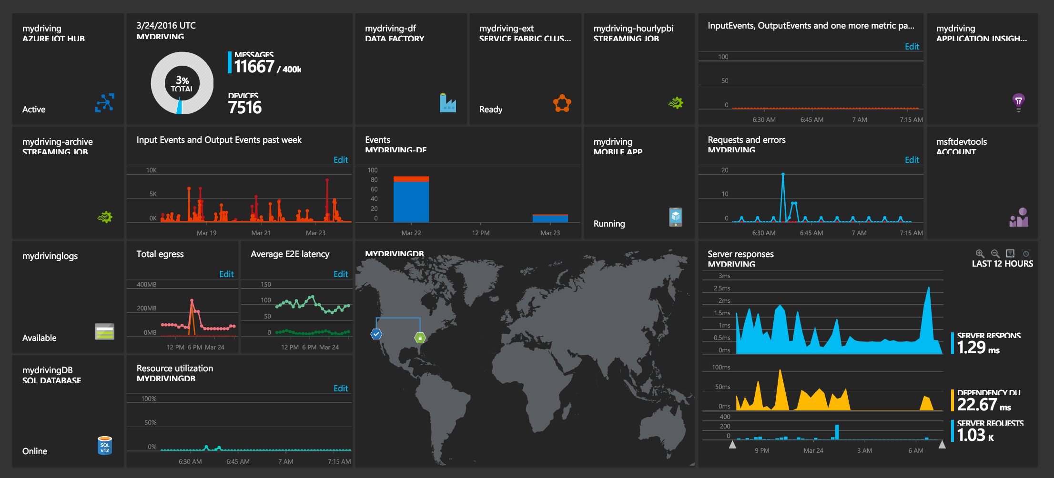
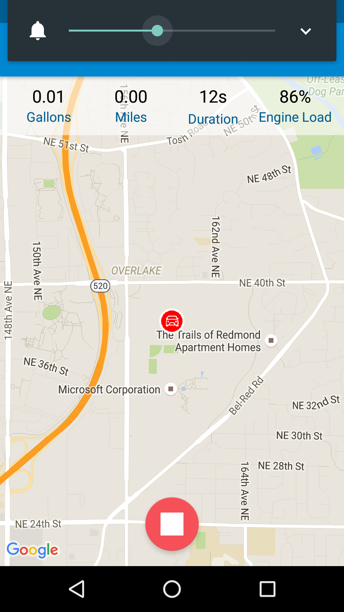
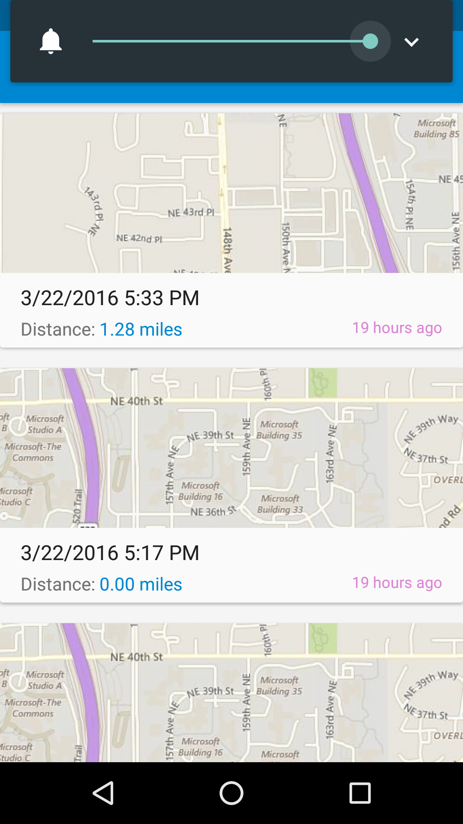
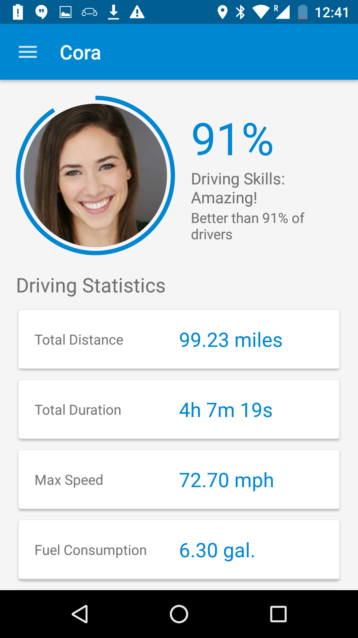
MyDriving

Slide 4
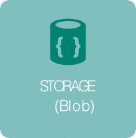
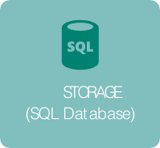
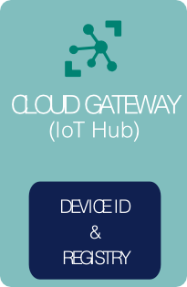
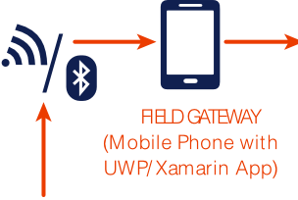
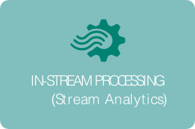
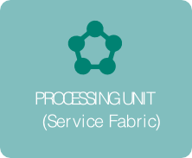
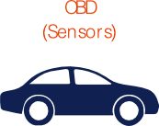
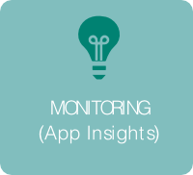
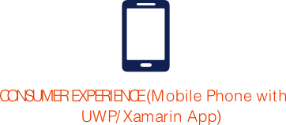

Slide 5
Let’s see it!

Slide 6
Demo: Using the App

Slide 7
Demo: Continuous Integration

Slide 8
Demo: Azure Dashboards, Service Fabric, PowerBI and Machine Learning

Slide 9
Demo: Deploying to your Subscription

Slide 10
Pricing
Cost of running this in your subscription
A team of no more than five (+ observing stakeholders).
Running for about a month.
100 users with 4 trips per day.
Total = $157 (Free Azure Credits for a new account is $200)

Slide 11
Call to Action
Get Started: http://aka.ms/iotsampleapp
Re-visit Build on Channel 9.
Continue your education at Microsoft Virtual Academy online.

Slide 12
Thank You

