Slide 1
5 things you didn’t know you can BUILD with Microsoft Edge
Charles Morris
Microsoft Edge Web Platform
@MSEdgeDev

Slide 2
Video chat on the web plug-in free

Slide 3
Real time communications using ORTC
Object RTC API: now in Microsoft Edge
Web standard for real-time communication using object-based JavaScript APIs
Announced October 2014, shipped in November 2015 in partnership with Skype team
Skype for Web without plug-ins!
New Skype for Web uses ORTC API for plug-in free video/audio chat
Easiest way to Skype without app download – perfect for shared computers
ORTC interoperability
Twilio Client SDK 1.3 release delivers interoperability with phone networks
SimpleWebRTC library enables interoperability with WebRTC 1.0 for audio
Samples for Twilio & SimpleWebRTC (WebRTC 1.0 audio interop) at demos.microsoftedge.com

Slide 4
Demo
Skype Web – plug-in free

Slide 5
ORTC – essential code
var videoRenderer = document.getElementById("myRtcVideoTag");
var mediaStreamRemote = new MediaStream();
mediaStreamRemote.addTrack(audioReceiver.track);
mediaStreamRemote.addTrack(videoReceiver.track);
videoRenderer.srcObject = mediaStreamRemote;
videoRenderer.play();

Slide 6
Run automated tests against your site

Slide 7
Testing in real browsers matters
Interop Efforts Helping
We’re working hard to minimize standards discrepancies through:
User feedback, top site feedback, bugs logged, standards involvement & vendor collaboration
Selenium & WebDriver for browser automation
Reduce cost and time. Supported natively by Chrome, Firefox and now MS Edge
An API and set of tools to record and replay tests
WebDriver API can even inject JavaScript into page for immediate execution
Just write code & keep us honest
Tests are just code – check them in, version control them and put rigor into your testing framework
Build your own test environment or use cloud services like Sauce Labs and BrowserStack
http://aka.ms/webdriver

Slide 8
Demo
WebDriver Accessibility Tests & Microsoft Edge

Slide 9
C# Example validating accessibility on fields
for (int i = 0; i < elements.Count; i++) {
driver.SendKeys("input" + (i + 1), "invalid");
driver.SendSubmit("input" + (i + 1));
if (!(elements[i].CurrentControllerFor != null &&
elements[i].CurrentControllerFor.Length > 0 &&
elements[i].CurrentIsDataValidForForm == 0)) {
return false;
}
}
// This sends the text “invalid” to elements of HTML5 field types number, telephone & url which should fail validation

Slide 10
Send notifications to Windows with your site

Slide 11
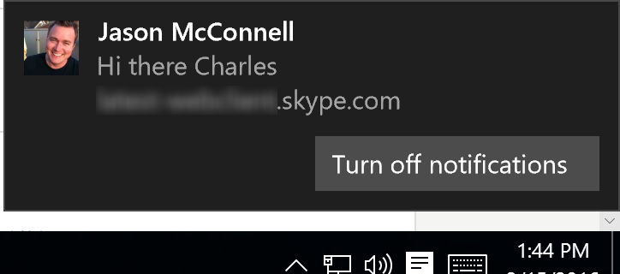
Web Notifications
Deliver notifications to Windows via web sites
Web standard API to deliver notifications to the user, even if tab/browser is in the background
User controls permission to receive notifications per web site (domain)
Microsoft Edge integrates web notifications with the Windows 10 Action Center

Slide 12
Demo
Skype Web – Chat Notifications

Slide 13
Web Notifications – essential code
function browserSupportsNotifications() {
return (window.Notification !== undefined);
}
Notification.requestPermission().then(function() {
var n = new window.Notification(title, { tag: notificationId, icon: imgUrl, body: message });
});

Slide 14
Speak web page content to your users

Slide 15
Web Speech Synthesis
Built-in text-to-speech for the web
Speech synthesis is a subset of Web Speech API standard
Leverages TTS engine and voices built into Windows 10
New scenarios for your website: accessibility, kids, “eyes-free” interaction…
Easy to implement
Requires 2 lines of code: Simply create a SpeechSynthesisUtterance object then tell it to speak!
Optionally control voice, pitch, rate, etc. or pause/resume/cancel the current speech

Slide 16
Demo
Web Speech Synthesis

Slide 17
Speech Synthesis – essential code
var synUtterance = new SpeechSynthesisUtterance();
synUtterance.text = textToRead;
synUtterance.voice = window.speechSynthesis.getVoices()[0];
synUtterance.lang = myLanguage;
synUtterance.rate = parseFloat(rateRange.value);
window.speechSynthesis.speak(synUtterance);

Slide 18
Log in to a web site…
with your face

Slide 19
FIDO 2.0: Edge + Windows Hello
Reducing reliance on passwords on the web
FIDO 2.0 is a new web standard to provide easier and more secure ways to authenticate to sites
Long-term goal is to enable password-less and 2FA authentication scenarios on the web
Status: experimental
Edge has an early version of FIDO 2.0 behind prefixes, will change in a future release as spec evolves
Built on Windows Hello (biometric sign-in) & Microsoft Passport (authentication) in Windows 10

Slide 20
Demo
USAA.com: FIDO 2.0 + Windows Hello prototype

Slide 21
5 Things You Can Build with Microsoft Edge
Video chat on the web, plug-in free
Run automated tests against your site
Send notifications to Windows from your site
Speak web content back to your users
Log in to a web site… with your face
@MSEdgeDev
https://dev.microsoftedge.com

