Slide 1
People API
Edward Thiele
Software Engineer, Office 365 People System
Notes:
Hi, I’m Edward Thiele – a software engineer on the office 365 people system team. In this video I will talk about the People API and some of the new features we have added recently. It is currently available for preview in the beta namespace through both Outlook and the Microsoft Graph.

Slide 2
Overview
The People API allows developers to access people data stored in Office 365.
Enable scenarios such as:
Autocomplete
People Search
People Disambiguation
Friend-of-friend discovery
Any other people-centric scenario
Notes:
This presentation is intended for developers who want to utilize people information within office 365 for scenarios such as:
Autocomplete
People Search
People Disambiguation
Friend-of-friend discovery scenarios
Any other people-centric scenario
In this presentation, I will give an overview of the API and walk through a quick demo highlighting how to get started.

Slide 3
Features
Single REST endpoint containing People data from multiple sources
Active Directory
Outlook and Social Contacts
Relevant People
Relevance based results
Results are always returned in order of relevance to the logged in user
Supports Browse and Fuzzy Search
Provide people suggestions before the user even starts typing
Find the person the user is looking for even if they misspell their name
Topic Search
Can’t remember the person’s name? Search for someone by a topic previously discussed in O365.
Notes:
The People API is an REST endpoint accessible via the Microsoft Graph that provides access to people data stored in office 365. The goal of this API is to enable developers to have a single endpoint that provides a rich view of people data accessible via both browse and search access patterns. The people API constructs its list of known people by analyzing and aggregating data from active directory, contacts, and communication signals known to office 365.
Utilizing this data, the people API provides support for relevance-ranked people search, including support for fuzzy matching and topic disambiguation. Results from either the browse or search scenarios are returned as a list of person objects with data filled in from all of the sources we know about.

Slide 4
Related People
Discover the people related to anyone in your organization
Org charts don’t always convey working relationships
Pick someone in your organization and learn who they actually work most closely with
Computed from Active Directory information and combined with signals from previous interactions
Relationships are only exposed when there is a publicly derivable connection.
Notes:
One powerful use case of this feature is to provide context when a user receives an email from someone they don’t know, but happens to be a colleague of someone who the user works with frequently but who’s connection might be difficult to find in via traditional org chart.

Slide 5
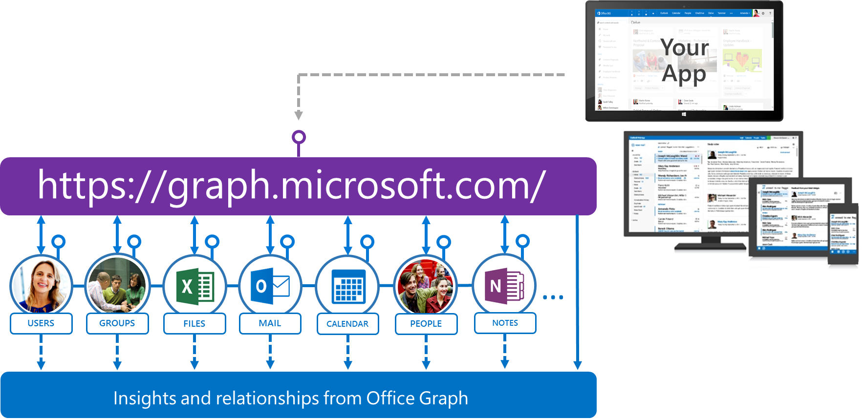
Microsoft Graph API
https://graph.microsoft.com/beta/me/people

Slide 6
Demo

Slide 7
Related content
Find more on dev.office.com
Docs, samples:
https://graph.microsoft.io/
Stack overflow: [MicrosoftGraph] and [ Office365]
Twitter: #MicrosoftGraph and #Office365dev

