Slide 2
Microsoft Graph
Yina Arenas
Lead Program Manager
Microsoft Graph and Office Extensibility

Slide 3
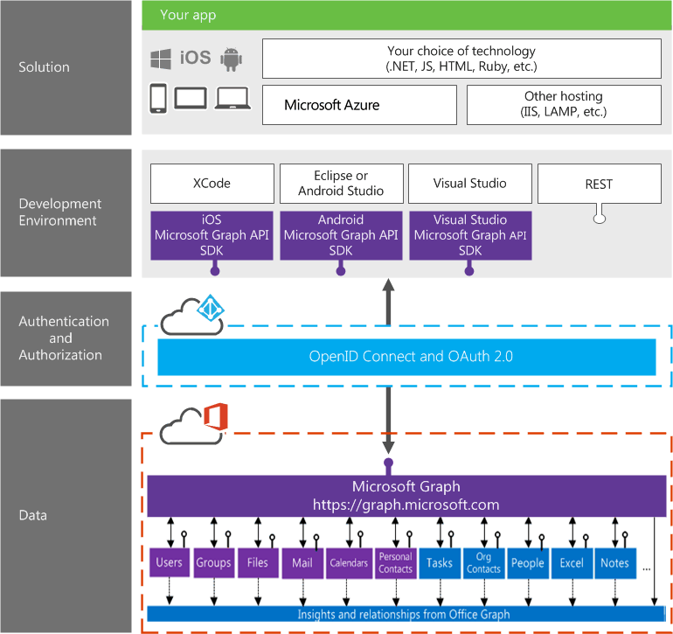
Building integration with
Office 365

Slide 4
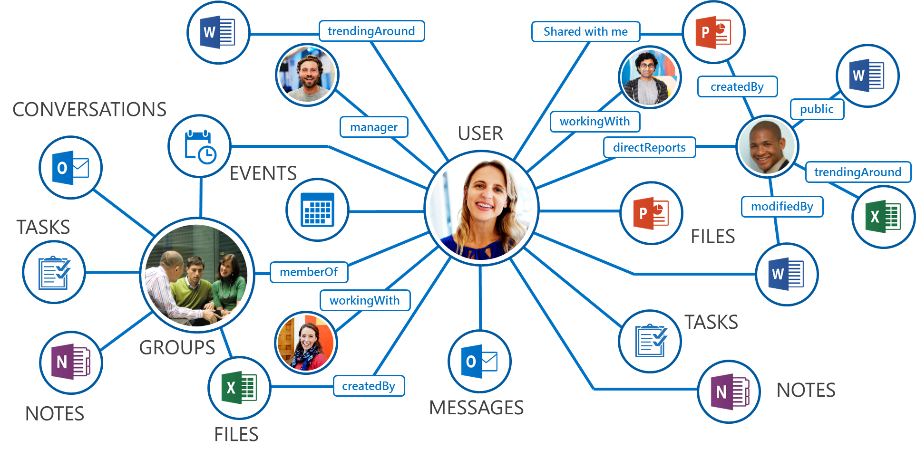
What is Microsoft Graph?
Single endpoint for:
Accessing data
  /me, /users, /groups, /messages, /drive, ….
Traversing data
  /drive/<id>/lastmodifiedByUser
Accessing insights
  /insights/trending
Work/School and Personal
https://graph.microsoft.com/

Slide 5
Demo

Slide 6
New at //build 2016
Generally Available:
Webhooks on Outlook entities
Access to consumer services OneDrive and Outlook.com
OneDrive large file upload/download
Preview:
Excel REST API
Administrative Units
Find meeting time API
Get/set out of office
Online meeting links
Updates to People API
Updates to trending APIs
more…

Slide 7

Use Microsoft Graph to build smart apps
Gateway to data and insights in Office365
Easy traversal of objects and rich relationships
Web Standards, Open Platform
Secure data access
OAuth2.0
OpenID Connect
REST
JSON

Slide 8

Related content
Documentation, samples and more:
https://graph.microsoft.io/
Stack overflow:
[MicrosoftGraph] and [Office365]
Twitter:
#MicrosoftGraph and #Office365dev

