Slide 2
Real World Design and Development to Accelerate your Universal Windows Apps
B873
Lynnette Reed & Rob Cameron
Sr. Visual Designer / Principal SDE
#Build2016

Slide 3
Lynnette Reed
Sr. Visual Designer
“goddess of design”

Slide 4
Rob Cameron
Principal SDE
“code monkey”

Slide 5
Design process

Slide 6
Thinking like a designer

Slide 7
brainstorm
moodboards & concept designs
sketch &
wireframe
design

Slide 8
prototype
test
iterate

Slide 9
App breakdown

Slide 10
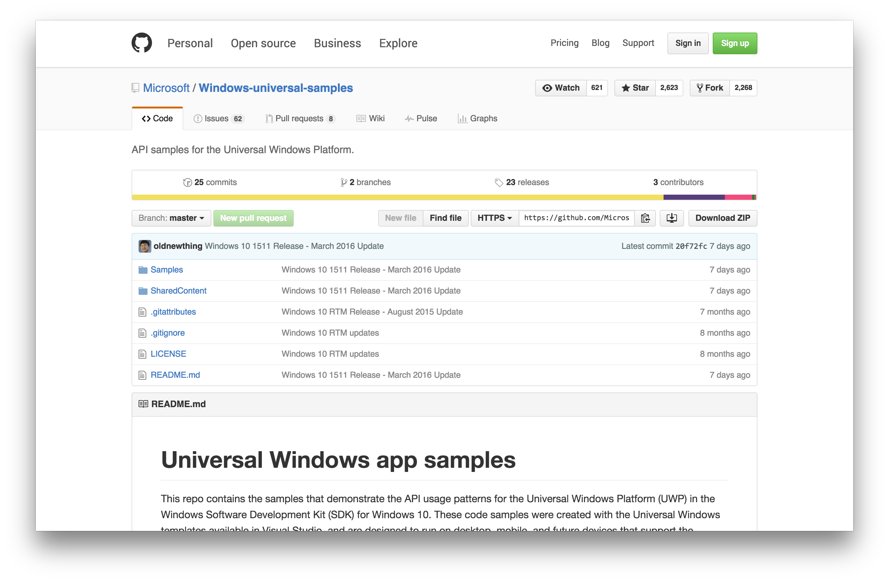

Slide 11
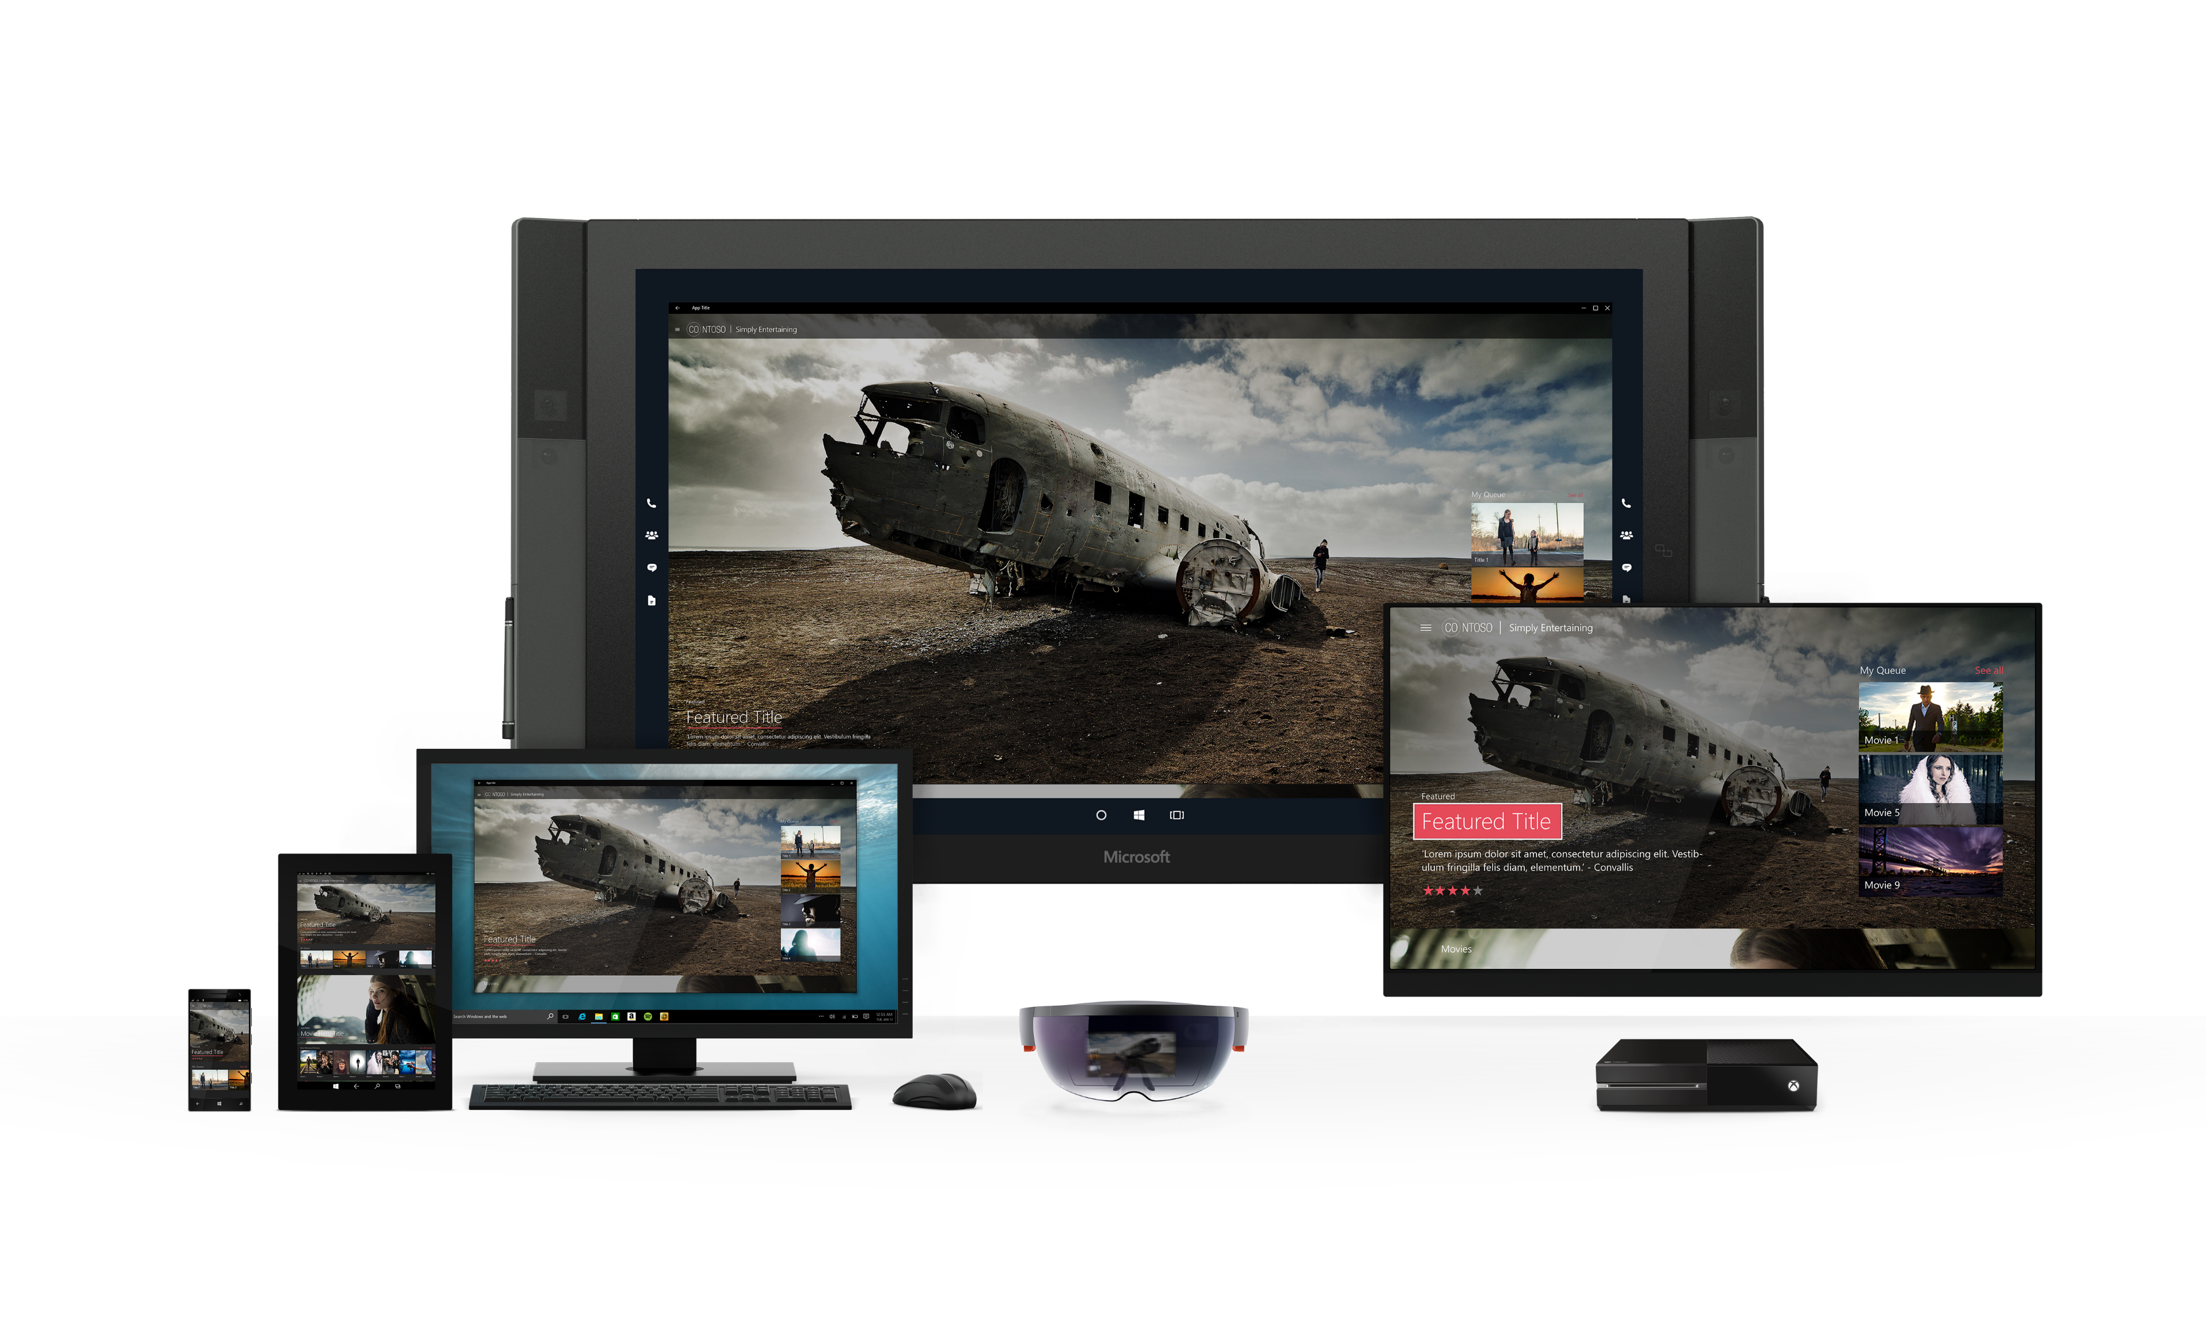
media sample

Slide 12
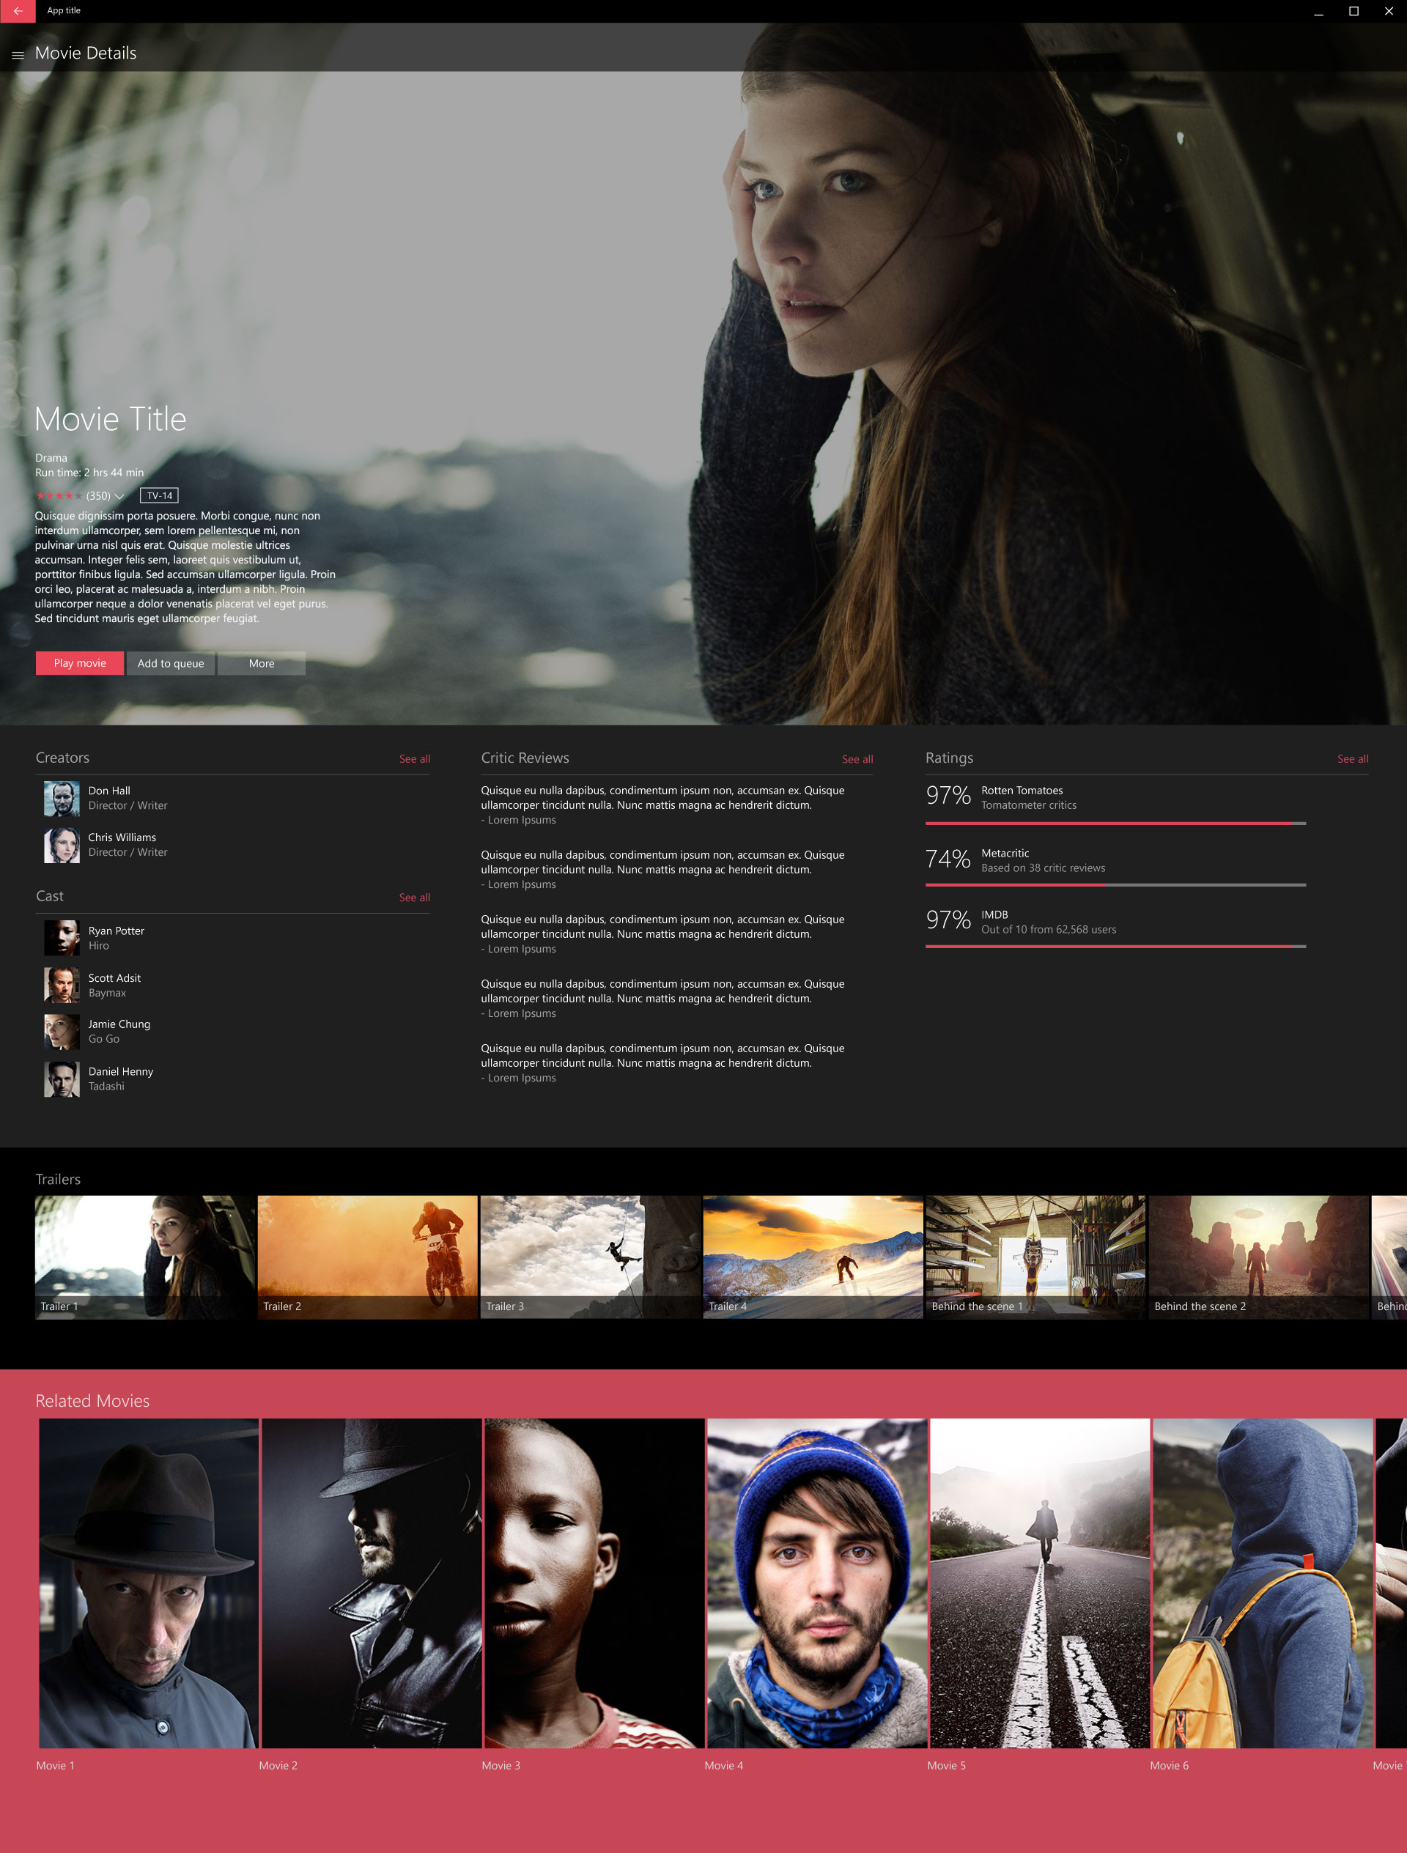
media sample
4 controls and patterns
List control
Featured Section
Carousel
Detail page

Slide 13
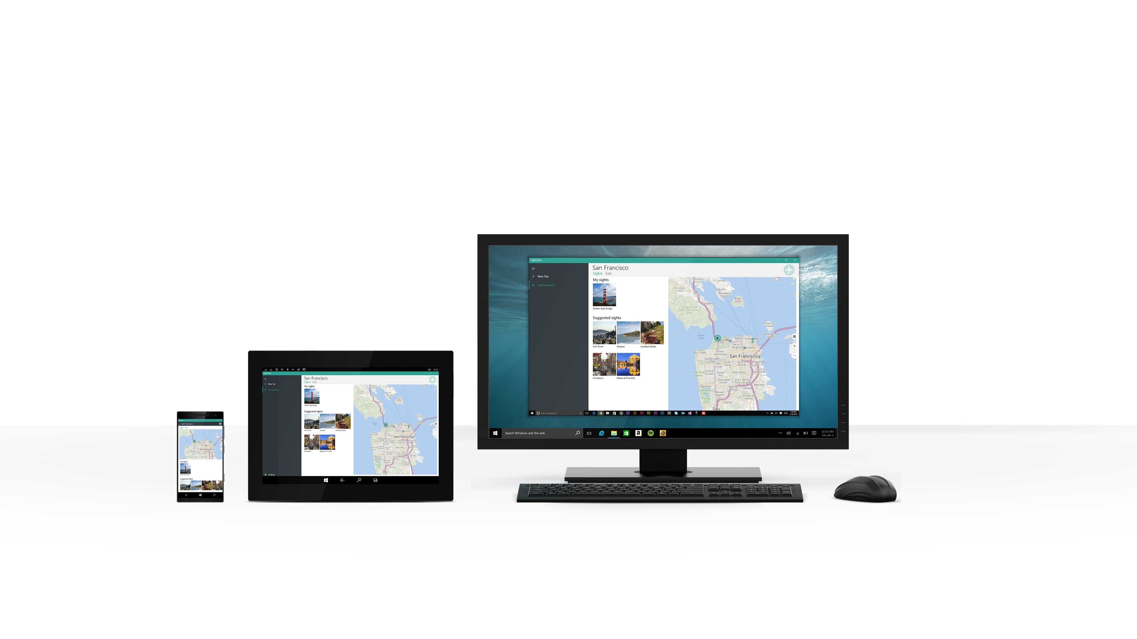
sights2see

Slide 14
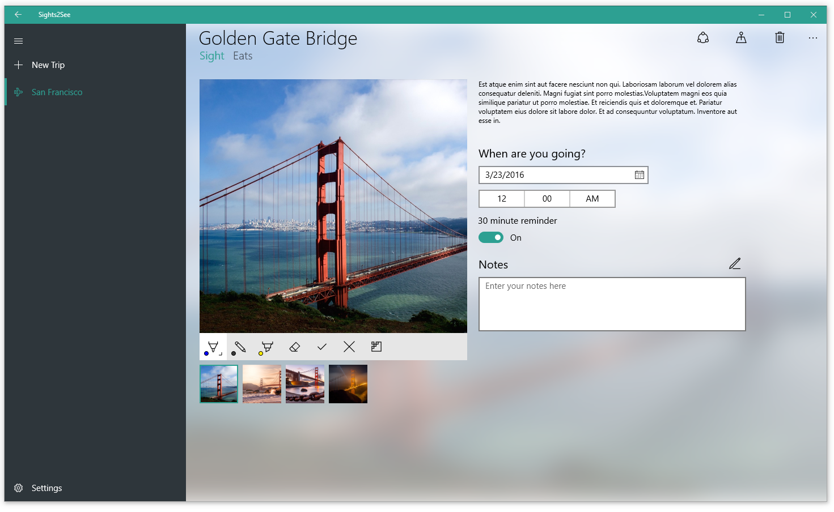
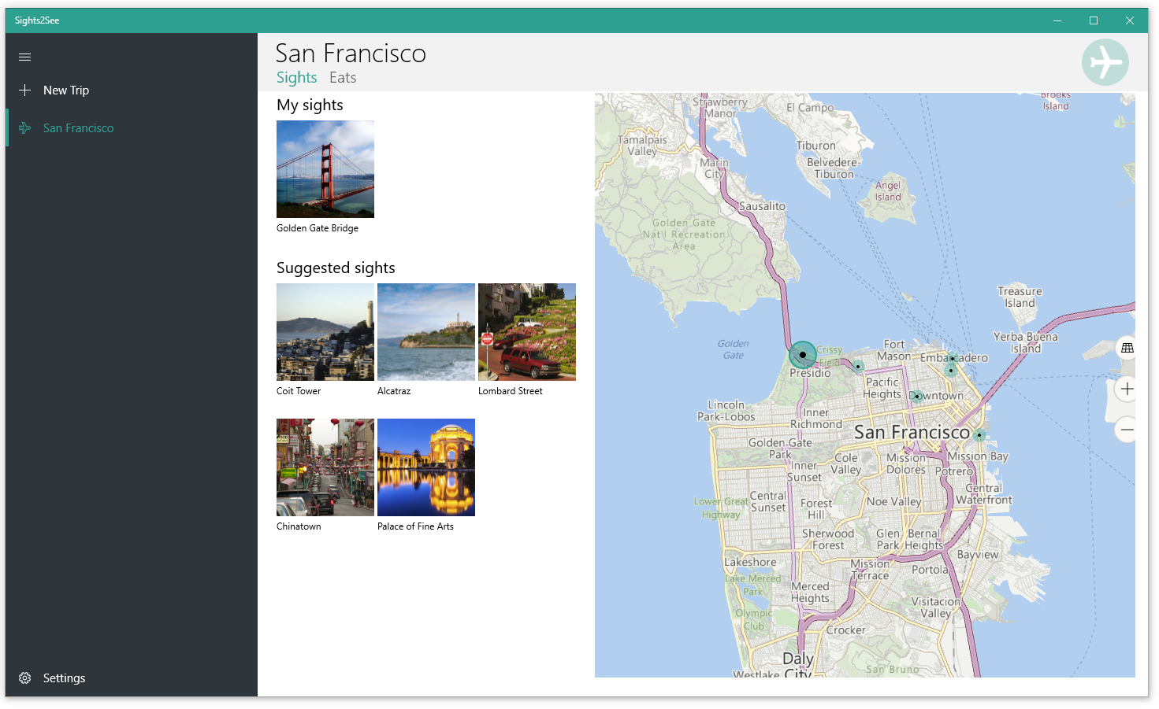
sights2see
2 controls and patterns
SplitView
Map view

Slide 15
Let’s get cooking

Slide 16
Prepping for a tasty design

Slide 17
ingredients
2 parts - App samples
6 parts - Windows templates
1 part - Windows controls
1 part - Color palette
A pinch of consistency

Slide 18
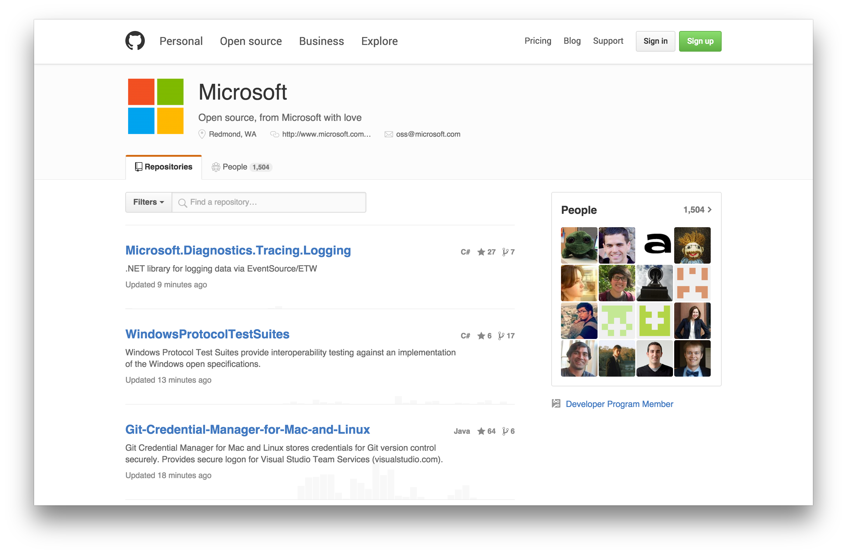

Slide 19
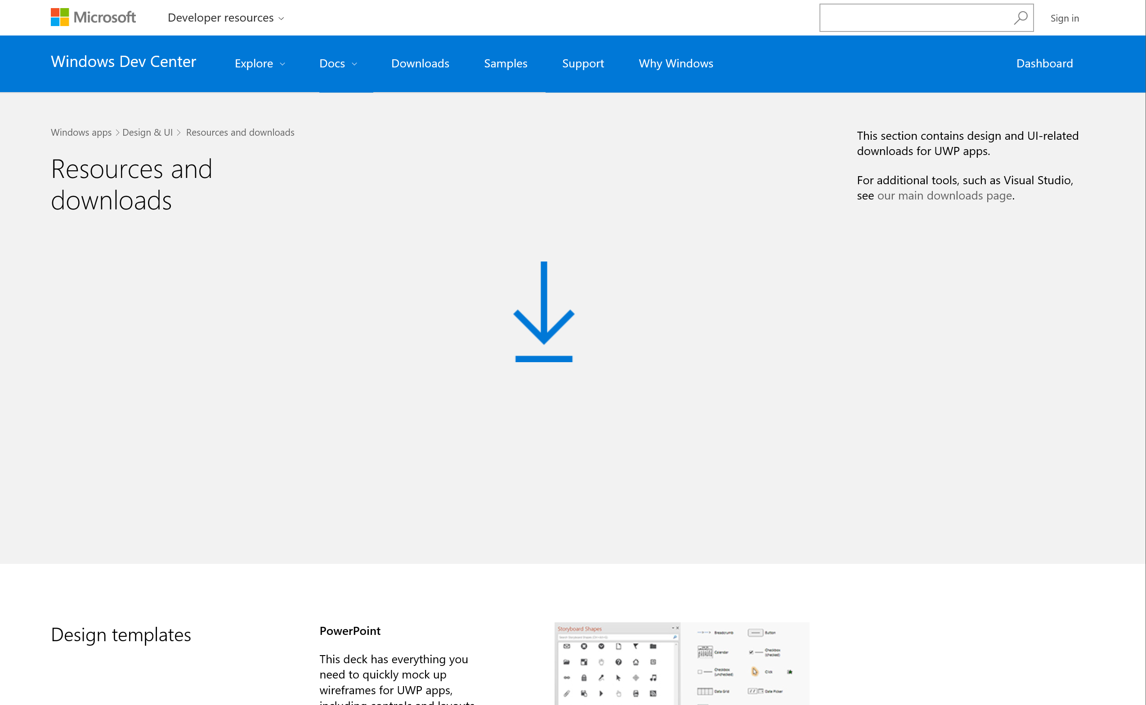

Slide 20
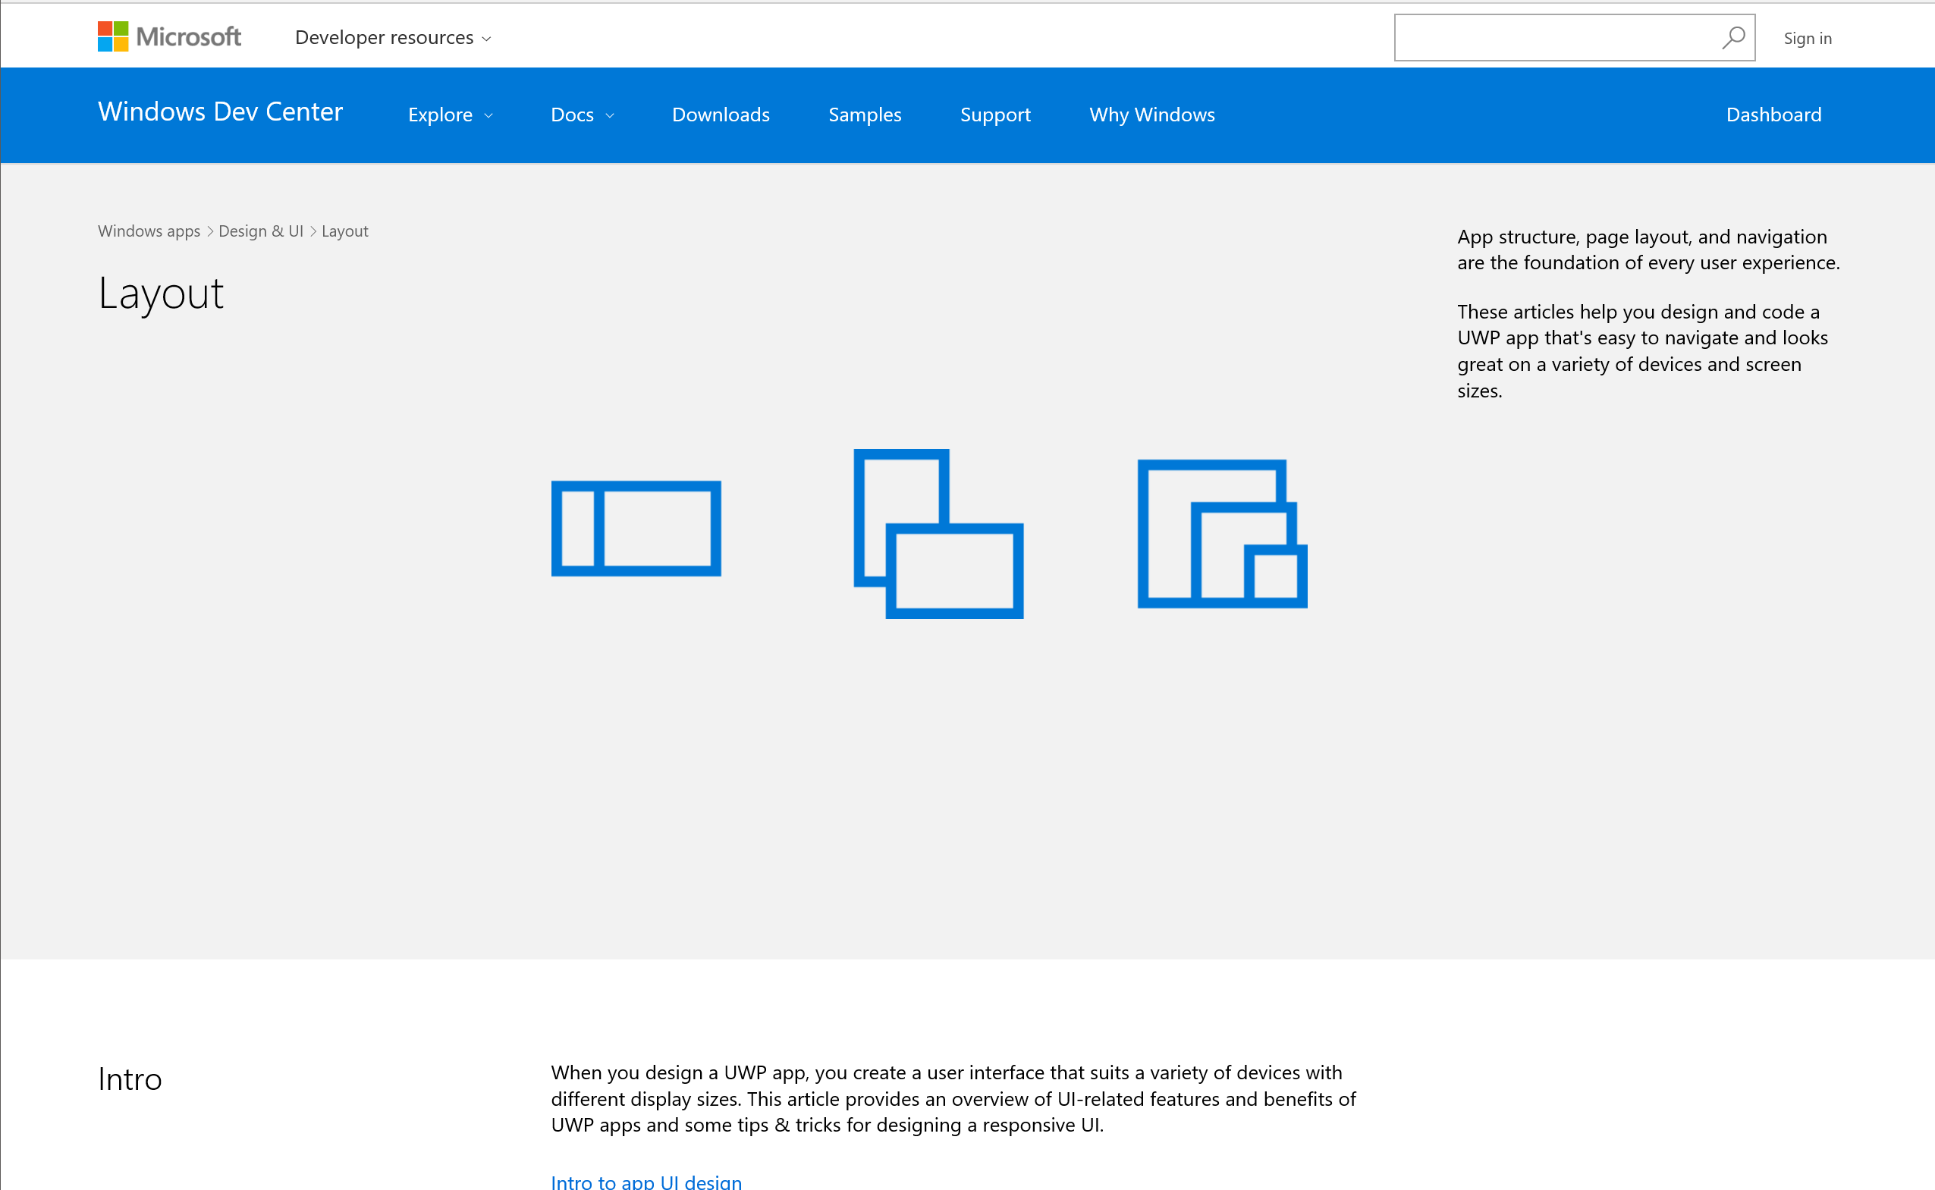

Slide 21
Making it tasty

Slide 22
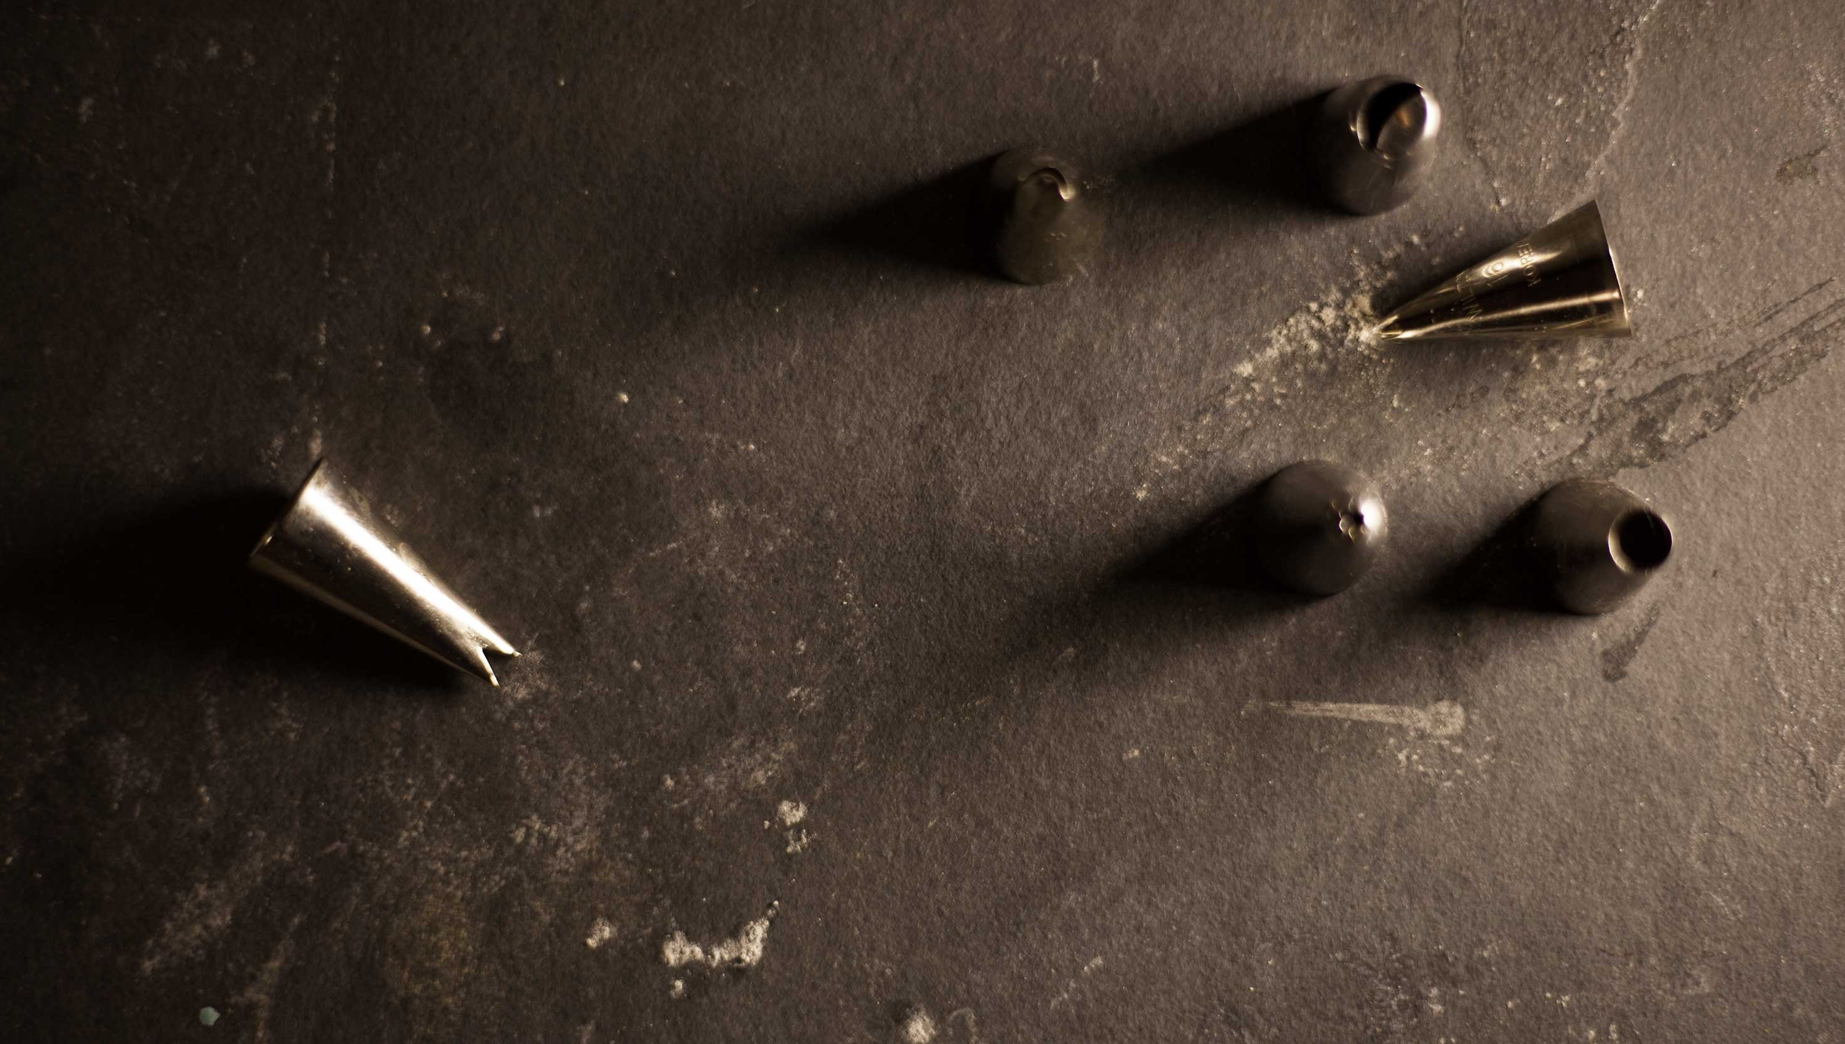
Contoso Sweets

Slide 23


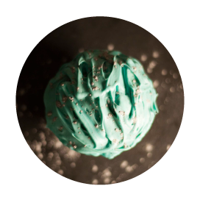

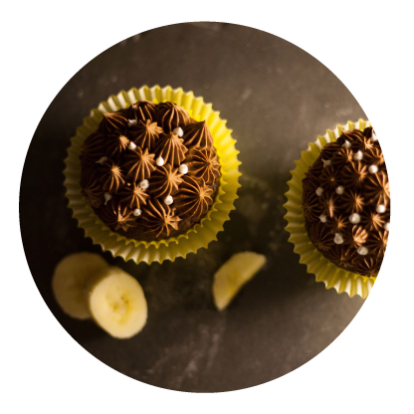


Slide 24



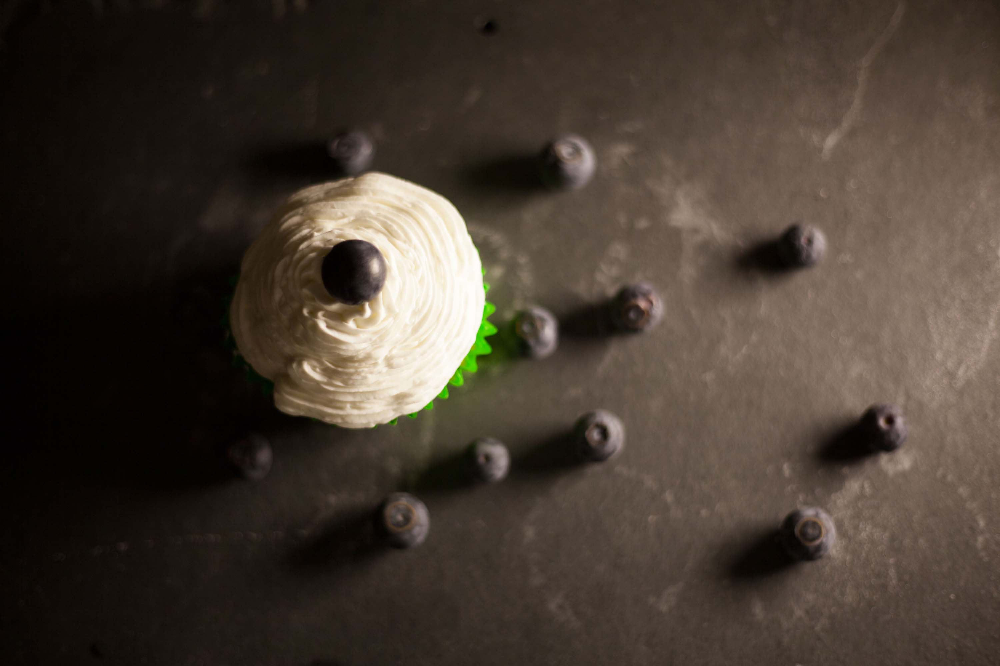
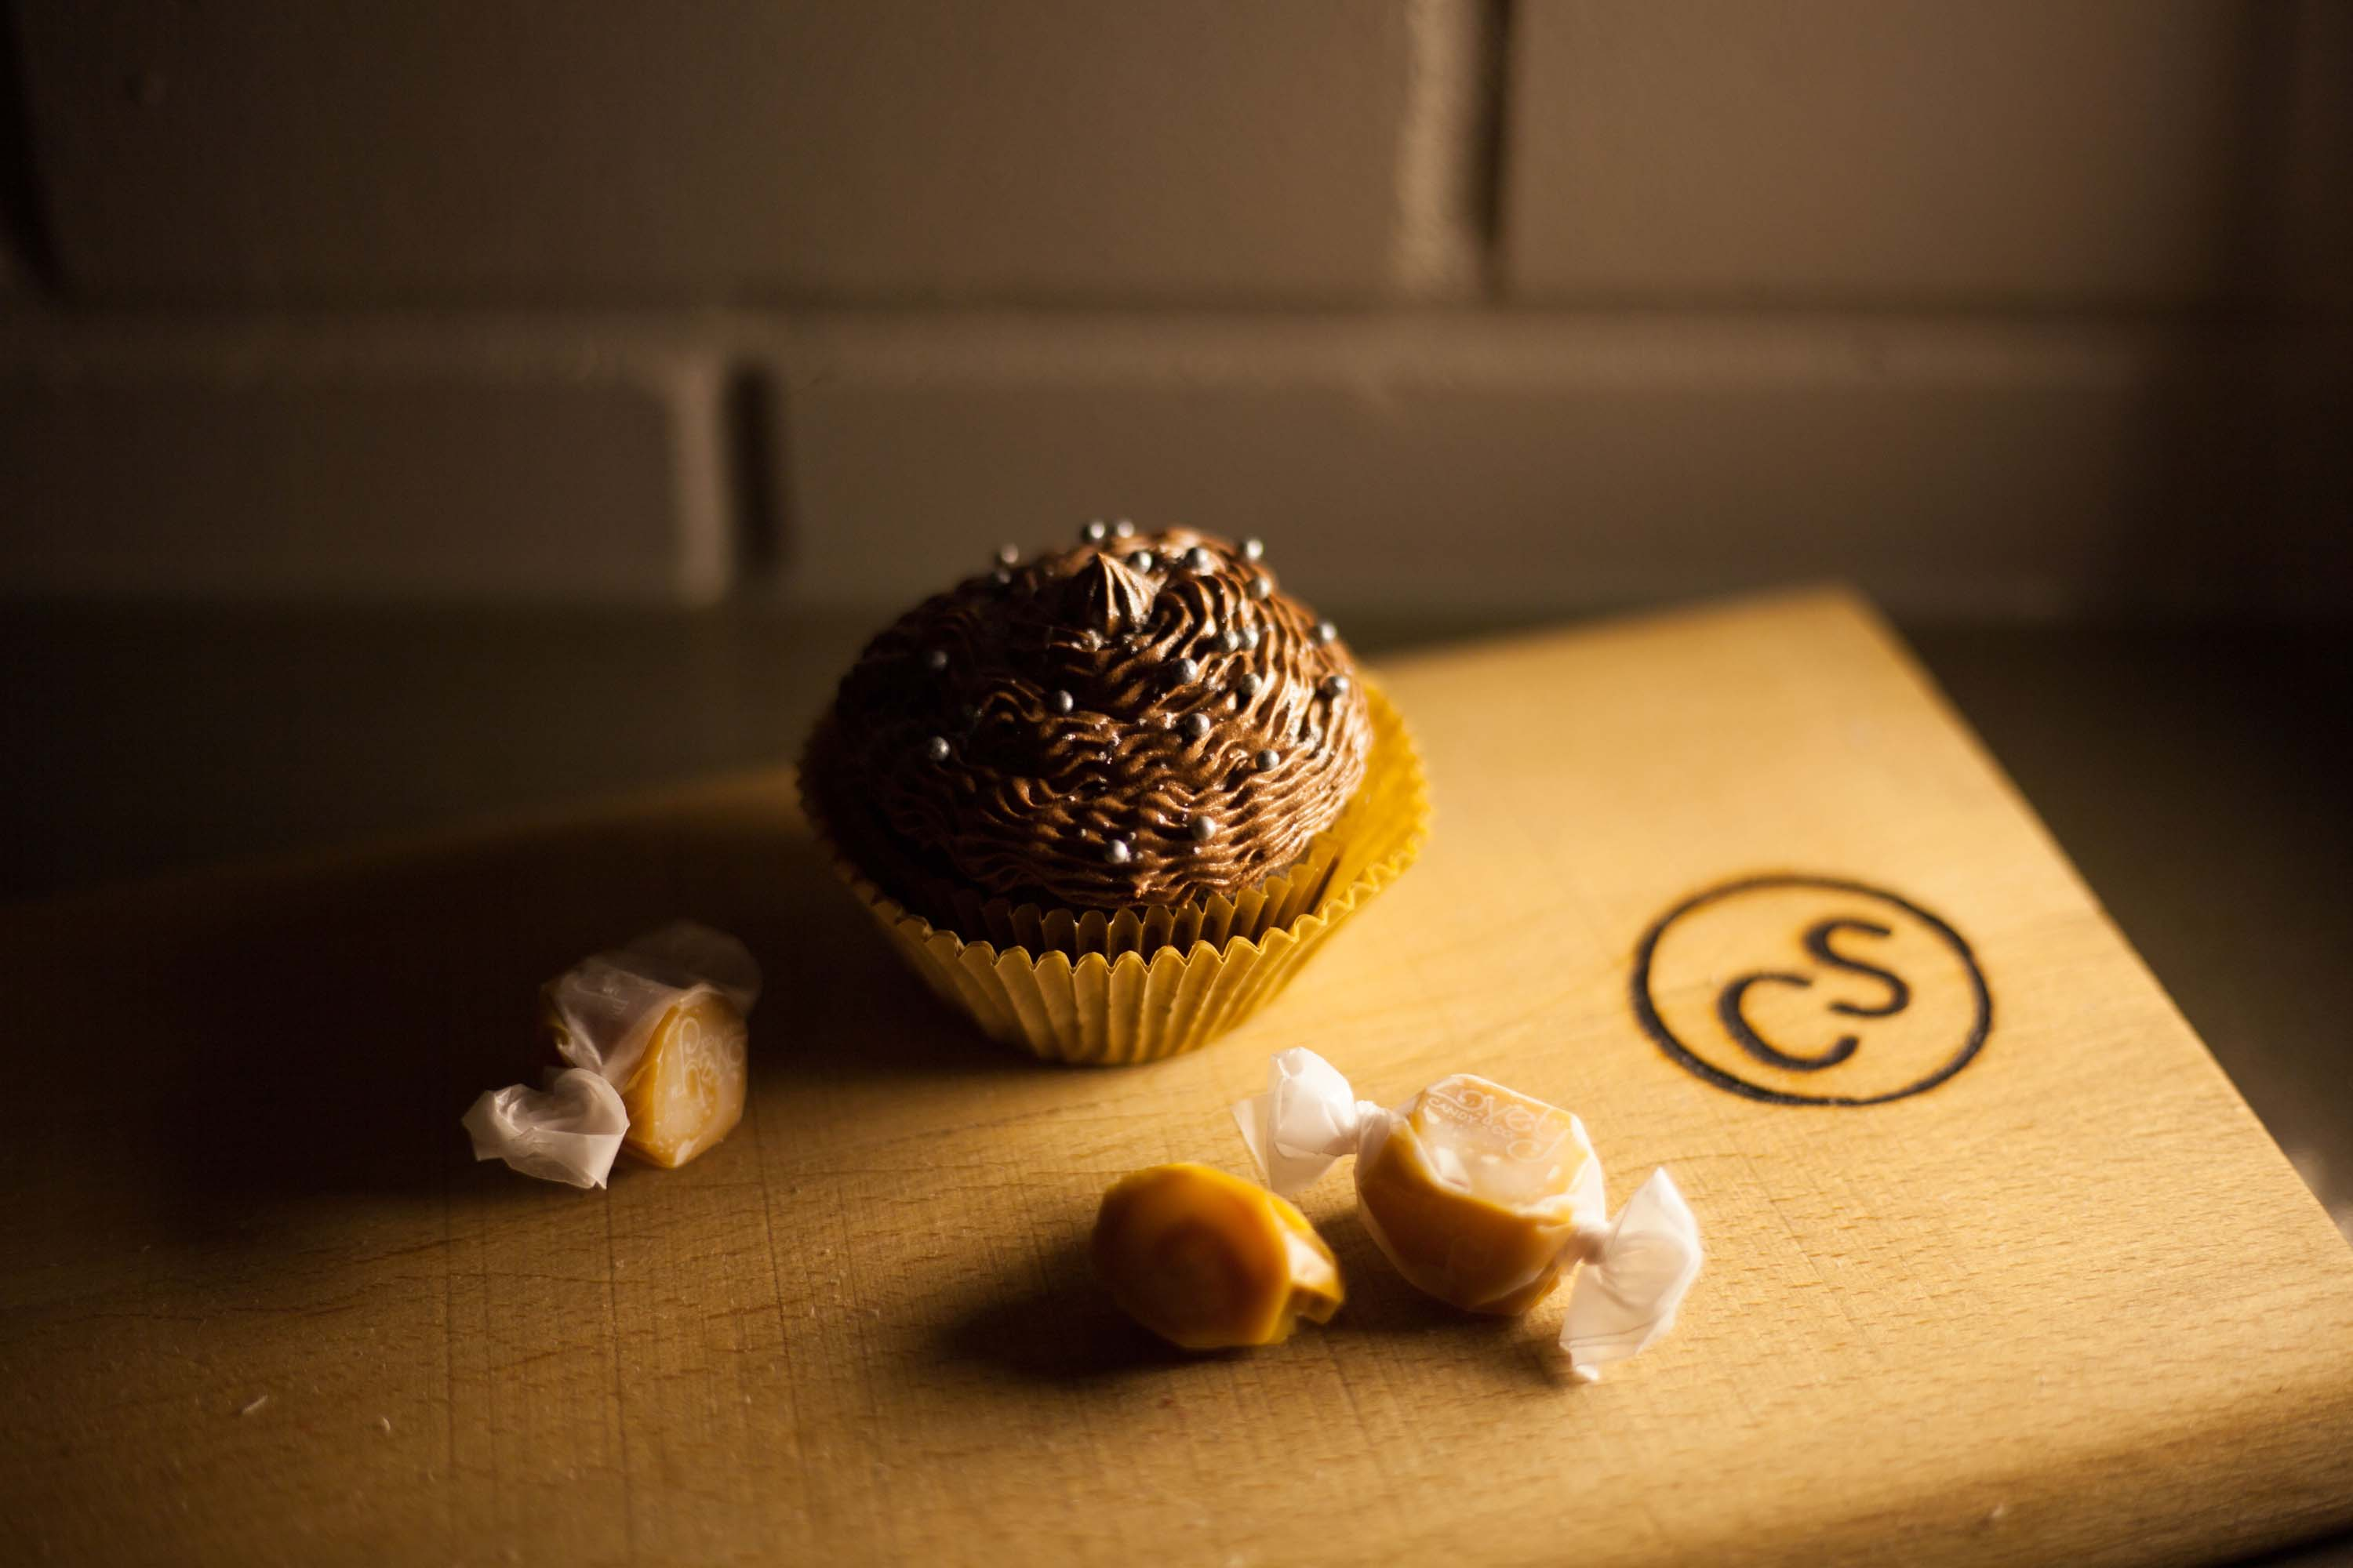

Slide 25
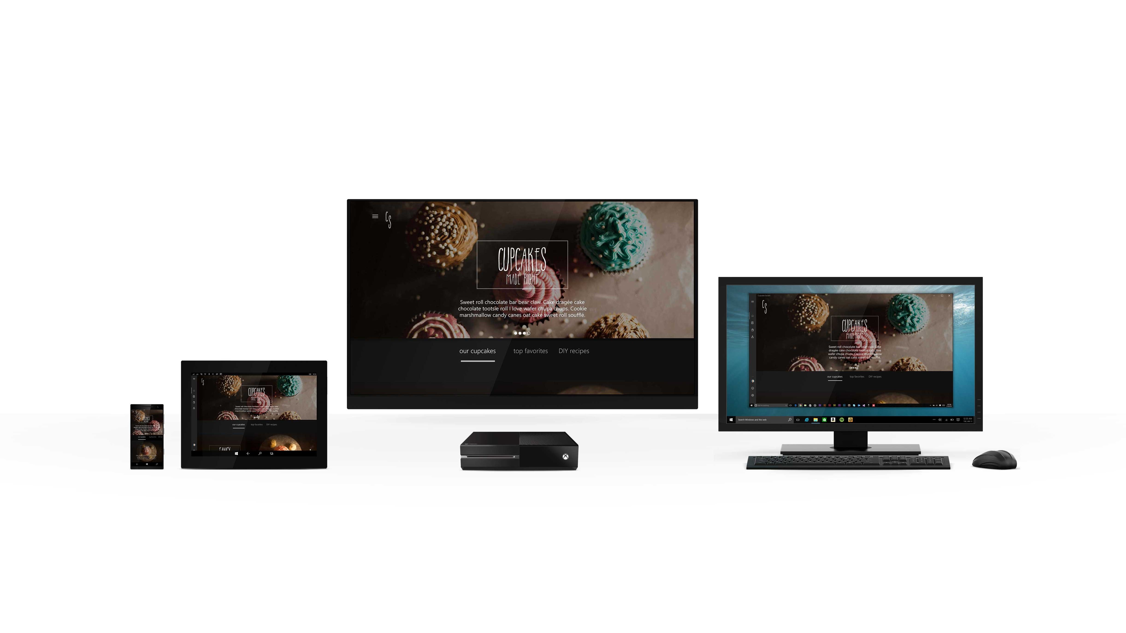
contoso sweets

Slide 26
Design demo part I

Slide 27
Ding!

Slide 28
Do you taste the batter along the way?

Slide 29
Or make a few cupcakes to test on your friends…

Slide 30
before the big party?

Slide 31
Design demo part II

Slide 32
Pop in the oven

Slide 33
Baking it up
3 parts – Good Design
4 parts – Windows Controls
2 parts – Responsive UI
2 parts – Tailoring for platform
Splash of GitHub goodness
http://microsoft.github.io/windows/

Slide 34
Cross-Device Platform Considerations
1’
Standard Device Resolutions
10’
360 x 640*
1024 x 640*
1366 x 768*
1920 x 1080*
1920 x 1080
Web App => 150%
XAML => 200%
* Scale Factor can vary from 100% to 300%

Slide 36
Dev demo

Slide 37
Bon Appétit!

Slide 38
To get started building your UWP App today visit:
http://aka.ms/uwpdesign
http://aka.ms/UWPSamples
http://aka.ms/UWPTVHelpers

Slide 39
Share Your Story for Challenge Points
Give us 3 minutes of feedback about your work right after this session at the Flash Voting sign.
Join in on 15-30 minutes in depth feedback sessions at the Visual Studio: Share Your Story booth.
Register in 2 minutes for Visual Studio feedback opportunities after build at http://aka.ms/devtodev.

Slide 40
Seriously…
We want to hear from you!
Please evaluate this session

Slide 41
Thanks!
Cupcake achievement unlocked!

Slide 42
Thanks!

Slide 43
Thanks!
Thx!

Slide 44
Q&A

