Slide 2
Microsoft’s new & improved modern mapping platform
B867
Apurva Thanky
Senior Program Manager
Ricky Brundritt
Senior Program Manager

Slide 3
Agenda
Maps Platform Overview
Native Map Control (UWP)
Bing Spatial Data Service Updates
Web Map Control Announcement

Slide 4





Maps Platform Overview
Native Control (UWP)
Web Control
REST Services
Spatial Data Services
Boundary Data
Reverse Geocoding
Geocoding
Routing
Traffic Incidents
Static Imagery
Elevations


Availability Across Devices
Multiple Culture Support
Cloud-Based Services
Enterprise Friendly

Slide 5
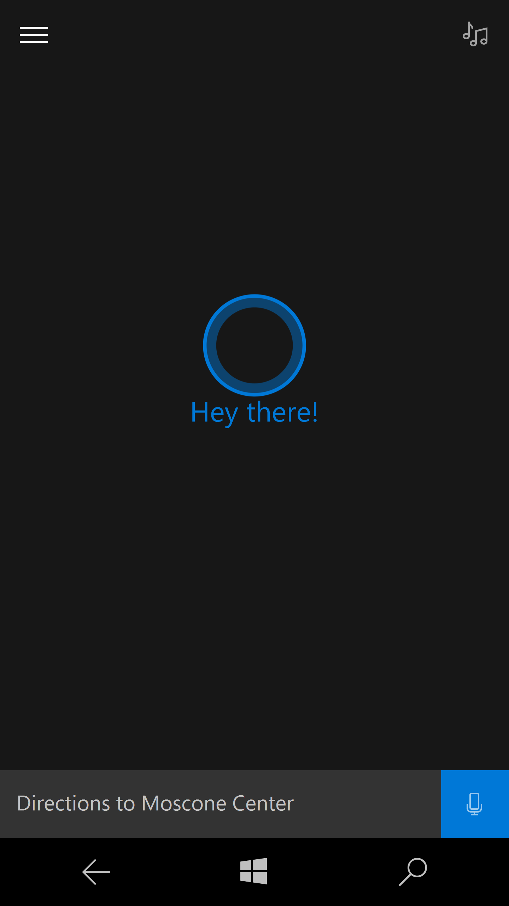
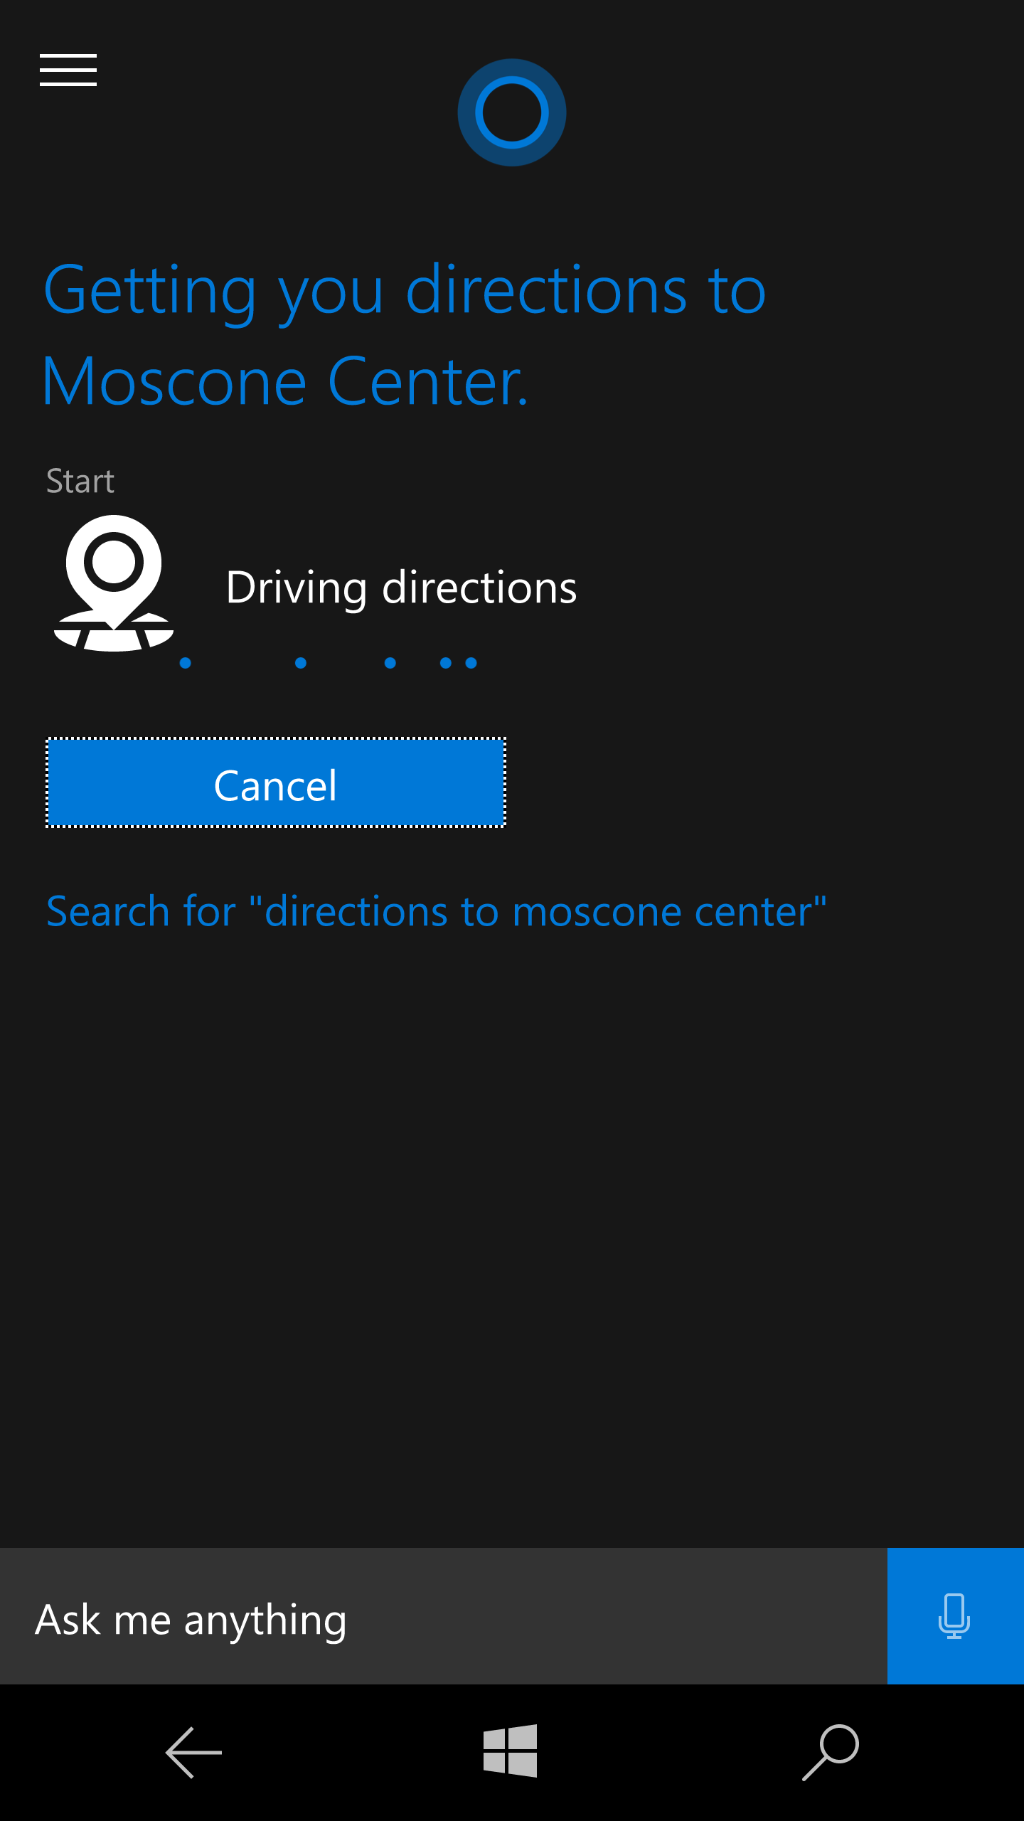
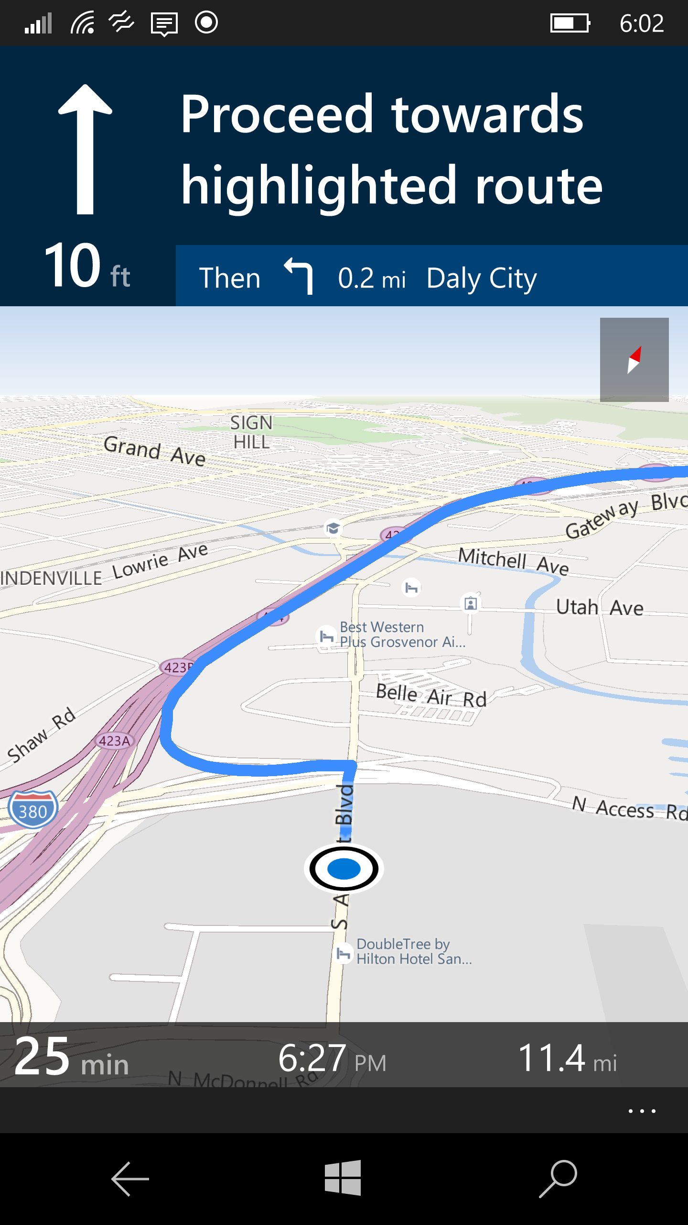
Maps across Microsoft Products

Slide 6
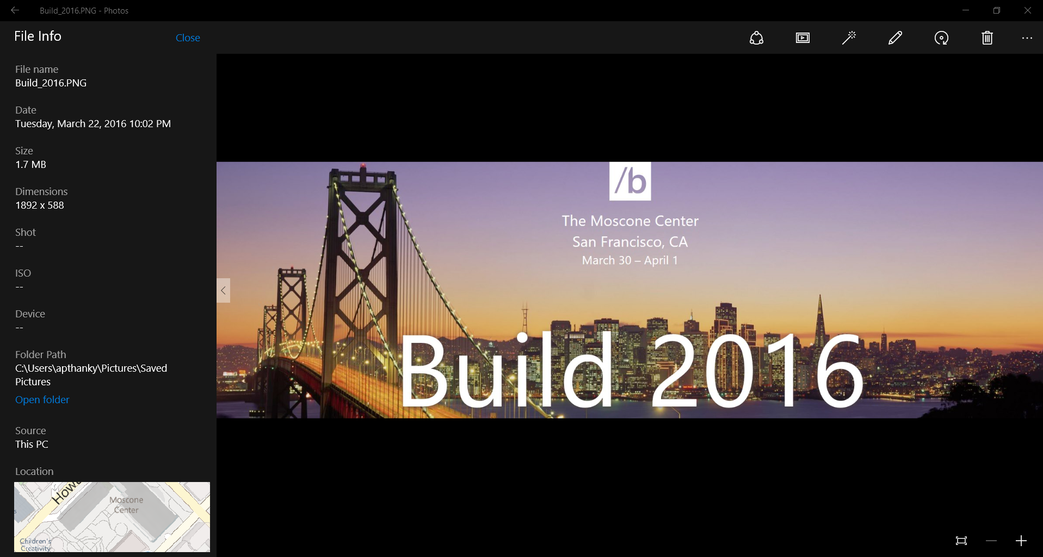
Maps across Microsoft Products

Slide 7
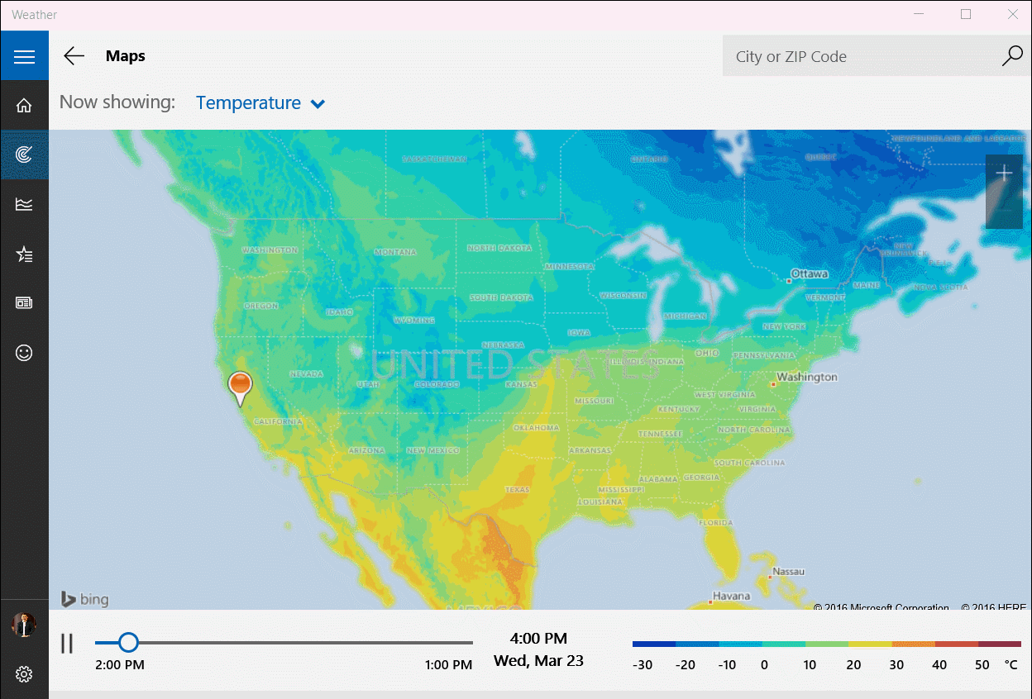
Maps across Microsoft Products

Slide 8
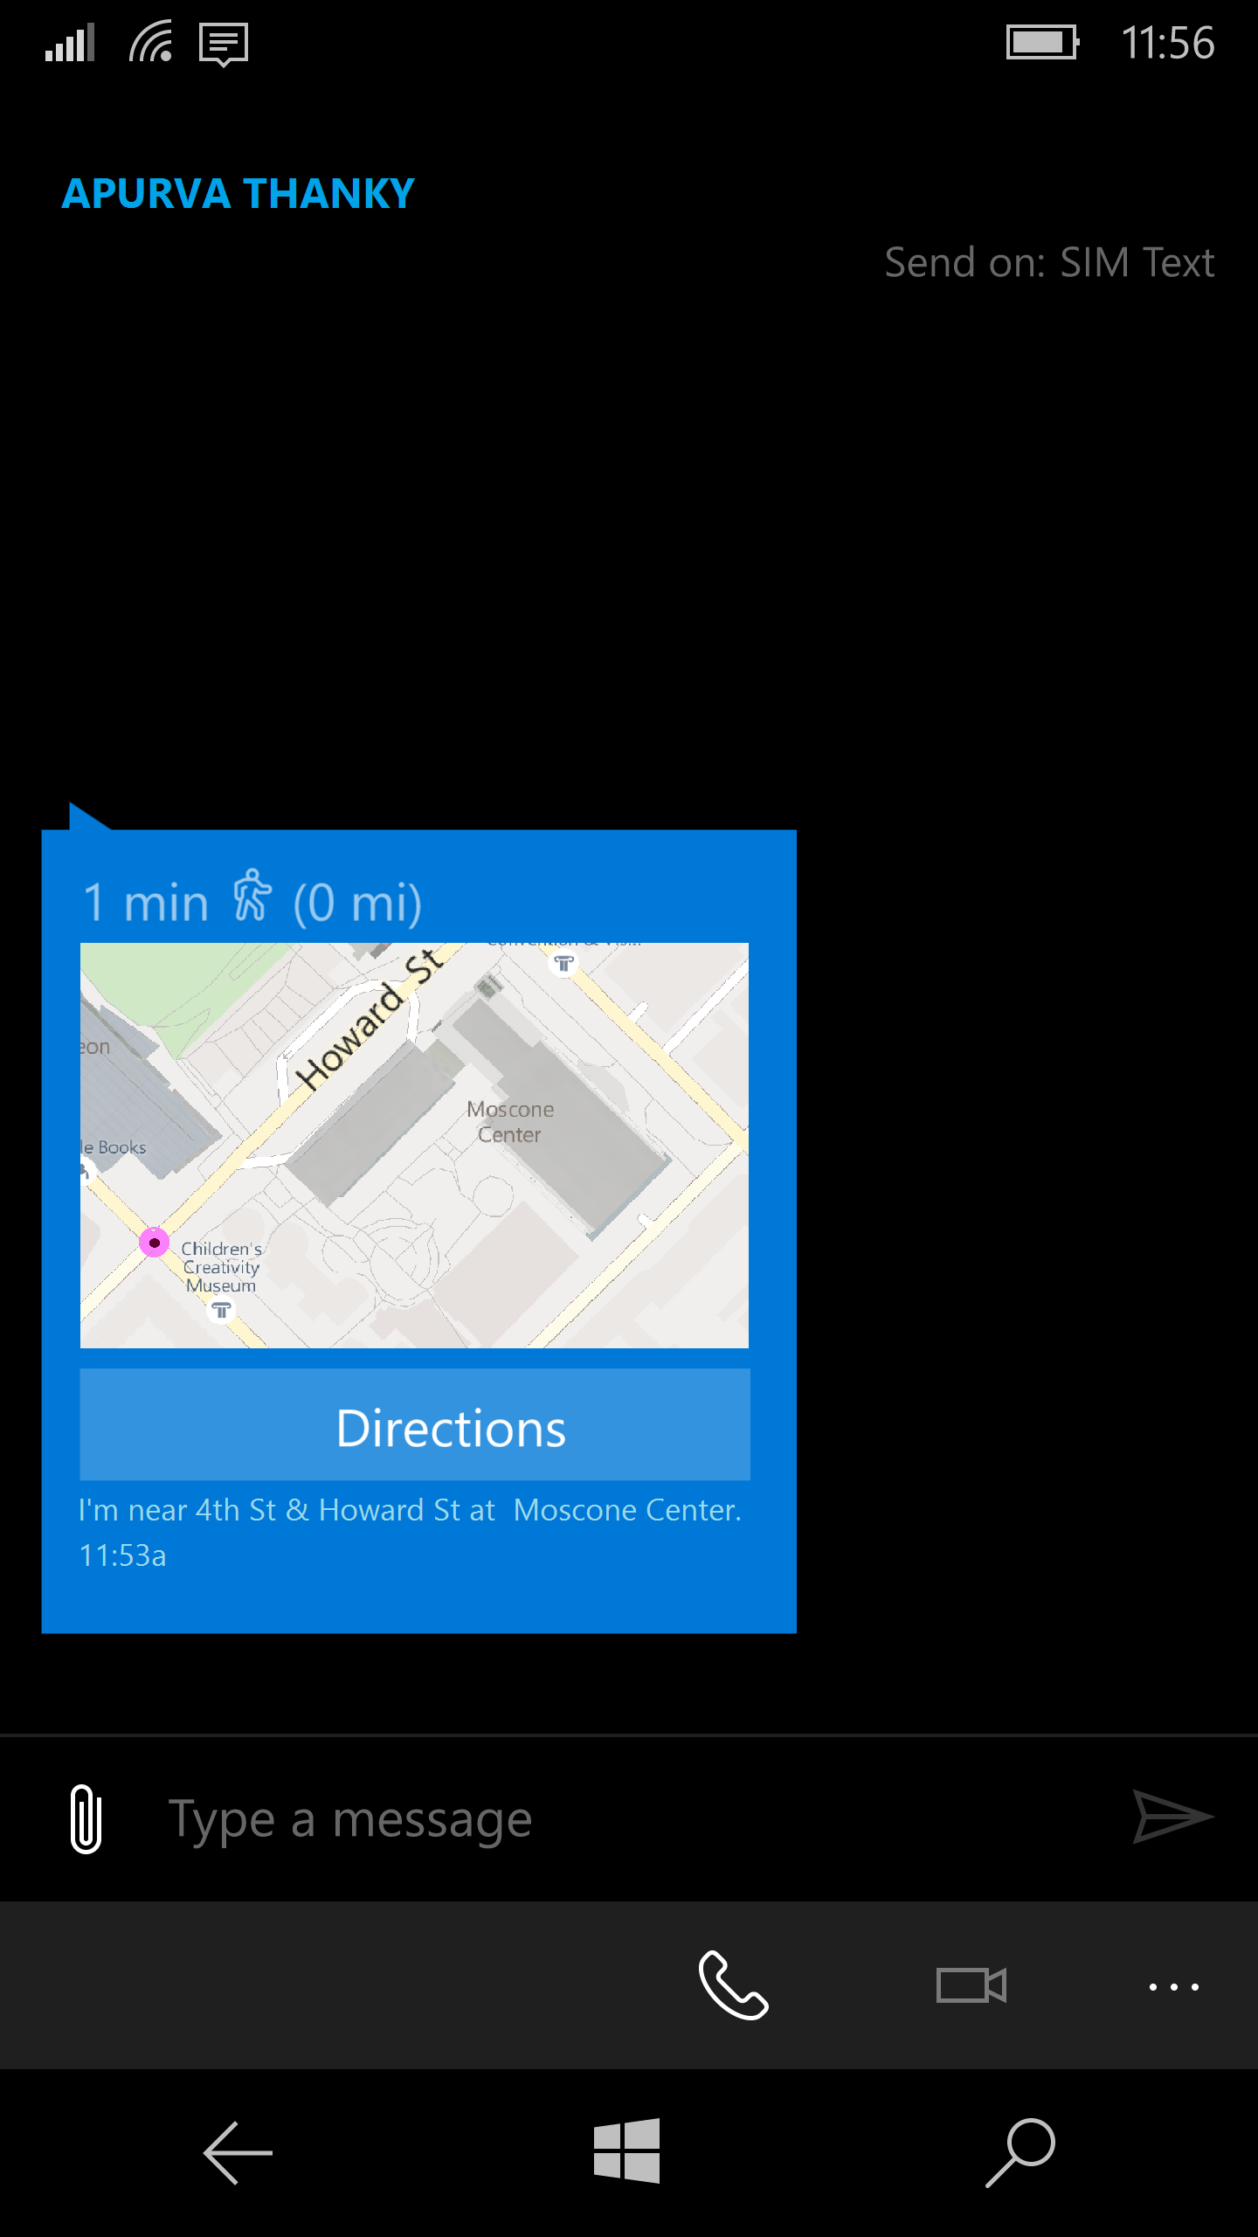
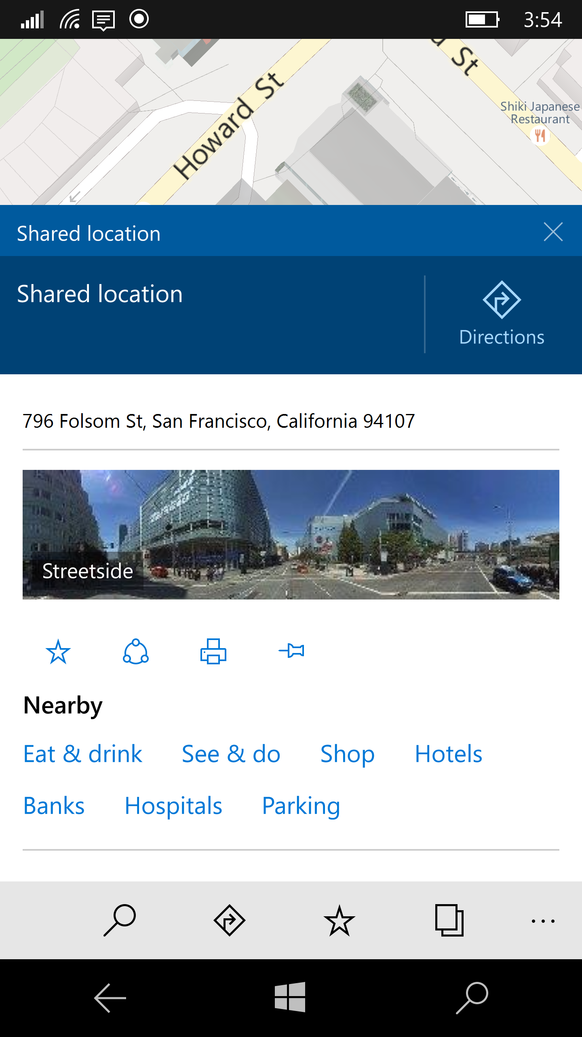
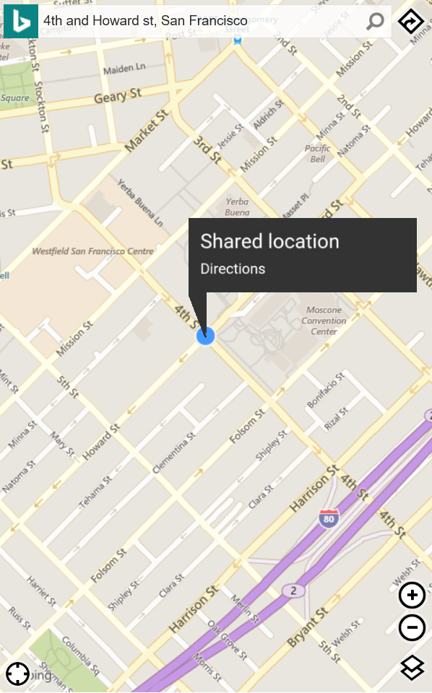
Maps across Microsoft Products

Slide 9
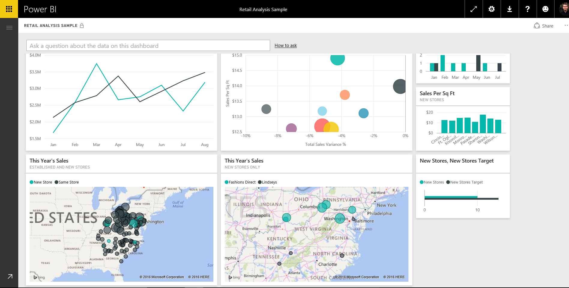
Maps across Microsoft Products

Slide 10
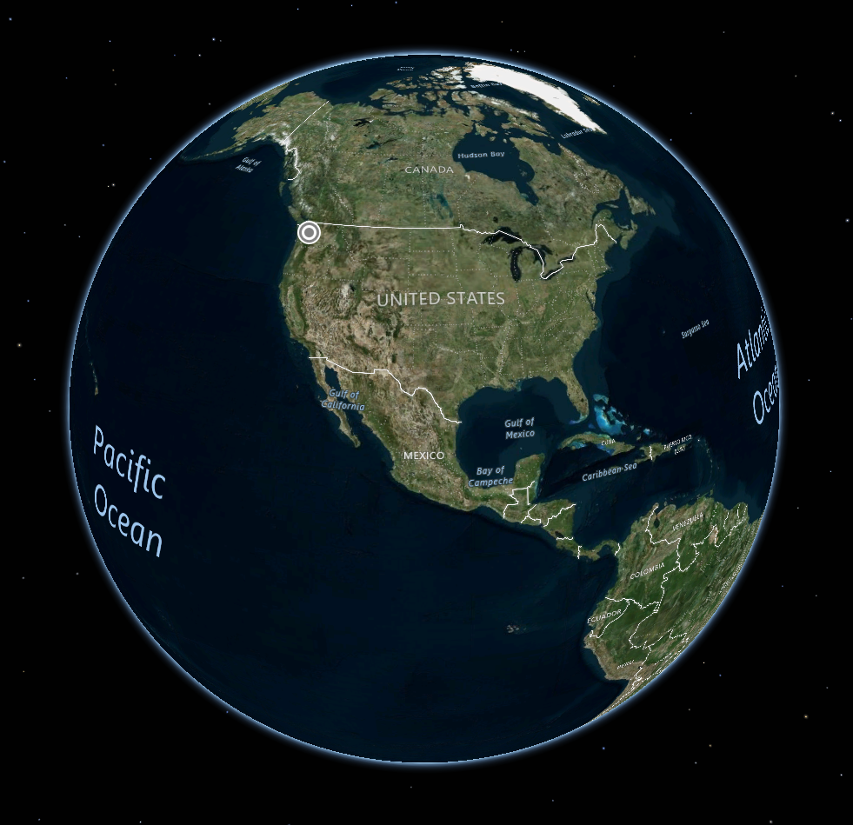
Native Map Control (UWP)

Slide 11
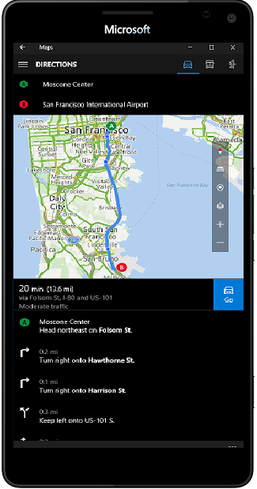
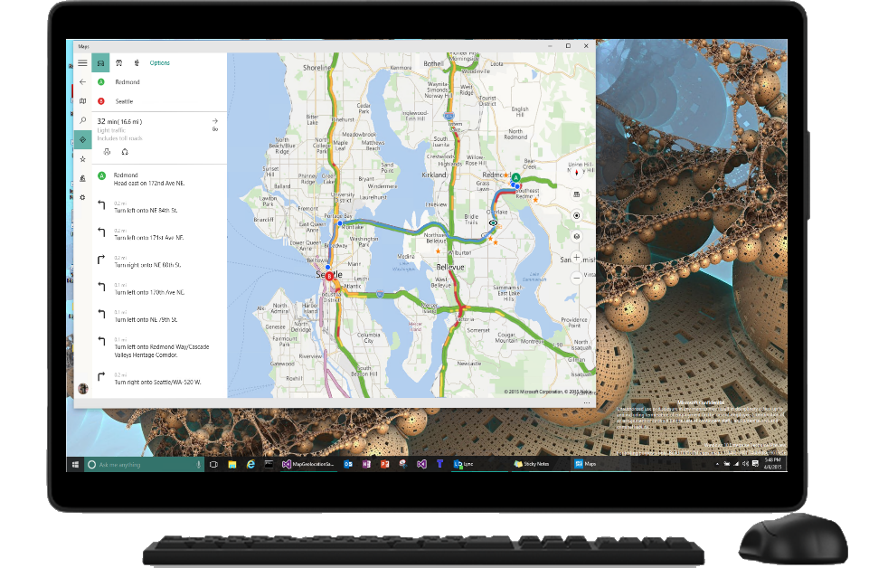
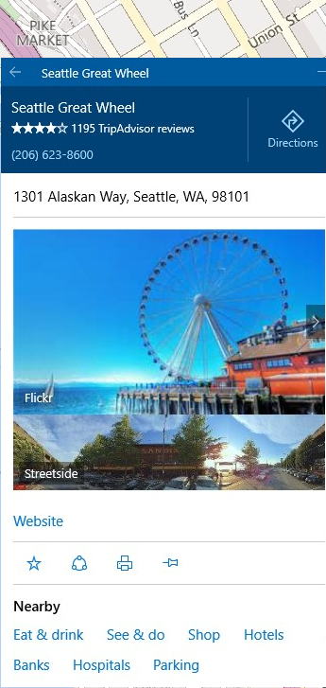
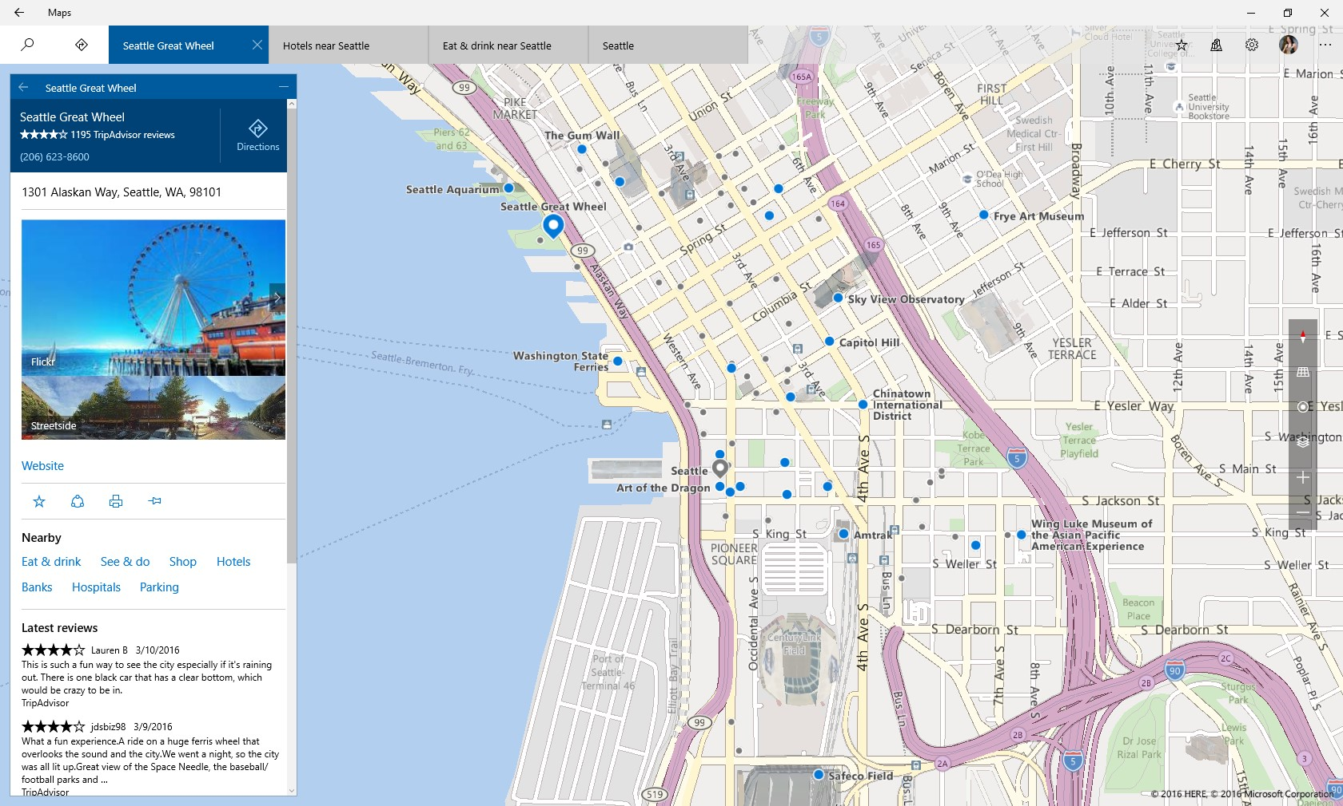
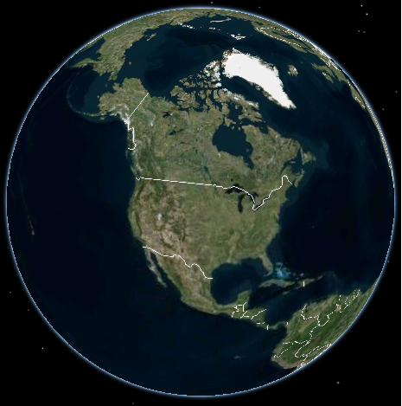
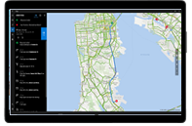


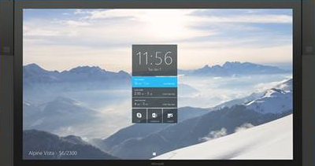

Maps across Windows Devices
Mobile
Desktop
Arriving soon
IoT
XBox One
Holographic
Surface Hub

Slide 12
Maps across Verticals

Slide 13
Code Snippets

Slide 14
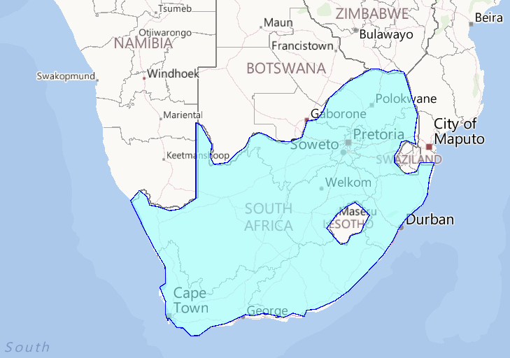
Polygon with holes
List<BasicGeoposition> innerPositions, outerPositions;
outerPositions = new List<BasicGeoposition>(){ /* List Outer Positions */ };
innerPositions = new List<BasicGeoposition>(){ /* List Inner Positions */ };
Geopath outerRing = new Geopath(outerPositions);
Geopath innerRing = new Geopath(innerPositions);
MapPolygon polygon = new MapPolygon();
polygon.Paths.Add(outerRing);
polygon.Paths.Add(innerRing);
polygon.FillColor = Color.FromArgb(150, 150, 255, 255);
map.MapElements.Add(polygon);
Polygon with holes

Slide 15
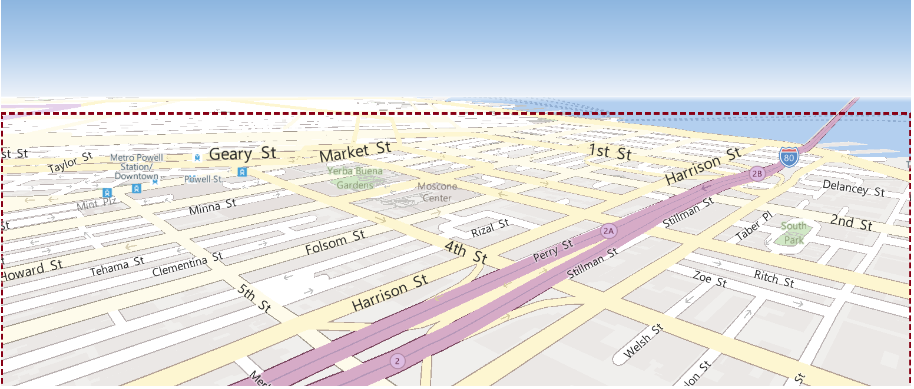
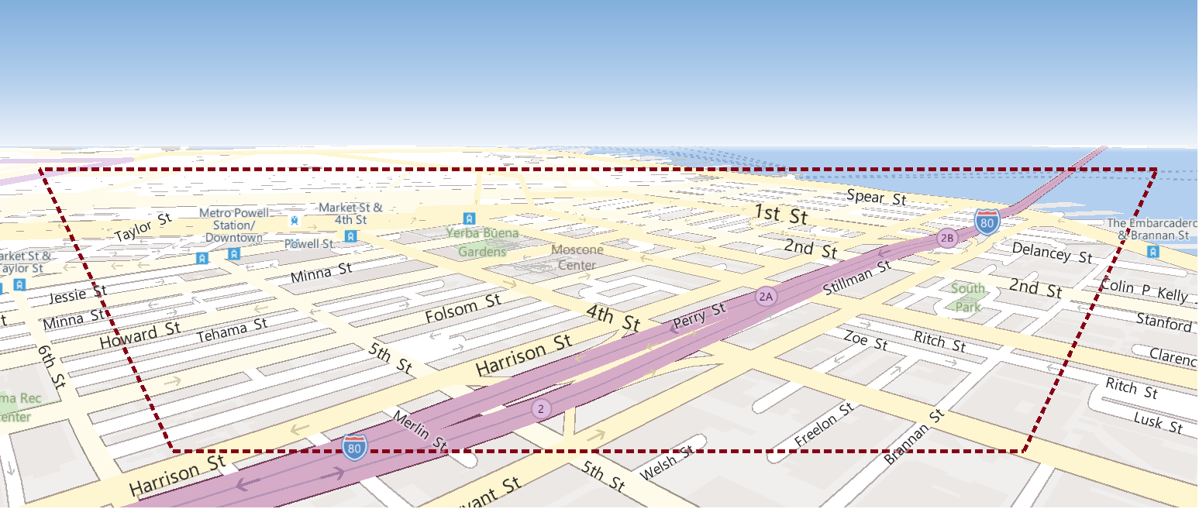
Get “Near” Visible Region
MapPolygon visibleRegion;
// Get "Near" Visible Region.
Geopath visibleRegionPath = map.GetVisibleRegion(MapVisibleRegionKind.Near);
// Draw Polygon depicting "Near" Visible Region.
visibleRegion = new MapPolygon();
visibleRegion.Paths.Add(visibleRegionPath);
visibleRegion.FillColor = Color.FromArgb(1, 255, 255, 255);
visibleRegion.StrokeThickness = 4;
visibleRegion.StrokeDashed = true;
visibleRegion.StrokeColor = Color.FromArgb(255, 25, 255, 255);
map.MapElements.Add(visibleRegion);
Get “Near” Visible Region – Flat View:
Get “Near” Visible Region – Zoomed Out & Tilted:

Slide 16
Demo: Using Native Map Control (UWP) & REST Services
Apurva Thanky

Slide 17


Bing Spatial Data Service Updates

Slide 18
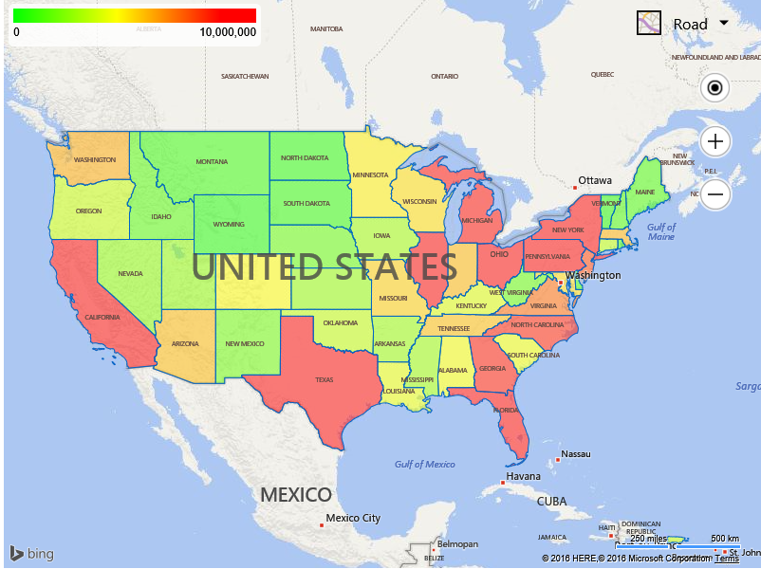
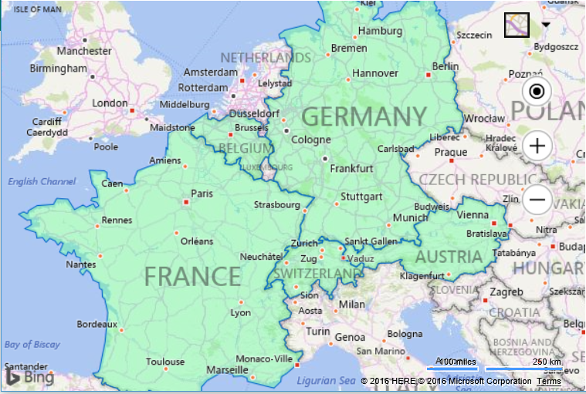
Bing Spatial Data Services
New Features
Automatically reprojects Shapefiles to WGS84
Roadmap
Bing Places integration
GeoData Directory
Current Features
Upload and host data. Expose as a spatial REST service
Access administrative boundaries from Bing Maps
Batch geocoding & reverse geocoding
Upload KML and Shapefiles as data sources

Slide 19
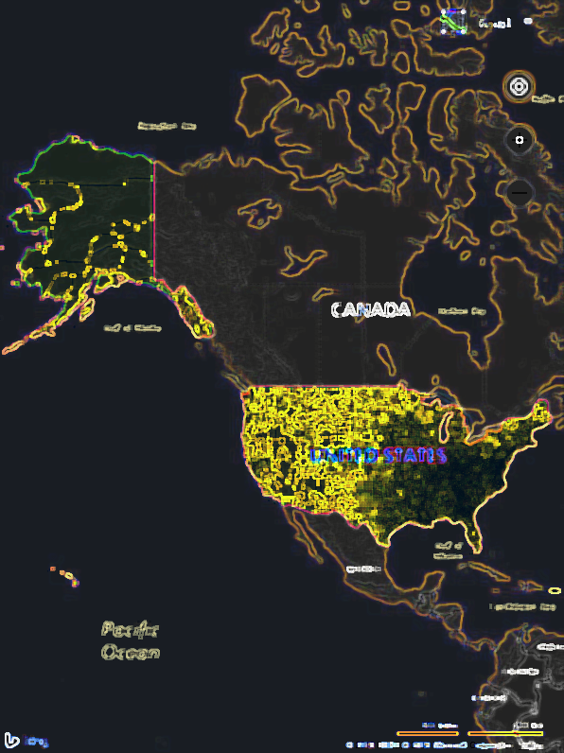
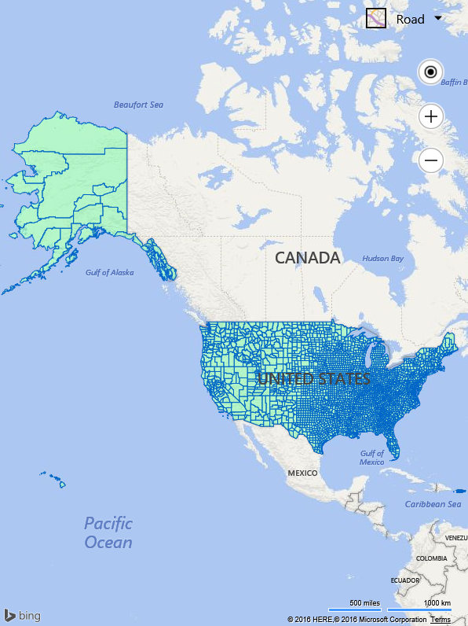
Release
Announcement:
Bing Maps V8 SDK Preview

Slide 20
Maps Across Platforms
Percent of JavaScript Sessions by Operating System
Approximately 70% of Bing Maps apps use it for Business Intelligence (including Asset Tracking)

Slide 21
Bing Maps V8 SDK – Preview release
Microsoft’s modern web mapping SDK
High Performance
Uses HTML5 Canvas
Feature Rich
Developer Friendly
Supports thousands of shapes
Vector map labels
Less code, more power
Improved Interactive SDK
8 new modules and lots of new features
Many more features planned
Scenario Driven Design
5 years of customer feedback used
Better aligns with the type of apps developers are trying to build with Bing Maps
New ‘lite’ mode available
Release Branches
V7 backwards compatibility

Slide 22
V7 Key Features
Bing Maps V7 SDK
Core Classes & Features
Map
Pushpins, Polylines, Polygons
Location, LocationRect, Point
Tile layers
Infobox
Modules
Advance Shapes
Directions
Search
Traffic

Slide 23
V8 Key Features
Bing Maps V8 SDK
Core Classes & Features
Map
Pushpins, Polylines, Polygons
Location, LocationRect, Point
Tile layers
Infobox
Additional Map Styles
Streetside imagery
Vector Map Labels
Test Data Generator
Point Compression
Modules
Advance Shapes
Directions
Search
Traffic
Autosuggest
Clustering
Drawing Tools
Heatmap
GeoJSON
Spatial Data Services
Spatial Math
Well Known Text

Slide 24
Release Branches
Access the latest and greatest features at your own pace
Experimental
Release
Frozen
New features have been fully tested and initial bugs have been fixed
New features available right away
New features added only after they have been in the release branch for while and all bugs have been fixed
Features still being tested and may have bugs
Not recommended for production apps
Equivalent to past release standards of Bing Maps
Recommended for production apps
Recommended for mission critical apps that don’t need new features right away
❆

Slide 25
Demo: Bing Maps V8 Interactive SDK
Ricky Brundritt

Slide 26
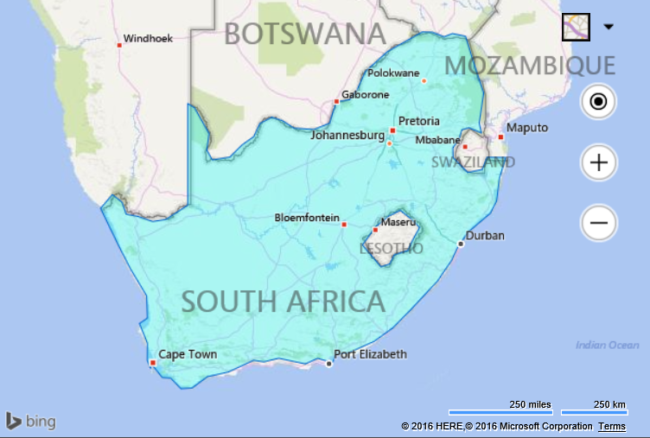
Add polygon with a hole to the map
var polygon = new Microsoft.Maps.Polygon(/*ring data*/);
Bing Maps V7 – 107 characters
Microsoft.Maps.loadModule('Microsoft.Maps.AdvancedShapes', function () {
map.entities.push(polygon);
});
Bing Maps V8 – 28 characters, 74% savings
map.entities.push(polygon);
V8 doesn’t require a module to support
polygons with holes, it supports them by
default

Slide 27
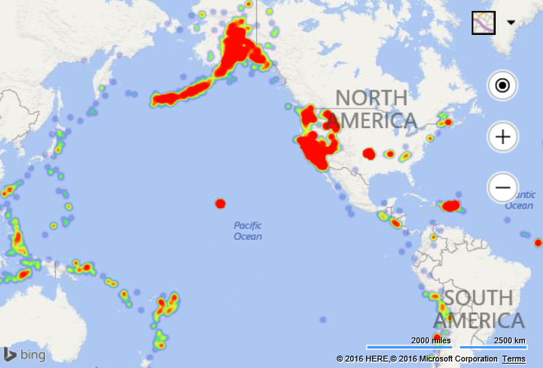
Load two modules at the same time
Bing Maps V7 – 144 characters
Microsoft.Maps.loadModule('Microsoft.Maps.GeoJson', function () {
Microsoft.Maps.loadModule('Microsoft.Maps.HeatMap', function () {
});
});
Bing Maps V8 – 98 characters, 32% savings
Microsoft.Maps.loadModule(['Microsoft.Maps.GeoJson', 'Microsoft.Maps.HeatMap'], function () {
});
With V8 you can load multiple modules at the
same time!
Modules loaded in parallel rather than
synchronously
The more modules you use, the more this
optimization will benefit you

Slide 28
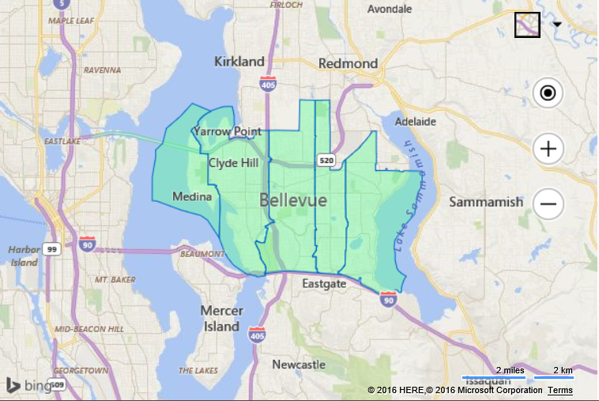
Display boundary of 5 zip codes
Bing Maps V7 – 2,444 characters
Bing Maps V8 – 466 characters, 81% savings
var zipCodes = ['98004', '98005', '98007', '98008', '98039'];
var options = {
entityType: 'Postcode1'
};
Microsoft.Maps.loadModule('Microsoft.Maps.SpatialDataService', function () {
Microsoft.Maps.SpatialDataService.GeoDataAPIManager.getBoundary(zipCodes, options, map,
function (data) {
if (data.results && data.results.length > 0) {
map.entities.push(data.results[0].Polygons);
}
});
});
V8 seamlessly integrates with Bing Maps services
Added Benefits
Automatic culture and region detection
Automatically uses a sessions key
Seamless integration with Bing Maps services

Slide 29
Demo: Real World example
Ricky Brundritt

Slide 30

Bing Maps V8 What’s Next

Slide 31
V8: What’s Next
Mobile Support
TypeScript Definitions
Extended
Localization
Export Map as Image
Embedded Map API
Configuration Driven Maps

Slide 32
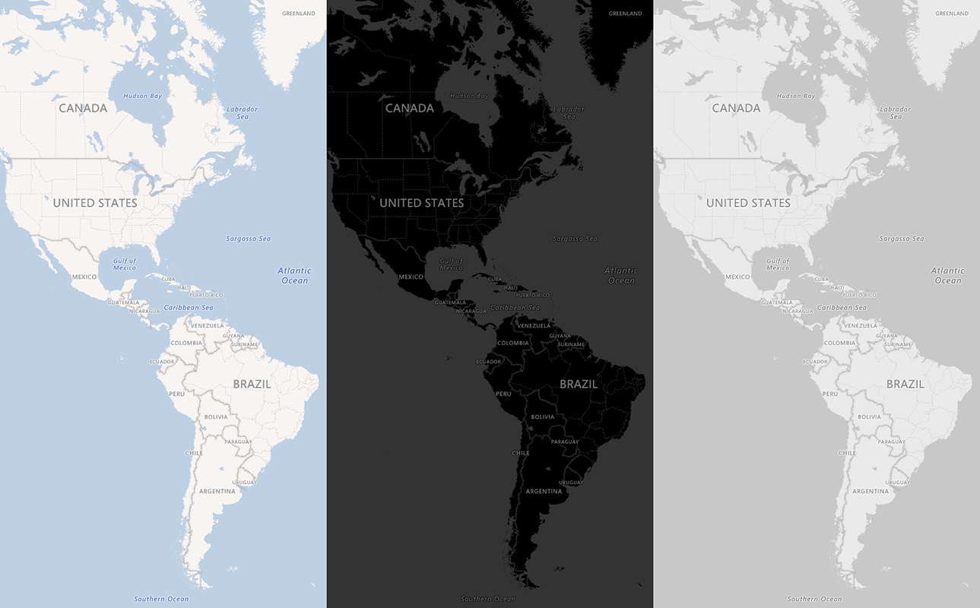
V8: What’s Next – Map Styles
Dark and Greyscale road map styles which are better suited for Business Intelligence apps

Slide 33
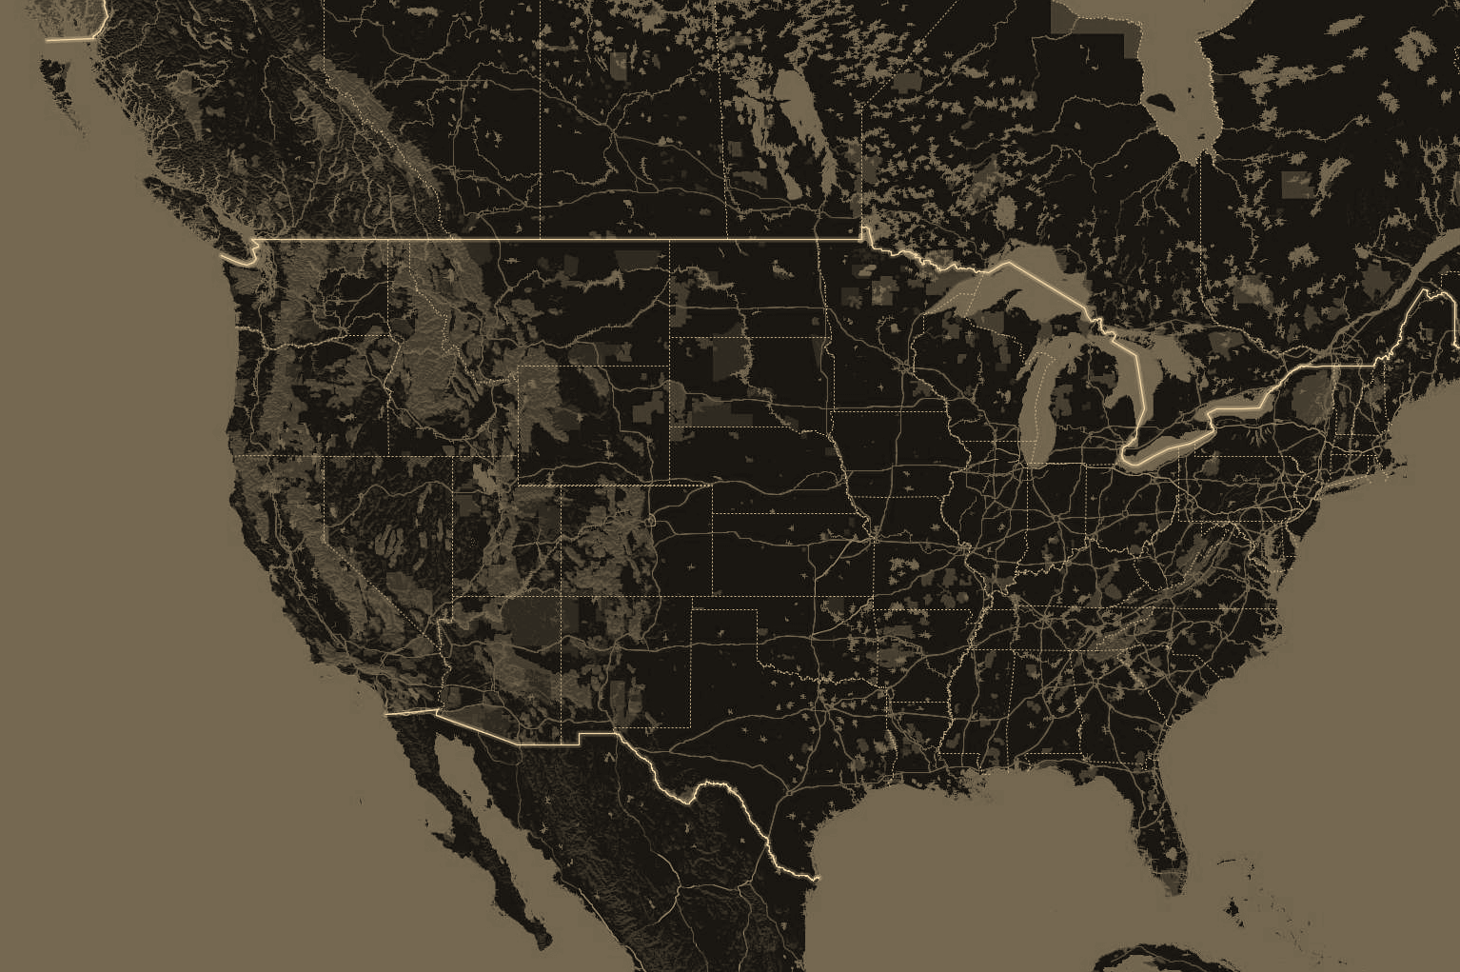
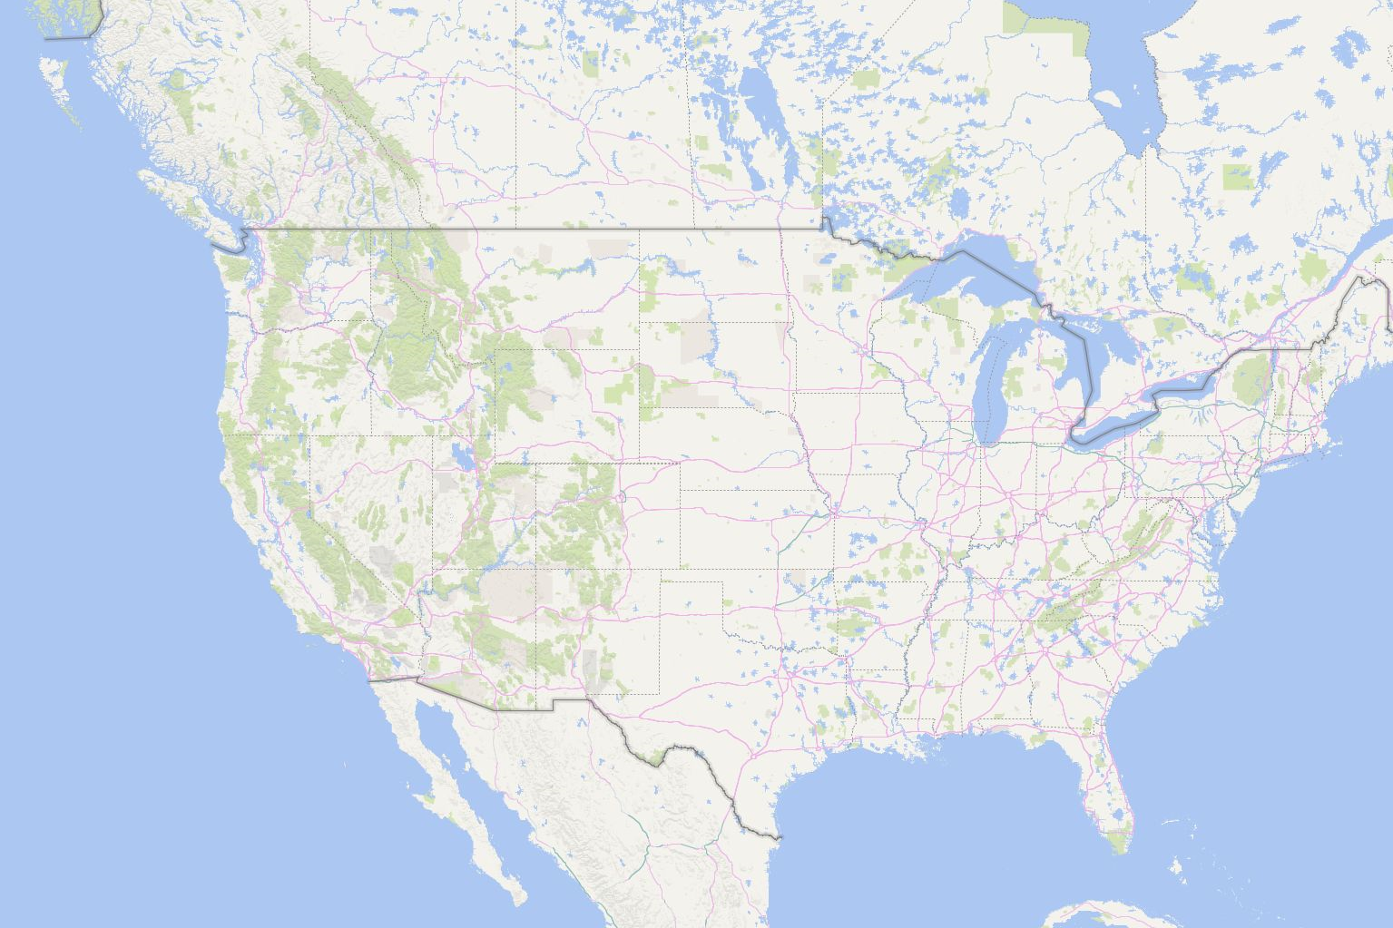
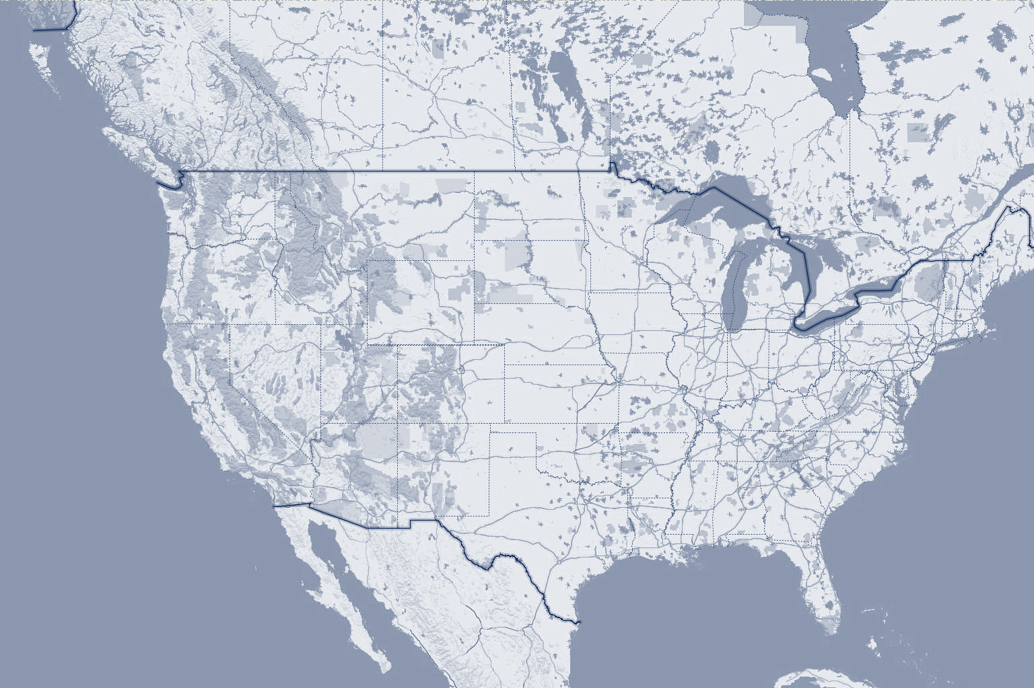
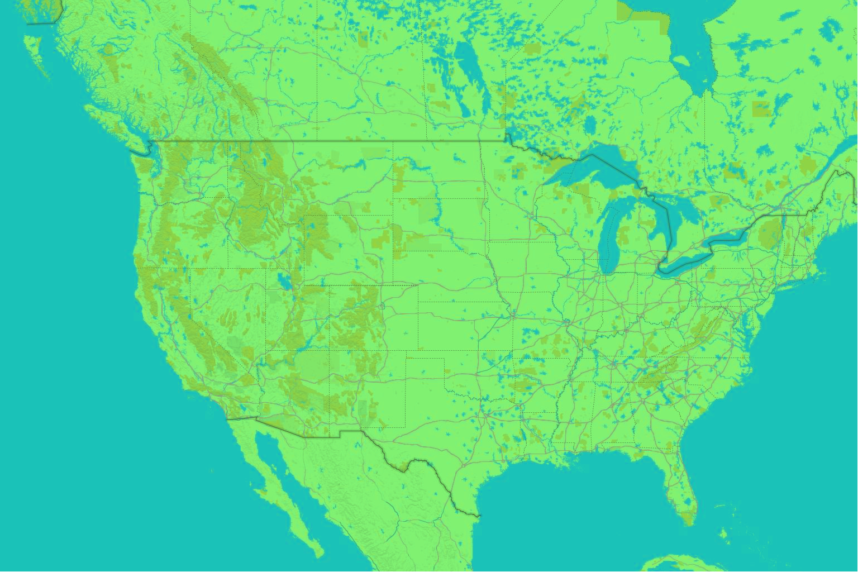
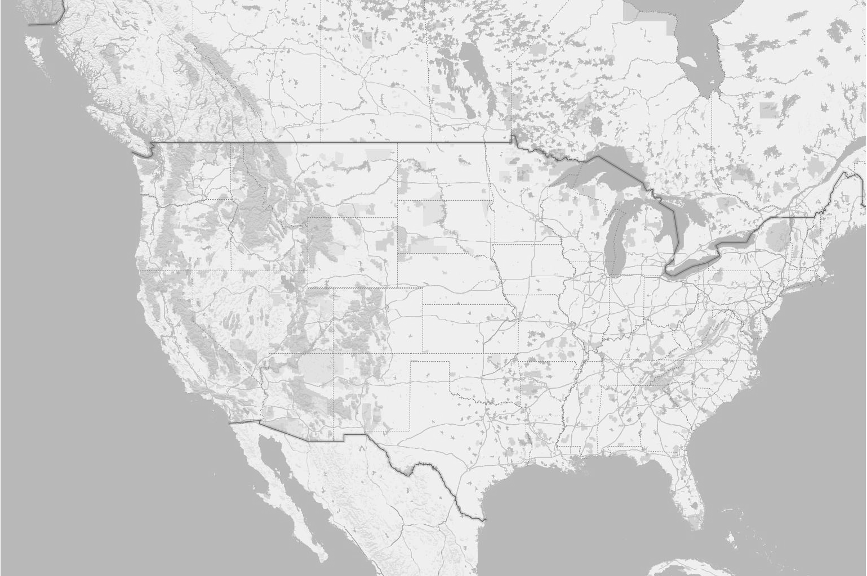
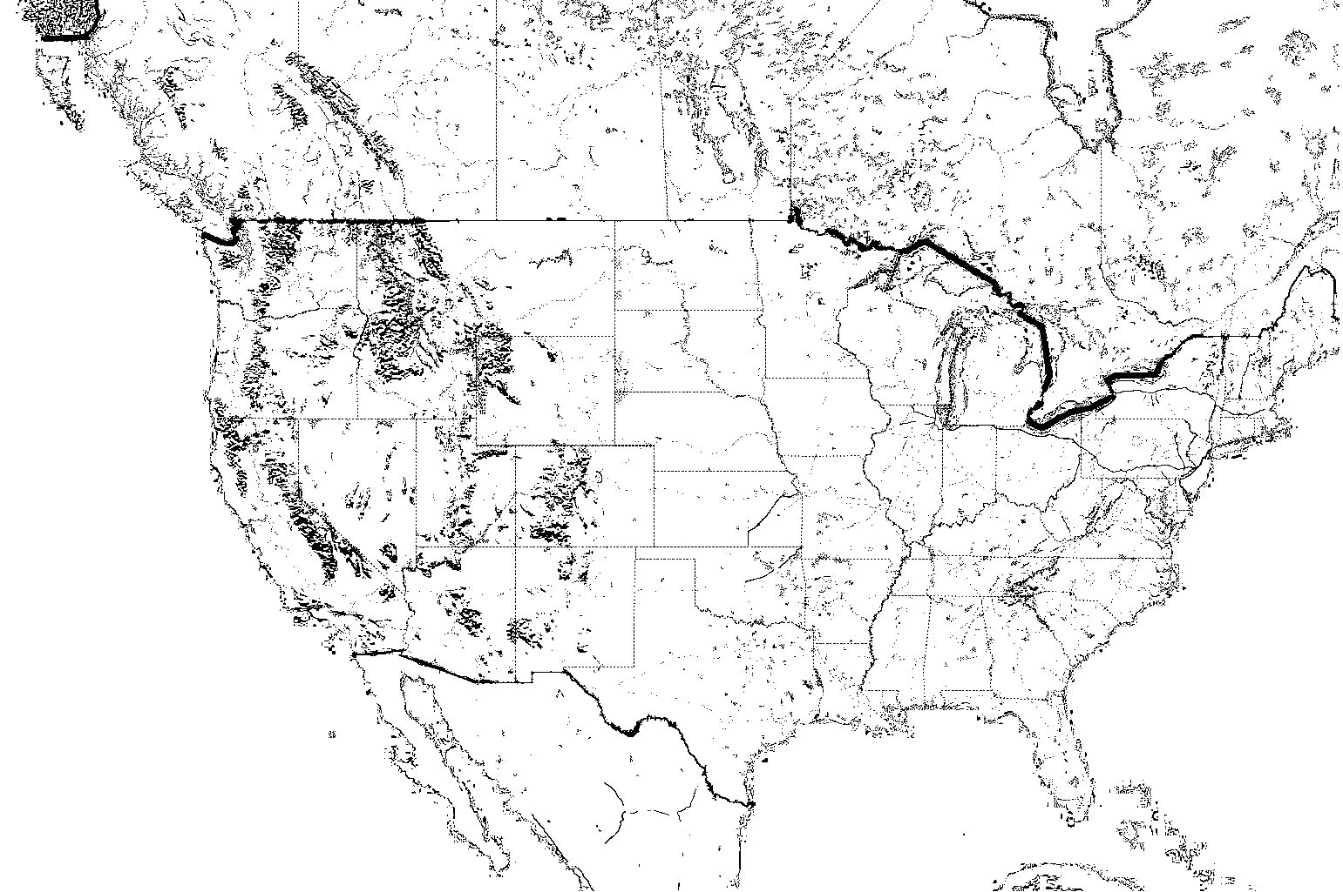
V8: What’s Next – Image Filters
Apply an image filter to the base map tiles to create a custom map style

Slide 34
V8: What’s Next - Geometry Calculations
Synchronous and Asynchronous Calculations
Types of Calculations
  Area, Distance, Length
  Binary Operations
  Buffer
  Concave & Convex Hulls
  Delaunay Triangles
  Intersects
  IsValid, MakeValid
  Center & Bounds
  Nearest Locations, Shortest Line between shapes
  Reduce
  Rotate
  Snapping
  Voronoi Diagrams
Binary Operations
B
B
B
B
A
A
A
A
Two Shapes A and B
difference(A, B)
difference(B, A)
B
A
intersection(A, B)
symDifference(A, B)
union(A, B)

Slide 35
Demo: Bing Maps V8 Spatial Math
Ricky Brundritt

Slide 36
Call to Action
http://aka.ms/MapsAtBuild
  How to get access to the Native Map Control (UWP) and V8 SDK
  Recap of all map sessions at Build
  Links to documentation & code samples
  How to provide feedback

Slide 37
Q&A
Apurva Thanky
apthanky@microsoft.com
Ricky Brundritt
richbrun@microsoft.com

Slide 38

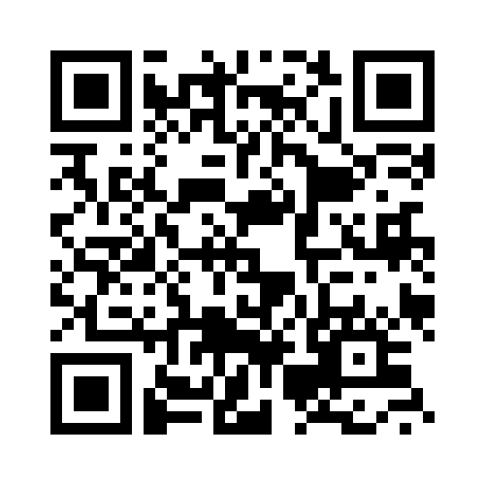

Please Complete An Evaluation Form
Your input is important!
or

