Slide 2
What’s next for Microsoft Edge
Session 864
Charles Morris & Sean Lyndersay
Microsoft Edge

Slide 3
What we’ll cover
Microsoft Edge: Year One
What’s new for end-users
What’s new for web developers
Ready for Enterprise
Web apps made simple

Slide 4

YEAR ONE

Slide 5

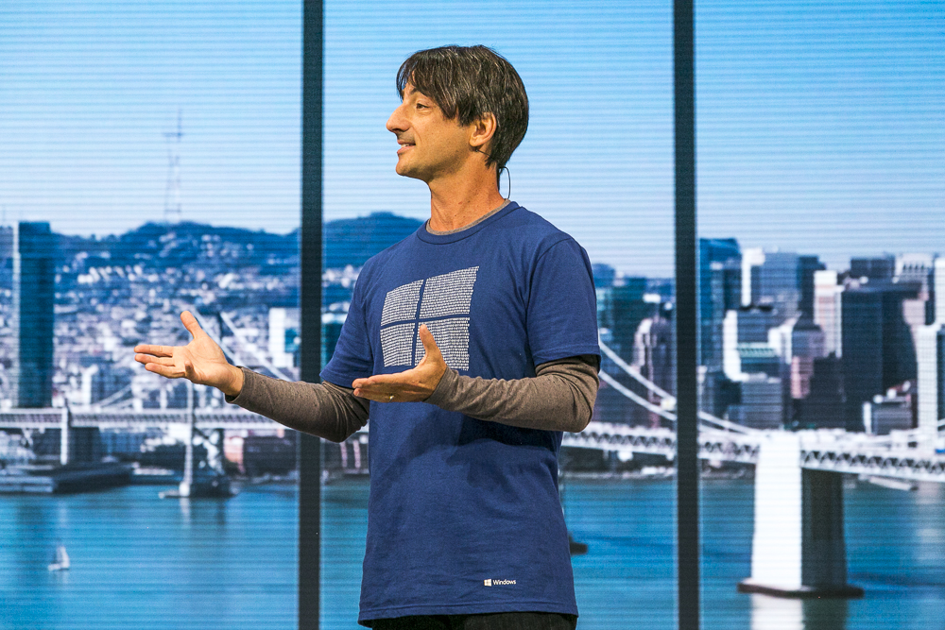
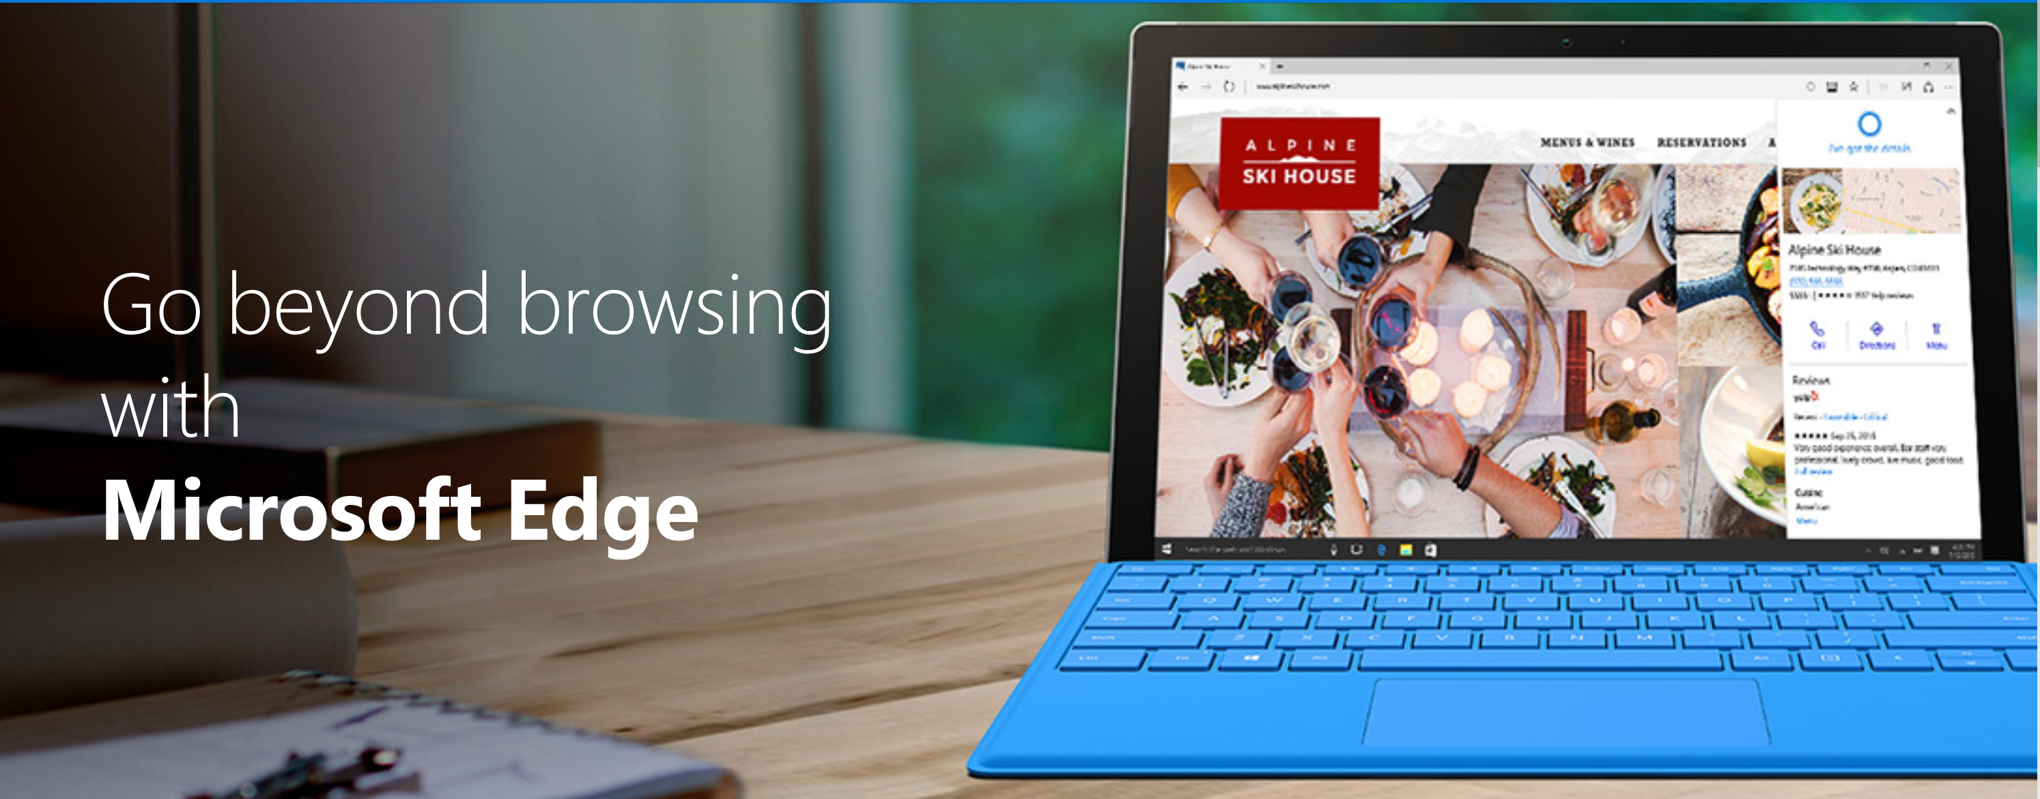
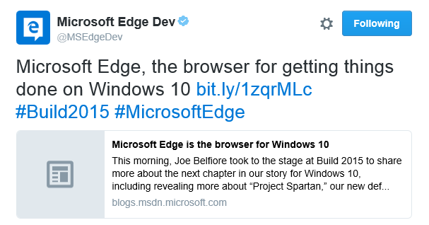
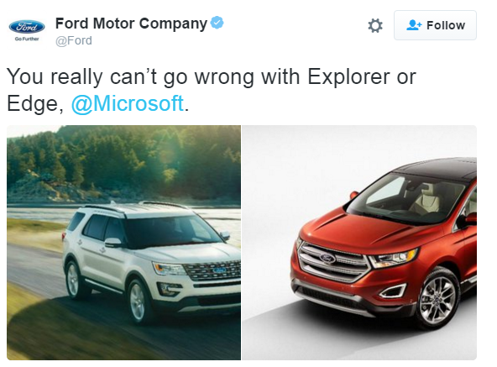
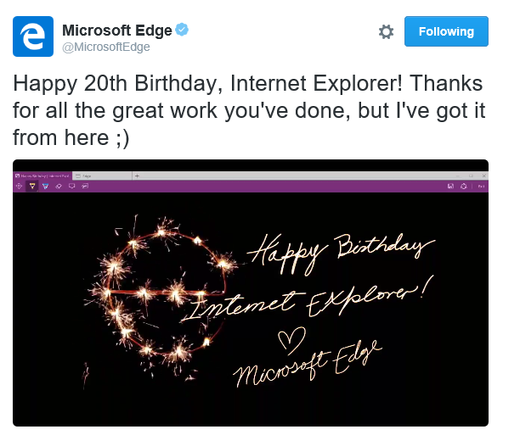
2015

Slide 6
Why did you build a new browser?

Slide 7
Two reasons:
Break from the past
Ready for the future

Slide 8
Pre-Windows 10
Windows 10
Microsoft Edge: EdgeHTML
Internet Explorer: MSHTML
Internet Explorer: MSHTML
Interoperability
Compatibility
Interoperability & compatibility

Default Browser
Legacy Support

Versioned “document modes”
IE11
IE10
IE9
IE8
IE7
IE5.5
IE11
IE10
IE9
IE8
IE7
IE5.5
New JS-based extensions
ActiveX, BHOs, Toolbars

ActiveX, BHOs, Toolbars
For modern HTML websites
For intranet or Enterprise Mode sites primarily

For modern HTML websites, intranet & Enterprise Mode

Slide 9
Our core design tenets
First, build an amazing browser
Be bold and forward-looking
Ship fast, try new things, learn and always get better

Slide 10
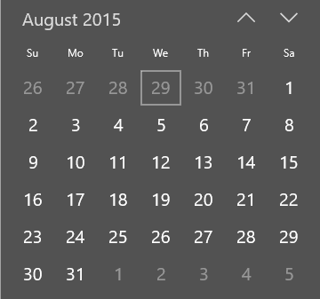
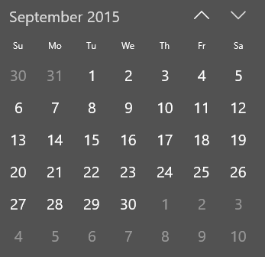
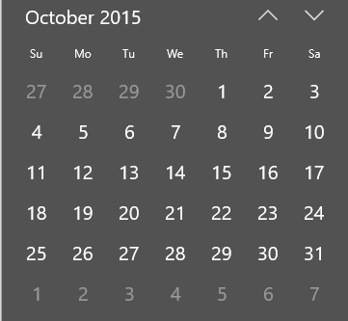
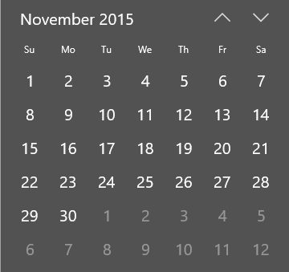
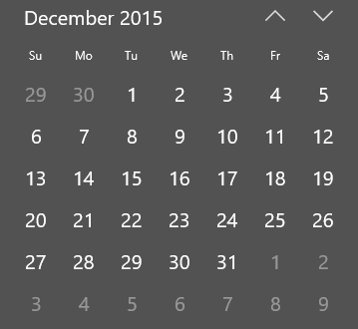
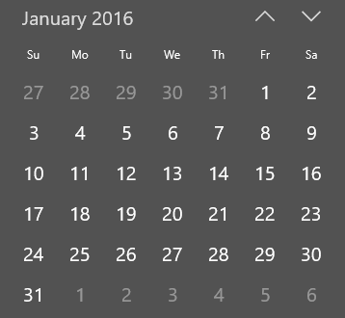
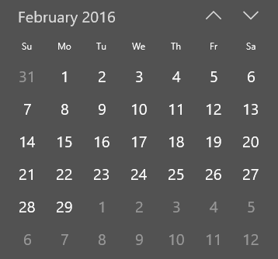
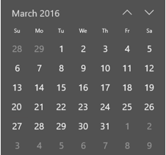
8 months since launch

Slide 11
Monthly Active Devices

Slide 12

Monthly Active Devices

Slide 13
Browsing share increase Jan to Feb 2016
2
X
Source: Net Applications

Slide 14

New browser usage share growth since launch
Source: Statcounter

Slide 15
New features and substantial changes
Since August…
12
Update releases
128
6,527
Bug fixes

Slide 16
Reliability improvements
Crash Free Sessions

Slide 17
Microsoft Edge – November Update
Open downloads folder directly from download notification
Scroll wheel responsiveness while page is loading
Drag and drop support for sites like OneDrive and Dropbox
Pause/resume downloads
F12 docking
Launch a second Microsoft Edge window from various shell entrypoints (e.g., middle-click Edge on taskbar)
Reading Bar in PDF for easier navigation (fit, go to, save, print, zoom) along with significant other improvements to PDF viewing experience in Edge
PDF interaction improvements like double tap to zoom and context menu within PDFs
Ask Cortana support with content in PDFs
Hardening to prevent websites from spamming alert() dialog boxes that cause DOS
HTML5 video and audio control context menus
Support for more file types like .svg and .xml
Casting audio, video, and image content to Miracast/DLNA
Improvements to notifications and address bar info (badges)
Integration of ‘Send Feedback’ with Windows Feedback tool to allow for +1 and improved tracking of issues you report
Accessibility, Reliability, Security improvements and performance tuning
Improved first-run experience for setting up Edge on 1st launch post upgrade
Importing favorites is easier to find
Favorites order is now preserved when you import from IE11 or Chrome
Better handling of really long favorite URLs/names
Tab Preview – hover to see a tab thumbnail without switching to it
Dragging a tab to create a new window where you dropped it
Roaming Favorites, Reading list and passwords
‘Save target as’ context menu to easily download/save files without navigating

Slide 18




Microsoft EdgeHTML – November Update
asm.js
ES2015:
Classes,
Destructuring (behind flag),
Conformance updates
ES2016:
Async/Await (behind flag),
Exponentiation operator (behind flag),
<template>
<picture>
<img srcset sizes>
<meter>
<a download>
<input type=text selectionDirection>
<input type=datetime-local>
<input type=time>
SVG <foreignobject>
oninvalid event
CSS filters (removed flag)
CSS initial, unset
CSS mutability pseudo-classes
CSS range pseudo-classes
Canvas ellipse
Canvas blending modes
Pointer Lock
WebRTC – Object RTC API

Slide 19
Demo
<picture> element

Slide 20
Looking forward

Slide 21
We are listening and learning
Telemetry
Feedback
Flighting

Slide 22
Organized around listening
Rank | Title | Feedback Type | Status
1 | Provide a modern extension/plugin model and extension/plugin store for Edge | Feature Request | Targeted for next version. Scenario 165079
2 | Bring back download prompt and option to save as on PC | Feature Takeback | Completed for next version. Deliverable 3597679
3 | Users report that Edge crashes or hangs frequently on desktop | Feedback | Work is ongoing in current and next version.
4 | Build ad blocking features into the browser | Feature Request | Targeted for next version. Deliverable 4682811
5 | Integrate Bing translator into the browser | Feature Request | Targeted for next version.
6 | Users report problems with websites that don't look right or don't work properly in Edge | Feedback | Work is ongoing in next version.
7 | Add the ability to swipe to navigate back and forward in Edge | Feature Takeback | Targeted for next version. Deliverable 262131
8 | Enterprise Feature Request: Provide a mechanism for deployment of favorites | Feature Request | Targeted for after the next version. Deliverable 6099728
9 | Edge should show a menu when you right click on the back button, allowing you to skip back several pages (a.k.a travel log) | Feature Takeback | Completed for next version. Deliverable 764700
10 | In general, favorites are hard to manage and organize in Edge | Feedback | Work is ongoing in next version.

Slide 23
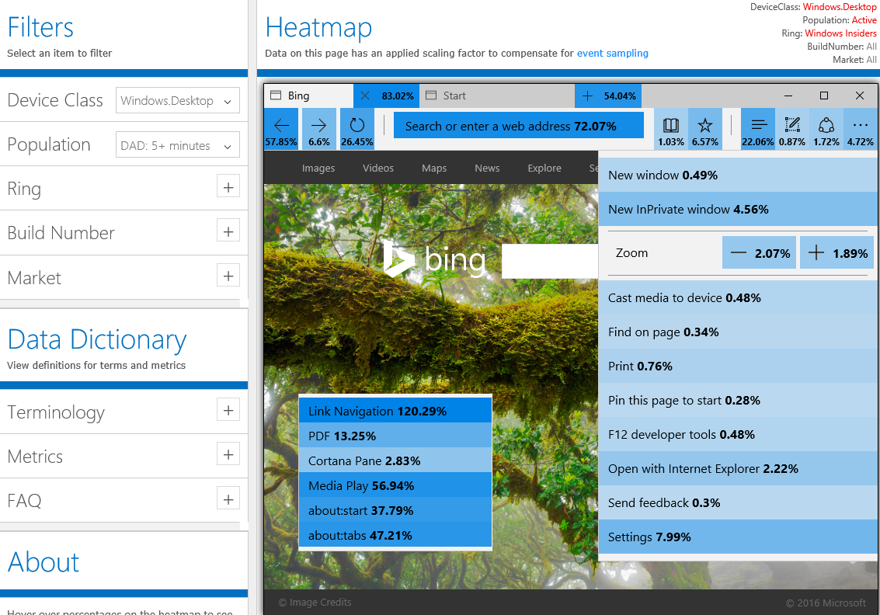
X%
X%
X%
X%
X%
X%
X%
X%
X%
X%
X%
X%
X%
X%
X%
X%
X%
X%
X%
X%
X%
X%
X%
X%
X%
X%
X%
X%
Anonymous, sampled data from our Insider population

Slide 24
What’s coming for end-users?
(Demos)

Slide 25
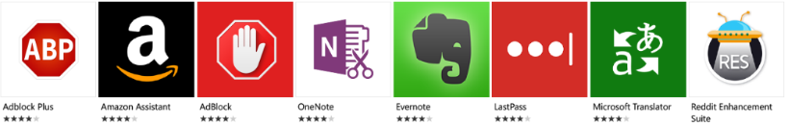

Extensions
We are working closely with a core set of partners to prove out the platform
Small set available today, more released over time.
Interested developers please go here:
http://aka.ms/extension-request

Slide 26
What’s coming for web developers?

Slide 27
2016 Edge Platform Priorities
Extensions
  Deliver a modern extension platform powered by web technologies and the Windows Store
  Accessibility
  Empower all Microsoft Edge customers through accessibility and inclusive design
Fundamentals
  Continue to reinforce Microsoft Edge fundamentals; security, performance and efficiency
New web standards
  Build thoughtfully for the future of the web
Openness & community
  Embrace more channels for community participation share what we plan & learn

Slide 28
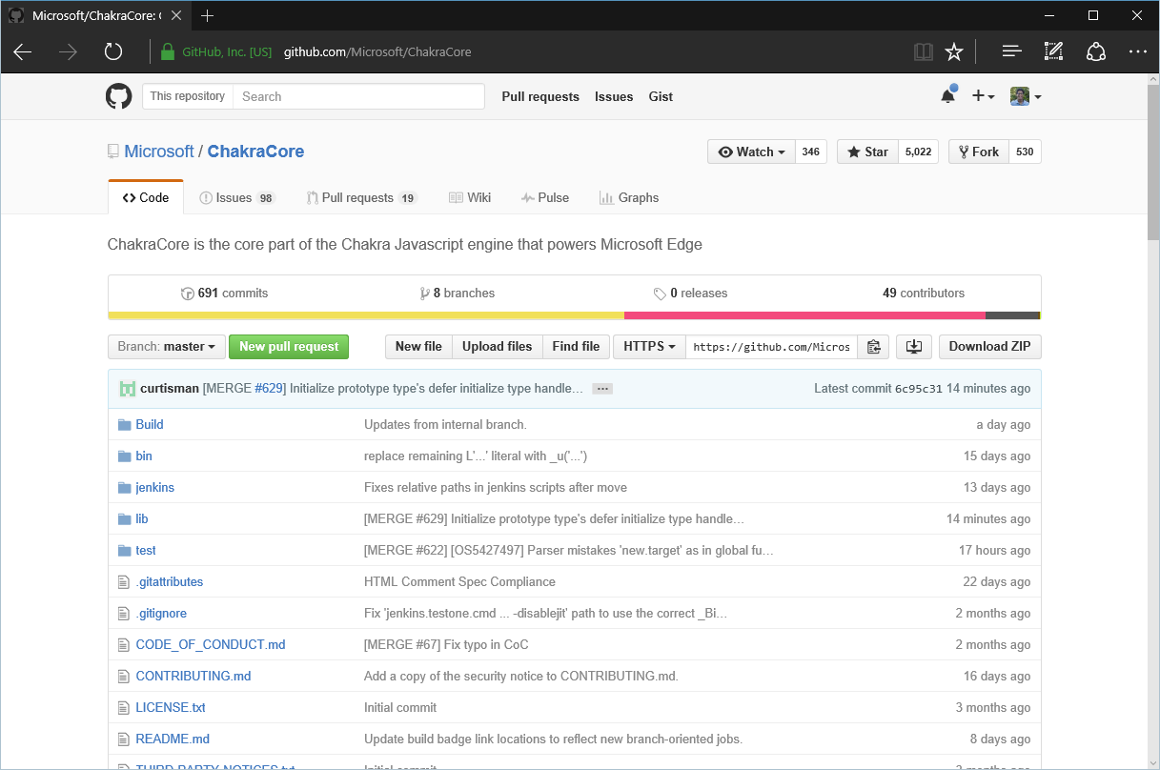
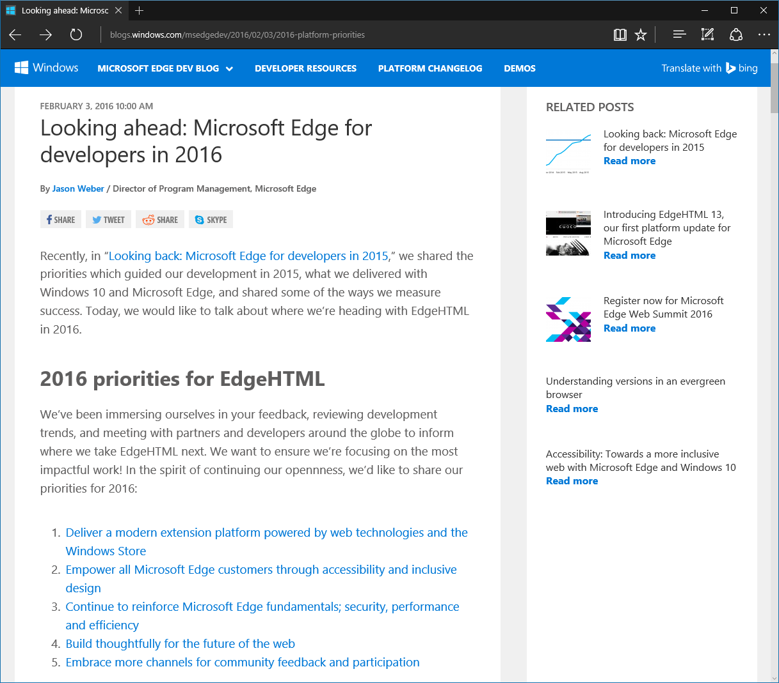
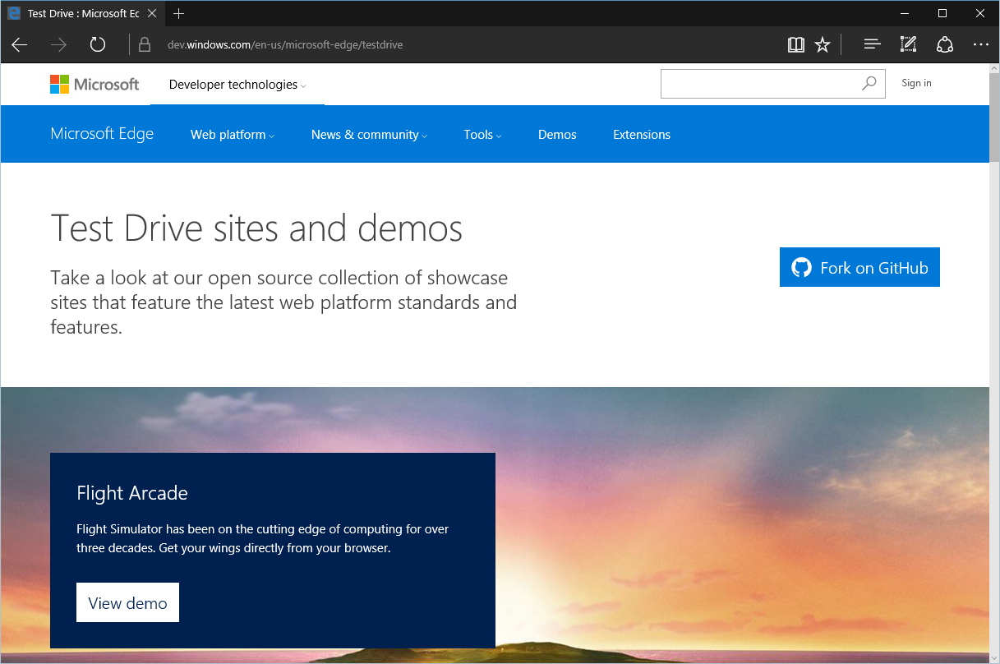
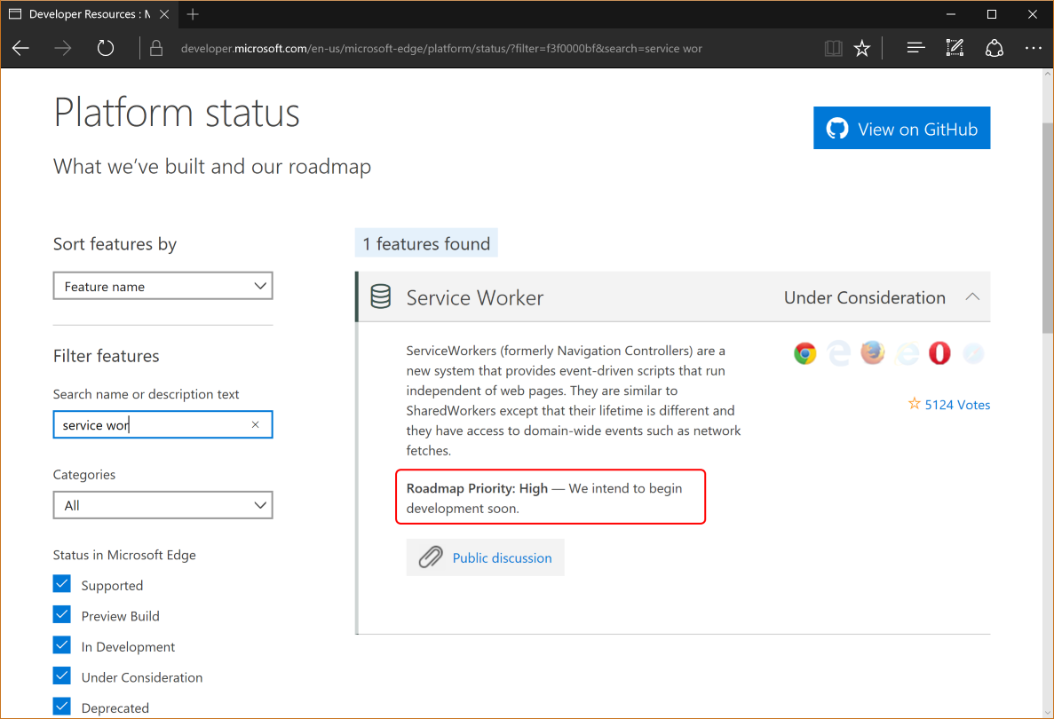
Openness & community

Slide 29

New EdgeHTML features coming soon
Beacon API
<input type="color">
ES2017: Object.entries/values
WOFF 2.0
VP9 codec support
ES2016: exponentiation
<output> element
FIDO 2.0 Web APIs
Fetch API
Web Notifications
ES2017: async/await
F12 Accessibility Inspection
OPUS codec support
Drag & drop directories
<time> element
Flash out-of-process
ES2016: destructuring
Speech Synthesis
F12: Device Profiles
High Resolution Time L2
HTML/Core Accessibility API mappings
Accessibility Name and Description API mappings
F12: DOM profiling
ES2016: Array.includes
High Contrast improvements

Slide 30





HTML5Test Scores
525
51
IE 336
402
458
486
11
12
13
14
484
48
414
9.3

Slide 31
Demo
Biometric login – FIDO 2.0
Skype for Web – ORTC & Web Notifications

Slide 32
Learn more
Time & Location | Title | Speakers | Session Code
Friday 12:30PM | Web Platform: an inside look at what’s new for Microsoft EdgeHTML, ChakraCore, F12 Tools, and extensions | Jacob Rossi David Catuhe | B847
Mini Theater | 5 Things You Didn’t Know You Can Build with Microsoft Edge | Charles Morris Jason McConnell | T645
Online | JavaScript’s Language Advancements in ChakraCore – ECMAScript’s Bleeding Edge | Brian Terlson | P461
Online / Mini Theater | A lap around ChakraCore – Microsoft’s Open Source JavaScript engine | Brian Terlson | P403
Online / Mini Theater | What’s next for the F12 Web Developer tools | Andy Sterland | P510

Slide 33
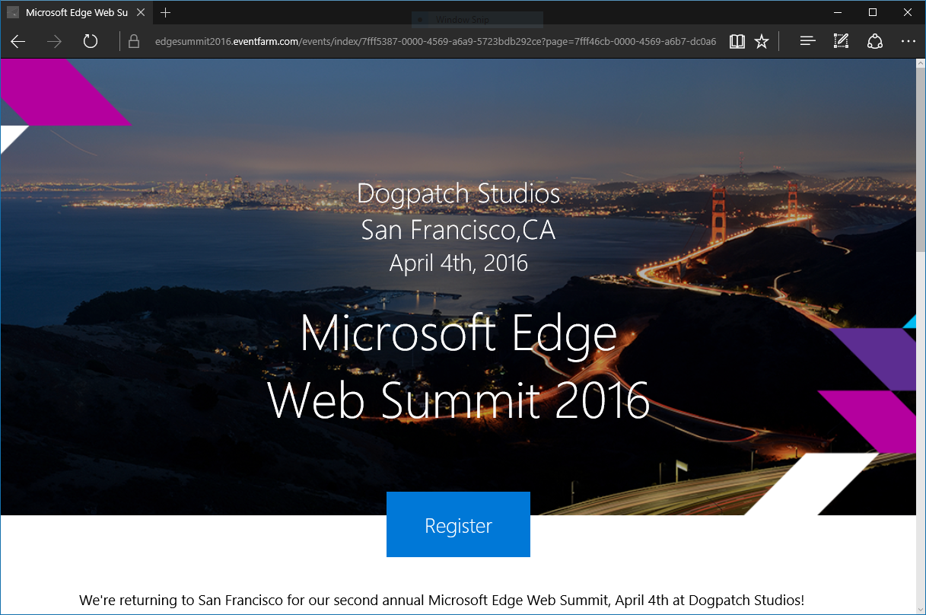
Microsoft Edge Web Summit
http://lanyrd.com/2016/edgesummit/schedule/

Slide 34
Ready for enterprise

Slide 35



Enterprise Strategy
Enterprise Web Needs
Legacy Compatibility
Modern Compatibility
Minimal changes = low risk
Reduces testing & upgrade costs across Windows 7, Windows 8.1, and Windows 10
Extends app investments with great backwards compatibility via Enterprise Mode
Better interoperability with modern web, with frequent updates
Faster, more secure web browsing
New end-user innovation

Slide 36
Enterprise Momentum
Enterprise Web Needs
Legacy Compatibility
Modern Compatibility
70+%
58%
Enterprises on IE11 by January 12th, 2016
Enterprises planning to test/deploy Edge in 2016
Sources: Microsoft internal account tracking / Enterprise customer survey (Dec 2015)

Slide 37
Enterprise features
http://technet.com/browser
Enterprise Mode
Higher fidelity IE8/IE7 emulation in IE11
(New!) Simplified Enterprise site list XML schema
Edge + IE
Configure Edge to open LOB sites in IE
(New!) Configure IE to open Internet sites in Edge
Enterprise Site Discovery
Discover which LOB sites are being used
Inventory ActiveX, legacy document modes
about:compat
(New!) See compatibility lists and features
applied on current machine

Slide 38
Demo
Edge + IE in the Enterprise

Slide 39
Web apps made simple

Slide 40
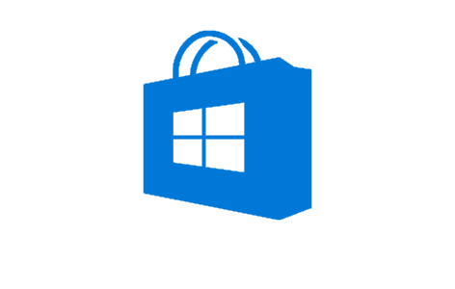
Hosted web apps
×
.appx
__
http://mysite.com
HTML
CSS
JS
Universal Windows Platform
http://aka.ms/webappsdocs

Slide 41

















Hosted web apps momentum

Slide 42
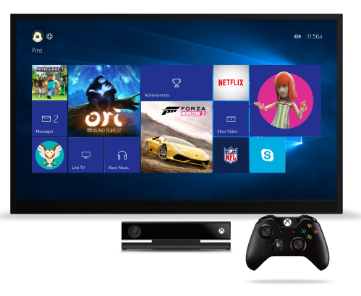
What’s next for web apps
Xbox One support
Support for W3C Gamepad API, directional navigation or mouse mode
Streamlined publishing
Just upload zip of W3C Manifest file & images to the Windows Store
Learn more
Thursday 3:30pm – Web Apps across Windows Devices (Jeff Burtoft, Kiril Seksenov)
Mini Theater - Magic Mirror: Powered by a Web App, Windows 10 on Raspberry Pi (Kiril Seksenov)
Online – Hosted Web Apps: Myth Busters (Jeff Burtoft, Kiril Seksenov)
Online - Web Frameworks (John-David Dalton)

Slide 43
In closing…

Slide 44
Recap
Microsoft Edge has had a great first year
We’re listening and improving continuously
Lots of big improvements coming in the next feature update

Slide 45


Connecting with the team
dev.
blog.
uservoice.
status.
microsoftedge.com
microsoftedge.com
microsoftedge.com
microsoftedge.com
microsoftedge.com
@MicrosoftEdge
Feedback Hub
@MSEdgeDev

Slide 46
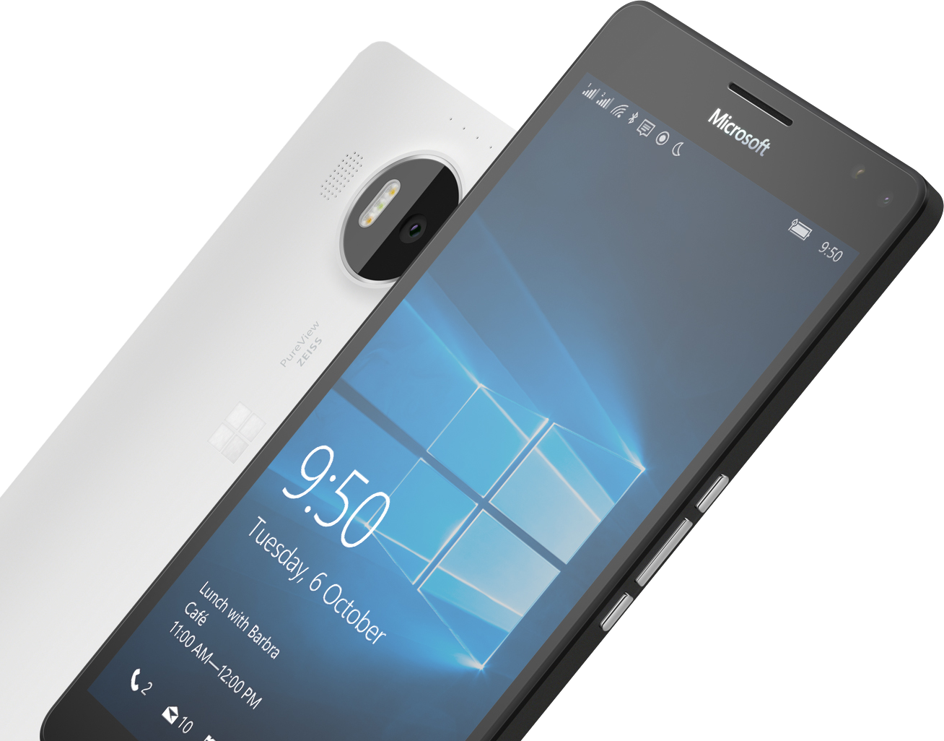
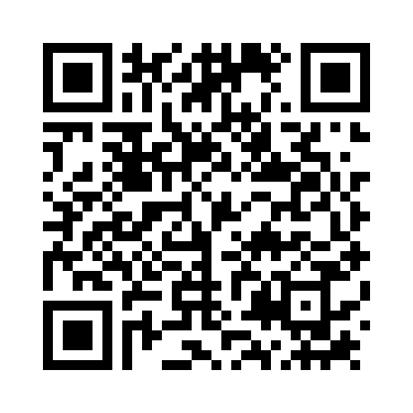

Please Complete An Evaluation Form
Your input is important!
or

