Slide 2
Microsoft Vision for IoT:
From Windows Devices to Azure
B861
Brett Bentsen James Osborne
Partner Group Program Manager Principal Program Manager
Windows 10 IoT Azure IoT

Slide 3
Agenda
IoT Market
Windows 10 IoT Overview
Azure IoT Overview
Call to Action

Slide 4
IoT Market

Slide 5
IoT 2010
Alarm clock
Refrigerator
Automobile
VoIP phone
Computer
Printer
Media player
Microwave
HOME
WORKPLACE
HOME
Coffee maker
Smart scale
Oven
Cell phone
HVAC
Vending
Security
Television

Slide 6
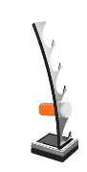
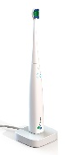

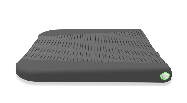

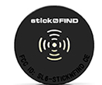


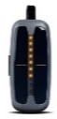

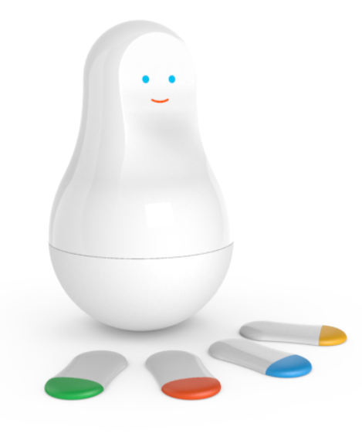
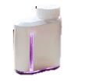

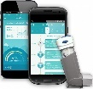


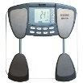

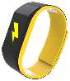
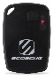
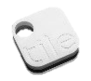

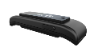



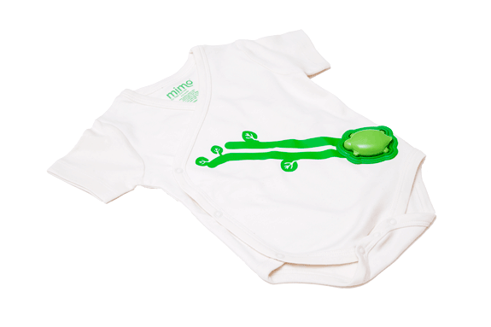
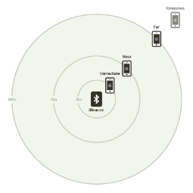
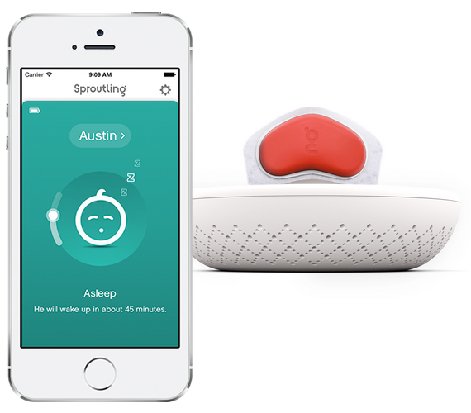


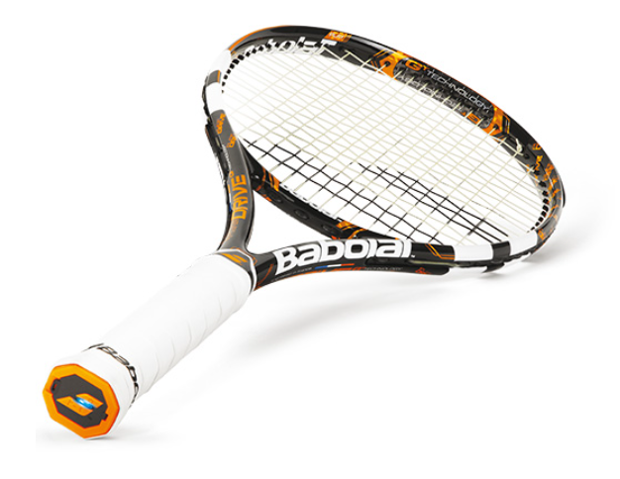

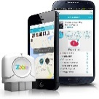





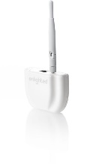




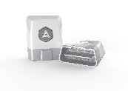
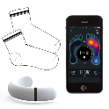
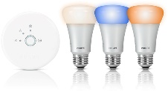




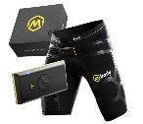
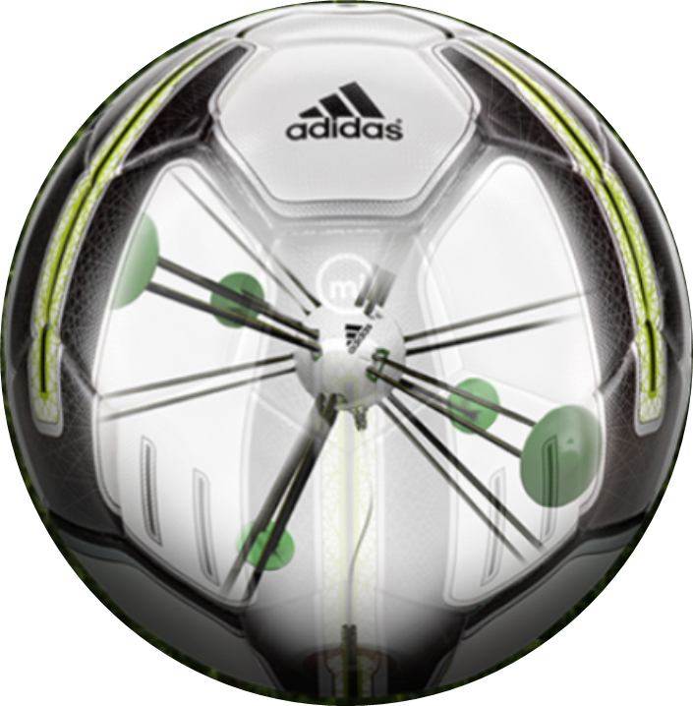


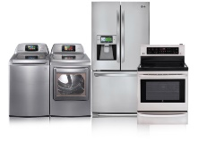
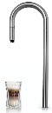
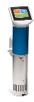
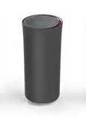

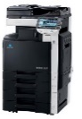
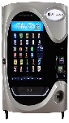
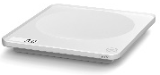

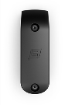
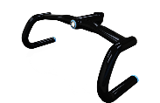
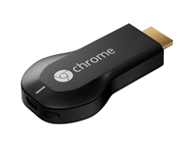


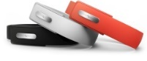

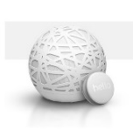
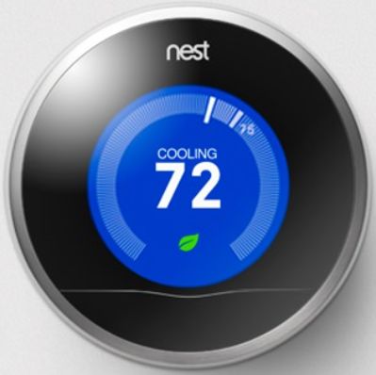
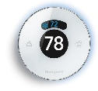
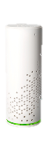
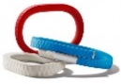
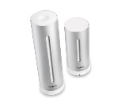
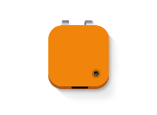
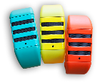
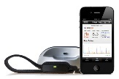




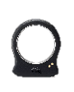


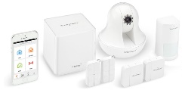
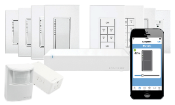
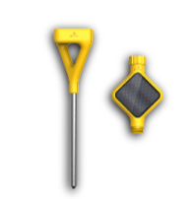
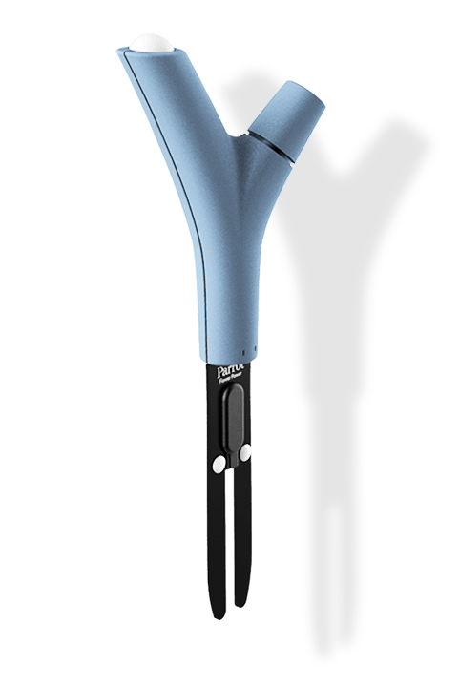

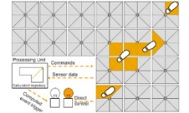










IoT 2016
Medication adherence
Health monitoring
Pet tracking
Behavior modification
Object tracking
Child and elder
monitoring
Sports
and fitness
Indoor
navigation
Trip tracking and car health
Smart lighting
Beacons
and proximity
HOME
WORKPLACE
HOME
Smart appliances
Food and nutrition tracking
Identity
Office equipment
Smart vending machines
Bike ride stats and protection
Air conditioning and temperature control
Sleep tracking
Environmental sensors
Information capture
Control
Home security
Home automation
Leak detection
Garden, lawn and plant care
New devices and sensors
Entertainment systems

Slide 7


IoT Market Growth
Explosion in Devices and Data
Worldwide Connected Devices
Worldwide Data Created
1 ISS Connected Device Market Sizing. Analyst estimates range from 22-75B connected devices by 2020.
2 Digital Universe Forecast. IDC, April 2014

Slide 8

Disruptive Forces
Moore’s Law
Metcalf‘s Law
Koomey’s Law
Transistors
Computations
per KWh
10,000,000,000
1.E+14
1,000,000,000
1.E+12
100,000,000
1.E+10
10,000,000
1.E+08
1,000,000
1.E+06
100,000
1.E+04
10,000
1.E+02
1,000
1.E+00
1970
1980
1990
2000
2010
1940
1975
2010
And more importantly:
What can you do by combining and analyzing signals from all of these IoT devices?

Slide 9
IoT is the Next Revolution
Hardware
is Cheap
Connectivity
is Pervasive
Development
is Easy
New Innovative Scenarios

Slide 10
Microsoft IoT
Comprehensive solutions from device to cloud
Azure IoT
IoT Editions Power a Broad Range of Devices
25 years of history in embedded devices
One Windows platform for all devices
Enterprise-ready, OEM-ready, Maker-friendly
Designed for today’s IoT environments
Scalable solutions from free Windows IoT Core to Windows IoT Enterprise on PC-Like Devices
Cloud-Based IoT Services & Solutions
Easy to provision, use and manage
Pay as you go, scale as you need
Global reach, hyper scale
End-to-end security & privacy
Windows, Mbed, Linux, iOS, Android, RTOS support

Slide 11
Updates Since //build 2015
Windows 10 Released
  Windows 10 IoT Enterprise, Windows 10 IoT Core for Makers – July 2015
  Windows 10 IoT Mobile Enterprise, Windows 10 IoT Core – December 2015
Dragonboard Launch
  Qualcomm QC8016 based reference board supporting Windows 10 IoT Core
Raspberry Pi 3 Launch
  NOOBs support with Windows 10 IoT Core Insider Flights
Open Connectivity Foundation Creation
  New standards body for IoT device connectivity with broad industry support
Azure IoT Hub Available
  Already one of the fastest growing services on Azure
Azure IoT Suite Available
  Get started quickly, customize to meet your needs
Azure IoT Device SDK Live on GitHub
  Open source, cross platform, multi language
Azure Certified for IoT Launched
  50 partners and growing

Slide 12
Windows 10 IoT Overview

Slide 13

Windows 10 IoT
Powering the Next Generation of Intelligent Devices
Universal Windows Platform
Connected
Windows 10 IoT
Secure

Slide 14

UWP apps
Universal Windows Platform
Natural & rich user experience
One management & servicing approach

Slide 15


Universal Windows Platform
  Pandora Web App on Windows 10 IoT Core running on Raspberry Pi
+
+
®
B888: Web Apps Across Windows Devices
Thursday, March 31, 3:30pm – Moscone 2005
Jeff Burtoft; Kiril Seksenov

Slide 16
Protect devices
Secure
Protect data
Protect identities

Slide 17
Securing Windows IoT Devices
Signature Verification
Code Integrity
Access Control
Lockdown
Boot Measurements
Native UEFI
User Login
3rd Party Drivers
System Drivers
Kernel Drivers
Verified OS Loader
Apps
  Boot malware resistance with UEFI Secure Boot
  Firmware enforces policy and only starts signed OS loader
  Secure device identity and health attestation
  TPM support across all IoT SKUs brings strong device identity, secure key management and health attestation
  Identity protection and access control
  Supported by features like Microsoft Passport (2FA), Windows Hello, Credential Guard (virtualization-based security)
  Advanced lock-down capabilities
  Supported in Windows 10 with AppLocker & Device Guard along with Enterprise Data Protection & BitLocker

Slide 18
Seamless connectivity to Microsoft Azure
Connected
Interoperability across connected devices
Easy incorporation of sensors and peripherals

Slide 19


Windows IoT Core Connection to Azure IoT
End-to-end Azure Connection Setup and Sample for Maker Images

Slide 20


Windows IoT Core Connection to Azure IoT
Platform Supported Secure Azure Device Key Storage

Slide 21

Windows IoT Core Connection to Azure IoT
Visual Studio Extension for Azure IoT Hub Client

Slide 22
Windows IoT Editions
Cost
Windows 10 IoT Enterprise [same as Windows 10 Enterprise LTSB]
Desktop Shell, Win32 apps, Universal Windows Apps and Drivers
2 GB RAM, 16 GB Storage
X86
Premium
Windows 10 IoT Mobile Enterprise [same as Windows 10 Mobile Enterprise]
Modern Shell, Universal Windows Apps and Drivers
1 GB RAM, 8 GB storage
ARM
Windows 10 IoT Core
No Shell, Universal Windows Apps and Drivers
256MB RAM, 2GB storage
X86 or ARM
Entry
Device Capabilities

Slide 23
Windows 10 IoT Enterprise
One platform optimized for PC-like devices
Leading and familiar user experiences and connectivity to empower business scenarios
Best in class manageability, including lockdown to enable industry specific scenarios
Enterprise-grade security specifically designed for mission critical devices

Slide 24
Microsoft Windows 10 IoT
Mobile Enterprise
One platform optimized for mobile devices
Leading user experiences and connectivity to empower business scenarios
Streamlined manageability, including lockdown and bulk provisioning to enable industry specific scenarios
Enterprise-grade security specifically designed for mobile devices

Slide 25
Microsoft Windows 10 IoT Core
One platform that scales down to small and low cost devices
Leading connectivity to empower business scenarios
Enterprise-grade security specifically designed for the resource constraints of small devices

Slide 26
Demo
Brett Bentsen

Slide 27
Azure IoT Overview

Slide 28
Harnessing the IoT Revolution
  What if my things could tell me when they go someplace they shouldn’t?
  What if I could use device telemetry to improve next generation devices?
  It all starts with a great idea…
  What if I knew when my things were going to break before they did?
  What insights could I find from all of my devices?
  What if I simply knew where my things were?
  What if I could tell when it’s the best time for my things to _______ ?

Slide 29
Harnessing the IoT Revolution
  Next comes a device…

Slide 30
Harnessing the IoT Revolution
  And data from that device…
  0100101010001010100101010010101010100101010101011010101010….

Slide 31
Harnessing the IoT Revolution
  And securing the device…
  0100101010001010100101010010101010100101010101011010101010….

Slide 32
Harnessing the IoT Revolution
  And insights from that data…
  0100101010001010100101010010101010100101010101011010101010….

Slide 33
Harnessing the IoT Revolution
  Then lots of devices and data…
  0100101010001010100101010010101010100101010101011010
  010010101000101010010101001010101010010101010101101010101011000101001011
  0100101010001010100101010010101010100101010101011010101010001
  01001010100010101001010100101010101001010101010110101010101001001010110001010101010
  0100101010001010100101010010101010100101010101011010101010101010100010101
  0100101010001010100101010010101010100101010101011010101010….
  010010101000101010010101001010101010010101010101101010101010001011110101010101010100
  010010101000101010010101001010101010010101010101101010101010101
  01001010100010101001010100101010101001010101010110101010101010101000101010

Slide 34
Harnessing the IoT Revolution
  Then monitoring their data in real time…
  0100101010001010100101010010101010100101010101011010
  010010101000101010010101001010101010010101010101101010101011000101001011
  0100101010001010100101010010101010100101010101011010101010001
  01001010100010101001010100101010101001010101010110101010101001001010110001010101010
  0100101010001010100101010010101010100101010101011010101010101010100010101
  0100101010001010100101010010101010100101010101011010101010….
  010010101000101010010101001010101010010101010101101010101010001011110101010101010100
  010010101000101010010101001010101010010101010101101010101010101
  01001010100010101001010100101010101001010101010110101010101010101000101010

Slide 35
Harnessing the IoT Revolution
  Then looking for patterns and insights in the data over time…
  0100101010001010100101010010101010100101010101011010
  010010101000101010010101001010101010010101010101101010101011000101001011
  0100101010001010100101010010101010100101010101011010101010001
  01001010100010101001010100101010101001010101010110101010101001001010110001010101010
  0100101010001010100101010010101010100101010101011010101010101010100010101
  0100101010001010100101010010101010100101010101011010101010….
  010010101000101010010101001010101010010101010101101010101010001011110101010101010100
  010010101000101010010101001010101010010101010101101010101010101
  01001010100010101001010100101010101001010101010110101010101010101000101010

Slide 36
Harnessing the IoT Revolution
  Then managing and updating the software on these devices…
  0100101010001010100101010010101010100101010101011010
  010010101000101010010101001010101010010101010101101010101011000101001011
  0100101010001010100101010010101010100101010101011010101010001
  01001010100010101001010100101010101001010101010110101010101001001010110001010101010
  0100101010001010100101010010101010100101010101011010101010101010100010101
  0100101010001010100101010010101010100101010101011010101010….
  010010101000101010010101001010101010010101010101101010101010001011110101010101010100
  010010101000101010010101001010101010010101010101101010101010101
  01001010100010101001010100101010101001010101010110101010101010101000101010

Slide 37
Harnessing the IoT Revolution
  And visualizing and managing all of these services…
  0100101010001010100101010010101010100101010101011010
  010010101000101010010101001010101010010101010101101010101011000101001011
  0100101010001010100101010010101010100101010101011010101010001
  01001010100010101001010100101010101001010101010110101010101001001010110001010101010
  0100101010001010100101010010101010100101010101011010101010101010100010101
  0100101010001010100101010010101010100101010101011010101010….
  010010101000101010010101001010101010010101010101101010101010001011110101010101010100
  010010101000101010010101001010101010010101010101101010101010101
  01001010100010101001010100101010101001010101010110101010101010101000101010

Slide 38
Harnessing the IoT Revolution
IoT can get complicated quickly
And that’s where Azure comes in

Slide 39
Our Industry Leading
IoT Offerings

Slide 40
Azure Services for IoT
Azure IoT Hub
  Connect, secure, communicate, monitor and manage billions of devices
Azure Stream Analytics
  Real time stream processing for billions of IoT devices
Azure Storage
  Blob, SQL, DocumentDB, Data Lake. Storage to meet every need at the scale of IoT
Azure App Service
  Web and mobile apps for any platform on any device
Power BI
  Dashboards and data connectors to visualize any data
Logic Apps
  Powerful workflows to automate business processes
And More…

Slide 41























































Platform Services
Security & Management
Services Compute
Web and Mobile
Data
Hybrid
Operations
Cloud
Services
Service
Fabric
Web Apps
API Apps
Portal
SQL
Database
Data
Warehouse
DocumentDB
Azure AD
Health Monitoring
Azure Active
Directory
Batch
RemoteApp
AD Privileged
Identity
Management
Mobile
Apps
Logic Apps
Redis
Cache
Azure
Search
Storage
Tables
Azure AD
B2C
Integration
Domain Services
Multi-Factor
Authentication
API
Management
Notification
Hubs
Storage
Queues
BizTalk
Services
Analytics & IoT
Backup
Automation
Hybrid
Connections
Service Bus
Developer Services
HDInsight
Machine
Learning
Stream
Analytics
Data
Lake
Operational
Analytics
Scheduler
Key Vault
Visual Studio
Azure
SDK
Data
Factory
Event
Hubs
Data
Catalog
Import/Export
Media & CDN
Store/
Marketplace
Media
Services
Content
Delivery
Network (CDN)
VS Online
App
Insights
Mobile
Engagement
Azure Site
Recovery
IoT Hub
VM Image Gallery
& VM Depot
StorSimple
Infrastructure Services
OS/Server Compute
Storage
Networking
Virtual Machines
Container
Service
BLOB Storage
Azure
Files
Premium
Storage
Virtual Network
Load Balancer
DNS
Express
Route
Traffic Manager
VPN Gateway
App
Gateway
Datacenter Infrastructure (30 Regions, 22 Online)

Slide 42
Wouldn’t it be great if someone assembled this for you?

Slide 43
Azure IoT Suite
Get started in minutes & customize to meet your needs
Devices
Azure IoT SDK (OSS)
Linux, RTOS, mBed, Windows,
Android, iOS
Business Process
ERP/CRM
Web App
Storage Blobs
DocumentDB
IoT Hub
Stream Analytics
Event Hub
Web Jobs
Logic Apps
Azure
Active Directory

Slide 44
Demo:
Azure IoT Suite

Slide 45
Azure IoT Suite
Remote Monitoring Service Architecture
Devices
Azure IoT SDK (OSS)
Linux, RTOS, mBed, Windows,
Android, iOS
Business Process
ERP/CRM
Web App
Storage Blobs
DocumentDB
IoT Hub
Stream Analytics
Event Hub
Web Jobs
Logic Apps
Azure
Active Directory

Slide 46

Azure IoT Device SDK
Open Source
  Everything is on GitHub, open source under MIT license
Cross-Platform Support
  RTOS, Linux, Windows, iOS, Android
Multi-Language Support
  C, Node.js, Java, C#, Python
Xamarin Compatible
  Includes Xamarin compatible libraries
Easy To Get Started
  Samples, walkthroughs to get you started quickly

Slide 47





Azure IoT Starter Kits
Get started quickly
Raspberry Pi 2 Kit
Windows 10 and Raspbian
Samples in C and C#
Intel Edison Kit
Linux Yocto
Samples in JavaScript (Node.js)
Feather M0 Wi-Fi Kit
RTOS
Samples in Arduino IDE and C
ThingDev Kit
RTOS
Samples in Arduino and C
Feather Huzzah ESP8266 Kit
RTOS
Samples in Arduino IDE and C
Start today: http://azure.com/iotstarterkits

Slide 48
New Offering Announcements
Azure IoT Hub Device Management
  Update firmware, software, configuration on any device running any operating system
  Organize and update devices based on hierarchical topologies
Azure IoT Gateway SDK
  Cross platform middleware for field gateways
  Connect, manage and monitor multiple devices
  Protocol translation & data normalization
Azure IoT Starter Kits
  5 new kits to get started quickly
New Region Availability
All Covered In Details Later Today…

Slide 49
Call to Action

Slide 50
Microsoft IoT
Comprehensive solutions from device to cloud
Azure IoT
IoT Editions Power a Broad Range of Devices
25 years of history in embedded devices
One Windows platform for all devices
Enterprise-ready, OEM-ready, Maker-friendly
Designed for today’s IoT environments
Scalable solutions from free Windows IoT Core to Windows IoT Enterprise on PC-Like Devices
Cloud-Based IoT Services & Solutions
Easy to provision, use and manage
Pay as you go, scale as you need
Global reach, hyper scale
End-to-end security & privacy
Windows, Mbed, Linux, iOS, Android, RTOS support

Slide 51
Learning More at //build
T616: Windows in the Smart Home: The Internet of Things and UWP
  Wednesday, March 30, 3:40pm – Main Theater, Moscone Center
  Jason Farmer
B815: Azure IoT: Complete Cloud Offerings for the IoT Revolution
  Thursday, March 31, 3:30 pm - Marriott 8
  Sam George and Cameron Skinner
B844: Developers’ Guide to Connection Devices to Azure IoT
  Thursday, March 31, 6:30 pm - Marriott 8
  Olivier Bloch
B860: Windows 10 IoT Core: From Maker to Market
  Friday, April 1, 10:30am - Marriott 7
  Dan Rosenstein
IoT Code Labs
  Moscone Center, 2nd Floor
IoT Coding Challenge
  //build Garage, Moscone Center
Customizing Your Device Experience with Assigned Access
  Pre-Recorded Session on Channel9
  Lily Hou
IoT Booths: Azure and Windows

Slide 52
Call to Action
Windows 10 IoT
  microsoft.com/en-us/WindowsForBusiness/windows-iot
  WindowsOnDevices.com
Azure IoT
  www.InternetofYourThings.com
  Azure IoT Dev Center – http://aka.ms/azureiotdev
  Azure IoT Blog - https://blogs.microsoft.com/iot/
  Starter Kits: http://azure.com/iotstarterkits
Re-visit Build on Channel 9
Continue your education at
Microsoft Virtual Academy online

Slide 53



Please Complete An Evaluation Form
Your input is important!
or

